Slide 1


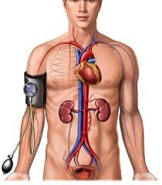


Cardiovascular Physiology
Regulation of Blood Pressure
Dr. Abeer A. Al-Masri, PhD
A. Professor,
Consultant Cardiovascular Physiologist, Faculty of Medicine, KSU.

Slide 2




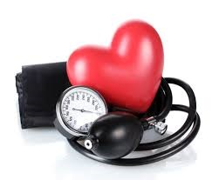



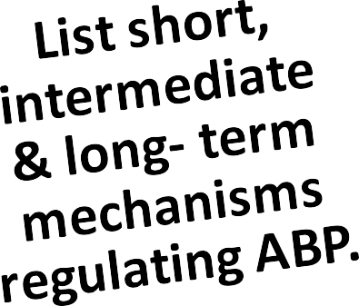
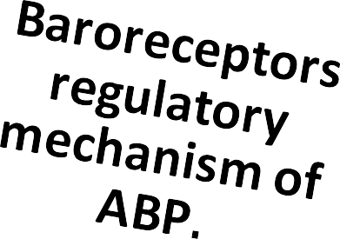


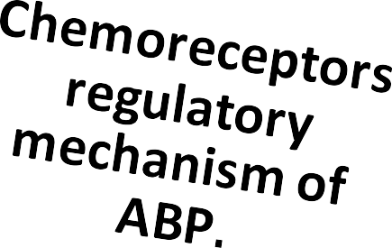



Lecture Outcomes
Dr. Abeer A. Al-Masri, Faculty of Medicine, KSU
2

Slide 3
Regulation of ABP
q Maintaining BP is important to ensure a steady blood flow (perfusion) to tissues.
q Inability to regulate blood pressurecan contribute to diseases.
q In order to regulate the blood pressure, the determining factors have to be regulated:
Cardiac output.
Peripheral resistance.
Blood volume.
Dr. Abeer A. Al-Masri, Faculty of Medicine, KSU
2

Slide 4
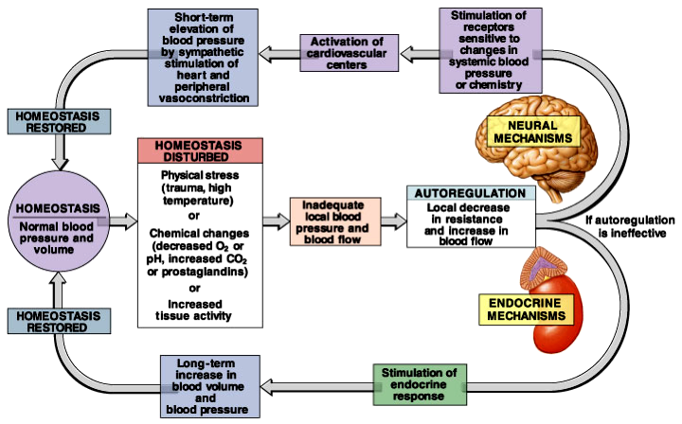
Mechanisms Regulating MAP
Dr. Abeer A. Al-Masri, Faculty of Medicine, KSU
4

Slide 5




Neurally- Mediated Regulation of ABP
Fast Response
(Short- Term)
Concerned in regulating Cardiac Output & Peripheral Resistance

Slide 6
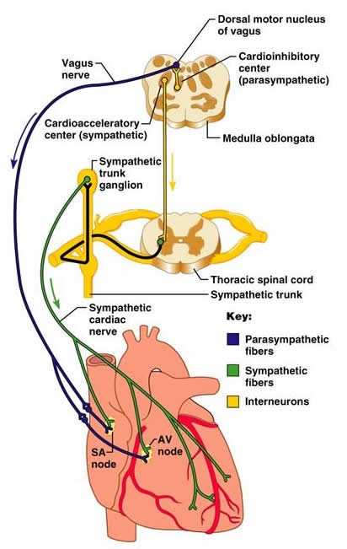
Rapidly Acting Control Mechanisms:
q Acts within seconds/ minutes.
q Concerned by regulating CO & PR.
q Reflex mechanisms that act through autonomic nervous system:
Centers in Medulla Oblongata:
  Vasomotor Center (VMC) … Sympathetic nervous system.
  Cardiac Inhibitory Center (CIC) ..
Parasympathetic nervous system.
Dr. Abeer A. Al-Masri, Faculty of Medicine, KSU
6

Slide 7
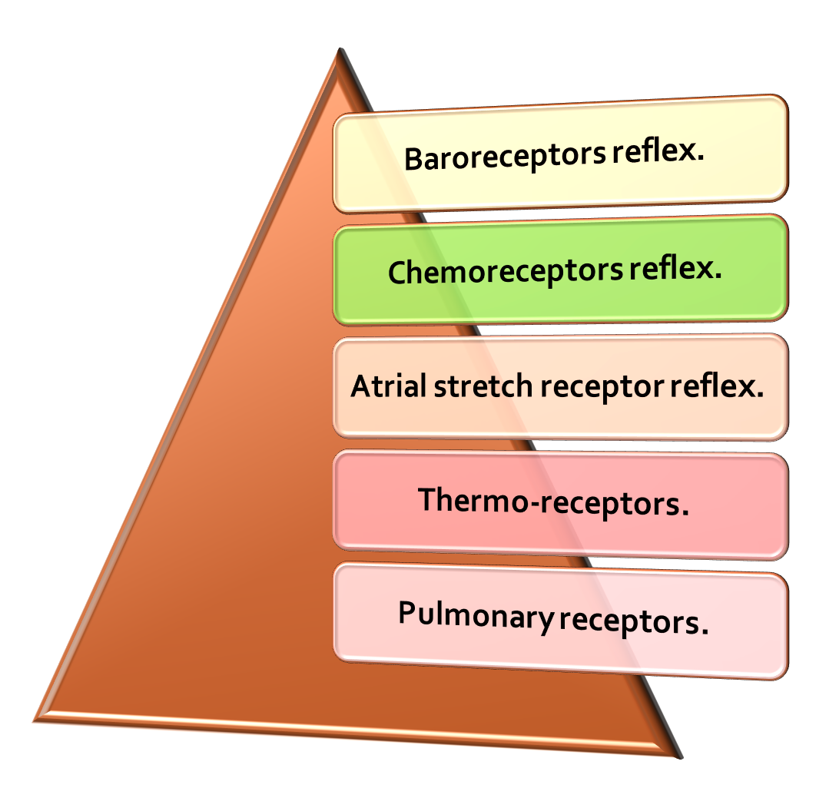
Short Term ABP Regulatory Reflex mechanisms
Dr. Abeer A. Al-Masri, Faculty of Medicine, KSU
13

Slide 8

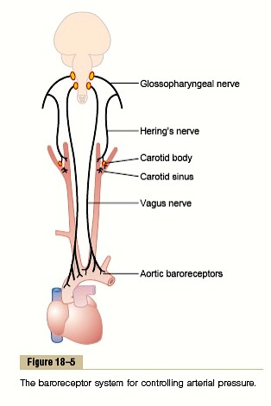



Baroreceptor Reflex
Mechano-stretch receptors.
Located in the wall of carotid sinus & aortic arch.
Fast & neurally mediated
Provide powerful moment-to-moment control of arterial blood pressure
Stimulated in response to blood pressure changes
Dr. Abeer A. Al-Masri, Faculty of Medicine, KSU
8

Slide 9
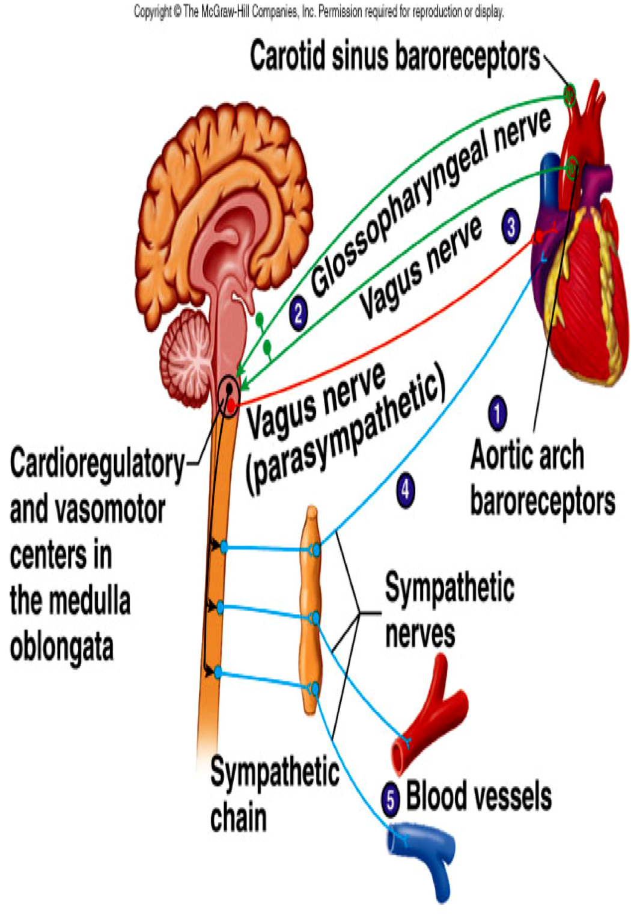
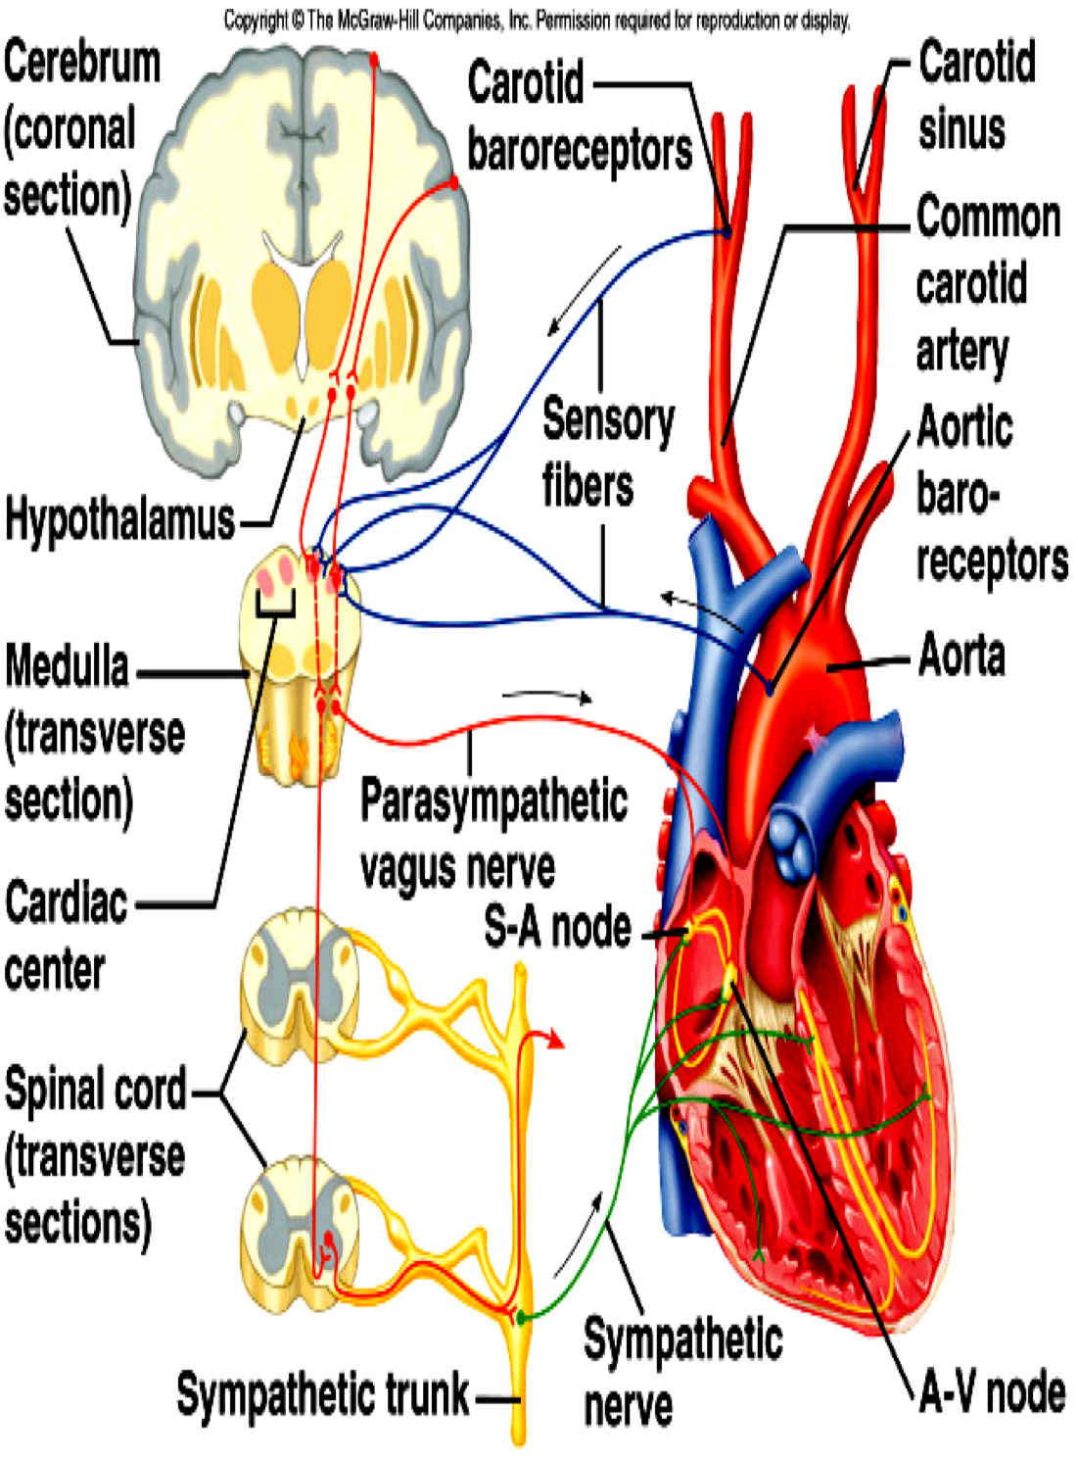
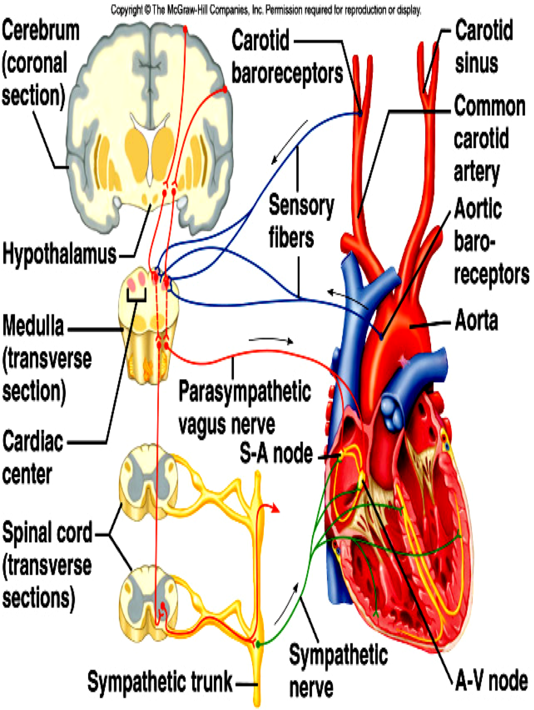
Baroreceptor Reflex
10

Slide 10
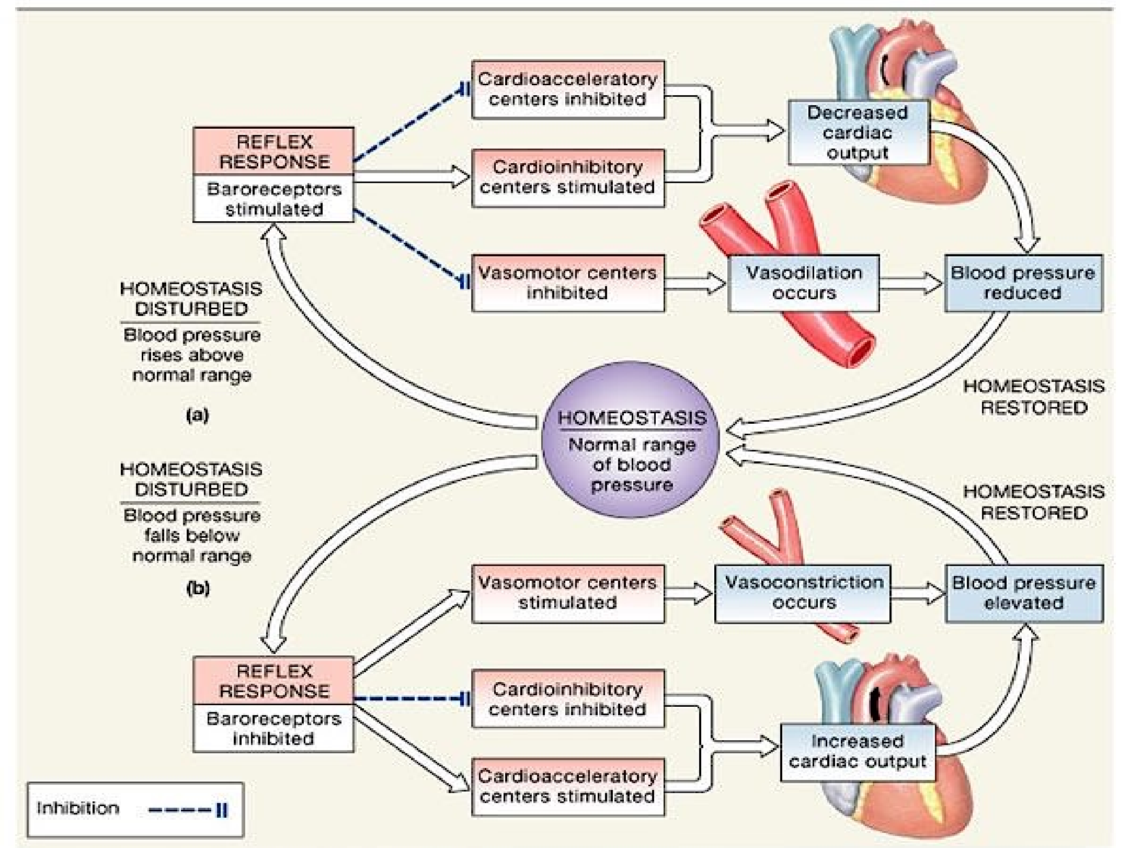
14

Slide 11
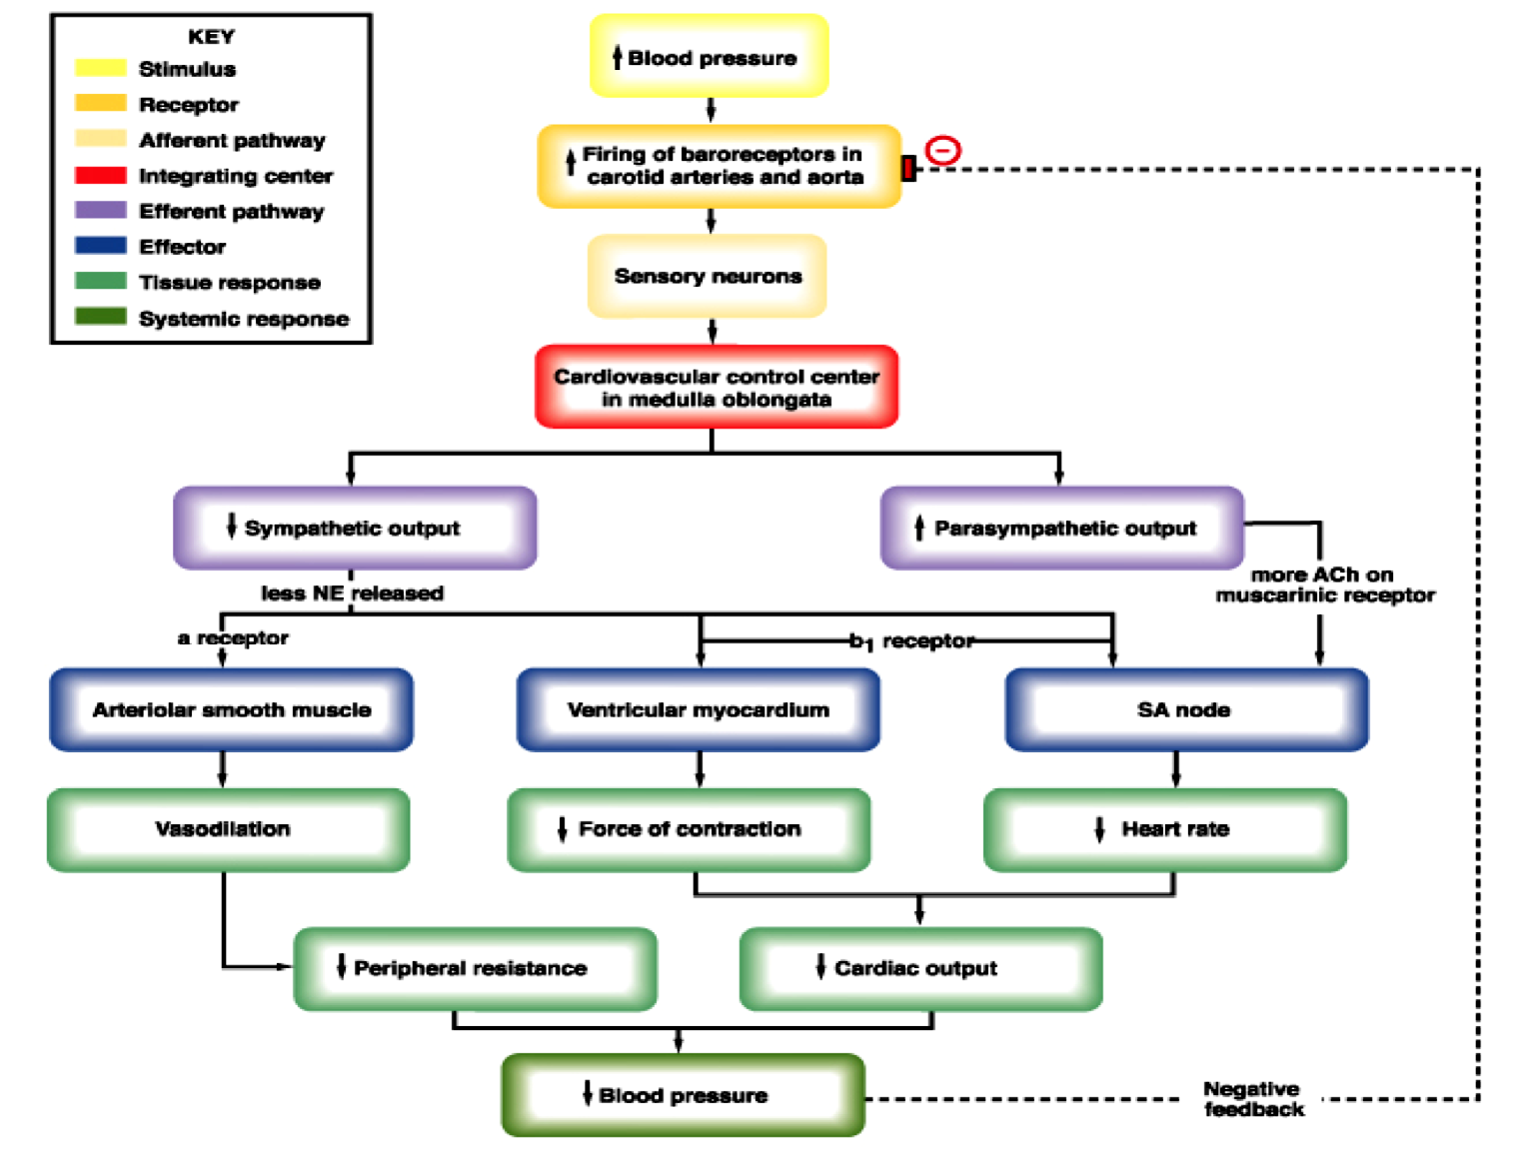
12

Slide 12
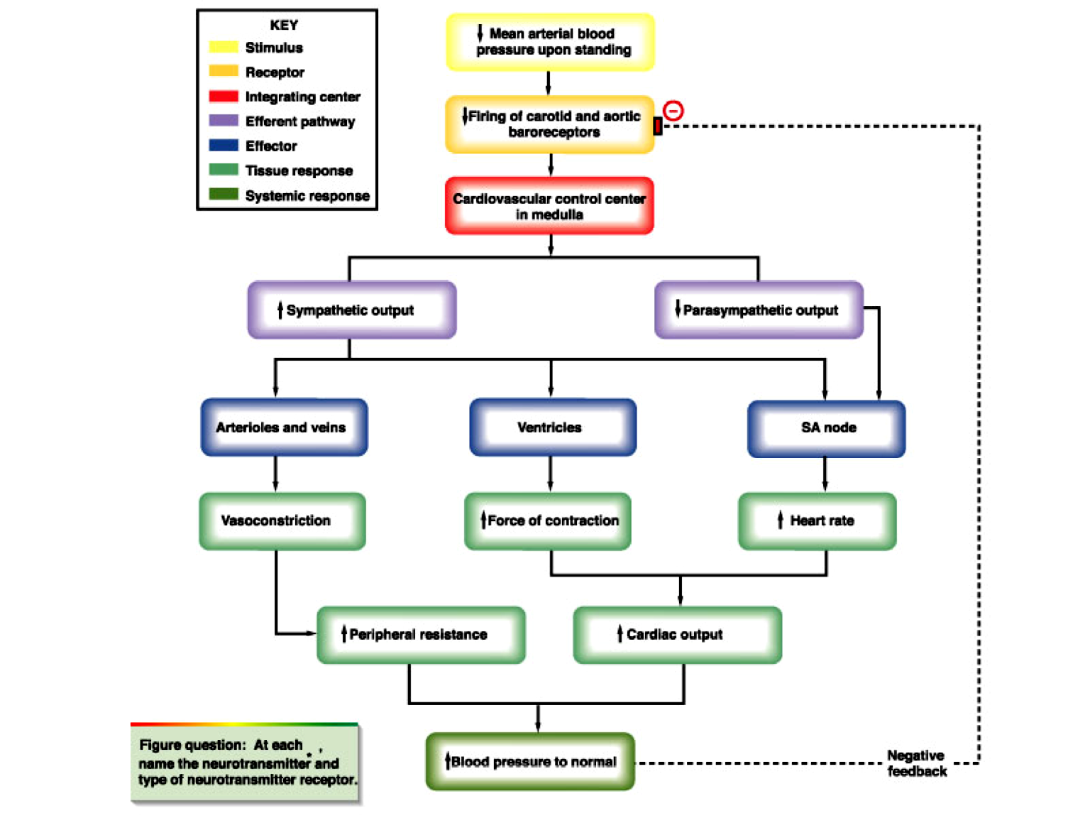
12

Slide 13
Baroreceptor Reflex Mechanism During Changes in Body Posture
q Immediately on standing, AP in the head & upper part of the body tends to fall … ? cause loss of consciousness.
q Falling pressure at the baroreceptors elicits an immediate reflex, resulting in strong sympathetic discharge throughout the body.
q This minimizes the decrease in pressure in the head & upper body.
Dr. Abeer A. Al-Masri, Faculty of Medicine, KSU

Slide 14
Chemoreceptor Reflex
q Closely associated with the baroreceptor pressure control system.
q Chemoreceptor reflex operates in much same way as the baroreceptor reflex, EXCEPT that chemoreceptors are chemo-sensitive cells instead of stretch receptors.
Dr. Abeer A. Al-Masri, Faculty of Medicine, KSU

Slide 15
Chemoreceptor Reflexes:
Two Types
q Peripheral chemoreceptors:
§ Sensory receptors located in carotid & aortic bodies.
§ Sensitive to O₂ lack (↓), CO₂ (↑ or ↓), & pH (↓ or ↑.)
§ Chemoreceptors’ stimulation excite nerve fibers, along with baroreceptor fibers.
q Central Chemoreceptors:
§ Sensory receptors located in the medulla itself.
§ Very sensitive to CO₂ excess (↑) & (↓) pH in medulla.
Dr. Abeer A. Al-Masri, Faculty of Medicine, KSU

Slide 16
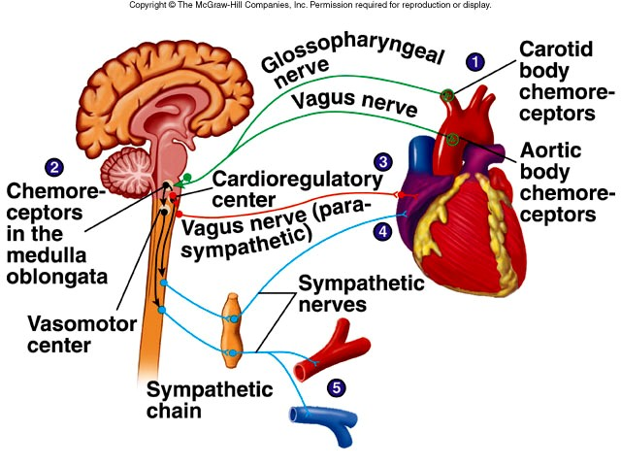
Peripheral Chemoreceptor Reflex
16

Slide 17


Peripheral Chemoreceptor Reflexes
↓ BP
Chemoreceptor reflexes usually act to increase BP
Haemorrhage
Hypoxia
+ Chemoreceptors
++ Vasomotor Center (VMC)
= Cardioinhibitory Center (CIC)
+ Sympathetic nerve fibers
= Parasympathetic nerve fibers
+ Adrenal medulla
Vasoconstriction & ↑ Total peripheral
resistance (TPR)
↑ Cardiac Output (CO)
↑ Heart Rate (HR)
Dr. Abeer A. Al-Masri, Faculty of Medicine, KSU
23

Slide 18
CNS Ischemic Response:
“Last ditch stand” pressure control mechanism
q It is not one of the normal mechanisms for regulating ABP.
q It operates principally as an emergency pressure control system to prevent further decrease in arterial pressure.
q It acts rapidly & very powerfully whenever blood flow to the brain ↓ dangerously close to the lethal level.
q Local concentration of CO₂ ↑ greatly.
q This has an extremely potent effect in stimulating the sympathetic vasomotor nervous control areas in the brain’s medulla.
Dr. Abeer A. Al-Masri, Faculty of Medicine, KSU
18

Slide 19
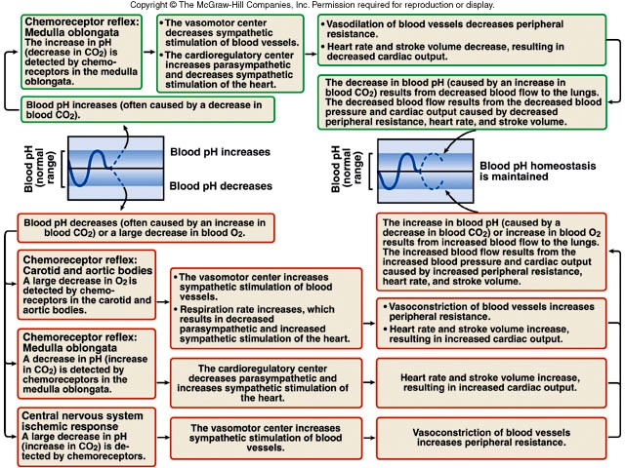
Effects of pH and Gases on Chemoreceptors’ Stimulation
19

Slide 20
Other Vasomotor Reflexes
Atrial stretch receptor reflex:
↑ Venous Return ⇒ ++ atrial stretch receptors ⇒ reflex vasodilatation & ↓ ABP.
Thermo-receptors: (in skin / hypothalamus)
q Exposure to heat ⇒ vasodilatation.
q Exposure to cold ⇒ vasoconstriction.
3. Pulmonary receptors:
Lung inflation ⇒ vasoconstriction.
Dr. Abeer A. Al-Masri, Faculty of Medicine, KSU
20

Slide 21




Hormonally- Mediated Regulation of ABP
Slow Response
(Long- Term)
Concerned in regulating blood volume

Slide 22
Long- Term Regulation of ABP
q Hormonally mediated.
q Takes few hours to begin showing significant response.
q Mainly renal: acts if BP is too low
Renin-Angiotensin-Aldosterone System.
Vasopressin [Anti-diuretic hormone (ADH)] Mechanism.
q Others:
Atrial Natriuretic Peptide Mechanism (Low-pressure volume receptors.)
EPO (erythropoietin.)
Dr. Abeer A. Al-Masri, Faculty of Medicine, KSU
22

Slide 23



1. Renin – Angiotensin Aldosterone System
↓ renal blood flow &/or ↓ Na⁺
++ Juxtaglomerular apparatus of kidneys
(considered volume receptors)
Renin
Angiotensinogen
(Plasma protein)
Angiotensin I
(Lungs)
Converting enzymes
Angiotensin II
(powerful vasoconstrictor)
Angiotensin III
(powerful vasoconstrictor)
Adrenal cortex
Aldosterone (Na⁺ retention)
Corticosterone
Dr. Abeer A. Al-Masri, Faculty of Medicine, KSU
23

Slide 24
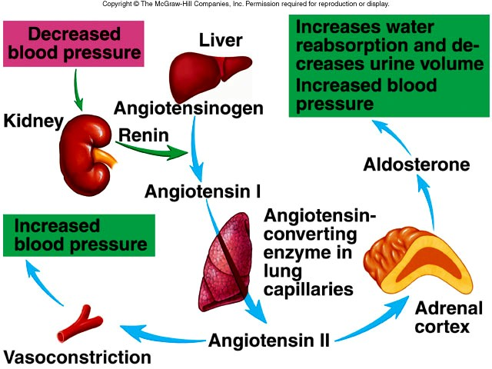
1. Renin–Angiotensin–Aldosterone Mechanism
& Na+
,
24

Slide 25
2. Anti-diuretic hormone (ADH), or vasopressin:
q Hypovolemia & dehydration stimulates Hypothalamic Osmoreceptors.
q ADH will be released from posterior pituitary gland:
Promotes water reabsorption at kidney tubules …↑ blood volume.
Causes vasoconstriction, in order to ↑ ABP.
q Thirst stimulation.
q Usually, when secreted aldosteroneis secreted.
Dr. Abeer A. Al-Masri, Faculty of Medicine, KSU
25

Slide 26
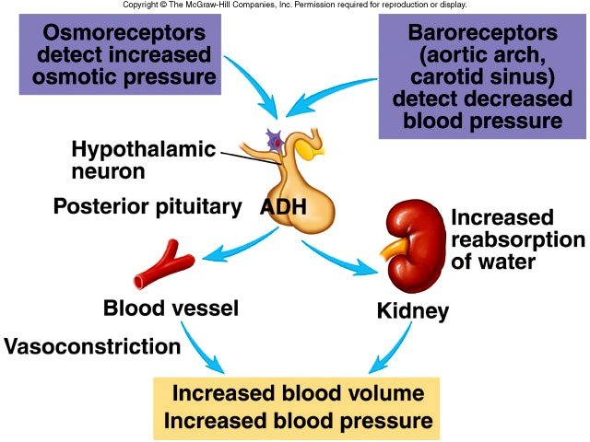
Vasopressin (ADH) Mechanism
26

Slide 27
3. Low-pressure volume receptors:
q Atrial Natriuretic Peptide (ANP) hormone:
Hormone released from cardiac muscle cells (wall of right atrium) as a response to an increase in ABP.
Simulates an ↑ in urinary production, causing a ↓ in blood volume & blood pressure.
Dr. Abeer A. Al-Masri, Faculty of Medicine, KSU

Slide 28
4. EPO (Erythropoietin)
Secreted by the kidneys when blood volume is too low.
Leads to RBCs formation → ↑ blood volume.
Dr. Abeer A. Al-Masri, Faculty of Medicine, KSU

Slide 29




Intermediate Mechanisms Regulating ABP

Slide 30
Intermediate Mechanisms:
Activated within 30 min to several hrs.
Renin-angiotensin vasoconstrictor mechanism.
Stress-relaxation of the vasculature.
Fluid Shift mechanism.
q During this time, the nervous mechanisms usually become less & less effective.
Dr. Abeer A. Al-Masri, Faculty of Medicine, KSU
30

Slide 31
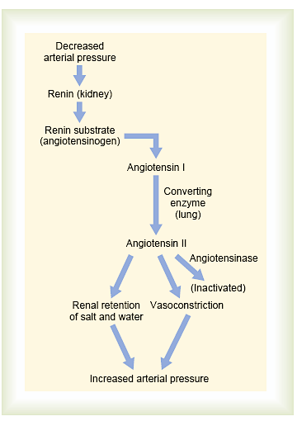
1. Angiotensin Vasoconstriction System
31

Slide 32
2. Fluid Shift Mechanism
q Movement of fluid from interstitial spaces into capillaries in response to ↓ BP to maintain blood volume.
q Conversely, when capillary pressure ↑ too high, fluid is lost out of circulation into the tissues, reducing blood volume as well as all pressures throughout circulation.
Dr. Abeer A. Al-Masri, Faculty of Medicine, KSU

Slide 33
3. Stress-Relaxation Mechanism
Adjustment of blood vessel smooth muscle to respond to changes in blood volume.
When pressure in blood vessels becomes too high, they become stretched & keep on stretching more & more for minutes or hours; resulting in fall of pressure in the vessels toward normal.
This continuingstretch of the vessels can serve as an intermediate-term pressure “buffer.”
Dr. Abeer A. Al-Masri, Faculty of Medicine, KSU

Slide 34
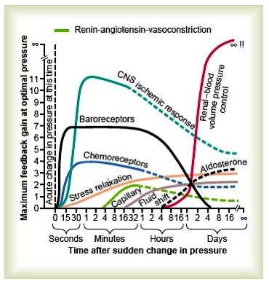
control mechanisms at different time intervals after onset of a disturbance to the arterial pressure.
34

Slide 35


Thank You

