Slide 1



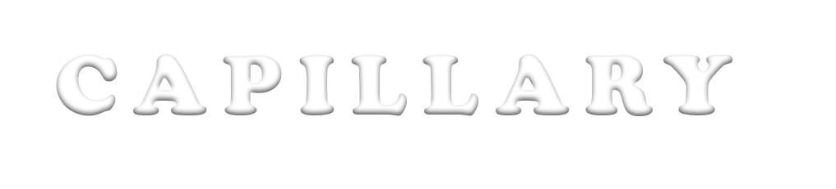

C A P I L L A RY C I R C U L AT I O N
C A R D I O V A S C U L A R P H Y S I O L O G Y
DR . A B E E R
A . A L - MA S R I
A . P R O F E S S O R & C O N S U L T A N T
CA R D I O V A S CU L A R P H Y S I O L O G I S T FA C U L T Y O F M E D I C I N E , K S U

Slide 2
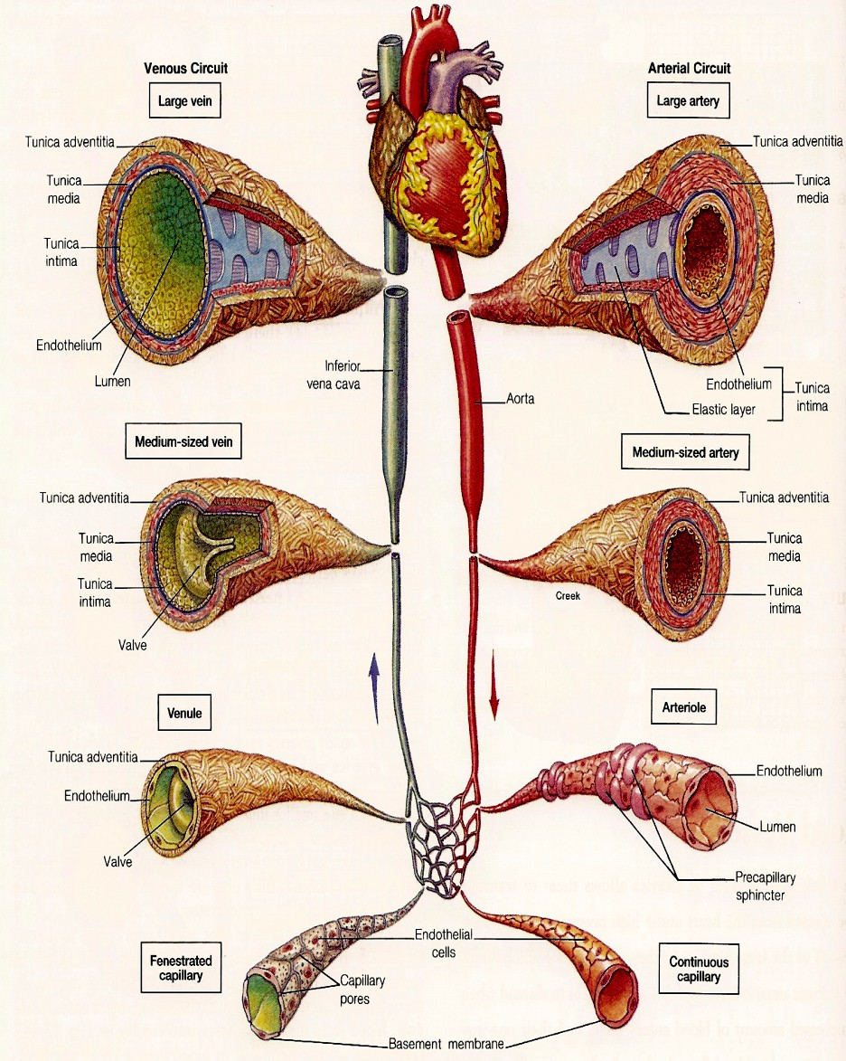
CLASSIFICATION OF THE VASCULAR SYSTEM
Aorta
… (elastic recoil)
Arteries
… (muscular, low resistance vessels)
Arterioles
… (high resistance vessels)
Capillaries
… (exchange vessels)
Venules
Veins
… (capacitance vessels)
Dr. Abeer Al-Masri, Faculty of Medicine, KSU.

Slide 3
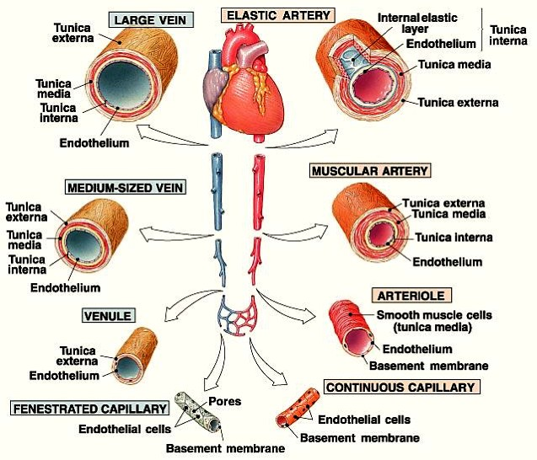
BLOOD VESSEL COMPARISON
4

Slide 4
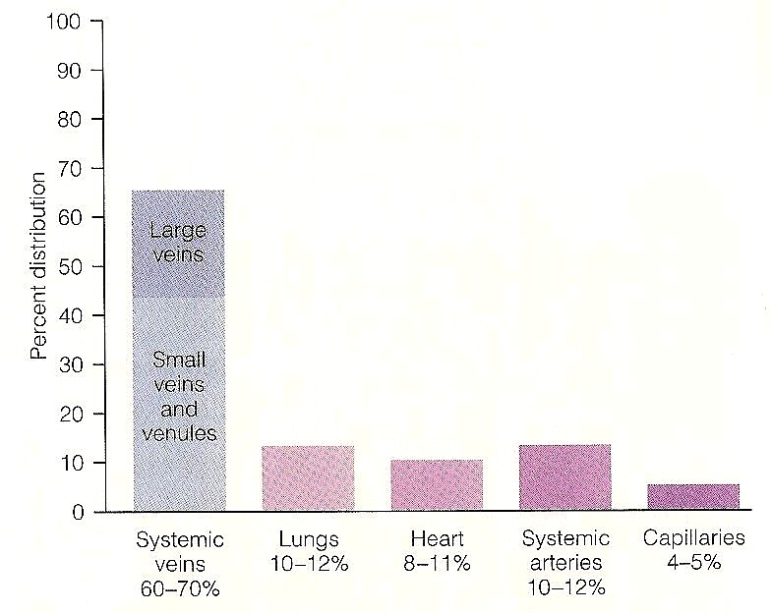
DISTRIBUTION OF BLOOD WITHIN THE CIRCULATORY SYSTEM AT REST
4

Slide 5
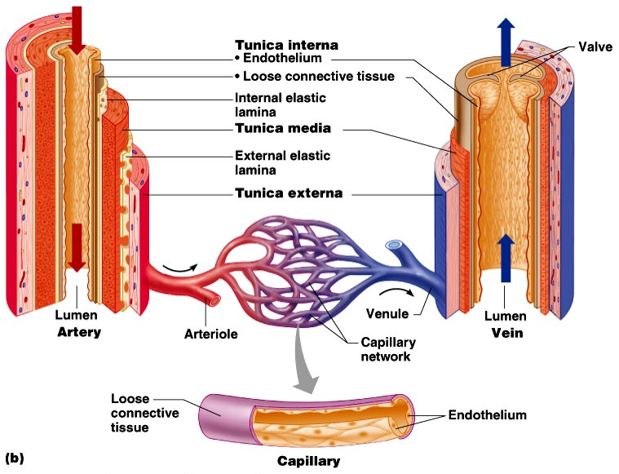
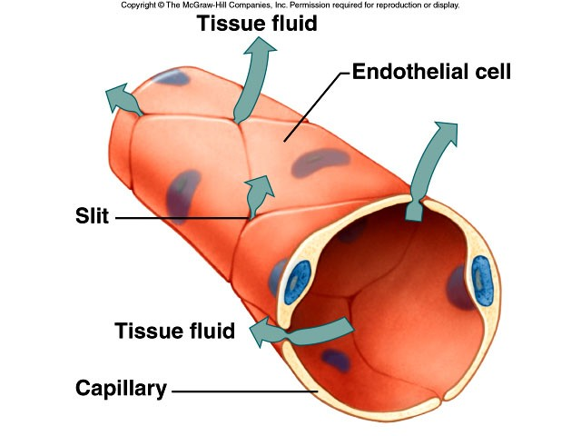
CAPILLARIES
q Smallest blood vessels.
§ One endothelial cell thickness.
q Exchange vessels.
Provide direct access to cells.
Most permeable.
Permits exchange of nutrients & wastes.
Dr. Abeer Al-Masri, Faculty of Medicine, KSU.
5

Slide 6
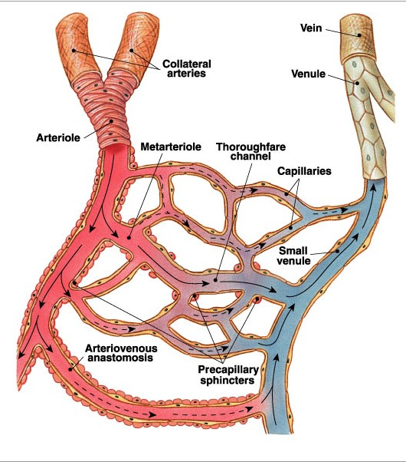






CAPILLARY NETWORK
Blood flows from arterioles
through metarterioles, then through capillary network
Venules drain network
Smooth muscle in
arterioles, metarterioles, precapillary sphincters regulates blood flow
6
Dr. Abeer Al-Masri, Faculty of Medicine, KSU.

Slide 7
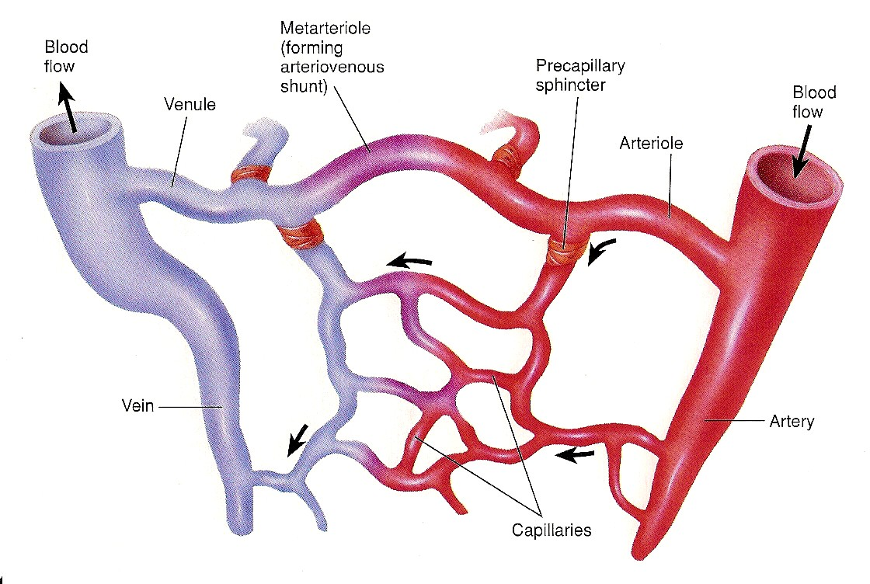
7

Slide 8
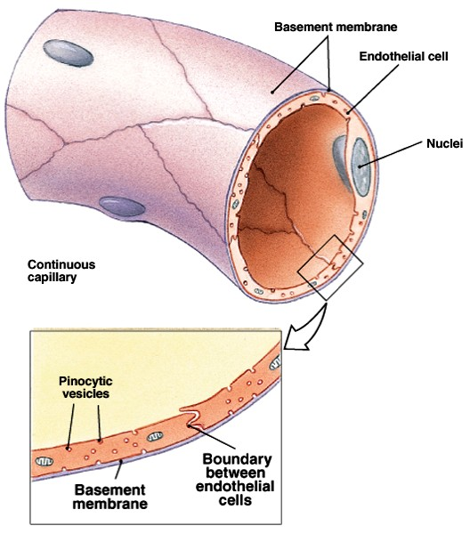
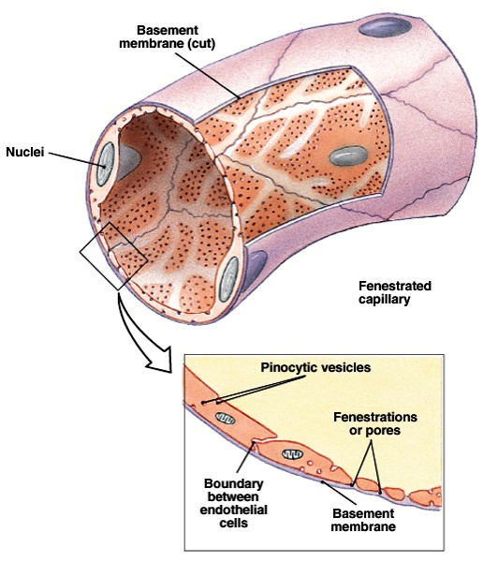
TYPES OF
CAPILLARIES
q Types are classified by diameter/permeability:
Continuous
  Do not have fenestrae.
Fenestrated
  Have pores.
Sinusoidal
  Large diameter with large fenestrae.
Dr. Abeer Al-Masri, Faculty of Medicine, KSU.
8

Slide 9
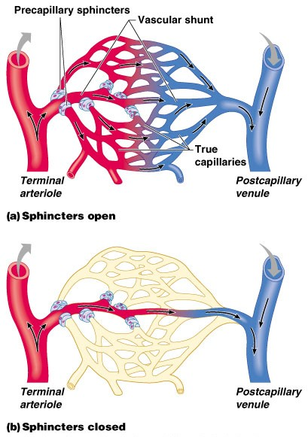
Capillary Beds
Capillary beds consist of two types of vessels:
  Vascular shunt – directly connects an arteriole to a venule.
  True capillaries – exchange vessels.
    Oxygen & nutrients cross to cells
    Carbon dioxide & metabolic waste products cross into blood
Dr. Abeer Al-Masri, Faculty of Medicine, KSU.
9

Slide 10
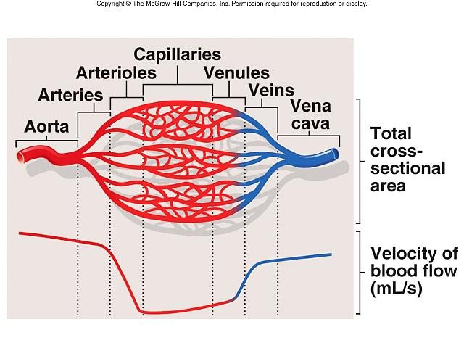
CROSS-SECTIONAL AREA
As diameter of vessels decreases, the total cross- sectional area increases & velocity of blood flow decreases.
Much like a stream that flows rapidly through a narrow gorge but flows slowly through a broad plane.
10
Dr. Abeer Al-Masri, Faculty of Medicine, KSU.

Slide 11



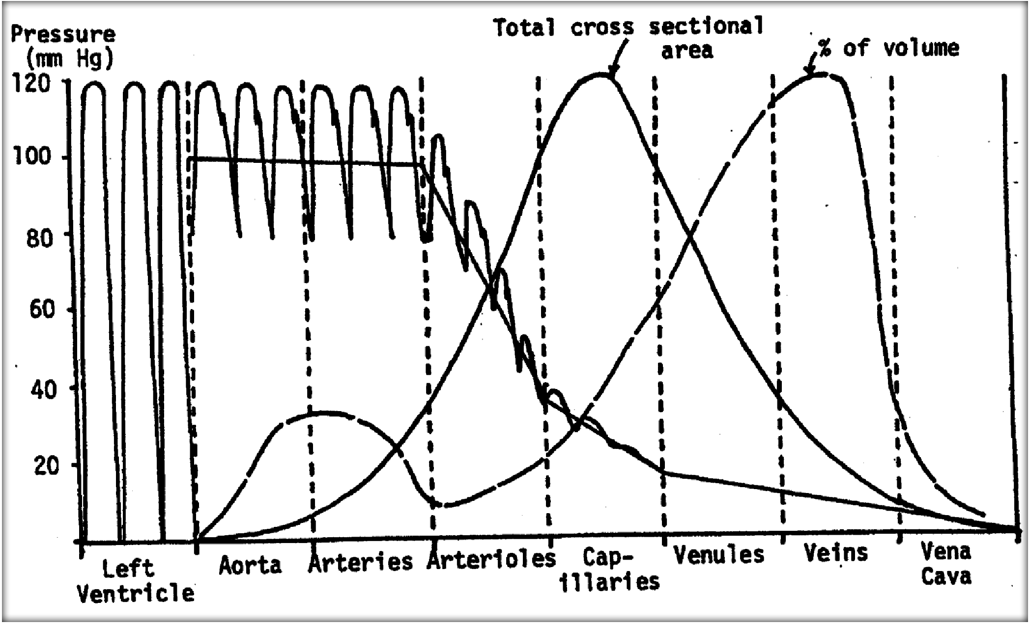
Total Cross Sectional Area
Capacity Vessels
11

Slide 12
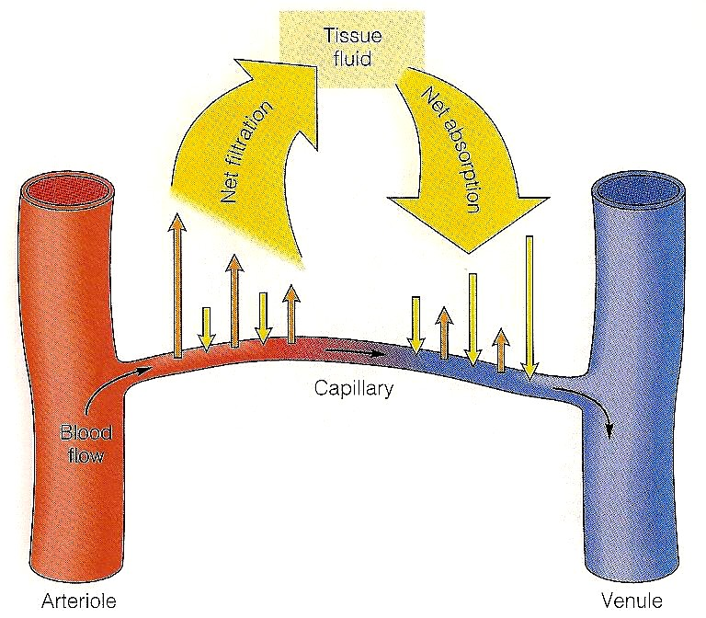
EXCHANGE OF FLUID BETWEEN CAPILLARIES AND TISSUES
12

Slide 13
CAPILLARY EXCHANGE AND INTERSTITIAL FLUID VOLUME REGULATION
Blood pressure, capillary permeability & osmosis affect movement of fluid from capillaries.
A net movement of fluid occurs from blood into tissues.
Fluid gained by tissues is removed by lymphatic system.
Dr. Abeer Al-Masri, Faculty of Medicine, KSU.

Slide 14
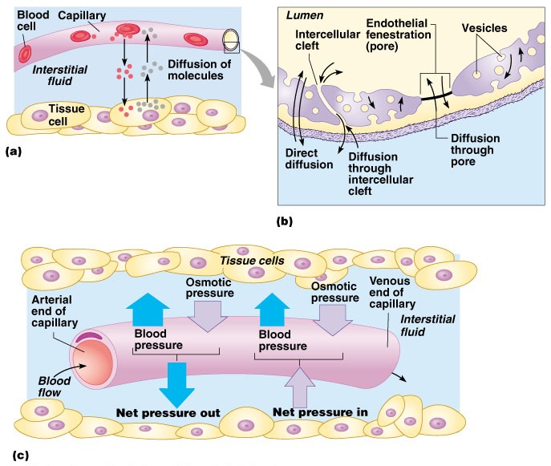
Diffusion at Capillary Beds (Fluid Balance)
Outward Forces:
Capillary blood pressure
(P_{c} = 30-35 to 10-15 mmHg)
Interstitial fluid pressure
(P_{IF} = 0 mmHg)
Interstitial fluid colloidal osmotic pressure
(μ_{IF} = 3 mmHg)
TOTAL = 38 to 18 mmHg
Inward Force:
1. Plasma colloidal osmotic pressure (μ_{C} = 25- 28 mmHg)
Dr. Abeer Al-Masri, Faculty of Medicine, KSU.

Slide 15
FLUID FILTRATION & REABSORPTION IN NORMAL MICROCIRCULATION
Hydrostatic Pressure= 0 mmHg
Osmotic Pressure= 3 mmHg
NFP = - 5 to -7 mmHg
Interstitial Fluid
NFP = +5 to +10 mmHg
Venous Blood
Blood Capillary
Arterial Blood
Hydrostatic Pressure = 18-20 mmHg
Colloid Osmotic Pressure= 25 mmHg
Hydrostatic Pressure = 30-35 mmHg
q At arterial end:
Water moves out of the capillary with a NFP of +5 to +10 mmHg.
Hydrostatic pressure dominates at the arterial end & net fluid flows out of the circulation.
q At venous end:
Water moves into the capillary with a NFP of -5 to -7 mmHg.
Oncotic pressure dominates at the venous end & net fluid will flow into the
bloodstream.
Dr. Abeer Al-Masri, Faculty of Medicine, KSU.
15

Slide 16
LYMPHATIC SYSTEM
Lymphatic vessels present b/w capillaries.
3 basic functions:
  Drain excess interstitial (tissue) fluid back to the bl, in order to maintain original bl volume.
  Transports absorbed fat from small intestine to the bl.
  Helps provide immunological defenses against pathogens.
Dr. Abeer Al-Masri, Faculty of Medicine, KSU.
16

Slide 17
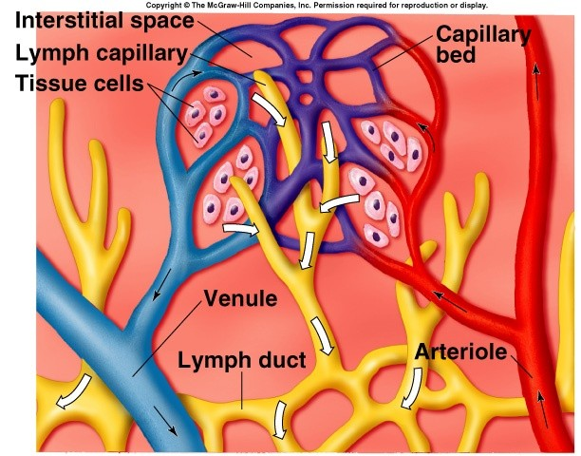
LY MPHATIC SYSTEM
17

Slide 18
Thank You

