Slide 1




C A R D I O V A S C U L A R P H Y S I O L O G Y
SHOCK
DR . A B E E R A . A L - MA S R I
A . P R O F E S S O R & C O N S U L T A N T
CA R D I O V A S CU L A R P H Y S I O L O G I S T FA C U L T Y O F M E D I C I N E , K S U

Slide 2















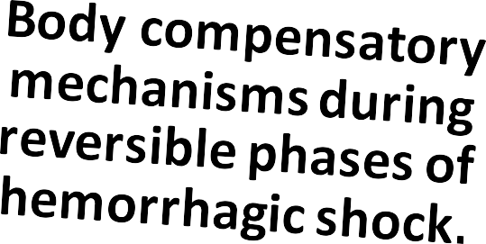






Slide 3



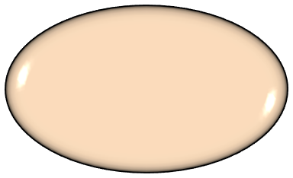
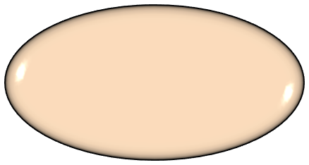
BASIC UNIT OF LIFE
Gets
their needed energy to stay alive.
Cell
No oxygen,
no energy.
No energy, no life.

Slide 4
WHAT IS SHOCK ?
Any condition in which the circulatory system is unable to provide adequate circulation & tissue perfusion, resulting in failure to deliver oxygen to the tissues & vital body organs relative to its metabolic requirement.
Defined as Circulatory Shock.
Results in organ dysfunction & cellular damage.
If not quickly corrected, it may lead to irreversible shock & death.

Slide 5
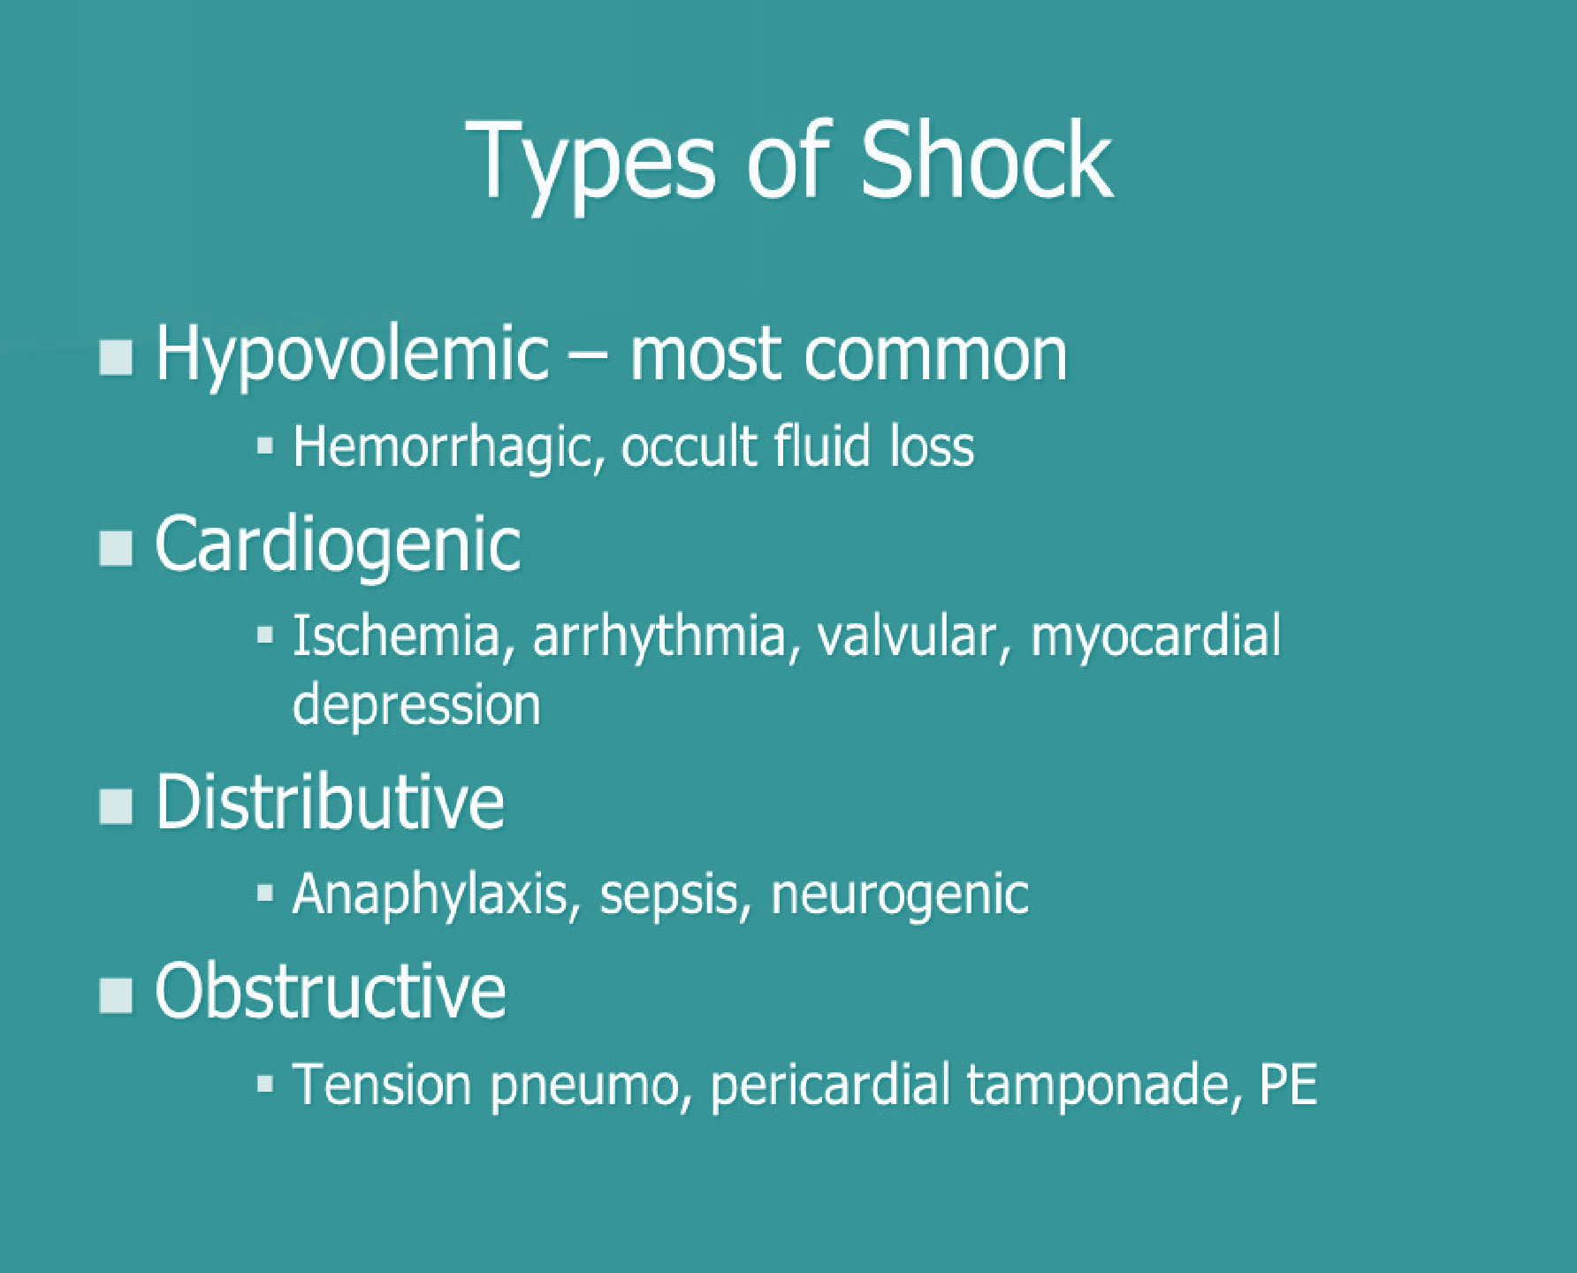
5

Slide 6


TYPES OF CIRCULATORY SHOCK
Circulatory Shock
MAP = CO X PR
MAP = CO X PR
Low Output Shock
High / N Output Shock
Hypovolemic
(most common)
Obstructive
Distributive
Cardiogenic
Anaphylactic
(Vasogenic)
Psychogenic
(Vasogenic)
Neurogenic
(Spinal)
Septic/Toxic
(Vasogenic)
Dr. Abeer A. Al-Masri, Faculty of Medicine, KSU

Slide 7

HYPOVOLEMIC SHOCK
q Low CO due to:
MAP = CO X PR
Inadequate blood/plasma volume (loss of 15-25% / 1-2 L).
Reduced venous return (preload.).
q Causes:
Blood loss/ Hemorrhage: (commonest)
  Internal or external.
Fluid/plasma loss: Vomiting, diarrhea, burn, excess sweating, dehydration, trauma.
Dr. Abeer A. Al-Masri, Faculty of Medicine, KSU

Slide 8
CARDIOGENIC SHOCK
q Low CO due to:
MAP = CO X PR
Failure of myocardial pump, despite adequate ventricular filling pressure.
q Causes:
Myocardial Infarction.. (Most common.)
Myocarditis.
Cardiomyopathy.
Cardiac tamponade.
Acute valvular dysfunction, e.g. rupture of papillary muscle post MI.
Congestive heart failure.
Sustained Arrhythmias, e.g. heart block, ventricular tachycardia.
Pulmonary embolism.
q Is associated with loss of > 40% of LV myocardial function.
q Mortality rate is high, 60-90%.
Dr. Abeer A. Al-Masri, Faculty of Medicine, KSU

Slide 9
OBSTRUCTIVE SHOCK
q CO is reduced by vascular obstruction:
Obstruction of venous return:
  e.g. Vena Cava Syndrome (usually neoplasms).
Compression of the heart:
  e.g. hemorrhagic pericarditis → cardiac tamponade.
Obstruction of the outflow of the heart:
  Aortic dissection.
  Massive pulmonary embolism.
Pneumothorax.
MAP = CO X PR
Dr. Abeer A. Al-Masri, Faculty of Medicine, KSU

Slide 10

DISTRIBUTIVE SHOCK:
HIGH/ NORMAL OUTPUT
q CO is normal or elevated.
q Distribution is inappropriate.
q Shock is due to loss of vascular resistance.
MAP = CO X PR
10

Slide 11

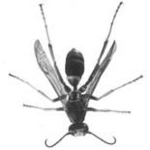

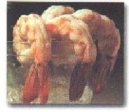

DISTRIBUTIVE SHOCK:
HIGH/ NORMAL OUTPUT
q Septic/ Toxic/ Endotoxic Shock:
MAP = CO X PR
Bacterial endotoxin triggers peripheral vasodilatation & endothelial injury. Hyperdynamic state.
•
•
q Anaphylactic shock:
•
•
•
•
Massive & generalized allergic reaction. IgE- mediated hypersensitivity.
Histamine triggers peripheral vasodilation & ↑ capillary permeability. Can lead to low output distributive shock.
q Psychogenic shock:
•
•
•
•
•
Simple fainting (syncope.) Caused by stress, pain, or fright.
↓ HR & vessels dilate.
Brain becomes hypoperfused. Loss of consciousness.

Slide 12
DISTRIBUTIVE SHOCK:
HIGH/ NORMAL OUTPUT
q Neurogenic/ Spinal Shock (venous pooling):
Loss or drop in vasomotor (vascular) tone/ spinal cord injury.
Generalized peripheral vasodilation.
Blood volume remains normal.
CO is severely reduced as blood is pooled in peripheral veins.. (Capacity of blood ↑, & venous return ↓.)
Behaves like hypovolemic shock.

Slide 13


PATHOPHYSIOLOGY OF SHOCK
Release of
free radicals & oxidative stress
Reduce capillary perfusion
Inadequate tissue oxygen
Shift to anaerobic metabolism
Metabolic acidosis
Tissue damage
Apoptosis

Slide 14
METABOLIC CHANGES & CELLULAR RESPONSE TO SHOCK
1. Reduce capillary perfusion:
→ Spasm of pre/post capillary sphincters.
→ hypoxic tissue damage, (oxidative stress.)
→ anaerobic metabolism (anaerobic glycolysis.)
→ lactic acid production.
→ metabolic acidosis (intracellular acidosis).
→ Failure of Na+/K+ pump (⬆ [Na⁺] & [C²⁺]).
→ Lysosomes, nuclear membranes & mitochondrial breakdown.

Slide 15
METABOLIC CHANGES & CELLULAR RESPONSE TO SHOCK
After 3 - 5 hrs of shock:
→ precapillary sphincters dilate, venules are still constricted.
→ blood stagnation in capillaries.
→ hypoxia continue + fluid leaves to extra vascular compartment.
→ further reduction in circulating blood volume.
Granulocytes accumulation at injured vessels:
→ free radicals release.
→ further tissue damage.

Slide 16
METABOLIC CHANGES & CELLULAR RESPONSE TO SHOCK
Damage in GIT mucosa → allows bacteria into circulation.
Cerebral ischemia → depression of VMC → vasodilation + ↓ HR
(vasomotor center .. sympathetic)
further decrease in blood pressure.
Myocardial ischemia → depressed contractility + myocardial damage
more shock & acidosis.
Respiratory distress syndrome occurs, due to damage of capillary endothelial cells & alveolar epithelial cells, with release of cytokines.
Multiple organ failure & death.

Slide 17
COMPENSATORY MECHANISMS
q ↓ BP stimulates baroreceptors reflex → sympathetic stimulation.
q Acidosis stimulates chemoreceptors reflex → sympathetic stimulation.
q Renin-Angiotensin mechanism stimulation:
Angiotensin II & III: powerful vasoconstrictors.
Aldosterone: Na+ retention.
q ADH (vasopressin) stimulation:
Water retention, vasoconstriction & thirst stimulation.
q Plasma proteins synthesis.
q Fluid- shift mechanism.

Slide 18
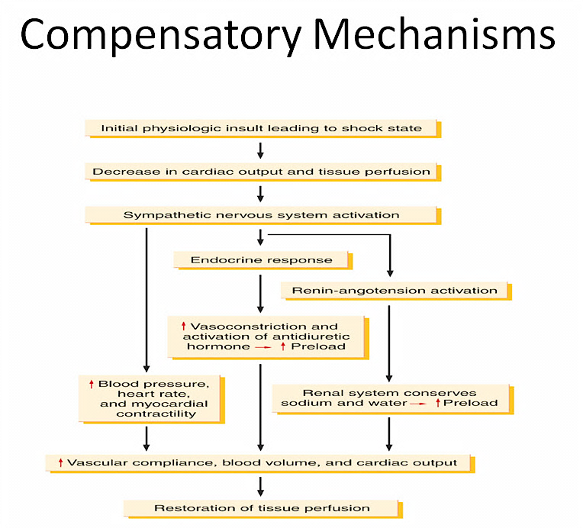
18

Slide 19
FLUID- SHIFT MECHANISM IN SHOCK
In shock, the hydrostatic pressure decreases & oncotic pressure is constant, as a result:
  The fluid exchange from the capillary to the extracellular space decreases.
  The fluid return from the extracellular space to the capillary increases.
That will increase the blood volume & will increase BP helping to compensate shock situations.
19

Slide 20
IN NORMAL MICROCIRCULATION
Hydrostatic Pressure= 0 mmHg
Osmotic Pressure= 3 mmHg
NFP = - 5 to -7 mmHg
Interstitial Fluid
NFP = +5 to +10 mmHg
Venous Blood
Blood Capillary
Arterial Blood
Hydrostatic Pressure = 18-20 mmHg
Colloid Osmotic Pressure= 25 mmHg
Hydrostatic Pressure = 30-35 mmHg
q At arterial end:
Water moves out of the capillary with a NFP of +5 to +10 mmHg.
Hydrostatic pressure dominates at the arterial end & net fluid flows out of the circulation.
q At venous end:
Water moves into the capillary with a NFP of -5 to -7 mmHg.
Oncotic pressure dominates at the venous end & net fluid will flow into the
bloodstream
20
Dr. Abeer A. Al-Masri, Faculty of Medicine, KSU

Slide 21


Fluid – Shift Mechanism In Shock
Hydrostatic Pressure= 0 mmHg
Increase inflow
Interstitial Fluid
Decrease outflow
Venous Blood
Hydrostatic Pressure = 10 mmHg
Arterial Blood
Hydrostatic Pressure = 20 mmHg
Blood Capillary
Colloid Osmotic Pressure= 25 mmHg
Dr. Abeer A. Al-Masri, Faculty of Medicine, KSU

Slide 22
STAGES OF SHOCK
q Reversible shock: (Compensated)
Changes can be reversed by compensatory mechanism
(neurohormonal activation) or by treatment.
Defense mechanisms are successful in maintaining perfusion.
Non-progressive.
q Progressive:
Defense mechanisms begin to fall.
Multi-organ failure.
q Irreversible shock:
Complete failure of compensatory mechanisms.
Can lead to death.
Dr. Abeer A. Al-Masri, Faculty of Medicine, KSU

Slide 23

POSSIBLE MECHANISM IN
DEVELOPMENT IRREVERSIBLE SHOCK
Shock Stimulus
Lysosomal Activation, Release Proteases Splitting of Plasma Proteins
Vasoactive Peptides, Amines, etc.
Hypotension, Fluid Loss Irreversible Shock
Dr. Abeer A. Al-Masri, Faculty of Medicine, KSU

Slide 24
SIGNS/SYMPTOMS:
HYPOVOLEMIC SHOCK
Hypotension… (? ≤ 85/40 mmHg)
Tachycardia… Compensation for ↓ MAP sensed by Baroreceptors.
Rapid, weak, & thready pulse… (? 140/min).
Intense thirst.
Tachypnea (rapid respiration)… Compensation for hypoxia sensed by Chemoreceptors.
Restlessness… due to hypo-perfusion.
Cold, pale skin… due to hypo-perfusion.
Oliguria (low urine output)/ Anuria (no urine output).
Blood test: Lactic acidosis.
Dr. Abeer A. Al-Masri, Faculty of Medicine, KSU

Slide 25
SIGNS/SYMPTOMS:
CARDIOGENIC SHOCK
Similar signs & symptoms to that of hypovolemic shock.
Congestion of lungs & viscera: (CXR)
  Interstitial pulmonary oedema.
  Alveolar edema.
  Cardiomegaly.
Dr. Abeer A. Al-Masri, Faculty of Medicine, KSU

Slide 26
SIGNS/SYMPTOMS:
SEPTIC SHOCK
q Patient flushed & warm due to his hyperdynamic state.
Dr. Abeer A. Al-Masri, Faculty of Medicine, KSU

Slide 27


Thank You

