Slide 1


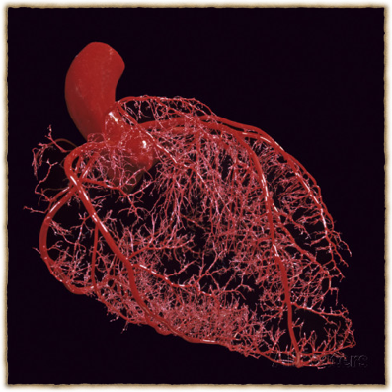
Dr. Abeer A. Al-Masri
Associate Professor & Consultant, Cardiovascular Physiologist, Faculty of Medicine, KSU.

Slide 2







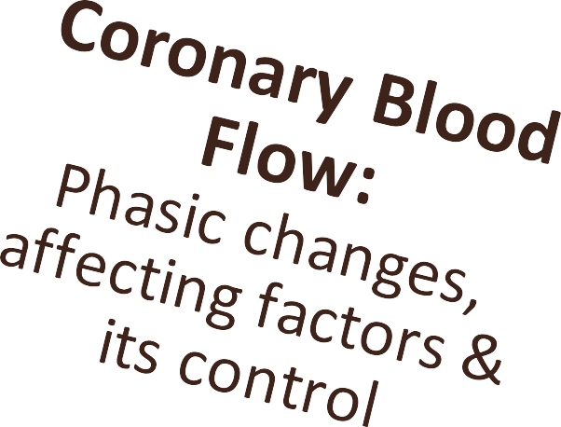
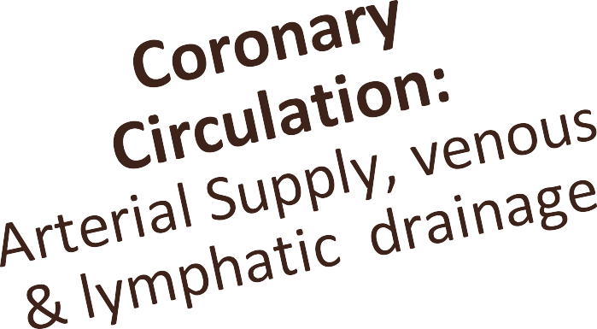





At end of this lecture you should be able to know:
Dr. Abeer Al-Masri, Faculty of Medicine, KSU.
2

Slide 3

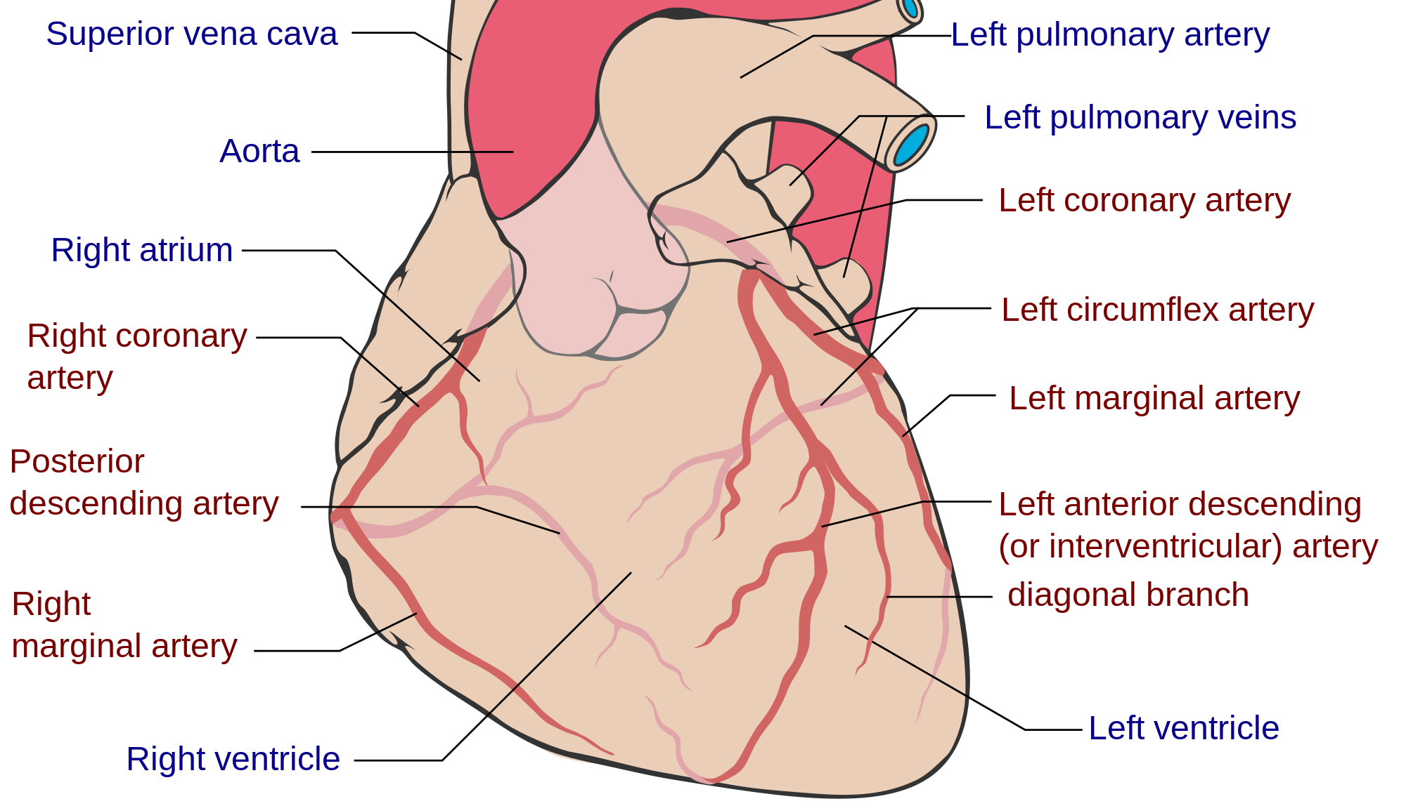
Coronary Circulation
3

Slide 4
Coronary Circulation
Consists of:
Arterial supply.
Venous drainage.
Lymphatic drainage.

Slide 5
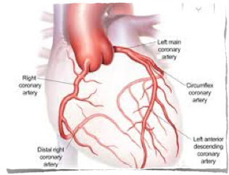
Arterial Supply
Cardiac muscle is supplied by two coronary arteries:
Right coronary artery (RCA.)
Left coronary artery (LCA.)
Both coronaries arise from the coronary sinuses just superior to the aortic valve cusps at the aortic root.

Slide 6

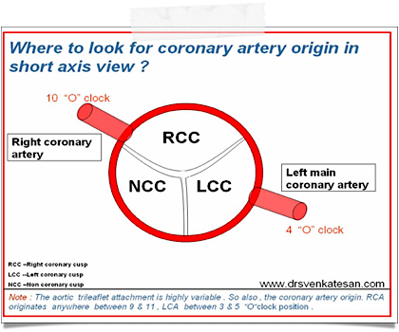
I: Arterial Supply
The aortic valve has three cusps: left coronary (LC), right coronary (RC) & posterior non-coronary
(NC) cusps.
Coronary arteries arise just superior to the aortic valve cusps.
Coronary Ostia (origins of the coronary arteries) may vary in shape & location, most of which are of no clinical significance.
Coronary arteries deliver
oxygenated blood to the cardiac muscle.

Slide 7


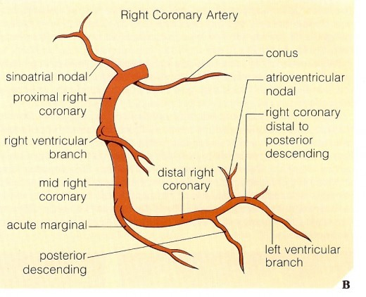
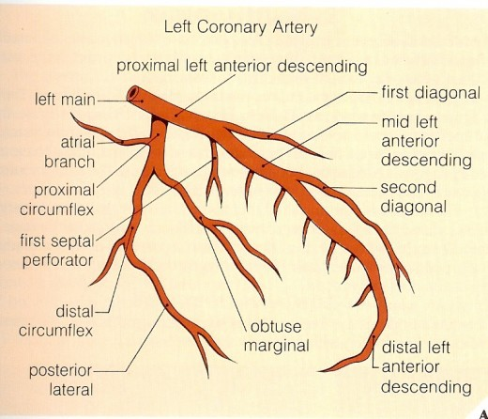
Right vs Left Coronary Arteries
Smaller than the left coronary artery.
Arises from the right coronary sinus.
Terminates by anastomosing with the left coronary artery.
Larger than the right coronary artery.
Arises from the left coronary sinus.
Terminates by anastomosing with the right coronary artery.

Slide 8
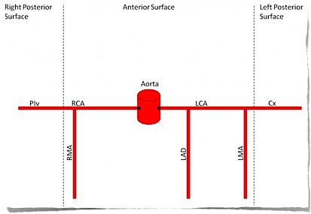
Branches of Coronary Arteries
Right Coronary Artery (RCA):
Right Marginal Artery (RMA)
Posterior Descending Branch
SA nodal Artery
AV nodal Artery
Left Coronary Artery (LCA):
Left Anterior Descending (LAD)
Circumflex Artery (CX)
  Left Marginal Artery (LMA)
  SA nodal Artery

Slide 9
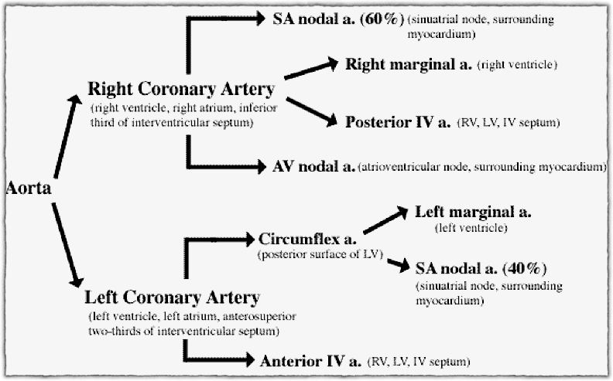
Branches and Areas of Distribution of Coronary Arteries

Slide 10
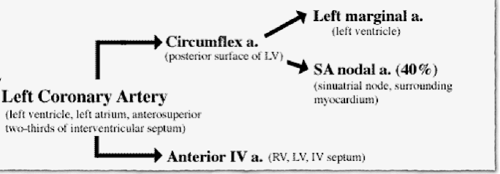
Areas of Distribution of Left Coronary Artery (LCA)
LAD supplies:
Anterior & apical parts of the heart: LV & the TV area adjoining the anterior inter ventricular (IV) groove.
Anterior 2/3rd of the inter ventricular (IV) septum.
CX & LMA supplies:
Lateral & posterior surfaces of the heart: LV & SA- node.
Dr. Abeer Al-Masri, Faculty of Medicine, KSU.
10

Slide 11
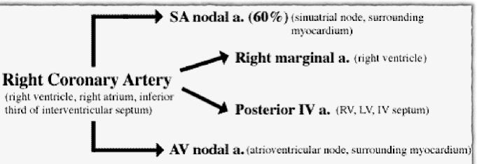
Areas of Distribution of Right Coronary Artery (RCA)
RMA supplies:
- RV, except the area adjoining the anterior inter ventricular (IV) groove.
PDA supplies:
Posterior 1/3rd of the inter ventricular (IV) septum.
Inferior part of Lt ventricle adjoining the posterior inter ventricular groove.
SA nodal Artery supplies:
The SA- node
(Note: in 40% of cases, it is supplied by LCA)
Surrounding Right atrium.
AV nodal Artery supplies:
- The AV- node
(Note: A part of the Lt branch of AV- Bundle)
- Surrounding Right atrium.

Slide 12
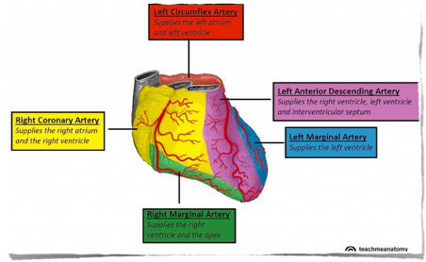
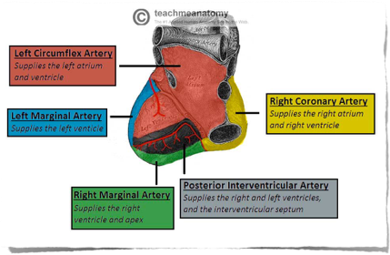
Areas of Distribution of Coronary Arteries

Slide 13
Collateral Circulation
Cardiac anastomosis:
The two coronary arteries anastomose in the myocardium.
Extra cardiac anastomosis:
The two coronary arteries anastomose with:
Vasa vasorum of the aorta.
Vasa vasorum of pulmonary arteries.
Internal thoracic arteries.
The bronchial arteries.
Phrenic arteries.
Extra cardiac channels open up in case of emergencies, when the coronary arteries are blocked.

Slide 14
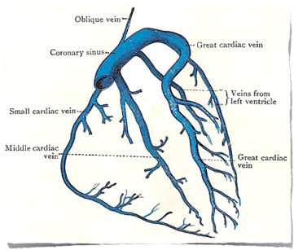
II: Venous Drainage of The Heart
Venous drainage brings deoxygenated blood back to the heart.
Cardiac venous drainage occur through:
Coronary sinus, which lies in the posterior part of the atrioventricular groove & is a continuation of the great cardiac vein.
Anterior, middle & small cardiac veins.
Venae Cordis Minimae (smallest cardiac veins.)

Slide 15
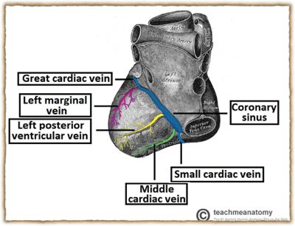
Venous Drainage of The Heart.. Cont.
Most of the venous blood return to the heart into the Right atrium
through the coronary sinus via the cardiac veins.
5- 10% drains directly into heart chambers, Right atrium & Right ventricle: by the anterior cardiac vein & the small veins that open directly into the heart chambers.

Slide 16
III: Lymphatic Drainage of The Heart
Lymphatics of the heart accompany the two coronary arteries.
Lymphatics of the heart form two trunks:
The right trunk: ends in the brachiocephalic node.
The left trunk: ends into the tracheo-bronchial lymph nodes, at the bifurcation of the trachea.

Slide 17
Coronary Dominance
Coronary dominance depends on which artery (or arteries) gives rise to the posterior descending artery (PDA), that runs along the posterior side of the heart & supplies the AV- node.
A person can be:
Right dominant,
Left dominant, or
Co-dominant.

Slide 18
Coronary Dominance… Cont.
Coronary dominance is recognized by the presence of septal perforating branches.
The right coronary artery is dominant in 80–85% cases.
The circumflex branch of the left coronary artery is dominant in 8- 10% cases0
Balanced or co-dominance is found in 7-10% of population where the posterior inter ventricular artery is formed by both Right coronary & LCX arteries.
Clinical importance:
In left dominance, a block in LCA affect the entire left ventricle & IV septum.
In right or balanced dominance, a block in RCA at least spares part (2/3) of the septum & Lt ventricle.

Slide 19
Coronary Blood Flow (CBF)
Coronary blood flow (CBF) at rest in humans is about 5% of the cardiac output, which is about 225-250 ml/min.
CBF increases in proportion to exercise or work output.
At rest, the heart extracts 60-70% of oxygen from each unit of blood delivered to the heart, due to the presence of more mitochondria which generate energy for contraction by aerobic metabolism (other tissue extract only 25% of O2.)

Slide 20


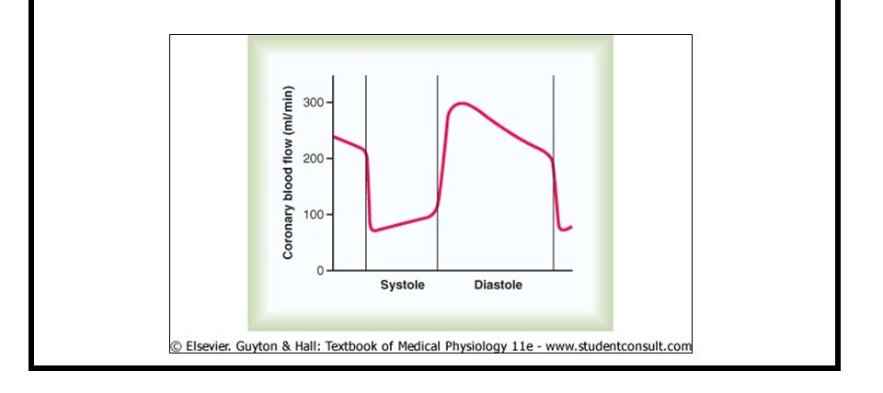

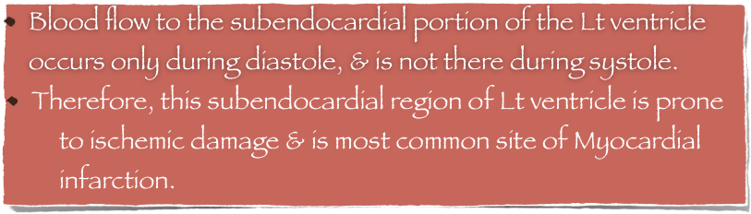
Phasic Changes in Coronary Blood Flow
During Systole & Diastole
During systole, coronary arteries are compressed & the blood flow to the left ventricle is reduced.
Dr. Abeer Al-Masri, Faculty of Medicine, KSU.
20

Slide 21
Factors Affecting Coronary Blood Flow (CBF)
Pressure gradient across the aorta. Chemical factors.
Neural factors.
Dr. Abeer Al-Masri, Faculty of Medicine, KSU.

Slide 22
Pressure Gradient between Aorta &
Ventricles Affects CBF
CBF to the Right side is not much affected during systole.
Pressure difference between the aorta & Right ventricle is greater during systole than during diastole, therefore more blood flow to Right ventricle occurs during systole.
 |  | Pressure (mmHg) in |  | Pressure difference (mmHg) between aorta &
 | Aorta | Left Ventricle | Right Ventricle | Left Ventricle | Right Ventricle
Systole | 120 | 120 | 25 | 0 | 95
Diastole | 80 | 0-2 | 0-2 | 80 | 80
Dr. Abeer Al-Masri, Faculty of Medicine, KSU.

Slide 23
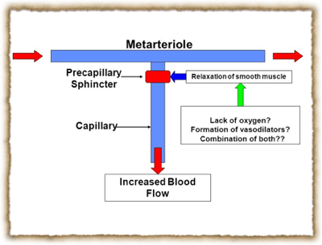
Chemical Factors Affecting Coronary
Blood Flow
Chemical factors causing Coronary vasodilatation (Increased coronary blood flow):
Lack of oxygen.
Increased local concentration of Co2.
Increased local concentration of H⁺ ion.
Increased local concentration of k ⁺ ion.
Increased local concentration of Lactate, Prostaglandin, Adenosine, Adenine nucleotides.
Dr. Abeer Al-Masri, Faculty of Medicine, KSU.

Slide 24
Neural Factors Affecting Coronary
Blood Flow
Sympathetic stimulation.
Parasympathetic stimulation.
Dr. Abeer Al-Masri, Faculty of Medicine, KSU.

Slide 25
Effect of Sympathetic Stimulation on
Coronary Blood Flow
Coronary arteries have:
Alpha Adrenergic receptors, which mediate vasoconstriction (more epicardial.)
Beta Adrenergic receptors, which mediate vasodilatation (more in the intramuscular arteries.)
Indirect effect of sympathetic stimulation:
Sympathetic stimulation in intact body will lead to release of adrenaline & noradrenaline, increasing HR & force of
contraction. Vasodilator metabolites will be increased leading to coronary vasodilatation.
Direct effect of sympathetic stimulation:
Experimentally, injection of noradrenalin after blocking of the beta adrenergic receptors in un-anesthetized animals elicits
coronary vasoconstriction.
Dr. Abeer Al-Masri, Faculty of Medicine, KSU.

Slide 26
Benefits of indirect effect of nor- adrenergic discharge
When systemic blood pressure decreases very low. Reflex increase of nor adrenergic discharge.
Increase CBF secondary to metabolic changes in the myocardium.
In this way, circulation of the heart is preserved while the flow to other organs compromised.
Dr. Abeer Al-Masri, Faculty of Medicine, KSU.

Slide 27
Effect of Parasympathetic Stimulation
on Coronary Blood Flow
Vagal stimulation (Parasympathetic) causes coronary vasodilatation.
However, parasympathetic distribution is not great. There is more sympathetic innervation of coronary vessels.
Dr. Abeer Al-Masri, Faculty of Medicine, KSU.

Slide 28
Effect of Tachycardia on Coronary
Blood Flow
CBF is reduced with tachycardia, as the diastolic period will be shortened.
Dr. Abeer Al-Masri, Faculty of Medicine, KSU.

Slide 29
Control of Coronary Blood Flow (CBF)
CBF shows considerable autoregulation.
Local muscle metabolism is the primary controller:
Oxygen demand is a major factor in local coronary blood flow regulation.
Nervous control of CBF:
Direct effects of nervous stimuli on the coronary vasculature.
Sympathetic greater effects than parasympathetic.
Dr. Abeer Al-Masri, Faculty of Medicine, KSU.

Slide 30




30

