Slide 1


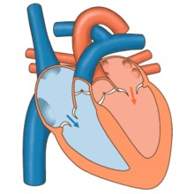



Cardiovascular Physiology
Cardiac Cycle- 1
Dr. Abeer A. Al-Masri, PhD
A. Professor,
Consultant Cardiovascular Physiologist, Faculty of Medicine, KSU.

Slide 2









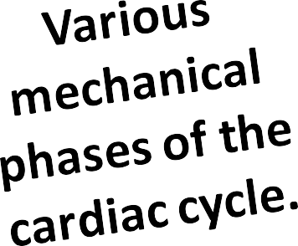





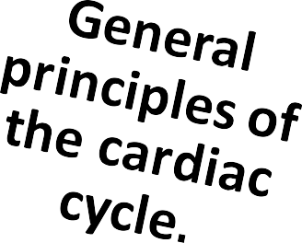
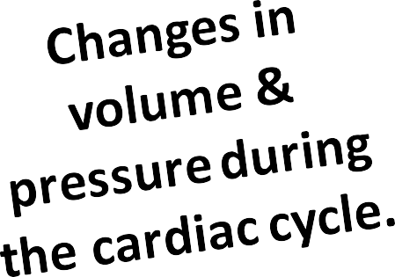
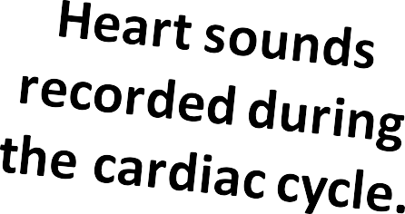
Lecture Outcomes:
Dr. Abeer A. Al-Masri, Faculty of Medicine, KSU

Slide 3
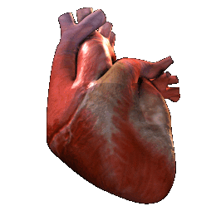
Pump
Dr. Abeer A. Al-Masri, Faculty of Medicine, KSU

Slide 4


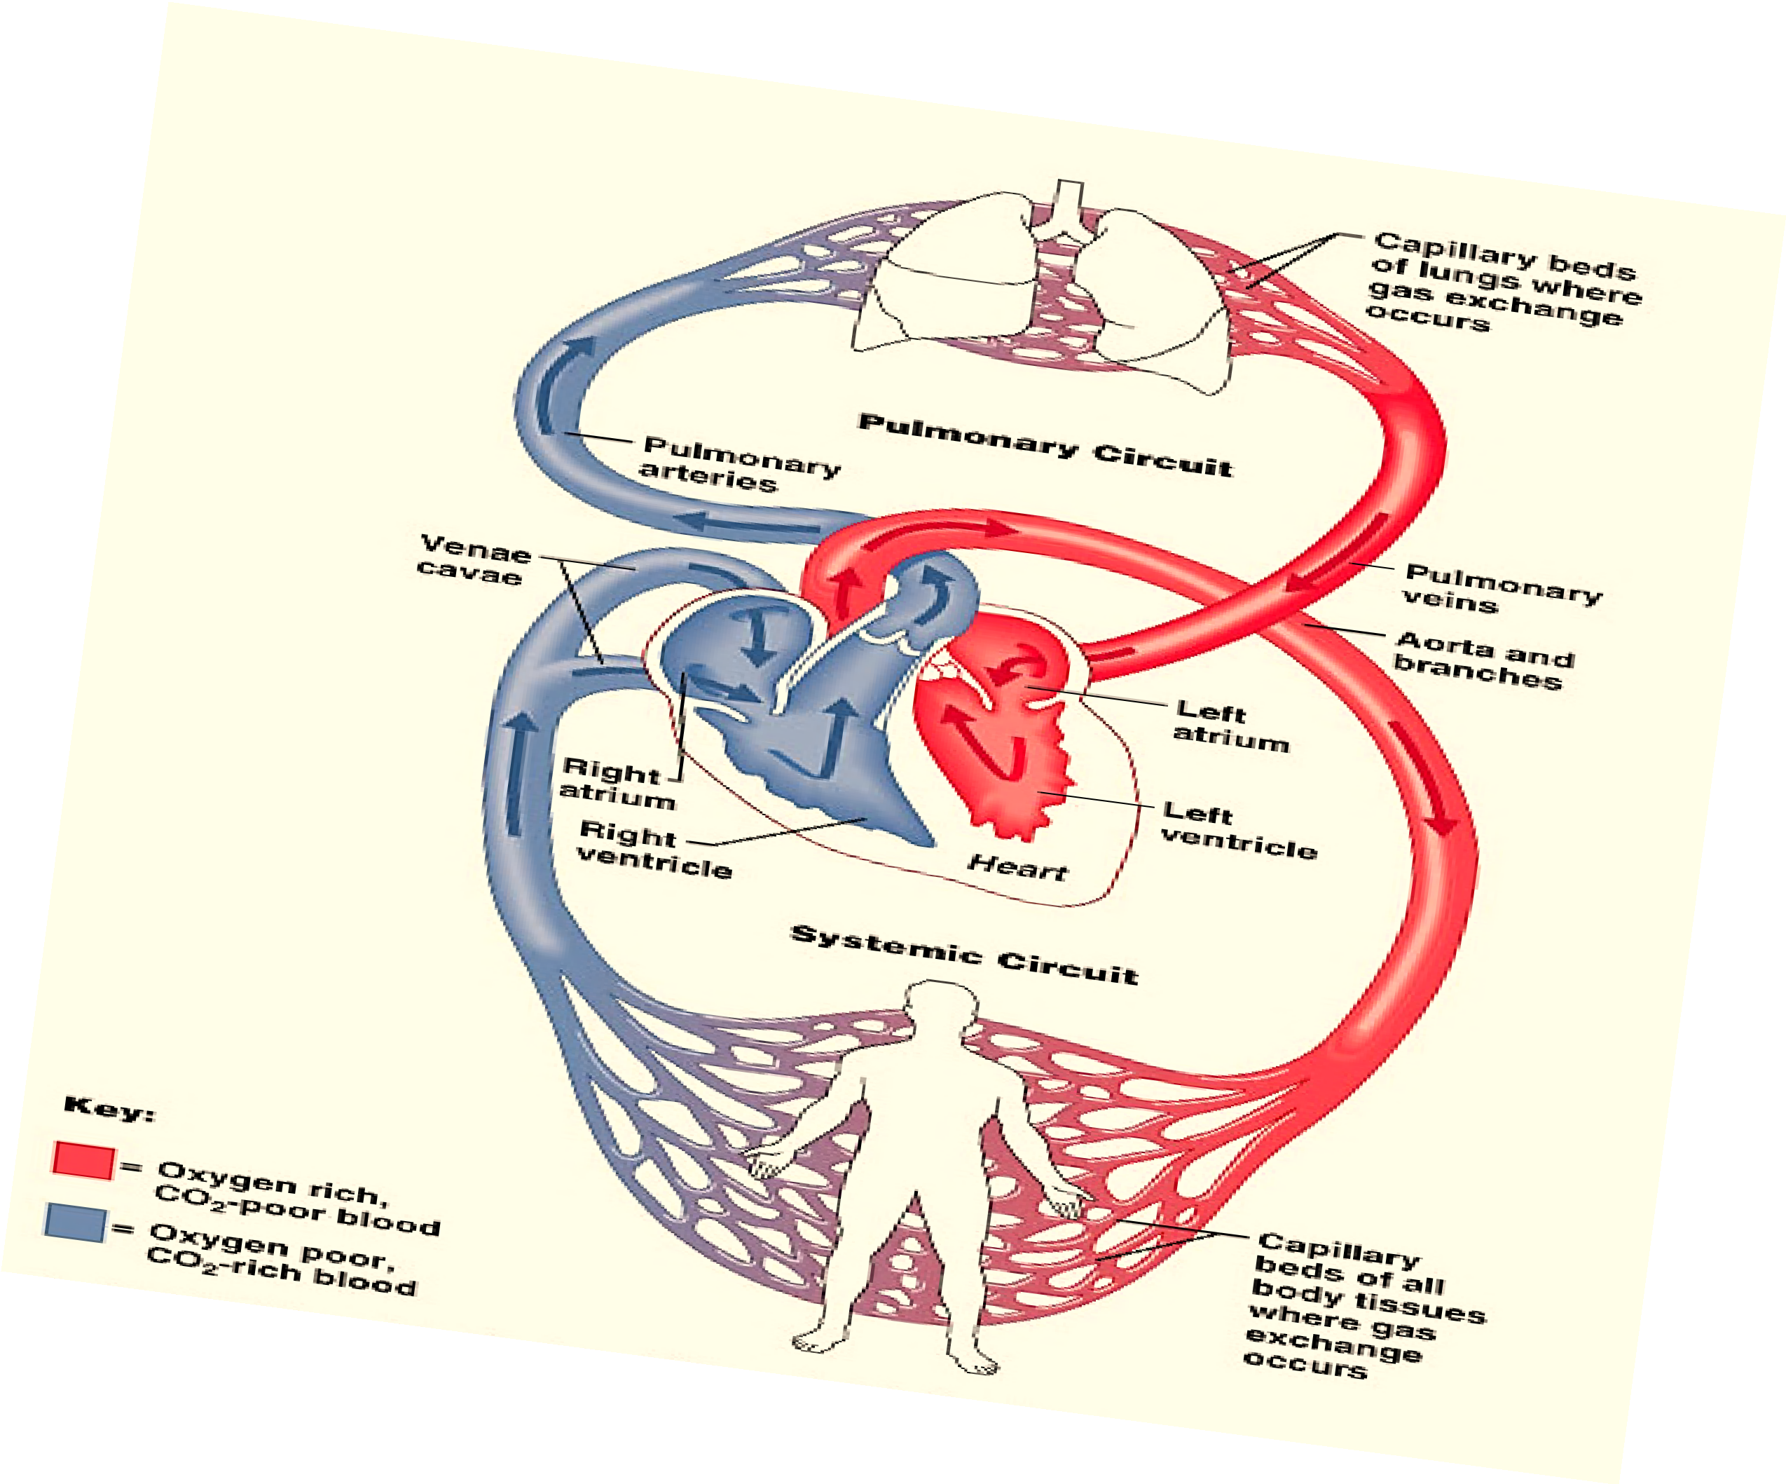


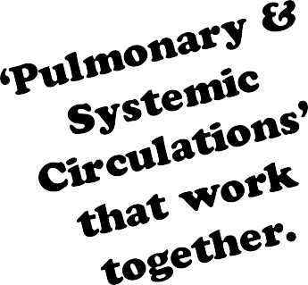
The Heart is a double pump
Dr. Abeer A. Al-Masri, Faculty of Medicine, KSU

Slide 5

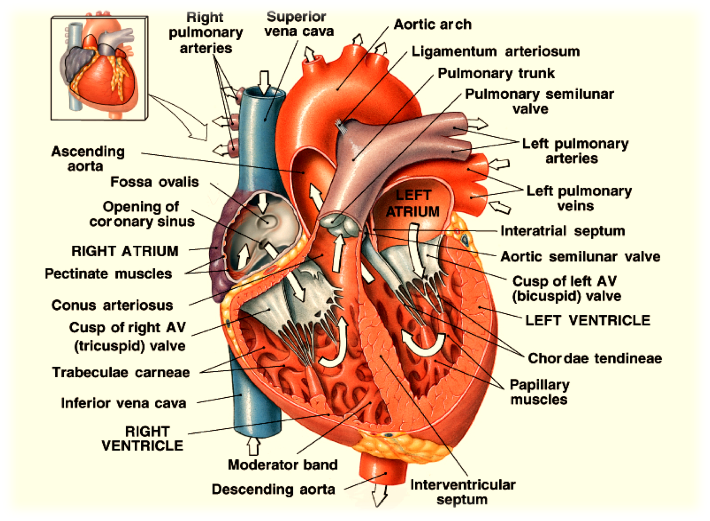


Dr. Abeer A. Al-Masri, Faculty of Medicine, KSU

Slide 6



4 valves.
Found at entry & exit of each ventricle.
Allow blood to flow in only ONE direction.
When AV- vs open, semilunar- vs close & vice versa.
Opening & closure of vs occur as a result of pressure gradient across the vs.
AV cusps are held by chordae tendinea to muscular projections called Papillary muscles.
Dr. Abeer A. Al-Masri, Faculty of Medicine, KSU

Slide 7
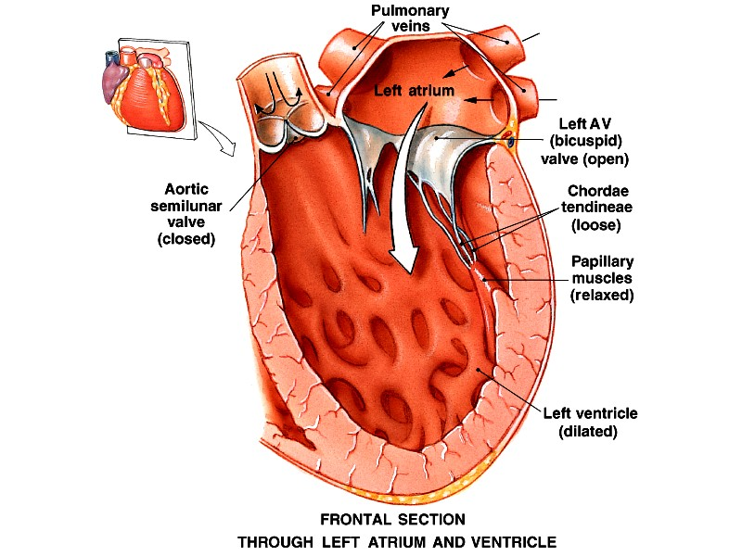
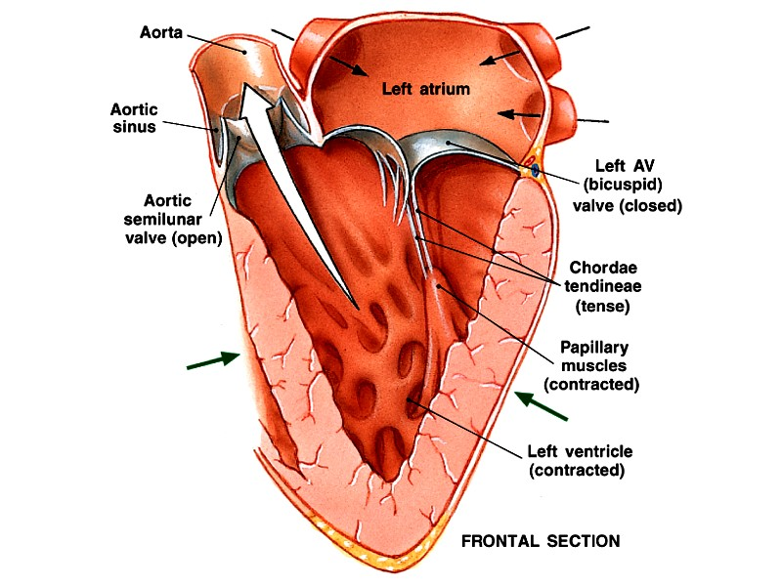
Dr. Abeer A. Al-Masri, Faculty of Medicine, KSU

Slide 8
General Principles
Contraction of the heart generates pressure changes, & results in orderly blood movement.
Blood flows from an area of high pressure to an area of low pressure.
Events are the same in the right & left sides of the heart, but with lower pressures in the right side.

Slide 9

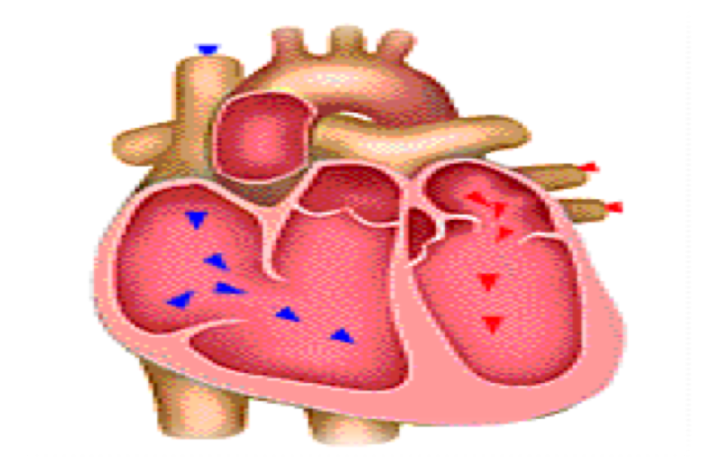
Cardiac Cycle ?
Sequence of events that take place in the heart in each beat
I: Mechanical events II: Volume changes III: Pressure changes IV: Heart sounds
V: Electrical events (ECG)
Cardiac cycle duration = 0.8 sec …
§ When HR 72 bpm
§ Shortened when HR ↑

Slide 10






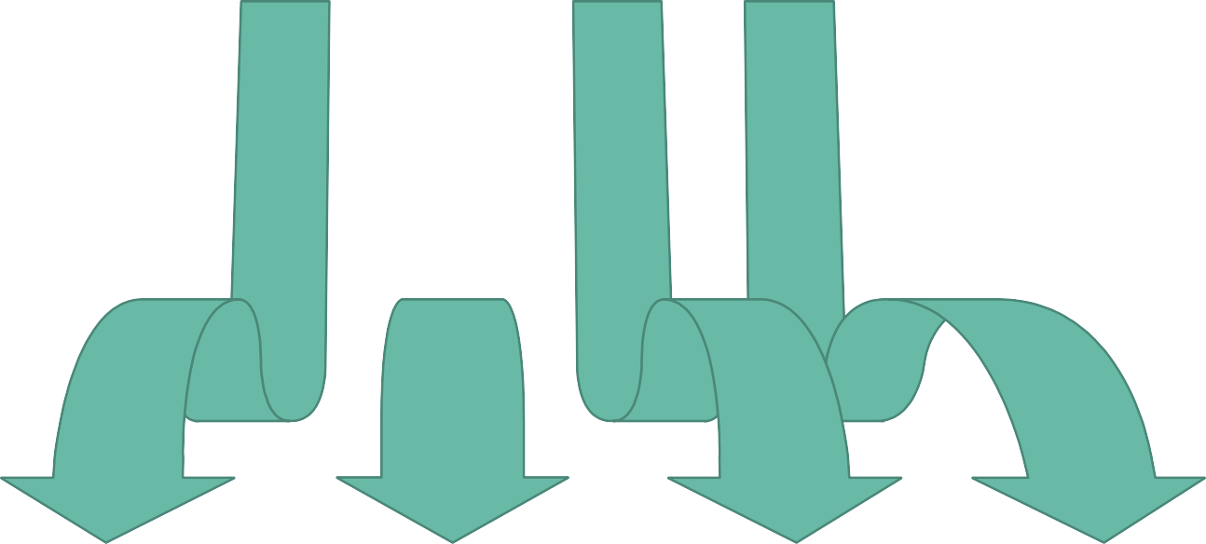







Events in the Cardiac Cycle
1
Mechanical events
2
Volume changes
3
Pressure changes
4
Heart sounds
5
Electrical events (ECG)
10

Slide 11

Events in the Cardiac Cycle
1
2
Volume changes
3
Pressure changes
4
Heart sounds
5
Electrical events (ECG)
Mechanical events

Slide 12


Mechanical Events:
Each heartbeat consists of 2 major periods:
§ Systole .. (Contraction)
§
V
Diastole
V
.. (Relaxation)
e
e
n
n
t
t
r
r
i
i
c
c
u
u
l
l
a
a
r
r
d
s
i
y
a
s
s
t
t
o
o
l
l
e
e
repeated in
(Relaxation) ^{next beat} (Contraction)
Atrial .. systole & diastole
Ventricular .. systole & diastole

Slide 13
Mechanical Events’ Periods
Normally diastole is longer > systole:
Ventricular systole = 0.3 sec
Ventricular diastole = 0.5 sec
Atrial systole = 0.1 sec
Atrial diastole = 0.7 sec
Importance of long ventricular diastole?
  Coronary blood flow
  Ventricular filling

Slide 14
Definitions
End-diastolic volume (EDV):
Volume of blood in ventricles at the end of diastole.
§ ≈ 110-130 mL.
Stroke volume (SV):
Amountof blood ejected from ventricles during systole.
≈ 70 mL/beat.
End-systolic volume (ESV):
Amountof blood left in ventricles at the end of systole.
§ ≈ 40-60 mL.
Ejection fraction (EF):
Fraction of end-diastolicvolume that is ejected.
§ ≈ 60-65 %.

Slide 15






Mechanical Events: Intra-Cardiac Pressures
120/80
mmHg
25-30/4-12
mmHg
2-10
mmHg
2-8
mmHg
120/3-12
mmHg
25-30/2-8
mmHg
Dr. Abeer A. Al-Masri, Faculty of Medicine, KSU

Slide 16
















































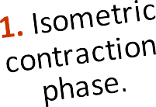







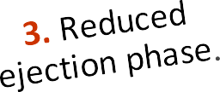





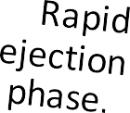






N.B. ? Considered ‘8’ phases if including 1st phase of diastole
Dr. Abeer A. Al-Masri, Faculty of Medicine, KSU

Slide 17
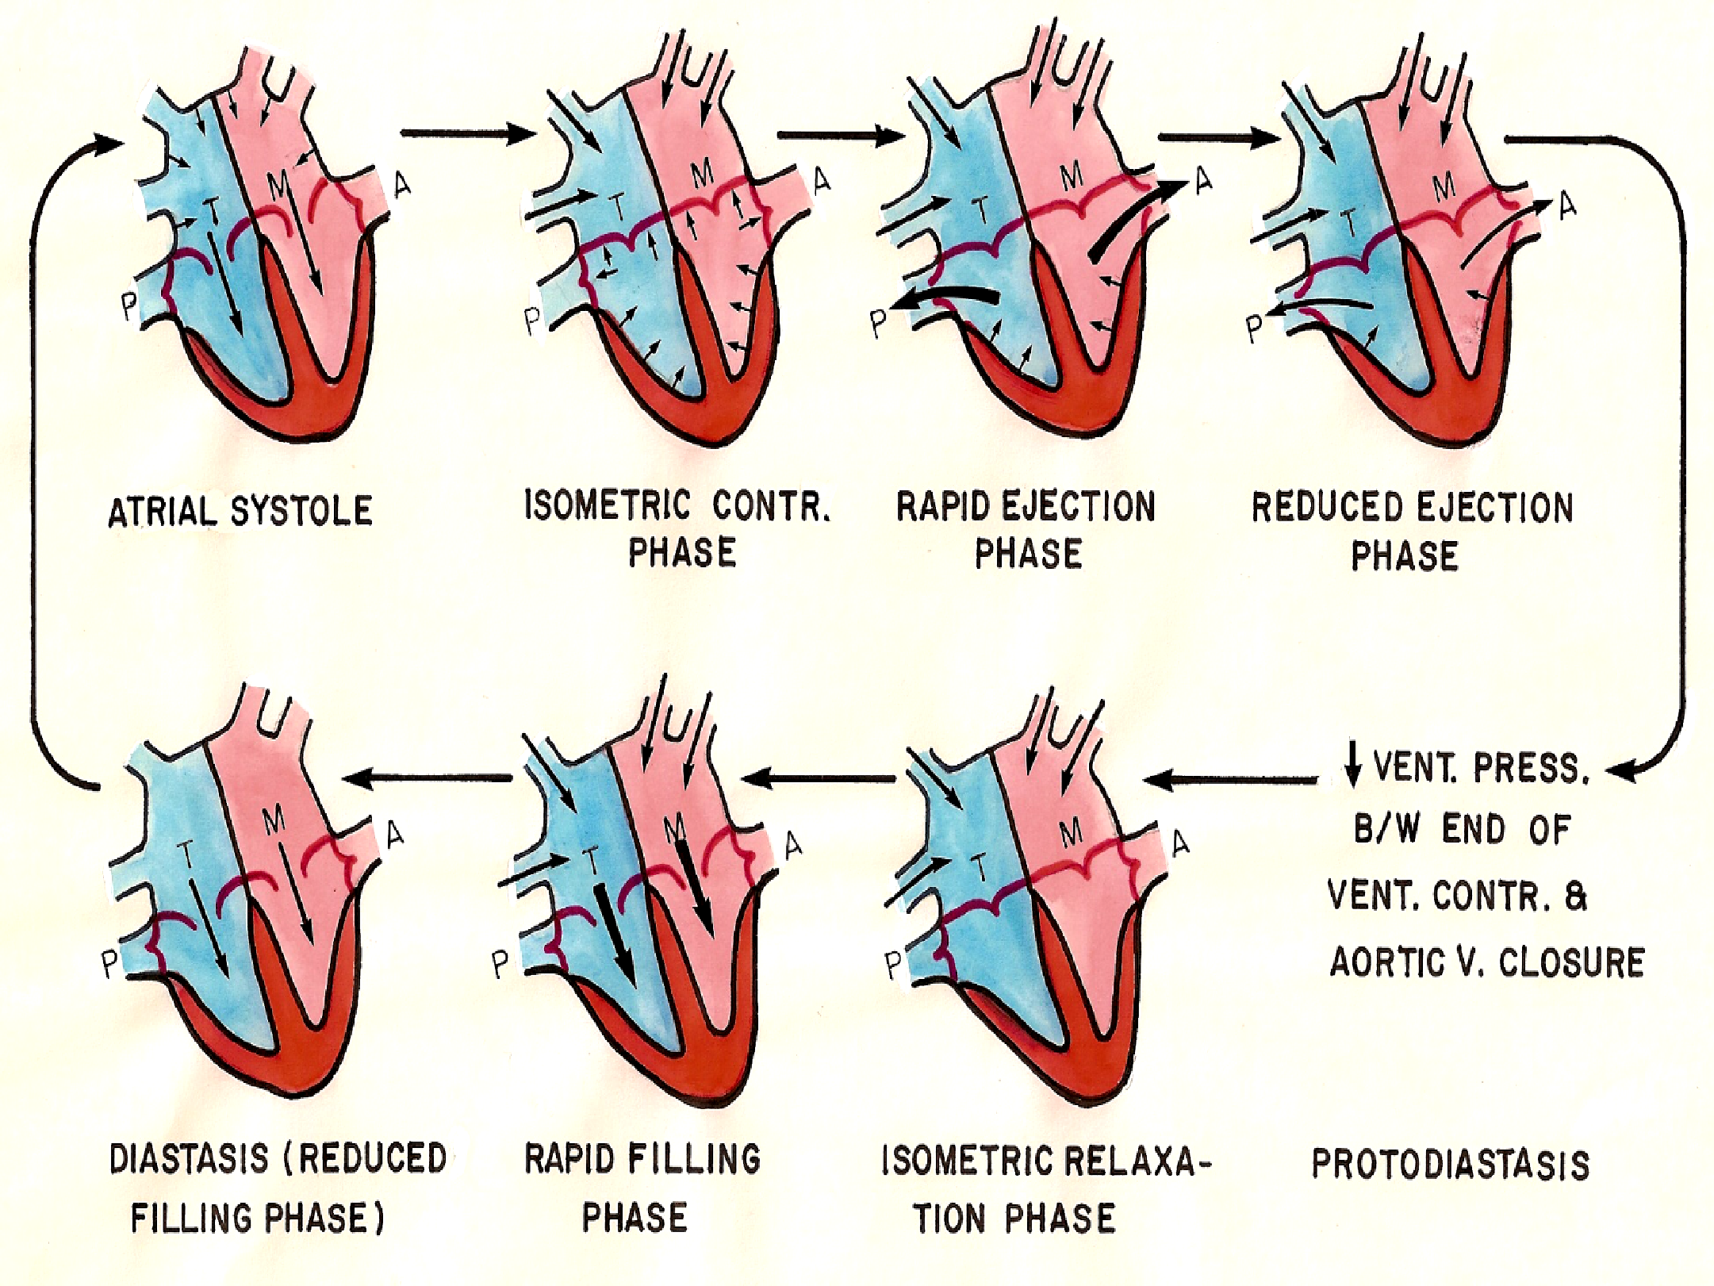

Dr. Abeer A. Al-Masri, Faculty of Medicine, KSU … Image Copyright
17

Slide 18
1. Atrial Systole:
Mechanical Phases of cardiac cycle:
At end of ventricular diastole … (lasts 0.1 sec.) Preceded by atrial depolarization.
Valves: AV- vs open (semilunar- vs closed.)
Volume changes: Tops off last 27-30% of ventricular filling.
Pressurechanges: ↑ Atrial pressure.
4th Heart sound heard.
Blood arriving the heart can’t enter atria, it flows back up jugular vein.
Dr. Abeer A. Al-Masri, Faculty of Medicine, KSU
18

Slide 19
2. Isovolumetric Contraction Phase:
Mechanical Phases of cardiac cycle:
At beginningof ventricular systole … (Lasts ≈ 0.04 sec.) Period between closure of AV- vs & openingof Semilunar- vs. Preceded by ventricular depolarization.
Starts with closure of AV- vs.
1st Heart sound heard. Ventricle is a closed chamber.
Volume in ventricle = EDV
Ventricle contracts with no changes in volume.
Ventricular pressure ↑
Aortic v opens at the end of this phase, when LV exceeds 80 mmHg.
Dr. Abeer A. Al-Masri, Faculty of Medicine, KSU
19

Slide 20
3. Maximum (Rapid) Ejection Phase:
Mechanical Phases of cardiac cycle:
Semilunar- vs open at beginningof this phase:
o When LV pressure exceeds 80 mmHg.
Almost 75% of ventricular blood is ejected, i.e. 75% of SV. Ventricular pressure reaches 120 mmHg.
4. Reduced Ejection Phase:
End of systole.
Almost 25% of ventricular blood is ejected, i.e. 25% of SV. Aortic- v closes at the end of this phase when LV pressure reaches 110 mmHg.

Slide 21
5. Isovolumetric Relaxation Phase:
Mechanical Phases of cardiac cycle:
Period between closure of semilunar- vs & opening of AV- vs. Beginning of diastole … (Lasts ≈ 0.04 sec.)
Preceded by ventricular repolarization.
2nd Heart sound heard .
LV is a closed chamber, i.e. relax with no changes in volume. Volume of blood in ventricle = ESV.
AV- vs open at the end of this phase.

Slide 22
6. Rapid Filling Phase:
Mechanical Phases of cardiac cycle:
Atrial pressure > ventricular pressure. AV- vs open.
≈ 60-70% of blood passes passively to the ventricles along pressure gradient.
3rd Heart sound heard.
7. Reduced Filling Phase (Diastasis):
Remainingatrial blood flows slowly into ventricles. AV- vs still open.

Slide 23
Events in the Cardiac Cycle
1
Mechanical events
2
3
Pressure changes
4
Heart sounds
5
Electrical events (ECG)
Volume changes

Slide 24


Ventricular Volume Changes During the Cardiac Cycle

Slide 25








Ventricular Volume Changes
Phases | Ventricular volume
1. Atrial systole | ↑
Isometric contraction phase Rapid ejection phase Reduced ejection phase | Constant
 | ↓ rapidly
 | ↓ slowly
? Protodiastole Isometric relaxation phase Rapid filling phase Reduced filling phase | Constant
 | Constant
 | ↑ rapidly
 | ↑ slowly

Slide 26
Events in the Cardiac Cycle
1
Mechanical events
2
Volume changes
3
4
Heart sounds
5
Electrical events (ECG)
Pressure changes

Slide 27


Pressure Changes During the Cardiac Cycle

Slide 28
Recorded Pressure Changes
Ventricular pressure
Aortic pressure
Arterial pressure waves Pulmonary artery pressure
Atrial pressure
Jugular venous pressure

Slide 29
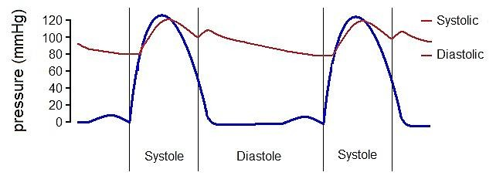
Ventricular Pressure Changes … 120/3-12 mmHg
Ventricular Pressure
0

Slide 30
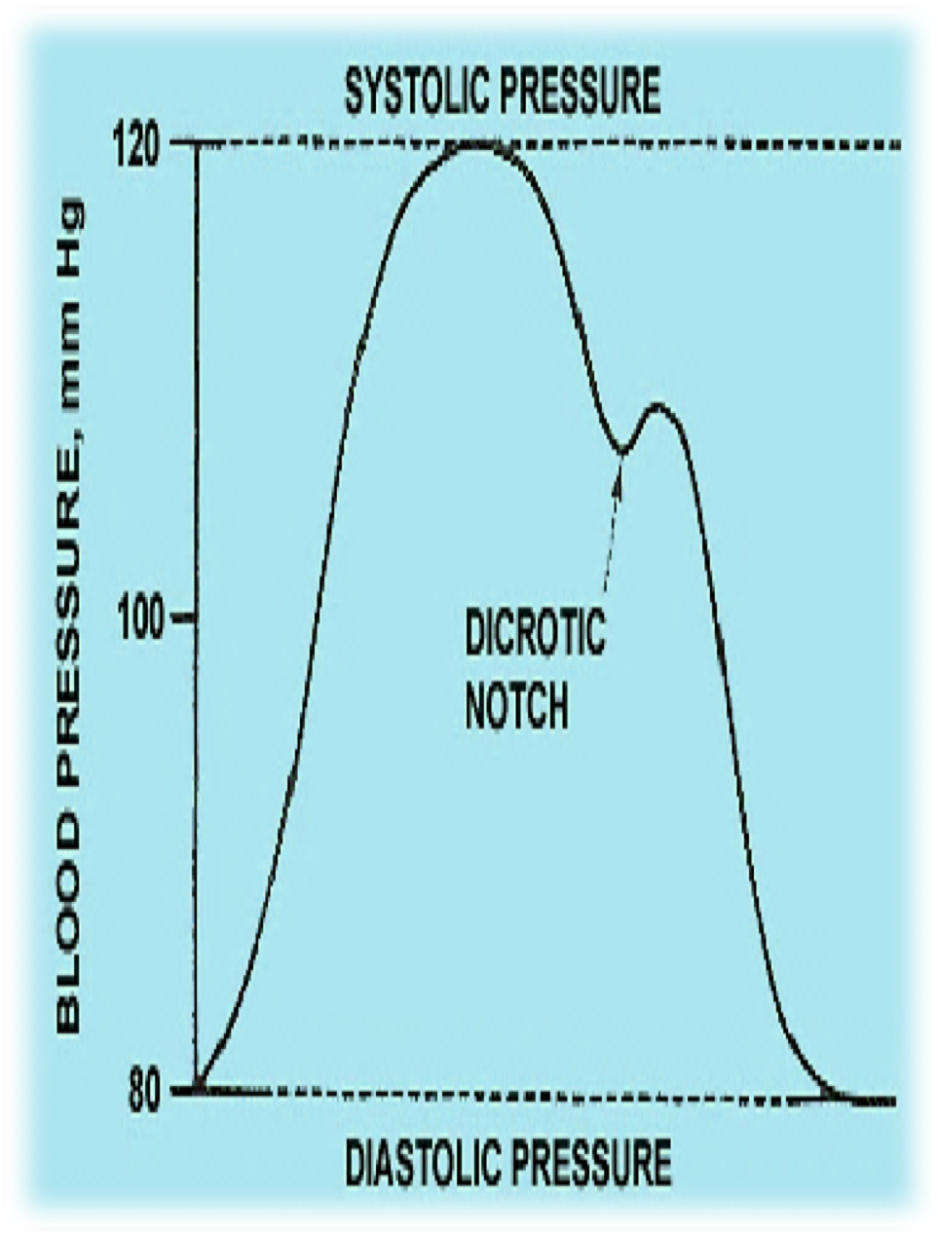
Aortic Pressure Changes … 120/80 mmHg
Ascending or anacrotic limb:
With ‘rapid ejection phase.’
Aortic press ↑ up to 120 mmHg.
Descending or catacrotic limb:
Passes in 4 stages.
30

Slide 31
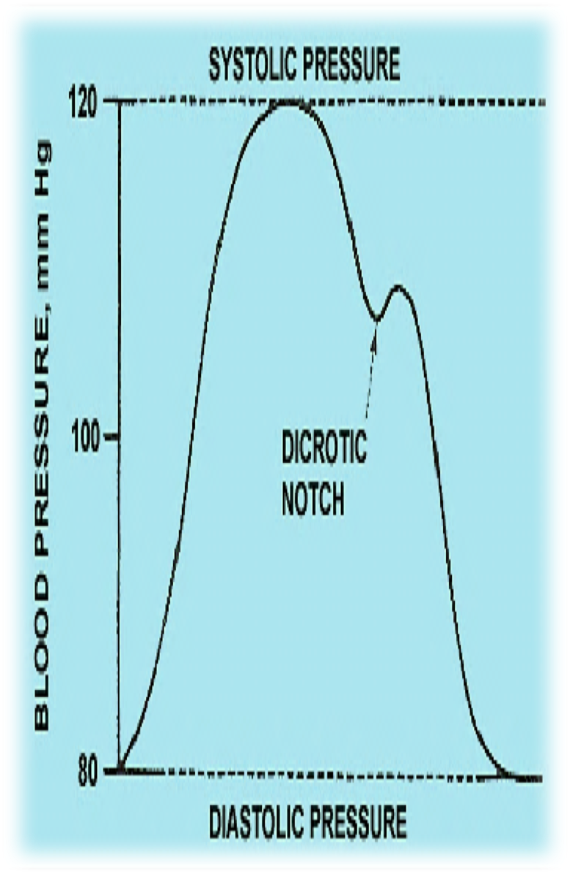
Stages of the Descending / Catacrotic Limb:
↓ Aortic press:
With ‘reduced ejection phase.’ Amount of blood enters aorta < leaves.
Dicrotic notch (incisura):
Due to closure of aortic- v.
Sudden drop in aortic pressure. At end of ventricular systole.
Dicrotic wave:
Due to elastic recoil of the aorta.
Slight ↑ in aortic pressure.
Slow ↓ aortic press: up to 80 mmHg. Due to continued flow of blood from aorta
→ systemic circulation.
Dr. Abeer A. Al-Masri, Faculty of Medicine, KSU
31

Slide 32
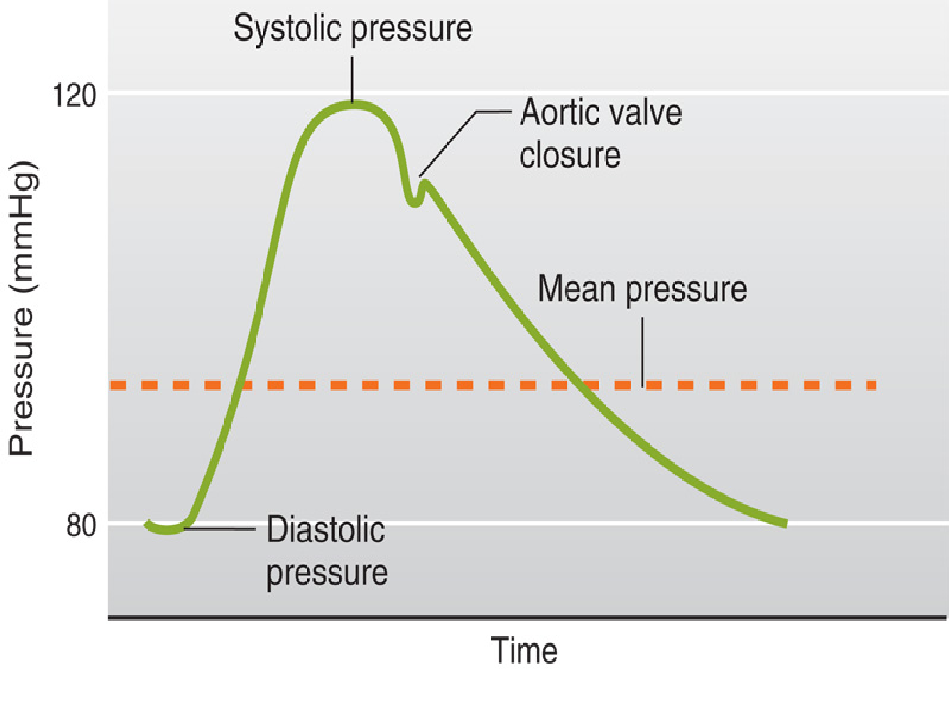

Aortic pressure changes … 120/80
Mean Pressure = diastolic P + 1/3 (systolic P - diastolic P)
Pulse pressure = Systolic P – Diastolic P
Adapted from Guyton
32

Slide 33
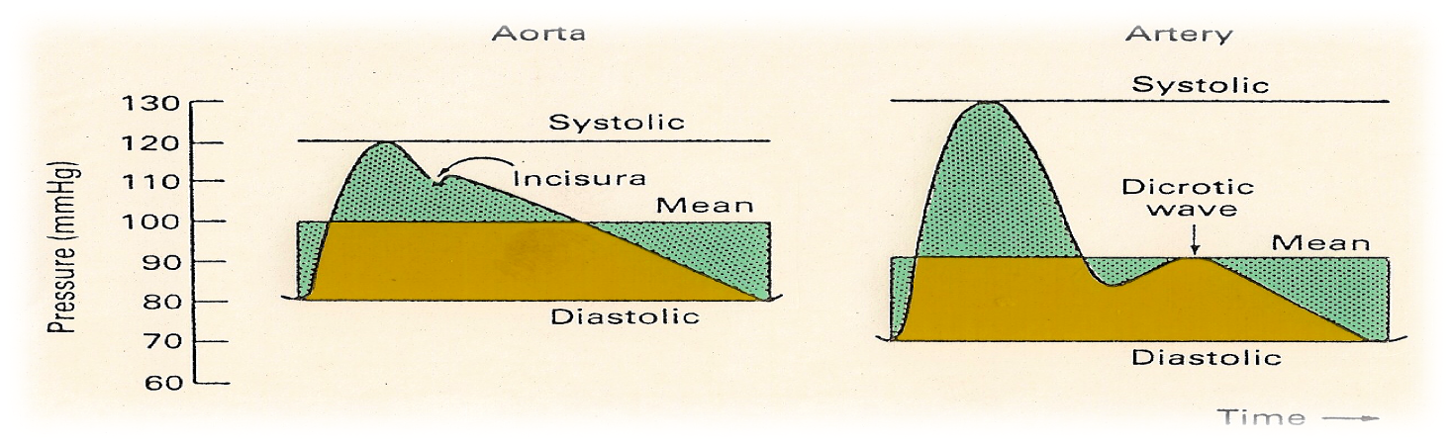
Arterial Pressure Changes … 110-130/70-85 mmHg
Similar to aortic pressure waves, but sharper.
Reflects a systolic peak pressure of 110-130 mmHg & a diastolic pressure of 70-85 mmHg.
Pulmonary Artery Pressure Changes … 25-30/4-12 mmHg
Similar to aortic pressure changes, but with difference in magnitude.
Dr. Abeer A. Al-Masri, Faculty of Medicine, KSU

Slide 34
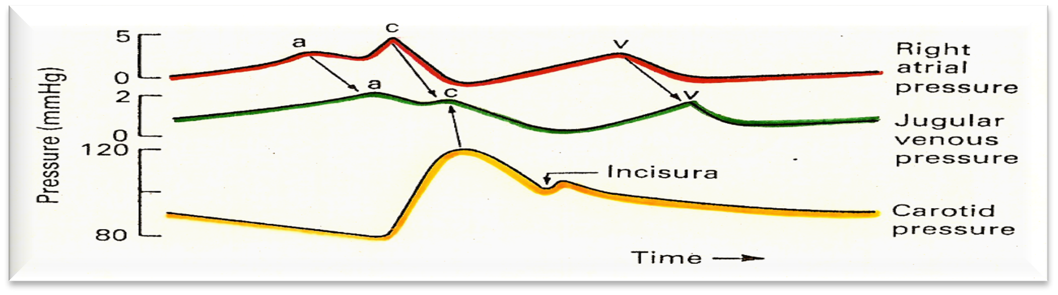
Atrial Pressure Changes:
x
y
Results in:
3 upward deflection → a, c, & v
o 2 components in each wave: +ve (↑ press),-ve (↓ press)
2 downward deflection → x & y
The 3 wave (a, c, & v) are equal to ONE cardiac cycle = 0.8 sec
Dr. Abeer A. Al-Masri, Faculty of Medicine, KSU

Slide 35
Causes of atrial pressure waves
‘a’ wave: Atrial systole:
↑ atrial pressure during atrial systole.
‘c’ wave: Ventricular systole
o +ve → due to the bulging of AV- vs into the atria during ‘isovolumetric contraction phase.’
-ve → due to the pulling down of the atrial muscle & AV cusps during ‘rapid ejection phase’, resulting in ↓ atrial pressure.
‘v’ wave:
o +ve → ↑ Atrial pressure due to ↑ venous return (VR) during atrial diastole.
-ve → ↓ ↓ atrial pressure during ‘rapid filling phase.’
Dr. Abeer A. Al-Masri, Faculty of Medicine, KSU

Slide 36
Causes of atrial pressure waves … (Cont.)
‘x’ descent:
Downward displacement of AV- vs during ‘reduced ejection phase.’
‘y’ descent:
↓ ↓ atrial pressure during ‘reduced filling phase.’

Slide 37
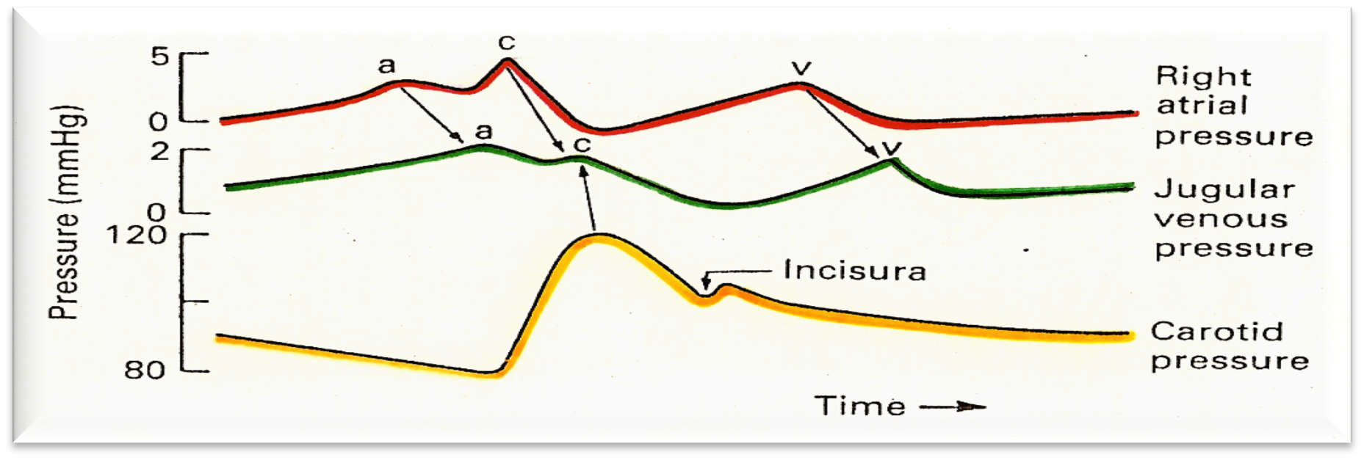
Jugular venous pulse changes:
x
y
x
y
Similar recordings of transmitted delayed atrial waves:
3 upward waves: a, c, & v
2 downward waves: x & y

Slide 38
Events in the Cardiac Cycle
1
Mechanical events
2
Volume changes
3
Pressure changes
4
5
Electrical events (ECG)
Heart sounds

Slide 39


Heart Sounds Recorded During the Cardiac Cycle

Slide 40


Detected over anterior chest wall by:
Auscultation… (Stethoscope.)
Phonocardiography… (sound recording device.)
‘4’ heart sounds can be detected:
1st & 2nd heart sounds … (usually audible)
3rd & 4th heart sounds … (of low pitch, usually not audible)
Important for diagnosis of valvular heart diseases (murmurs)
Dr. Abeer A. Al-Masri, Faculty of Medicine, KSU

Slide 41

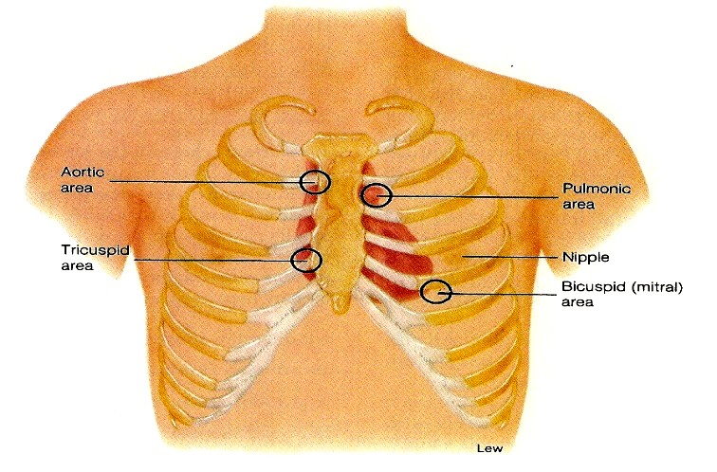
Best heard at 4 certain areas:
Pulmonary area:
  2nd Lt intercostal space.
Aortic area:
  2nd Rt costal cartilage.
Mitral area:
  5nd Lt intercostal space crossing mid- clavicular line, or
  9 cm (2.5-3 in) from sternum.
Tricuspid area:
  lower part of sternum towards Rt side.
Dr. Abeer A. Al-Masri, Faculty of Medicine, KSU

Slide 42
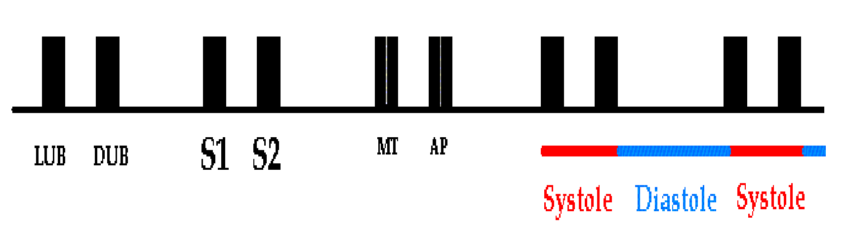
Dr. Abeer A. Al-Masri, Faculty of Medicine, KSU

Slide 43


Due to closure of the AV- vs.
Recorded at the beginning of the the ‘isovolumetric contraction phase.’ It marks beginning of ventricular systole.
Long in duration .. 0.15 sec. Of low pitch (LUB) .. Loud.
25-35 Hz.
Best heard at Mitral & Tricuspid areas.
Dr. Abeer A. Al-Masri, Faculty of Medicine, KSU

Slide 44


Due to closure of semilunar- vs.
Recorded at the beginning of the ‘isovolumetric relaxation phase.’ Marks the beginning of ventricular diastole.
Short in duration .. 0.11-0.125 sec. Of high pitch (DUB) .. Soft & Sharp.
50 Hz.
Best heard at Aortic & Pulmonary areas.
Dr. Abeer A. Al-Masri, Faculty of Medicine, KSU

Slide 45



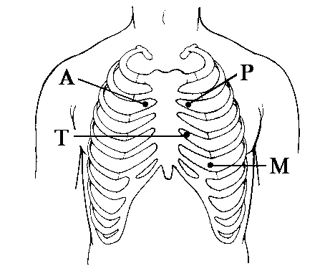
S2 splits physiologically into 2 sounds duringinspiration
= Physiological Splitting.
Physiological splitting during INSPIRATION
This splitting occurs due to delay closure of pulmonary valve.
Dr. Abeer A. Al-Masri, Faculty of Medicine, KSU

Slide 46

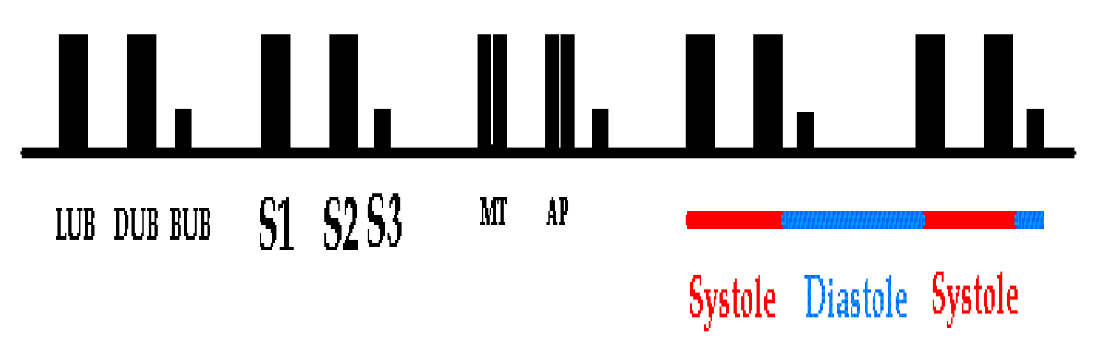
Recorded during the ‘rapid filling phase’ due to rush of blood into the ventricle.
S3 is usually not audible (very low pitch.)
0.05 sec.
? heard in children.
Best heard at Mitral area.
Dr. Abeer A. Al-Masri, Faculty of Medicine, KSU

Slide 47

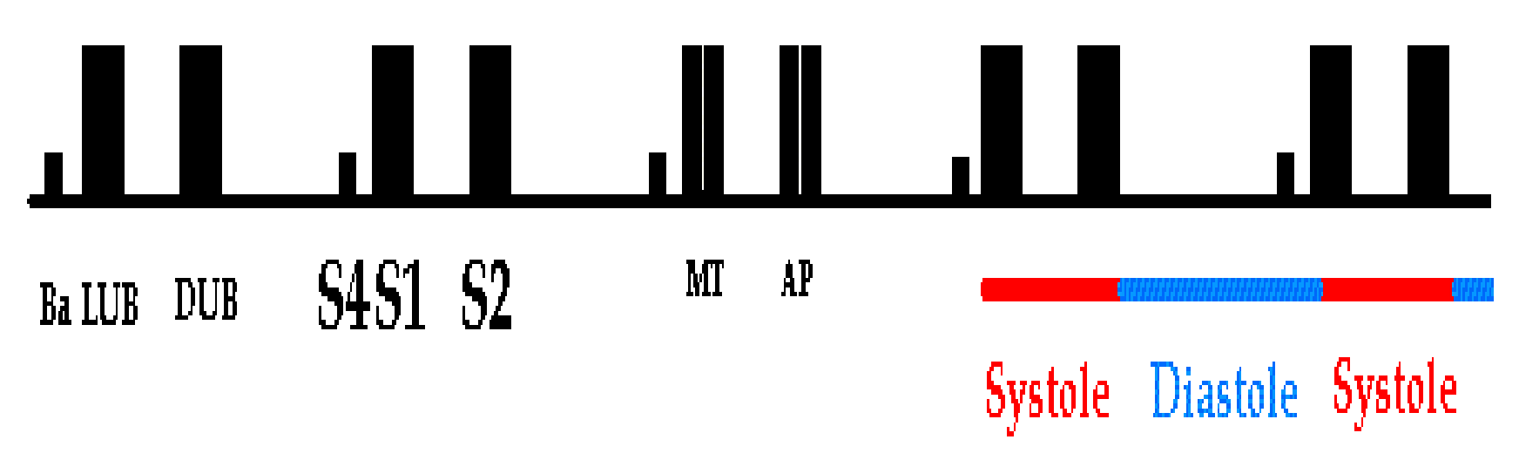
Recorded during ‘atrial systole.’
S4 is usually not audible (very low pitch.)
§ 0.04 sec.
? heard in elderly.
Best heard at Mitral area.
Dr. Abeer A. Al-Masri, Faculty of Medicine, KSU

Slide 48

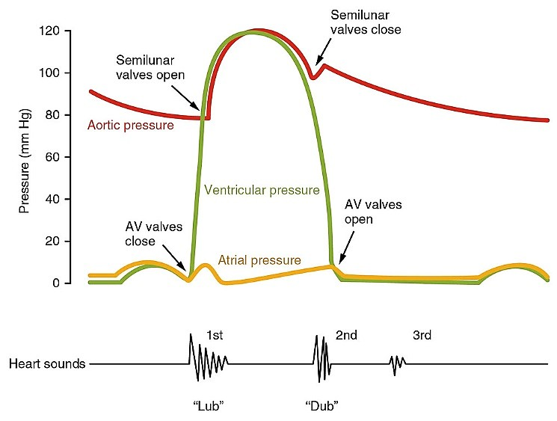

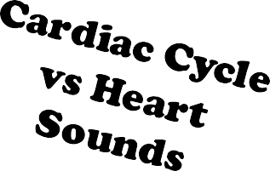
48

Slide 49


Thank You

