Slide 1


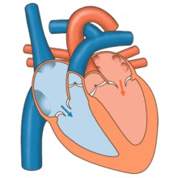



Cardiovascular Physiology
Cardiac Cycle- 2
Dr. Abeer A. Al-Masri, PhD
A. Professor,
Consultant Cardiovascular Physiologist, Faculty of Medicine, KSU.

Slide 2






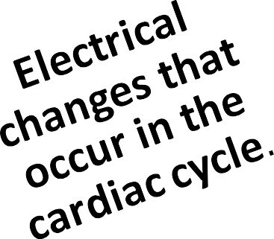
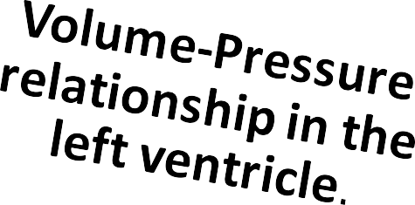


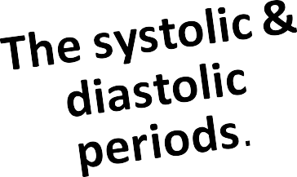

At end of this lecture you should be able to know:
2

Slide 3





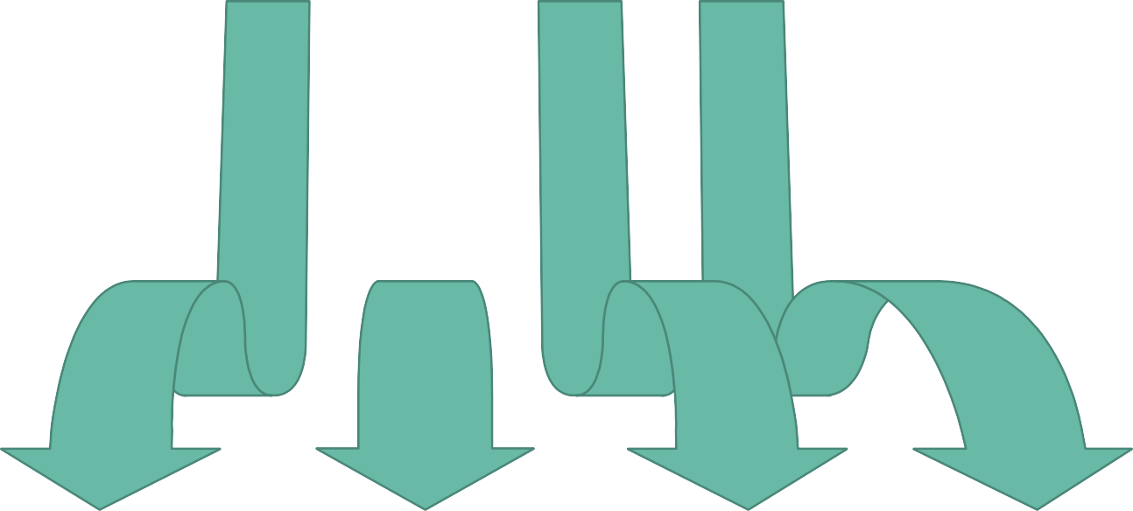








Events in the Cardiac Cycle
1
Mechanical events
2
Volume changes
3
Pressure changes
4
Heart sounds
5
Electrical events (ECG)
2

Slide 4



Electrical Changes (ECG) During the Cardiac Cycle

Slide 5
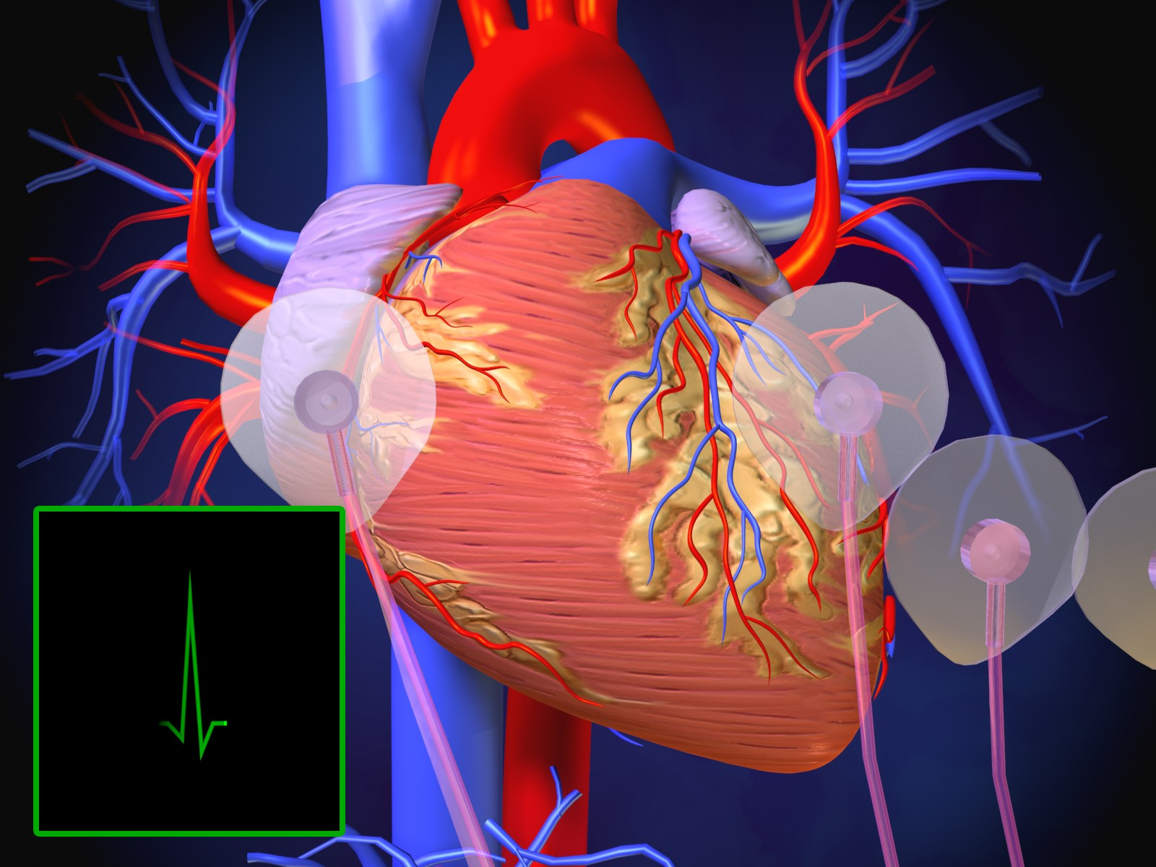



ECG?
A diagnostic tool that records of the electrical activity (action potentials) generated by the heart from chest surface, per unit time
6

Slide 6


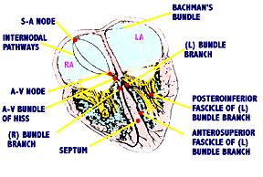
6

Slide 7

Electrical activity of heart
To produce normal sinus rhythm, (3) criteria must be met:
  Action potential must originate in SA- node.
  SA nodal impulse must occur regularly at a rate of 60 – 100 impulses per minute.
  Activation of myocardium must occur in correct sequence & correct timing & delays.
SA node rate: 60-100 b/min.
Under vagal influence 70-80 b/min.

Slide 8
Electrical activity of heart…
Action potential (AP) originates in SA- node at time zero.
It then takes a total of (0.1 sec.) to spread through the atria.
Atrial depolarization is followed by atrial contraction for (0.1 sec.)
The impulse then reaches AV- node, His Bundle & the Purkinje system to the farthest point in ventricles in (0.08 - 0.1 sec.)
Ventricles contract for a total time period of (0.3 sec.)
Total time period for one cardiac cycle = 0.8 - 0.83 sec. when heart rate = 72 bpm.

Slide 9

Ectopic & Latent Pacemakers
In addition to the SA- node, AV- node, His bundle & Purkinje fibers have intrinsic automaticity & ability to set a pace. They are called latent Pacemakers.
Latent Pacemakers are normally suppressed & function only if the SA- node is damaged, or its impulse is blocked, or if the rate of firing of the latent pacemakers increases.
AV- node discharges at 40 –60 b/min.
•
If both damaged then bundle of His or Purkinje fibers fires at 20- 40 beats/min.
Sometimes atrial or ventricular fiber is excessively excitable & become pacemaker.
A pacemaker elsewhere than the SA- node is called Ectopic Pacemaker.

Slide 10
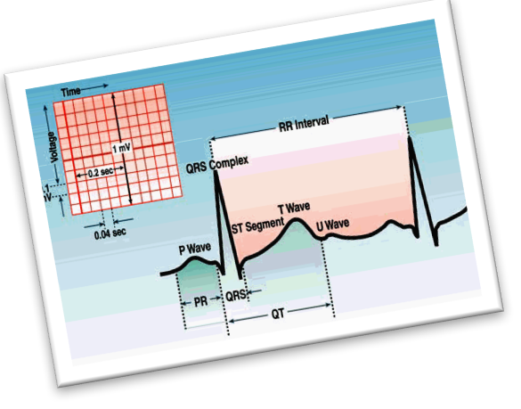

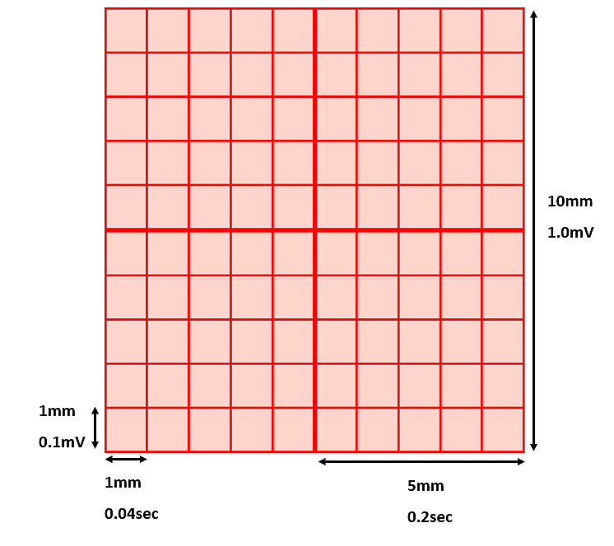
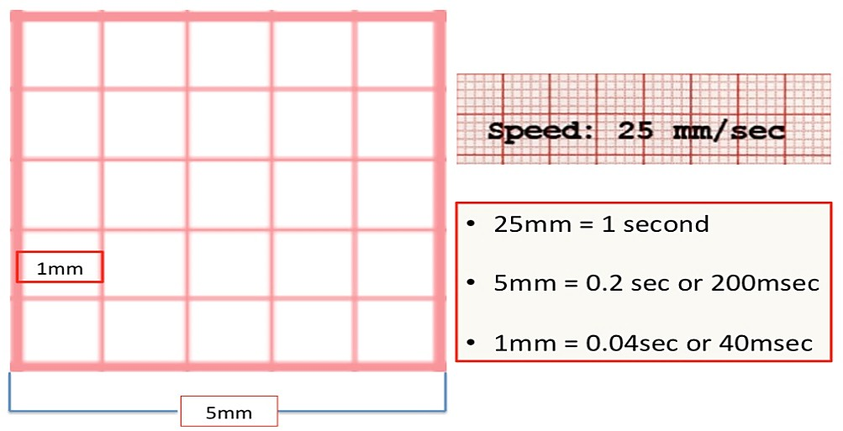
q ECG is displayed on a graph paper as waves.
q Speed: ECG machine runs at 25mm/sec.
X-axis is the time.
1mm square corresponds to 0.04 sec.
q Voltage is measured on vertical Y-axis.
§ 0.1mV/mm (1mV=10mm.)
10

Slide 11

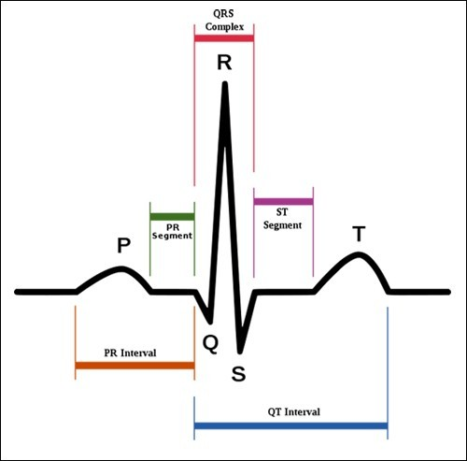
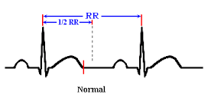

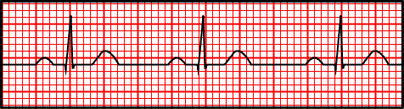


ECG waveforms, Intervals & Segments
One heartbeat is normally recorded as:
q 3 waves: (depolarize & repolarize)
P- wave
QRS complex
T- wave
3 positive waves (P, R & T- waves)
2 negative waves (Q & S- waves)
q 3 time intervals: (include waves)
P-R interval
Q-T interval
R-R interval
q 3 segments: (isoelectric, & doesn’t include waves)
PR segment
ST segment
TP segment
TP segment
11

Slide 12




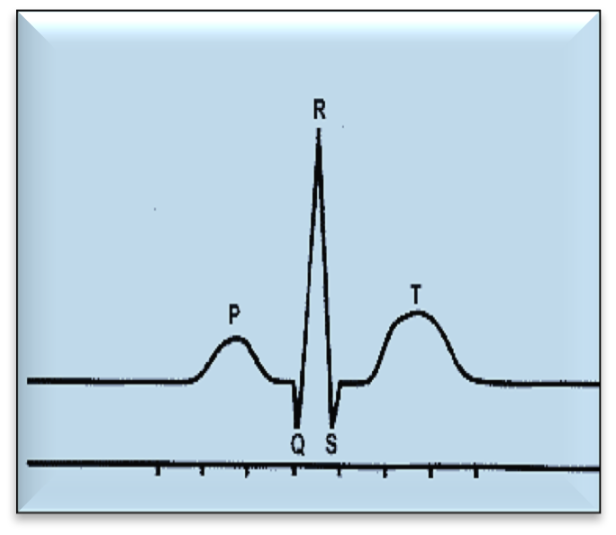
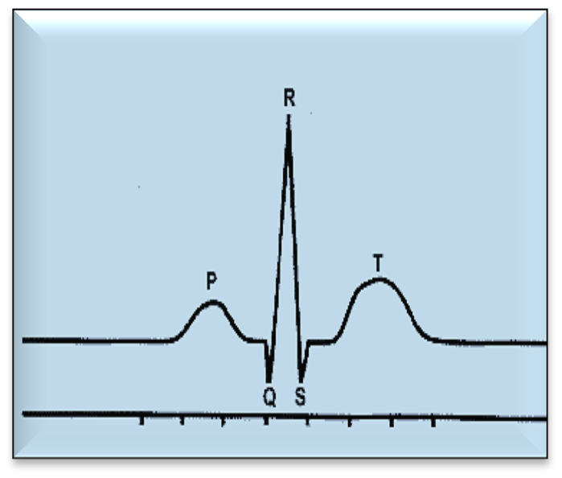
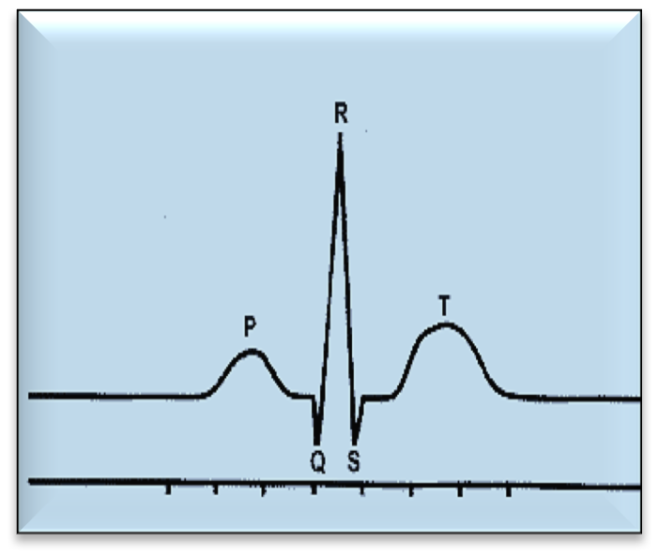
Causes of ECG Waves
P- Wave
QRS Complex T- Wave
 | Due to ventricular | Due to ventricular
Due to atrial | depolarization | repolarization
depolarization. | QRS complex is | T- wave is recorded
P- wave is recorded before the onset of atrial systole. | recorded before the onset of ventricular systole (isometric contraction phase.) | before the onset of ventricular diastole (isometric relaxation phase.)
13

Slide 13

Causes of ECG waves
ECG Wave | Cause | Represent
P- wave | Atrial depolarization | Time of electrical impulse from SA node to spread through atrial muscle. Duration = 0.08 – 0.1 sec Precedes atrial contraction by ≈ 0.01 - 0.02 sec
QRS complex | Ventricular depolarization | Measured from beginning of Q wave till end of S wave. Consists of 3 waves: Q wave: (-ve): Produced by depolarization of interventricular septum. R wave: (+ve): Produced by depolarization of ventricular wall. S wave: (-ve): Produced by depolarization of the base of the heart. Duration ≤ 0.1 sec. Precedes ventricular contraction by ≈ 0.02 sec. Occurs after P-wave by ≈ 0.12-0.2 sec = PR interval
T- wave | Ventricular repolarization | Occurs during latter part of systole, before the onset of diastole. Ventricular repolarization progresses from apex to the base of the heart. Duration = 0.27 sec.
N.B.
Atrial repolarization occurs at the same time with ventricular depolarization. But, since ventricular depolarization wave is giant, it masks the atrial repolarization wave
13

Slide 14



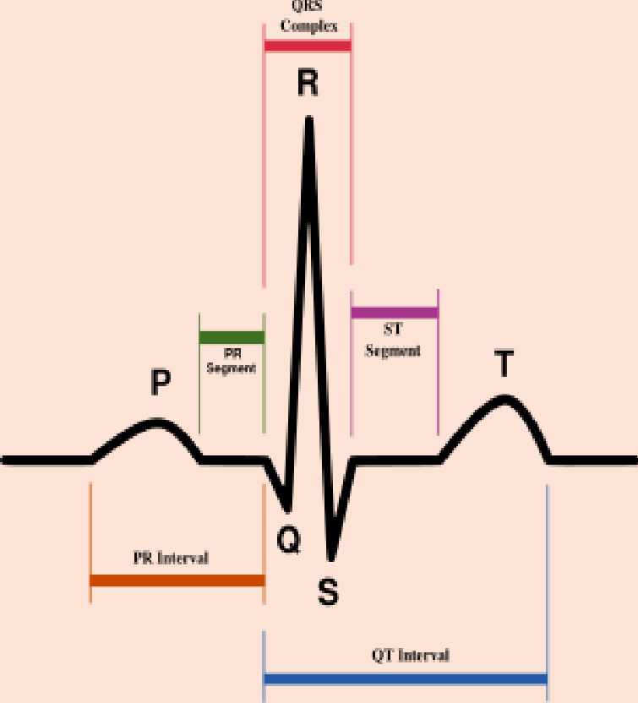
P-R interval
q P-R interval is the time from the initial depolarization of atria to the initial depolarization of ventricles.
q Time period measured from start of P- wave to start of QRS complex; Thus P-R interval includes P- wave & PR segment
q P-R interval range = 0.12-0.2 sec.
q An increase in conduction velocity through AV node will decrease P-R interval (sympathetic stimulation) & vice versa.

Slide 15


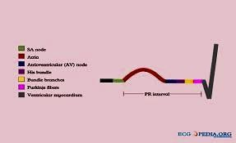
PR segment
q P- wave is followed by brief isoelectric (zero voltage) flat portion of ECG that corresponds to AV- node conduction à PR segment.
q This segment correlates with conduction time through the AV- node & AV bundle or AV nodal delay = 0.13 sec.

Slide 16

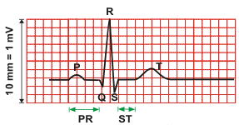
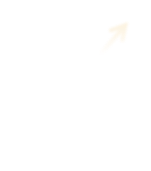
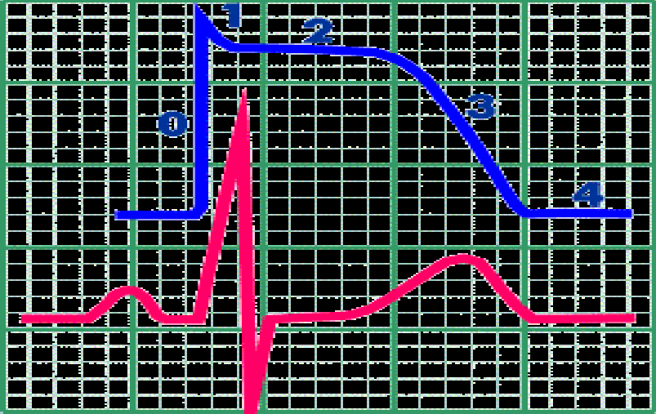
ST segment
q Isoelectric segment follows the QRS complex, showing that there is no potential difference between
areas of myocardium at this stage.
q At this time, both ventricles depolarized & roughly corresponds to the plateau phase of the ventricular action potential.
J point
q J point: at end of QRS, zero reference potential for analyzing current of injury.

Slide 17
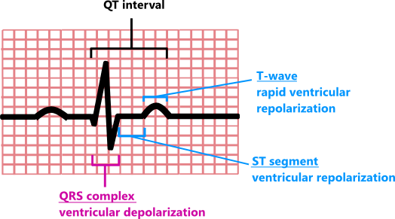





Q-T interval
q The Q-T interval includes the QRS complex, ST segment & T- wave.
q It represents total time taken by ventricle to depolarize & repolarize [contraction of ventricles]
q Q-T interval range = 0.35 – 0.45 sec.
q Approximate Refractory period of ventricle.

Slide 18



TP segment
TP segment
q Time interval from ventricular repolarization till next atrial depolarization.
q Calculated from end of T- wave to beginning of P- wave.
q It represents ventricular filling.

Slide 19
Note:
No current flow in the heart during segment’s time.
PR segment: AV- node delay.
ST segment: Cardiac muscle completely depolarized.
TP segment: Ventricular filling takes place.

Slide 20



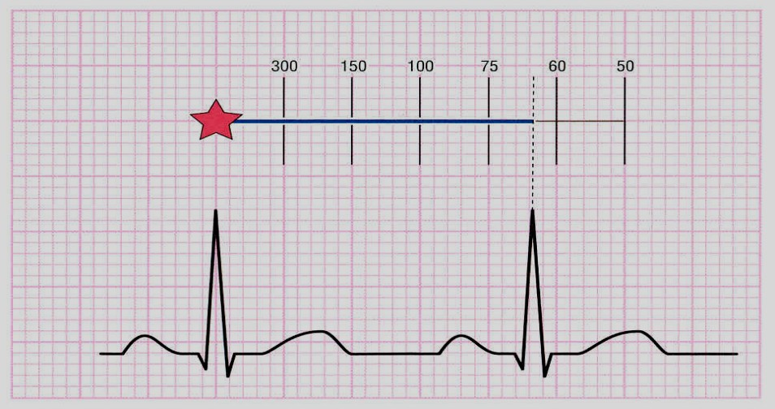
R-R interval
q The interval between two successive R- waves.
q It determines the heart rate & cardiac cycle length.
q Heart rate can be measured by counting the number of R- waves per minute.

Slide 21
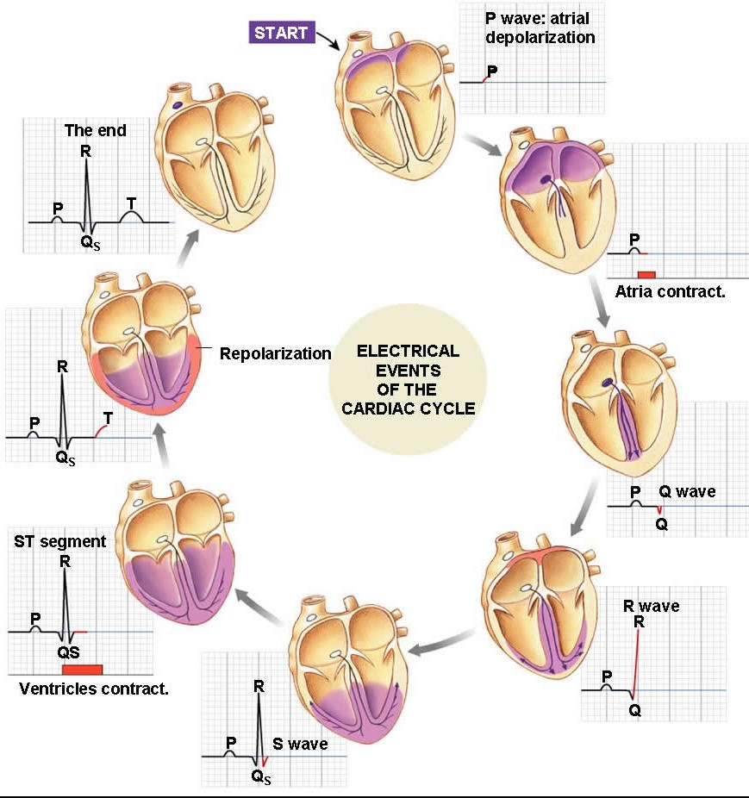
21

Slide 22
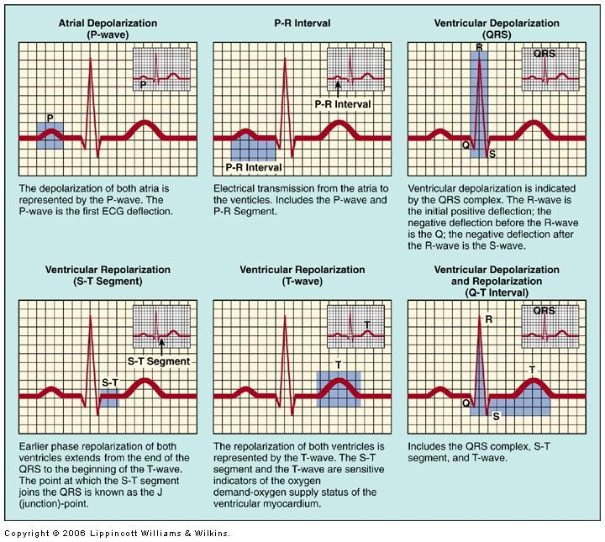
21

Slide 23

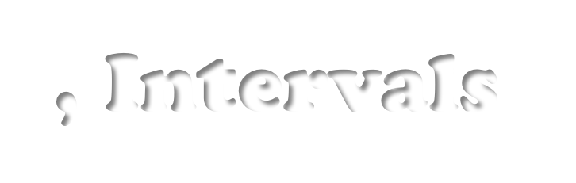

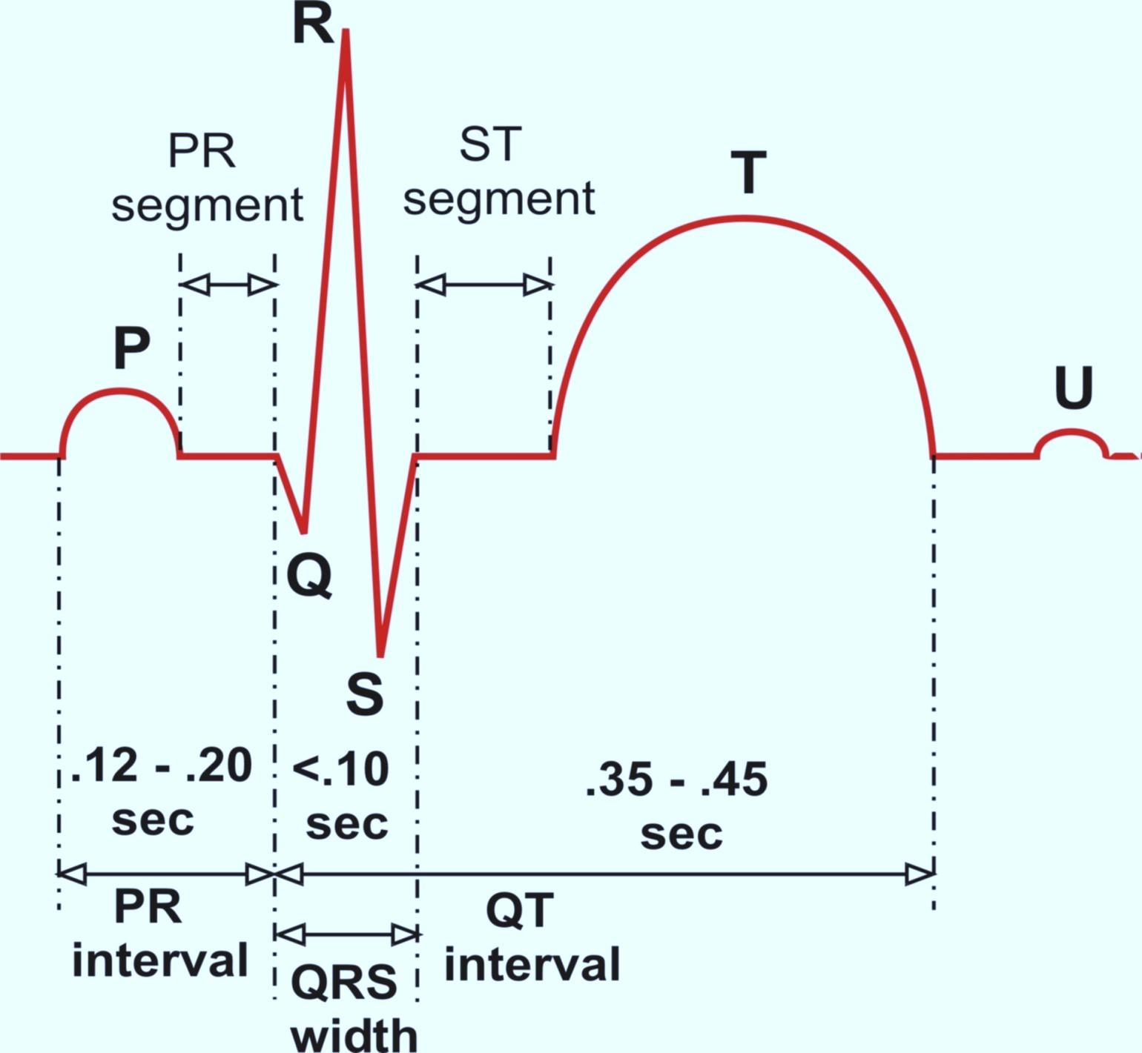
ECG Waves, Intervals & Segments
0.04 - 0.1 sec
0.3-0.32 sec
0.08 - 0.1 sec
23

Slide 24


Left Ventricular Pressure versus Volume

Slide 25





Left Ventricular
Pressure – Volume Curve “The Complete Picture”

Slide 26
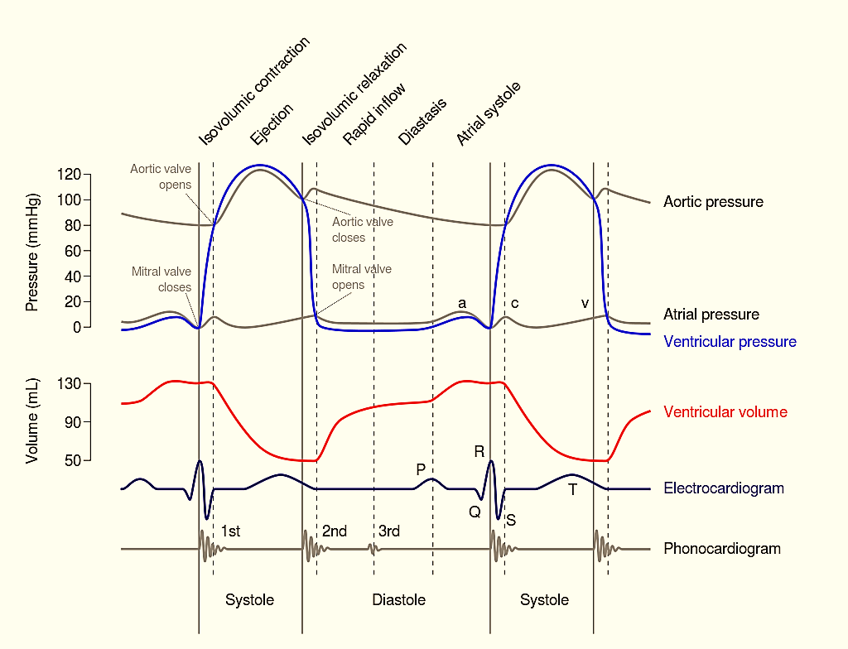
26

Slide 27




Left Ventricular Pressure - Volume Loop

Slide 28

Left Ventricular
Pressure – Volume Loop
Correlation of intra-ventricular changes in volume & pressure that occur during one cardiac cycle
29

Slide 29
Basic Myocardial Muscle Mechanics:
Both ventricular systole & diastole can be divided into early & late phases.
Systole:
Early systole = ‘Isovolumetric Contraction.’
Late systole = Isotonic Contraction ‘Ejection Phase.’
Diastole:
Early diastole = ‘Isovolumetric Relaxation.’
Late diastole = Isotonic Relaxation ‘Filling Phase.’
29

Slide 30
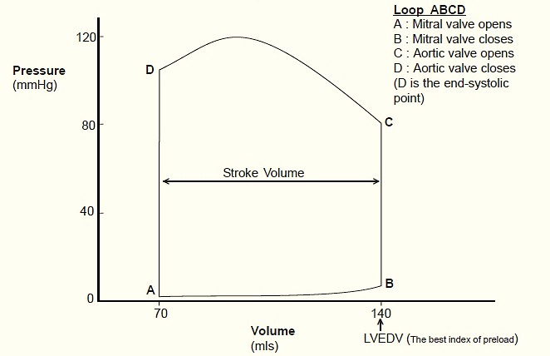
Ventricular Pressure - Volume Loop
Late Systole (Ejection phase)
←
Plots LV pressure against LV volume through one complete cardiac cycle
Systole: divided into,
Early systole Late systole
Diastole: divided into,
Early diastole Late diastole
Early Diastole (Isovolumetric relaxation)
↑
Early Systole
(Isovolumetric Contraction)
↓
→
Late Diastole
(Filling phase)
ESV
EDV
30

Slide 31
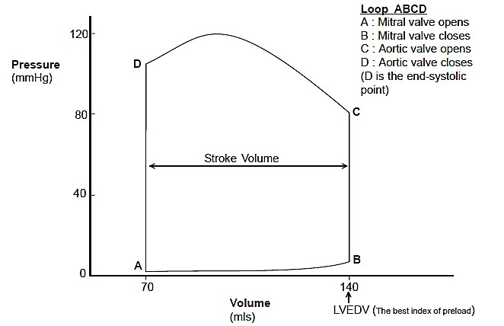
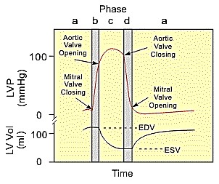
Ventricular Pressure - Volume Loop
Late Systole (Ejection phase)
←
A – Mitral valve opens B – Mitral valve closes C – Aortic valve opens D – Aortic valve closes
Early Diastole (Isovolumetric relaxation)
↑
Early Systole (Isovolumetric Contraction)
↓
→
Late Diastole
(Filling phase)
ESV
EDV
31

Slide 32
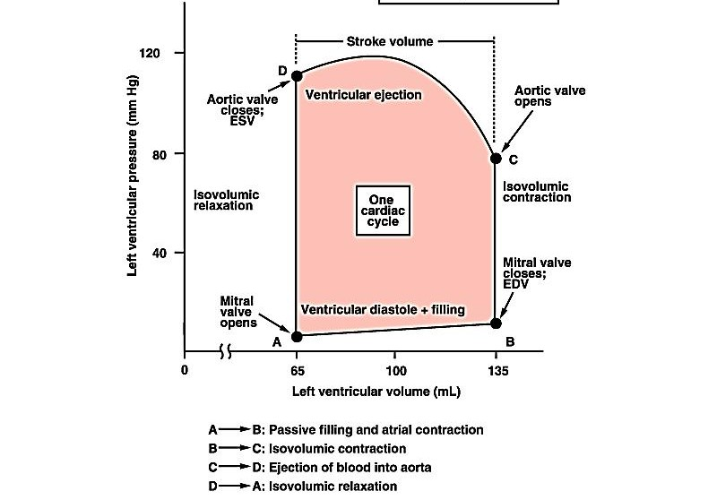



Ventricular Pressure - Volume Loop
End of Systole
Systolic BP
Diastolic BP
Contractility
Area = Work
Compliance
Beginning of Systole
EDV
ESV
SV = EDV - ESV
31

Slide 33
What you should remember about Pressure – Volume loop?
Closer & openingof mitral & aortic- vs during each phase. Beginning of systole (B) & end (D.)
Early & late systolicperiods. Beginning of diastole (D) & end (B.) Early & late diastolicperiods.
Diastolic filling occurs between points A & B. Ejection occurs between points C & D.
31

Slide 34


Thank You

