Slide 1








Cardiovascular Physiology
Heart Sounds & Murmurs
Dr. Abeer A. Al-Masri
MBBS, MSc, PhD
Associate Professor
Consultant Cardiovascular Physiologist Faculty of Medicine, KSU

Slide 2




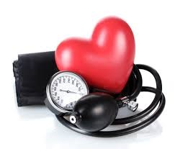



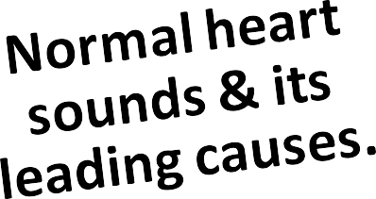
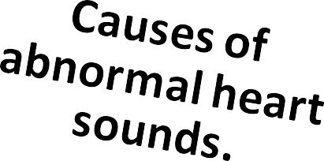


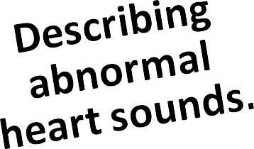
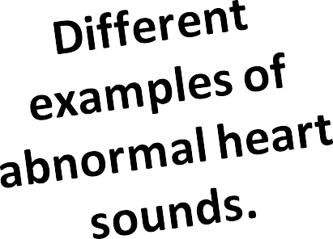
Lecture Outcomes
Dr. Abeer A. Al-Masri, F^{D}a^{r}c. u^{A}lt^{b}y^{ee}o^{r}f ^{A}M.e^{A}di^{l}c⁻i^{M}nªe^{s},^{r}K^{i,}S^{F}U^{aculty of}
Medicine, KSU

Slide 3

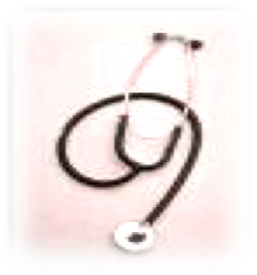

Detected over anterior chest wall by:
Auscultation: … (Stethoscope)
Phonocardiography: (sound recording device)

Slide 4

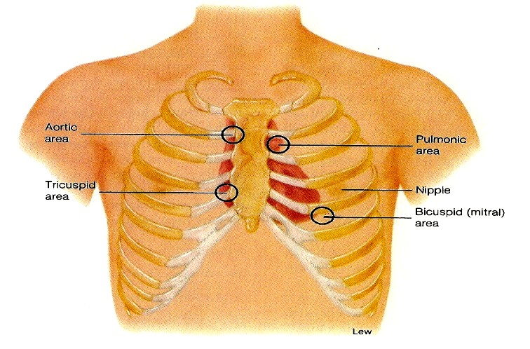
Best heard at 4 certain areas:
Pulmonary area:
  2nd Lt intercostal space
Aortic area:
  2nd Rt costal cartilage
Mitral area:
5nd Lt intercostal space crossing mid- clavicular line, or
9 cm (2.5-3 in) from sternum
Tricuspid area:
  lower part of sternum towards Rt side

Slide 5
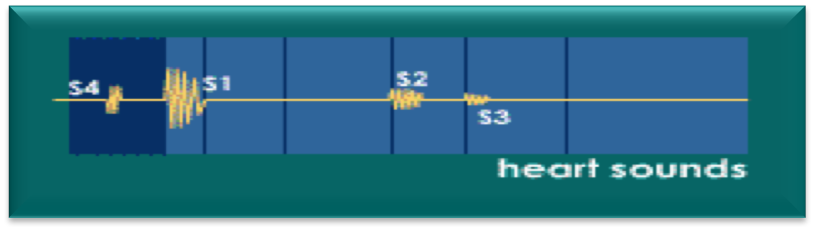
Heart Sounds:
‘4’ heart sounds can be detected:
1st & 2nd ht sounds … (usually audible)
3rd & 4th ht sounds … (sometimes detected)

Slide 6
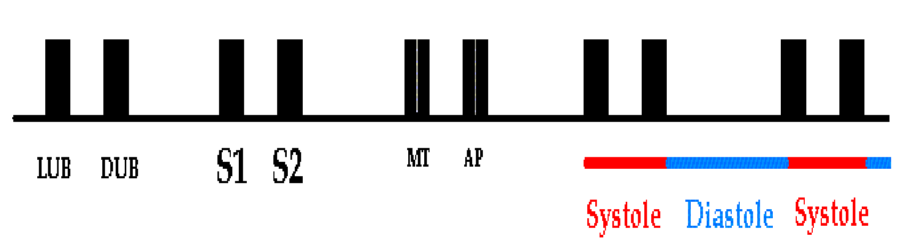

Slide 7


Due to closure of the AV- vs.
It marks beginning of ventricular systole.
Recorded at the beginning of the ‘isometric contraction’ phase. Long in duration (≈ 0.15 sec.)
Of low pitch (LUB) .. (Loud) 25-35 Hz.
Best heard at Mitral & Tricuspid areas.

Slide 8

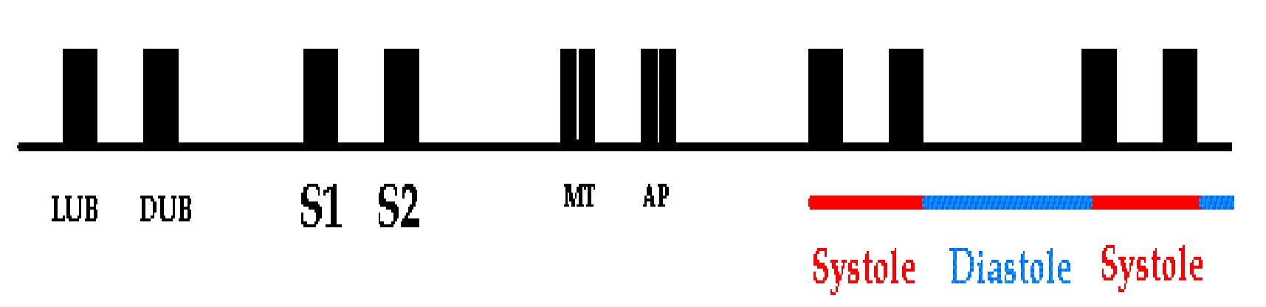
Due to closure of semilunar- vs.
Marks the beginning of ventricular diastole.
Recorded at the beginning of the ‘isometric relaxation’ phase.
Short in duration (≈ 0.11-0.125 sec.) Of high pitch (DUB) .. (Soft & Sharp) 50 Hz.
Best heard at Aortic & Pulmonary areas.

Slide 9



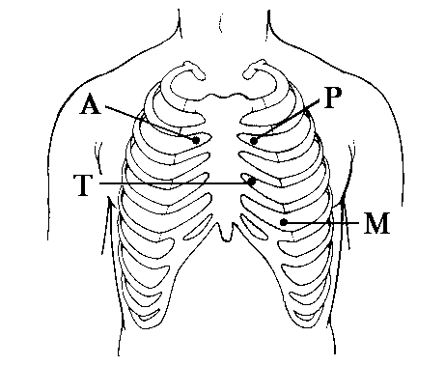
S2 splits physiologically into 2 sounds duringinspiration
= Physiological Splitting
Physiological splitting during INSPIRATION
This splitting occurs due to delay closure of pulmonary valve

Slide 10

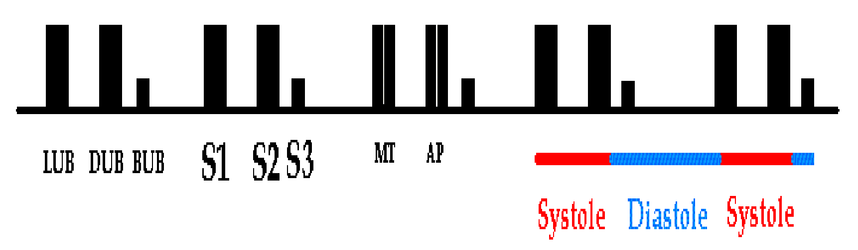
Recorded during the ‘rapid filling’ phase, due to rush of blood into the ventricle.
Duration ≈ 0.05 sec.
S3 is usually not audible .. (very low pitch)
? heard in children.
Best heard at Mitral area.
10

Slide 11

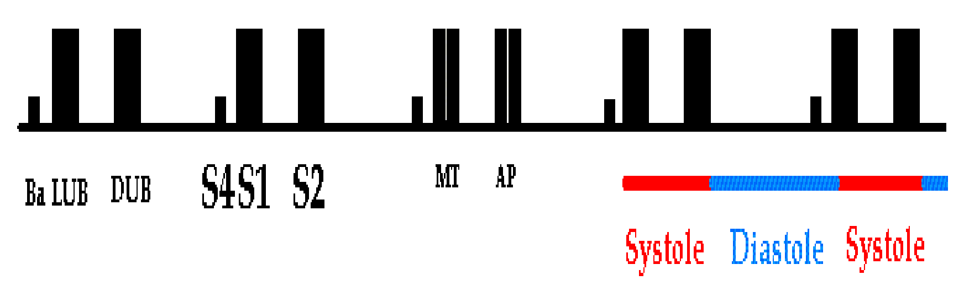
Recorded during ‘atrial systole.’
Duration ≈ 0.04 sec.
S4 is usually not audible .. (very low pitch)
? heard in elderly.
Best heard at Mitral area.

Slide 12







Important for diagnosis of heart murmurs.
Abnormal extra heart sounds heard during the heart beat cycle.
Produced by turbulence (abnormal patterns) of blood flow through the heart & its valves.
Murmurs are longer than heart sounds.

Slide 13

q Valves closing:
Atrio-ventricular = (S1)
Semilunar = (S2)
q Increased intra-cardiac hemodynamics (Murmurs):
q Blood striking the left ventricle = (S3, S4)
q Increased flow across normal valves.
q Turbulent flow through an abnormalvalve.
q Turbulent flow through septal defect.

Slide 14






1. Physiological Murmurs:
2. Pathological Murmurs:
- ↑ blood flow across normal valves:
e.g.
Pregnancy
Hyperthyroidism
Anemia
Fever
Children
- Turbulent flow through
abnormal valves, or septal defect..
? Congenital
e.g.
Tight valve (stenosis)
Leaky valve (regurgitation or insufficiency)

Slide 15
q Timing (systolic or diastolic)
q Shape
q Location q Radiation q Intensity
q Pitch
q Quality

Slide 16



Murmurs are described according to their position in the cardiac cycle:
Systolic.
Diastolic.
Continuous.
Holosystolic Murmur
Diastolic Murmur

Slide 17


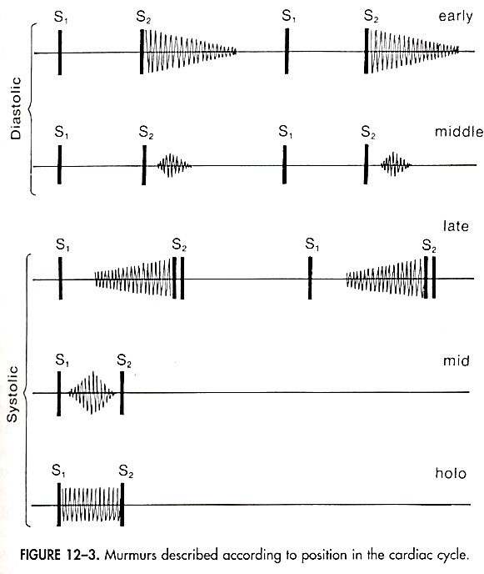


Diastolic Murmurs
Between S₂ & S₁
Classified as early, mid, late
Systolic Murmurs
Between S₁ & S₂
Classified as early, mid, late, holosystolic

Slide 18

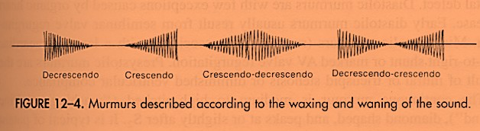

Crescendo (grows louder.)
Decrescendo.
Crescendo-decrescendo (Diamond-shaped.)
Plateau.
Murmurs described according to the waxing & waning of the sound
Diamond-shaped Murmur

Slide 19
3. Location of maximum intensity
Determined by the site where the murmur originates;
e.g. Aortic, Pulmonary, Tricuspid, & Mitral listening areas.
4. Radiation
Reflects intensity of the murmur & direction of blood flow.

Slide 20

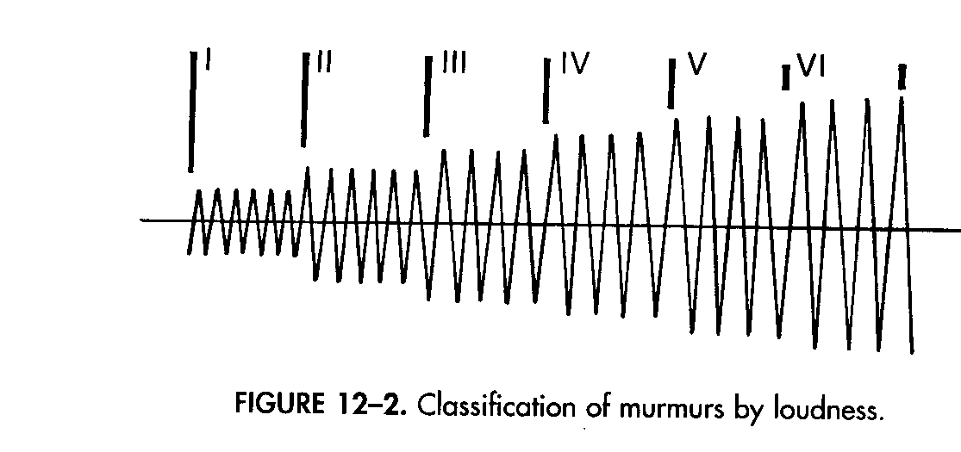
§ Graded on a (6) point according to Levine scale:
Classification of murmurs by loudness
Grade 1
Grade 2
Grade 3
Grade 4
Grade 5
Grade 6
Lowest intensity
Very faint
Low intensity
Quiet but heard
Medium intensity
Medium intensity
Loud intensity
Heard with stethoscope partly off the chest
Thrills
Loudest intensity
No
stethoscope needed
Thrills
20
Moderately • Loud
loud
Thrills
immediately
Dr. Abeer A. Al-Masri, Faculty of Medicine, KSU

Slide 21
I / VI | need quiet room and trained ear to hear. (difficult to hear even by expert listeners)
II / VI | audible to anyone who listens attentively (usually audible by all listeners)
III / VI | loud, but not palpable (easy to hear even by inexperienced listeners, but without a palpable thrill)
IV / VI | loud and palpable: it produces a precordial thrill
V / VI | audible with your stethoscope placed perpendicular to chest wall
VI / VI | audible without a stethoscope

Slide 22
6. Pitch
High, medium, low.
Quality
Blowing, harsh, rumbling & musical.
Others:
  Variation with respiration:
Right sided murmurs change > left sided.
  Variation with position of patient.
  Variation with special maneuvers:
Valsalva ⇒ Murmurs ↓ in length & intensity.

Slide 23

Systolic Murmurs

Slide 24
q Derived from harsh & ↑ turbulence in flow.
q Associated with:
↑ flow across normal valve.
↑ flow into a dilated great vessel.
↑ flow across an abnormal valve, or narrowed ventricular outflow tract - e.g. aortic /pulmonary stenosis.
↑ flow across an incompetent AV valve - e.g. mitral/tricuspid regurgitation.
↑ flow across the inter-ventricular septum - e.g. VSD.

Slide 25

Aortic stenosis – ejection murmur.
Pulmonary stenosis – ejection murmur + spilling S2.
Mitral / Tricuspid regurgitation – holosystolic.
Mitral valve prolapse – mid-late systole.
Ventricular septal defect (VSD) – holosystolic.
S1
S2
S1

Slide 26






q Most common kind of heart murmur.
q Usually crescendo-decrescendo.
q They ?may be:
Innocent
Common in children & young adults.
Physiological
Can be detected in hyper-dynamicstates,
e.g. anemia, pregnancy, fever & hyperthyroidism.
3. Pathological
Secondary to structural CV abnormalities,
e.g. Aortic/pulmonary stenosis, Hypertrophic cardiomyopathy & mitral prolapse.

Slide 27







q Pathological murmur.
q Begins immediately with S1 & continues up to S2.
q Heard with:
Mitral/tricuspid regurgitation.
Ventricular septal defect (VSD).

Slide 28






Narrowing of aortic outflow tract causing obstruction of flow from LV into ascending aorta
Ø T- mid-systolic (ejection) murmur.
L- best heard @ aortic area, radiates along carotid arteries.
C- harsh, loud, may have associated thrill, “ejection click.”
A- older age, bicuspid aortic valve, rheumatic fever.
S1
S2
Note: T- Timing; L- Location; C- Character; A- Association

Slide 29





Bulging of one or both mitral valve leaflets into LA during LV systole
Ø T- mid- late systolic murmur.
L- best heard @ apex.
C- mid systolic click.
S1
S2
Ø A- ~5% normal population, asymptomatic, ? sudden death.
Note: T- Timing; L- Location; C- Character; A- Association

Slide 30



Retrograde flow from LV into LA through an incompetent mitral valve
T- holosystolic murmur.
L- best heard @ apex, radiates to left axilla.
C- soft, high-pitched, blowing.
S1
S2
Ø A- MV prolapse, MV myxomatous degeneration, MI, rheumatic heart disease, cardiomyopathy, endocarditis.
Note: T- Timing; L- Location; C- Character; A- Association
30

Slide 31

Diastolic Murmurs

Slide 32
q Almost always indicate heart disease.
q Two basic types:
Early decrescendo diastolic murmurs:
Signify regurgitant flow through an incompetent semilunar valve,
e.g. aortic/pulmonary regurgitation.
2. Rumbling diastolic murmurs in mid- or late diastole:
Suggest stenosis of an AV valve,
e.g. mitral/tricuspid stenosis.

Slide 33


Soft, blowing, gurgle
Aortic regurgitation - early diastole
Mitral stenosis - mid to late (pre-systolic)diastole
S1
S2
S1

Slide 34



Retrograde flow from aorta into LV through incompetent aortic cusps
Ø T- diastolic (early) murmur.
Ø L- best heard @2nd-4th left intercostal spaces.
S1
S2
S1
C- high-pitched, blowing, decrescendo.
A- aortic root degeneration, rheumatic heart disease, VSD w/aortic valve prolapse (kids.)
Note: T- Timing; L- Location; C- Character; A- Association

Slide 35




Obstruction of flow from LA to LV because of a narrowed mitral orifice
(Valve becomes thickened & calcified)
T- diastolic (mid-diastolic, or pre-systolic)
murmur with ‘opening snap’ after closure of aortic valve.
L- best heard @ apex.
C- low pitched (heard with bell.)
A- rheumatic fever.
S1
S2
S1
Note: T- Timing; L- Location; C- Character; A- Association

Slide 36



S2 OS
S1
S1

Slide 37
Continuous Murmurs

Slide 38
q Begin in systole, ? peak near S2 & continue into all or part of diastole.
q Heard with:
Patent ductus arteriosus (PDA)
Ventricular septal defect (VSD)

Slide 39

1. Patent ductus arteriosus (PDA)
2. ? Ventricular septal defect (VSD)
S1
S2
S1

Slide 40



Failure of closure of the duct between pulmonary artery & aorta
T- continuous murmur.
L- best heard @ upper left sternal border.
C- machine-like.
A- left to right shunt, cyanosis.
S1
S2
S1
Note: T- Timing; L- Location; C- Character; A- Association
40

Slide 41
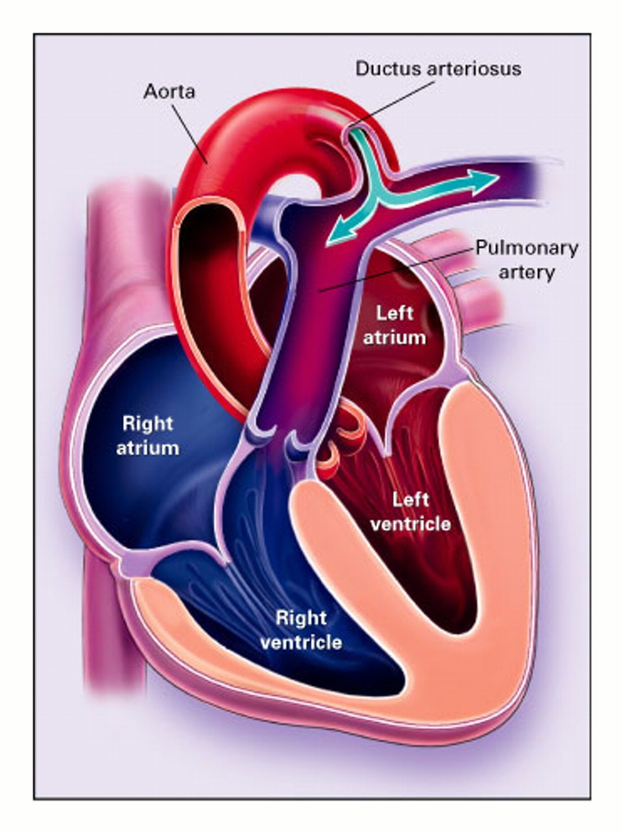
Patent Ductus Arteriosus with Resultant Left-to-Right Shunting
41

Slide 42


Thank You

