Slide 1
Lipoproteins and Atheroscloresis
Cardiovascular Block
Dr. Usman Ghani

Slide 2
Objectives
By the end of this lecture, the First Year students will be able to:
Correlate the imbalance in lipoprotein metabolism with the development of atherosclerosis
Understand the functions and metabolism of LDL and HDL cholesterol
Describe the receptor-mediated endocytosis of LDL and its regulation
Recognize how LDL is considered a bad cholesterol whereas HDL a good cholesterol
Understand the biochemistry of atherosclerosis and its laboratory investigations
Discuss the role of lipoprotein(a) in the development of heart disease

Slide 3
Overview
Low density lipoprotein (LDL)
Receptor-mediated endocytosis of LDL and its regulation
LDL is bad cholesterol
High density lipoprotein (HDL) and its functions
Metabolism of HDL
HDL is good cholesterol
Atherosclerosis
Lipoprotein(a)

Slide 4
Overview
Cholesterol homeostasis is a balance between cholesterol transport:
From the liver to peripheral tissues by LDL
From peripheral tissues to the liver by HDL
Imbalance in the above leads to:
Cholesterol deposition in blood vessels
Thickening and narrowing of the lumen of arteries
Atherosclerosis
Heart disease

Slide 5
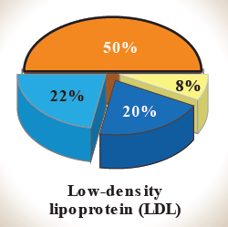
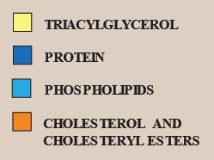
Low density lipoprotein (LDL)
LDL particles mainly contain cholesterol and cholesteryl esters
Produced from VLDL particles
Contain Apo B-100 lipoprotein
Provides cholesterol to peripheral tissue
LDL binds to cell surface receptors thru Apo B-100
Called receptor-mediated endocytosis

Slide 6
Receptor-mediated endocytosis of LDL particles
Major steps:
Binding of Apo B-100 to LDL receptor glycoprotein
Endocytosis
Endosome formation (LDL vesicle fuses with other vesicles)
Separation of LDL from its receptor
Receptor is recycled
LDL degraded by lysosomes releasing:
Free cholesterol, fatty acids, amino acids, phospholipids

Slide 7
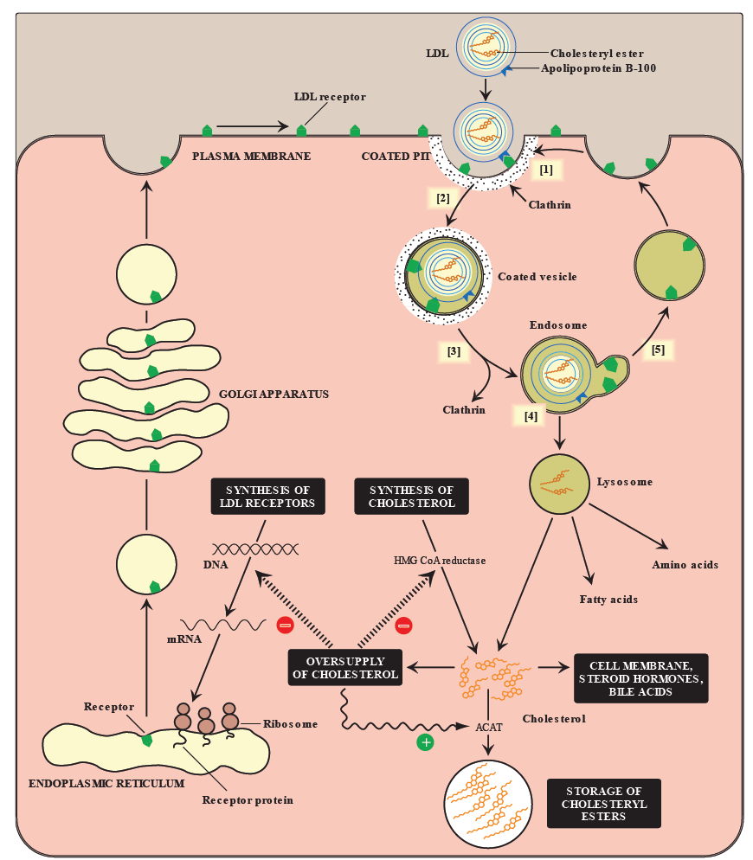
Cellular uptake and degradation
of LDL particles

Slide 8
Regulation of LDL endocytosis
Down regulation:
High intracellular cholesterol level causes:
Degradation of LDL receptors
Inhibition of receptor synthesis at gene level
Reduction in cell surface receptors
Decreased uptake of LDL by cells
Decreased de novo synthesis of cholesterol
Up regulation:
Low intracellular cholesterol level causes:
Recycling of LDL receptors
Increased receptor synthesis at gene level
Increase in cell surface receptors
Increased uptake of LDL by cells
Increased de novo synthesis of cholesterol

Slide 9
LDL is bad cholesterol
Transports cholesterol to peripheral tissues
Elevated LDL levels → increased risk for atherosclerosis / heart disease
Deficiency or defects in LDL receptors results in:
Decreased uptake of cholesterol by cells
Increased accumulation of cholesterol in blood vessels
Familial hypercholesterolemia
Patients are unable to clear LDL from blood
Premature atherosclerosis and heart disease

Slide 10
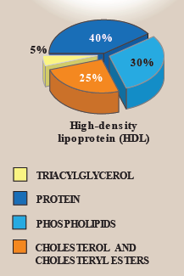
High density lipoprotein (HDL)
HDL particles mainly contain:
Protein, phospholipids, cholesterol, cholesteryl esters
Produced in the liver and intestine
Contains Apo A-1, C-II and E lipoproteins
Take up cholesterol from peripheral tissues to the liver

Slide 11
High density lipoprotein (HDL)
Nascent HDL:
Disk-shaped
Contains apo A-I, C-II and E lipoproteins
Mainly contains phospholipids
Mature HDL:
Nascent HDL + cholesteryl esters → HDL₃
HDL₃ + more cholesteryl esters → spherical HDL₂
HDL₂ transfers cholesterol to the liver

Slide 12
Functions of HDL
Reservoir of apoproteins (Apo C-II and E)
Transports cholesterol to liver from:
Peripheral tissues
Other lipoproteins
Cell membranes
Suitable for cholesterol uptake due to:
High content of phospholipids
Phospholipids solubilize cholesterol and provide fatty acids for cholesterol esterification

Slide 13
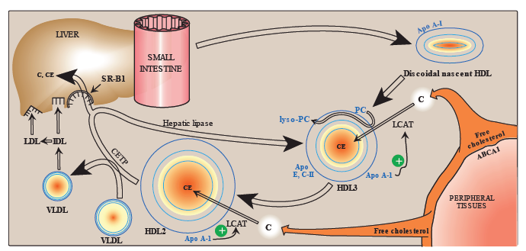
HDL metabolism

Slide 14
HDL is a good cholesterol
HDL transports cholesterol from peripheral tissues to the liver for degradation
Reduces cholesterol level in tissues and circulation (reverse cholesterol transport)
High HDL levels have inverse correlation with atherosclerosis
Reverse cholesterol transport includes:
Cholesterol efflux from peripheral tissues to HDL
Cholesterol esterification
Binding and transfer of cholesteryl ester-rich HDL₂ to liver
Release of lipid-depleted HDL₃

Slide 15
Atherosclerosis
LDL uptake by cells is receptor mediated
Additionally, macrophages possess scavenger receptors called scavenger receptor class A (SR-A)
The macrophages take up chemically-modified LDL by endocytosis

Slide 16
Atherosclerosis
Chemically-modified LDL contains oxidized lipids and Apo B
Unlike LDL receptors, the SR-A is not down-regulated in response to high intracellular cholesterol
Cholesteryl esters accumulate in macrophages converting to foam cells
Foam cells contribute to plaque formation and atherosclerosis

Slide 17
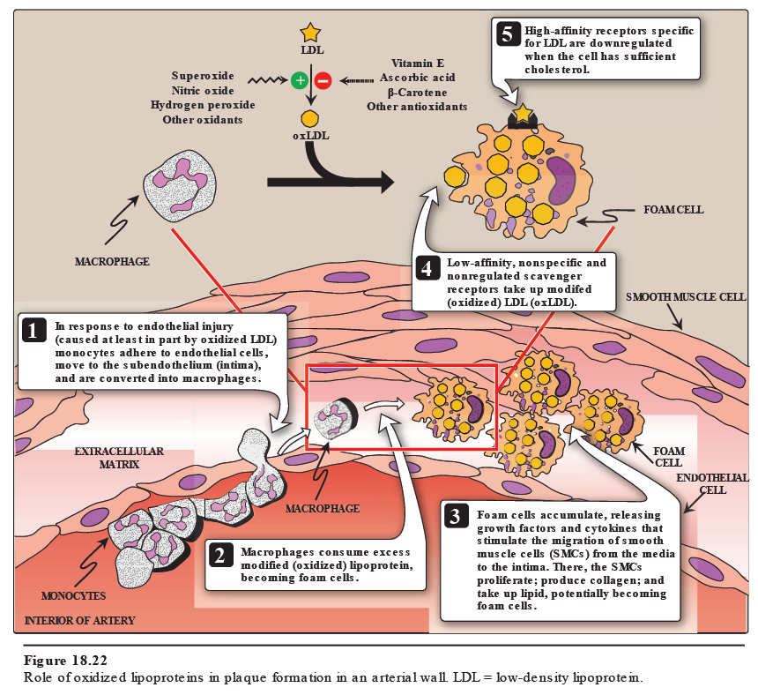

Slide 18
Lab investigations of atherosclerosis
Fasting serum lipid profile:
TAG level (reflects chylomicron and VLDL levels)
LDL, HDL levels
Total cholesterol level (reflects LDL, HDL and cholesterol levels)
Other tests:
Serum lipoprotein electrophoresis
Serum apoprotein levels (e.g., apo-B)

Slide 19
Lipoprotein (a)
Lp(a) is identical in structure to LDL particle
Contains apo(a) in addition to apo B-100
High plasma Lp(a) level is associated with increased risk of coronary heart disease
Circulating levels of Lp(a) are determined by:
Genetics (mainly)
Diet (trans FAs increase Lp(a) levels)
Estrogen (decreases Lp(a) levels)

Slide 20
Lipoprotein (a)
The apo(a) protein is structurally similar to plasminogen
Competes with plasminogen
Slows the breakdown of blood clots
Triggering heart attack
A risk factor for CAD

Slide 21
Take home message
Imbalance in the LDL and HDL metabolism causes increased accumulation of lipids in the body
LDL is bad cholesterol whereas HDL is good cholesterol
The pathogenesis of atherosclerosis includes the uptake of oxidized LDL by macrophages through scavenger receptor class A (SR-A) producing foam cells and atherosclerotic plaque
Individuals with high level of plasma Lp (a) are at higher risk for coronary heart disease

Slide 22
References
Lippincott’s Biochemistry. 6th Edition, Chapter 18, pp. 231-237. Lippincott Williams & Wilkins, New York, USA.

