Slide 1
Pathology of cardiovascular system 6 lectures
Rheumatic Heart Disease………….Dr Rikabi
Ischemic Heart Disease
Atherosclerosis
Hypertension
Thromboembolism
Vasculitis
1
Revision
2
3,4
Revision
5

Slide 2
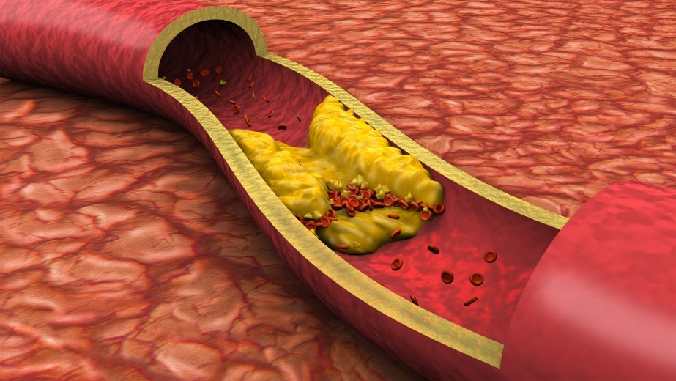
Atherosclerosis and ischemic heart disease Ahmed Alhumidi. Pathology. KSU. Riyadh. 2015

Slide 3
Objectives:
Atherosclerosis and ischemic heart disease
Understand the pathology, pathogenesis and clinical consequences of atherosclerosis.
Be able to discuss pathology and complications of ischaemic heart diseases with special emphasis on myocardial infarction.
Know how lifestyle modifications can reduce the risk of ischaemic heart disease.

Slide 4
Arteriosclerosis "hardening of the arteries") is a generic term for thickening and loss of elasticity of arterial walls.
Atherosclerosis
Mönckeberg medial calcific sclerosis
Arteriolosclerosis
Old age
Hypertention

Slide 5
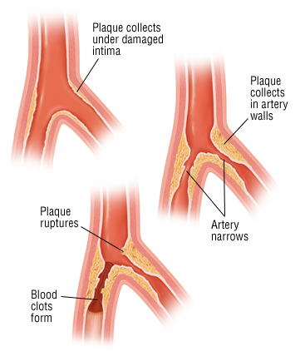
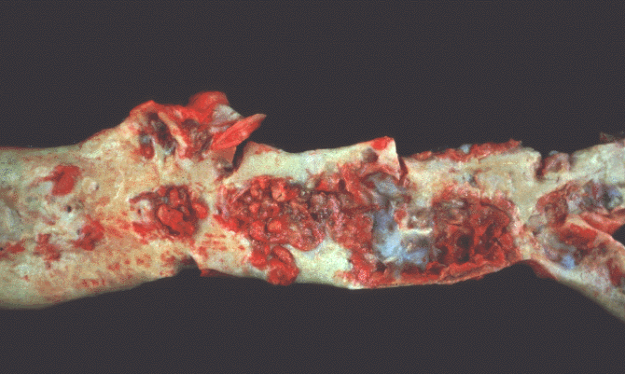
Atherosclerosis (AS)
Atherosclerosis is characterized by intimal lesions called atheroma, which protrude into and obstruct vascular lumens and weaken the underlying media.
Atheroma=
Intimal thickening + lipid accumulation

Slide 6
Atheroma
Atherosclerotic plaques have three principal components:
Cells: SMCs, foam macrophages, lymphocytes
Extracellular matrix: collagen, elastic fibers
Lipid: Typical atheromas contain relatively abundant lipid both intracellular and extracellular lipid .

Slide 7
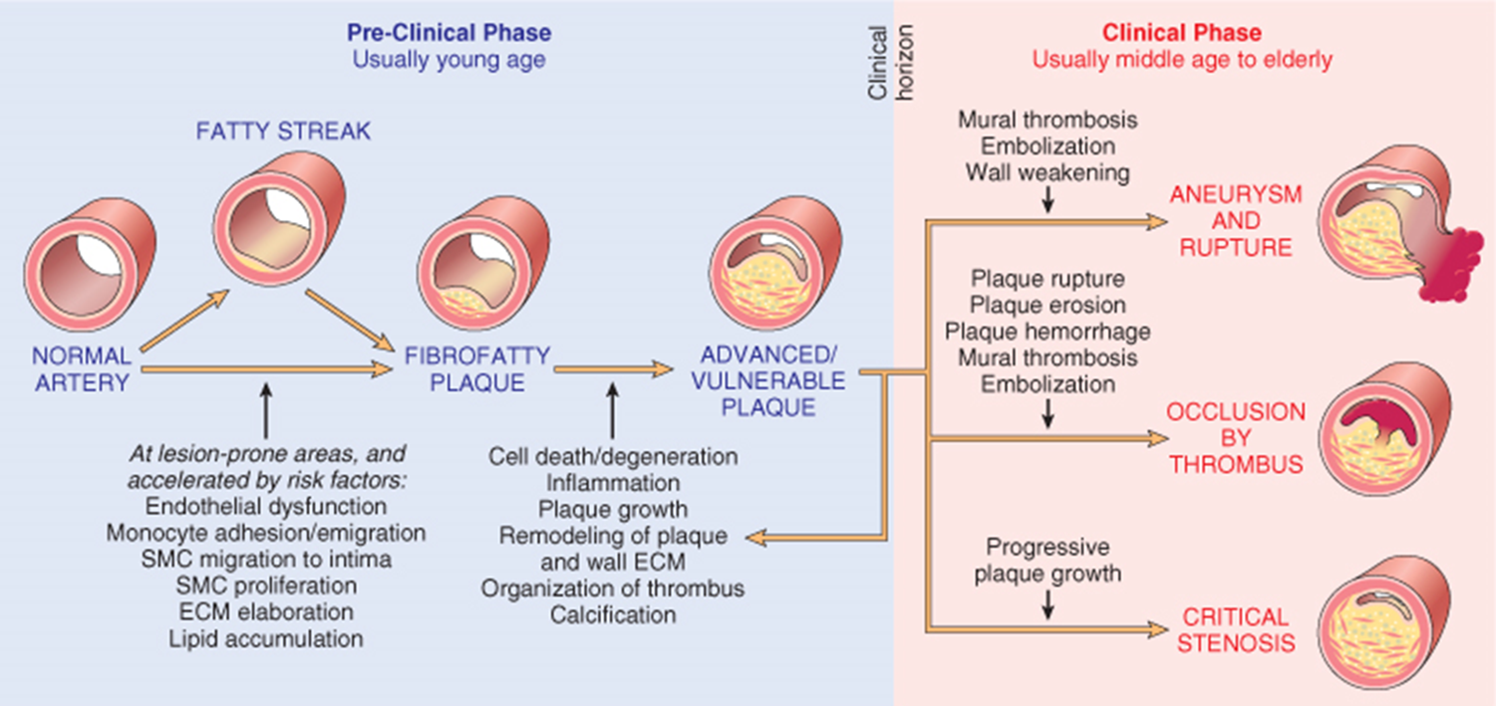
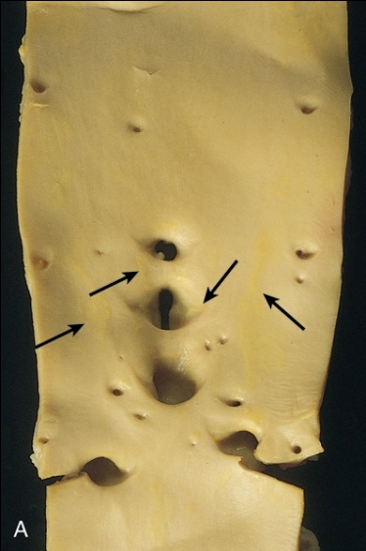
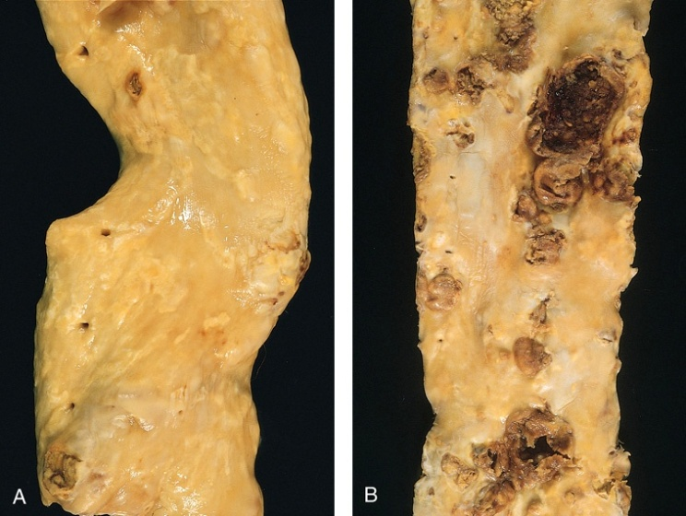
COMPLICATIONS
Rupture, ulceration
Hemorrhage
thrombosis,
Aneurysmal dilation.
Fatty streaks=
macrophage-derived foam cells
fibrous plaques
complicated lesions

Slide 8
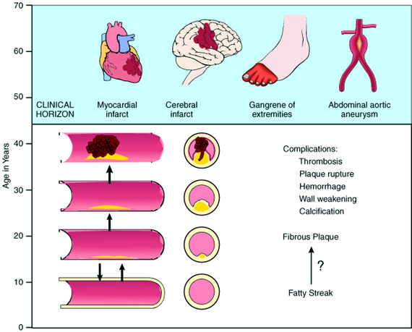
Natural history of atherosclerosis
Slide 12.5
Notes:
Natural history of atherosclerosis. Plaques usually develop slowly and insidiously over many years, beginning in childhood or shortly thereafter. As described in the text, they may progress from a fatty streak to a fibrous plaque and then to a complicated plaque that is likely to lead to clinical effects.

Slide 9
Risk Factors for Atherosclerosis
MINOR/UNCERTAIN/NONQUANTITATED RISK FACTORS
Obesity
Physical inactivity
Stress ("type A" personality)
Postmenopausal estrogen deficiency
High carbohydrate intake
Alcohol
Lipoprotein Lp(a)
Hardened (trans)unsaturated fat intake
Chlamydia pneumoniae
MAJOR RISK FACTORS
NON-MODIFIABLE | POTENTIALLY MODIFIABLE
Increasing age | Hyperlipidemia
Male gender | Hypertension
Family history | Cigarette smoking
Genetic abnormalities | Diabetes
anti-C. pneumoniae antibodies
detection of the organism within atherosclerotic lesions,

Slide 10
Importance of types of lipoproteins in hypelipidemia
Low-density lipoproteins (LDLs)
Very-low-density lipoproteins (VLDLs)
Chylomicrons
High-density lipoproteins (HDLs)
“good” cholesterol, because high levels seem to protect against heart attack.

Slide 11
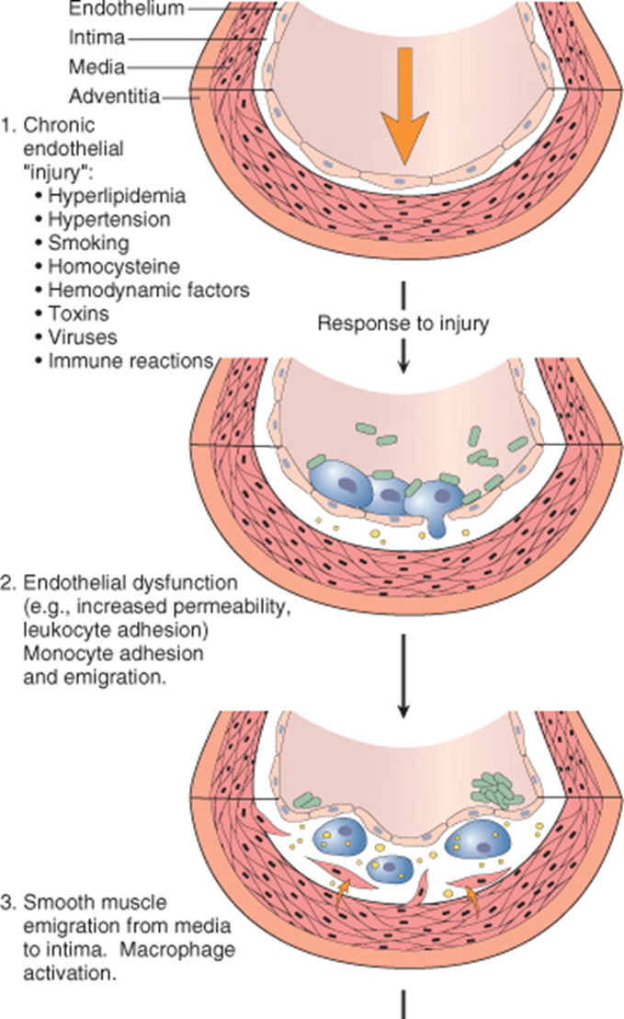
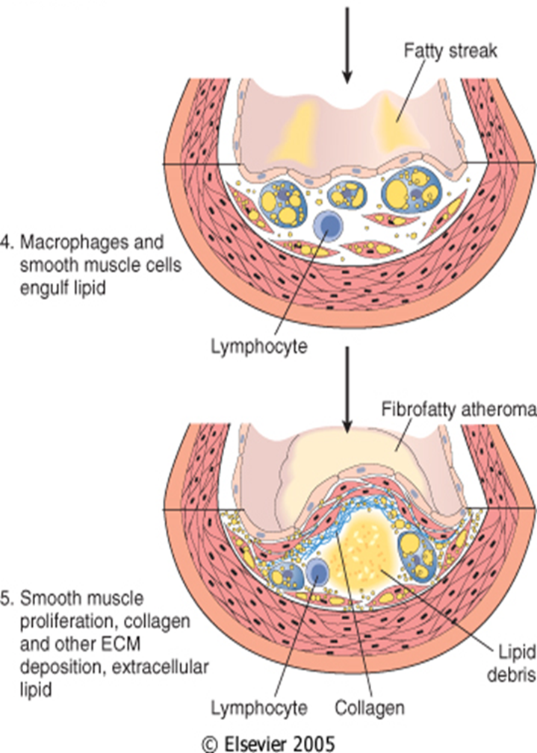
Risk Factors
PATHOGENESIS

Slide 12
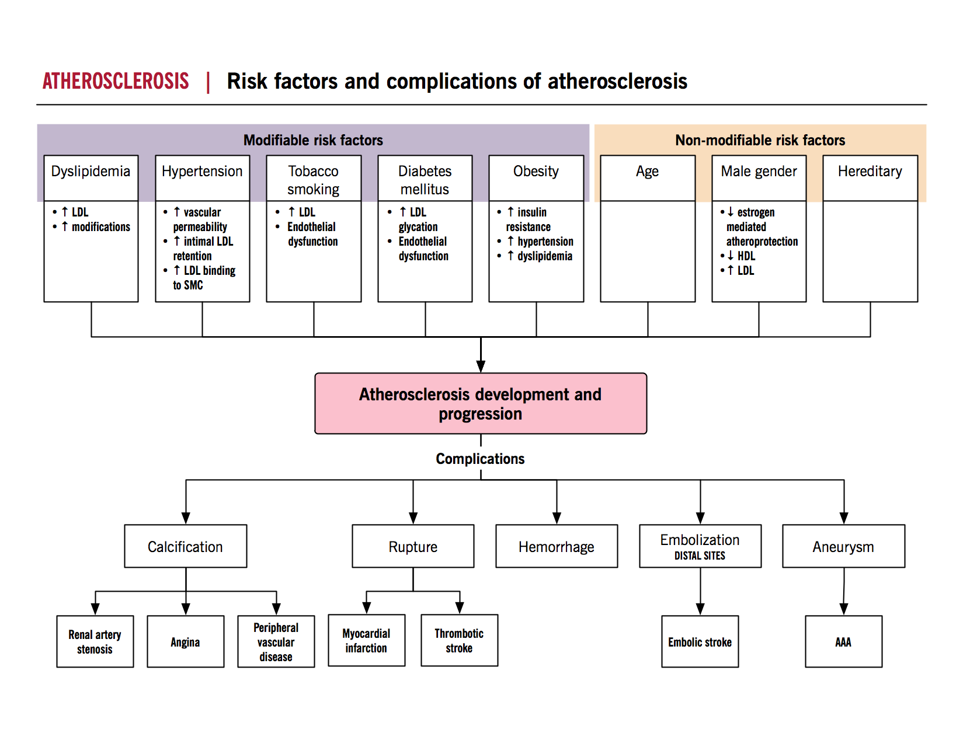
SUMMARY
treatment : Angioplasty
http://www.pathophys.org/

Slide 13
Ischemic Heart Disease
Ahmed Alhumaidi
Pathology Department
KSU, Riyadh
2015
Reference: Robbins & Cotran Pathology and Rubin’s Pathology

Slide 14
Ischemic Heart Disease
atherosclerosis
insufficient blood supply
Myocardium
Angina pectoris (chest pain).
Acute myocardial infarction.
Sudden cardiac death.
Chronic ischemic heart disease

Slide 15
Pathogenesis
A lesion obstructing 70% to 75% or more of a vessel lumen-so-called critical stenosis-generally causes symptomatic ischemia (angina) only in the setting of increased demand
A fixed 90% stenosis can lead to inadequate coronary blood flow even at rest
In most patients, unstable angina, infarction, occur because of abrupt plaque change followed by thrombosis
Rupture, fissuring, or ulceration

Slide 17
Angina pectoris
Angina pectoris is a type of IHD characterized by paroxysmal and usually recurrent attacks of substernal chest discomfort (variously described as constricting, crushing, squeezing, choking, or knifelike). May radiate down the left arm or to the left jaw (referred pain) .
Intermittent chest pain caused by transient, reversible ischemia
Typical (stable) angina
pain on exertion
fixed narrowing of coronary artery
Unstable (pre-infarction) angina
increasing pain with less exertion
plaque disruption and thrombosis
Prinzmetal (variant) angina
pain at rest
coronary artery spasm of unknown etiology
ذبحة صدرية مخالفة للمعتاد،

Slide 18
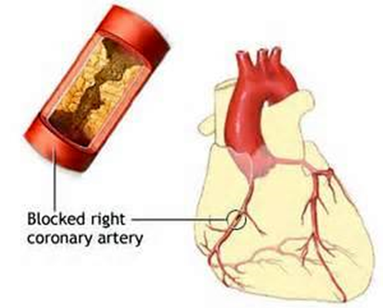
Myocardial Infarction
Definition: MI, also known as "heart attack," is the death of cardiac muscle resulting from ischemia.
Risk factors are the same as those of atherosclerosis.
Disruption of an atherosclerotic plaque results in the formation of thrombus

Slide 19
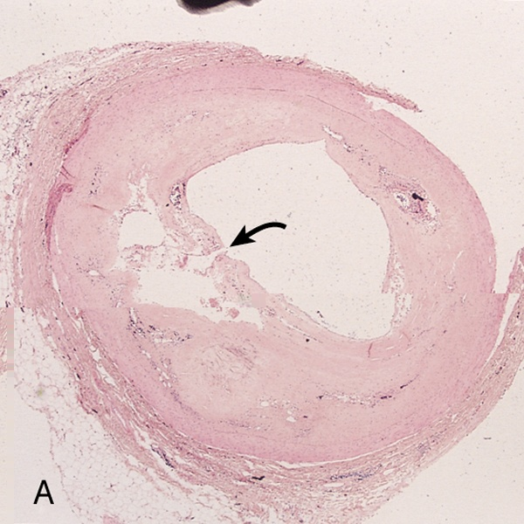
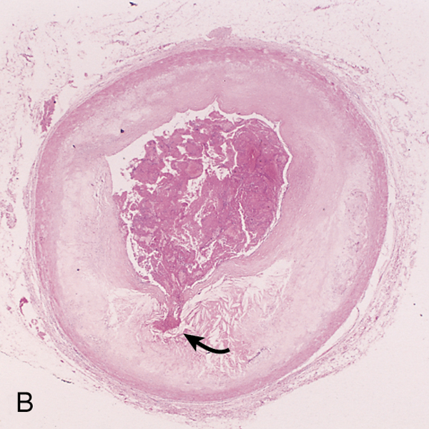
A. Plaque rupture without superimposed thrombus in a patient who died suddenly.
B. Acute coronary thrombosis superimposed on an atherosclerotic
plaque with focal disruption of the fibrous cap, triggering fatal
myocardial infarction.
C. Massive plaque rupture with superimposed thrombus, also
triggering a fatal myocardial infarction (special stain highlighting
fibrin in red). In both

Slide 20
Pathogenesis of MI
Myocardial necrosis begins within 20-30 minutes, mostly starting at the subendocardial region (less perfused, high intramural pressure).
Infarct reaches its full size within 3-6 hrs., during this period, lysis of the thrombus by streptokinase or tissue plasminogen activator, may limit the size of the infarct.
Irreversible cell injury: 20-40 min
Types
Transmural
Full thickness (>50% of the wall)
Subendocardial
Inner 1/3 of myocardium

Slide 21
Morphologic Changes in Myocardial Infarction
Time | Gross changes | Microscopic changes
0-4h | None | None
4-12h | Mottling تبقع | Coagulation necrosis
12-24h | Mottling | More coagulation necrosis; neutrophils come in
1-7 d | Yellow infarct center | Neutrophils die, macrophages come to eat dead cells
1-2 w | Yellow center, red borders | Granulation tissue
2-8 w | Scar | Collagen

Slide 22
day 1,
Day 2,
Day 3,
Day 4,
Day 5,
Day 6,
day 7
Neutrophils
Macrophages
Coagulation necrosis
MI: day 1, day 3, day 7

Slide 23
2 weeks
1 month
Granulation tissue
collagenous scar

Slide 24
Myocardial Infarction: Clinical Features
Pain:
Severe crushing sub-sternal chest pain, which may radiate to the neck, jaw, epigastrium, shoulder or left arm.
Pain lasts for hours to days and is not relieved by nitroglycerin.
Absent in 20% of patients (diabetics, hypertensive, elderly).
Pulse is rapid and weak.
Diaphoresis (sweating)
Dyspnea.
Cardiogenic shock in massive MI(>40%of lt. ventricle).
ECG shows typical findings of ischemia.
shock is low blood perfusion to tissues

Slide 25
Ischemic Heart Disease Laboratory evaluation
Troponins: best marker, TnT, TnI (more specific).
TnI and TnT are not normally detectable in the circulation
After acute MI both troponins become detectable after 2 to 4 hours, peaks at 48 hours. Their levels remain elevated for 7 to 10 days
CK-MB is the second best marker:
It begins to rise within 2 to 4 hours of MI, peaks at 24 to 48 hours and returns to normal within approximately 72 hours
Lactate dehydrogenase (LD)… LD1.
Rise 24 hrs, peaks 72 hrs, persists 72 hrs.
Troponins are regulatory proteins ((troponin C, troponin I, and troponin T) that are integral to muscle contraction
Creatine kinase (CK) —is an enzyme expressed by various tissues and cell types 3 isoypes CK-MM, CK-BB and CK-MB. [M: musle B brain ]
A lactate dehydrogenase (LDH or LD) is an enzyme found in nearly all living cells [LDH-1— heart RBC, brain].

Slide 26
Myocardial Infarction: Outcomes or complications
No complications in 10-20%.
80-90% experience one or more of the following complications:
Cardiac arrhythmia (75-90%). Many patients have conduction disturbances and myocardial irritability following MI, which undoubtedly are responsible for many of the sudden deaths. Sudden coronary death can occur due to ventricular arrhythmia.
Left ventricular failure with mild to severe pulmonary edema (60%).
Cardiogenic shock (10%).

Slide 27
Complications of MI
Myocardial rupture:
Thromboembolism (15-49%). the combination of a local myocardial abnormality in contractility (causing stasis) with endocardial damage (causing a thrombogenic surface) can foster mural thrombosis and, potentially, thromboembolism
Pericarditis
Ventricular aneurysm in which the ventricle is dilated and the wall is thinned out.
External rupture of the infarct with associated bleeding into the pericardial space (hemopericardium).
Progressive late heart failure in the form of chronic IHD.

Slide 28
Myocardial Infarction (MI), summary
Necrosis of heart muscle caused by ischemia
Most due to acute coronary artery thrombosis
irreversible injury/cell death in 20-40 minutes
Prompt reperfusion can salvage myocardium
Salvage ينقذ

Slide 29
Myocardial Infarction (MI), summary
Clinical features
Severe, crushing chest pain ± radiation
Not relieved by nitroglycerin, rest
Sweating, nausea, dyspnea
Sometimes no symptoms
Laboratory evaluation
Troponins detected within 2-4 hours, remain elevated for a week.
CK-MB increases within 2-4 hours, returns to normal within 72 hours.
Complications
contractile dysfunction
arrhythmias
rupture
chronic progressive heart failure
Prognosis
depends on remaining function and perfusion
overall 1 year mortality: 30%
3-4% mortality per year thereafter

Slide 30
Chronic ischemic heart disease
Progressive heart failure due to ischemic injury, either from:
prior infarction(s) (most common)
chronic low-grade ischemia

Slide 31
Ischemic Heart Disease Sudden cardiac death
Unexpected death from cardiac causes either without symptoms or within 1 to 24 hours of symptom onset
Results from a fatal arrhythmia, most commonly in patients with severe coronary artery disease

Slide 32
Objectives:
Atherosclerosis and ischemic heart disease
Understand the pathology, pathogenesis and clinical consequences of atherosclerosis.
pathology Cells, Extracellular matrix:, Lipid, fibrous cap
Pathogenesis endothelial cell injury….dysfunction….smooth muscle immigration ……macrophages and smooth muscle engulf fat …… smooth muscle proliferation and collagen deposition
Complications
Arterial obstruction………ischemia
Embolization of plaque material…… ischemia
Weakening with rupture of the arterial wall …..aneurism and rupture of vessel
Be able to discuss pathology and complications of ischaemic heart diseases with special emphasis on myocardial infarction.
Pathology
MI
Complications
MI
how lifestyle modifications can reduce the risk of atherosclerosis and ischaemic heart disease.
0-4 h No pathological findings
4-12h coagulation necrosis
12-1day neutrophils
1 day – 7 days less neutrophils and more macrophages
1 week-2 weeks granulation tissue
2 weeks – 8 weeks fibrosis
Typical Angina
Unstable angina
Prinzmetal angina
Arrhythmia
Left ventricular failure
Cardiogenic shock
Myocardial rupture
Thromboembolism
Serum Troponins and CK MB
ECG finding

Slide 33
A 68-year-old obese woman (BMI = 32 kg/m2) presents with substernal chest pain. Results of laboratory studies include an elevated WBC count (13,000/μL), CK-MB of 6.6 ng/mL, and troponin-I of 2.5 ng/mL. ECG confirms a myocardial infarction of the left ventricular wall. Which of the following mechanisms is most likely responsible for the myocardial infarction in this patient?
(A) Coronary artery thrombosis
(B) Coronary artery vasospasm
(C) Decreased collateral blood flow
(D) Deep venous thrombosis
(E) Paradoxical embolism
Ahmed alhumaidi
Associate professor

Slide 34
The answer is A: Coronary artery thrombosis. Coronary artery thrombosis is the most common cause of acute myocardial infarction and is often secondary to rupture of an atherosclerotic plaque.
Diagnosis: Myocardial infarction
Ahmed alhumaidi
Associate professor

Slide 35
A study of atheroma formation leading to atherosclerotic complications evaluates potential risk factors for relevance in a population. Three factors are found to play a significant role in the causation of atherosclerosis: smoking, hypertension, and hypercholesterolemia. These factors are analyzed for their relationship to experimental models for atherogenesis. Which of the following events is the most important direct biologic consequence of these factors?
□ (A) Endothelial injury and its sequelae
□ (B) Conversion of smooth muscle cells to foam cells
□ (C) Alterations of hepatic lipoprotein receptors
□ (D) Inhibition of LDL oxidation
□ (E) Alterations of endogenous factors regulating vasomotor tone
Ahmed alhumaidi
Associate professor

Slide 36
(A) Atherosclerosis is thought to result from a form of endothelial injury and the subsequent chronic inflammation and repair of the intima. All risk factors, including smoking, hyperlipidemia, and hypertension, cause biochemical or mechanical injury to the endothelium. Formation of foam cells occurs after the initial endothelial injury. Although lipoprotein receptor alterations can occur in some inherited conditions, these account for only a fraction of cases of atherosclerosis, and other lifestyle conditions do not affect their action. Inhibition of LDL oxidation should diminish atheroma formation. Vasomotor tone does not play a major role in atherogenesis.
Ahmed alhumaidi
Associate professor

Slide 37
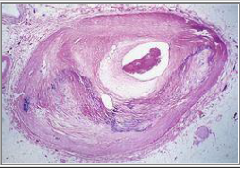
A 59-year-old man has experienced chest pain at rest for the past year. On physical examination, his pulse is 80/min and irregular. The figure shows the microscopic appearance representative of the patient's left anterior descending artery. Which of the following laboratory findings is most likely to have a causal relationship to the process illustrated?
□ (A) Low Lp(a)
□ (B) Positive VDRL
□ (C) Low HDL cholesterol
□ (D) Elevated platelet count
□ (E) Low plasma homocysteine
Ahmed alhumaidi
Associate professor

Slide 38
(C) The figure shows an arterial lumen that is markedly narrowed by atheromatous plaque complicated by calcification. Hypercholesterolemia with elevated LDL and decreased HDL levels is a key risk factor for atherogenesis. Levels of Lp(a) and homocysteine, if elevated, increase the risk of atherosclerosis. Syphilis (positive VDRL test result) produces endarteritis obliterans of the aortic vasa vasorum, which weakens the wall and predisposes to aneurysms. Although platelets participate in forming atheromatous plaques, their number is not of major importance. Thrombocytosis can result in thrombosis or hemorrhage.
Ahmed alhumaidi
Associate professor

Slide 39
A 60-year-old man has experienced angina on exertion for the past 6 years. A coronary angiogram performed 2 years ago showed 75% stenosis of the left anterior descending coronary artery and 50% stenosis of the right coronary artery. For the past 3 weeks, the frequency and severity of the anginal attacks have increased, and pain sometimes occurs even when he is lying in bed. Which of the following is most likely to explain these findings?
□ (A) Hypertrophy of ischemic myocardium with increased oxygen demands
□ (B) Increasing stenosis of right coronary artery
□ (C) Fissuring of plaque in left coronary artery with superimposed mural (partial) thrombosis
□ (D) Sudden complete thrombotic occlusion of right and left coronary arteries
□ (E) Reduction in oxygen-carrying capacity owing to pulmonary congestion
Ahmed alhumaidi
Associate professor

Slide 40
(C) This patient has 75% stenosis of the left anterior descending branch of the coronary artery. This degree of stenosis prevents adequate perfusion of the heart when myocardial demand is increased, which occurs during exertion. The patient had angina on exertion. The patient has recently developed unstable angina, which is manifested by increased frequency and severity of the attacks and angina at rest. In most patients, unstable angina is induced by disruption of an atherosclerotic plaque followed by a mural thrombus and possibly distal embolization, vasospasm, or both.
Hypertrophy of the heart is unlikely in this case because there is neither hypertension nor a valvular lesion.
The remaining choices theoretically can give rise to a similar picture, but plaque disruption with mural thrombosis is the most common anatomic finding when the patient develops unstable angina.
It is important to recognize this because unstable angina is a harbinger of myocardial infarction.
Ahmed alhumaidi
Associate professor

