Slide 1
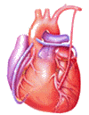
Cardiovascular Block Physiology Contractile Mechanism in Cardiac Muscle

Slide 2
Objectives
Intended learning outcomes (ILOs)
After reviewing the PowerPoint presentation and the associated learning resources, the student should be able to:
Describe the general features and overall design of the cardiovascular system.
Explain how the heart accomplishes its function as the central pump of the cardiovascular system.
Describe the structure of a typical myocyte.
Discuss excitation-contraction coupling in the heart.
Explain sliding-filament mechanism of contraction.
Summarize the effects of sympathetic and parasympathetic stimulation on cardiac contractility.

Slide 3
Learning Resources
Guyton and Hall, Textbook of Medical Physiology; 13th Edition; Unit III-Chapter 9, and Unit IV-Chapter 14.
Linda Costanzo, Physiology, 5th Edition; Chapter 4.
Ganong’s Review of Medical Physiology; 25th Edition; Section V; Chapter 30.

Slide 4
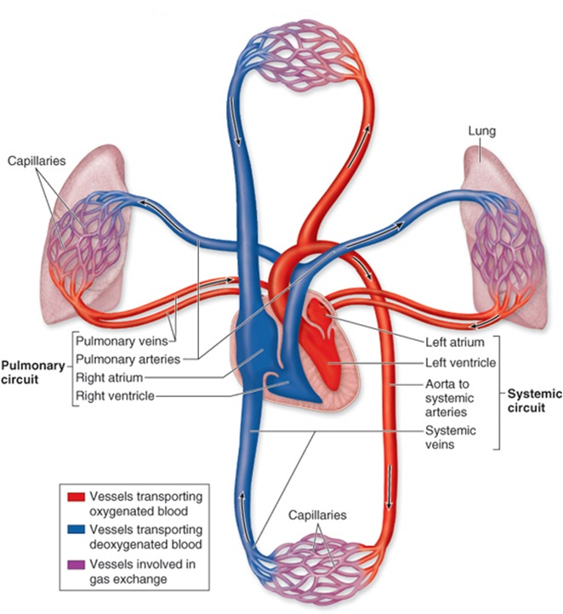
Major components
of the cardiovascular system
The cardiovascular system consists of the heart and blood vessels.
It is a closed system in which blood circulates, hence the synonym ‘circulatory system’.

Slide 5
Main functions of the cardiovascular system
Delivery of O₂, glucose and other nutrients to active tissues.
Removal of CO₂, Lactate and other waste products (by-products of metabolism) from active tissues.
Participate in homeostatic mechanisms.
Adjustment of oxygen and nutrient supply in different physiologic states.
Transport of metabolites and other substances to and from storage sites.
Transport of hormones, antibodies and other substances to site of action.
Defense.
Thermoregulation.

Slide 6
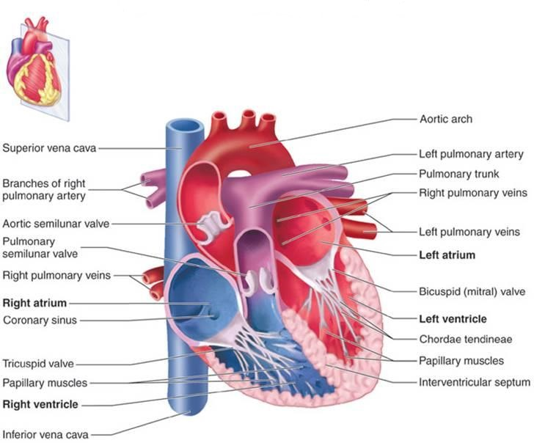
The heart as the central pump
The Right and Left Atria:
Are thin-walled, low pressure chambers.
They function as blood reservoirs for their respective ventricles.
Under normal conditions, the atria are not important as pumps.
The Right and Left Ventricles:
Are the principle pumps of the cardiovascular system. They are capable of generating flow with pressure.
The right ventricle is considerably thinner than the left ventricle.
The thickness of the ventricular wall is related to pressure generated.
Systole; Diastole; Heart beat; cardiac cycle

Slide 7
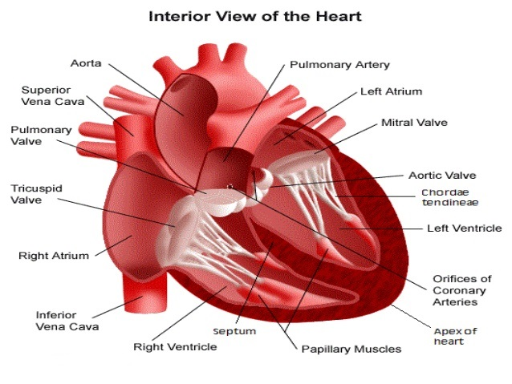
Cardiac valves:
The atrio-ventricular valves (AV valves); tricuspid valve and mitral valve.
The semilunar valves; aortic valve and pulmonary valve.
The edges of the AV valves are attached to ventricular papillary muscle by the chordae tendineae in order to prevent eversion of valves during ventricular systole.
The heart as the central pump

Slide 8
The heart as the central pump
Requirements for effective pumping
For effective pumping, the heart must be functioning properly in five basic respects:
The contractions of individual cardiac muscle cells (myocytes) must occur at regular intervals and be synchronized (not arrhythmic).
The valves must open fully (not stenotic).
The valves must not leak (not insufficient or regurgitant).
The ventricular contractions must be forceful (not failing).
The ventricles must fill adequately during diastole.
Q1. Specify five different mechanisms which can lead to ineffective cardiac pumping.
Q2. Think of five possible cardiac diseases which may precipitate ineffective cardiac pumping.

Slide 9
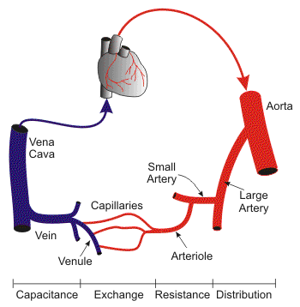
Blood vessels

Slide 10
Blood vessels
HEART
VEINS
CAPACITY
VESSELS
ARTERIES
(LOW COMPLIANCE)
(Pressure reservoirs)
VEINS
(HIGH COMPLIANCE)
(Volume reservoirs)
CAPILLARIES

Slide 11
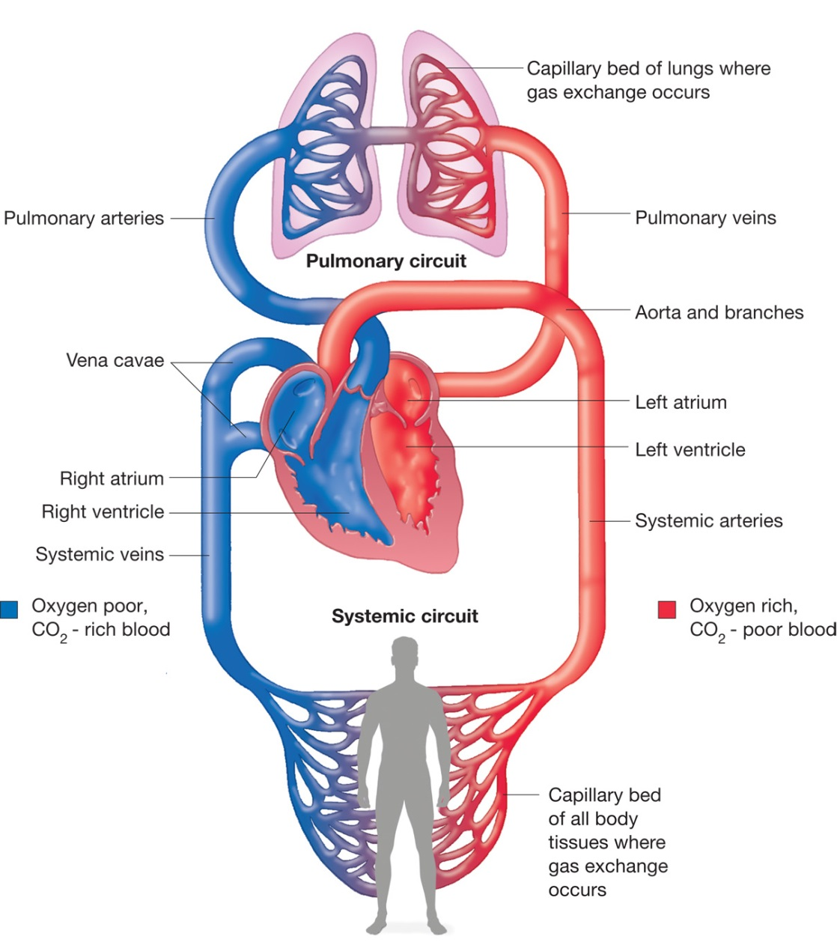
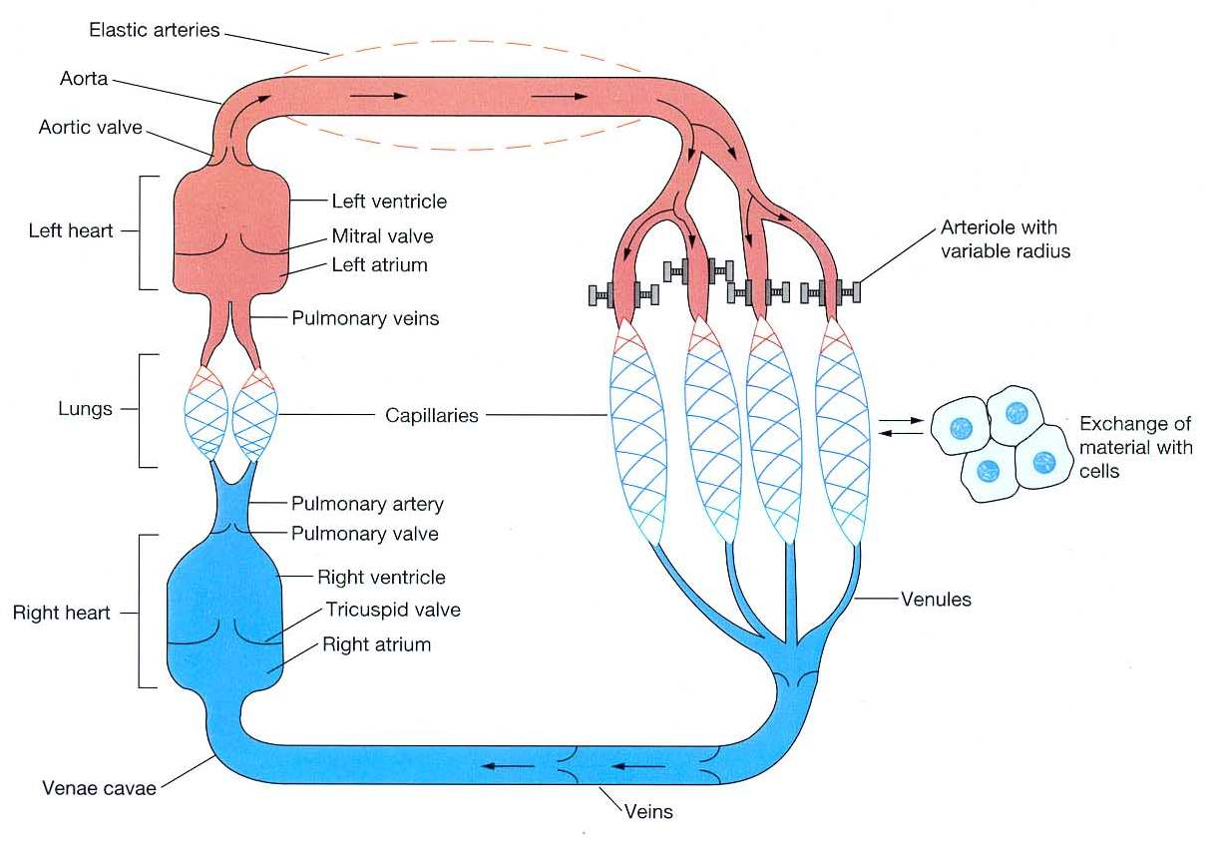
Systemic and pulmonary circulations

Slide 12
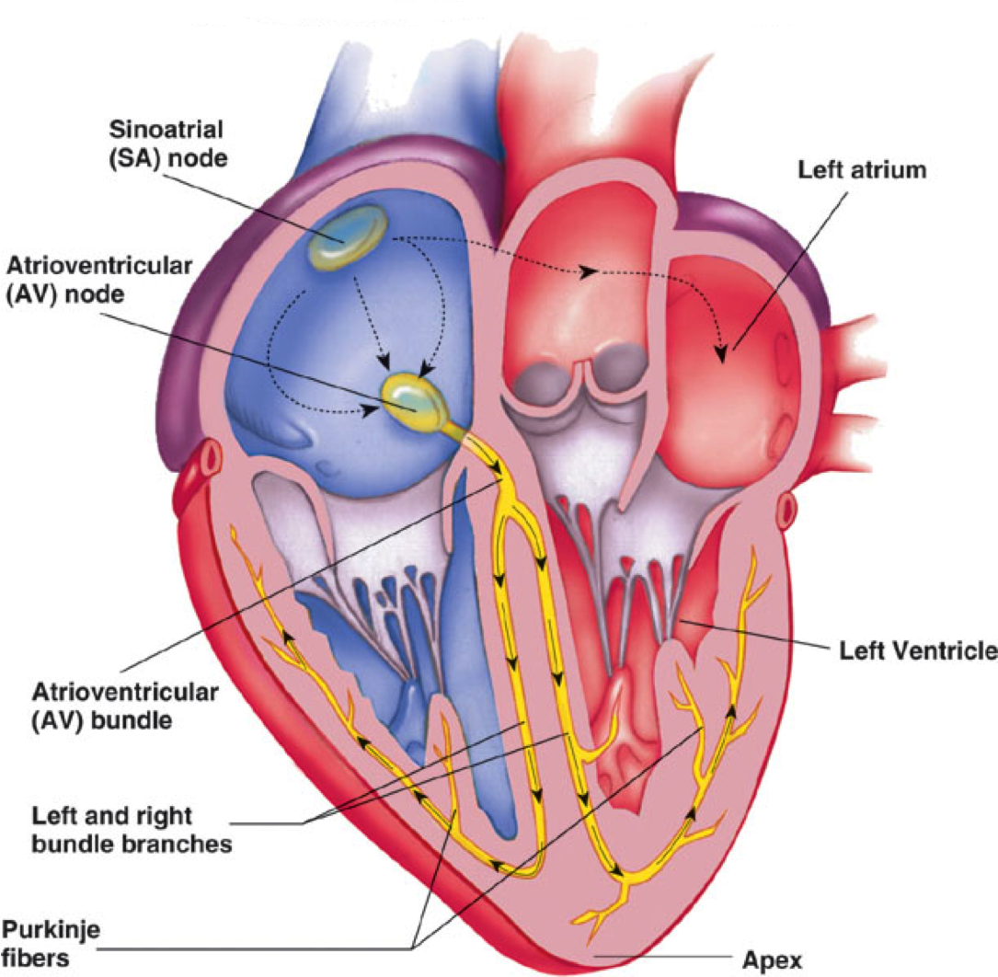
How the heart performs its function as the central pump of the CVS?
The heart has four basic properties which are essential for its functioning as the central pump of the CVS. These are:
Autorhythmicity
Conductivity
Excitability
Contractility
There are 2 main types of cells in the heart:
Cells of the specialized conduction system.
Contractile cells (myocytes; working cells).

Slide 13
Ultrastructure of myocyte
(the contractile, working cell)
The cardiac muscle cells (fibers; myocytes) branch and interdigitate, but each is a complete unit surrounded by a cell (plasma) membrane (sarcolemma).
Where the end of one muscle fiber abuts on another, the membranes of both fibers parallel each other through an extensive series of folds. These areas are called intercalated disks.
Thus, each fiber is separated from its neighboring fibers by its sarcolemma (laterally) and by the intercalated disks (end-to-end).
The intercalated discs enable the synchronization of the contraction of the cardiac muscle fibers by providing both mechanical and electrical coupling.

Slide 14
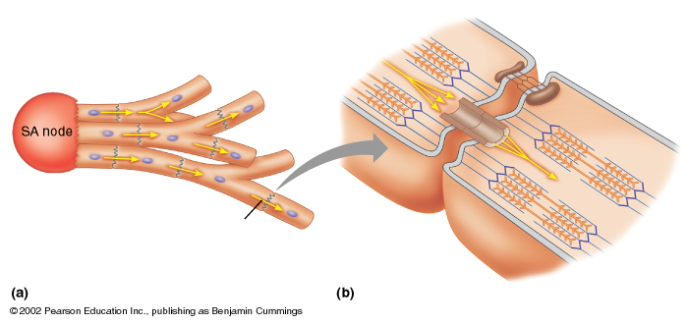
Mechanical and electrical coupling of the cardiac muscle cells
via the intercalated discs
desmosome
Cardiac Muscle Cells
Gap Junction
Desmosome resist stretching and prevent detachment of the cardiac fibers during contraction.
Gap junction: are trans-membrane channel proteins, connecting the cytoplasm of the neighboring cardiac muscle cells. They allow free diffusion of ions between neighboring cells. Action potentials can also travel from one cardiac muscle cell to another. So intercalated discs allow passage of current through cells this mechanism ensures electrical coupling of the cells.

Slide 15
Cardiac muscle is a syncytium
Cardiac muscle functions as a syncytium as each muscle cell is electrically connected to its neighboring cells through the gap junctions.
Thus, stimulation of a single myocyte:
→ the action potential spreads from cell to cell through the gap junctions.
→ synchrnous contraction of all the myocytes.
The atrial syncytium is separated from the ventricular syncytium by the fibrous tissue surrounding the valvular openings (fibrous skeleton of the heart).

Slide 16
Mitochondria
Sarcolemma
T-tubule
SR
Fibrils
At the ultrastructural level, cardiac muscle cells (myocytes) typically resemble skeletal muscle in also having: (a) Myofibrils packed in the cytoplasm (sarcoplasm), (b) specialized transverse tubular and sarcoplasmic reticular membrane systems.
However, the T system in cardiac muscle is located at the Z lines of the sarcomeres rather than at the A–I junction, where it is located in skeletal muscle. The sarcoplasmic reticulum makes complexes with the transverse tubular membrane at dyad rather than triad junctions.
Cardiac muscle cell contains large amount of mitochondria to provide continuous ATP for the cell.
Cardiac muscle has a rich capillary supply: about 1 capillary per fiber.

Slide 17
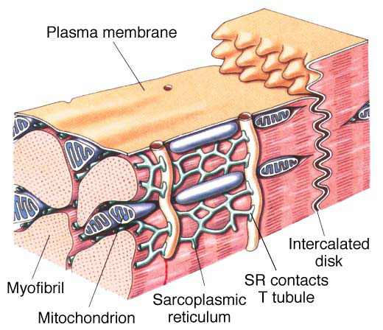
In the myocytes, a significant Ca²⁺ influx comes from extracellular space during the plateau phase of the action potential.
The role of Ca²⁺ in excitation–contraction coupling in myocytes is similar to its role in skeletal muscle; (the term “excitation-contraction coupling” refers to the mechanism by which the action potential causes the myofibrils of the muscle cell to contract).
However, it is the influx of extracellular Ca²⁺ through the voltage-sensitive Dihydropyridine receptors (DHPR) in the T system (L-type calcium channels), which triggers calcium-induced calcium release through the ryanodine receptors (RyR) at the sarcoplasmic reticulum.
Cardiac ryanodine receptors are different from the skeletal muscle ryanodine receptors.
Calcium-induced
calcium release through
the ryanodine receptors (RyR) at the sarcoplasmic reticulum

Slide 18
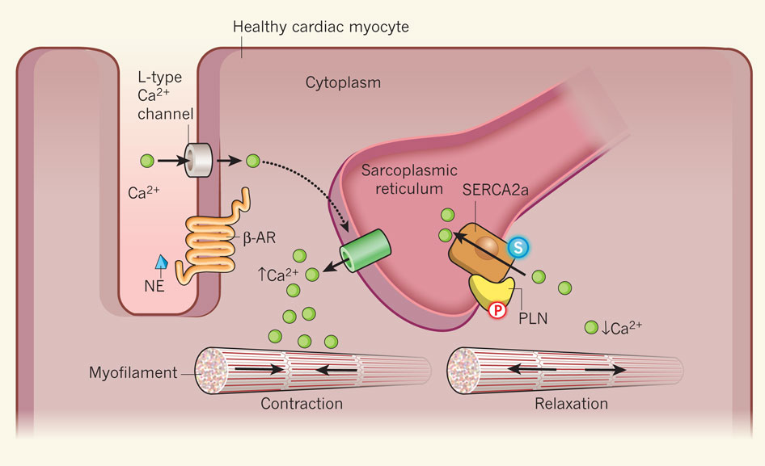
Mechanism of calcium-induced calcium release through the ryanodine receptors (RyR) at the sarcoplasmic reticulum
Excitation of cardiac muscle cell (fiber; myocyte) → fast action potential in the sarcolemma. This fast action potential propagates across the sarcolemma and travels down the transverse tubules to the fiber’s interior
Voltage-gated L-type calcium channels (dihydropyridine receptors; DHPR) are opened by the action potential and Ca²⁺ ions move into the cell.

Slide 19
Mechanism of calcium-induced calcium release through the ryanodine receptors (RyR) at the sarcoplasmic reticulum
3. External Ca²⁺ (Ca²⁺ influx) is required for the excitation-contraction coupling in the heart, but is not sufficient to produce contraction by itself. It is used as a trigger for Ca²⁺ release from the sarcoplasmic reticulum.
4. Thus, calcium coming into the cell through L-type voltage-gated Ca²⁺ channels binds to the ryanodine receptor of the sarcoplasmic reticulum.
5. The Voltage-gated calcium channels are usually very near to the ryanodine receptors, so that Ca²⁺ influx will induce high local levels of Ca²⁺.

Slide 20
Mechanism of calcium-induced calcium release through the ryanodine receptors (RyR) at the sarcoplasmic reticulum
6. At micromolar Ca²⁺ levels (local levels), the ryanodine receptors open, releasing stored Ca²⁺ from the sarcoplasmic reticulum.
7. This calcium-induced calcium release is pH sensitive, showing strong inhibition at pH 6.5 and maximal release at pH 7.4.

Slide 21
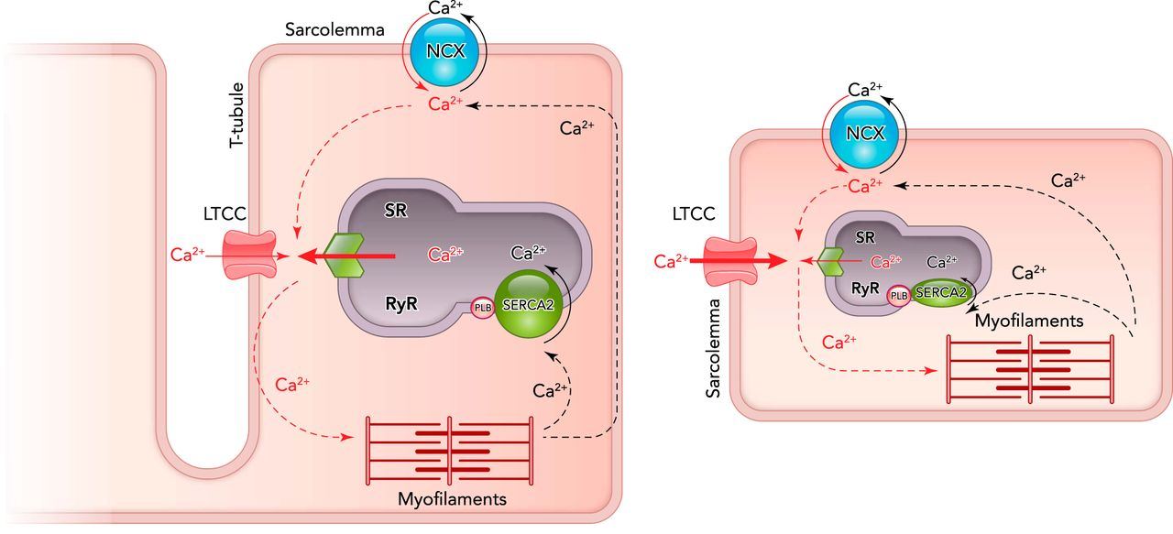
Mechanism of calcium-induced calcium release through the ryanodine receptors (RyR) at the sarcoplasmic reticulum

Slide 22
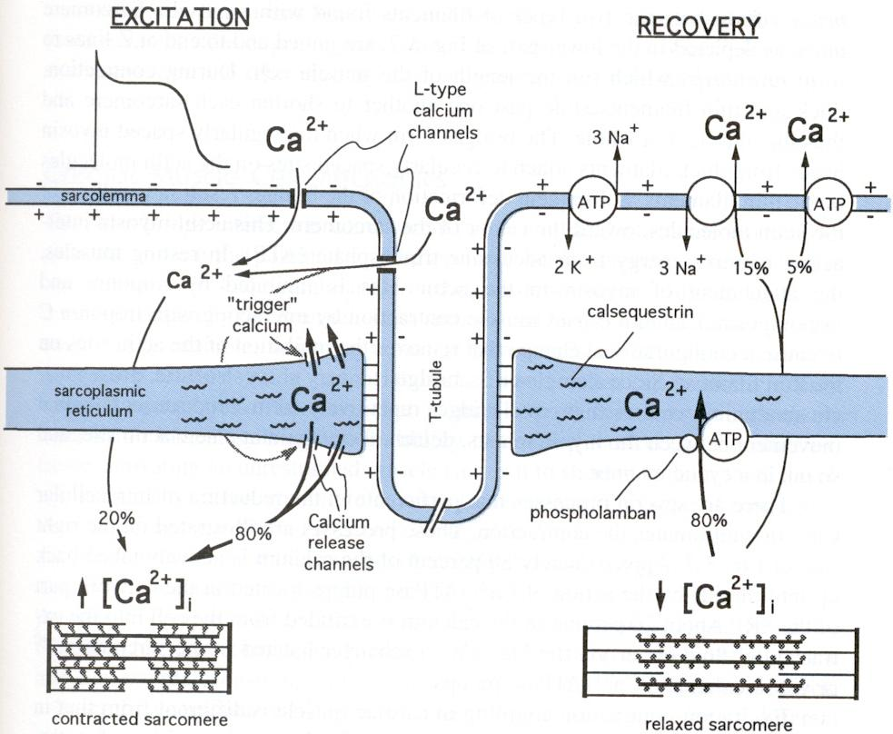
Excitation contraction coupling
Excitation-contraction coupling is similar in cardiac and skeletal muscles. Increased intracellular Ca²⁺ triggers contraction by binding to troponin on the thin filament.
Tension generation in cardiac, but not in skeletal muscle is profoundly influenced by:
Extracellular calcium levels.
Factors that affect the magnitude of the inward calcium current.
For example, doubling the extracellular calcium concentration may nearly double the maximum cardiac contractile force.
Drugs which reduce calcium influx have profound negative inotropic effects on the myocardium (↓ contractility), but affect skeletal muscle only when present in massive overdose.

Slide 23
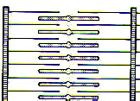
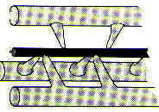
Myocardial fiber
Myofibril
myosin
Myofilaments
actin
relaxed
contracted

Slide 24
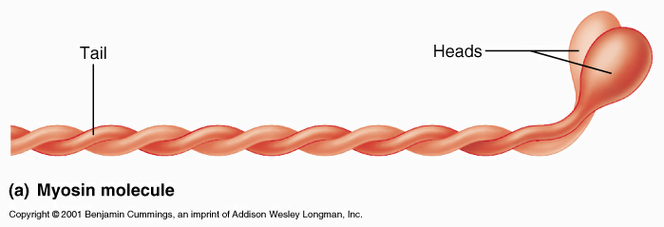
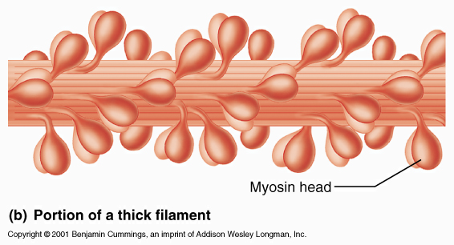
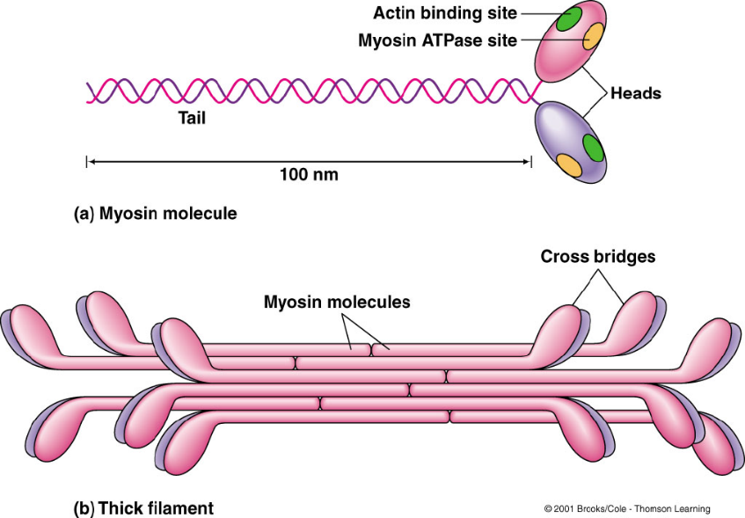
Thick filaments
Each myosin molecule has a tail and 2 globular heads.
The myosin molecules combine to form a Thick filament (myosin filament)
KEY POINT: The heads of each myosin molecule have an ACTIN binding site and an ATPase site (splits ATP)

Slide 25
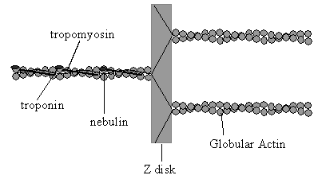
Thin filaments
Sliding-filament mechanism of contraction
In the relaxed state, myosin binding sites on actin molecules are covered by tropomyosin.
Excitation rises calcium level.
Ca²⁺ binds to troponin C.
Ca-troponin C complex interacts with tropomyosin → uncovering the myosin binding sites on actin molecules.
Myosin head binds to actin.

Slide 26
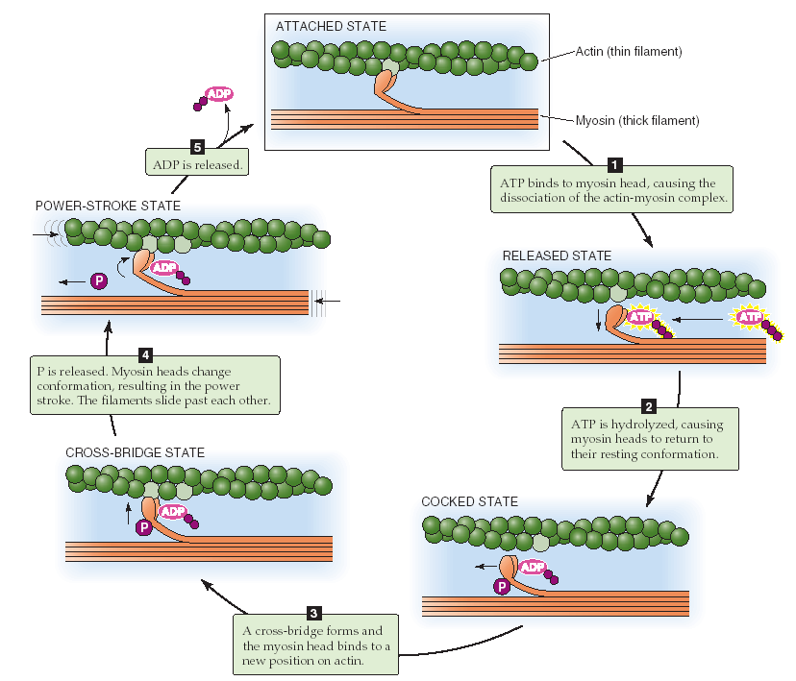
Contraction cycle
By definition, contraction is the continuous cycling of cross-bridges.
As long as calcium concentrations remain high, actin and myosin cross-bridges interact to produce contraction of the muscle, similar to that seen in skeletal muscle.
Power stroke

Slide 27
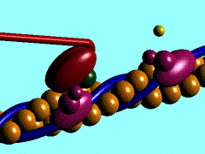
Contraction cycle
Skeletal muscle is susceptible to rigor if no ATP is present in the muscle cell to bind to the myosin head and allow it to detach from the actin filament.
Cardiac muscle is unlikely to ever undergo rigor, due to the large amounts of mitochondria producing ATP.

Slide 28
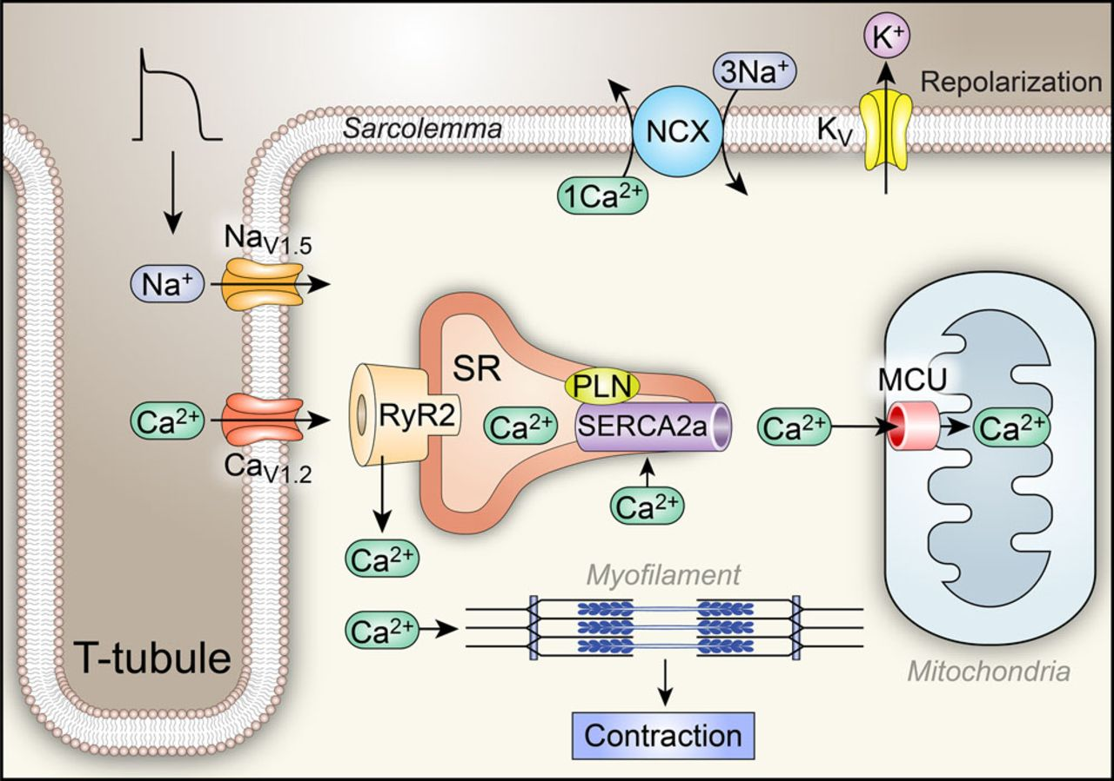
The plasma membrane and the sarcoplasmic reticular membranes contain calcium-ATPase pumps, which translocate calcium ions into both the extracellular fluid and the lumina of the sarcoplasmic reticulum.
The activity of the sarcoplasmic reticular calcium pump (Ca²⁺-ATPase; SERCA) is modified by phospholamban, speeding up the pump when it is phosphorylated by cAMP-protein kinase.
Catecholamines → phosphorylation of phospholamban → speeding up calcium removal.
Mechanisms maintaining low intracellular Ca²⁺ between successive action potentials 1. Calcium-ATPase pumps

Slide 29
Mechanisms maintaining low intracellular Ca²⁺ between successive action potentials 2. Sodium-Calcium exchanger
The plasma membrane also contains a sodium-calcium exchange system , which drives calcium efflux across the plasma membrane. The exchanger removes 1 Ca²⁺ ion for every 3 Na⁺ ions which enter the cell.
The exchanger utilizes the energy from the influx of sodium ions down an electrochemical gradient previously established by the ATPase coupled sodium-potassium pump.
Increases in intracellular sodium concentration decrease this inward electrochemical gradient driving sodium ion entry and result in an increased internal calcium concentration and contractile force.
if there is high Na inside the cell, the exchanger will work to bring in 1 Ca²⁺ ion for every 3 Na⁺ ions removed.
Mechanism of action of digitalis used in the management of cardiac failure: These agents block the sodium pump and thereby allow such an increase in intracellular sodium concentration → reverse Na⁺-Ca²⁺ exchanger.

Slide 30
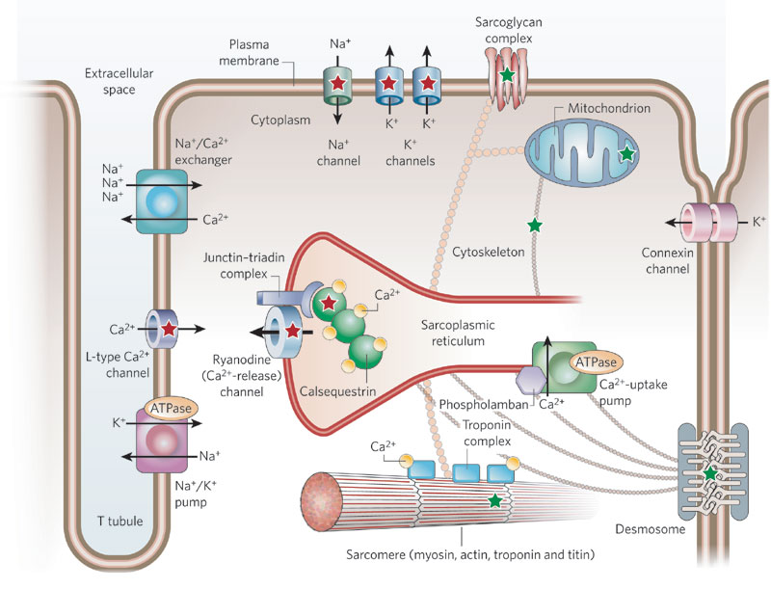

Slide 31
Factors affecting cardiac contractility
Cardiac contractility is an intrinsic property of the contractile cardiac muscle cells and is defined as the force of contraction of the heart.
It is essential for the pumping action of the heart.
In physiological terms, cardiac contractility is referred to as the inotropic state of the myocardium. An inotropic effect is an effect or a mechanism that affects cardiac contractility.
Positive ionotropic effects: these are the factors/mechanisms that increase the cardiac contractility
Sympathetic stimulation (catecholamines)
Calcium ions
Negative Ionotropic effects: these are the factors/mechanisms that decrease the cardiac contractility
Parasympathetic stimulation (vagal stimulation)
Acetylcholine

Slide 32
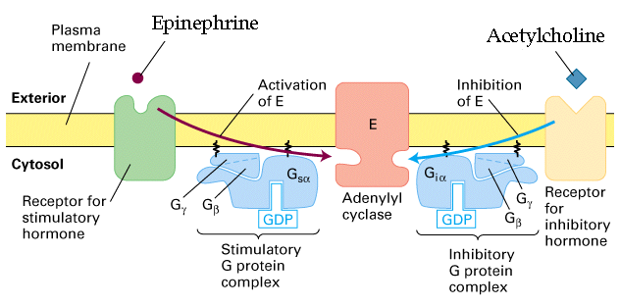
Catecholamines interact with beta-adrenergic receptors → activation of adenylyl cyclase. This increases intercellular levels of cAMP.
cAMP activates protein kinases which promote the phosphorylation of L-type Ca²⁺ channels.
Phosphorylation of L-type Ca²⁺ channels increases the influx of Ca²⁺ during the action potential and hence more Ca²⁺ is released from the sarcoplasmic reticulum.
Factors affecting
cardiac contractility
1. Sympathetic stimulation

Slide 33
The mechanisms of parasympathetic influences on cardiac contractility involve:
Interaction of acetylcholine with muscarinic receptors on cardiac muscle cell, and
Inhibition of the release of norepinephrine from neighboring sympathetic neurons.
Interaction of acetylcholine with muscarinic receptor inhibits adenylyl cyclase → ↓ intracellular levels of cAMP.
The reduction in cAMP leads to a reduction in Ca²⁺ influx during the action potential , and thus a decrease in contractility.
The reduction in contractility induced by parasympathetic stimulation is seen primarily in the atria.
Factors affecting cardiac contractility
2. Parasympathetic stimulation

Slide 34
Objectives
Intended learning outcomes (ILOs)
After reviewing the PowerPoint presentation and the associated learning resources, the student should be able to:
Describe the general features and overall design of the cardiovascular system.
Explain how the heart accomplishes its function as the central pump of the cardiovascular system.
Describe the structure of a typical myocyte.
Discuss excitation-contraction coupling in the heart.
Explain sliding-filament mechanism of contraction.
Summarize the effects of sympathetic and parasympathetic stimulation on cardiac contractility.

Slide 35
Thank You

