Slide 1
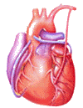

Cardiovascular Block
Physiology
Arterial Blood Pressure
Regulation of Arterial Blood Pressure

Slide 2
Intended learning outcomes (ILOs)
After reviewing the PowerPoint presentation and the associated learning resources, the student should be able to:
Describe systemic and pulmonary vascular resistances and explain physiological significance of arterial blood pressure in overcoming the vascular resistance.
Compare and contrast measurement of arterial blood pressure in systemic and pulmonary circulations and state normative data for pulmonary and systemic circulations.
Describe physiological variation in arterial blood pressure.
Explain the effect of gravity on arterial blood pressure.
Define mean arterial blood pressure and describe how it is calculated.
Define pulse pressure and state how it is affected in aortic stenosis, aortic regurgitation and arteriosclerosis.
List factors which determine arterial blood pressure and explain how they influence arterial blood pressure.
Outline synthesis of NO and state its physiological significance.
Explain the physiological importance of regulating arterial blood pressure.
Discuss short-, intermediate- and long-term regulation of blood pressure; nervous, hormonal and renal regulation of arterial blood pressure.
Define systemic hypertension and state its complications.

Slide 3
Learning Resources
Guyton and Hall, Textbook of Medical Physiology; 13th Edition; Unit IV-Chapters 15, 18 and 19.
Linda Costanzo, Physiology, 5th Edition; Chapter 4.
Ganong’s Review of Medical Physiology; 25th Edition; Section V; Chapter 32.

Slide 4
Arterial blood pressure (ABP)
Blood pressure is defined as the force exerted by the blood against a vessel wall.
Blood pressure is an important characteristic of our body since it is the force that drives blood along blood vessels after it has left the heart.
Without blood pressure, nutrients, oxygen, and proteins could not travel from the arterial side of the body to the venous side.

Slide 5
Physiological significance of blood pressure
As blood flows through the systemic and pulmonary circulations friction develops between the moving fluid and the stationary walls of the blood vessels. Thus, the vessels tend to resist fluid movement through them. Such resistance is known as vascular resistance.
The resistance to the flow of the blood through the systemic circulation is known as systemic vascular resistance and the resistance to the flow of the blood through the pulmonary circulation is known as pulmonary vascular resistance.
The ratio of pulmonary to systemic vascular resistance is approximately 1:6.
It is because the vascular resistance to flow that we need the heart in the cardiovascular system to generate flow with pressure to overcome the vascular resistance.

Slide 6
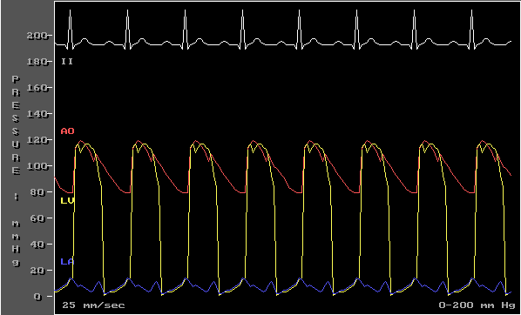
Measurement of arterial blood pressure
in the systemic circulation
Direct
Arterial catheter
Indirect
Stethoscope and blood pressure cuff

Slide 7
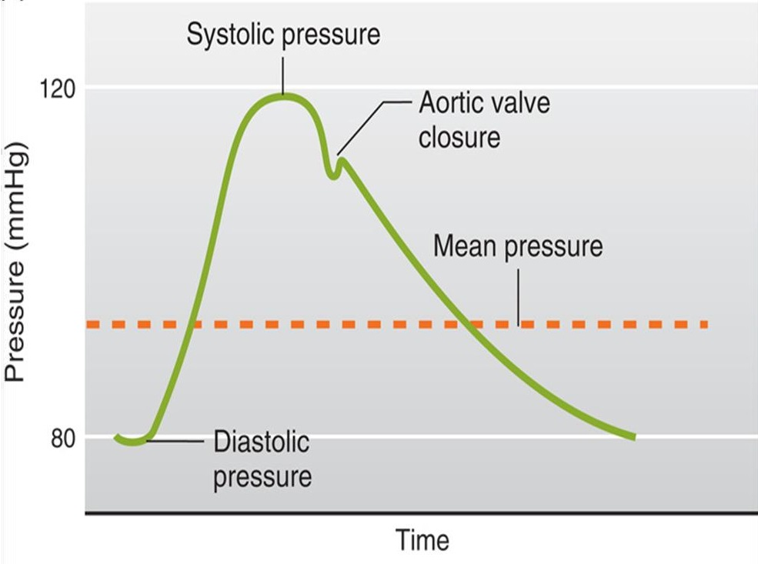
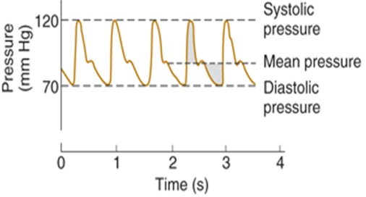
Measurement of arterial blood pressure
in the systemic circulation
Direct
Arterial catheter

Slide 8

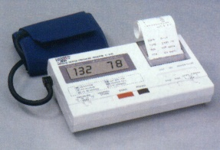

Indirect measurement
of arterial blood pressure
in the systemic circulation
There are three different types of sphygmomanometers: mercury, aneroid, and digital.

Slide 9
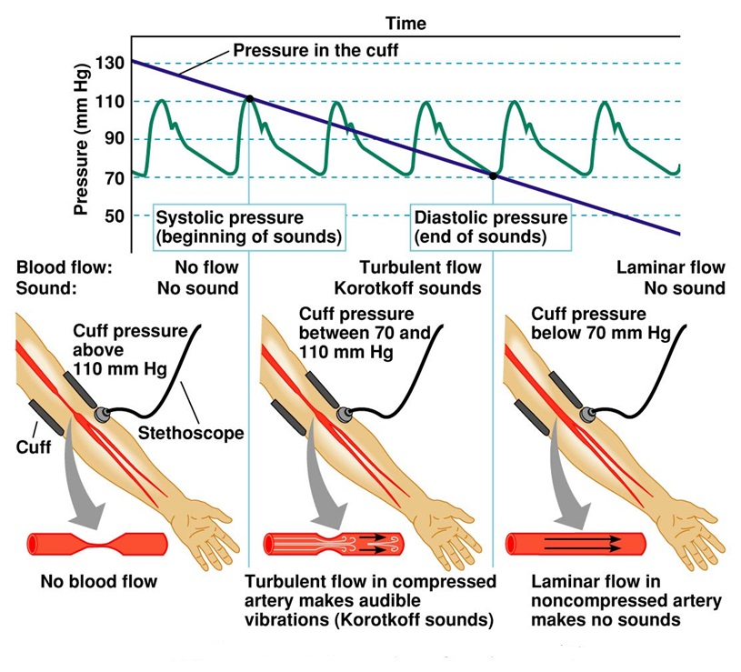

Slide 10
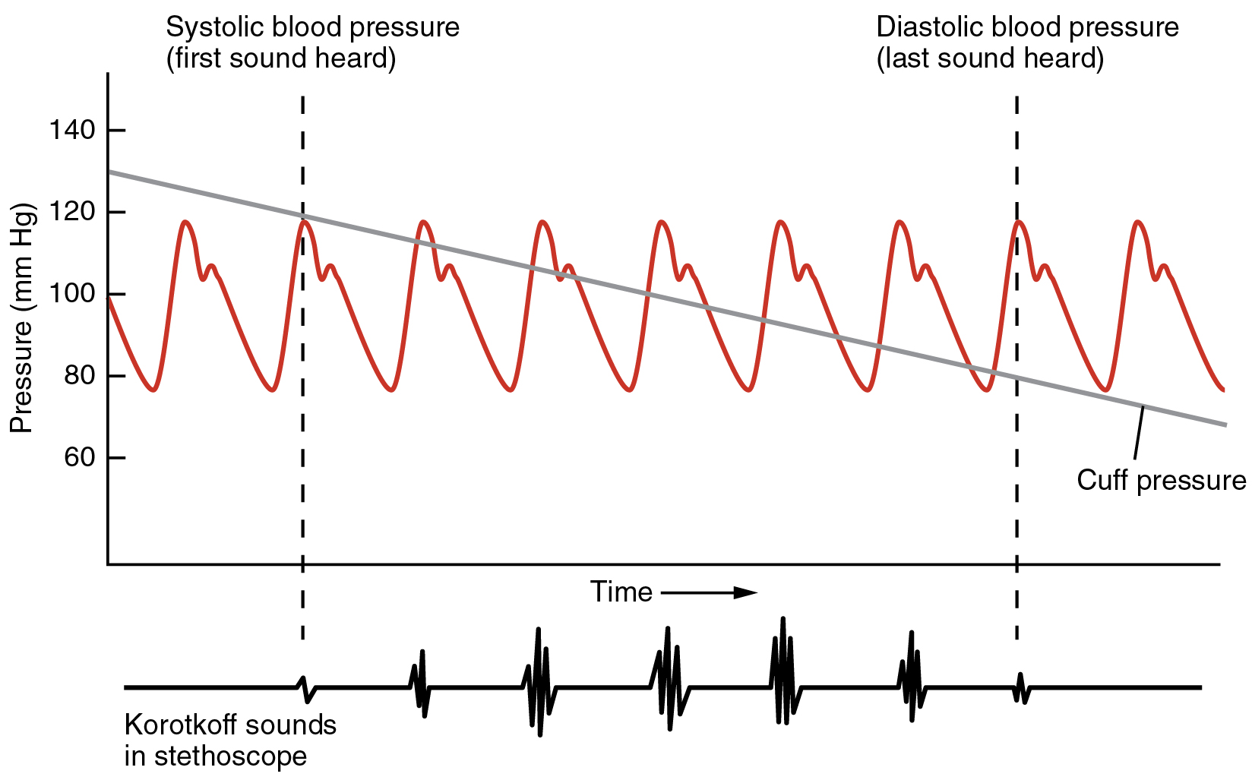

Slide 11
Arterial blood pressure (ABP)
Systolic blood pressure: Is the maximum level of arterial blood pressure. It is reached during the rapid ejection phase of ventricular systole. For a normal adult, it is about 120 mmHg (range of normal: 90-140).
Diastolic blood pressure: Is the minimum level of arterial blood pressure. It is reached during the isometric contraction phase of ventricular systole. For a normal adult, it is about 80 mmHg (range of normal: 60-90).

Slide 12
Mean arterial pressure (MAP)
MAP is the average pressure responsible for driving blood into the tissues throughout the cardiac cycle.
MAP is not halfway between systolic and diastolic pressures because arterial pressure remains closer to diastolic than to systolic pressure for a longer period of each cardiac cycle.
A good approximation of the MAP can be determined using the following formula:
MAP = Diastolic pressure + 1/3 pulse pressure
Mean arterial pressure tends to increase with age because of an age-dependent increase in total peripheral resistance which is controlled primarily by arterioles.

Slide 13
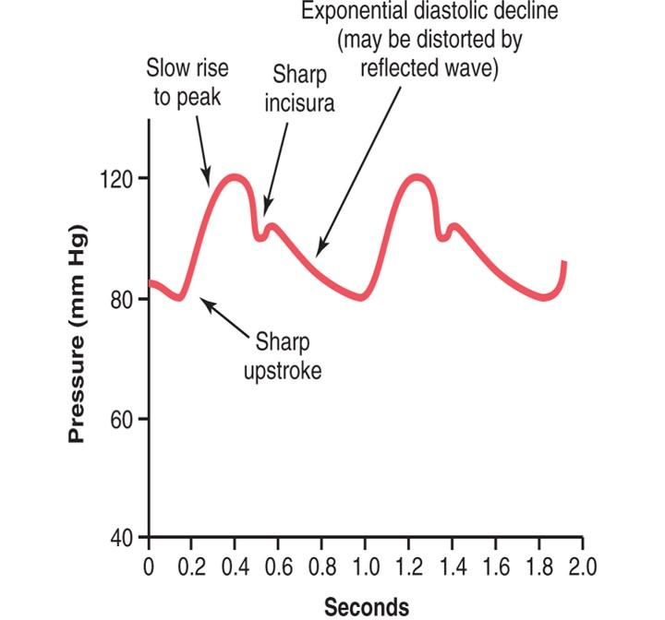
Pulse pressure: Is the difference between the systolic and diastolic blood pressure values. For a normal adult the pulse pressure = 120 – 80 = 40 mmHg.
Pulse pressure is determined by two parameters:
  Change in volume (ΔV): could be approximated as stroke volume
  Compliance
Arterial pressure pulsations; pulse pressure

Slide 14
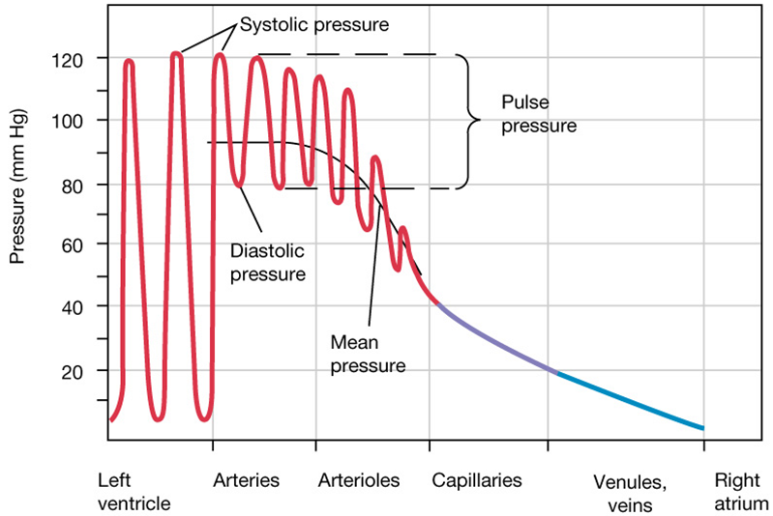

Slide 15
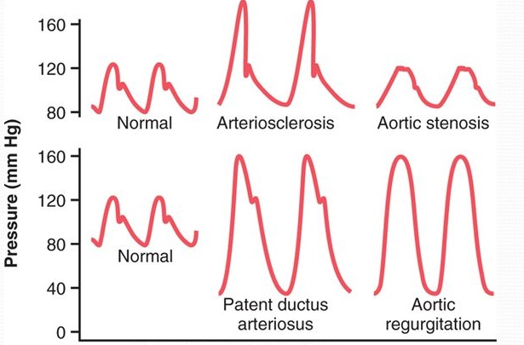
Atherosclerosis: Pulse pressure tends to increase with ageing because of a decrease in arterial compliance ("hardening of the arteries").
Aortic regurgitation: in early diastole, blood leaks back into the ventricles. As a results, diastolic pressure falls to very low levels.
Abnormalities in
pulse pressure

Slide 16
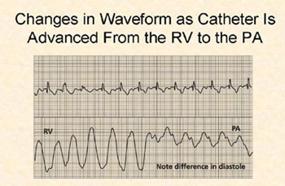
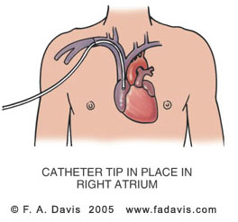
Measurement of arterial blood pressure
in the pulmonary circulation
Right Heart Pressures
Swan-Ganz / PA Catheter

Slide 17
Pressures in the systemic
and pulmonary circulations
Pressures in the pulmonary circulation | Pressures in the systemic circulation
Right ventricle 25/0 mm Hg | Left ventricle 120/0 mm Hg
Pulmonary artery 25/10 mm Hg | Aorta 120/80 mm Hg
Mean pulmonary artery 15 mm Hg | Mean arterial BP 93 mm Hg
Capillary 7-9 mm Hg | Capillary: skeletal 30 mm Hg renal glomerular 45-50 mm Hg
Pulmonary veins 5 mm Hg | Peripheral veins 7-15 mm Hg
Left atrium 5-10 mm Hg | Right atrium (CVP) 0 mm Hg
Pressure gradient 15-5 = 10 mm Hg | Pressure gradient 93-0 = 93 mm Hg

Slide 18
Physiological variation in blood pressure
BP range: 90-140/60-90 mmHg.
Age:
    At birth: 50/30
    Adult : 120/80
    Old age: 170/90
Sex: males have higher BP than F before menopause.
Body built : increase in obese.
Emotions (↑ BP).
Exercise (↑ BP).
Meals (↑ BP).
Sleep (↓ BP).

Slide 19
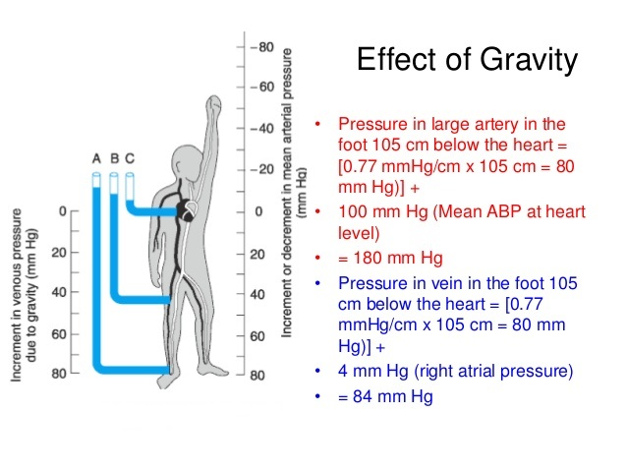
The pressure in any vessel below the level of the heart increased, while decreases in any vessel above the level of the heart due to the effect of Gravity.
Gravitational effect = 0.77 mmHg/cm at the density of normal blood.
In an adult human in the upright position, if mean MAP at heart level = 100 mmHg, the MAP in an artery at the head (50 cm above heart) = 100-[0.77X 50] = 62 mmHg.
Effect of gravity
on blood pressure

Slide 20
Determinant of blood pressure in the systemic circulation:
Flow = ΔP/R
CO = The blood pumped per minute (ml/min).
All of the CO flows through the systemic circulation
Therefore, CO = Flow
MAP – Venous Pressure = MAP
MAP drives blood flow in the systemic circulation
Therefore, MAP = ΔP
R = TPR
MAP = mean arterial pressure
CO = cardiac output
TPR = total peripheral resistance
CO = MAP / TPR

Slide 21
In the systemic circulation:
CO = MAP / TPR
MAP = CO X TPR
MAP = SV X HR X TPR
Thus, the main determinant of arterial blood pressure are:
Cardiac output
TPR

Slide 22
Factors affecting vascular resistance
Poiseuille’s law
R = 8Lη / πr⁴
Flow = ΔP/R
L= vessel length
η =viscosity
r = radius
If η increases, R increases and flow decreases. The viscosity of blood is dependent on the haematocrit and plasma protein concentration.
If the radius of a vessel increases, R decreases and flow increases.
Vessel radius can have a tremendous influence on blood flow
because resistance is dependent upon r⁴ not just r. If r is doubled, TPR is reduced by 16, and flow increases 16 times.

Slide 23
Factors affecting vessel diameter
Vasodilator agents:
  Nitric oxide.
  Histamine.
  Atrial natriuretic peptide (ANP).
  Prostacyclin; PGI₂.
Vasoconstrictor agents:
  Norepinephrine.
  Angiotensin II.
  Vasopressin.
  Endothelin-1.
  Thromboxane A₂.

Slide 24
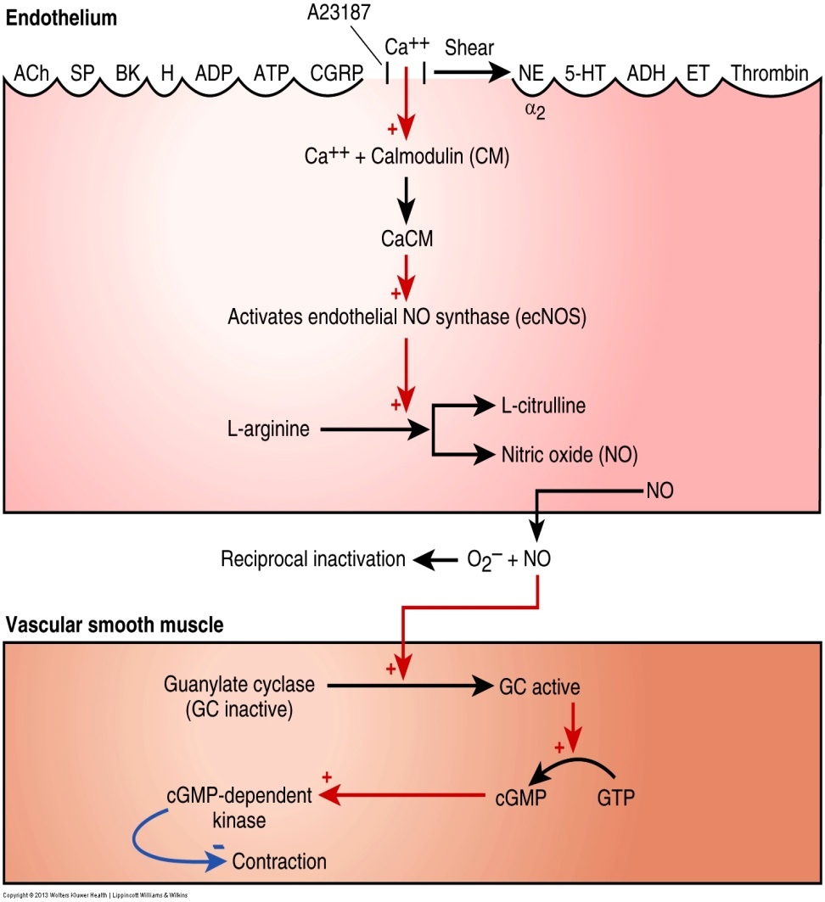
NO
Shear stress causes the endothelium to release NO.
NO allows large blood vessels like aorta to regulate flow in absence of any metabolic signals.
Increased velocity of flow increases shear stress → ↑ release of vasodilators.

Slide 25
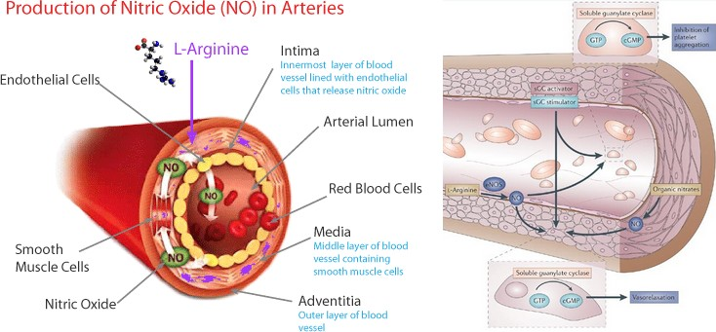
NO

Slide 26
NO
Mechanism of action of agonists, which work through production of nitric oxide:
  Agonist binds to receptor on endothelial cell.
  Binding stimulates production of nitric oxide synthase.
  Nitric oxide synthase catalyzes production of nitric oxide from l-arginine.
  Nitric oxide diffuses through endothelial cell wall and acts to stimulate a guanylate cyclase in vascular smooth muscle.
  The stimulated guanylate cyclase catalyzes the production of cGMP from GTP.
  cGMP is an important smooth muscle relaxer, resulting in vasodilation:
    Viagra works by blocking the breakdown of cGMP, thereby increasing flow.
    Overproduction of nitric oxide is dangerous, and can result in hypotension.

Slide 27
Other factors determining blood pressure
3. Blood volume:
An increase in blood volume → ↑CO → ↑ABP.
A decrease in blood volume as in hemorrhage, dehydration → ↓VR → ↓CO → ↓ ABP.
4. Elasticity of blood vessels:
  Changes in the elasticity of great vessels affects ABP.
  In atherosclerosis, there is decrease in arterial compliance ("hardening of the arteries"). This makes arteries like a tube, so during systole, as blood is ejected into the arteries, they don’t distend as normal and pressure increases significantly → ↑ PP.

Slide 28
Regulation of blood pressure
BP varies over 24 hours:
    Lower during sleep.
    Higher during waking, especially in stress.
BP is well regulated – why?
    To provide organs (especially brain) with adequate perfusion pressure.
    To optimize cardiovascular work.

Slide 29
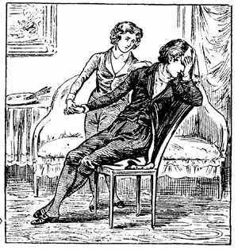
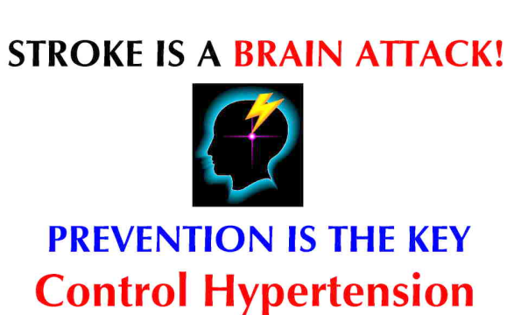
Regulation of blood pressure
Too low a value of arterial blood pressure
hypotension
blood flow to the tissues will be reduced
(for example to the brain and induce a faint)
Too high a value of arterial blood pressure
hypertension
this may cause excessive capillary pressures and damage
e.g., heart (myocardial infarction) kidneys, brain (stroke) and eyes

Slide 30
Regulation of blood pressure
Short term mechanisms (seconds to minutes): are largely neural. They regulate cardiac function and arteriolar diameter.
    Baroreceptor reflex.
    Chemoreceptor reflex.
    CNS ischemic response.
    Atrial reflexes.
Intermediate and long term mechanisms (minutes to days): are largely renal and hormonal. They regulate blood volume.

Slide 31
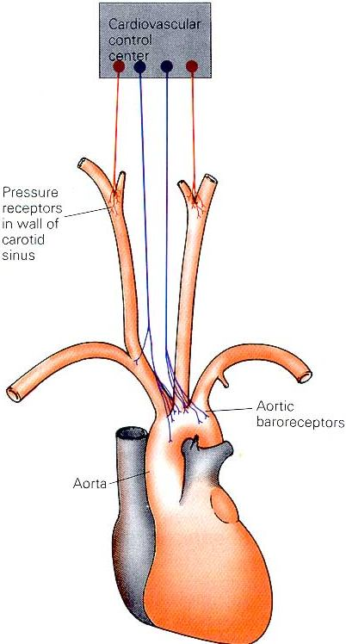
1. The arterial baroreceptors
Changes in MAP are detected by baroreceptors (pressure receptors) in the carotid and aortic arteries.
These receptors provide information to the cardiovascular centres in the medulla oblongata about the degree of stretch because of pressure changes.
Carotid baroreceptors are located in the carotid sinus on both sides of the neck. Aortic baroreceptors are located in the aortic arch.

Slide 32
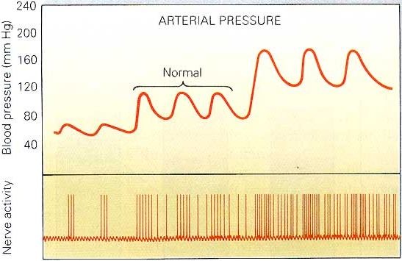
Increased arterial pressure
increases baroreceptor activity
At normal arterial pressure the baroreceptors are active.
Increased pressure increases their rate of fire, while decreased pressure decreases the rate of fire.
They play an important role in maintaining relatively constant blood flow to vital organs (such as brain) during rapid changes in pressure, such as standing up after lying down. That is why they are called “pressure buffers”.

Slide 33
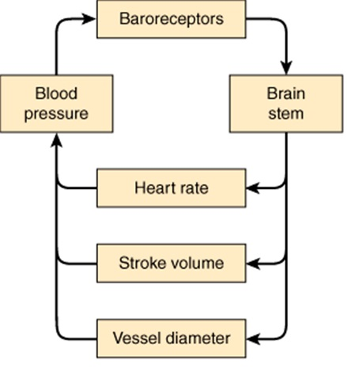

Slide 34
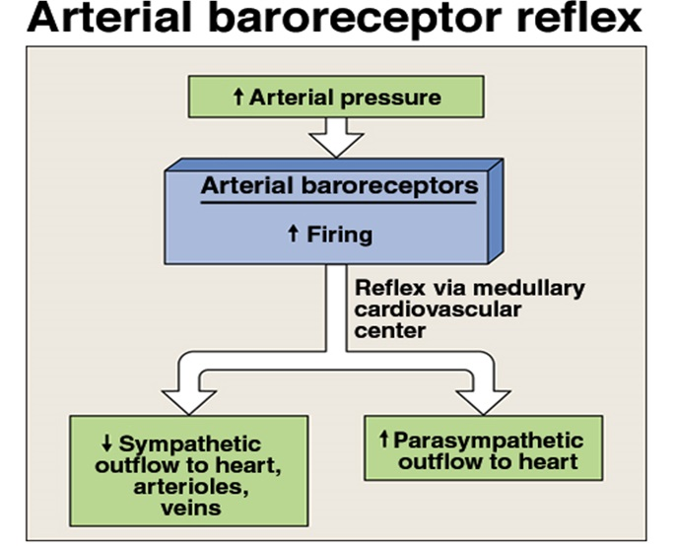

Slide 35
Arterial Baroreceptor Reflex
↑ MAP
Baroreceptors
↑ Parasympathetic
(vagal) activity
↓ Sympathetic
activity
↓ HR
↓ SV
↓ TPR
↓ MAP

Slide 36
Arterial Baroreceptor Reflex
↓ MAP
Baroreceptors
↓ Parasympathetic
(vagal) activity
↑ Sympathetic
activity
↑ HR
↑ SV
↑ TPR
↑ MAP
Flow to the heart and brain is maintained; reductions in flow to other organs.
The cerebral arteries are relatively insensitive to adrenergic neural stimuli.

Slide 37
Arterial Baroreceptor Reflex
Baroreceptors are important in maintaining MAP constant during changes in body posture.
When you change your posture from supine to erect, a drop in the MAP in the head and upper part of the body will occur.
The barorecptor reflex is activated → strong sympathetic impulses → vasoconstriction. This minimizes the drop in MAP.

Slide 38
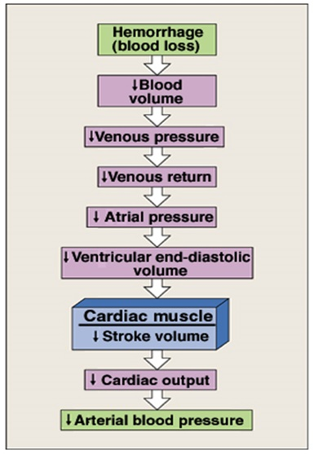
Cardiovascular changes initiated by the baroreflex
in hemorrhage

Slide 39
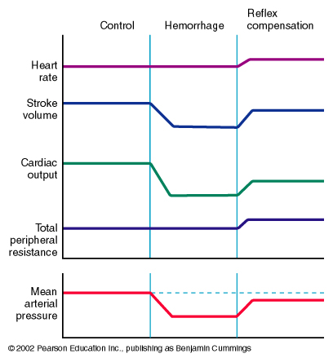
Cardiovascular changes initiated by the baroreflex
in hemorrhage
Control
Haemorrhage
Reflex
Compensation
Heart Rate
Stroke Volume
↓ EDV
Cardiac Output
Total Peripheral Resistance
Mean Arterial Pressure
↓ CO

Slide 40
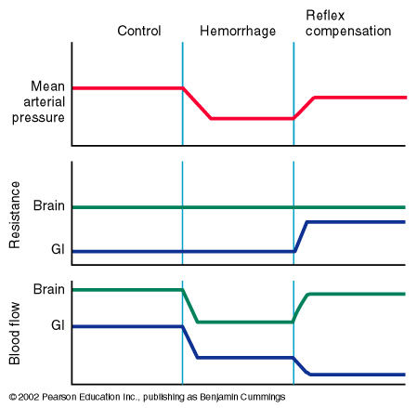
Cardiovascular changes initiated by the baroreflex
in hemorrhage
Control
Haemorrhage
Reflex
Compensation
Mean Arterial Pressure
Brain
Resistance
Gut
Brain
Blood Flow
Gut
This can
Become problematic.
Flow to the heart and brain is maintained; reductions in flow to other organs.

Slide 41
Unimportance of arterial baroreceptors
in long-term pressure control
The baroreceptor reflex mechanism functions primarily as a short-term regulator of MAP. It is activated at once by any blood pressure change and attempt to restore blood pressure rapidly toward normal.
Yet, if MAP deviates from its normal operating point for more than a few days, the arterial baroreceptors adapt to this new pressure and reset their activity. Adaptation of receptors means decrease in impulse discharge from the receptors despite persistence of the stimulus.
This adaptation of the baroreceptors obviously prevents the baroreflex from functioning as a long-term blood pressure control system.

Slide 42
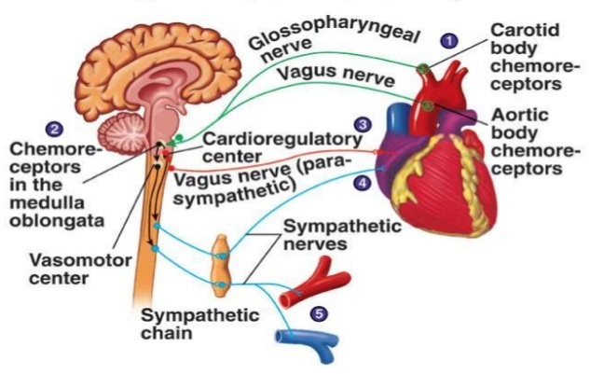
Supply of O₂ to tissues depends on both respiratory and cardiovascular factors.
Chemoreceptors have a very high blood flow (1200 ml/min/g tissue). This makes it easy for these cells to detect changes in O₂, CO₂, and H⁺. Reduced blood flow (due to reduced MAP) stimulates the chemoreceptors through oxygen lack, increased hydrogen ions or carbon dioxide. Chemoreceptors are stimulated when the MAP is lower than 60 mmHg.
Response is excitatory, NOT inhibitory; mainly through activation of sympathetic nervous system.
They reduce blood flow to unessential areas and protect vital tissues like brain and heart.
2. Arterial chemoreceptor reflex

Slide 43
3. CNS ischemic response
CNS ischemic response operates as an emergency arterial pressure control system that acts rapidly and powerfully to prevent further decrease in MAP whenever blood flow to the brain decreases to lethal levels.
It is one of the most powerful activators of the sympathetic vasoconstrictor system.
When MAP < 20 mmHg → cerebral ischemia of vasomotor center → strong excitation of vasomotor center (due to accumulation of CO2, lactic acid,….) → strong vasoconstriction of blood vessels including the kidney arterioles.

Slide 44
3. CNS ischemic reflex:
Cushing reaction
Brain is enclosed within the cranium, which is a rigid structure. Thus, ↑ intracranial pressure (e.g., due to tumour or oedema) → compress cerebral blood vessels → ↓ cerebral blood flow with consequent hypercapnia (PCO₂).
This will directly stimulate the pressor area of the vasomotor centre → systemic vasoconstrction with resultant rise in mean arterial pressure (MAP).
The resultant rise in MAP coupled with local cerebral vasodilation will tend to restore cerebral blood flow back to normal.
At the same time, the rise in MAP will reflexly decrease heart rate via baroreceptors.
This is called Cushing’s reflex.
If ↑ intracranial pressure was due to oedema caused by brain concussion: damage to capillaries) → ↑ cerebral blood flow → ↑ cerebral capillary pressure → further oedema (vicious circle).

Slide 45
4. Atrial volume receptors
There are receptors in the large veins close to the heart and in the walls of the atria.
They are sensitive to blood volume. The following mechanisms occurs to prevent excess elevation in blood pressure upon response to an increase of body fluid volume:
An increased blood volume → stretch of atria → activate atrial volume receptors → sensory afferent nerves to medulla →inhibiting the cardiovascular centre → This results into decreased blood volume through:
  (a) → ↓ sympathetic drive to kidney:
  → dilate afferent arterioles → ↑ glomerular capillary hydrostatic pressure →↑ GFR → ↓ blood volume (towards normal).
  ↓ renin secretion (Renin is an enzyme which activates angiotensinogen in blood). Hence inhibition of renin secretion → inhibit RAAS → inhibit aldosterone production → ↓ Blood volume (towards normal)
  (b) → ↓ ADH secretion → ↓ blood volume (towards normal).
  (c) → ↑ Atrial Natriuretic Peptide (ANP) causes loss of blood volume.

Slide 46
Hormonal regulation of blood pressure
A. Catecholamines (Adrenaline and Noradrenaline)
↓ MAP
↑ Sympathetic Activity
Splanchnic nerve
Adrenal Medulla
↑ Adrenaline Secretion
↑ HR (SA node) and ↑ SV (ventricular myocardium)

Slide 47
Hormonal regulation of blood pressure
A. Catecholamines (Adrenaline and Noradrenaline)
α-adrenoceptor
β-adrenoceptor
Adrenoceptor = Adrenergic Receptor
(binds adrenaline and noradrenaline)

Slide 48
Hormonal regulation of blood pressure
A. Catecholamines (Adrenaline and Noradrenaline)
α-adrenoceptor
β-adrenoceptor
α-adrenoceptor stimulation promotes vasoconstriction
β -adrenoceptor stimulation promotes vasodilation

Slide 49
Hormonal regulation of blood pressure
A. Catecholamines (Adrenaline and Noradrenaline)
α-adrenoceptor
β-adrenoceptor
Noradrenaline
Noradrenaline
Noradrenaline
Noradrenaline released from the sympathetic nerves binds
primarily to α adrenoceptors.

Slide 50
Hormonal regulation of blood pressure
A. Catecholamines (Adrenaline and Noradrenaline)
α-adrenoceptor
Adrenal Gland
β-adrenoceptor
Kidney
adrenaline
adrenaline
adrenaline
adrenaline
adrenaline
adrenaline
Adrenaline released from the adrenal medulla circulates in the
blood and can bind to both α and β adrenoceptors.

Slide 51
Adrenaline binding to α- and β-ddrenoceptors
Adrenaline has a greater affinity for β-adrenoceptors
than for α-adrenoceptors
At low [Adrenaline]
→ Preferential binding to β-adrenoceptors
→ Vasodilation
At high [Adrenaline]
→ Binding to both α and β-adrenoceptors
→ Vasodilation and/or vasoconstriction??
α: vasoconstriction
β: vasodilation

Slide 52
Vasodilation and/or Vasoconstriction??
In cardiac and skeletal muscle: # β-receptors > # α-receptors
→ Adrenaline promotes vasodilation
In most other tissues: # α-receptors > # β -receptors
→ Adrenaline promotes vasoconstriction
α: vasoconstriction
β: vasodilation

Slide 53
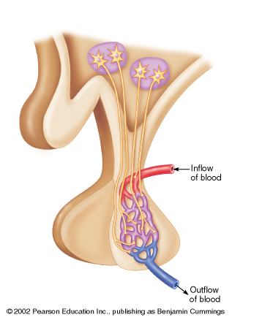
Hormonal regulation of blood pressure
B. Role of vasopressin (Antidiuretic hormone; ADH )
ADH (vasopressin) is synthesized within the
Paraventricular Nucleus of the hypothalamus.
hypothalamus
Paraventricular
nucleus
ADH is stored in the
posterior pituitary.
pituitary
Vasopressin exerts a
pressor effect
(i.e., ↑BP)

Slide 54
Hormonal regulation of blood pressure
B. Vasopressin (Antidiuretic hormone; ADH )
hypothalamus
1. Dehydration or salt ingestion
2. ↑ Blood osmolarity
3. Stimulates osmoreceptors
in the hypothalamus
pituitary
4. Triggers ADH release
from the pituitary
5a. Causes vasoconstriction
→ ↑ TPR
→ ↑ BP
5b. Promotes water retention by the kidney
→ ↑ Blood Volume

Slide 55
Renal regulation of blood pressure
The baroreceptor reflex and other reflex mechanisms are important for the short term control of blood pressure.
Long term control of blood pressure requires control of blood volume.
Blood volume is controlled by the kidney.

Slide 56
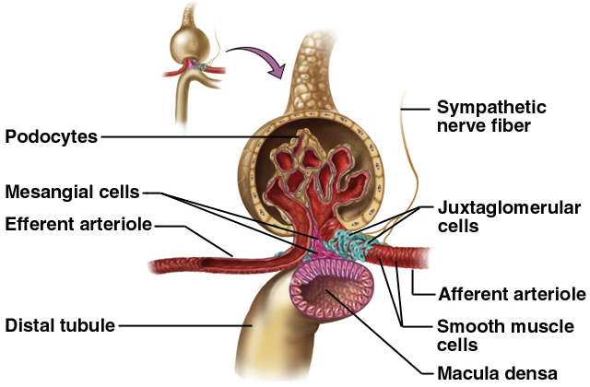
Renal regulation of blood pressure

Slide 57
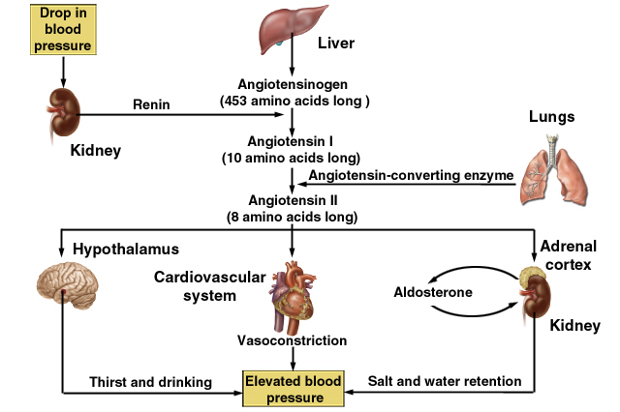
Renal regulation of blood pressure
Efferent arterioles

Slide 58
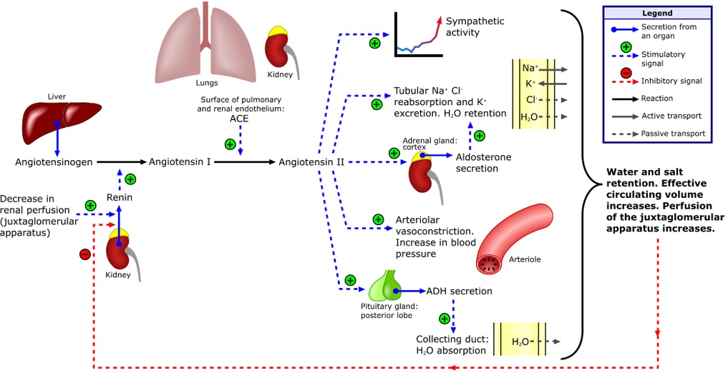
Renal regulation of blood pressure

Slide 59
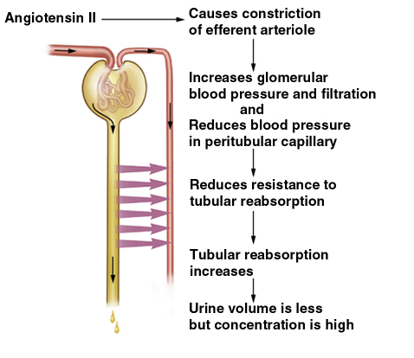
Effects of angiotensin II

Slide 60
Hypertension
Sometimes blood-pressure control mechanisms do not function properly or unable to completely compensate for changes that have taken place.
Blood pressure may be above the normal range (hypertension if above 140/90 mm Hg) or below normal (hypotension if less than 100/60).
Theoretically, hypertension could result from an increase in cardiac output or in TPR, or both.
In reality, however, the major abnormality in most cases of well-established hypertension is increased TPR, caused by reduced arteriolar radius.

Slide 61
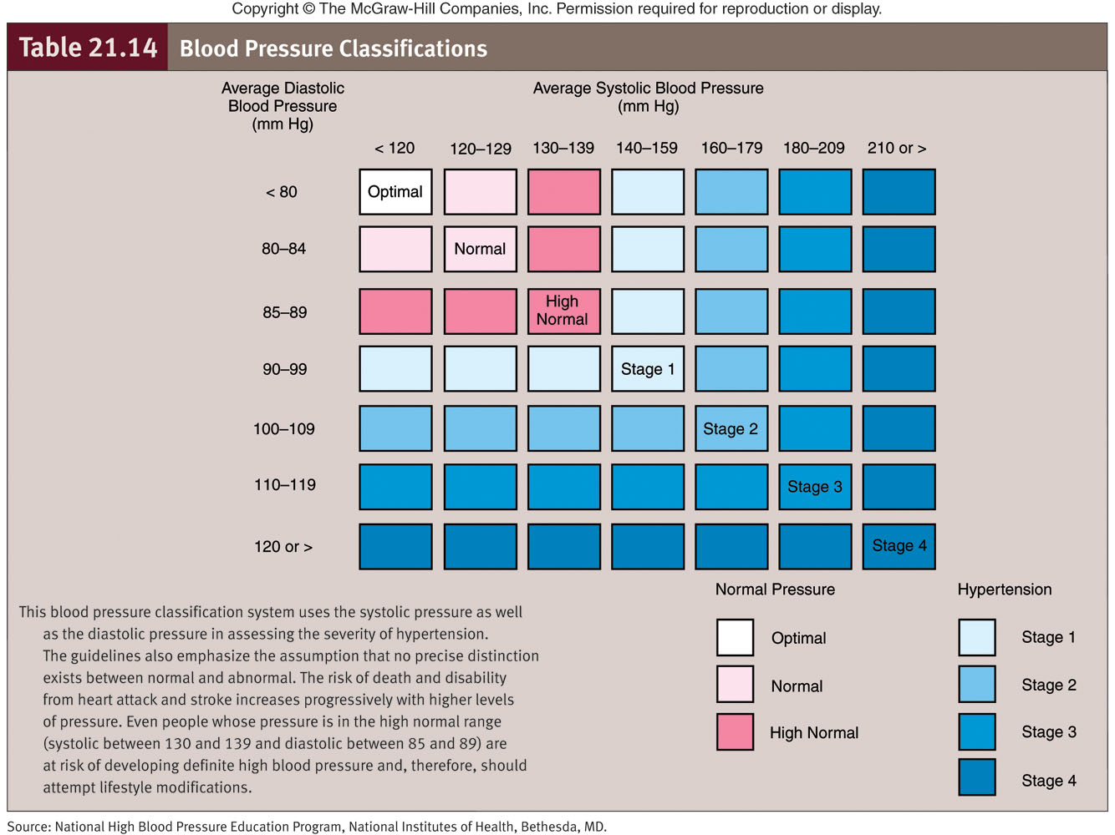

Slide 62
Hypertension
In only a small fraction of cases (only 10% of cases) the cause of arteriolar constriction is known.
Hypertension that occurs secondary to another primary problem is called secondary hypertension.
The underlying cause is unknown in the remaining 90% of hypertension cases. Such hypertension is known as primary (essential or idiopathic) hypertension.

Slide 63
Secondary hypertension
Causes:
1- renal diseases account for over 80% of the case of secondary hypertension.
2- Endocrine causes:
- Conn’s syndrome.
- Adrenal hyperplasia.
- Phaeochromocytoma.
- Cushing’s syndrome.
- Acromegaly.
3. Coarctation of the aorta.
4. Drugs.
5. Pregnancy.

Slide 64
What are the complications of hypertension?

Slide 65
Intended learning outcomes (ILOs)
After reviewing the PowerPoint presentation and the associated learning resources, the student should be able to:
Describe systemic and pulmonary vascular resistances and explain physiological significance of arterial blood pressure in overcoming the vascular resistance.
Compare and contrast measurement of arterial blood pressure in systemic and pulmonary circulations and state normative data for pulmonary and systemic circulations.
Describe physiological variation in arterial blood pressure.
Explain the effect of gravity on arterial blood pressure.
Define mean arterial blood pressure and describe how it is calculated.
Define pulse pressure and state how it is affected in aortic stenosis, aortic regurgitation and arteriosclerosis.
List factors which determine arterial blood pressure and explain how they influence arterial blood pressure.
Outline synthesis of NO and state its physiological significance.
Explain the physiological importance of regulating arterial blood pressure.
Discuss short-, intermediate- and long-term regulation of blood pressure; nervous, hormonal and renal regulation of arterial blood pressure.
Define systemic hypertension and state its complications.

Slide 66
Thank You

