Slide 1
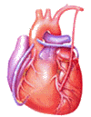
Cardiovascular Block Physiology Shock

Slide 2
Intended learning outcomes (ILOs)
After reviewing the PowerPoint presentation and the associated learning resources, the student should be able to:
Define shock and state the pathophysiological classification of shock.
Describe the pathways leading to shock and decreased tissue perfusion.
Discuss the stages of a hypovolemic shock.
Explain how stage III hypovolemic shock might result in major organs failure.
Discuss the different compensatory mechanisms during a hypovolemic shock.
Describe the positive feedback mechanisms in the irreversible stage of a hypovolemic shock.

Slide 3
Learning Resources
Guyton and Hall, Textbook of Medical Physiology; 12th Edition, Unit IV- Chapters 22 and 24.
Linda Costanzo, Physiology, 5th Edition; Chapter 4.
Ganong’s Review of Medical Physiology; 25th Edition; Section V; Chapter 30.

Slide 4
Definition of shock
Shock may be defined as a pathophysiological state in which there is widespread, serious reduction of tissue perfusion, which if prolonged, leads to generalized impairment of cellular function.
Reduction of tissue perfusion → decreased availability of oxygen and nutrients → cellular hypoxia and energy deficit → generalized impairment of cellular function → cell death → organ failure → whole body failure → death.

Slide 5
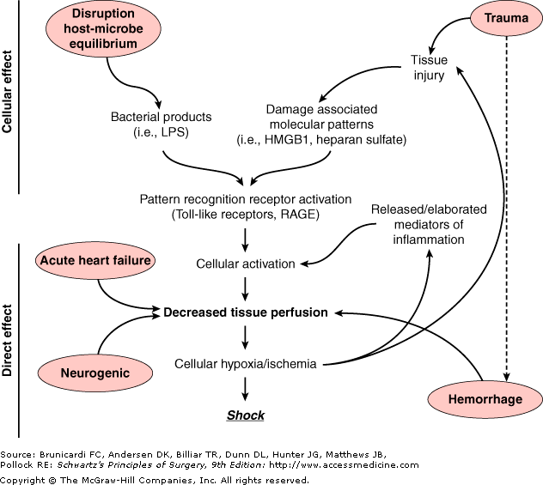
Decreased tissue perfusion can result from hemorrhage / hypovolemic, cardiac failure, or neurologic injury.
Decreased tissue perfusion and cellular injury can then result in immune and inflammatory responses.
Alternatively, elaboration of microbial products during infection or release of endogenous cellular products from tissue injury → cellular activation → influences tissue perfusion and the development of shock.
Pathways leading to decreased tissue perfusion and shock
Endotoxins
endogenous cellular products from tissue injury
Activation of receptors

Slide 6
What drives the blood
along the blood vessels
after it has left the heart?

Slide 7
Systemic hypotension
NORMAL BP: 120/80
LOW BP < 90/60
Arterial pressure = cardiac output x systemic vascular resistance
Reduction in either component (cardiac output or vascular resistance) without a compensatory elevation of the other will result in hypotension.
DIASTOLE
80 mmHg
120 mmHg
Diastolic BP
Systolic BP
SYSTOLE
Mean systemic arterial BP ~ 93 mmHg

Slide 8
Causes and classification of shock
TYPE | CAUSES | SYMPTOMS AND SIGNS
Hypovolemic shock | Bleeding (internal/external), dehydration (sever voming, sever diarrhea), plasma loss (as in burns) → low blood volume → decreased cardiac output → hypotension | hypotension; weak but rapid pulse; cool, clammy skin; rapid, shallow breathing; anxiety, altered mental state
Cardiogenic shock | Heart problems (e.g., myocardial infarction, heart failure; cardiac dysrhythmias) → decreased contractility → decrease in stroke volume → decreased cardiac output → hypotension | as for hypovolaemic shock + distended jugular veins & may be absent pulse
Obstructive shock | Circulatory obstruction (e.g., constrictive pericarditis, cardiac tamponade, tension pneumothorax, pulmonary embolism → reduced blood flow to lungs → decreased cardiac output → hypotension | as for hypovolaemic shock + distended jugular veins & pulsus paradoxus (in cardiac tamponade).
Distributive shock Vasogenic, Low-resistance shock | Septic shock: infection → release of bacterial toxins → activation of NOS in macrophages → production of NO → vasodilation → decreased vascular resistance→ hypotension Anaphylatic shock: allergy (release of histamine → vasodilation → decreased vascular resistance→ hypotension Neurogenic shock: spinal injury → loss of autonomic and motor reflexes → reduction of peripheral vasomotor tone → vasodilation → decrease in peripheral vascular resistance → hypotension | Septic shock: hypotension; fever; warm, sweaty skin Anaphylatic shock: skin eruptions; breathlessness, coughing; localized edema; weak, rapid pulse Neurogenic shock: as for hypovolemic except warm, dry skin

Slide 9
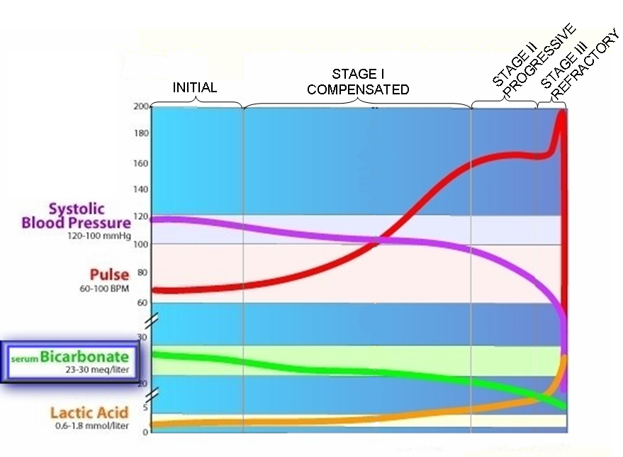
Stages of shock - General

Slide 10
Stages of hypovolemic shock

Slide 11
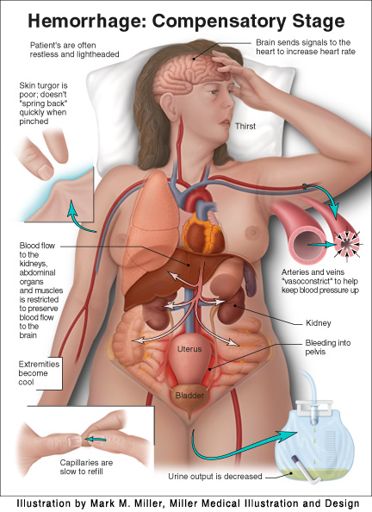
Stages of hypovolemic shock
STAGE I COMPENSATORY STAGE
10-15% blood loss In healthy individuals, acute blood loss of 10 – 15 % of the normal blood volume (e.g., blood donation) results in activation of the sympathetic nervous system. Compensation is achieved acutely by: Increase in heart rate. Constriction of the arterioles. Thus, cardiac output is normal or slightly reduced especially when the patient assumes the erect position. Symptoms and signs: Arterial pressure is maintained; pressure decline when the patient assumes the erect position Increase in heart rate Paleness Anxiety See opposite figure.

Slide 12
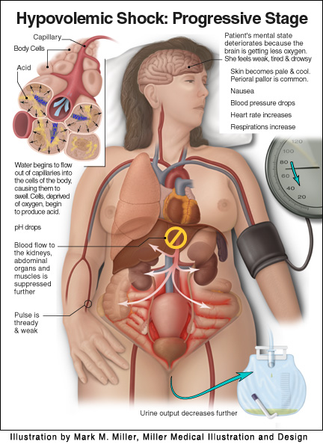
Stages of hypovolemic shock
STAGE II; PROGRESSIVE STAGE (maximal mobilization of compensatory mechanisms)
20 – 40% blood loss When 20-40% of blood volume are lost, cardiac output cannot be maintained and falls markedly, even in the recumbent position. Accordingly, there will be massive activation of the sympathetic nervous system. This results in: → intense arteriolar constriction in the vascular beds of the kidney, gut, and skin → redistribution of blood flow (i.e., centralization of blood flow) with larger fractions going to the vital organs (heart and brain) and smaller fractions going to the kidney, gut, and skin. Despite intense arteriolar constriction, systolic arterial BP declines by 10 to 20 mm Hg. → generalized venoconstriction (increasing blood volume in the central circulation and tending to sustain venous return) Fluid also moves from the interstitial to the intravascular compartment (i.e., reabsorption of tissue fluids).

Slide 13
Stages of hypovolemic shock
STAGE II PROGRESSIVE STAGE, continued
Symptoms, signs, and complications Systolic arterial blood pressure declines by 10-20 mm Hg Tachycardia (heart rate increases and pulse is thready and weak) Skin is pale and cool (peripheral pallor is common) Deterioration of the mental state because the brain is getting less oxygen. Patient looks weak, tired and drowsy. Patient may show anxiety, aggressiveness, and restlessness. Thirst. Oliguria (urine output is decreased). Angina may occur in patients who have intrinsic coronary vascular disease. pH drops and metabolic acidosis develops due to increased anaerobic glycolysis.

Slide 14
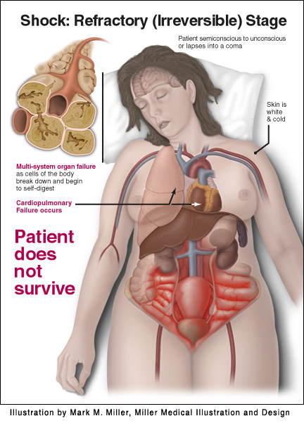
Stages of hypovolemic shock
STAGE III; REFRACTORY STAGE Irreversible stage Decompensated stage
> 40% blood loss The compensatory mechanisms are maximally mobilized in stage II. Thus, small additional losses of blood (>40 %) can result in life-threatening reductions in cardiac output, blood pressure, and tissue perfusion. Blood flow to heart, brain and kidney is further reduced → severe ischemia and irreversible tissue damage → this may result in impaired organ function and death. The severe vasoconstriction may itself become a complicating factor and initiate a vicious cycle (see later). Thus, stage III is complicated by major organs failure.

Slide 15
Stages of hypovolemic shock
STAGE III REFRACTORY STAGE, continued
> 40% blood loss The factors that determine the ultimate outcome include: Duration of stage III. Severity of tissue anoxia. Age and condition of the patient.

Slide 16
Compensatory mechanisms during hypovolemic shock
Cardiovascular.
Respiratory.
Endocrine.
Renal.
Others.

Slide 17
Cardiovascular and respiratory compensatory mechanisms during hypovolemic shock
These compensatory reactions are rapid and act within seconds to minutes

Slide 18
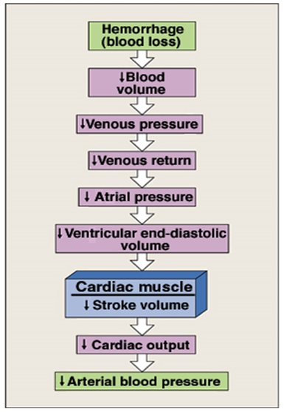
Compensatory mechanisms during hypovolemic shock
I. Arterial baroreceptor reflex

Slide 19
Compensatory mechanisms during hypovolemic shock
I. Arterial baroreceptor reflex
Reduction in arterial MAP during hemorrhage decreases the
stimulation of the baroreceptors in the carotid sinuses and aortic arch
↓ Parasympathetic
(vagal) activity
↑ Sympathetic
activity and activation of adrenal medulla
↑ HR
↑ SV
↑ TPR
↑ MAP
Flow to the heart and brain is maintained; reductions in flow to other organs.

Slide 20
Compensatory mechanisms during hypovolemic shock
II. Arterial chemoreceptor reflex
Reductions in mean arterial blood pressure (MAP) below 60 mmHg do not evoke any additional responses through the baroreceptor reflex.
However, low MAP indirectly stimulates peripheral chemoreceptors (aortic bodies, carotid bodies, heart) that sense changes in pO2, pCO2, and pH through tissue hypoxia and lactacidosis.
This results in:
Enhancement of the existing tachycardia and vasoconstriction
Respiratory stimulation → tachypnea

Slide 21
Compensatory mechanisms during hypovolemic shock
Arterial baroreceptor and chemoreceptor reflexes
Vasoconstriction (arteriolar constriction): this increases TPR and hence MAP. It is produced by:
Baroreceptor reflex.
Chemoreceptor reflex.
Noreadrenaline-adrenaline vasoconstrictor mechanism (due to activation of adrenal medulla).
Vasoconstriction is also produced by vasopressin-vasoconstrictor mechanism (in subsequent slides).
Vasoconstriction is marked in:
Skin: cold, pale.
kidneys: drop in GFR & urine volume.
Viscera.
Flow to the heart and brain is maintained; reductions in flow to other organs.

Slide 22
Compensatory mechanisms during hypovolemic shock
Arterial baroreceptor and chemoreceptor reflexes
Venoconstriction: It is produced by:
Baroreceptor reflex.
Chemoreceptor reflex.
Noreadrenaline-adrenaline vasoconstrictor mechanism (due to activation of adrenal medulla).
Venoconstriction is also produced by vasopressin.
Venoconstriction is important in:
Shifting blood from the venous reservoir into the circulation.
Maintaining filling pressure of the heart.

Slide 23
Compensatory mechanisms during hypovolemic shock
Arterial baroreceptor and chemoreceptor reflexes
Tachycardia: produced by:
Baroreceptor reflex.
Chemoreceptor reflex.
Increased sympathetic activity.
Tachypnea: caused by activation of chemoreceptor reflex and sympathetic over activity.
Importance:
Increase O₂ delivery.
Increase thoracic pump activity→ help venous return.
The increased sympathetic activity also causes restlessness → ↑ skeletal muscle activity → help venous return.

Slide 24
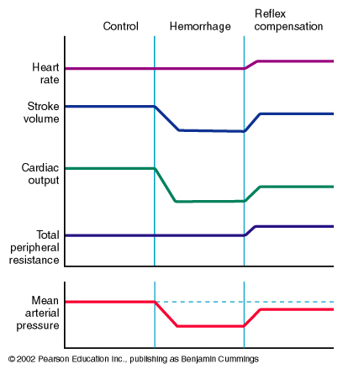
Compensatory mechanisms during hypovolemic shock
Arterial baroreceptor reflex
Control
Haemorrhage
Reflex
Compensation
Heart rate
Stroke volume
↓ EDV
Cardiac output
Total peripheral resistance
Mean arterial blood pressure
↓ CO

Slide 25
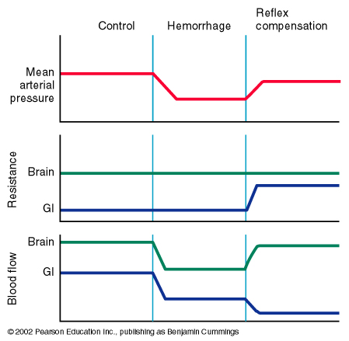
Compensatory mechanisms during hypovolemic shock
Arterial baroreceptor reflex
Control
Haemorrhage
Reflex
Compensation
Mean arterial blood pressure
Brain
Resistance
Gut
Brain
Blood Flow
Gut
This can
Become problematic.
Flow to the heart and brain is maintained; reductions in flow to other organs.

Slide 26
Endocrine and renal
compensatory mechanisms during hypovolemic shock
These compensatory reactions are activated:
Within hours
From hours to days

Slide 27
Compensatory mechanisms during hypovolaemic shock
Endocrine and renal compensatory mechanisms
Release of hormones that initiate vasoconstriction.
Renal conservation of salt and water.
Stimulation of hematopoeisis by erythropoietin.

Slide 28
Compensatory mechanisms during hypovolaemic shock
Endocrine and renal compensatory mechanisms
Endocrine and renal compensatory mechanisms
↑ Circulating vasoconstrictors | Stimulation of sympathetic nervous system → release of epinephrine, norepinephrine from the adrenal medulla (sympatho-adrenal axis) . Epinephrin is released almost exclusively from adrenal medulla where as norepinephrin is released from adrenal medulla and sympathetic nerve endings. → Vasoconstriction.
 | ADH is actively secreted by the posterior pituitary gland in response to hemorrhage. Thus, hemorrhage → stimulates posterior pituitary → synthesis and release of vasopressin (ADH). ADH is potent vasoconstrictor. It also stimulates reabsorption of water.
 | ↓ renal perfusion → secretion of renin from juxtaglomerular apparatus → generates angiotensin II → Angiotensin II is a powerful vasoconstrictor

Slide 29
Compensatory mechanisms during hypovolaemic shock
Endocrine and renal compensatory mechanisms
Endocrine and renal compensatory mechanisms
↑ secretion of glucocorticoids by adrenal cortex | This helps to maintain blood glucose
Stimulation of hematopoiesis | ↓ blood volume & hypoxia → synthesis of erythropoeitin (EPO) → hematopoiesis.

Slide 30
Compensatory mechanisms during hypovolaemic shock
Endocrine and renal compensatory mechanisms
Endocrine and renal compensatory mechanisms
Renal conservation of salt and water | Vasopressin → ↑ water reabsorption → ↑ blood volume → ↑ arterial pressure. Angiotensin II → release of aldosterone → ↑ salt reabsorption → ↑ blood volume → ↑ arterial pressure. ↓ arterial pressure in kidney → ↓ decreases glomerular filtration rates and thereby decreases the excretion of water and electrolytes directly

Slide 31
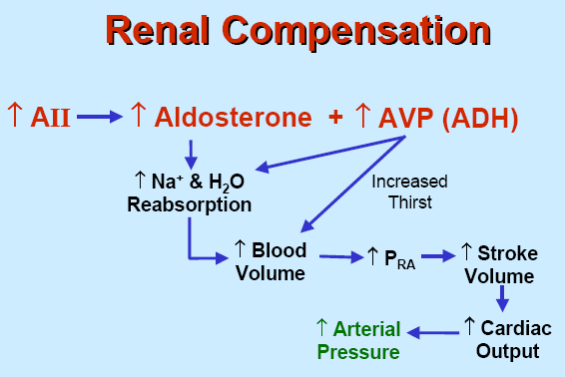
Compensatory mechanisms during hypovolaemic shock
Endocrine and renal compensatory mechanisms

Slide 32
Other compensatory mechanisms during hypovolemic shock
These compensatory reactions are activated:
Within hours
From hours to days

Slide 33
Other compensatory mechanisms during hypovolemic shock
Responses activated within hours:
Increased movement of interstitial fluid into capillaries (capillary fluid shift).
Increased 2,3 DPG concentration in RBCs: This is important to help Hb deliver more O₂ to the tissues (shift O₂ dissociation curve to the right).
Responses activated within hours-days:
Restoration of circulatory plasma volume. This takes 12-72 hrs after moderate hemorrhage.
Restoration of plasma proteins: this occurs in 2 stages:
Rapid entry of preformed albumin from extracellular stores.
Hepatic synthesis of proteins over 3-4 days.
Restoration of RBCs: this occurs in 2 stages:
Increase RBCs count in response to erythropoietin within 10 days.
Restoration of red cell mass within 4-8 weeks.

Slide 34
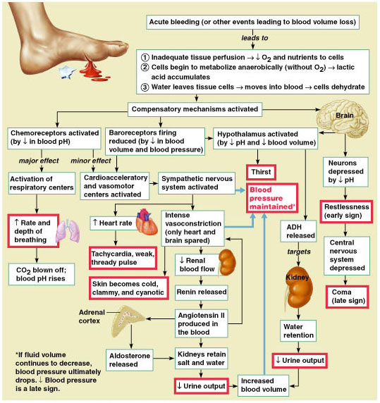
Summary of compensatory mechanisms in hypovolemic shock

Slide 35
Irreversible stage of hypovolemic shock
In the irreversible stage of hypovolemic shock, a series of positive feed back mechanisms take place leading to further deterioration in cardiac output and MAP and more tissue hypoxia.
This depends on the amount of blood lost. When blood loss is excessive and not immediately replaced, and proper treatment is delayed, this stage is reached and the patient dies.
In this stage, there is also failure of compensatory mechanisms.

Slide 36
Irreversible stage of hypovolemic shock
The severe vasoconstriction may itself become a complicating factor and initiate a vicious cycle.
Impaired coronary perfusion → cardiac ischemia → depression of cardiac function → further lowering of cardiac output.
Reduced blood flow to the vasomoter centers in the medulla depresses the activity of compensatory reflexes.
Prolonged renal ischemia → acute tubular necrosis → may lead to prolonged post-shock renal insufficiency.
Bowel ischemia → breakdown of the mucosal barrier. This may lead to entry of bacteria and toxins into the circulation.

Slide 37
Irreversible stage of hypovolemic shock
In the irreversible stage of hypovolemic shock, a number of positive feedback mechanisms lead to further drop in cardiac output and MAP.
Impaired coronary perfusion → cardiac ischemia → depression of cardiac function → further lowering of cardiac output.
Reduced blood flow to the vasomoter centers in the medulla → vasomotor failure → depression of the activity of compensatory reflexes → depression of cardiac function → further lowering of cardiac output.
Bowel ischemia → breakdown of the mucosal barrier. This may lead to entry of bacteria and toxins into the circulation → depression of cardiac function → further lowering of cardiac output.
Generalized cellular deterioration:
↓ Mitochondrial activity inside the cells →↓ in ATP.
↓ of cellular metabolism, especially glucose →↓ in ATP.
↓ in active transport of Na⁺ and K⁺ across the cell → Na⁺ accumulation inside the cell.
Rupture of many lysosomes.

Slide 38
Intended learning outcomes (ILOs)
After reviewing the PowerPoint presentation and the associated learning resources, the student should be able to:
Define shock and state the pathophysiological classification of shock.
Describe the pathways leading to shock and decreased tissue perfusion.
Discuss the stages of a hypovolemic shock.
Explain how stage III hypovolemic shock might result in major organs failure.
Discuss the different compensatory mechanisms during a hypovolemic shock.
Describe the positive feedback mechanisms in the irreversible stage of a hypovolemic shock.

Slide 39
Thank You

