Slide 1
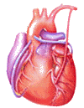

Cardiovascular Block
Physiology
Coronary Circulation

Slide 2
Intended learning outcomes (ILOs)
After reviewing the PowerPoint presentation and the associated learning resources, the student should be able to:
Describe the control of tissue blood flow and state its physiological importance.
Outline the distribution of cardiac output during rest and exercise.
Explain the mechanisms of intrinsic and extrinsic regulation of tissue blood flow.
Summarize the unique features of cardiac metabolism.
Discuss autoregulation and nervous control of coronary blood flow.
List the risk factors for coronary artery disease and outline ECG changes in myocardial ischemia and myocardial infarction.

Slide 3
Learning Resources
Guyton and Hall, Textbook of Medical Physiology; 13th Edition; Unit IV-Chapters 17 and 21.
Linda Costanzo, Physiology, 5th Edition; Chapter 4.
Ganong’s Review of Medical Physiology; 25th Edition; Section V; Chapter 33.

Slide 4
Importance of control of
tissue (local) blood flow
Each tissue receives only a fraction of the total cardiac output.
Each tissue must receive sufficient blood flow for its metabolic needs or necrosis will occur.
Increasing cardiac output increases the work done by the heart to pump blood.
By controlling tissue perfusion so each tissue receives just enough blood, cardiac output and heart work are minimised.

Slide 5
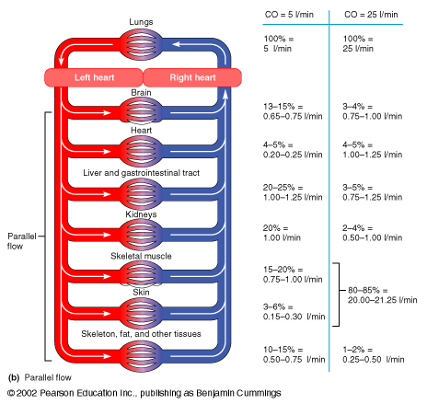
Distribution of cardiac output
during rest and exercise
Rest
(5 L/min)
Exercise
(25 L/min)
Brain
Heart
Liver/Gut
Kidneys
Skeletal Muscle
Skin
Skeleton/Fat
13-15%
4-5%
20-25%
20%
15-20%
3-6%
10-15%
3-4%
4-5%
3-5%
2-4%
80-85%
1-2%

Slide 6
Control of tissue (local) blood flow
Intrinsic regulation of blood flow (autoregulation).
Paracrine regulation of blood flow: paracrine regulators are molecules produced by one tissue and help to regulate another tissue of the same region.
Extrinsic regulation of blood flow: neural and hormonal regulation. Thus, extrinsic regulation of blood flow refers to control by the autonomic nervous system and endocrine system).

Slide 7
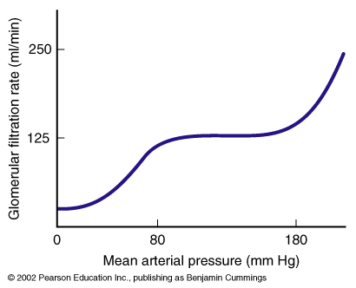
Intrinsic regulation of blood flow; (Autoregulation)
Intrinsic mechanisms of control of tissue blood flow are “built-in” mechanisms within individual organs that provide a localized regulation for vascular resistance and blood flow.
The brain and kidneys in particular, utilize these intrinsic mechanisms to maintain relatively constant flow despite fluctuations in blood pressure.
Two main mechanisms have been suggested to explain acute autoregulation:
  Myogenic mechanisms.
  Local metabolites (metabolic regulation).

Slide 8
I- Myogenic mechanisms or response
This is a direct response of vascular smooth muscle to changes in pressure and can occur in the absence of neural or hormonal influences.
This action is purely myogenic, no mediators required.
This involves stretch sensitive ion channels on the cell membrane.
BP ↑
Flow = ΔP/R
BP ↓
Smooth muscle contracts
Smooth muscle relaxes
Vessels constrict
Vessels dilate
Protects small vessels
from damage
(important in the brain)
Maintain blood flow

Slide 9
II- Metabolic regulation
(Metabolic Mediators)
Reduced blood flow or increased metabolic rate (MR), allows metabolic products to accumulate.
One or more of the accumulated metabolic products acts as a vasodilator.
Vasodilatation increases local blood flow.
Oxygen may act in the opposite manner, i.e. oxygen acts as a vasoconstrictor.
Reduced blood flow or increased metabolism reduces oxygen concentration.
Reduced oxygen concentration inhibits oxygen mediated vasoconstriction.

Slide 10
II- Metabolic regulation
Effects of oxygen
1. Under resting conditions, O₂ delivered to a tissue by blood is matched by removal to the metabolizing tissue (Steady state O₂ delivery to the tissues)

Slide 11
II- Metabolic regulation
Effects of oxygen
tissues
Extracellular fluid
oxygen
blood flow
capillaries
arteriole
2. Increase in metabolic rate
3. O₂ consumption by the tissues increases.

Slide 12
II- Metabolic regulation
Effects of oxygen
tissues
Extracellular fluid
oxygen
blood flow
capillaries
arteriole
4. O₂ levels in the ECF decrease
5. ↓ [O₂] causes vascular smooth muscle to relax: vasodilation

Slide 13
II- Metabolic regulation
Effects of oxygen
tissues
Extracellular fluid
oxygen
blood flow
capillaries
arteriole
6. Increased blood flow
7. Increased O₂ delivery

Slide 14
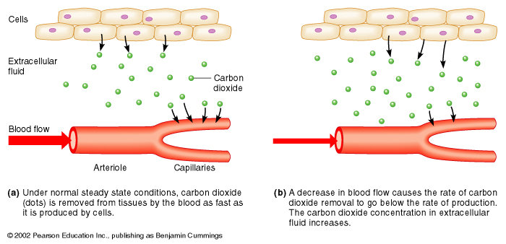
II- Metabolic regulation
Effects of CO₂
Steady State:
CO₂ production = CO₂ removal
Increased MR or ↓ Blood Flow:
CO₂ production > CO₂ removal

Slide 15
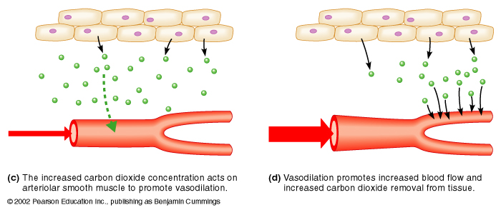
II- Metabolic regulation
Effects of CO₂
↑ [CO₂]: Vasodilation
Increased Blood Flow:
↓ pH; ↑ K⁺; ↑ lactic acid
CO₂ removal increases to
match CO₂ production.
→ vasodilation

Slide 16
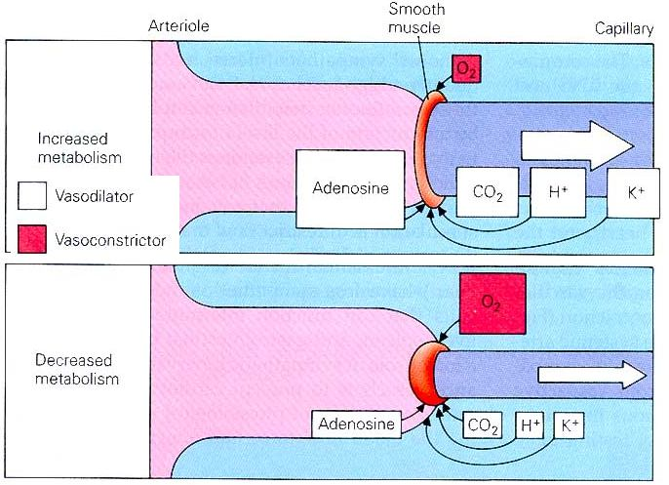
II- Metabolic regulation
Metabolic Mediators

Slide 17
Extrinsic control of tissue blood flow
I - Sympathetic neural control
Most vascular beads are under resting sympathetic constrictor tone.
Increasing the level of sympathetic tone constricts vascular smooth muscle.
Reducing the level of sympathetic tone reduces the level of vascular smooth muscle constriction.
Most sympathetic fibres release noradrenaline that acts on a₁-receptors on the smooth muscle producing contraction.
Thus, stimulation of a₁-receptors by noradrenalin produces vasoconstriction.
The coronary blood vessels and the cerebral vessels in the brain are little altered by sympathetic nerves and are predominantly regulated by local metabolic factors.

Slide 18
Extrinsic control of tissue blood flow
II – Circulating adrenaine
Adrenaline stimulating a₁-receptors contracts vascular smooth muscle.
Blood vessels also contain β₂-receptors which produce vasodilatation when activated.
The blood vessels in most tissues have more a₁-receptors than β₂-receptors so adrenaline (and NA) contracts vascular smooth muscle.
Blood vessels in skeletal muscle have many β₂-receptors so the constrictor actions of adrenaline are minimal.
Blood vessels in the myocardium:

Slide 19
Unique Characteristics of cardiac metabolism
At rest, oxygen consumption by the beating heart is ≈ 9ml/100 g/min. Obviously, more amounts of oxygen are needed during exercise.
Thus, the heart has the largest metabolic demand per gram of any organ in the body.
Energy production in the heart is almost completely dependent on aerobic metabolism.
The heart extracts a very high fraction (60% - 70%) of the O₂ content of the arterial blood flowing through the myocardium even at resting conditions. That is equal to the percentage extracted by skeletal muscles during severe exercise.
Therefore, the heart is characterized by a low venous O₂ reserve.
Thus, the extra O₂ requirements for cardiac work upon stress must be obtained by enhancement of the myocardial blood flow.
In contrast, most other tissues under resting conditions extract only about 25% of the O₂ content of the arterial blood flowing trough them, leaving a considerable O₂ reserve that can be drawn on when a tissue has increased needs.

Slide 20
Unique Characteristics of
cardiac metabolism
O₂ consumption by the heart is determined by:
    Intra-myocardial tension.
    Contractile state of the myocardium.
    Heart rate.
    An increase in afterload causes greater increase in O₂ consumption than an increase in preload does.
    Thus, angina due to deficient delivery of O₂ to the myocardium is more common in aortic stenosis than in aortic regurgitation.

Slide 21
Unique Characteristics of cardiac metabolism
Adequate amounts of chemical fuel, namely adenosine triphosphate (ATP), must be generated to support the contractile demands of the heart and maintain its viability.
Fatty acids, ketone bodies, and carbohydrates are the primary substrates of the heart and are metabolized to generate ATP.
Optimal cardiac function depends on the efficient matching of energy generation pathways to energy expenditure. This balance requires the close communication and regulation of various metabolic pathways.
Fatty acids are the major source of acetyl coenzyme A for the Krebs cycle and for the oxidative production of ATP in the heart.
Glycolysis converts glucose to pyruvate and provides a relatively small amount of ATP to the normal adult heart.

Slide 22
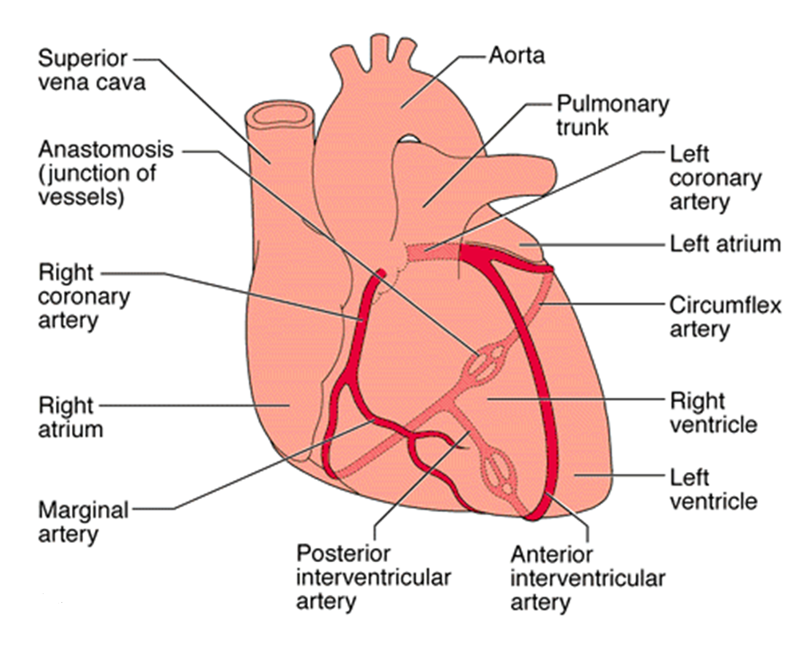
Coronary arteries
The coronary arteries supply blood flow to the heart, and when functioning normally, they ensure adequate oxygenation of the myocardium at all levels of cardiac activity.
  Left main coronary artery divides into left anterior descending artery (anterior interventricular) and circumflex artery.
  Right coronary artery divides into smaller branches, including the right posterior descending artery (posterior interventricular) and the acute marginal artery.

Slide 23
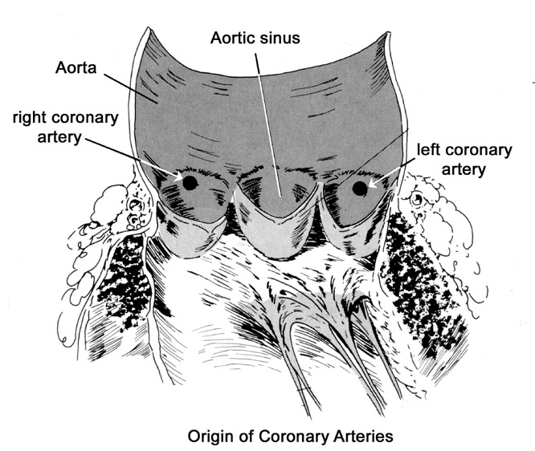
The openings for the coronary arteries are on the aortic side of the aortic valve.
    The openings for the right and left coronary arteries are in different parts of the aortic valve.
Blood flow through the coronary arteries is greatest during diastole, due to recoil of the aorta which pushes blood back against the aortic valve, and hence pushing blood into the coronary arteries.
    In systole, blood is moving forward too rapidly to provide greatest flow. However, the turbulent flow in the ascending aorta pushes some blood back toward valve and into the coronary arteries.
Coronary arteries

Slide 24
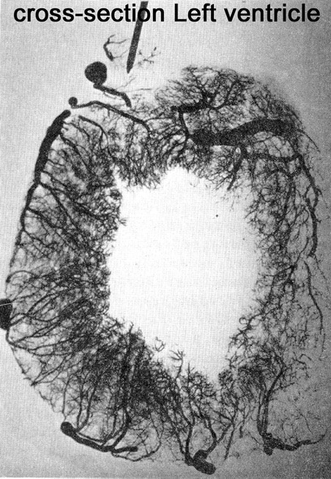
Transmural arteries
The main coronary arteries feed transmural arteries.
Transmural arteries plunge into the muscle of the ventricles.
Transmural arteries supply arterioles, which control flow to capillaries:
  There are ~4000 capillaries/cm² of myocardium.
  Adequate blood supply is important. Inadequate blood supply results in ischemia and myocardial infarction (MI).

Slide 25
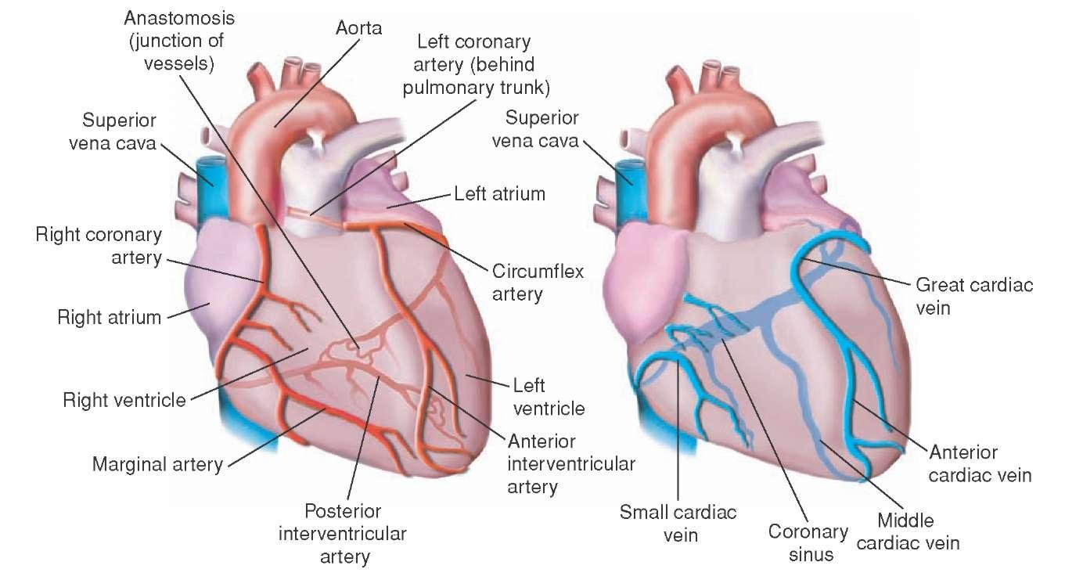
The right coronary artery has a greater flow in 50% of population.
The left has a greater flow in 20%.
Flow is equal in 30%.
Coronary blood flow at rest in humans = 250 ml/min (5% of cardiac output).
Venous blood:
  Most of the venous drainage of the heart returns through the coronary sinus and anterior cardiac veins.
Coronary blood flow

Slide 26
At rest the heart extracts 60-70% of oxygen from the blood delivered to the heart.
Why?
Because:
The heart muscle has more mitochondria (40% the cell volume) that generate energy for cardiac contraction by aerobic metabolism.
When more O₂ is needed as during exercise, coronary blood flow increases.
Coronary blood flow

Slide 27
Control of coronary blood flow
Autoregulation:
    Physical factors
    Myogenic mechanisms
    Metabolic control
Nervous control
NB: Constriction and dilation of the coronary arteries is governed primarily by local regulatory mechanisms. This regulates the amount of blood flow to the myocardium in a manner that matches the amount of oxygen delivered to the myocardium with the myocardial oxygen demand.

Slide 28
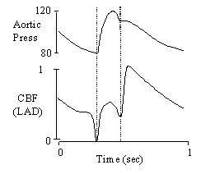
Control of coronary circulation; coronary blood flow
I – Physical Factors
Coronary Perfusion Pressure
Aortic pressure and direction of blood flow influence the perfusion pressure feeding the coronary arteries.
In systole, the aortic pressure is highest but the direction and velocity of blood flow limit the coronary perfusion pressure. Additionally, the turbulent blood flow in the ascending aorta limits the coronary perfusion pressure.
In diastole, the aortic pressure is lower than in systole. However, the perfusion pressure is greatest due to recoil of blood back against aortic valves (origin of coronary arteries).

Slide 29
Control of coronary circulation; coronary blood flow
I – Physical Factors
Phasic pattern of coronary flow; Systolic Crunch (squeeze)
Most coronary blood flow (about 70%) occurs during diastole. Flow is driven by the aortic blood pressure, with the flow declining as the aortic pressure drops.
Only about 30% of coronary blood flow occurs during systole.
Blood supply to the myocardium is substantially reduced during systole (systolic crunch).

Slide 30
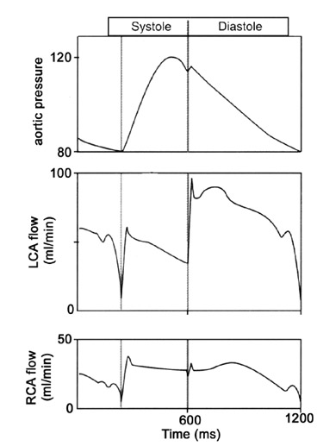
Control of coronary circulation; coronary blood flow
I – Physical Factors
Systolic Crunch
Systolic crunch results is coronary extravascular resistance.
Contraction of the ventricular muscle during systole squeeze the arteries in the muscle, and hence increasing the resistance to flow.
  The contraction is greatest near the endocardial surface. Thus, this region has the greatest “systolic crunch”.
  The greatest resistance to flow is also found in the endocardial region of the heart.
  Thus, the majority of myocardial infarctions begin at the endocardial region of the heart.

Slide 31
Control of coronary circulation; coronary blood flow
I – Physical Factors
Systolic Crunch
Systolic crunch has the biggest effect on the left ventricle, which has more muscle and generates more pressure).
  Flow through the left coronary artery is reduced during systole, whereas there is little noticeable effect on flow in the right coronary artery.

Slide 32
Control of coronary circulation; coronary blood flow
I – Physical Factors
Systolic Crunch
During diastole, the ventricular muscle relaxes.
  The heart normally spends 2/3 time of the cardiac cycle in diastole, so it is able to supply muscle with sufficient blood.
    At greater heart rate, diastole is shortened. At greatest heart rate, there is also increased oxygen demand of the heart. This is coupled with the greater extravascular resistance to blood flow.
    Metabolic regulation acts to compensate to increase blood flow in response to increased oxygen demand.

Slide 33
Control of coronary circulation; coronary blood flow
I – Physical Factors
Reactive hyperemia: Occlusion of flow during systolic “crunch” would produce metabolic wastes, which act to dilate blood vessels and increase blood flow.

Slide 34
Control of coronary circulation; coronary blood flow
I – Physical Factors
Blood flow to the left ventricle is decreased in patients with aortic stenosis.
This is because in aortic stenosis, the left ventricle must generate much higher pressure to overcome the resistance of the stenotic aortic valve, in order to eject blood.
Consequently, coronary vessels are severely compressed during systole.
Thus, these patients are more prone to develop myocardial ischemia.

Slide 35
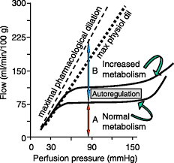
II – Myogenic coronary autoregulation
Coronary blood flow is maintained nearly constant over a range of mean MAP, usually 60 to 140 mm Hg.
Above or below these limits autoregulation fails and coronary blood flow increases or decreases in a linear fashion with corresponding increases or decreases in aortic pressure.

Slide 36
III – Metabolic control
Constriction and dilation of the coronary arteries is governed primarily by local regulatory mechanisms. This regulates the amount of blood flow to the myocardium in a manner that matches the amount of oxygen delivered to the myocardium with the myocardial oxygen demand.
When cardiac work increases, the coronary blood flow is increased and vice versa.
Myocardial oxygen requirement is the single most important factor in determining coronary blood flow.
Coronary vasodilators during increased activity are:
  Local hypoxia.
  Adenosine.
  NO.
  Increased PCO₂.
  Increased H⁺.
  Increased K⁺.
  Prostaglandins.
  Histamine.

Slide 37
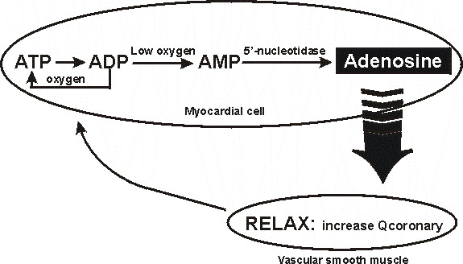
III – Metabolic control
Adenosine Hypothesis
Myocardial cells need oxygen to convert ADP to ATP.
If oxygen is low, ADP isconverted to AMP, which is broken down to Adenosine, which is lipid permeable.
Adenosine acts on receptor in smooth muscle in arteries and arterioles resulting in vasodilatation and increased coronary flow.

Slide 38
IV – Nervous control
Coronary arteries have both α₁- and β₂-adrenergic receptors.
Stimulation of α₁-receptors cause vasoconstriction, while β₂-receptor activation causes vasodilatation.
Experimental direct stimulation of the cardiac sympathetic fibers causes coronary vasoconstriction, due to the presence of more α- than β- adrenergic receptors in the coronaries.
However, during physiologic conditions of enhanced sympathetic activity, the heart rate and contractility are both activated by sympathetic nerve fibers and blood catecholamines on myocardial β₁-adrenergic receptors. The resulting increase in cardiac metabolites induces vasodilatation that overrides the direct constrictor effect of sympathetic fibers to the vascular wall with a net increased Coronary blood flow.
Thus, it is evident that such extrinsic control can be overridden by the local cardiac metabolic state.

Slide 39
IV – Nervous control
In cardiac and skeletal muscle: # β-receptors > # α-receptors
→ Adrenaline promotes vasodilation
In most other tissues: # α-receptors > # β -receptors
→ Adrenaline promotes vasoconstriction
α: vasoconstriction
β: vasodilation

Slide 40
IV – Nervous control
Parasympathetic stimulation of the heart causes modest coronary vasodilation (due to the direct effects of released acetylcholine on the coronaries).
However, if parasympathetic activation of the heart results in a significant decrease in myocardial oxygen demand due to a reduction in heart rate, then intrinsic metabolic mechanisms will increase coronary vascular resistance by constricting the vessels.
  In summary, sympathetic activation to the heart results in coronary vasodilation and increased coronary flow due to increased metabolic activity (increased heart rate, contractility).
  Parasympathetic activation of the heart results in a significant decrease in myocardial oxygen demand due to a reduction in heart rate, and so decreases coronary blood flow.

Slide 41
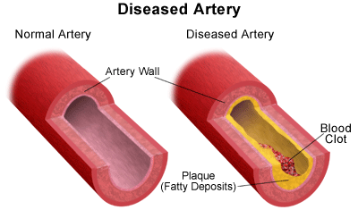
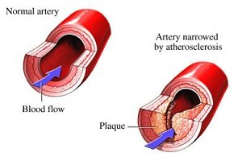
Risk factors for coronary artery disease (CAD)
Conventional risk factors
Older age: Over age 45 years in men and over age 55 years in women
Family history of early heart disease.
Race: Among persons with CAD, the cardiovascular death rate for African Americans is reported to be particularly high.

Slide 42
Risk factors for coronary artery disease (CAD)
Modifiable risk factors
High blood cholesterol levels (specifically, low-density lipoprotein cholesterol [LDL-C])
High blood pressure
Cigarette smoking: Cessation of cigarette smoking constitutes the single most important preventive measure for CAD
Diabetes mellitus
Obesity
Lack of physical activity
Metabolic syndrome
Mental stress and depression

Slide 43
Electrocardiographic changes during
exercise test. Upper trace – significant horizontal ST segment depression during exercise.

Slide 44
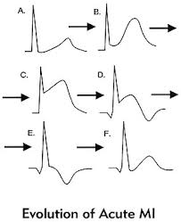
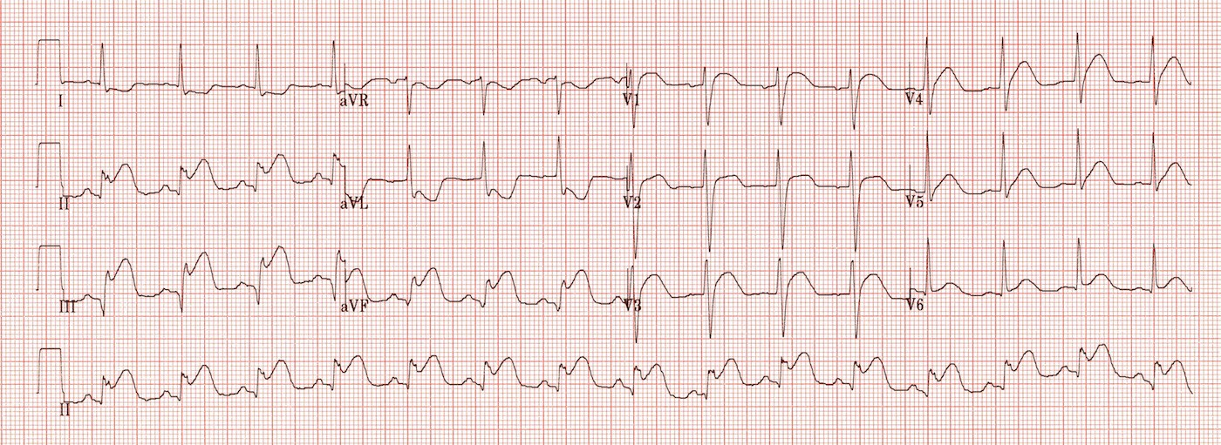
Electrocardiographic changes in inferior MI

Slide 45
Intended learning outcomes (ILOs)
After reviewing the PowerPoint presentation and the associated learning resources, the student should be able to:
Describe the control of tissue blood flow and state its physiological importance.
Outline the distribution of cardiac output during rest and exercise.
Explain the mechanisms of intrinsic and extrinsic regulation of tissue blood flow.
Summarize the unique features of cardiac metabolism.
Discuss autoregulation and nervous control of coronary blood flow.
List the risk factors for coronary artery disease and outline ECG changes in myocardial ischemia and myocardial infarction.

Slide 46
Thank You

