Slide 1
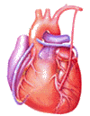
Cardiovascular Block Physiology Cardiac Electric Activity

Slide 2
Intended learning outcomes (ILOs)
After reviewing the PowerPoint presentation and the associated learning resources, the student should be able to:
State and define the main electrical and mechanical properties of the heart.
Explain the genesis of the resting membrane potential in the cardiac muscle cell and identify the ionic currents during the different phases of the fast-response and slow-response action potentials in the cardiac muscle cell.
Discuss pacemaker electrical activity.
Define ectopic pacemaker and explain the mechanisms of ectopic pacemakers.
Summarize the function of the different parts of the conducting system of the heart and describe the sequence of normal conduction in the heart.
Describe the effects of sympathetic and parasympathetic stimulation on the electrophysiological properties of the heart.

Slide 3
Learning Resources
Guyton and Hall, Textbook of Medical Physiology; 13th Edition; Unit III-Chapter 10.
Linda Costanzo, Physiology, 5th Edition; Chapter 4.
Ganong’s Review of Medical Physiology; 25th Edition; Section V; Chapter 29.

Slide 4
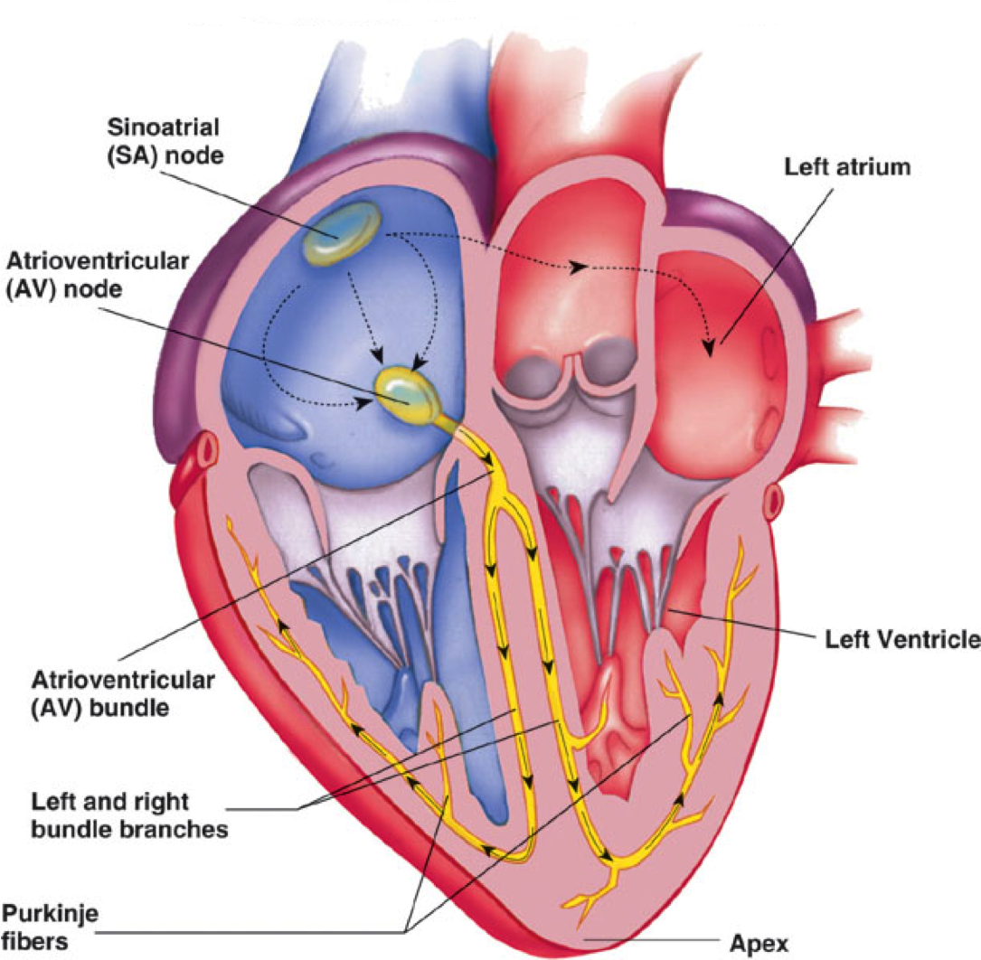
How the heart performs its function as the central pump of the CVS?
The heart has four basic properties which are essential for its functioning as the central pump of the CVS.
Autorhythmicity (automaticity and rhythmicity)
Conductivity
Excitability
These 3 properties are the electrophysiological properties of the heart.
Contractility
Mechanical property of the heart (mechanical response to excitation.
There are 2 main types of cells in the heart:
Cells of the specialized conduction system (non-contractile cardiac cells).
Contractile cells (myocytes; working cells).

Slide 5
Automaticity, rhythmicity and conductivity of the heart
The heart is capable of generating rhythmical electrical impulses (cardiac impulses) independent of any extrinsic stimulation. These impulses are normally generated in the SA node.
The cells of the specialized conduction system of the heart carry cardiac impulses to the myocytes in the atria, and, after a pause, to the myocytes in the ventricles.
The cells of the specialized conduction system are found in:
SA Node
Bachmann’s bundle (interatrial bundle)
Internodal pathways (anterior, middle and posterior)
AV Node
Bundle of His
Left and right bundle branches
Purkinje fibers
The primary difference between the cells of the specialized conduction system and the myocytes is absence of myofibrils; thus, little or no contraction is seen!

Slide 6
Electrophysiological properties of the heart The resting membrane potential; (RMP)
AMP
Voltmeter
To oscilloscope
Cardiac Cell

Slide 7
The resting membrane potential; (RMP)
The intracellular potential of the resting myocyte is found to be –80 mV to –90 mV (i.e., 80 – 90 mV lower than the extra cellular potential). This is called the resting membrane potential (RMP).
In atrial and ventricular cells, this RMP is stable until external stimulation (excitation) is applied.
In the sino-atrial node cells in particular, and many conduction fibers, the RMP is not stable, drifting towards zero with time.
Electrical potentials arise from:
Differences in the concentrations of ions across the membrane.
The presence of selective ion-conducting channels spanning the membrane, namely K⁺, Na⁺, and Ca²⁺.

Slide 8
Characteristics of a resting ventricular myocyte
Extracellular
Intracellular
K⁺
4 mM/L
140 mM/L
Na⁺
140 mM/L
10 mM/L
Ca⁺⁺
1.2 mM/L
0.0001 mM/L
Ion pumps and exchangers establish differences in ions concentration across the cell membrane.

Slide 9
Potassium: generator of the resting membrane potential
IN
OUT
K⁺
K⁺
140 mM
4 mM
Negative intracellular ions mainly organic phosphates and intracellular proteins cannot accompany the K⁺ ions.

Slide 10
Potassium: generator of the resting membrane potential
IN
OUT
_
_
_
_
_
_
_
+
+
+
+
+
+
+
K⁺
K⁺
140 mM
4 mM
Negative intracellular ions mainly organic phosphate and intracellular proteins cannot accompany the K ions.

Slide 11
Potassium equilibrium potential
IN
OUT
_
_
_
_
_
_
_
K⁺
K⁺
140 mM
4 mM

Slide 12
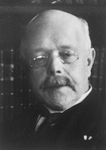
The Nernst equation
Describes the balance of electrical and chemical forces across a cell membrane
Walther Hermann Nernst
Nobel Prize 1920
[X]_{e}
E_{m} = 61.5 log₁₀
Note the subscript ‘e’ is usually replaced by ‘o’.
[X]_{i}

Slide 13
Equilibrium Potentials
Cell Membrane
extracellular intracellular
K⁺ = 4mM K⁺ = 140mM
Na⁺ = 140mM Na⁺ = 10mM
Let the membrane be permeable to K⁺
E_{K} = 61.5 log₁₀ 4
140
= -95 mV
Let the membrane be permeable to Na⁺
E_{Na} = 61.5 log₁₀ 140
10
= +71 mV

Slide 14
RMP is not equal to E_{K} due to background currents
EXTRA-CELL.
INTRA-CELL.
+
+
+
+
+
+
+
_
_
_
_
_
_
_
Na⁺
i_{b}
i_{k}
K⁺

Slide 15
Excitability Action potential and ionic currents in cardiac cells
Excitability is the electrical response to excitation (stimulation).
When an excitable tissue is excited, it responds by generating action potentials.
Cardiac action potentials can be broadly classified into tow types, termed fast-response and slow-response potentials.
Atrial, ventricular and His-Purkinje cells have fast-response action potentials, and sinus node and atrioventricular (AV) node have slow-response action potentials.

Slide 16
Action potentials from different areas of the heart
VENTRICULULAR
CELL
SAN
1
2
0
0
0
3
0
3
-50
-50
4
MEMBRANE POTENTIAL (mV)
4
-100
-100

Slide 17
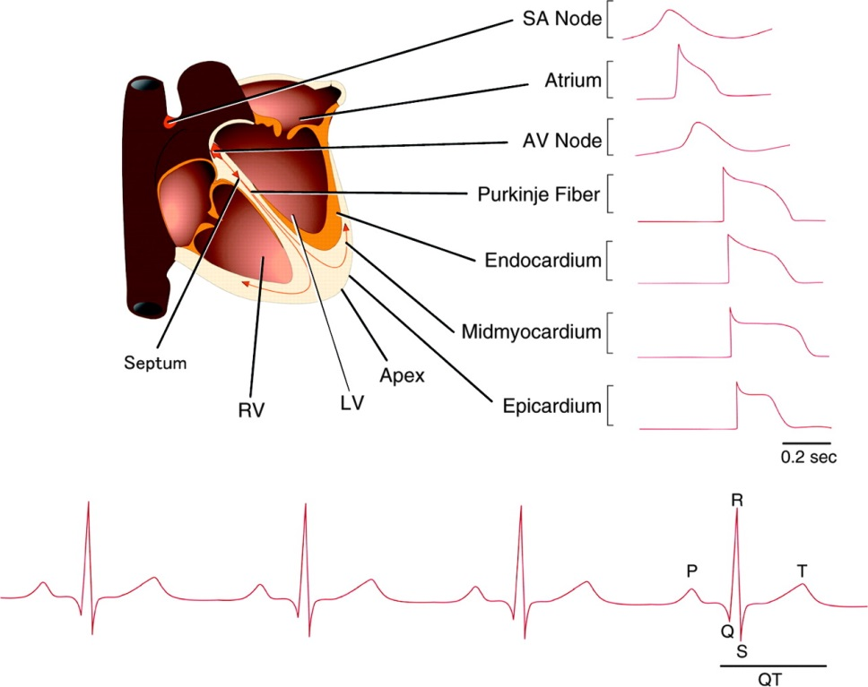
Major differences between fast-response and slow-response action potentials
Resting membrane potential (Phase 4)
In fast-response, voltage is constant
In slow-response, voltage slowly decreases
Phases
In fast-response, all phases of action potential are present
In slow-response, phases 1 & 2 are absent

Slide 18
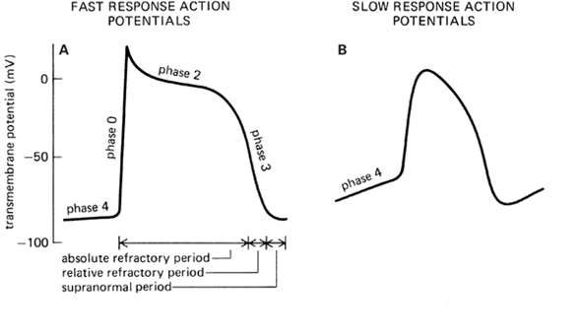
Fast-response and slow-response action potential in cardiac cells
Fast response action potentials are characterized by:
A rapid depolarization (phase 0) with a substantial overshoot (positive inside voltage),
A rapid reversal of the overshoot potential (phase 1),
A long plateau (phase 2), and
A repolarization (phase 3) to
A stable, resting membrane potential (phase 4).
Rapid conduction velocity
Slow response action potentials are characterized by:
A slower initial depolarization phase,
A lower amplitude overshoot,
A repolarization to an unstable, slowly depolarizing "resting" potential
Slow conduction velocity

Slide 19
Fast response action potentials
Mechanical Response
Phase
1
0 = Rapid Depolarization
(inward Na⁺ current)
0
2
1 = Early partial repolarization
2 = Plateau
(inward Ca⁺⁺ current)
0
MEMBRANE POTENTIAL (mV)
3 = Repolarization
(outward K⁺ current)
3
4 = Resting Potential
4
-90
TIME

Slide 20
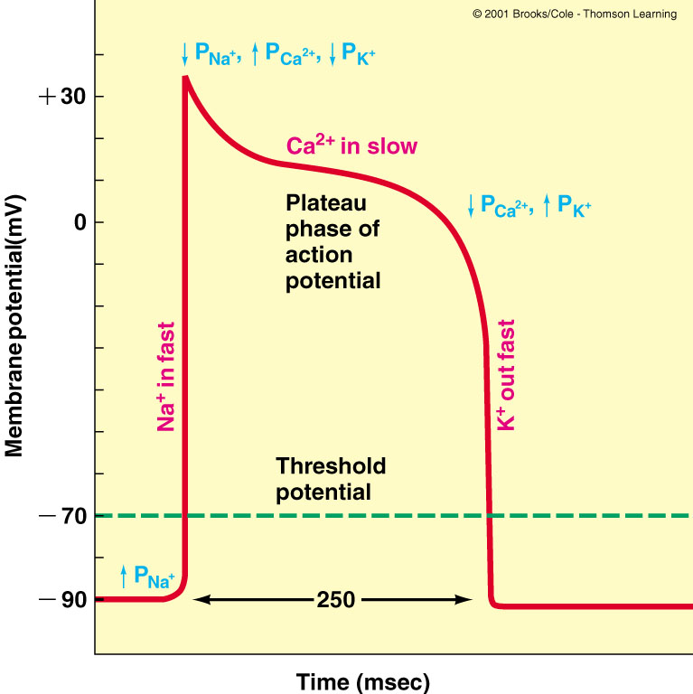
Phase 0 – Very rapid depolarization by Na⁺ influx through voltage-gated (fast) Na⁺ channels.
Phase 1 – Early partial repolariztion
Inactivation of fast (Na⁺) channels
K⁺ begins to moves out of cell
Phase 2 - Plateau
↑ permeability of slow (Ca²⁺) channels
L-type calcium channels
Chemical & electrical forces of K⁺ & Ca²⁺ balanced
K⁺ movement out of cell = Ca²⁺ movement into cell
Catecholamines → ↑ inward current
Ca²⁺ channel blocker drugs → ↓ inward current
Phase 3 - Repolarization
Inactivation of slow (Ca²⁺) channels
↑ conductance of K⁺ out of cell
Polarity of the cell interior becomes more (-)
Phase 4
Resting state ; RMP established
Fast response action potentials

Slide 21
The decay of pacemaker potential with time is caused by:
A small current of Na⁺ flow into the cell. This current may be partly a specialized pace maker current termed i_{f} and partly the inward background current i_{b} (i_{f} and i_{b}).
Membrane permeability to K⁺ gradually falls. As a result the outward background current i_{k} falls progressively allowing the inward currents (i_{f} and i_{b}) to dominate increasingly.
Ca²⁺ current in the later part.
Electrical activity of the pacemaker
Auto-rhythmicity

Slide 22
The decay of pacemaker potential with time is caused by:
K⁺
i_{b}
i_{f}
i_{Ca}
OUT
IN
i_{K}
Na⁺
Ca⁺⁺

Slide 23
Pacemaker potential
intracellular
[Na⁺]_{e} high
[K⁺]_{e} low
[Ca²⁺]_{e} high
[Na⁺]_{i} low
[K⁺]_{i} high
[Ca²⁺]_{i} low
extracellular
fluid

Slide 24
Pacemaker potential
A. ↓ P_{K}; ↑ P_{Na}
A.
Closure of K⁺ channels.
Opening of “funny”
channels (Na⁺)
intracellular
[Na⁺]_{e} high
[K⁺]_{e} low
[Ca²⁺]_{e} high
[Na⁺]_{i} low
[K⁺]_{i} high
[Ca²⁺]_{i} low
Na⁺
K⁺
extracellular
fluid

Slide 25
Pacemaker potential
A. ↓ P_{K}; ↑ P_{Na}
A.
B.
Closure of K⁺ channels.
Opening of “funny”
channels
B. ↑ P_{Ca}
Opening of voltage-
gated Ca⁺⁺ channels
(T-type channels)
Closure of funny channels
T channel
Ca⁺
K⁺
Na⁺

Slide 26
Pacemaker potential
A. ↓ P_{K}; ↑ P_{Na}
A.
B.
C.
Closure of K⁺ channels.
Opening of “funny”
channels
B. ↑ P_{Ca}
Opening of voltage-
gated Ca⁺⁺ channels
(T-type channels)
Closure of funny channels
T channel
C. ↑↑ P_{Ca}
Ca⁺
Opening of voltage-
gated Ca⁺⁺ channels
(L-type channels)
K⁺
Na⁺
Closure of T- type Ca⁺⁺ channels
Ca⁺
L channel

Slide 27
Pacemaker potential
A. ↓ P_{K}; ↑ P_{Na}
Closure of K⁺ channels.
Opening of “funny”
channels
A.
B.
C.
D.
B. ↑ P_{Ca}
Opening of voltage-
gated Ca⁺⁺ channels
(T-type channels)
Closure of funny
channels
D. ↑ P_{K;} ↓ P_{Ca}
Opening of voltage-
gated K⁺ channels
Closure of voltage-
dependent Ca⁺⁺
channels (L-type)
Ca⁺
C. ↑↑ P_{Ca}
Opening of voltage-
gated Ca⁺⁺ channels
(L-type channels)
K⁺
Na⁺
Closure of T- type Ca⁺⁺
channels
Ca⁺

Slide 28
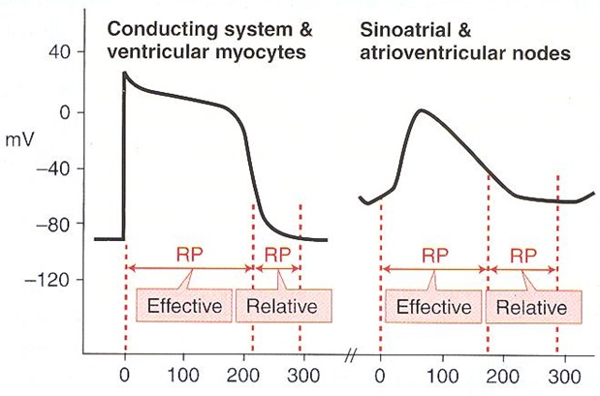
Refractory periods
Effective refractory period (ERP):
The cell is unable to be depolarized
Phase 0 to portion of Phase 3
Relative refractory period (RRP)
Follows ERP
Depolarization possible with supra-normal stimulus
Phase 3 to Phase 4
???

Slide 29
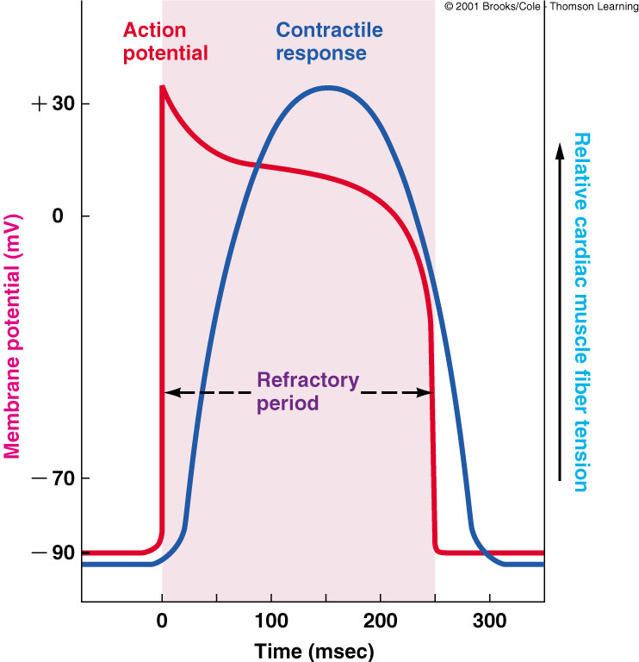
Refractory periods
Importance of the long plateau
Cardiac muscle cannot be tetanized because the duration of the effective refractory period is approximately equal to the duration of the mechanical event.

Slide 30
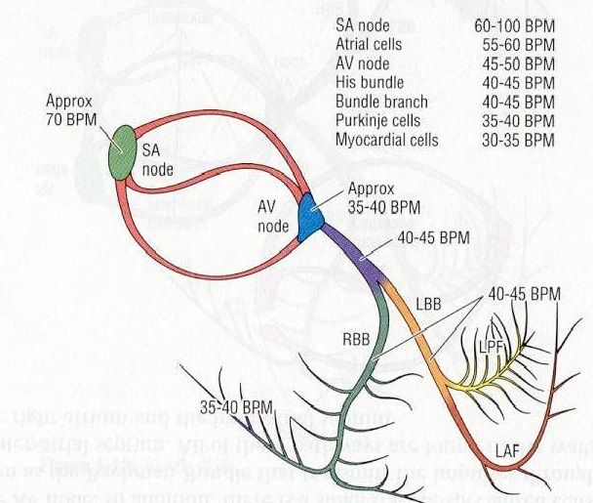
All slow response tissues have the ability to auto-activate (automaticity).
Normally, the SA node is the pacemaker of the heart:
Highest order of rhythmicity (its rate of rhythmic discharge is greater than any other part in the heart).
The action potential is characterized by diastolic depolarization
Slow depolarization of Phase 4.
The fastest pacemaker normally drives the heart and suppresses other pacemakers (overdrive suppression).
A beat generated outside the normal pacemaker is an ectopic beat.
The site that generates an ectopic beat is known as an ectopic focus (foci pl.) or ectopic pacemaker.
Pacemakers
(in order of their inherent rhythm)

Slide 31
Abnormal pacemakers; ectopic pacemakers
An ectopic pacemaker is a pacemaker elsewhere than the SA node.
This may develop if :
Any other part of the heart develops a rhythmical discharge rate which is more rapid than that of the SA node; for example: the AV node or in the Purkinje fibers.
Or if there is a:
Blockage of transmission of the cardiac impulse from the SA node to the other parts of the heart as in AV block.
→ cardiac impulses fails to pass from atria into the ventricles.
→ the atria continue to beat with the SA node as their pacemaker.
→ a new pacemaker develops in the Purkinje system with a new rate in the ventricles.

Slide 32
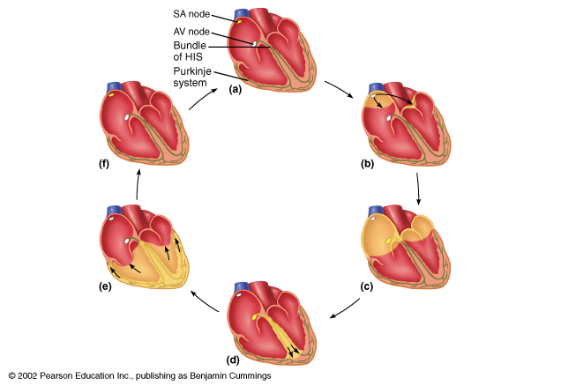
Normal conduction of the action potential in the heart
Conductivity
a. AP is generated in the SA node

Slide 33
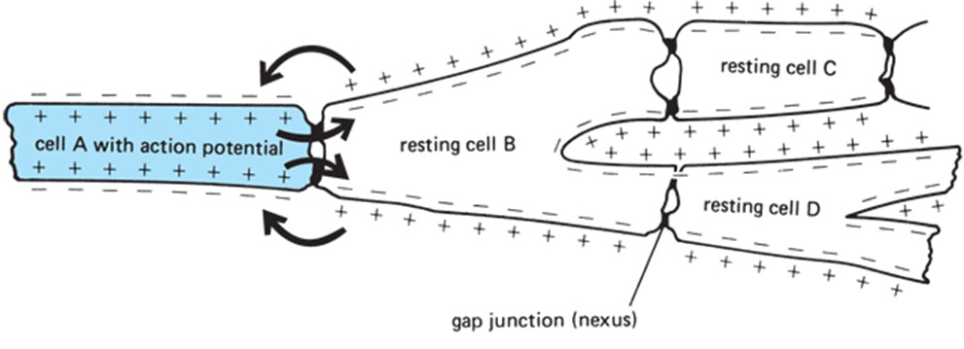
Conduction of the action potential in the heart
(Cell to cell conduction of action potential)

Slide 34
1. AP is initiated in the SA node
2. AP is conducted through the atria.
Very rapid.
Large cells

Slide 35
1. AP is initiated in the SA node
2. AP is conducted through the atria.
Very rapid.
Large cells
The atria contract about one sixth of a second ahead of ventricular contraction
Why?
To allow filling of the ventricles before they pump the blood into the circulation

Slide 36
1. AP is generated in the SA node
2. AP is conducted through the atria.
Very rapid.
Large cells.
b. AP are
conducted
throughout
the atria
very rapid
large cells
Fibrous septum
3. Conduction slows at the AV node and delayed for 0.1 – 0.15 seconds.
- Small cells.
- Effects of sympathetic and parasympathetic stimulation on AV nodal conductivity.
SA node versus AV node
(frequency and refractory period)

Slide 37
1. AP is generated in the SA node
2. AP is conducted through the atria.
Very rapid.
Large cells.
b. AP are
conducted
throughout
the atria
very rapid
large cells
Fibrous septum
3. Conduction slows at the AV node and delayed for 0.1 – 0.15 seconds.
Why?
To allow time for the atria to empty the blood into the ventricles before ventricular contraction begin
SA node versus AV node
(frequency and refractory period)

Slide 38
1. AP is generated in the SA node
2. AP is conducted through the atria.
Very rapid.
Large cells.
b. AP are
conducted
throughout
the atria
very rapid
large cells
Fibrous septum
3. Conduction slows at the AV node.
-Small cells.
4. AP travels rapidly through the bundle of His and bundle branches
SA node versus AV node
(frequency and refractory period)

Slide 39
1. AP is generated in the SA node
2. AP is conducted through the atria.
Very rapid.
Large cells.
b. AP are
conducted
throughout
the atria
very rapid
large cells
5. Ventricular cells are electrically coupled through gap junctions.
Depolarization begins in Interventricular septum
Spreads to right and left endocardial surfaces
Spreads from endocardium to epicardium
Contraction (apex to top)
Fibrous septum
3. Conduction slows at the AV node.
-Small cells.
4. AP travels rapidly through the bundle of His and bundle branches
SA node versus AV node
(frequency and refractory period)

Slide 40
1. AP is generated in the SA node
2. AP is conducted through the atria.
Very rapid.
Large cells.
6. Rest
b. AP are
conducted
throughout
the atria
very rapid
large cells
5. AP spreads through the ventricles (bottom to top)
Contraction (apex to top)
Fibrous septum
3. Conduction slows at the AV node.
-Small cells.
4. AP travels rapidly through the bundle of His and bundle branches
SA node versus AV node
(frequency and refractory period)

Slide 41
Conduction velocity (CV) in heart
CV depends on current spread, hence, depends on the diameter and the number of gap junctions between cells (larger diameter, more gap junctions → faster conduction).
Purkinje fibers: have very large diameter and more gap junctions with high permeability.
AV node and bundle (Bundle of His): have small diameter and few gap junctions.
Approximate CV:
SA node 0.05 m/sec
Atria 0.3m/sec (internodal pathway 1.0m/sec)
AV node 0.05m/sec
Bundle of His: 1 m/sec
Purkinje system: 4 m/sec
Ventricular muscle: 1 m/sec
The high conduction velocity of Purkinje fibers ensure that the ventricular myocytes contract at almost the same time.

Slide 42
Effects of sympathetic and parasympathetic stimulation on the electrophysiological properties of the heart
The heart is supplied with both sympathetic and parasympathetic nerves.
Parasympathetic nerves (vagi): mainly to the SA and AV nodes.
Sympathetic nerves: to all parts of the heart with strong supply to the ventricles.

Slide 43
Effects of sympathetic stimulation on the electrophysiological properties of the heart
↑ rate of rhythmical discharge of impulses from the SA node.
↑ conduction of impulses through the AV node.
In addition, sympathetic stimulation:
↑ force of contraction

Slide 44
Effects of parasympathetic stimulation on the electrophysiological properties of the heart
↓ rate of rhythmical discharge of impulses from the SA node.
↓ conduction of impulses through the AV node.
Strong stimulation of the vagi:
Stops completely the rhythmical discharge of cardiac impulses from the SA node.
Blocks completely the conduction of cardiac impulses from the atria to the ventricles.
A part of the Purkinje fibers develops a rhythmic activity of its own and the ventricles begin to beat according to its rhythm. This phenomenon is known as: “Ventricular Escape”.

Slide 45
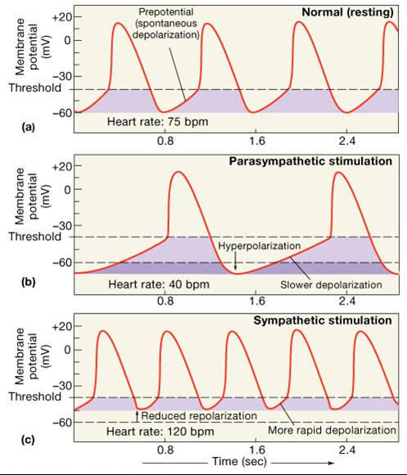

Slide 46
Intended learning outcomes (ILOs)
After reviewing the PowerPoint presentation and the associated learning resources, the student should be able to:
State and define the main electrical and mechanical properties of the heart.
Explain the genesis of the resting membrane potential in the cardiac muscle cell and identify the ionic currents during the different phases of the fast-response and slow-response action potentials in the cardiac muscle cell.
Discuss pacemaker electrical activity.
Define ectopic pacemaker and explain the mechanisms of ectopic pacemakers.
Summarize the function of the different parts of the conducting system of the heart and describe the sequence of normal conduction in the heart.
Describe the effects of sympathetic and parasympathetic stimulation on the electrophysiological properties of the heart.

Slide 47
Thank You

