Slide 1
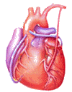

Cardiovascular Block
Physiology
The Electrocardiogram (ECG)

Slide 2
Intended learning outcomes (ILOs)
After reviewing the PowerPoint presentation and the associated learning resources, the student should be able to:
Describe the procedure for recording an electrocardiogram (ECG).
Identify the ECG recording points.
Classify ECG leads and compare and contrast unipolar and bipolar ECG leads.
State Einthoven’s law and describe its physiological significance.
Explain the electrophysiological bases and give normal values of the voltage and duration of the ECG waves, intervals and segments.
Define and interpret normal sinus rhythm and depict the causes of abnormal ECG waves and intervals.

Slide 3
Learning Resources
Guyton and Hall, Textbook of Medical Physiology; 13th Edition; Unit III-Chapter 11.
Linda Costanzo, Physiology, 5th Edition; Chapter 4.
Ganong’s Review of Medical Physiology; 25th Edition; Section V; Chapter 29.

Slide 4
The Electrocardiogram; (ECG/EKG)
The electrocardiogram (ECG) is a record of the electrical activity of the heart from the surface of the body.
This is possible as the body tissues function as electrical conductors because they contain electrolytes.
P
T
Q
S

Slide 5
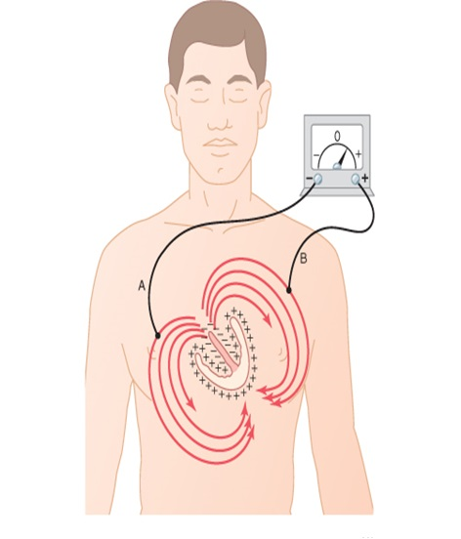
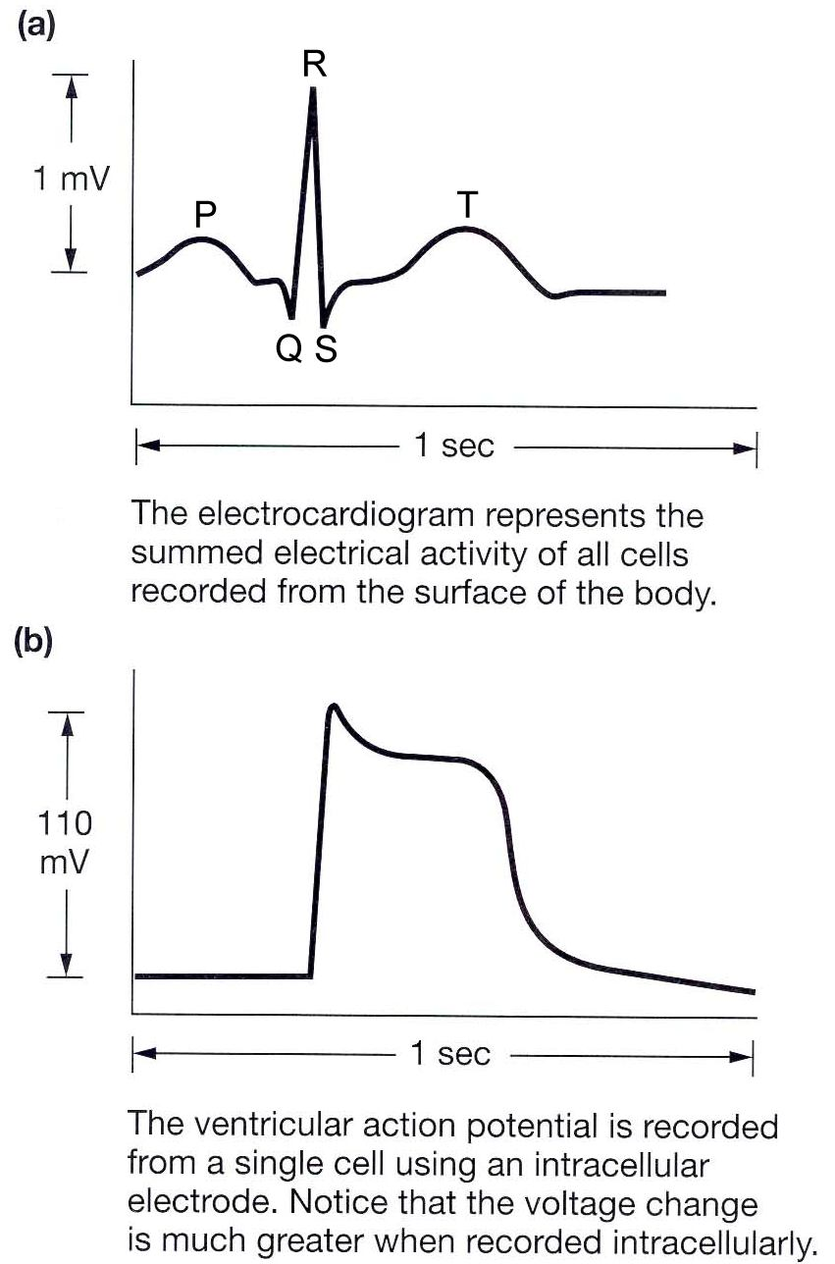
The Electrocardiogram; (ECG/EKG)

Slide 6
The Electrocardiogram; (ECG/EKG)
If a recording electrode is applied on any point on the surface of the trunk, it will detect electrical waves reflecting the electrical activity in the heart. These electrical waves may be as small as 1 mv and are amplified, recorded on ECG paper / monitor / computer and stored.
A positive wave is recorded when depolarization is propagating towards the electrode or when repolarization is propagating away from the electrode.
A negative wave is recorded when depolarization is propagating away from the electrode or when repolarization is propagating towards the electrode.
When there are no propagating potentials, no waves are recorded and the recording needle will be on the line of zero potential, which is called the isoelectric line.

Slide 7
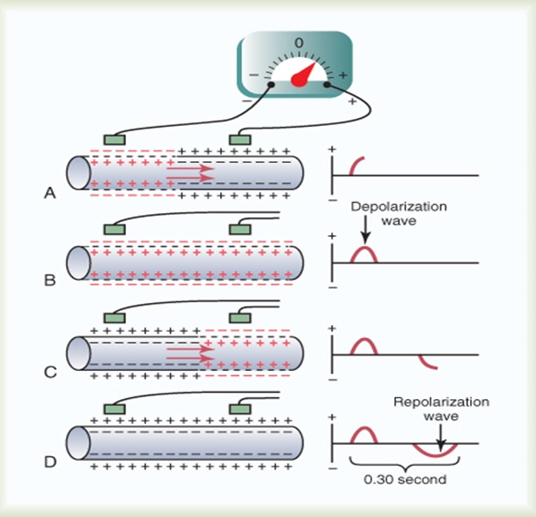
The active
and reference electrodes
For recording an ECG, two electrodes are required.
One of the them is the active electrode (also called searching electrode or exploring electrode) which is applied to a recoding point on the surface of the body.
The other is the reference electrode which serves a reference to the active electrode.

Slide 8
Recording points
on the body surface
By convention, there are nine standard points on the surface of the body from which an ECG should be recorded.
Six points are on the chest wall and the other three points are on the limbs.

Slide 9
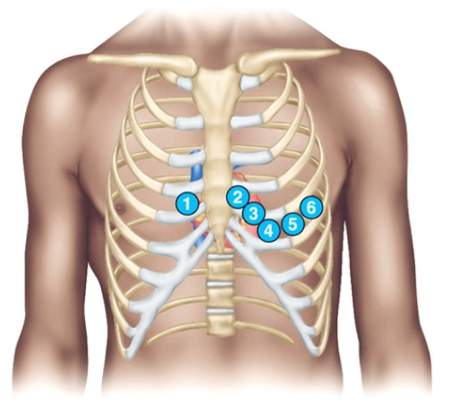
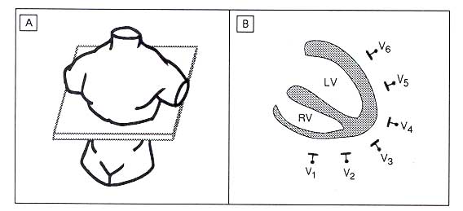
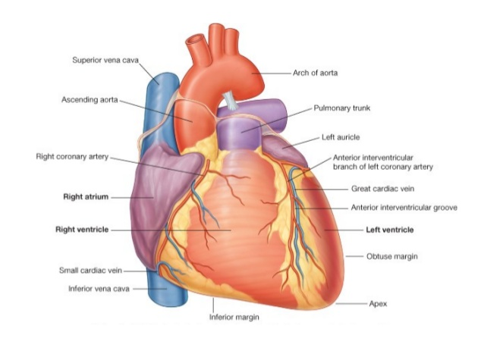
Chest points
V₁: at the right fourth intercostals space near the sternum.
V₂: at the left fourth intercostals space near the sternum.
V₃: midway between V₂ and V₄.
V₄: at the left fifth intercostals space at the midcalvicular line.
V₅: at the left fifth intercostals space at the anterior axillary line.
V₆: at the left fifth intercostals space at the midaxillary line.

Slide 10
Limb points
VL: at the junction of the left arm with the trunk. Any point on the left upper limb has the same potential.
VR: at the junction of the right arm with the trunk. Any point on the right upper limb has the same potential.
VF: at the junction of the left lower limb with the trunk. Any point on the left or right lower limbs has the same potential.

Slide 11
ECG leads
An ECG lead is the ECG record obtained when the recording electrodes are placed at specific points on the body.
Unipolar ECG leads
These are the ECG records obtained when the reference electrode is at zero potential. The active electrode is applied to the recording points on the body surface.
There are six standard unipolar chest leads recorded from the six standard chest points and designated as V1, V2, V3, V4, V5 and V6.
There are other three standard unipolar limb leads recorded from the standard limb points and designated as aVL, aVR, aVF.

Slide 12
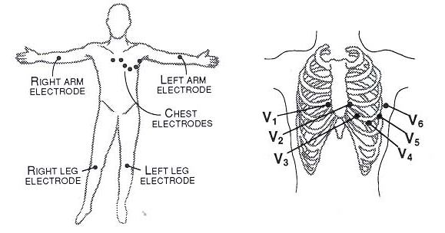
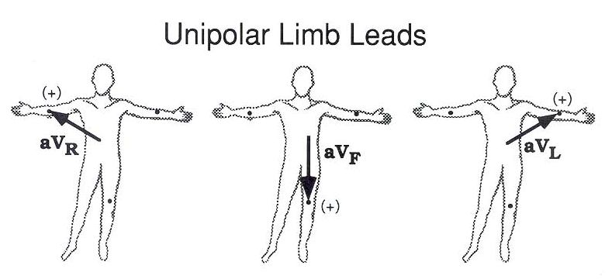
Unipolar ECG leads

Slide 13
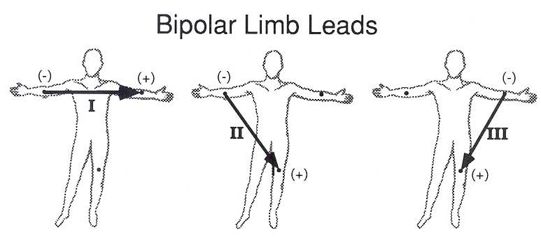
Bipolar ECG leads
These are the ECG records obtained when the active electrode is applied to a recording point and the reference electrode is applied to another recording point.
The ECG will be a record of the changes in electrical potential at the active electrode relative to the reference electrode.
Lead I: records the potential between left arm and right arm. The active electrode is at VL and the reference electrode is at VR.
Lead II: records the potential between left leg and right arm. The active electrode is at VF and the reference electrode is at VR.
Lead III: records the potential between left leg and left arm. The active electrode is at VF and the reference electrode is at VL.

Slide 14
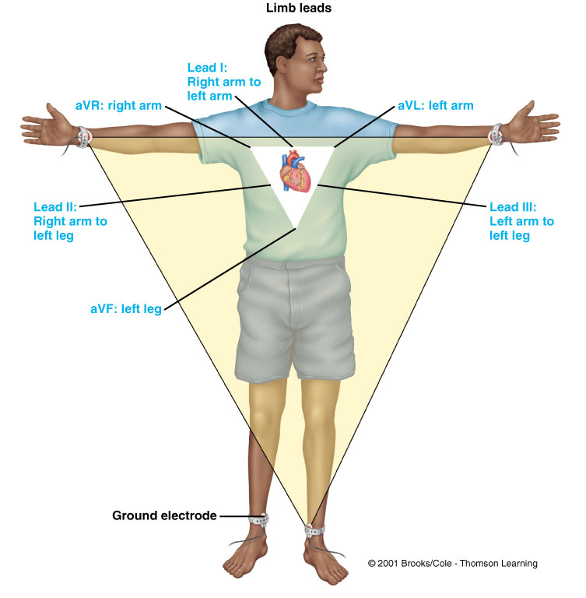
Einthoven’s Law
In the ECG, at any given instant, the potential of any wave in lead II is equal to the sum of the potentials in lead I and III.
Lead I = E_{LA}- E_{RA}
Lead II = E_{LL}- E_{RA}
Lead III = E_{LL}- E_{LA}
E = electrical potential
E_{I} + E_{III} = E_{II}
If the electrical potentials of any two of the three bipolar limb electrocardiographic leads are known at any given instant, the third one can be determined mathematically.

Slide 15
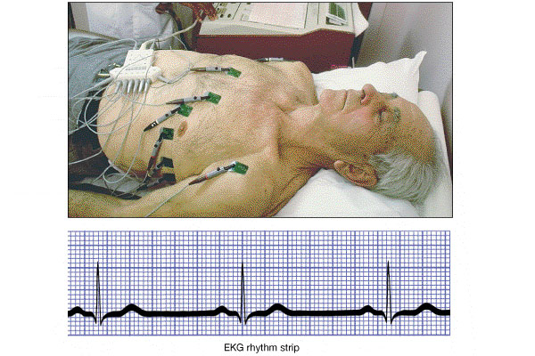
Recording an ECG

Slide 16
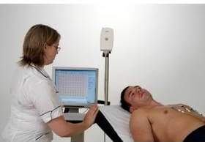
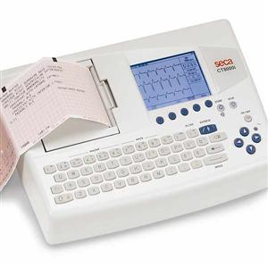
Recording an ECG
Pen recorder and a moving sheet
Computer-based and electronic display

Slide 17
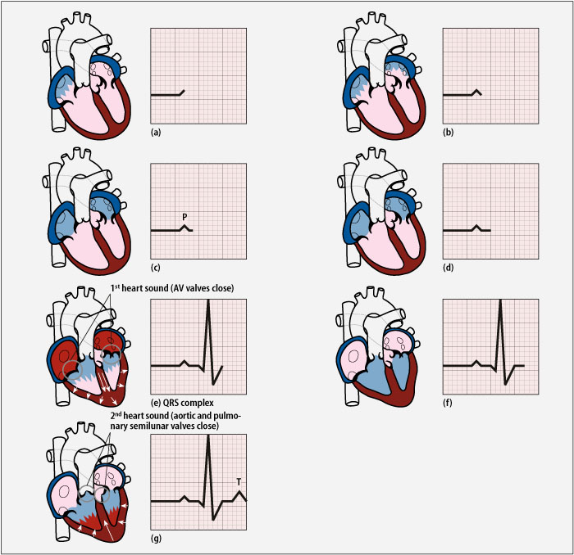
ECG waves
The impulse originates at the SA node and spreads to the atria
Atrial depolarisation generates a ‘P wave’ on the ECG
The impulse is delayed at the
AV node
P

Slide 18
The impulse then spreads to ventricles generating a QRS complex
Ventricles uniformly depolarised - ST segment
R
Q
S
Ventricles repolarize
T wave
T
Question
Why atrial repolarization does not appear in ECG?

Slide 19
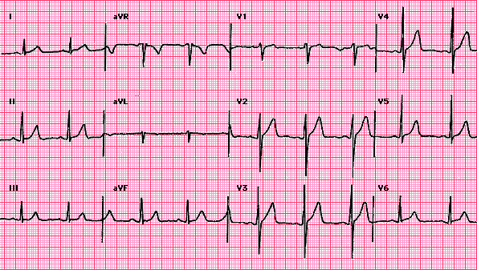
A standard 12-lead ECG

Slide 20
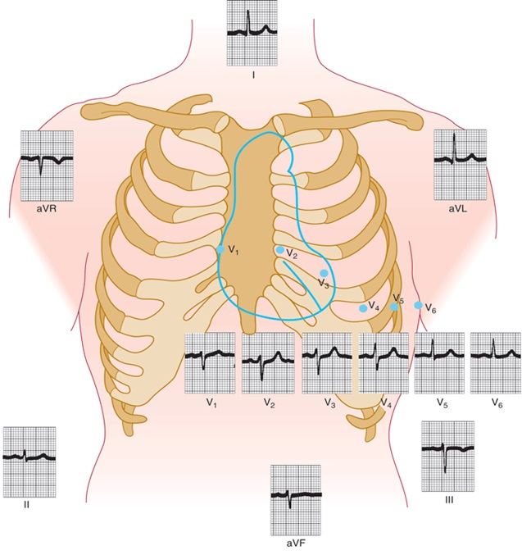
A standard 12-lead Normal ECG

Slide 21
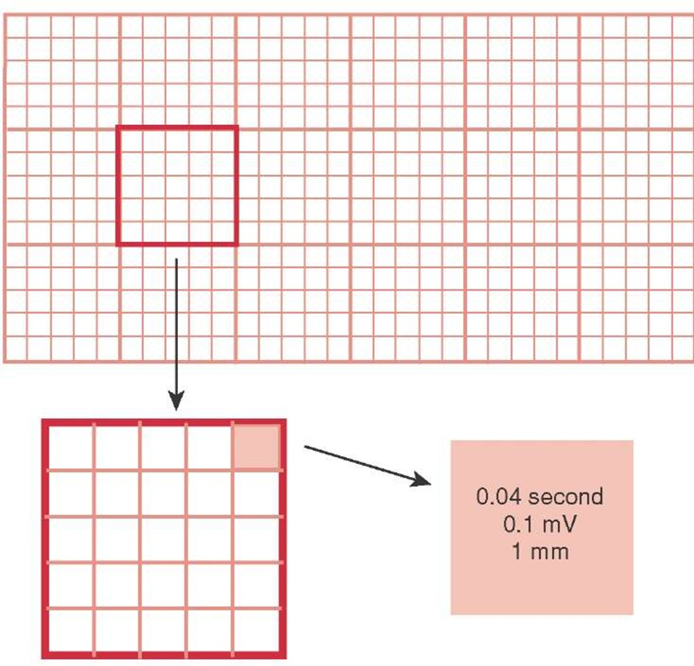
Voltage and time calibration of the ECG
The vertical calibration lines:
  Represent voltage (in millivolts).
  1 small square in the vertical calibration = 1 mm = 0.1 mv.
  Thus, 5 small squares = 1 large square = 5 mm = 5 x 0.1 = 0.5 mV.
The horizontal calibration lines:
  Represent time (in seconds).
    The ECG papers comes out of the machine with a speed of 25 mm/sec. Thus each second = 25 small squares.
    1 small square in the horizontal calibration = 1 mm = 0.04 second.
    Thus, 5 small squares = 1 large square = 5 mm = 5 X 0.04 = 0.2 second

Slide 22
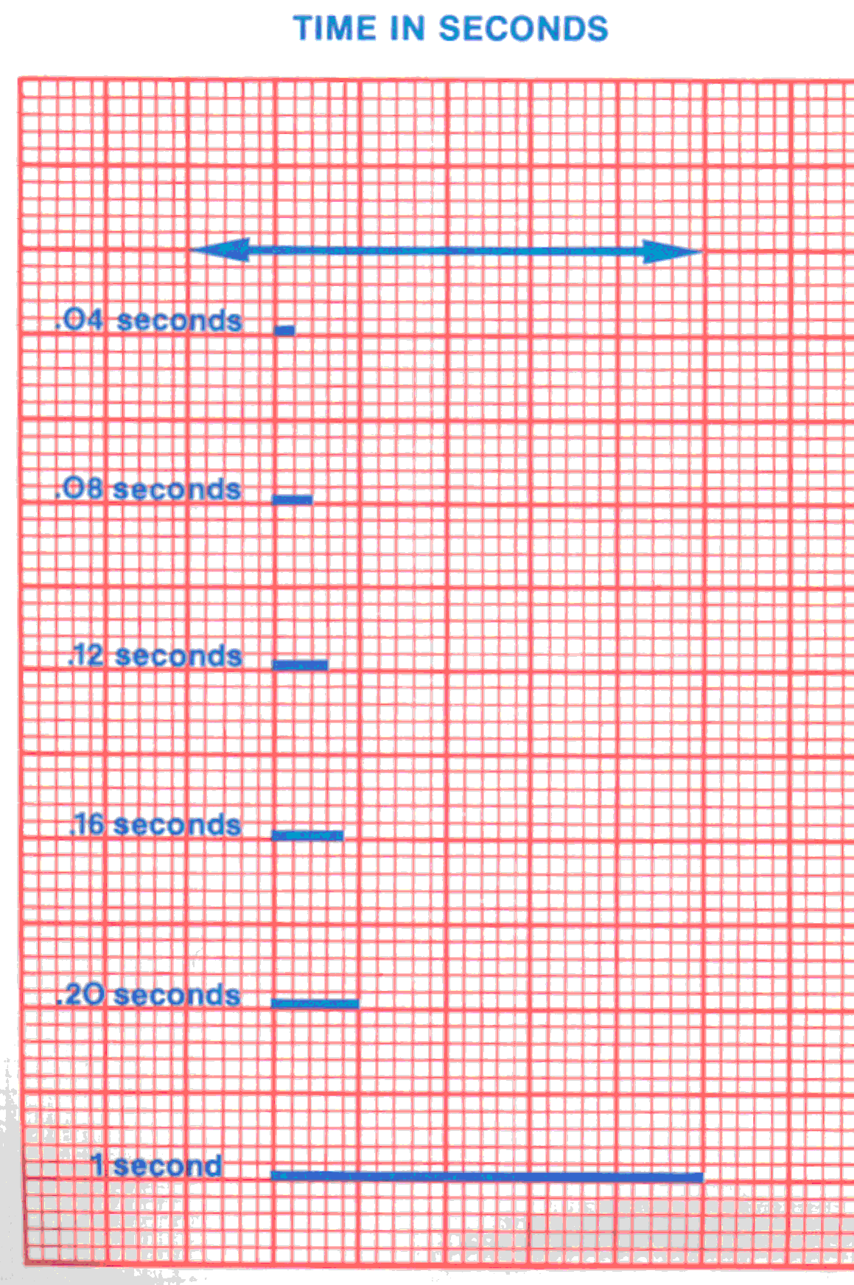
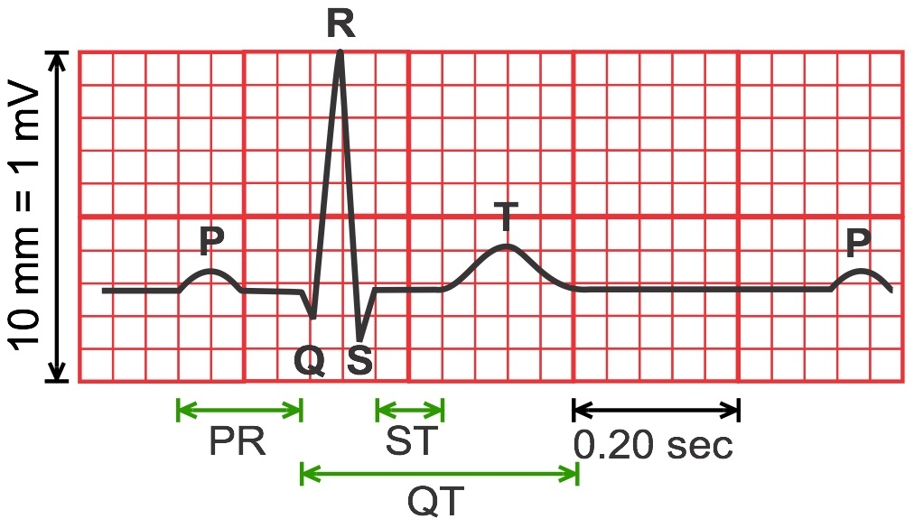

Slide 23
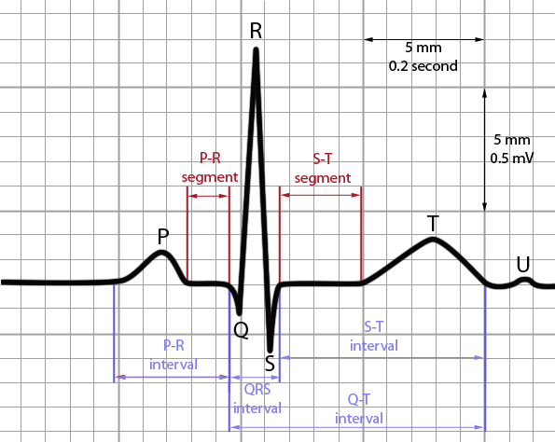
P wave
What does the P-wave represent?
- Atrial depolarization
What is a normal P-wave?
  - Amplitude
    < 2.5 mm
  - Duration
    < 0.12 sec

Slide 24
QRS Complex
What does the QRS complex represent?
- Ventricular depolarization
What defines a normal QRS complex?
  - Duration
    0.08 – 0.10 sec
Increased width of the complex is characteristic of defects in the branch bundles or Purkinje fibres, i.e., bundle branch block.

Slide 25
T wave
What does the T wave represent?
- Ventricular repolarization
What defines a normal T wave?
  - Polarity of P wave = polarity of T wave

Slide 26
PR Interval
It is the time interval between the beginning of the P wave and the beginning of the QRS complex, i.e., it is the interval between the beginning of electrical excitation of the atria and the beginning of excitation of the ventricles.
What defines a normal PR interval?
  0.12 – 0.21 sec
What is defined by a ↑ PR interval?
  1⁰ AV block
What is the significance of ↓ PR interval?
  Accessory pathway

Slide 27
QT Interval
It is the time interval between the beginning of the Q wave and the end of the T wave.
What does the QT interval represent?
  Total ventricular depolarization and repolarization
QT interval is normally about 0.35 second
Contraction of the ventricles last from the beginning of the Q wave to the end of the T wave.
QT interval roughly approximates the period of ventricular systole.

Slide 28
ST Segment
ST segment: No electrical potentials are measured on the body surface; ventricular muscle cells are in the plateau phase of their action potentials.

Slide 29
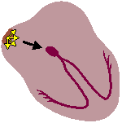


Normal rate and rhythm; Sinus rhythm
Impulses originate in the SA node regularly at a rate
of 60-100 per minute in adults.
P waves upright and of uniform size and contour from beat to beat.
Each P followed by QRS with resulting P:QRS ratio 1:1.
All complexes are evenly spaced.
  PR interval is constant and within normal range.

Slide 30
Intended learning outcomes (ILOs)
After reviewing the PowerPoint presentation and the associated learning resources, the student should be able to:
Describe the procedure for recording an electrocardiogram (ECG).
Identify the ECG recording points.
Classify ECG leads and compare and contrast unipolar and bipolar ECG leads.
State Einthoven’s law and describe its physiological significance.
Explain the electrophysiological bases and give normal values of the voltage and duration of the ECG waves, intervals and segments.
Define and interpret normal sinus rhythm and depict the causes of abnormal ECG waves and intervals.

Slide 31
Thank You

