Slide 1
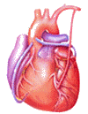

Cardiovascular Block
Physiology
Cardiac Cycle (I & II)

Slide 2
Intended learning outcomes (ILOs)
After reviewing the PowerPoint presentation and the associated learning resources, the student should be able to:
Define cardiac cycle and state its duration at rest.
State the function of the heart valves.
Identify the phases of the cardiac cycle.
Explain the relationship between the electrical and mechanical events during the cardiac cycle.
Discuss left ventricular pressures and volumes changes during the normal cardiac cycle.
Compare and contrast left and right ventricular pressures and volumes during the normal cardiac cycle.
Define and state the normal values for the end-diastolic volume, end-systolic volume, stroke volume and ejection fraction.
Describe the use of the pressure-volume loop in describing the phases of the cardiac cycle.
Explain changes in aortic pressure during the normal cardiac cycle.
Calculate pulse pressure and mean arterial pressure.
Describe right atrial pressure changes during the cardiac cycle.
Outline the venous pulse waves during the cardiac cycle.

Slide 3
Learning Resources
Guyton and Hall, Textbook of Medical Physiology; 13th Edition; Unit III-Chapter 9.
Linda Costanzo, Physiology, 5th Edition; Chapter 4.
Ganong’s Review of Medical Physiology; 25th Edition; Section V; Chapter 30.

Slide 4
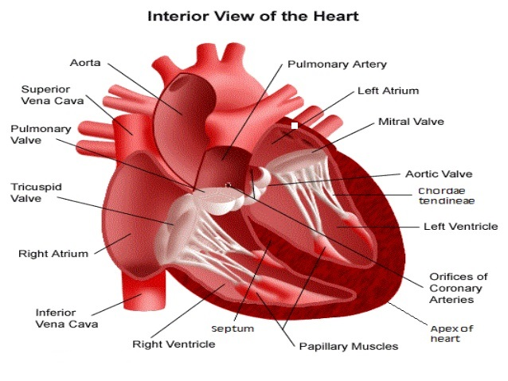
The cardiac valves are found at entry & exit of each ventricle.
They allow blood to flow in ONLY ONE direction.
When the AV valves are open, semilunar valves are closed and the opposite is true.
Opening and closure of the valves occur as a result of pressure gradient across the valves.
The cusps of the AV valves are held by the chordae tendinea to muscular projections called Papillary muscles:
  Papillary muscles limit valve movements & prevent eversion of the valve during ventricular systole.
  Papillary muscles don’t open or close the valve.
Valves of the heart

Slide 5
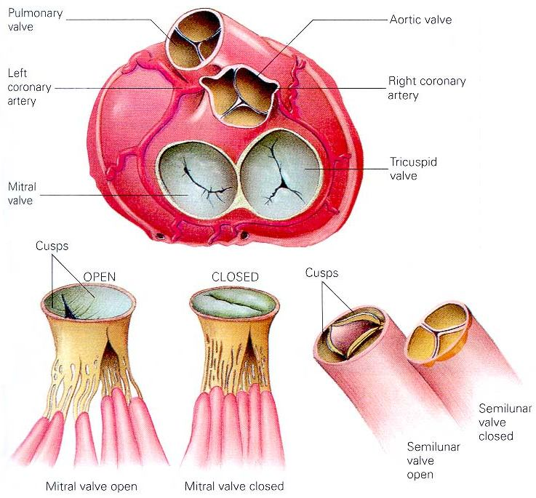
Valves of the heart

Slide 6
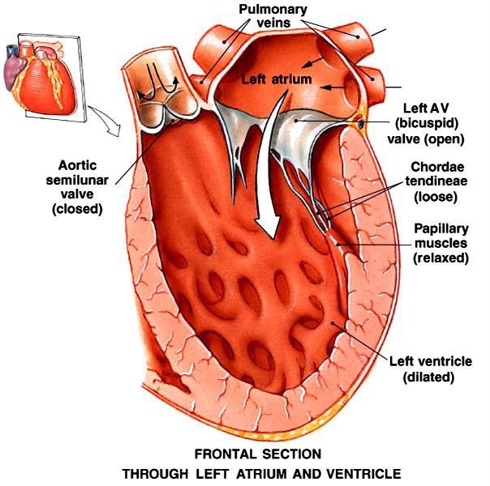
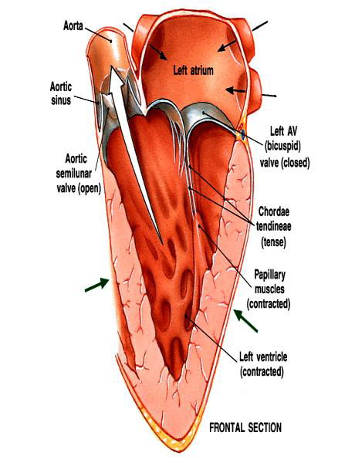
Valves of the heart

Slide 7
The cardiac cycle; the heart beat
The cardiac cycle (heart beat) consists of alternate periods of systole (contraction and emptying) and diastole (relaxation and filling).
The duration of the cardiac cycle is 0.8 sec when the heart rate (HR) is 72 beats/min. The duration is shortened when the HR increases.
The atria and ventricles go through separate cycles of systole and diastole.
Contraction occurs as a result of the spread of excitation across the heart, whereas relaxation follows the subsequent repolarization of the cardiac musculature.
Contraction of the ventricles generates pressure changes, resulting in orderly blood movement. The ventricles are flow and pressure generators.

Slide 8
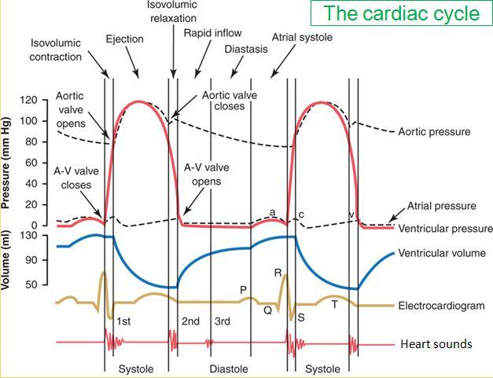
Events during the cardiac cycle
Electrical events (ECG)
Mechanical events
    Mechanical phases of the cardiac cycle
Pressure changes
Volume changes
Heart sounds

Slide 9
Electrical events → Excitation and ECG changes
Contraction followed by relaxation → Mechanical events
Ventricular pressure changes
Ventricular volume changes
Valve closure
↓
Heart sounds
Aortic pressure changes
Right atrial pressure changes
Jugular venous waveforms
Valve opening

Slide 10
Review of ventricular volumes
End-diastolic volume (EDV): is the volume of blood in each ventricle at the end of diastole. It is about 110 - 130 ml.
End-systolic volume (ESV): is the volume of blood in each ventricle at the end of systole. It is about 40 - 60 ml.
Stroke volume (SV): is the volume of blood that is pumped by each ventricle per beat. It is equal to the difference between the EDV and ESV. Its is about 70 ml.
Diastolic filling volume (DFV): is the volume of blood which flows from the atrium into a ventricle during diastole. It is equal to the difference between the EDV and the ESV. It is about 70 ml.

Slide 11
Mechanical events (phases) during the cardiac cycle
Each cardiac cycle (heartbeat) consists of 2 major periods (phases):
  Systole (Contraction)
  Diastole (Relaxation)
The atria and ventricles go through separate cycles of systole and diastole.
  Atrial: systole & diastole
  Ventricular: systole & diastole
Normally, diastole is longer > systole:
  Ventricular systole = 0.3 sec
  Ventricular diastole = 0.5 sec
  Atrial systole = 0.1 sec
  Atrial diastole = 0.7 sec
Importance of the long ventricular diastole? This is important for:
  Coronary blood flow
  Ventricular filling

Slide 12
Mechanical events (phases) during the cardiac cycle
Ventricular Diastole | Protodiastole | Early ventricular diastole | 7
 | Isometric relaxation phase |  | 8
 | Rapid filling phase |  | 1
 | Reduced (slow) filling phase | Mid ventricular diastole | 2
 | Atrial systole | Late ventricular diastole | 3
Ventricular systole | Isometric contraction phase |  | 4
 | Rapid ejection phase |  | 5
 | Reduced (slow) ejection phase |  | 6

Slide 13
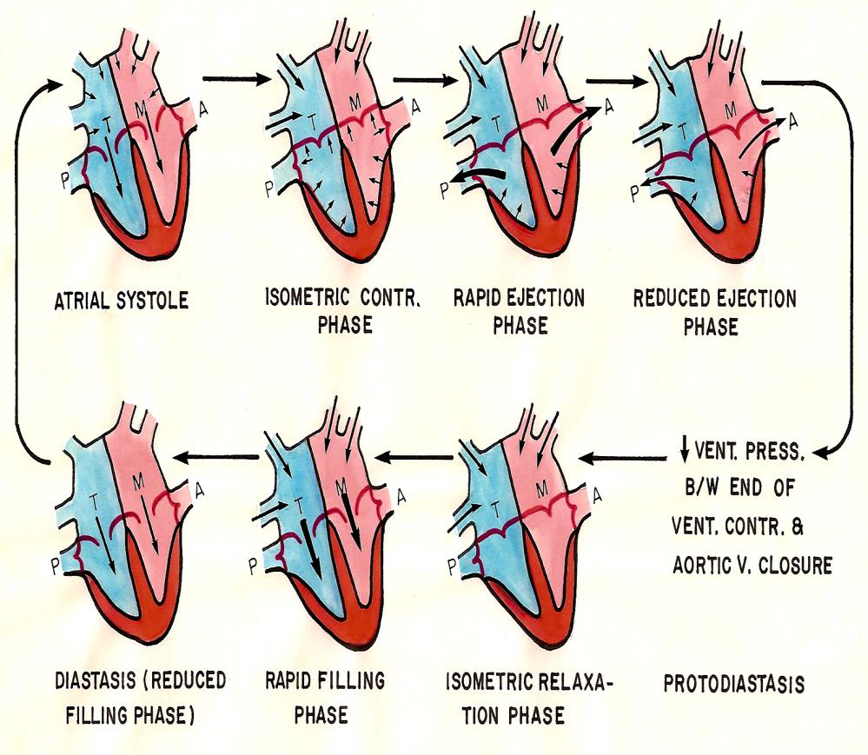
3
4
5
6
2
1
8
7

Slide 14
The SAN has not yet reached threshold.
The atrium is still also in diastole.
Because of the continuous inflow of blood from the venous system into the atrium, atrial pressure slightly exceeds ventricular pressure even though both chambers are relaxed.
Because of this pressure differential, the AV valve is open, and blood flows directly from the atrium into the ventricle.
≈ 60-70% of blood passes passively to the ventricles along pressure gradient:
    Ventricular volume ↑ rapidly.
    Ventricular pressure starts to ↑ and atrial pressure starts to ↓.
A 3rd heart sound may be heard during this phase.
Aortic pressure is still ↓.
This stage corresponds to the TP interval on the ECG: the interval after ventricular repolarization and before another atrial depolarization.
Rapid filling Phase; Early diastole

Slide 15
Reduced filling Phase (Diastasis); Mid diastole
The AV valves are still open.
The remaining atrial blood flows slowly into the ventricles.
LV volume ↑ > slowly.
LV pressure gradually ↑.
Aortic pressure is still ↓.
This stage corresponds to the TP interval on the ECG: the interval after ventricular repolarization and before another atrial depolarization

Slide 16
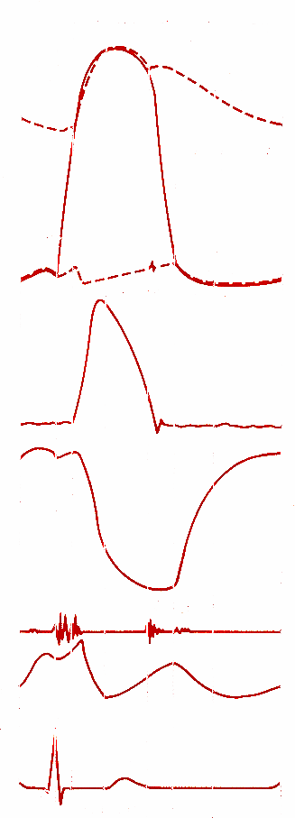
Atrial systole; Late ventricular diastole
120
80
40
0
The SA node reaches threshold and fires.
Impulse spreads throughout the atria → atrial depolarization → P wave on the ECG.
Atrial contraction (systole for about 0.1 sec) → rise in atrial pressure curve → a wave in the atrial pressure curve.
Throughout atrial contraction, atrial pressure slightly exceeds ventricular pressure, so the AV valve remains open.
More blood is squeezed into the ventricle
Tops off last 27-30% of ventricular filling ≈ 40 ml → rise in ventricular pressure.
EDV (averages about 135 ml).
Blood arriving the heart can’t enter atria, it flows back up into the jugular vein.
A 4th heart sound may be heard during this phase.
Aortic pressure is still ↓.
Pressure
mm Hg
140
70
Ventricular
volume, ml
4
heart sounds
a
venous pulse
P
ECG
Q
0 0.5 1.0 s

Slide 17
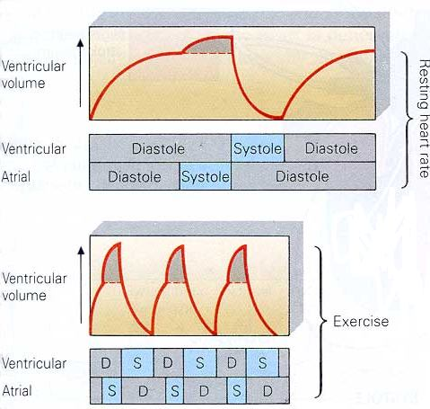
Effect of Atrial Contraction on Ventricle Filling
At rest, atrial contraction adds little extra blood to the ventricles.
When the heart rate is high, ventricle filling time is reduced.
During exercise, atrial contraction adds a substantial amount of blood to the ventricles.

Slide 18
Isovolumetric ventricular contraction
120
80
40
0
The impulse passes through the AV node and specialized conduction system to excite the ventricles → ventricular depolarization → QRS complex in the ECG.
This is followed by ventricular contraction → ventricular pressure immediately exceeds atrial pressure → The AV valve is closed → 1st heart sound is heard.
The aortic valve is still closed.
Ventricular pressure must continue to increase before it exceeds aortic pressure to open the aortic valve.
Because no blood enters or leaves the ventricle, the ventricular chamber remains at constant volume, and the muscle fibres remain at constant length.
This period lasts about 0.04 - 0.05 s, until the pressures in the left ventricle exceeds the pressures in the aorta (80 mm Hg) and the aortic valve opens.
During isovolumetric contraction, the AV valves bulge into the atria, causing a small but sharp rise in atrial pressure → c wave in the atrial pressure curve.
Aortic pressure is still ↓.
Pressure
mm Hg
mitral
valve
closes
140
70
Ventricular
volume, ml
4
1
heart sounds
a
venous pulse
R
P
ECG
Q
S
0 0.5 1.0 s

Slide 19
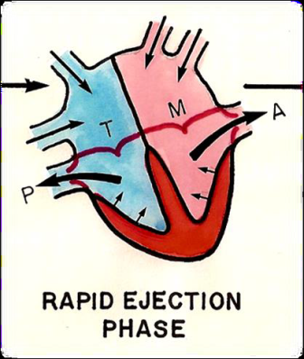
Rapid (maximum) ejection phase
aortic
valve
opens
120
80
40
0
Contraction of the ventricle → ↑ intraventricular pressure. When ventricular pressure exceeds aortic pressure , i.e., at ≈ 80 mmHg → the aortic valve is forced open → ejection of blood begins.
Ejection is rapid during this phase, then slowing down as systole progresses during the slow ejection phase.
Ventricular volume decreases substantially as blood is rapidly pumped out.
The ejected volume is the SV. ≈ 75% of SV is ejected during this phase.
the remaining volume is the ESV (averages about 65 ml).
Blood is forced into the aorta faster than blood is draining off into the smaller vessels at the other end → ↑ of aortic pressure .
Peak pressures in the left ventricle is about 120 mm Hg. Late in systole, pressure in the aorta actually exceeds that in the left ventricle, but for a short period momentum keeps the blood moving forward.
Pressure
mm Hg
mitral
valve
closes
140
70
Ventricular
volume, ml
4
1
2
a
c
x
venous pulse
The atria are in diastole. The AV valves are pulled down by the contractions of the ventricular muscle, and atrial pressure drops → x decent in the atrial pressure curve.
R
P
T
ECG
Q
S
0 0.5 1.0 s

Slide 20
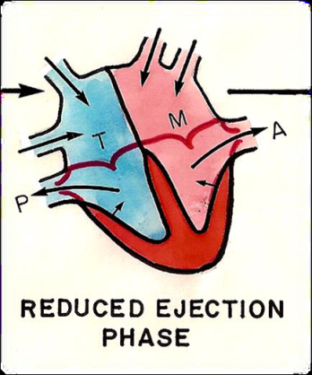
Slow (reduced) ejection phase
aortic
valve
opens
120
80
40
0
This is the last phase of ventricular systole.
Ejection is slow → ventricular volume ↓ more slowly.
≈ 25% of SV is ejected during this phase.
The intraventricular pressure declines somewhat before ventricular systole ends.
Aortic valve closes at the end of this phase, as a result of:
  ↓ Ventricular pressure < aortic pressure
  when LV pressure 110 mmHg (Aortic back pressure)
Pressure
mm Hg
mitral
valve
closes
140
70
Ventricular
volume, ml
4
1
2
a
c
heart sounds
x
venous pulse
The atria are in diastole.
R
P
T
ECG
Q
S
0 0.5 1.0 s

Slide 21
Ventricular repolarization and onset of ventricular diastole
Protodiatolic phase ???
The T wave on the ECG signifies ventricular repolarization occurring at the end of ventricular systole.
The already falling ventricular pressures drop more rapidly. This is the period of protodiastole, which lasts for a very short period of time ; ≈ 0.04 s.
Physiologists have different opinion about the existence of this phase. Physiologists believe in its existence think that the aortic valve has not yet closed by the end of the slow ejection phase and that the protodiatolic phase is the period between the end of ventricular systole and closure of the aortic valve.
Thus, protodiastole ends when the momentum of the ejected blood is overcome and the aortic valves closes, setting up transient vibrations in the blood and blood vessel walls → second heart sound (S₂).
After the valves are closed, pressure continues to drop rapidly during the period of isovolumetric ventricular relaxation, which follows.
The atria are still in diastole. The atrial pressure continues to rise due to continuous venous return. However, atrial pressure is still lower than the ventricular pressure.

Slide 22
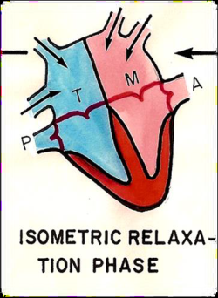
Isovolumetric
Ventricular relaxation
aortic
valve
opens
aortic valve
closes
120
80
40
0
Pressure
mm Hg
When the aortic valve closes, the AV valve is not yet open, because the ventricular pressure still exceeds atrial pressure, so all valves are once again closed for a brief period of time and no blood can enter or leave the ventricle.
The muscle fibre length and chamber volume remain constant.
As the ventricle continues to relax → the pressure steadily falls.
The atria are still in diastole. The atrial pressure continues to rise due to continuous venous return → v wave in the atrial pressure curve. However, atrial pressure is still lower than the ventricular pressure.
The mitral valve opens at the end of this phase.
This phase thus represents the beginning diastole and it’s the quiescent period between closure of the aortic valve and opening of the mitral valve.
It lasts for ≈ 0.04 sec.
mitral
valve
closes
140
70
4
1
2
a
c
v
venous pulse
x
R
P
T
Q
S

Slide 23
Ventricular filling
aortic
valve
opens
aortic valve
closes
120
80
40
0
Blood continues to flow from the pulmonary veins into the left atrium → atrial pressure rises continuously.
When the ventricular pressure falls below the atrial pressure, the AV valve opens, and ventricular filling occurs once again.
Atrial pressure drops and this → y descent in the atrial pressure curve.
This was explained before.
Pressure
mm Hg
mitral
valve
closes
mitral valve
opens
140
70
Ventricular
volume, ml
4
1
2
3
a
c
v
x
y
R
P
T
P
Q
S
0 0.5 1.0 s

Slide 24
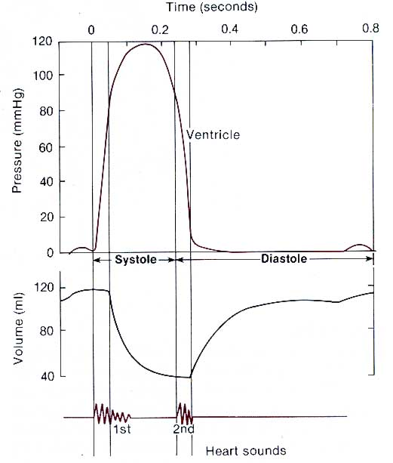
Normal LV volume and pressure
Normal LV pressure during the cardiac cycle ≈ 120/3-12 mmHg

Slide 25
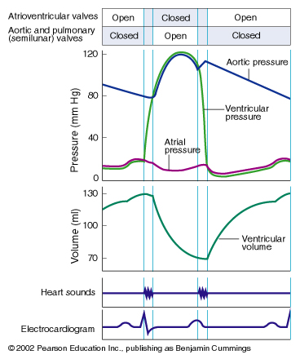
Stroke volume
Stroke Volume (SV)
= EDV – ESV (ml)
SV = the amount of blood
pumped in one heartbeat
End Diastolic Volume (EDV)
Maximum
End Systolic Volume (ESV)
Minimum
↑ contraction force results in
an ↑ SV

Slide 26
Ejection fraction (EF)
Ejection Fraction (EF)
= SV/EDV
EF = the proportion of EDV
pumped in a single beat
End Diastolic Volume (EDV)
End Systolic Volume (ESV)
EF can be a diagnostic
indicator of heart function. Normally, it is about 65%.

Slide 27
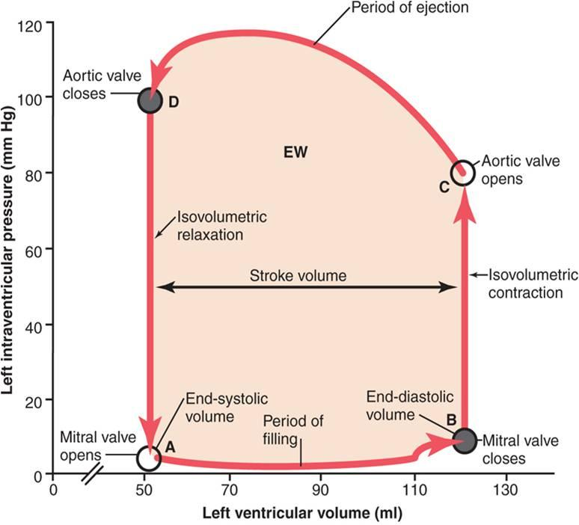
LV Pressure volume relationship during the cardiac cycle
LV pressure–volume cycle (loop)

Slide 28
Basic myocardial mechanics
Ventricular systole and diastole can be divided into early and late phases
Systole:
    Early systole = ‘Isovolumetric Contraction’
    Late systole = ‘Isotonic Contraction’ = ‘Ejection Phase’
Diastole:
    Early diastole = ‘Isovolumetric Relaxation’
    Late diastole = ‘Isotonic Relaxation’ = ‘Filling Phase’

Slide 29
Systolic BP
Late Systole
Diastolic BP
Early Diastole
Early Systole
Late Diastole

Slide 30
Ventricular systole
It is measured by ‘Contractility’
Affected by:
    Function of the muscle
    Initial volume (Preload)
    Initial pressure (Afterload)

Slide 31
Ventricular diastole
It is measured by ‘Compliance’: C = ΔV / ΔP
Affected by:
    Connective tissue
    Venous pressure
    Venous resistance

Slide 32
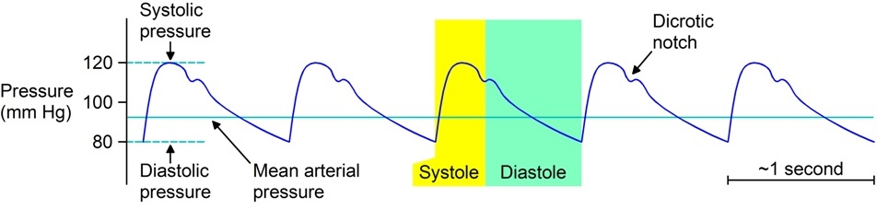
Aortic pressure

Slide 33
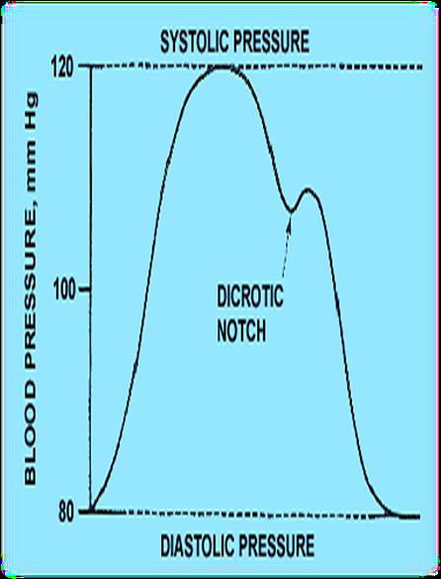
Changes in aortic pressure
a. Ascending or anacrotic limb:
    This coincides with the ‘rapid ejection phase’
    The amount of blood enters aorta > leaves
    Aortic pressure ↑ up to 120 mmHg
b. Descending or catacrotic limb:
    Passes in 4 stages

Slide 34
Stage in the descending / catacrotic limb in in aortic pressure
↓ Aortic pressure:
  This coincides with the ‘reduced ejection phase’
  The amount of blood enters aorta < leaves
Dicrotic notch (incisura):
Due to closure of aortic valve
  There is sudden drop in aortic pressure
  This notch is seen in the aortic pressure curve at end of ventricular systole
Dicrotic wave:
Due to elastic recoil of the aorta
  Slight ↑ in aortic pressure
Slow ↓ aortic press: up to 80 mmHg
Due to continued flow of blood from aorta → systemic circulation

Slide 35
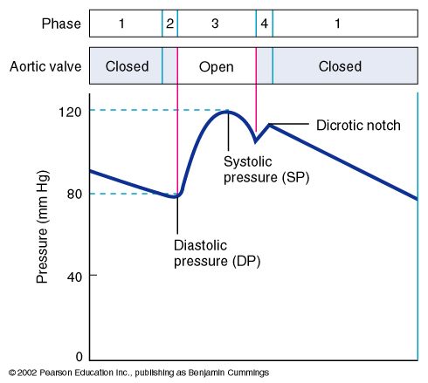
Systolic and diastolic pressure
Aortic (semilunar) valve
Minimum Aortic Pressure
= Diastolic Pressure
Systolic
Pressure
Maximum Aortic Pressure
= Systolic Pressure
Systolic Pressure (SP)
= 120 mm Hg
Diastolic
Pressure
Diastolic Pressure (SP)
= 80 mm Hg

Slide 36
Pulse pressure
Systolic Pressure (SP)
= 120 mm Hg
Diastolic Pressure (SP)
= 80 mm Hg
Aortic valve
Pulse Pressure (PP)
= SP – DP
= 120 mmHg – 80 mmHg
= 40 mm Hg
Systolic
Pressure (SP)
(120 mmHg)
Diastolic
Pressure (DP)
(40 mmHg)
An increase in pulse pressure
can indicate a hardening of
the arteries. (arteries are pressure reservoirs)

Slide 37
Mean arterial pressure (MAP)
Mean Arterial Pressure (MAP)
does not equal
(SP + DP) / 2
SP
(120 mmHg)
DP
(80 mmHg)
Aortic pressure is closer to
the minimum value for longer
than it is close to the
maximum value.
SP= systolic pressure
DP = diastolic pressure
PP = pulse pressure

Slide 38
Mean arterial pressure (MAP)
Mean Arterial Pressure (MAP)
= 1/3 SP + 2/3 DP
= 1/3 (120 mmHg) + 2/3 (80mmHg)
= 40 mmHg + 53 mmHg
= 93 mmHg
SP
(120 mmHg)
DP
(80 mmHg)
Mean Arterial Pressure (MAP)
= PP/3 + DP
= 40 mmHg/3 + 80 mmHg
= 13 mmHg + 80 mmHg
= 93 mmHg
SP= systolic pressure
DP = diastolic pressure
PP = pulse pressure
MAP is the driving force for blood flow.

Slide 39
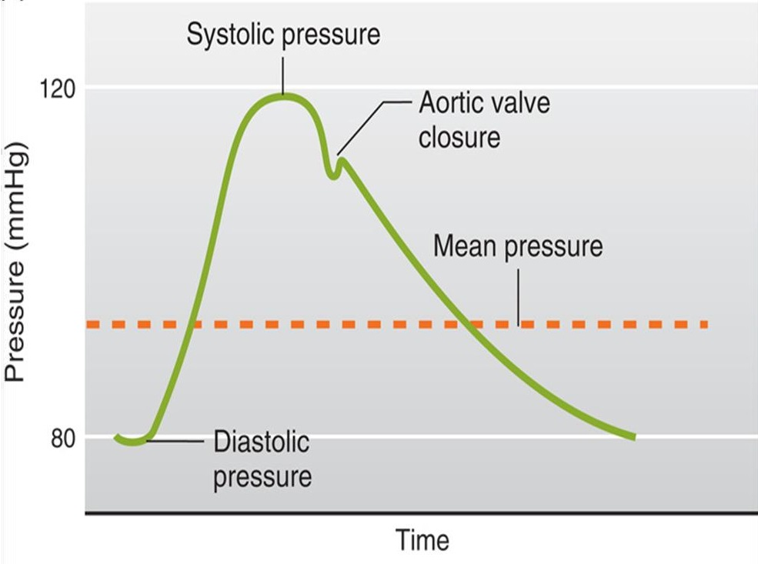
Mean arterial pressure (MAP)
Pulmonary artery pressure changes are similar to the aortic pressure changes but with difference in magnitude. Normal pulmonary artery pressure during the cardiac cycle ≈ 25-30/4-12 mmHg

Slide 40
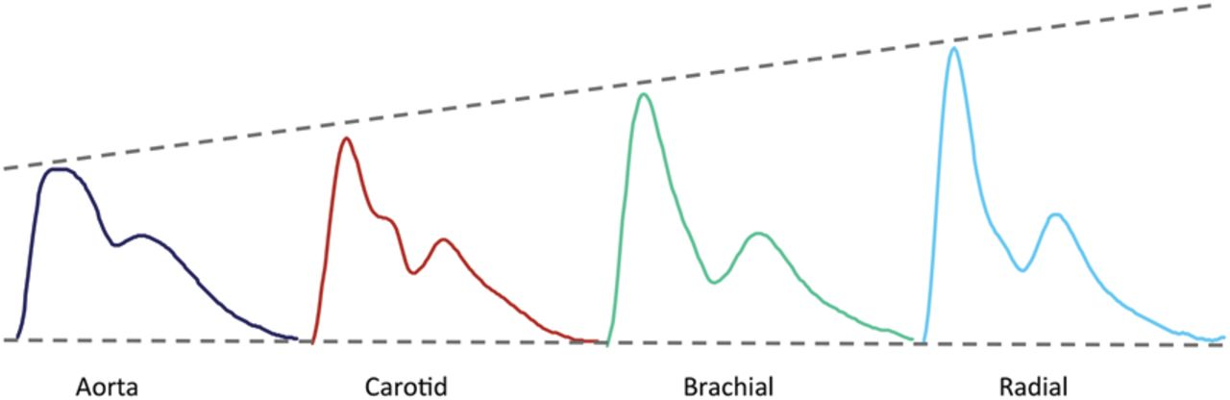
Pressure changes in peripheral arteries … 110-130/70-90
Similar to aortic pressure waves but sharper
Reflects a systolic peak pressure of 110-130 mmHg & a diastolic pressure of 70-90 mmHg

Slide 41
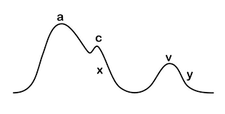
Atrial pressure changes during the cardiac cycle
3 upward deflections (waves):
  a, c, & v waves
  2 components in each wave: +ve (↑ pressure), -ve (↓ pressure)
2 downward deflection (waves):
  x & y waves
The 3 wave (a, c, & v) are equal to ONE cardiac cycle = 0.8 sec

Slide 42
Atrial pressure changes during the cardiac cycle
‘a’ wave: Atrial systole: ↑ atrial pressure during atrial contraction
‘c’ wave: Ventricular systole
    +ve as a result of bulging of AV valve into the atria during ‘isovolumetric contraction phase’
    -ve as a result of pulling of the atrial muscle & AV cusps down during ‘rapid ejection phase’, resulting in ↓ atrial pressure
‘v’ wave: Atrial diastole or ↑ venous return (VR)
    +ve: atrial pressure ↑ gradually due to continuous VR
    -ve as a result of ↓ atrial pressure during ‘rapid filling phase’
‘x’ descent:
    Downward displacement of AV valves during ‘reduced ejection phase’
‘y’ descent:
    ↓ atrial pressure during ‘reduced filling phase’

Slide 43
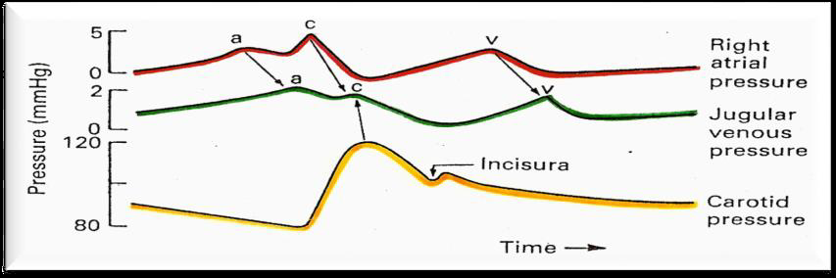
Jugular venous pulse waveforms
The atrial pressure changes are transmitted to the great veins, producing three characteristic waves in the record of jugular pressure.
y

Slide 44
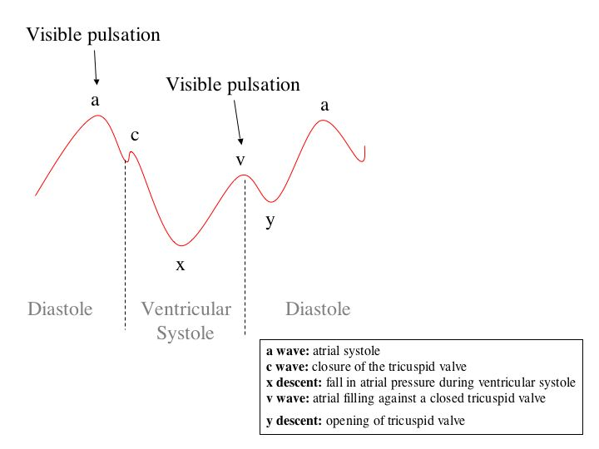
Jugular venous pulse waveforms
y

Slide 45
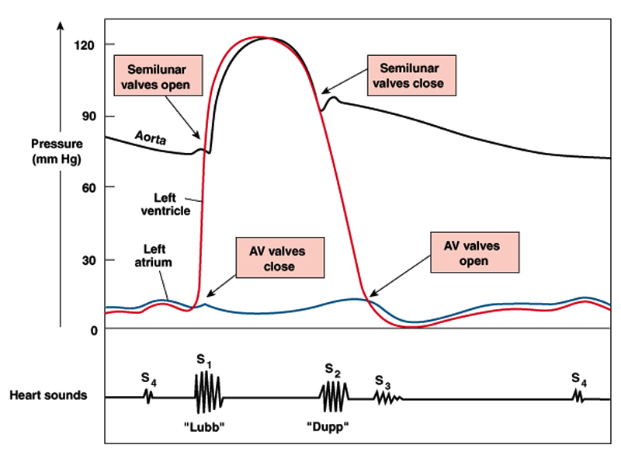
Summary of the events of the cardiac cycle

Slide 46
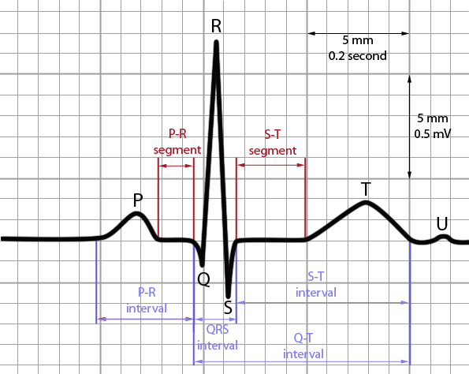
Summary of the electrical changes during the cardiac cycle
P- wave is recorded before the onset of the atrial systole.
QRS complex is recorded before the onset of ventricular systole (isovolumetric contraction phase).
T- wave is recorded before the onset of ventricular diastole.

Slide 47
Cardiac cycle timing
Although the events of the cardiac cycle on the two sides of the heart are similar, they are somewhat asynchronous.
Right atrial systole precedes left atrial systole.
Right ventricular systole starts after that of the left. However, since pulmonary arterial pressure is lower than aortic pressure, right ventricular ejection begins before that of the left.
During expiration, the pulmonary and aortic valves close at the same time; but during inspiration, the aortic valve closes slightly before the pulmonary.
When measured over a period of minutes, the outputs of the two ventricles are equal, but transient differences in output during the respiratory cycle occur in normal individuals.

Slide 48
Length of systole and diastole
The duration of systole decreases from 0.27 s at a heart rate of 65 beats/min to 0.16 s at a heart rate of 200 beats/min.
However, the duration of systole is much more fixed than that of diastole.
When the heart rate is increased, diastole is shortened to a much greater degree. For example, at a heart rate of 65 beats/min, the duration of diastole is 0.62 s, whereas at a heart rate of 200 beats/min, it is only 0.14 s.
Physiologic and clinical implications of shortened diastole: The heart muscle rests during diastole. Coronary blood flows to the subendocardial portions of the left ventricle only during diastole. Furthermore, most of the ventricular filling occurs in diastole.
At heart rates up to about 180, filling is adequate as long as there is enough venous return, and cardiac output per minute is increased by an increase in rate. However, at very high heart rates, filling may be compromised to such a degree that cardiac output per minute falls.

Slide 49
Intended learning outcomes (ILOs)
After reviewing the PowerPoint presentation and the associated learning resources, the student should be able to:
Define cardiac cycle and state its duration at rest.
State the function of the heart valves.
Identify the phases of the cardiac cycle.
Explain the relationship between the electrical and mechanical events during the cardiac cycle.
Discuss left ventricular pressures and volumes changes during the normal cardiac cycle.
Compare and contrast left and right ventricular pressures and volumes during the normal cardiac cycle.
Define and state the normal values for the end-diastolic volume, end-systolic volume, stroke volume and ejection fraction.
Describe the use of the pressure-volume loop in describing the phases of the cardiac cycle.
Explain changes in aortic pressure during the normal cardiac cycle.
Calculate pulse pressure and mean arterial pressure.
Describe right atrial pressure changes during the cardiac cycle.
Outline the venous pulse waves during the cardiac cycle.

Slide 50
Thank You

