Slide 1
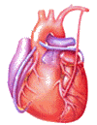
Cardiovascular Block Physiology Heart Sounds and Murmurs

Slide 2
Intended learning outcomes (ILOs)
After reviewing the PowerPoint presentation and the associated learning resources, the student should be able to:
List the standard positions of stethoscope placement for cardiac auscultation.
Distinguish between the 1st, 2nd, 3rd and 4th heart sounds.
Explain physiological splitting of the 2nd heart sound and depict the pathophysiology of fixed and paradoxical splitting of the 2nd heart sound.
Define and classify cardiac murmurs and list cause of heart murmurs.
Outline how heart murmurs are described and graded.
Outline the haemodynamic changes and murmurs in conditions of:
Aortic stenosis
Aortic regurgitation
Mitral stenosis
Mitral regurgitation
Mitral valve prolapse
Ventricular septal defect
Patent ductus arteriosus

Slide 3
Learning Resources
Guyton and Hall, Textbook of Medical Physiology; 13th Edition; Unit III-Chapter 9 and Unit IV-Chapter 23.
Linda Costanzo, Physiology, 5th Edition; Chapter 4.
Ganong’s Review of Medical Physiology; 25th Edition; Section V; Chapter 30.

Slide 4
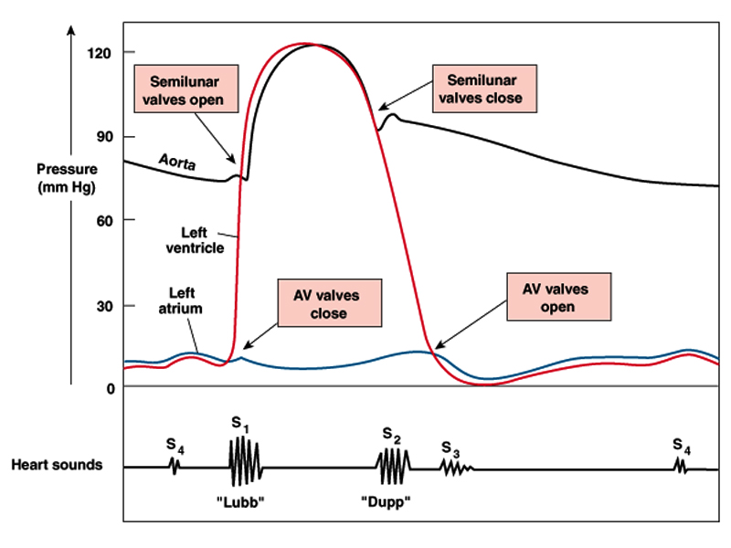
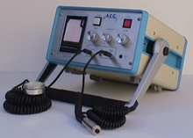
Events of the cardiac cycle and heart sounds
The heart sounds are detected over anterior chest wall by:
Auscultation: using stethoscope
Phonocardiography:
Phonocardiogram is a graphic recording of the heart sounds.
It involves picking up the sonic vibrations from the heart through a highly sensitive microphone. Such waves are then converted into electrical energy and fed into a galvanometer, where they are recorded on paper.

Slide 5
Heart sounds
Normally, only S₁ and S₂ are heard with the stethoscope.
S₃ and S₄ are detectable by phonocardiogram.
Occasionally S₄ is heard in normal individuals.
S₃ is often heard about one third of the way through diastole in children and in many normal young individuals.

Slide 6
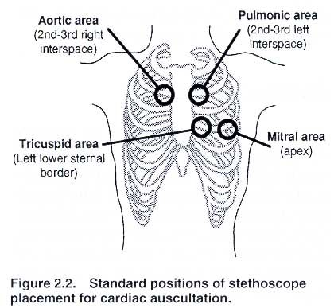
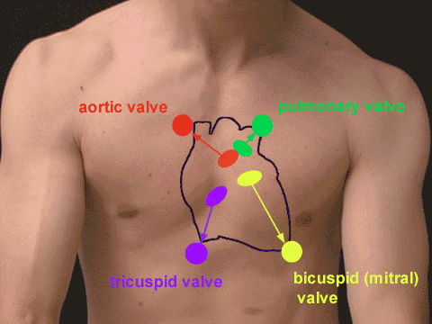
Auscultation of the Heart
Generally the sounds produced by each valve is best heard over a particular region of the chest.
Pulmonary area:
2nd - 3rd Lt intercostal space, near the sternum.
Aortic area:
2nd - 3rd Rt intercostal space, near the sternum.
Mitral area:
5th Lt intercostal space crossing mid-clavicular line (apex), or
9 cm (2.5-3 in) from sternum.
Tricuspid area:
Left lower sternal border.
In general both the first and the second heart sounds can be heard at all areas.

Slide 7
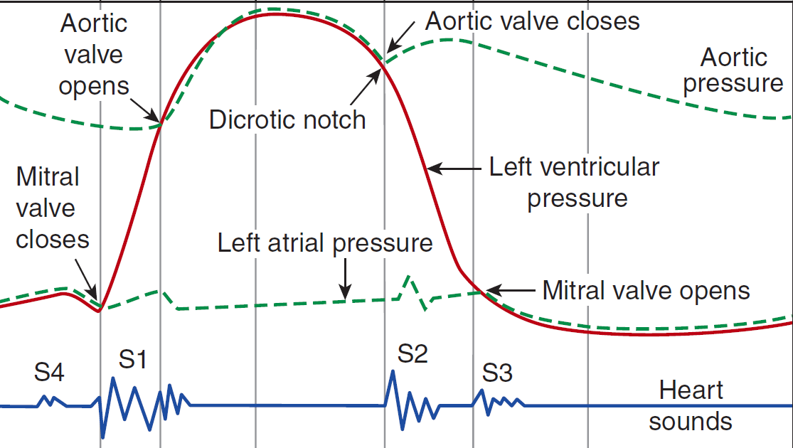
S₁ is caused by vibrations set up by the sudden closure of the AV valves at the start of ventricular systole.
S₁ is a slightly prolonged, low “lub” sound.
S₁ has a duration of about 0.15 s and a frequency of 25–45 Hz.
S₁ is soft when the heart rate is low, because the ventricles are well filled with blood and the leaflets of the AV valves float together before systole.
Heart sounds; S₁

Slide 8
S₂ is caused by vibrations associated with closure of the aortic and pulmonary valves just after the end of ventricular systole, and at the beginning of the isometric relaxation phase.
S₂ is a shorter, high-pitched “dup” sound.
S₂ lasts about 0.12 s, with a frequency of 50 Hz.
S₂ is loud and sharp when the diastolic pressure in the aorta or pulmonary artery is elevated, causing the respective valves to shut briskly at the end of systole.
Heart sounds; S₂

Slide 9
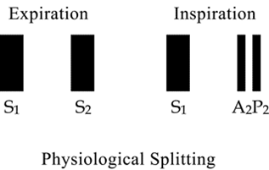
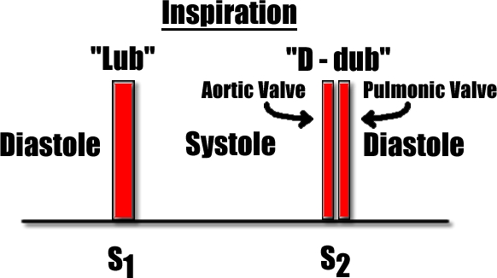
Physiological splitting of S₂
During inspiration, the aortic valve closes before pulmonary valve → reduplication (physiologic splitting of S₂.
The increased venous return to the right side of the heart delays closure of the pulmonary valve. The right ventricle has more blood than usual to eject and it thus takes more time.
No splitting of the second heart sound is normally seen during expiration.

Slide 10
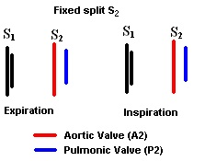
Fixed splitting of S₂
Splitting of S₂ is heard both during inspiration and expiration, with the aortic valve closing before the pulmonary valve.
This is heard in cases of ASD.

Slide 11
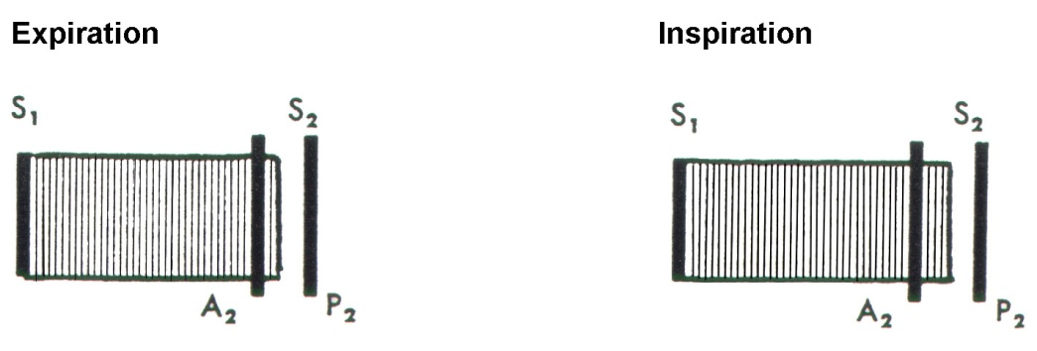
Wide splitting of S₂
A split in the second heart sound during inspiration may become wider and the split may also be seen during expiration if:
There is a delay in the closing of the pulmonic valve (as would be seen in right bundle branch block due to delay in right ventricular depolarization and contraction).
2. The aortic valve closes earlier than normal (this is seen with either mitral regurgitation or ventricular septal defect).

Slide 12
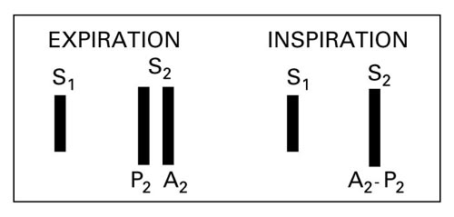
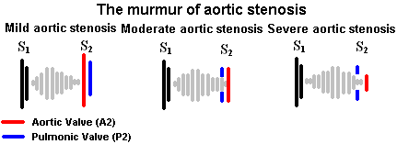
Reversed (paradoxical) splitting of the second heart sound is typically heard during expiration, with the pulmonary valve closing before the aortic valve. No splitting is apparent during inspiration, since the pulmonary valve is closing earlier (relative to the aortic valve) than normal.
This may be caused by the following:
Delayed onset of left ventricular systole (example: left bundle branch block).
Prolonged left ventricular systole (examples: aortic stenosis, severe hypertension, left-sided congestive heart failure).
Early onset of right ventricular systole (example: Wolff-Parkinson White syndrome).
Paradoxical (reversed) splitting of S₂

Slide 13
S₃ is heard about one third of the way through diastole in children and many normal young individuals.
S₃ coincides with the period of rapid ventricular filling and occurs during transition between rapid filling and slow filling of ventricle.
It is probably due to vibrations set up by the inrush of blood.
S₃ is a soft, low-pitched.
Duration ≈ 0.05 sec.
Best heard at the mitral area.
Heart sounds; S₃

Slide 14
S₄ is caused by oscillations of the ventricles during atrial contraction.
Recorded during ‘atrial systole’.
S₄ is usually not audible .. (very low pitch).
Duration ≈ 0.04 sec.
? heard in elderly.
Best heard at Mitral area.
Heart sounds; S₄

Slide 15
Significance of heart sounds
Important for diagnosis of abnormal heart sounds (murmurs)

Slide 16
Closure of the valves:
Atrio-ventricular = (S₁)
Semilunar = (S₂)
Increased intra-cardiac hemodynamics:
Blood striking the left ventricle, e.g., S₃, S₄.
Murmurs:
Increased flow across normal valves.
Turbulent flow through an abnormal valve.
Turbulent flow through septal defect.
What makes sounds
and noise in the heart
Murmurs are longer than heart sounds

Slide 17
Causes of murmurs
Innocent murmurs: common in children and young adults.
Physiological murmurs:
Associate with increased blood flow across normal valves: e.g.
Pregnancy
Hyperthyroidism
Anemia
Fever
Children
Pathological murmurs:
Turbulent flow through abnormal valves, or septal defect.. ? Congenital: e.g.
The most common abnormalities of the valves are:
Stenosis (narrowing): the valve does not open properly.
Insufficiency (the valve fails to close completely, and hence causing backflow or leaks of the blood across the insufficient valve. Valvular insufficiency is also known as Regurgitation or Incompetency).
A combination of Stenosis and Insufficiency.

Slide 18
How to describe heart murmurs
Timing (systolic or diastolic)
Shape
Location
Radiation
Intensity (grade)
Pitch
Quality

Slide 19
1. Timing of heart murmurs
Murmurs are described according to their position in the cardiac cycle:
Systolic murmurs: are further classified into:
Early systolic murmurs.
Mid systolic murmurs (ejection systolic murmurs; ESM).
Late systolic murmurs.
Pansystolic (holosystolic murmurs).
Diastolic: are further classified into:
Early diastolic murmurs.
Mid diastolic murmurs.
Late diastolic murmurs.
Continuous:

Slide 20
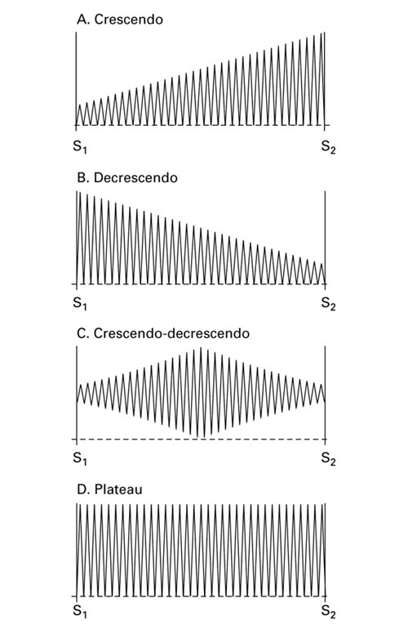
2. Shape of heart murmurs
Crescendo (increasing intensity).
Decrescendo (decreasing intensity).
Crescendo-decrescendo (Diamond-shaped); (increasing then immediate decreasing intensity).
Plateau (uniform); the intensity of the murmur remains uniform throughout.

Slide 21
3. Location of maximum intensity of heart murmurs
Determined by the site where the murmur originates
e.g. A, P, T, M listening areas
4. Radiation of heart murmurs
Reflects intensity of the murmur & direction of blood flow

Slide 22
5. Intensity of heart murmurs
Graded on a 6 point according to Levine scale:
Grade 1: Grade I/VI
Grade 2: Grade II/VI
Grade 3: Grade III/VI
Grade 4: Grade IV/VI
Grade 5: Grade V/VI
Grade 6: Grade VI/VI

Slide 23
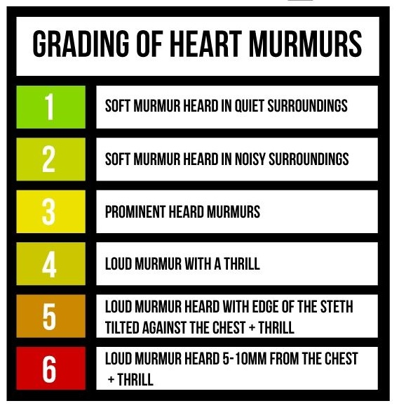
5. Intensity (grades) of heart murmurs
Graded on a 6 point according to Levine scale:
A thrill is a slight palpable vibration felt by the hand over the chest wall

Slide 24
6. Pitch (frequency) of heart murmurs
High, medium, low
7. Quality of heart murmurs
Blowing, harsh, rumbling, musical
8. Others
Variation with respiration
Murmurs increasing with expiration originate with left side (aortic or mitral) valves, while murmurs increasing in intensity with inspiration originate with tricuspid or pulmonary valves.
Variation with position of patient
Variation with special maneuvers
Valsalva maneuver decreases the intensity and duraion of most murmurs.

Slide 25
Pathophysiology of systolic murmurs
Systolic murmurs are derived from harsh & ↑ turbulence in blood flow during ventricular systole.
They are associated with:
↑ flow across a normal valve.
↑ flow into a dilated great vessel.
↑ flow across a narrowed ventricular outflow tract or stenosis of the aortic valve or pulmonary valve.
↑ flow across an incompetent AV valve, e.g., mitral and tricuspid regurgitation.
↑ flow across a VSD.

Slide 26
Mid-systolic murmurs (ejection systolic murmurs; ESM)
Most common kind of heart murmur.
Usually crescendo-decrescendo.
They may be:
Innocent:
In children & young adults.
Physiological:
As result of increased intra-cardiac hemodynamics,, as in cases of anemia, pregnancy, fever & hyperthyroidism.
Pathological:
Secondary to structural cardiovascular abnormalities, e.g., Aortic/pulmonary stenosis, hypertrophic cardiomyopathy & mitral valve prolapse.

Slide 27
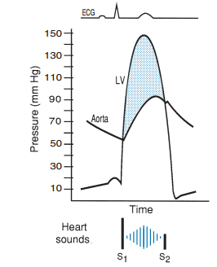
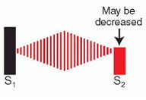
Aortic stenosis; AS
Narrowing of the aortic outflow tract causes obstruction of flow from the LV into ascending aorta.
This causes a mid-systolic murmur; ejection systolic murmur.
Best heard at the aortic area, and radiates along carotid arteries.
The ESM of AS has a crescendo-decrescendo contour and a gap between the end of the audible sound and S₂.
It is harsh, loud, and may have associated thrill, “ejection click”.
AS may be associated with:
Older age as a result of wear and tear of the aortic valve in the elderly,
Bicuspid aortic valve,
Scarring of the aortic valve due to rheumatic fever as a child or young adult.

Slide 28
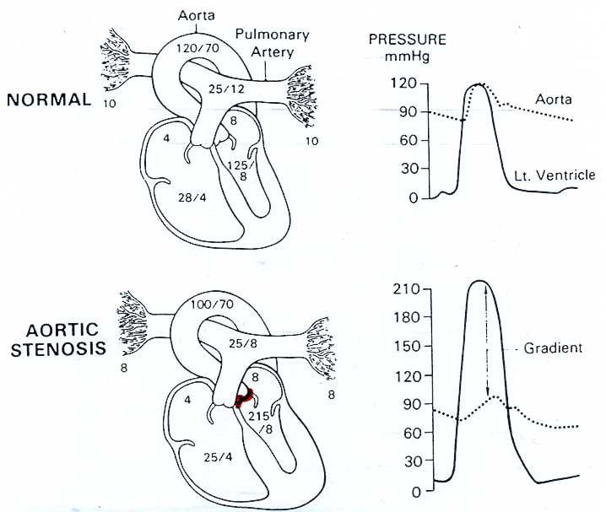
Aortic stenosis; AS
The narrow orifice of the aortic valve increases resistance of the aortic valve and slows the rate at which SV is ejected.
Ventricular systolic pressure increases to overcome the increased resistance of the aortic valve.
Thus, there is a pressure gradient between the left ventricle and aorta during ejection.
AS may result in concentric hypertrophy of the LV.

Slide 29
Reversed splitting of S₂ in aortic stenosis
Diagram showing the reverse paradoxical splitting in aortic stenosis with different levels of severity.

Slide 30
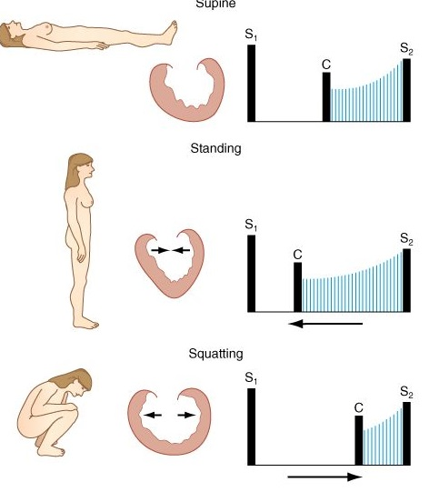
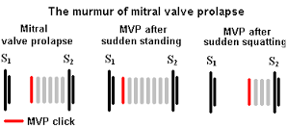
Mitral valve prolapse
In mitral valve prolapse, there is bulging of one or both mitral valve leaflets into LA during LV systole.
This causes a mid- late systolic murmur.
Best heard at the apex.
Characterized by mid systolic click.
Mitral valve prolapse may be seen in ~5% normal population, asymptomatic, ? sudden death.

Slide 31
Pan-systolic murmurs (holosystolic murmurs)
Pan-systolic murmurs are pathological murmur.
They begin immediately with S1 & continue up to S2.
Heard with:
Mitral/tricuspid regurgitation.
Ventricular septal defect (VSD).

Slide 32
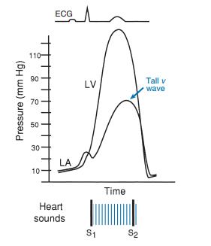
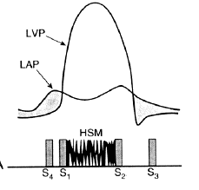
Mitral regurgitation; MR
An incompetent mitral valve allows blood to regurgitate from the left ventricle to the left atrium throughout ventricular systole. Thus,
Left atrial volume and pressure are increased during ventricular systole.
Left ventricular volume and pressure are increased during diastole, but there is NO pressure gradient between the LA and the LV.
This results in a holosystolic murmur.
The sound is of reasonably constant intensity throughout the ejection period.
Best heard at apex, radiates to left axilla.
Soft, high-pitched, blowing.
May be associated with MV prolapse, MV myxomatous degeneration, MI, rheumatic heart disease, cardiomyopathy, endocarditis.
left ventricular
pressure
left atrial
pressure
S₄ S₁ S₂ S₃

Slide 33
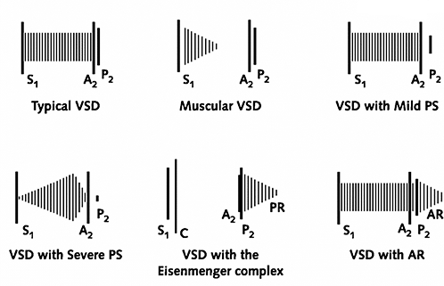
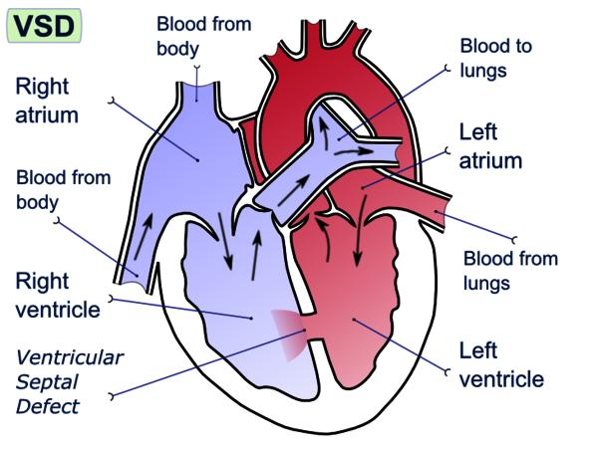
Ventricular septal defect; VSD

Slide 34
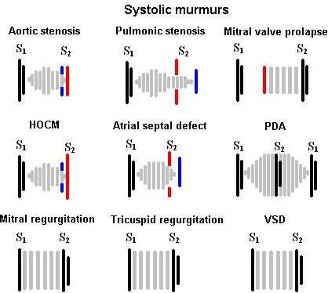
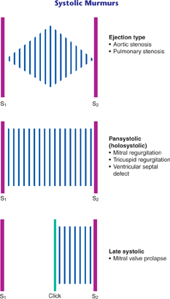
Summary of systolic murmurs

Slide 35
Diastolic murmurs
Diastolic murmurs almost always indicate heart disease.
There are two basic types:
Early decrescendo diastolic murmurs:
This murmur signifies regurgitant flow through an incompetent semilunar valve, e.g., aortic/pulmonary regurgitation (incompetency).
Rumbling mid- or late diastole diastolic murmurs:
This murmur suggests stenosis of an AV valve, e.g., mitral/tricuspid stenosis.

Slide 36
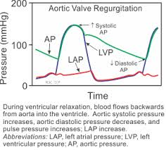
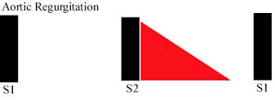
Aortic regurgitation; AR
The aortic valve does not close properly at the beginning of diastole.
As a result, there is retrograde flow of blood from the aorta into the ventricle during diastole.
The amount of the blood regurgitated into the left ventricle may be as much as 60-70% of the amount ejected during systole.
Thus, there is:
Decreased aortic diastolic pressure.
increased left ventricular and aortic systolic pressures.
Increased aortic pulse pressure.
AR causes an early diastolic murmurs; decrescendo murmur.
Best heard at the 2nd – 4th left intercostal space with the patient sitting up, leaning forward, at end expiration.
High pitched, loud blowing. It wanes with time as aortic pressure falls.
May be associated with aortic root degeneration, rheumatic heart disease, VSD, w/aortic valve prolapse (kids).

Slide 37
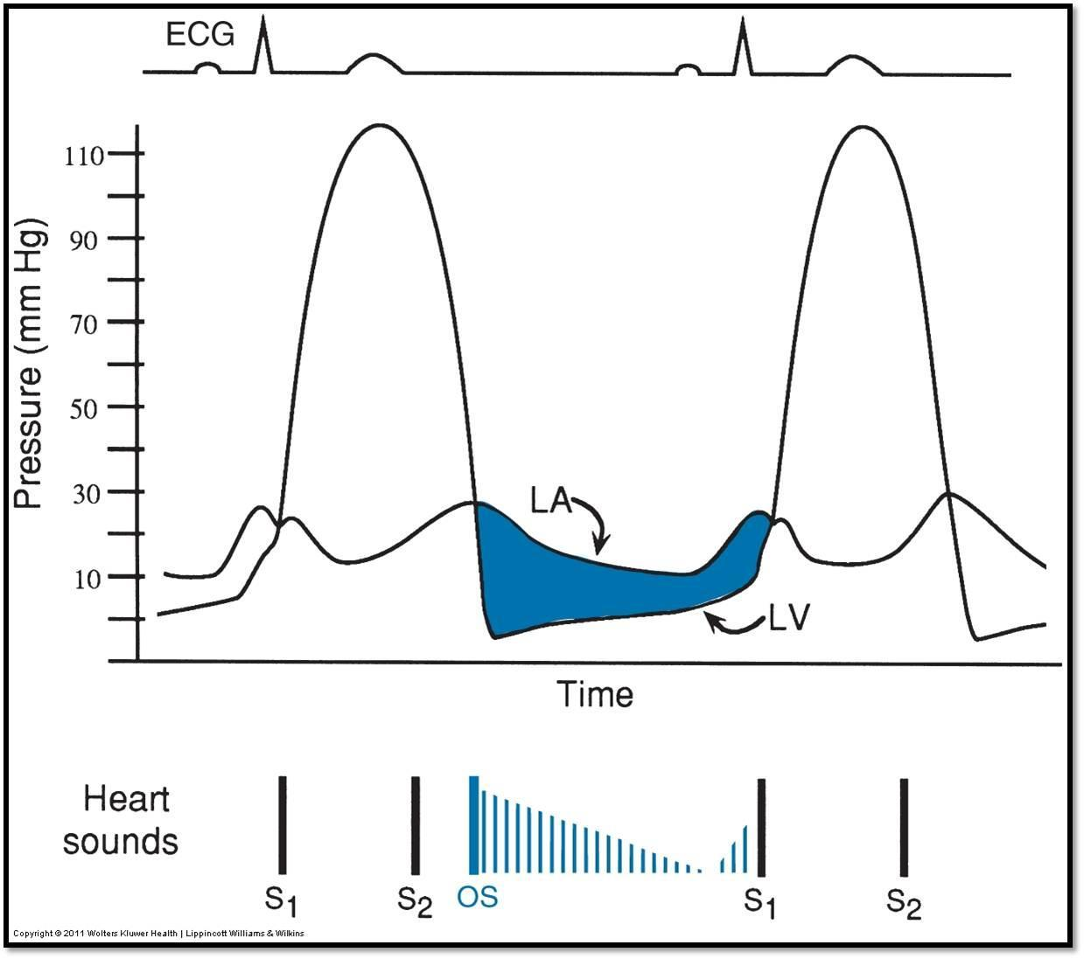
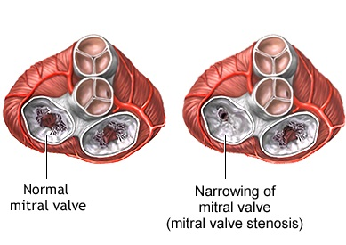
Mitral stenosis; MS
Narrowing of the mitral valve orifice impairs emptying of the left atrium into the left ventricle during diastole.
Left atrial pressure greatly exceeds left ventricular pressure when the stenotic valve is open. This generates a pressure gradient between the left atrium and the left ventricle during filling.
Thus, pressure and volume can be dramatically elevated in the left atrium.
However, in most cases of MS, LV pressure curve is normal, and similarly, the aortic pressure curve is also normal.

Slide 38
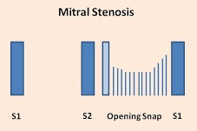
Mitral stenosis; MS
MS results in a diastolic murmur.
The murmur is often heard with an opening snap (OS) This gives the murmur a decreschendo-creschendo profile.
It begins early after the OS. Its timing is thus mid-diastolic or pre-systolic.
It is best heard at the apex.
It is a low-frequency (low pitched) blowing sound and thus heard with the bell of the stethoscope.
MS may be associated with rheumatic fever.

Slide 39
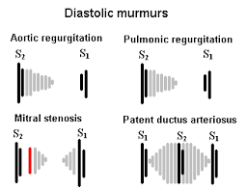
Summary of diastolic murmurs

Slide 40
Continuous murmurs
Patent ductus arteriosus; PDA
Failure of closure of the ductus arteriosus between pulmonary artery & aorta results in a continuous murmur.
Best heard at upper left sternal border.
Machine-like.
May be associated with left to right shunt, cyanosis.

Slide 41
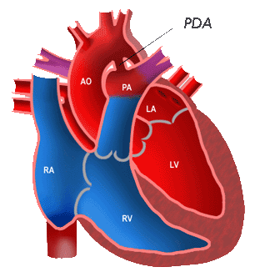
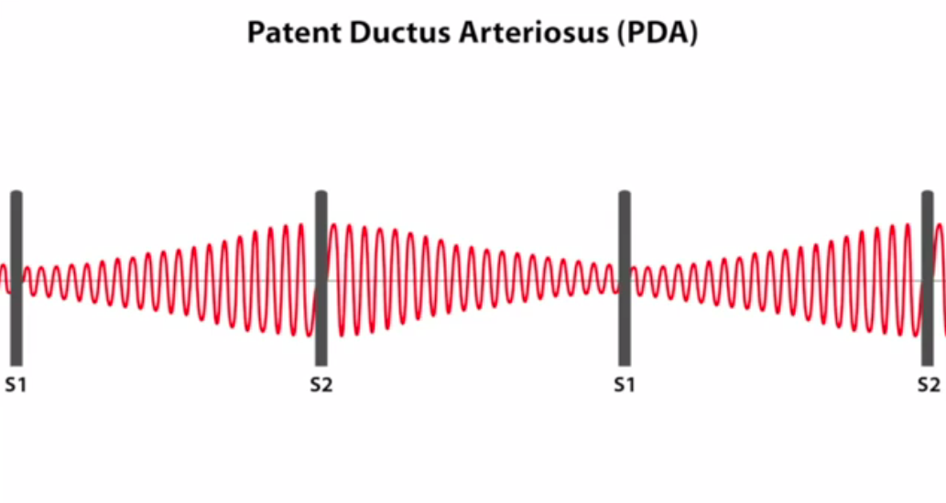
Continuous murmurs of PDA

Slide 42
Intended learning outcomes (ILOs)
After reviewing the PowerPoint presentation and the associated learning resources, the student should be able to:
List the standard positions of stethoscope placement for cardiac auscultation.
Distinguish between the 1st, 2nd, 3rd and 4th heart sounds.
Explain physiological splitting of the 2nd heart sound and depict the pathophysiology of fixed and paradoxical splitting of the 2nd heart sound.
Define and classify cardiac murmurs and list cause of heart murmurs.
Outline how heart murmurs are described and graded.
Outline the haemodynamic changes and murmurs in conditions of:
Aortic stenosis
Aortic regurgitation
Mitral stenosis
Mitral regurgitation
Mitral valve prolapse
Ventricular septal defect
Patent ductus arteriosus

Slide 43
Thank You

