Slide 1
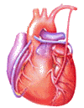
Cardiovascular Block Physiology Cardiac Arrhythmias

Slide 2
Intended learning outcomes (ILOs)
After reviewing the PowerPoint presentation and the associated learning resources, the student should be able to:
Define the normal sinus rhythm.
Classify cardiac arrhythmias.
Discuss the mechanisms of cardiac arrhythmias.
Describe the ECG diagnosis of important cardiac arrhythmias.

Slide 3
Learning Resources
Guyton and Hall, Textbook of Medical Physiology; 13th Edition; Unit III-Chapter 13.
Linda Costanzo, Physiology, 5th Edition; Chapter 4.
Ganong’s Review of Medical Physiology; 25th Edition; Section V; Chapter 29.

Slide 4
Cardiac Rhythm
The term rhythm refers to the regularity of:
Initiation of cardiac impulses.
Sequence of excitation of the heart.
i.e., regularity of the electrical activity of the heart.
The normal cardiac rhythm is called normal sinus rhythm (NSR).
Any variation from the normal rhythm (sinus rhythm) is termed: a cardiac arrhythmia or dysrhythmia.

Slide 5
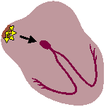
Normal sinus rhythm; NSR
Impulses originate in the SA node regularly at a rate
of 60-100 per minute in adults.
P waves upright and of uniform size and contour from beat to beat.
Each P followed by QRS with resulting P:QRS ratio 1:1.
All complexes are evenly spaced
PR interval is constant and within normal range

Slide 6
Classification of cardiac arrhythmias
according to mechanism of arrhythmia
Cardiac arrhythmias
Arrhythmias due to alterations or disturbances of impulse formation
Arrhythmias due to disturbances of impulse conduction

Slide 7
Anatomical classification of
cardiac arrhythmias (origin of the arrhythmia)
Cardiac arrhythmias
Supraventricular arrhythmias
Ventricular arrhythmias
Atrial arrhythmias
Atrioventricular (AV) junctional arrhythmias

Slide 8
Classification of
cardiac arrhythmias
according to heart rate
Cardiac arrhythmias
Bradyarrhythmias
Tachyarrhythmias

Slide 9
Arrhythmias due to alterations or disturbances of impulse formation
Arrhythmias due to alterations or disturbances
of impulse formation
Arrhythmias due to alterations in SA node pacemaker activity
Arrhythmias due to enhanced automaticity of the AV junction
Arrhythmias due to triggered activity and reentry

Slide 10
Mechanisms of arrhythmias due to alterations or disturbances
of impulse formation
Enhanced automaticity.
Triggered activity.
Reentrant circuits (circus movement).
Arrhythmias due to reentrant circuits (circus movement) can also be considered as arrhythmias due to disturbances of impulse conduction.

Slide 11
1. Enhanced automaticity
Enhanced automaticity is defined as an inappropriate increase in the rate of discharge of a tissue having physiological pacemaker properties (i.e., sinus node, atrioventricular node or Purkinje fibers).

Slide 12
2. Triggered activity
The term triggered activity is used to define the appearance of automaticity as a result of external stimulation, and may arise in tissues that do not demonstrate physiological automaticity.

Slide 13
3. Re-entry (Lewis circus movement)
Re-entry (reentry): Re-entry occurs when a cardiac impulse re-excites some region of the heart through which the impulse has already passed in that heart beat.
Unidirectional or partial conduction block is required to initiate re-entry.
Once started re-entry may generate a self-initiating and self-sustaining AP that propagates as a wave around the heart.

Slide 14
3. Re-entry by unidirectional block
Depolarization of a ring of cardiac tissue.
Normally, the impulse spreads in both directions in the ring and the tissue immediately behind each branch of the impulse becomes refractory.
When a transient block occurs on one side (unidirectional block), the impulse on the other side goes around the ring, and if the transient block has now worn off, the impulse passes this area and continues to circle indefinitely (circus movement).

Slide 15
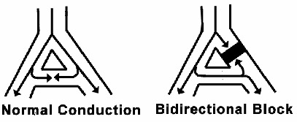
3. Re-entry
1. Bidirectional Block:
In bidirectional block, the impulse may not be conducted through a region of cardiac tissue.
This is generally due to intense vagal stimulation or cellular damage (often due to cell death in infarct).

Slide 16
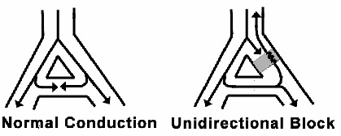
3. Re-entry
2. Unidirectional Block:
In unidirectional block, the impulse is blocked in the antegrade direction but may be propagated slowly through the retrograde direction → reentry arrhythmias.
This is often seen when a region of cardiac tissue is damaged but not yet dead, as in ischemia.
In ischemic tissue, metabolic wastes are not removed. Hence, lactic acid builds up inside the cell. This causes an acidic cell interior, which closes gap junctions. Thus, the refractory period in this tissue may be out of synchrony with the surrounding tissue, causing a unidirectional block of conduction.
Treatment of unidirectional block: lidocaine blocks the few sodium channels firing and allows a bidirectional block to form in the ischemic tissue.

Slide 17
Arrhythmias due to alterations in
SA node pacemaker activity
Sinus
Bradycardia
Arrhythmias due to alterations in SA node pacemaker activity
Sinus
Tachycardia
Respiratory Sinus
Arrhythmia

Slide 18
Sinus bradycardia
Heart rate slower than 60 per minute
Causes:
1- Physiological: This occurs in healthy individuals (usually athletes) with increased vagal tone and in most people during deep quite sleep.
2- Pharmacological and pathological:
- Structural SA node disease or ischaemia (sick sinus syndrome or SA node disease).
- Increased vagal tone (due to vagal stimulation or e.g., drugs).
- Beta blockers.
- Acute myocardial infarction.
- Hypothermia.
- Hypothyroidism.
- Raised intracranial pressure.
- Obstructive jaundice.
- Uraemia.
The symptoms of sinus bradycardia include:
Dyspnea, dizziness, and extreme fatigue.

Slide 20
Sinus tachycardia
Heart rate faster than 100 per minute
Causes:
1- Physiological: During exercise, sympathetic stimulation, pregnancy.
2- Pharmacological and pathological:
- Any cause of adrenergic stimulation (including pain).
- Anticholinergic drugs (e.g., atropine).
- Vasodilator drugs, including many hypotensive agents.
- Thyrotoxicosis .
- Hypovolaemia.
- Anaemia.
- Fever.
- Myocarditis.
Sinus tachycardia results from increased automaticity (i.e., enhanced automaticity) of the SA node.

Slide 21
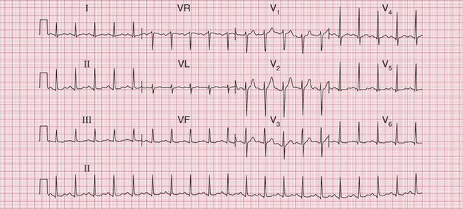
Sinus tachycardia

Slide 22
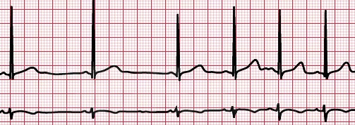
Sinus arrhythmia
Sinus arrhythmia is an increase in heart rate during inspiration and a decrease during expiration
Causes:
1- Sinus arrhythmia is due to variations in the vagal tone that affects the SA node.
It is a normal finding in children and young adults and tends to diminish or disappear with age.

Slide 23
Atrial extrasystoles
= atrial premature beats
= atrial premature complexes
= atrial premature contractions = APCs)
Atrial tachycardia
= Supraventricular tachycardia (SVT)
Arrhythmias due to triggered activity and reentry
Atrial flutter
Atrial fibrillation
Ventricular extrasystoles
= ventricularpremature beats
= venatricular premature complexes
= ventricular premature contractions = VPCs
Ventricular tachycardia
Ventricular fibrillation

Slide 24
Atrial extrasystoles
= atrial premature beats
= atrial premature complexes
= atrial premature contractions = APCs)
Atrial (Narrow QRS)
Atrial tachycardia
= Supraventricular tachycardia (SVT)
Anatomical classification of cardiac arrhythmias
Atrial flutter
Atrial fibrillation
Ventricular extrasystoles
= ventricularpremature beats
= venatricular premature complexes
= ventricular premature contractions = VPCs
Ventricular (Wide QRS)
Ventricular tachycardia
Ventricular fibrillation

Slide 25
Atrial and ventricular extrasystoles
= Premature beats
= Premature contractions
= Premature complexes
A premature beat is an abnormal beat that occurs prematurely during the diastole of the previous beat (i.e., before the expected sinus beat).
Atrial and ventricular premature beats are caused by abnormal impulses generated in a hyperexcitable focus in the atrial or ventricular myocardium (i.e., in an ectopic focus) or reentry.
If the focus is in the ventricles, the premature beat is called ventricular premature beat. If the focus is in the atrial wall, the premature beat is called atrial premature beat.

Slide 26
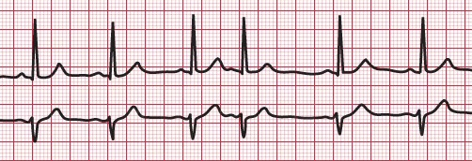
Atrial extrasystoles
= Premature atrial beats
= Premature atrial contractions
= Premature atrial complexes (PACs)
An atrial premature beat is an abnormal beat that arises from the atrium and occurs before the expected sinus beat.

Slide 27
Supraventricular tachcyardia (SVT, PSVT)
Atrial tachycardia
Junctional tachycardia
due to:
- Enhanced automaticity of the AV junction.
- AV node reentry.

Slide 28
Paroxysmal supraventricular tachycardia
(SVT, PSVT)
SVT is most common among young people and is more unpleasant than dangerous. It may occur during vigorous exercise.
It is characteristically abrupt in onset and termination.
The overall heart rates vary from 150 to 250 beats/min; the most common range is 160 to 200 beats/min.

Slide 29
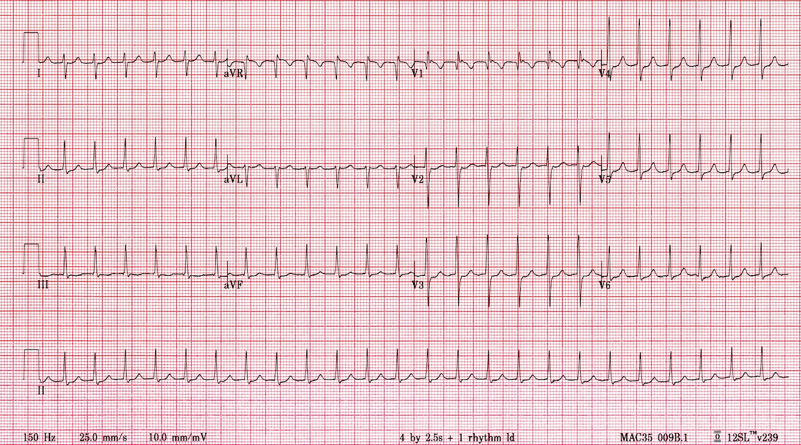
Paroxysmal supraventricular tachycardia (SVT, PSVT)

Slide 30
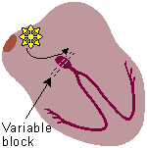
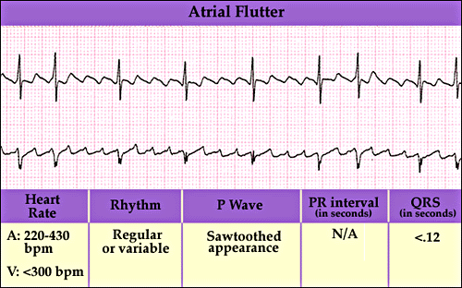
Atrial flutter
Atrial flutter occurs when the atria are stimulated to beat at a rate 200-350 beats per minute.
The mechanism of atrial flutter is usually circus movement in the atria.
Atrial flutter results in poor atrial pumping since some parts of the atria are relaxing while other parts are contracting.

Slide 31
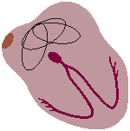
Atrial fibrillation (AF)
Atrial fibrillation occurs when the atria are stimulated to beat repeatedly and in an irregular uncontrolled manner usually at an atrial rate greater than 350 beats per minute.
Atrial fibrillation often involves micro-reentry and several ectopic foci in atria that fire independently.
As a result, atrial contractions are not synchronized → ineffective atrial contractions.
The chaotic atrial depolarization waves (impulses) penetrate the AV node in an irregular manner, resulting in irregular ventricular contractions.
Some ventricular beats come very close together that little filling can occur between beats.
When less filling occurs, the subsequent contraction is weaker.
In fact, some of the ventricular contractions may be too weak to eject enough blood to produce a palpable wrist pulse → pulsus deficit.

Slide 32
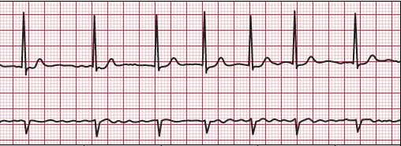
Atrial fibrillation (AF)

Slide 33
Ventricular extrasystoles
= Premature ventricular beats
= Premature ventricular contractions
= Premature ventricular complexes (PVCs)
A ventricular premature beat is an abnormal beat that arises from the ventricles and occurs before the expected sinus beat.
The antegrade impulse originating in the sinus node (resulting in normal atrial depolarization) and the retrograde impulse traveling towards the atria from the ventricles may meet in the AV node. Then neither can spread further because of the other's refractory period.
Thus, the next sinus impulse from the SA node reaches the ventricles in its normal timing. It finds the ventricles still in the effective refractory period of the abnormal impulse. So, it will be ineffective.
The ventricles then, wait in diastole for a longer period (fully compensatory pause) until the next impulse from the SA node arrives to excite them and start the next systole.

Slide 34
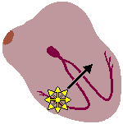
Ventricular tachycardia (VT)
Ventricular tachycardia is defined as: three or more beats of ventricular origin in succession at a rate greater than 100 beats/min.
The heart rate is usually about 200 beats/minute.
The mechanism of VT is a high rate of discharge from an ectopic focus or circus movement in the ventricles.
During ventricular tachycardia, pumping blood is less efficient because the rapid ventricular contractions prevent the ventricles from filling adequately with blood. As a result, less blood is pumped to the body. The reduced blood flow to the body causes weakness, dizziness, and fainting.
Torsade de pointes is a form of ventricular tachycardia in which the QRS morphology varies.

Slide 35
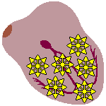
Ventricular fibrillation
Ventricular fibrillation occurs when the ventricles are stimulated to beat repeatedly and in an irregular uncontrolled manner at very rapid rates.
Ventricular fibrillation is usually caused by several ectopic foci in ventricles that fire independently.
As a result, ventricular contractions are not synchronized → ineffective ventricular contraction → loss of pumping action of the heart → no pulse.
If circulation is not restored in less than 4 minutes through external cardiac compression or electrical defibrillation, irreversible brain damage occurs and death is imminent.

Slide 36
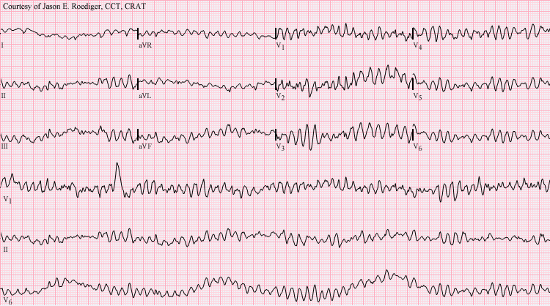
Ventricular fibrillation
There are no normal-looking QRS complexes

Slide 37
Other arrhythmias due to disturbances
of impulse conduction
Heart block
= Atrioventricular (AV) block
Arrhythmias due to Alterations in impulse conduction
Bundle branch block

Slide 38
Atrioventricular (AV) block
There are 3 degrees of AV block:
1st degree block (partial block): all impulses pass through the AV node but with greater than normal delay.
2nd degree block: some, but not all impulses pass through the AV node.
3rd degree block (complete block): no impulses pass through AV node → atria and ventricles beat independently.

Slide 39
1st degree AV block
1st degree block: all impulses pass through the AV node but with greater than normal delay. Every P wave is followed by R wave. P-R interval > 0.2 second.

Slide 40
2nd degree AV block
Mobitz I: Progressive increase in P-R interval until one QRS is dropped.

Slide 41
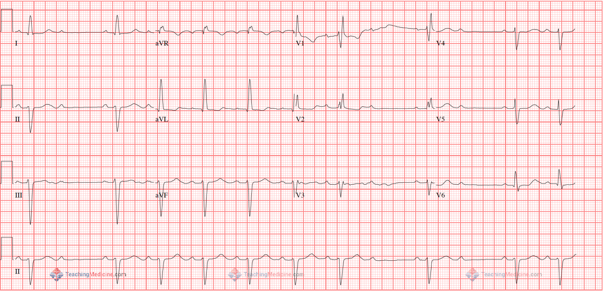
2nd degree AV block
Mobitz II: with 2:1 Block.

Slide 42
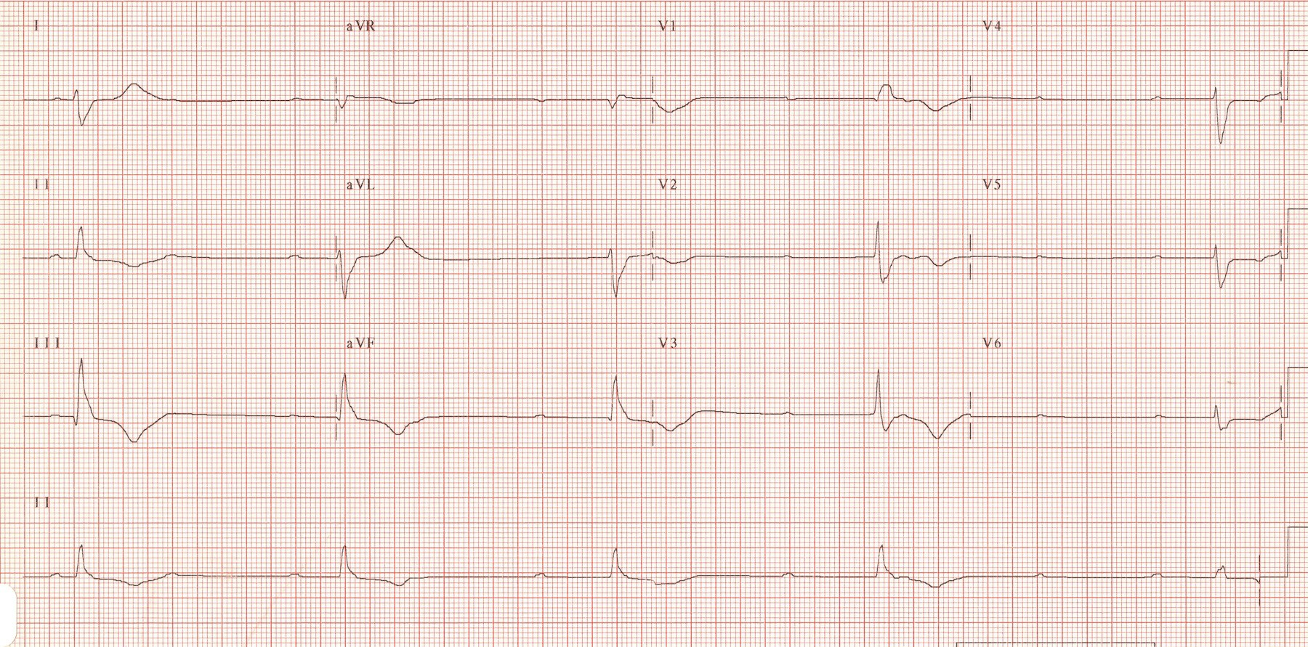
3rd degree AV block
Complete dissociation between P wave and QRS complex.
Third-degree AV block (complete heart block). Atrial rate is 100 beats/min; ventricular rate is 57 beats/min.

Slide 43
Intended learning outcomes (ILOs)
After reviewing the PowerPoint presentation and the associated learning resources, the student should be able to:
Define the normal sinus rhythm.
Classify cardiac arrhythmias.
Discuss the mechanisms of cardiac arrhythmias.
Describe the ECG diagnosis of important cardiac arrhythmias.

Slide 44
Thank You

