Slide 1
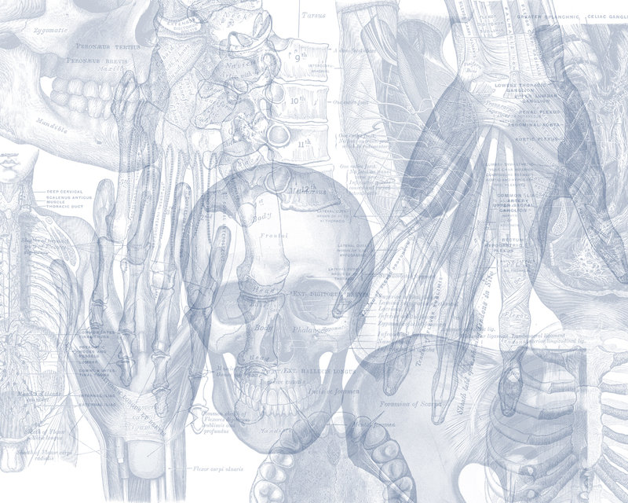
OSPE CARDIOVASCULAR BLOCK
Color Code
Nerves
Arteries
Veins
Muscles
Lymphatics

Slide 2
اللهم لا سهل إلا ما جعلته سهل وأنت تجعل الحزن إذا شئت سهل
Important Points
Read the questions carefully.
Make sure your write the FULL name of the structures with the correct spelling.
Example: SVC ✕→ Superior Vena Cava ✓
Thoracic aorta ✕→ Descending thoracic aorta ✓
3. There is NO guarantee whether or not the exam will go out of this file.
Good luck!

Slide 9
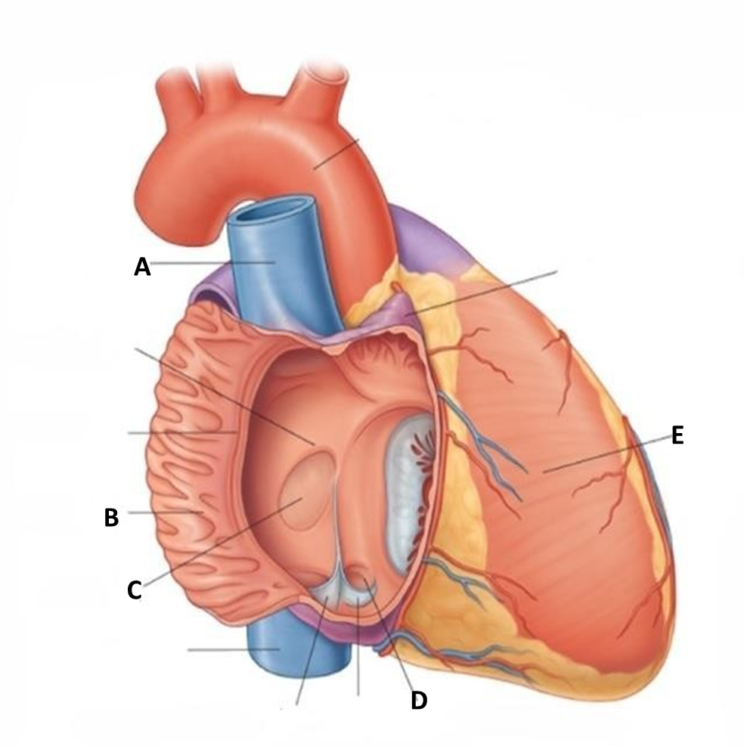
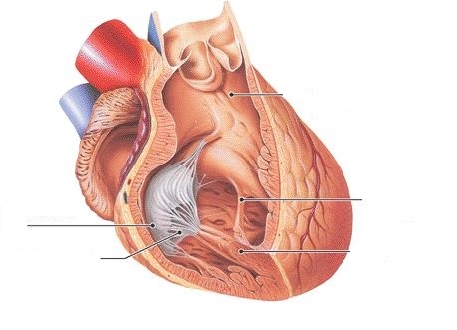
Identify :
A: Superior vena cava.
B: Musculi pectinate of right atrium.
C: Fossa ovalis.
D: Opening of coronary sinus.
E: Right ventricle.
a. Pulmonary valve.
b. Tricuspid valve (right atrioventricular valve).
c. Chordae tendineae.
d. Papillary muscle.
e. Moderator band.
a
e
b
c
d

Slide 10
Identify :
Internal jugular vein.
Facial vein.
Subclavian vein.
Brachiocephalic vein
Vertebral vein.
a
e
b
c
d

Slide 11
Identify :
a b
a. Right adrenal (suprarenal) vein
b. Renal vein
c. Left gonadal vein
Inferior vena cava
Common iliac vein
c
d
e

Slide 12
Identify :
A
B
C
A: Left pulmonary veins.
B: Coronary sinus/sulcus.
C: Left ventricle.
D :Right pulmonary veins.
E: Inferior vena cava.
F: Left atrium.
A
D
F
B
E
C

Slide 16
Identify :
A= External carotid artery
B= Facial artery
C= Internal carotid artery
D= Common carotid artery

Slide 17
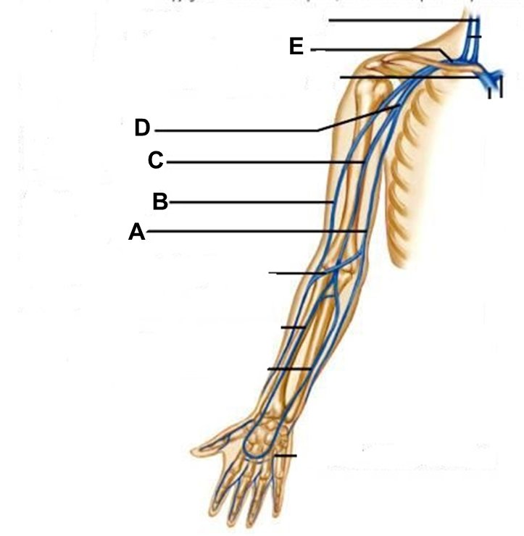
Identify :
E
F
Note: they might show you the veins but from the posterior view. Make sure you can tell which side is medial and which side is lateral (anatomically) to answer correctly.
Basilar artery
Internal carotid artery
Brachiocephalic trunk
Arch of aorta
Vertebral
Common Carotid
Basilic vein
Cephalic vein
Brachial vein
Axillary vein
Subclavian vein

Slide 19
The heart is surrounded by a fibroserous sac called pericardium which is differentiated into:
an outer fibrous layer (Fibrous pericardium)
inner serous sac (Serous pericardium).
Apex of the Heart
It is formed by the left ventricle.
Lies at the level of left 5th intercostal space (3.5 inch from midline.)
Arch of Aorta
Continuation of the ascending aorta.
Leads to descending aorta.
Located behind the lower part of manubrium sterni and on the left side of trachea.
Branches :
Brachiocephalic trunk.
Left common carotid artery.
Left subclavian artery.
Ascending aorta
Originates from left ventricle.
Continues as the arch of aorta
Has three dilatations at its base, called aortic sinuses
Branches :
Right & Left coronary arteries (supplying heart), arise from aortic sinuses.

Slide 20
Identify :
A= Portal vein
B= Splenic vein
C= Superior mesenteric vein
D= Inferior mesenteric vein
Note:
Immediately before reaching the liver, the portal vein divides into right and left that enter the liver.
Tributaries:
right and left gastric veins,
cystic vein,
para-umbilical veins.

Slide 21
Identify :
A= Internal jugular vein
B= External jugular vein
C= Subclavian vein
D= Right brachio-cephalic vein

Slide 22
External jugular vein
Superficial Veins
Lies superficial to the sternomastoid muscle
It drains blood from:
Outside of the skull
Deep parts of the face.
Common carotid (internal & external)
The internal has No branch in the neck
It will join basilar artery to form arterial circle of Willis’
It supplies : Nose , Scalp , Eyes
External carotid : it divides behind the neck of mandible into superficial temporal & maxillary arteries.
Internal jugular vein
Deep Veins
Drains blood from the brain ,face, head & neck.
It descends in the neck along with the internal and common carotid arteries and vagus nerve ,within the carotid sheath.
Joins the subclavian vein to form the brachiocephalic vein.
Tributaries:
Superior thyroid
Lingual
Facial
Pharyngeal.
Occipital veins
Dural venous sinuses (inferior petrosal sinus).
Subclavian artery:
Its main branches:
Thyrocervical trunk: supplies thyroid gland & neck
Vertebral artery: supplies brain & spinal cord (passes through transversus processes of the cervical vertebrae)
Internal thoracic artery: supplies breast & thoracic wall
Right subclavian + Right common carotid form Brachiocephalic trunk But the left one forms Arch of aorta .

Slide 25
Done by:
Mohammed Ghandour
Mohammed Alyousef
Jawaher Abanumy
Special Thanks to TEAM 434
anatomyteam436@gmail.com
@anatomy436

