Slide 1
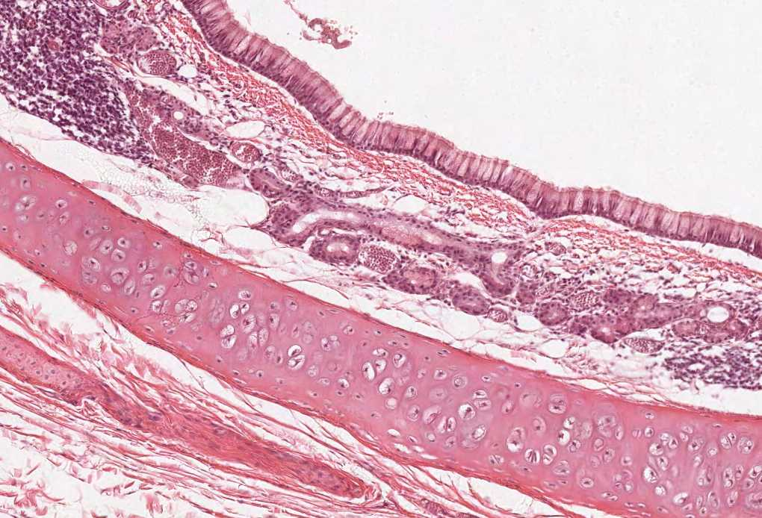

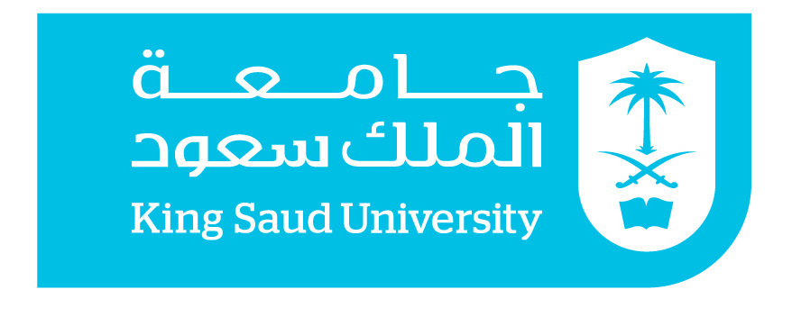
Practical Histology
Cardiovascular block

Slide 2
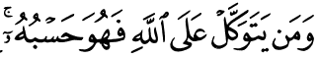

Things you need to know before the exam :
The pictures in the exam will be the same as the ones included in the slides.
Don’t try to take short cuts during the exam so avoid using abbreviations so you don’t lose marks.
Please keep in mind that this work is done by students , so if there are any mistakes please inform us .
This work is not by any means a reference.
Please study hard and don’t worry the exam will be easy!!

Slide 3
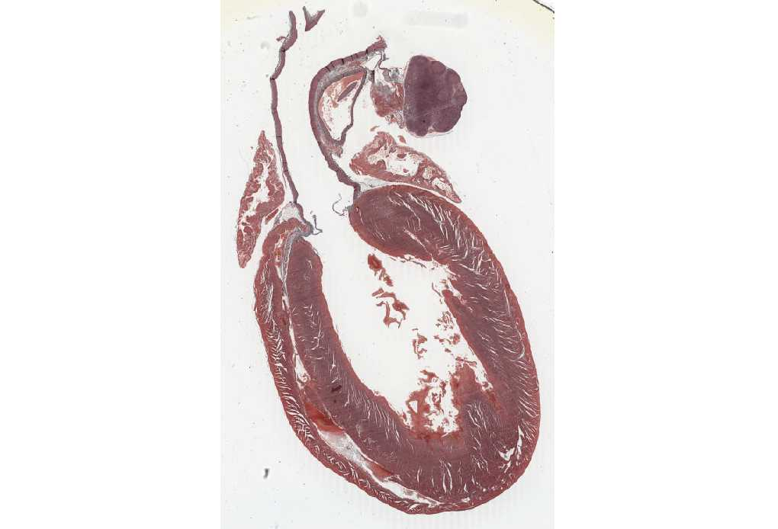
Wall of the Heart
Cardiac Valves “ cusps “
The wall of heart composed of:
Endocardium ( most inner layer )
Myocardium
Epicardium ( most outer layer )
Type of epithelium found endocardium :
Endothelium which is SIMPLE SQUAMOUS EPITHELIUM
Type of epithelium found in epicardium :
Mesothelium which is SIMPLE SQUAMOUS EPITHELIUM

Slide 4
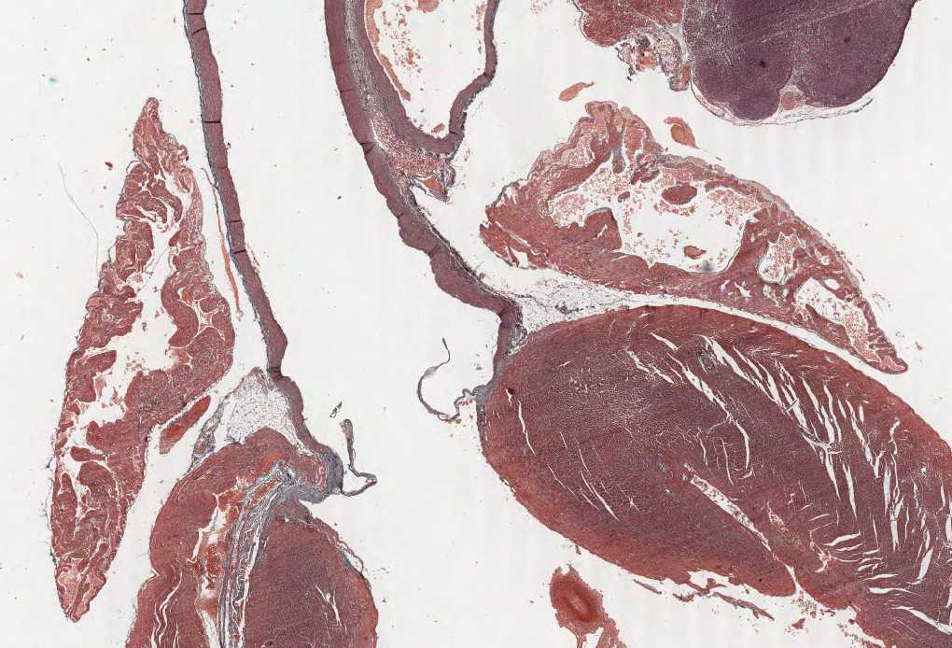
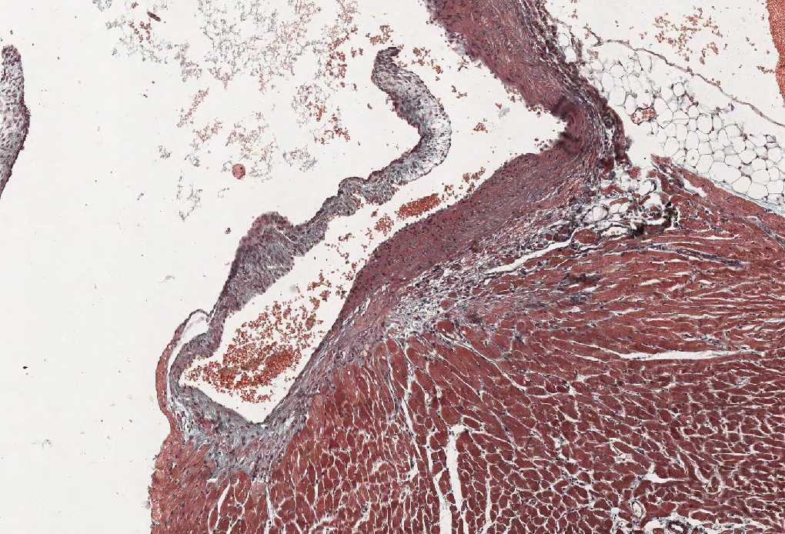
Cardiac Valve
Identify the structure :
Cardiac Valve
Each cusp of the heart valve is formed of :
A core of Dense irregular C.T. , this core is cover by endothelium
Features:
Avascular
Blood capillaries can be found only in the base “root” of the cusp.

Slide 5
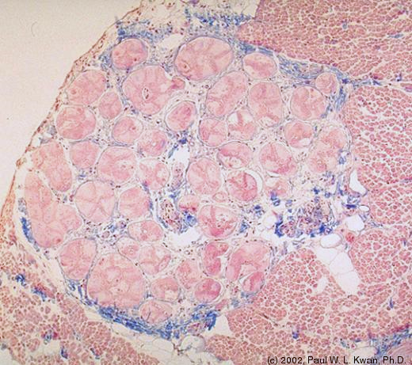
Moderator Band
Endocardium
Myocardium
Lumen
Features:
Present in the right ventricle.
Contains purkinje fibers.
it’s a modified cardiac muscle
Moderator band

Slide 6
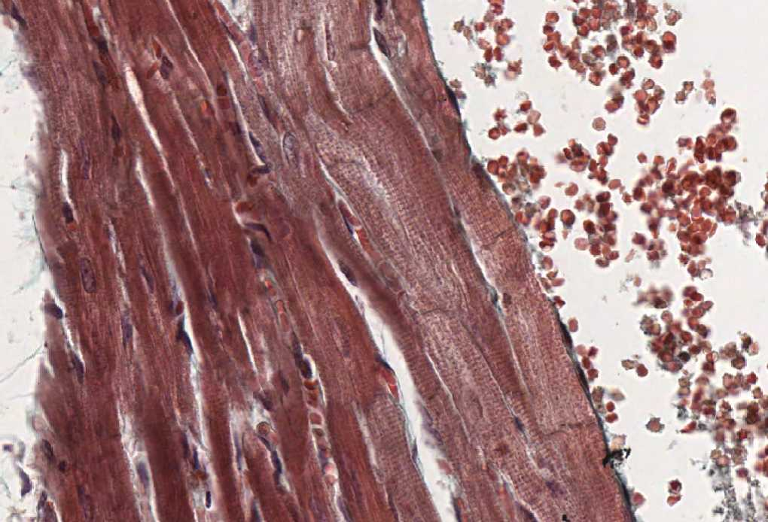
Endocardium and Myocardium
Identify A and B :
A: Endocardium
B: Myocardium.
A
B
Features of the endocardium:
Endothelium.
Subendothelial C.T.
Dense C.T. layer.
Subendocardial layer.

Slide 7
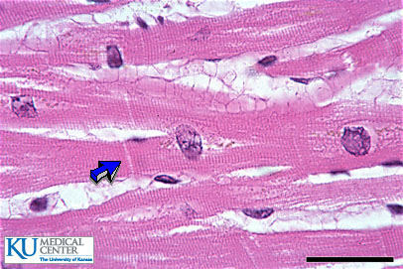

Myocardium
Features:
Intercalated discs (blue arrow).
Endomysium which is a loose C.T. (Yellow arrow)
Nuclei of myocardial cells:
Central and round nuclei.
(Black Circles)

Slide 8
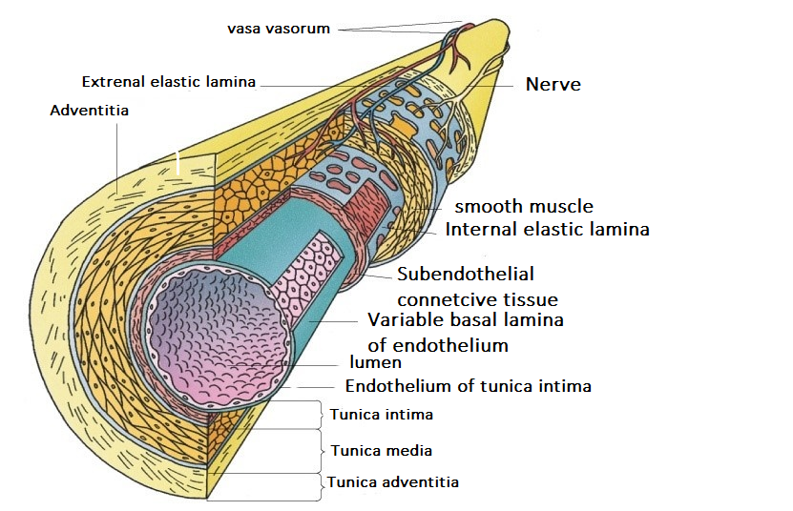
EXTRA FOR UNDERSARINDING THE LAYERS OF A BLOOD VESSEL
Tunica adventitia
(vasa vasorum)
Tunica media
Tunica intima

Slide 9
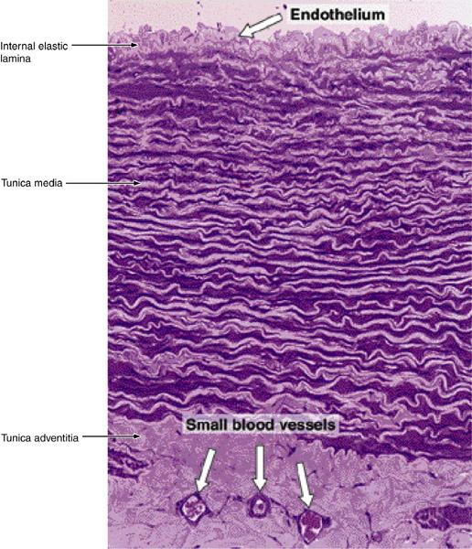
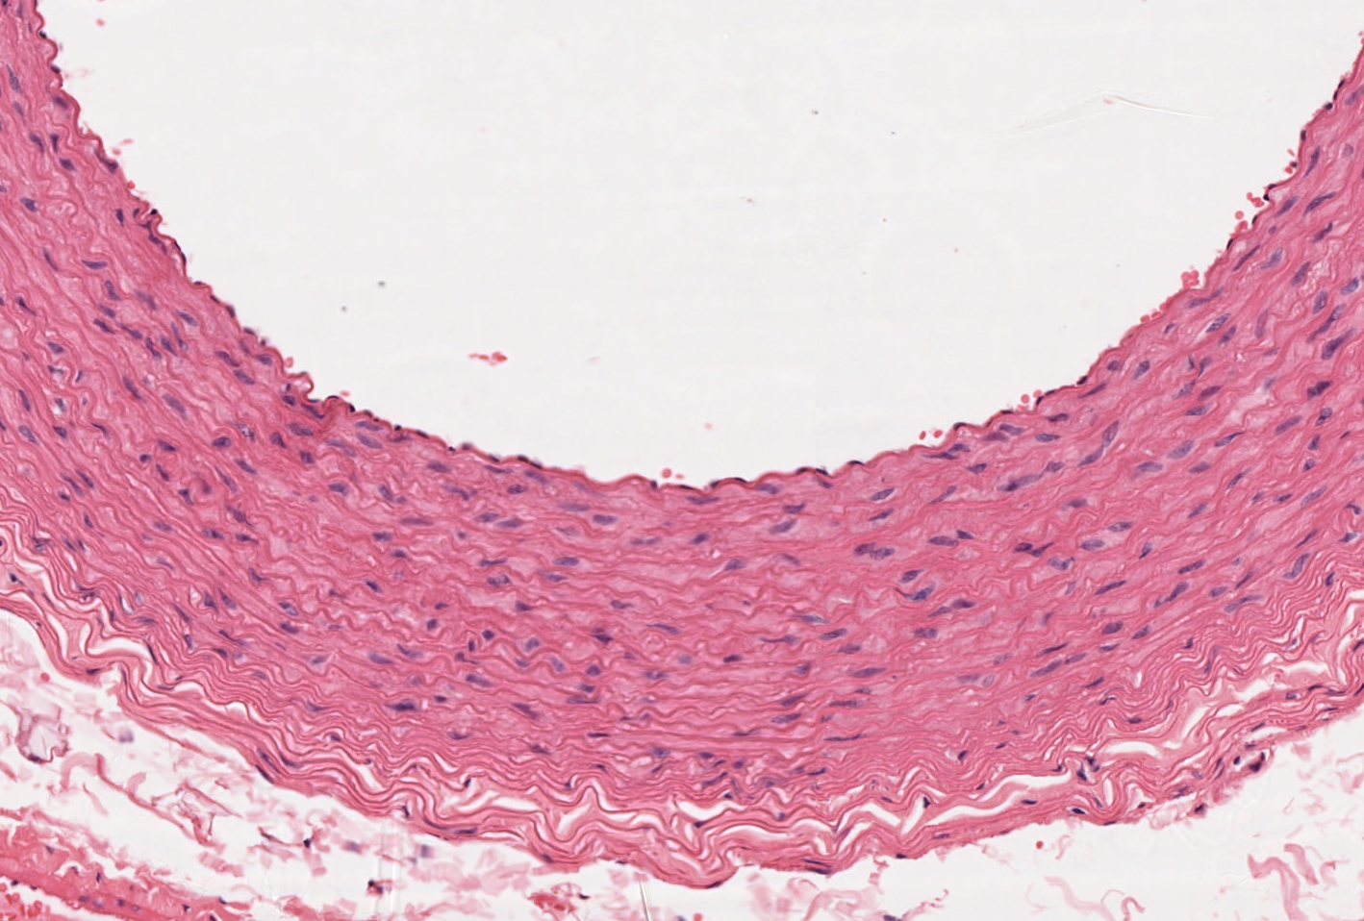
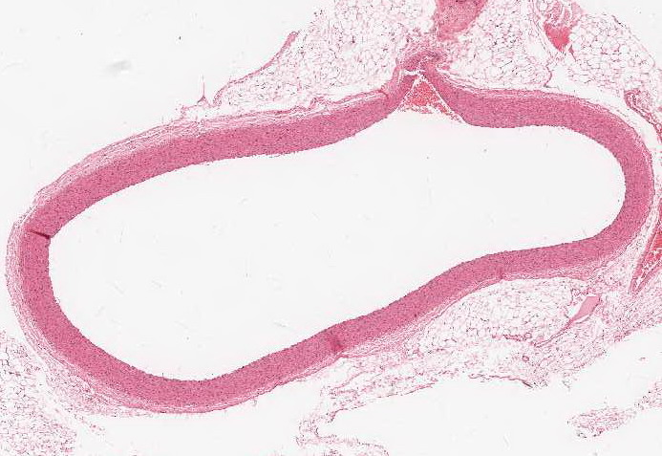
Elastic Artery
Features:
Endothelium in the Intima
Fenestrated elastic lamellae (membrane) in the media.
Vasa vasorum in adventitia and outer part of the media (for blood supply)
Examples:
Aorta and Pulmonary Trunk

Slide 10
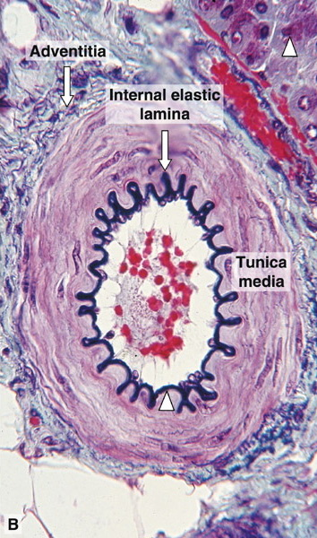
Muscular Arteries
(Medium-sized Artery)
Identify the structure:
Muscular Arteries or Medium-sized Artery
Features:
Prominent internal elastic lamina.
T. Media is rich in smooth muscle cells.
T. Media is Thicker than T.Adventitia.
Examples:
Brachial, Ulnar and Renal Artery

Slide 11
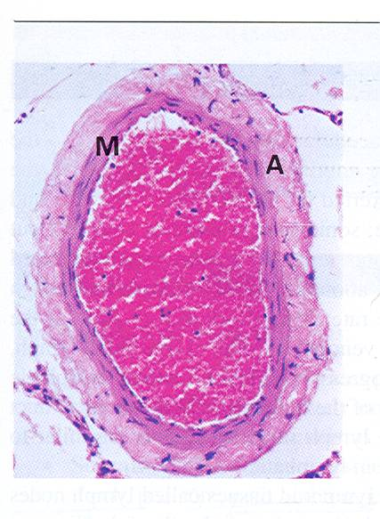
Medium-sized Vein
Identify:
Medium-Sized Vein
Features:
NO internal elastic lamina.
Type I & III Collagen fibers in T. Media.
T. Media is Smaller than T.Adventitia.
T. Media contains smooth muscle cells

Slide 12
Comparison between medium-Sized Artery and Vein
A : Artery
V : Vein
Valve
A
V
A

Slide 13
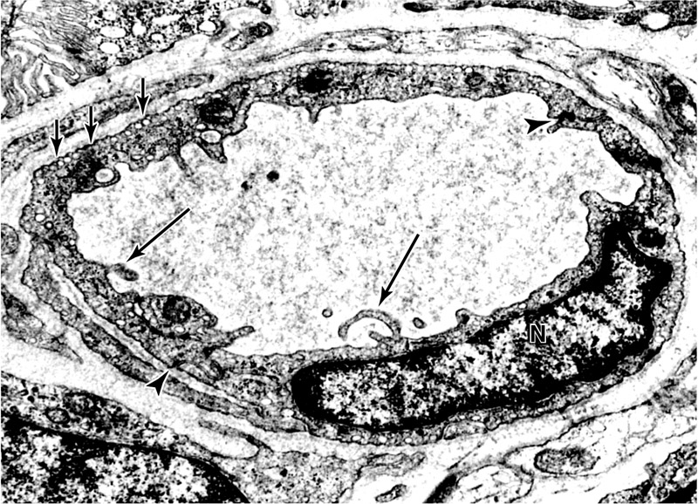
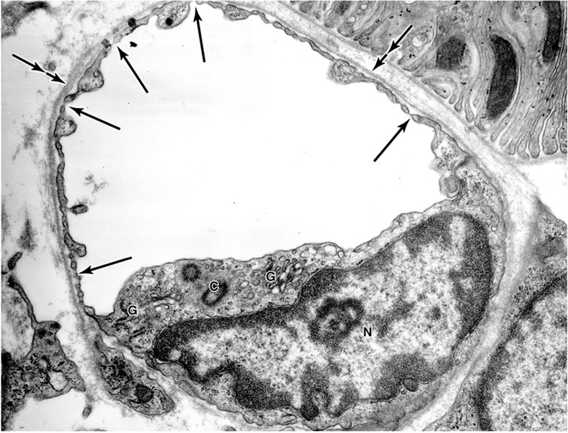

Blood capillaries
Continuous Blood Capillary
Fenestrated Blood Capillary
Pericyte
Nucleus of the endothelial cell
Nucleus of the endothelial cell
Note: The fenestrated blood capillaries
without diaphragm are found only in the kidney
Features:
Fenestrated Blood capillary
with diaphragm.
Distribution:
Intestine.
Pancreas.
Endocrine glands.
Features:
Continuous Blood Capillary no pores “fenestrae”.
Distribution:
Muscle.
Nervous Tissue.

Slide 14
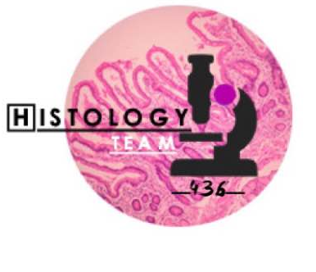


Thank you & good luck
- Histology team
Done by :
Team leaders
Team leaders:
Rana Barasain
Faisal Alrabaii
Please if you need anything or even further explanation contact us on :
HistologyTeam436@gmail.com
@histology436

