Slide 1
Please Read This Notes!
This file contain the 4 lectures.
This work is not by any means a reference.
Please keep in mind that this work is done by students , so if there are any mistakes please inform us .
Some slides have notes and extra explanation that will help you to understand the contents, please see it.
Some lectures (especially ECG) have different contents between males and females.
We put all the contents of male / female slides to make sure that the file is including everything
we put this sign ( ) for the very important notes from doctors .
Please study hard and don’t worry the exam will be easy !
GOLDEN ADVICE >>> STUDY SMART <<<
تفسير الملاحظة اعلاه :
حاولنا في هذا الملف أنه يكون شامل لجميع المعلومات اللي موجودة في سلايدات العيال و البنات ... أي شي جمبه هذه العلامة يعني أنه مهم جدا و أكد عليه الدكتور في المراجعه, بالتوفيق للجميع .

Slide 2


ElectroCardioGraphy
Contents :
ECG paper.
ECG leads
Limb leads.
Chest leads.
Interpretation of the ECG.
Cardiac axis
Heart rhythm.
Heart rate
Physiology lab Team 436 – Respiratory block
This work include Boy’s + girl’s slides + girl’s handout

Slide 3
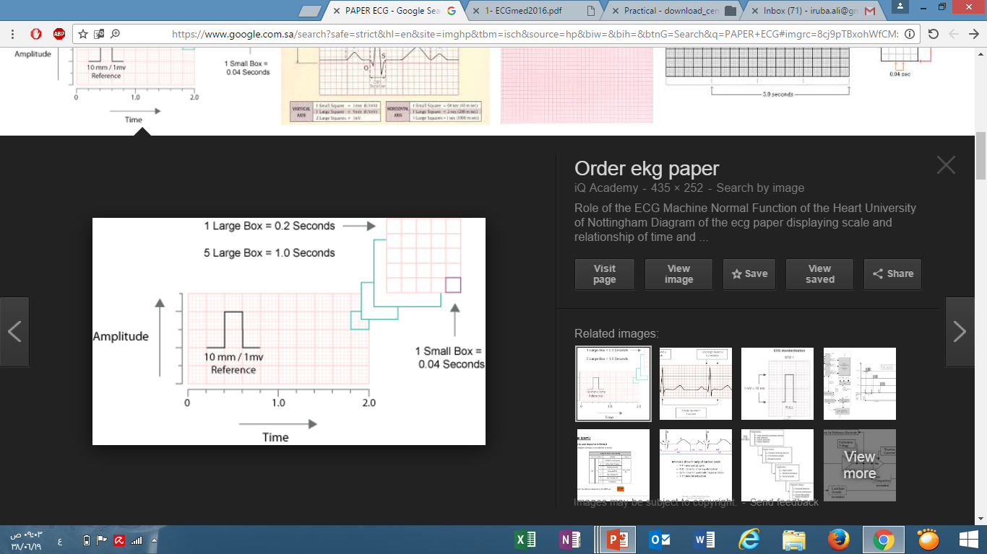
principle of ECG
ECG : is the algebraic sum of all electrical potentials (depolarization and repolarization) that take place in the heart/cardiac cycle .
These electrical potentials can be detected by electrodes attached to the surface of the body. Because body fluid is good conductors of electricity
Subject position (patient) : supine, relaxed , avoid sweating and muscle movement to minimize artifacts .
Room temperature : neutral.
ECG paper : The ECG is recorded on a graphic paper with standard-sized squares (lines are 1mm apart).
ECG paper speed : 25mm/sec.
What can we obtain from an ECG ?
Heart Rate
Electrolyte Disturbances
Drug toxicity
Myopathies
Heart Rhythm
i.e. hyperkalemia, hypokalemia
digoxin and drugs which prolong the QT interval
Electrodes عبارة عن أقطاب تنحط على الجسم و تقوم بكشف الإشارات الكهربائية.

Slide 4
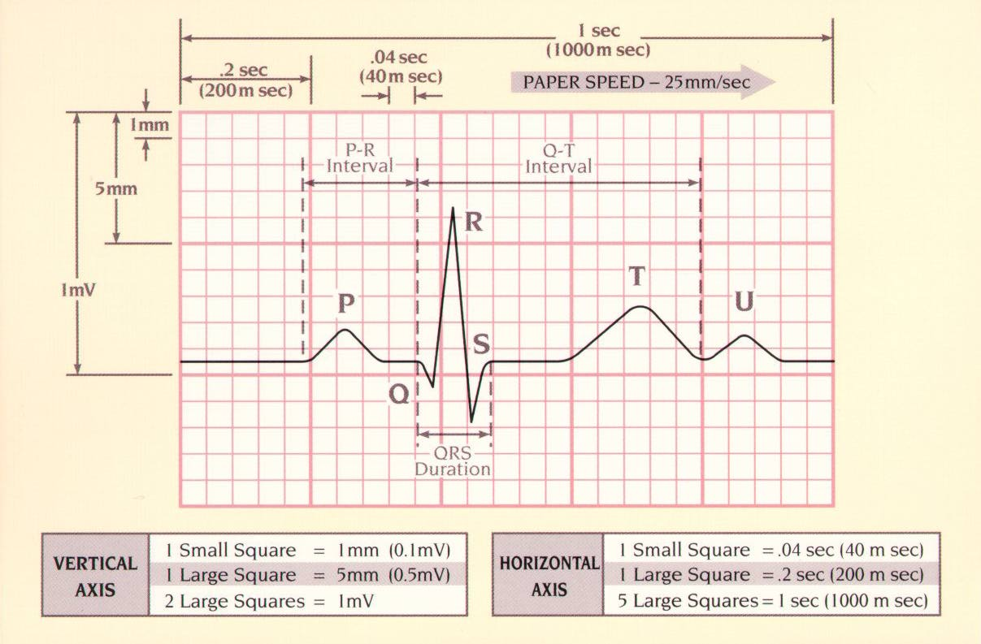
ECG paper
All details in the diagram are important
Large squares are defined by dark lines and are 5 small squares high x 5 small squares long
Explanation :
1 large sq = 5 small sq
0.04 x 5 = 0.2 sec
5 large sq = 0.2 x 5 = 1sec
Explanation : 10mm = 1cm = 1 millivolt = 2 large sq
The vertical axis represents the change of voltage.
The horizontal axis represents the time measured in seconds.
ليش مهمة : في الإختبار ممكن يعطيك رسمة زي هذه و يقولك مثلا احسب لي Q – T Interval, عشان كذا لازم تعرف كل مربع صغير عبارة عن ايش من الجهة الأفقية و من الجهة العمودية.

Slide 5
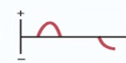
The 12 standard ECG leads
*** YOU Have to know the difference between them***
A lead is : a pair of electrodes joined together to record the potential difference between the two electrodes
Frontal Plane ( 6 limb leads) |  |  | Transverse Plane (6 chest)
Bipolar Leads: I , II , and III |  | Unipolar leads: aVR, aVL, aVF | Unipolar chest leads: V1 to V6
Record : the difference in potential between 2 active electrode (limbs ) ECG is recorded by : placing electrodes on 3 places: Right arms , Left arms , Left leg 2 electrodes : one is (Recording +ve Ede) , Other is (-ve reference Ede) |  | Record : of 1 active electrode and other inactive electrodes (provides resistance to the inactive electrodes making their potential zero)
 |  | Recordings : between 1limb and the other 2 limbs: aVR (augmented Voltage Right arm) = active Ede (+ve) is placed on right arm while the other Edes are made inactive. aVL: active Ede (+ve) is placed on left arm while the other Edes are made inactive aVF: active Ede (+ve) is placed on left leg while the other Edes are made inactive | 6 standard chest leads depict electrical events in the horizontal plane. One +ve Ede is placed on 6 different positions Around the chest. The reference –ve Ede is combined with limb lead ( 3unipolar limb + 3bipolar).
Depolarization moving towards a +ve Ede produces a +ve deflection. ( ) | Depolarization moving in the opposite direction produces a -ve deflection. ( )
Bipolar Leads will be explained in details, see image 1 on the next slide.
see image 3 on the next slide
see image 2 on the next slide
Ede = electrode
Why Unipolar ?
Because They are single active Ede + inactive Ede.
aVF, aVR & aVL are Not present when practice… why ?
Because the are the same electrodes used for lead I , II and III.

Slide 6
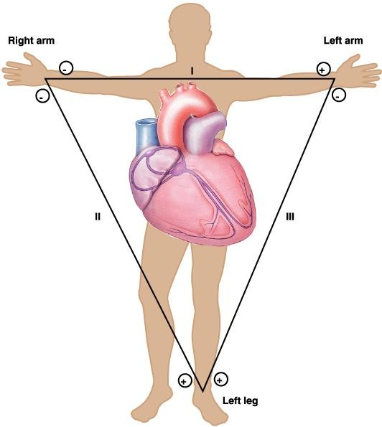
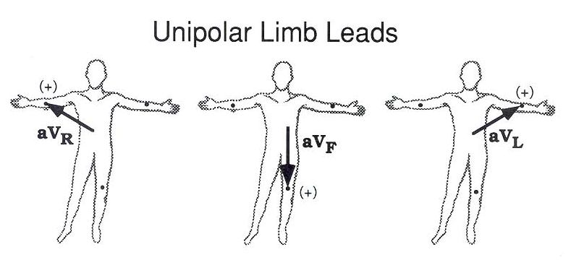
Cont…
Image 1
Image 2
-
Lead 1
+
-
-
Lead II
Lead III
+
+
Lead I: Right arm Ede is –ve, while Left arm Ede is +ve
Lead II: Left foot Ede +ve , while right arm Ede is -ve.
Lead III: Left foot Ede is +ve , while left arm Ede is -ve.
The 3 leads arranged as a triangle are known as
Einthoven’s triangle.
Image 3
Remember :
+ ve Ede = Active electrode.
- ve Ede = Reference electrode.
Direction of the lead : from – to +
في الإختبار ممكن يعطيك رسمة زي اللي على اليسار و يأشر لك مثلا على مكان محدد و يقولك أيش اسم lead هذا ... عشان كذا لازم تعرف كل lead وين مكانه + ‪‬اذا كان bipolar lead تحدد وين قطبه السالب و الموجب.

Slide 7
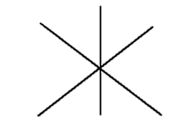
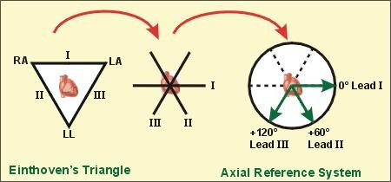
ECG leads Angles
Bipolar Leads: I , II , and III | Unipolar leads: | Unipolar chest leads:
By bringing the sides of the triangle to the common center. The axis are : 60° apart. Axis of a lead: direction from the negative to the positive electrode Angles : Lead I (+) is at 0° Lead II (+) is at +60° Lead III (+) is at +120 | leads aVR, aVL, aVF cross at angles and produce an intersection of 3 other lines Angles of 60° like for lead I, II, III aVR(+) is at -150° aVL (+) is at -30° aVF (+) is at +90 | V1 – Right sternal border, 4th ICS ( intercostal space) V2 – Left sternal border, 4th ICS. V3 – Halfway between leads V2 & V4. V4 – Left mid-clavicular line, 5th ICS. (in women: under breast) V5 – Anterior axillary line, 5th ICS. (horizontal to V4) V6 – Mid axillary line, 5th ICS. (horizontal to V5)
 | Leads aVR, aVF, aVL divide the angles formed by lead I, II, III. The leads cross precisely at 30°
0°
توضيح:
لما ندمج رسمة (I , II , and III ) مع رسمة (aVR, aVF, aVL ) راح يطلع لنا هذه الرسمة و راح تكون مقسمة بزوايا مقدارها 30 وهذا يفسر لنا كيف طلعنا (-150° , -30°, +90 )
(نبدأ حساب الزوايا باتجاه عقارب الساعة )
عكس عقارب الساعة = سالب
More explanation for this pic on # next slide
Just understand it

Slide 8
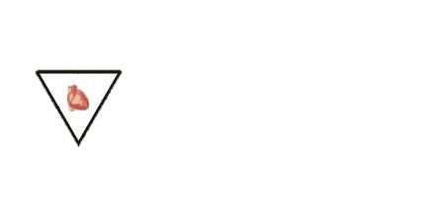
Explanation (if u understand it just skip it )
The heart is the reference point
Lead 1 is horizontal = no angle is made
بما ان زاوية lead I تساوي صفر لأنها افقية مع القلب ... لو حطينة منقلة على lead II في الرسمة اللي على اليمين حنلقى أن الزاوية بين lead II و الخط الافقي 0° ( اللي عليه lead I) تساوي °60 , و لو حطينا المنقلة على lead III حنلقى أن الزاوية بين lead III و الخط الافقي 0° ( اللي عليه lead I) تساوي °120 .

Slide 9

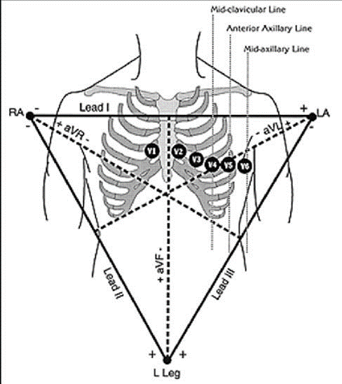
The standard 12-lead ECG
How many electrodes are there ?
10 electrodes (3 unipolar + 6 chest electrode + one on the right foot (للتصفير).
How many leads are there?
12 leads.
الفرق بين ال Electrodes و ال leads :
Electrodes هي الأقطاب اللي نحطها على الجسم اما Leads فهي القراءات الي تطلع لنا.
As summary :
Types of lead | Limb leads | Precordial or chest leads
bipolar | I , II , and III (standard limb leads) | -
unipolar | aVR, aVL, aVF (augmented limb leads) | V1-V6

Slide 10
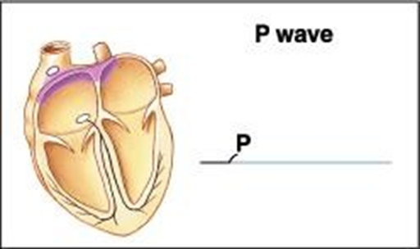
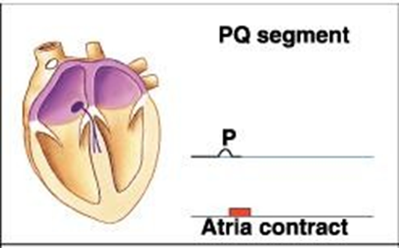
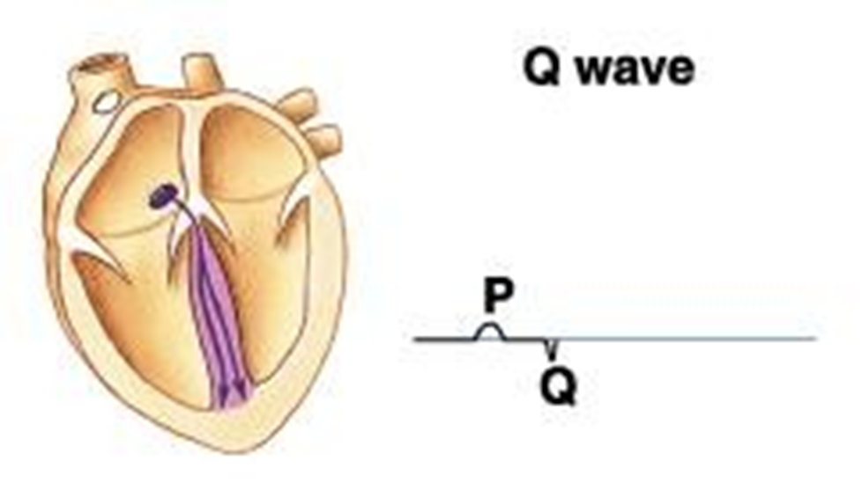
Interpretation of the normal ECG
 | Normal range | Wave\ segment | cause | Definition
 | Pw: <0.12 sec < 2.5 mm | P wave | Positive Upward Deflection | - The impulse originates at SA node . - Then spreads through the atria | Atrial Depolarization (Activation) Represented by : P wave
 | ------ | Q wave (During PR segment) | Negative Downward Deflection | The impulse spreads to : 1- the AV node 2- common bundle of His 3- R & L bundle. - branches then enters the IV septum | Septal Activation (Depolarization)
We advise you to apply the definition on the images.

Slide 11
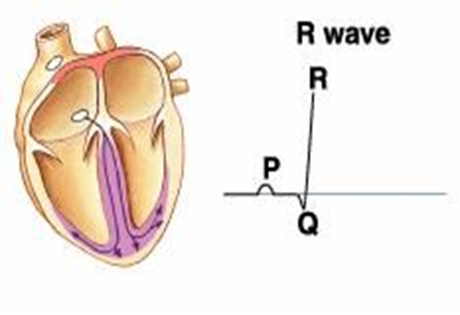
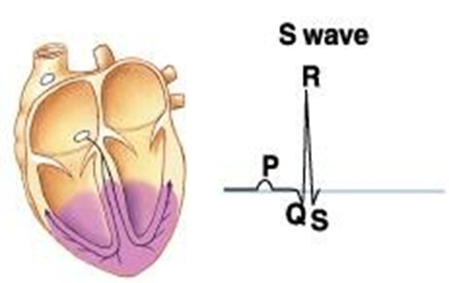
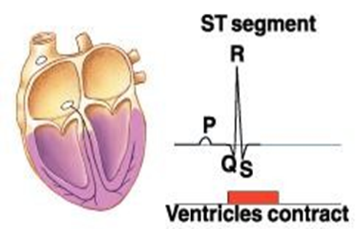
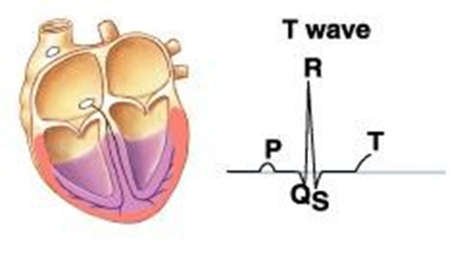
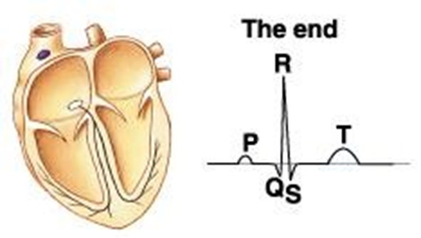
Interpretation of the normal ECG
 | Normal range | Wave\ segment | Definition
 | QRS duration: < 0.10 sec. | -Q wave : The initial negative deflection. - R wave : The first positive deflection . -S wave :The negative deflection after R wave. So : QRS complex represent : Ventricular Depolarization | The wave of depolarization spreads in the Purkinje fibers to all parts of the ventricles. | Ventricular Depolarization Represented by : QRS complex
 | (ventricular dep and rep) < 0.43 sec. ST interval: QT-QRS = 0.32 sec. | ST segment: period between the end of QRS and the start of T wave. QT interval: from beginning of Q wave to end of T wave | represented by ST segment and T wave. | Ventricular Repolarization Represented by :T- wave
We advise you to apply the definition on the images.

Slide 12
ECG intervals
The intervals are explained in details on the next slide with the important things
Intervals | Normal duration |  | Event in the heart during interval | ECG abnormalities
 | Average | range
PR interval = P wave + PR segment | > 0.18 | 0.12 - 0.20 seconds ( >1 large square) | Time of transmission of electrical impulse from the beginning of atrial depolarization (P wave) & conduction through AV node to the beginning of ventricular depolarization (R wave in case Q wave is absent ) | PR prolonged : >0.20 sec. First degree heart block PR shortens : heart rate increases.
QRS duration | 0.08 | 0.08 - 0.10 | Ventricular depolarization & atrial repolarization(from Q wave to S wave ) | -
QT interval | 0.40 | 0.40 - 0.44 | Ventricular depolarization +ventricular repolarization (from Q wave to the end of T wave) | Prolonged QT interval: hypocalcaemia Short QT interval: hypercalcaemia
ST interval = QT - QRS | 0.32 | - | Ventricular repolarization | ST elevation, T inversion, large Q wave : myocardial infarction Tall T wave : hyperkalaemia.
U wave (not prominent & not an iinterval) | - | - | Present due repolarization of hypertrophied papillary muscle | Prominent U wave: hypokalaemia
For extra understanding, ECG abnormalities ( from 435 ) :
Prominent U wave
Tall T wave
Prolonged QT interval
VS.
VS.
Short QT interval
Normal QT interval

Slide 13
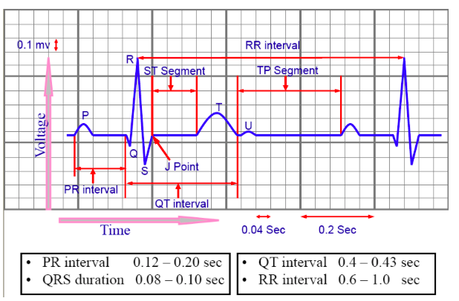
Example 1 : Calculate the duration of R – R Interval in the diagram above. What is the normal value for it? (they can ask u about any other interval)
Solution : Number of small squares between R - R * 0.04
= 18 * 0.04 → 0.72 second . Normal value = 0.6 – 1 second.
-----------------------------------
Example 2 : Is there 1st degree Heart block in this ECG ?
Solution : P – R Interval = 3 * 0.04 = 0.12 sec .
P – R Interval within normal range … no 1st degree heart block
----------------------------------
Example 3 : Calculate Q-T interval an indicate the abnormality’s name (if there is) ?
Solution : Q-T Interval = 8 * 0.04 = 0.32 sec .
Q-T Interval is less than the normal range (short) … Abnormality : hypercalcaemia
If P – R interval above normal range, there will be 1st degree heart block
Hypocalcemia → prolong Q-T interval more than the normal range
في الإختبار ممكن يعطيك رسمة زي هذه و يقولك مثلا احسب لي Q – T Interval , P – R Interval , QRS Complex و يقولك ايش هو normal value حقتها . لا تنسى أنك لازم تعرف كل interval متى تبدأ و متى تنتهي عشان الحسبة تطلع صح.

Slide 14
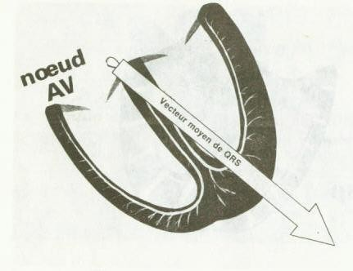
Cardiac axis
The electrical activity of the heart starts at the (SA) node then → to (AV) node. → bundle of His → purkinje fibers which cause ventricular contraction.
So when viewing the heart from the front, the direction of depolarization is 11 o’clock to 6 o’clock.
The direction of the depolarization is called : Mean electrical axis
Which is an electrical axis represent the average direction of the current flow in heart during cardiac cycle
Since it is an ventricular depolarization we can call it : Mean QRS vector
Mean electrical axis angle of the ventricles: from (-30° to 90°) almost 59°
In certain pathological condition :
Mean electrical axis
 | Left axis deviation (LAD) | Right axis deviation (RAD)
Deviate : | to the left (-30° to -90°) | to the right (90°-180°)
Normal in : | Obese people | Thin tall people
Abnormal in | - Left ventricular hypertrophy - Left bundle branch block (LBBB) | Right ventricular hypertrophy Right bundle branch block (LBBB)
Beyond these value: | extreme or far left axis deviation | extreme or far Right axis deviation

Slide 15
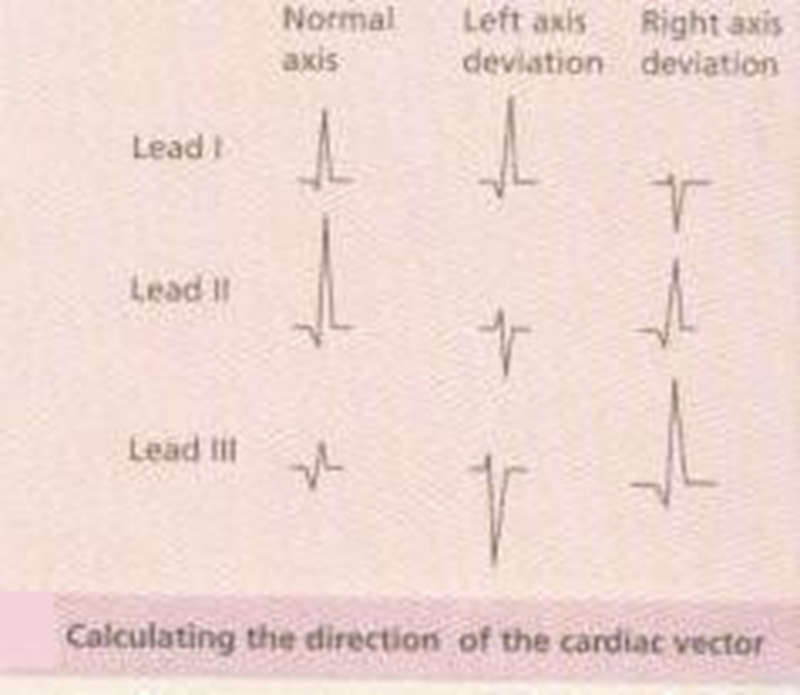
Cardiac axis
Rule of the thumb to determine electrical axis deviation :
R- deflection |  | Axis
Lead 1 | Lead III or aVF
Positive (Up) | Positive | Normal
Positive | Negative(down) | LAD
Negative | Positive | RAD
Negative | Negative | extreme left/right
Explanation of the above :
-If the direction of R-wave is upwards in both the leads I and III, then the electrical axis of the heart will be normal.
-If the direction of R-wave is upwards in the lead-I and is downwards in the lead-III, then the electrical axis of the heart would be deviated to the left.
-If the direction of R-wave is downwards in the lead-I and is upwards in the lead-III, then the electrical axis of the heart would be deviated to the right.
- If the direction of R-wave is downwards in both the leads I and III, then the electrical axis of the heart will be deviated to the extreme left/right
Right axis deviation = (RAD)
Left axis deviation = (LAD)

Slide 16
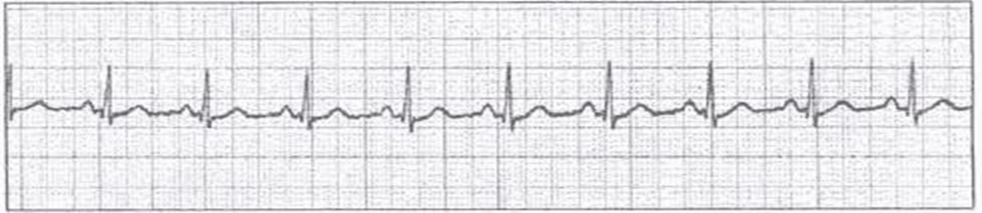
Heart Rhythm
Refer to : regularity with which heart beats.
Impulse arise from : SA node
On exam : They may give you an ECG pic and u should describe it upon the rhythm and rate ?
  First : Rhythm : (see if it sinus or not )
    1- Sinus → P wave before every QRS.
    2- not sinus
  Second : If it is a sinus u should say is it a regular sinus or not
    1- Sinus Regular : distance between R-R is constant → heart beat regularly → rhythm is normal
    2- Irregular : Unequal R-R intervals → Heart beat is irregularly→ arrhythmia
      Sinus arrhythmia it is normal physiological phenomenon when :
        1- Deep inspiration : R waves are closer → Tachycardia
        2- Deep expiration: R waves are far from each other → bradycardia
  Third : calculate heart Rate (on next slide )

Slide 17
Heart rate
It is defined as the time interrelationship between 2 (adjacent) “R” waves.
Examine the distance between : 2 QRS complexes
If the distances are regular, use one of these two formulas:
300
Big squares between R-R
Or :
1500
Small squares between R-R
To obtain the heart rate in beats per minute.
Normal R-R interval : 0.6-1.0 second
Normal HR : 60 – 100 beats / min
HR>100 beat / min = Tachycardia
HR<60 beat / min = Bradycardia
When the speed is 25mm/sec (25 x 60 = 1500)
Which 1500 = total number of small sq pulled by the machine every min (60sec)
so R-R interval = 1 heart beat
Remember :
When R-R = 0.6 ( 3 big squares ) → 300 / 3 = 100
When R-R = 1 ( 5 big squares ) → 300 / 5 = 60
في الإختبار ممكن يعطيك رسمة ECG ويقولك احسب لي ال heart rate .

Slide 18
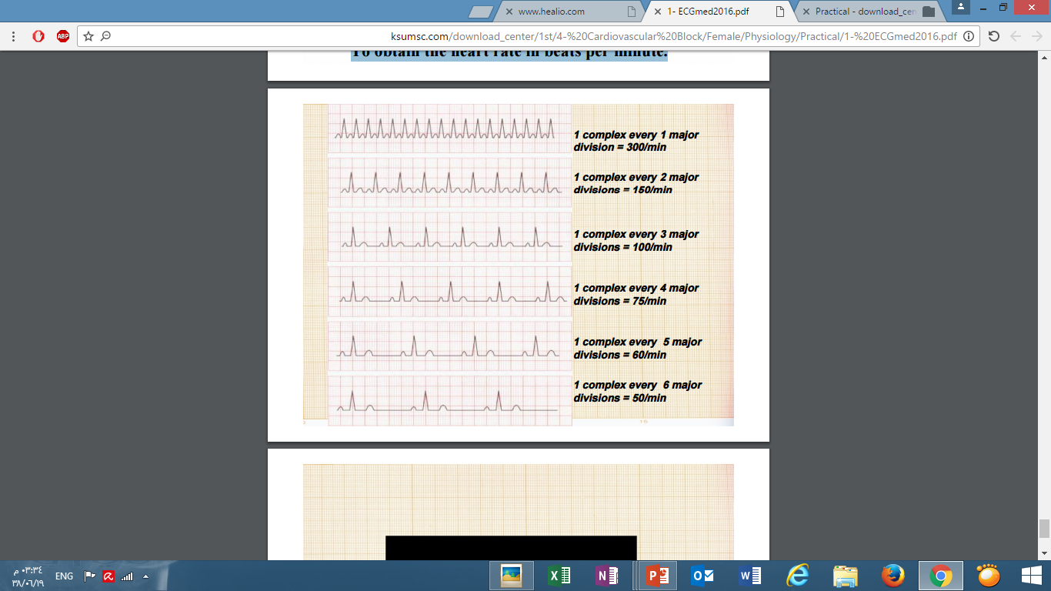
Examine Yourself !! ***
Remember : normal HR : 60 – 100 beats / min
1
1- 1500/5=300b/min. (5= no. of small squares) - HR is above normal → Tachycardia
2
2- 300 / 2 = 150 b\min → Tachycardia
- 2 is number of large sq between R-R
3
3- 300 / 3 = 100 b\min → normal HR
- (3 is number of large boxes between R-R)
4
4- 300 / 4 = 75 b\min → normal HR
- 4 is number of large boxes between R-R
5
5- 300 / 5 = 60 b\min → normal HR
6
6- 300 / 6 = 50 b\min → bradycardia
Remember : You can use both methods to calculate HR.

Slide 19
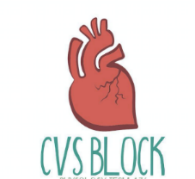
Heart Sounds
Objectives :
• To understand why the different heart sounds are produced.
• To know the sites at which heart sounds are best recorded.
• To recognize the value of phonocardiography.
Physiology lab Team 436 – Cardiovascular block
This work include Boy’s + girl’s slides + girl’s handout

Slide 20
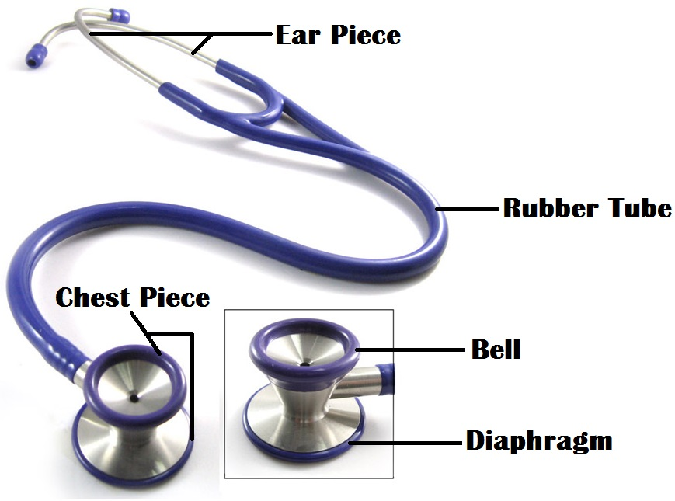
Stethoscope
Just Understand it
Consist of :
Chest piece
Bell
Diaphragm
Ear piece
Rubber tubing
- Light skin contact
- Hearing low frequency sound
- firm skin contact
- Hearing high frequency sound
One way valve system prevents sounds being transmitted by the bell when the diaphragm is being used and vice versa

Slide 21
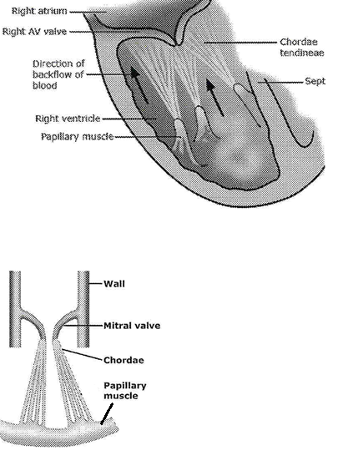
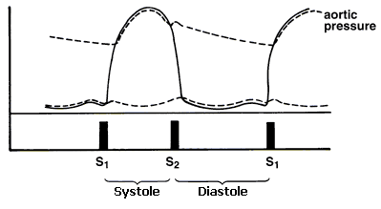
Introduction
There are four heart sounds : SI, S2, S3 & S4.
Phonocardiography: (sound recording device) is the sensitive technique, by which a recording can be made of all four heart sounds by placing a transducer on specific areas of auscultation.
Ventricular diastole period is longer than systole
Ventricular systole is between S1 and S2 explanation: S1 occurs at the beginning of systole ,S2 occurs at the beginning of diastole so the period between them is systole (shorter interval)
Ventricular diastole is between S2 and S1 (longer interval)
Function of papillary muscles and chordae tendineae:
Remember :
The edges of the AV valves are attached to ventricular papillary muscle by the chordae tendineae in order to prevent eversion of valves during ventricular systole.
We identify heart sound based on : character , time interval of separation

Slide 22
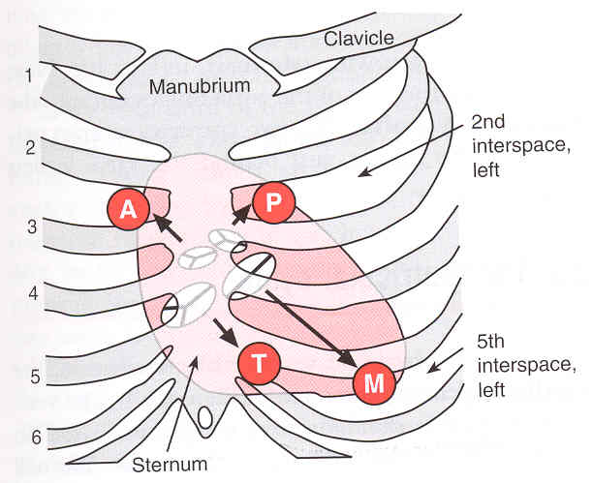
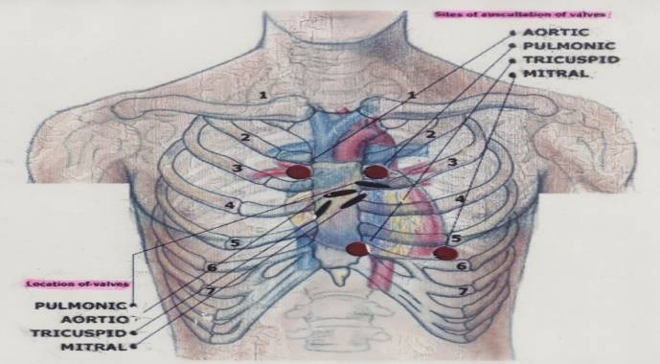
Areas of Auscultation
Position of the patient during auscultation either :
1- supine
2- left lateral
3- sitting
الصور مهمة
All People Take Medicine
Areas of auscultation | Aortic area (A) | Pulmonary area (P) | Tricuspid area (T) | Mitral area (M)
Type of valve | Aortic | Pulmonary | Tricuspid | Mitral
Position | Right to sternum 2nd intercostal space | Left to sternum 2nd intercostal space | Left 5th or 4th intercostal space (left lower border of sternum) . | (site for Apex beat ) on left 5th intercostal space crossing Mid clavicle line
في الإختبار ممكن يعطيك رسمة زي الثنتين اللي فوق و يأشر لك على نقطة معينة و يقولك ايش اسم ال valve اللي ممكن تسمع صوتة في هذه النقطة .
في الإختبار ممكن بعد يسألك عن valve معين , مثلا Aortic valve و يقولك أيش ال position of auscultation .

Slide 23
Next slide contain a useful picture to understand the relations
Numbers may differ between one source and other
The heart sounds | First heart sound (S1) | Second heart sound (S2) | Third heart sound (S3) | Fourth heart sound (S4)
Characteristic | Audible by stethoscope Always normal |  | Not audible in normal physiologic person They are mostly pathologic but can be physiologic.
 | Usually prolonged, but dull in nature Sounds as LUB | -Short , sharp in nature -Sounds as DUB | Heard normally in children , thin people , pregnancy or after exercise but usually pathological in old age. |  | May be heard normally in old people
Cause | Due to the closure of Atrioventricular valves (AV valve) (Mitral & Tricuspid valve Where it is best Heard by auscultation ) | Due to the closure of Semilunar valves (Aortic & Pulmonary area where it is best Heard by auscultation ) | Vibration of blood due to Blood rush from Atria to Ventricle during rapid filling phase of Cardiac Cycle ( early diastole) |  | Due to Atrial forceful contraction which causes rapid flow of blood from Atria to Ventricle and vibration in the blood
Relation to cardiac cycle | Beginning of the ventricular systole | -Beginning of ventricular diastole | The beginning of middle third of Diastole |  | The last one third (late) of Diastole (just before S1).
Relation to ECG | after QRS complex | After T-wave | Between T & the next P wave |  | Between P & QRS complex
Frequency | 50-60 htz | 80-90 htz | 20-30 htz Low frequency--> can't be heard |  | <20 htz Low frequency--> can't be heard
Time | 0.15 sec | 0.11-0.12 sec | 0.1 sec |  | ---
Remember : electrical event (waves) always come before mechanical event (contractions\ relaxation)
في الإختبار ممكن يحدد لك heart sound محدد , و يقولك ايش ال Characteristic , cause, frequency , time حقت هذا ال heart sound و ايش علاقته بال cardiac cycle & ECG ... عشان كذا لازم نعرف التفاصيل اللي بالجدول .
Audible = heard

Slide 24
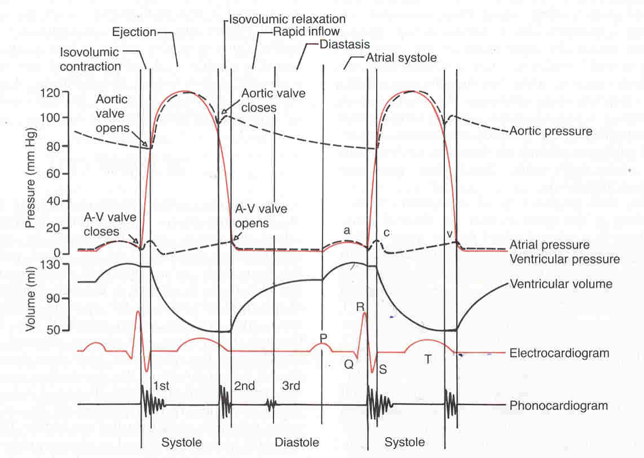
The Heart Sound in Relation to The Cardiac Cycle & ECG ( more explanation)
For further explanation
Cardiac cycle
Remember The Cardiac Cycle :
Rapid filling phase.
Reduced (slow) filling phase.
Atrial systole.
Isometric contraction phase.
Rapid ejection phase .
Slow ejection phase.
Isometric relaxation phase.
S1: closure of Atrioventricular valves (Mitral & Tricuspid) ( At the beginning of Isometric contraction phase)
S2: closure of Semilunar valves (Aortic & Pulmonary) ( At the beginning of Isometric relaxation phase )
S3: Rush of blood from Atria to Ventricle ( During rapid filing phase )
S4 : Atrial contraction which causes rapid flow of blood from Atria to Ventricle (Atrial systole)
ECG

Slide 25
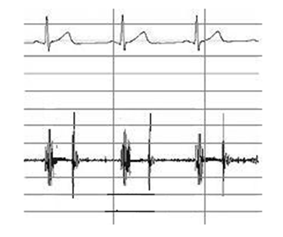
The Heart Sound in Relation to ECG
Splitting of Second Heart Sound and Murmurs
To summarize it :
What is murmur ?
Murmurs are abnormal sounds produced due to abnormal blood flow e.g. (through abnormal heart valves) i.e. stenosis or incompetence (Regurgitation).
Just Understand it
T
QRS
Splitting of S2 ( Lub … Dub-Dub ):
A physiologic splitting of the 2nd heart sound (Normal)
Occurs : during deep inspiration
Auscultation Place to hear it : at aortic or pulmonary areas
What happened : 2 semi-luner valves should be closed at the same time
but the Aortic valve (A2) component splits from the Pulmonary valve (P2) component by more than 0.2 seconds. Then it will be audible.Why the lateness in closure?
Deep inspiration → chest expand → decreased intra-thoracic pressure → increased venous return → more filling in RV (compared to LV) → RV takes more time to contract → delay closure of pulmonary valve → Splitting of S2 due to closure of aortic valve before pulmonary valve.
S1
S2
The first heart sound (S1) occur at the beginning of contraction ( During QRS Complex )
The second heart sound (S2) occur at the beginning of relaxation ( After T - Wave )
RV = Right Ventricle
https://www.youtube.com/watch?v=5tBk1XuEyuM
To actually hear the real sound of splitting
Normal : Lub …Dub
Splitting of S2 : Lub … Dub-Dub

Slide 26
Examine Yourself !!!
These are a general questions related to our topic … these questions are just to make sure you understand the heart sound.
The answers you can get it from the previous slides.
What is the functions of A-V valves & Semilunar valves ?
What is the functions of papillary muscles ?
How many Heart Sounds do we have ?
Witch of them are audible with stethoscope ?
Determine the auscultation Places on the chest for heart sounds?
What is Phonocardiogram ?
Explain the relationship of heart sound with ECG?
What is the reason of S2 splitting and when it happen ?
What is murmur ? give an example.

Slide 27
Pulses of Carotid Artery & Jugular Vein
Contents :
The events causing different waves of the JVP & CAP tracings.
Difference between JVP & CAP.
Correlation between JVP, CAP, ECG and Phonocardiogram.
Physiology lab Team 436 – Cardiovascular block
This work include Boy’s + girl’s slides + girl’s handout

Slide 28
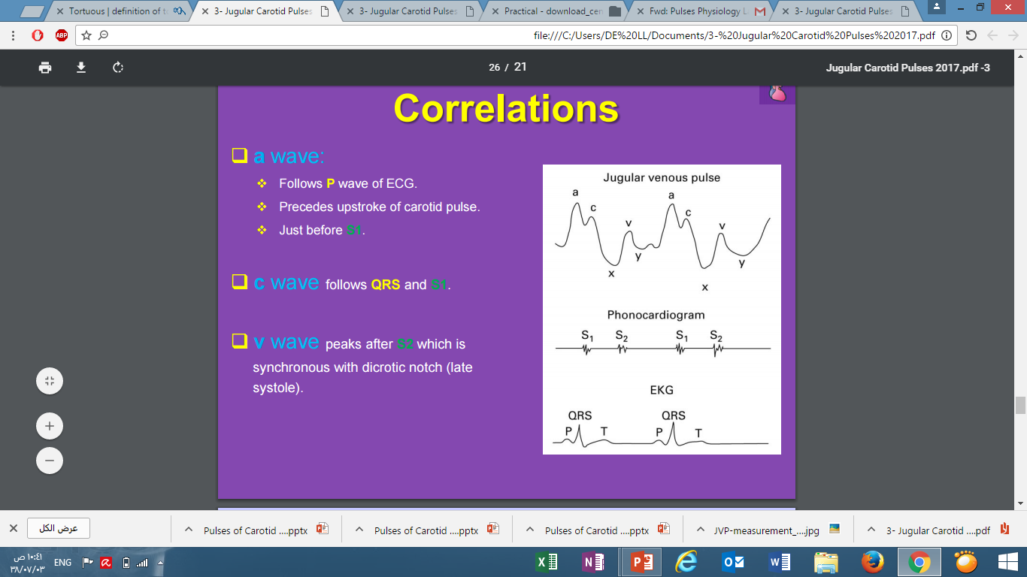
Distinguishing features between venous and arterial pulses
Evaluation of pulse waveform helps in the diagnosis of certain cardiac diseases & assessing their severity.
Carotid artery pulse | Jugular Vein Pulse
Tells about: the aorta and left ventricular function. | Tells about: hemodynamic changes in the right side of the heart
Palpable (the expansion of the arterial wall ) | Visible but not palpable
Not obliterated by pressure | Obliterated by pressure
1 pulsation / systole (One beat ) | 2 pulsation / systole 1st pulse : atrial contraction (termed a) 2nd pulse : venous filling of right atrium against closed tricuspid (termed v)
No effect of respiration | Decrease with deep inspiration
No effect of abdominal pressure | Enhanced by H-J-reflex (hepatojugular reflux)

Slide 29
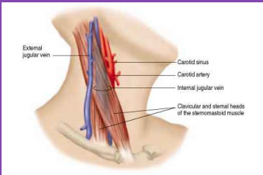
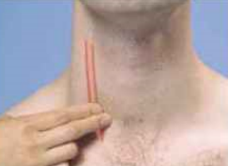
Carotid arterial pulse (CAP)
It Is examined to determine : heart rate.
How to examine ?
Subject supine at 30° head slightly bend to the examined side.
Feel CAP on right side of the neck medial of SCM (sternocleidomastoid muscle) alongside the lateral border of thyroid cartilage.
Apply transducer over CAP using soft rubber band & connect it to recorder.
Just Understand it
When blood is forced into the aorta during ventricular systole, two things happen:
  Blood is moved forwards.
  A pressure wave is set up which travels along the wall of arteries (faster than the flow of blood), expanding the arterial walls as it travels. (The expansion of the arterial wall is palpable as the pulse)
Just Understand it
في الإختبار ممكن يعطيك صورة و يسألك ايش الشي اللي ممكن تستفيده منها / أو يسألك وين تقدر تقيس ال carotid arterial pulse .

Slide 30
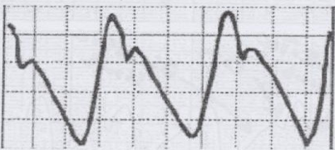
Carotid arterial pulse (CAP)
Dicrotic notch
بعد ال rapid ejection راح تجينا مرحة slow ejection و في هذاالمرحلة يقل ال aortic blood pressure لأن كمية الدم اللي تدخل الأورطا أقل من كمية الدم اللي تطلع من الأورطا و تروح باقي الجسم , بعد ما ينتهي ال systole يتسكر ال aortic valve و الاورطا راح ينقبض (elastic recoil) و هذا يفسر لنا كيف صارت ال Dicrotic notch .
Dicrotic Limb
sys
diastole
Anacrotic Limb
The diaphragm above shows :
Anacrotic Limb (ANA means up) (rapid upstroke) : Record of increased pressure to a peak 120mmHg in the artery during the maximum ejection phase of ventricular systole.
Dicrotic Notch (Dn) or Incisura : Aortic valve snaps shut: traced when continual fall in the arterial pressure is interrupted by the closure of the aortic valve at the end of ventricular systole
  Happened during : beginning of ventricular diastole - 2nd heart sound - after the T wave
Dicrotic Limb : (During ventricular diastole) happened after incisura due to pressure in aorta drops to 80 mmHg only WHY it didn’t complete to 0 ?
Because of elastic recoil of the arterial wall .
(الدم كان يندفع بقوة في الاورتا الى ان اغلق الصمام فيقل الضغط لكنه لا يقل كثيراً والسبب هو الارتداد المرن. حيث ان الشريان في هذي الحالة كالمطاط يحاول انه يرجع لحالة الأول فيضغط ويقلل قطره وبهذا يحافظ على الضغط)
في الإختبار ممكن يعطيك صورة ال CAP و يحدد لك على جزء منها (مثلا : Anacrotic Limb ) و يقولك أيش سببها و هل هي وقت systole or diastole ... عشان كذا لازم نفهم الرسمة هذه و نعرف سبب كل جزء فيها .

Slide 31
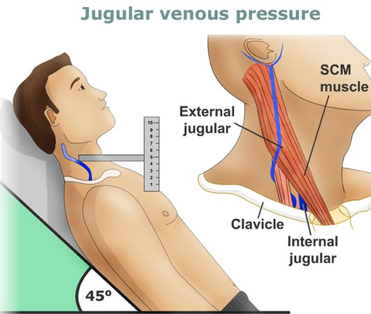
Jugular Venous Pulse (JVP)
Video of JVP Duration: 2:28
Right internal jugular vein (RIJV) : we use it because ? Pressure changes in the right atrium are transmitted directly to it because there are no valves between this vein and the right atrium.
The external jugular vein is easier to see but we can’t choose it because :
Has valves
Can be compressed as it enters the chest making >(tortuous course) or by fascial and muscular layers. Having twists and turns
How to examine ?
Patient at a 45° angle.
Head turned slightly to the left.
  Use the right Internal Jugular which runs from medial end of clavicle to the ear lobe under medial aspect of the Sternocleidomastoid muscle (between t 2 head) away from CAP.
More prominent with: Valsalva maneuver
(الزفير مع اغلاق طرق التنفس مثل ما تفعل اذا انسدت اذنك في الطيارة )
Just Understand it
في الإختبار ممكن يعطيك صورة و يسألك ايش الشي اللي ممكن تستفيده منها / أو يسألك وين تقدر تشوف ال jugular venous pressure.

Slide 32
Jugular Venous Pulse (JVP)
Waves | A- wave | C-wave | X-decent | V-wave | Y-decent
Cause | Right Atrial contraction , will lead → increase right atrial pressure | Increase RV pressure when all valves are closed (Isovolumetric Contraction phase) → Tricuspid valve bulging into the Right Atrium → increase RA pressure This Called : Carotid artifact | due to downwards displacement of the Tricuspid valve by the contraction of papillary muscles during Ventricular systole. ( Rt atrial pressure ) | filling of the Right Atrium by venous return before the Tricuspid valve opens. (incraese in Rt atrial pressure) | the fall in the Right Atrial Pressure when the blood starts to flow from the Right Atrium into the Right Ventricle (tricuspid valve open)
Relation to cardiac cycle | End of ventricular diastole | During Isovolumetric Contraction | During Ventricular systole (&atrial relaxation)
 |  |  |  |  | passive filling
+/- wave | (+ve wave) | (+ve wave) | (-ve wave) | (+ve wave) | (-ve wave)
Relation to ECG | after P-wave | Follows QRS | - | - | -
Relation to phonocardiogram | before 1st heart sound | Just 1st heart sound | - | Peaks after 2nd heart sound. | -
Relation to carotid pulse | before Carotid pulse | after Carotid pulse | - | - | -
a
c
v
y
x
For easy Identification of waves we look for the letter W in the graph. Once we find it the first decent is X the second one is y between them is V and the two waves before X are a which is followed by C.
في الإختبار ممكن يجيب لك هذه الرسمة و يقولك ايش اسم هذه ال wave , cause of it , و ايش علاقتها بال cardiac cycle , ECG , Phonocardiogram , CAP ... عشان كذا لازم نعرف التفاصيل اللي بالجدول .

Slide 33

Abnormal Pulses of JVP :
Abnormal Pulses of CAP :
Hyperkinetic (strong pulse)
In :
1- aortic regurgitation
2- high cardiac output
Hypokinetic (decrease pulse)
In :
1- aortic stenosis
2- low cardiac output
Normal JVP
Atrial Fibrillation
loss of a-wave
Rt atrium pressure cannot be increased by Rt atrial contraction.
Prominent a waves :
Inreased Rt atrial pressure caused by forceful right atrial contraction which caused by
 Tricuspid /pulmonary valve stenosis.
 High right ventricular pressure.(pulmonary hypertension)
 Rt ventricle Heart failure
Cannon a waves : (a-wave very high) result from atrial systole while the Tricuspid valve is closed. This can happen from:
Complete AV block(heart block) = 3rd degree Heart blick (atria and ventricles will generate their own rhythms which results in them contracting at the same time)
Ventricular tachycardia
Atrial flutter
Tricuspid regurgitation : loss of x wave which will result in merging of c and v waves(mainly v-wave) (shown in blue) incompetant tricuspid valve →leaking blood into RA from RV → RA pressure is increased so much

Slide 34

Blood Pressure
Objectives :
To be able to measure arterial blood pressure using a sphygmomanometer
To recognize the effects of exercise on the arterial blood pressure
Physiology lab Team 436 – Cardiovascular block
This work include Boy’s + girl’s slides + girl’s handout

Slide 35
Definitions
Blood pressure : it is the force exerted by the blood against any unit area of the vessel wall .
Exp = 50mmHg Which Means : the force exerted is sufficient to push a column of mercury against gravity up to a level of 50mmHg high.
Normal systolic pressure: ranges from 100 to 140 mm Hg.p
Normal diastolic pressure: ranges from 60 to 90 mm Hg.
Pulse pressure : is the difference between systolic and diastolic blood pressures
Pulse pressure = Systolic – Diastolic pressure
i.e. 120 –80 = 40 mmHg.
Exp: subject’s blood pressure is measured to be 120/90 mmHg : calculate the M.A.B.P.!
M.A.B.P.= diastolic blood pressure + 1/3 pulse pressure
Determine the pulse pressure : 120 – 90 = 30 mmHg
Divide the pulse pressure by 3 : 30/3 = 10 mmHg
Add the above answer to the diastolic blood pressure: 10 + 90 = 100 mmHg
So 100 mmHg will be the mean arterial blood pressure in this example.
Mean Arterial Blood Pressure : It is the average blood pressure within the arteries during a whole cardiac cycle
It significance : the force responsible for maintaining a continuous forward flow of the blood in the circulation during the whole cardiac cycle.
M.A.B.P.= diastolic blood pressure + 1/3 pulse pressure
(Because the diastole phase of a cardiac cycle is longer than its systole phase, that is why we cannot apply mathematical average to determine the mean arterial blood pressure)
في الإختبار ممكن يعطيك the systolic/ diastolic blood pressure و يقولك احسبلي : Pulse Pressure , Mean Arterial Blood Pressure .

Slide 36
Procedure
Equipment:
1- Stethoscope
2- Sphygmomanometer
3- Bicycle and/or a Treadmill (to see the difference of pulse during exercise & rest)
Precautions :
The cuff size should be appropriate for the age and built of the subject.
  A large cuff is recommended for : obese subjects.
  Smaller one is available for : children.
The cuff must be applied snuggly (not too tight and not too loose) about 4 cm above the cubital fossa.
Make sure that the rubber bag within the cuff is on the medial side so that it can occlude (obstruct) the brachial artery when the cuff is inflated.
It is important that the manometer should be at the same level as the heart to exclude the effect of gravity while measuring the blood pressure.
The mercury manometer should be in the vertical position.
Check that there is an adequate amount of mercury in the bulb of the instrument. This can be done by seeing whether the mercury level is at the zero position of the manometer.
The subject must be physically and mentally relaxed and in a comfortable environment.
recheck the BP of the patient after 2 minutes, while he is in the standing position as well, in a similar manner to check for Postural hypotension.
Body Position (reading varies with position).
Record the systolic and diastolic pressure to the nearest 2 mmHg.
Before starting the procedure, we should ask the following questions:
  Have you ever get your blood pressure checked? If so, what is your blood pressure usually?
  Are you in any medication for BP?
  Did you do any exercise in the last half hour?
  Did you have any tea, coffee or a cigarette in the last half hour?
Just Understand it
2 methods to measure the pulse ( on the next slide ) :
1- Palpatory
2- Auscultatory

Slide 37
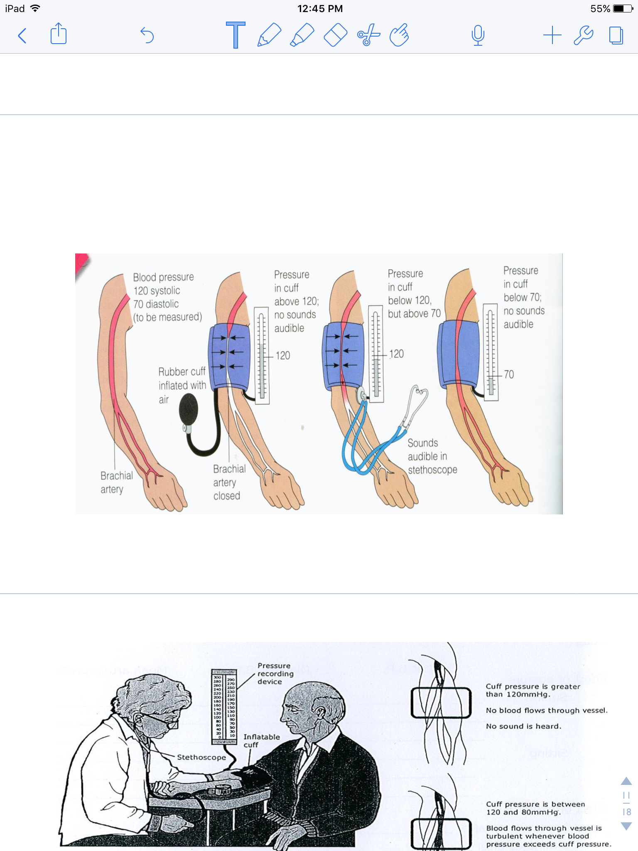
Methods for measuring Arterial BP
1. Palpatory Method
2. Auscultatory Method
This method only gives an estimate of the systolic blood pressure only.
The subject's arm should be resting comfortably so that it does not need to be actively supported while the blood pressure is being taken.
A standard cuff (12 x 24 cm) is applied like a bandage about 4cm above the elbow joint.
Inflate the cuff until the radial pulse cannot be felt (inflate more 20-30mmhg). By compressing the brachial artery, the pulse or pressure wave can no longer be transmitted to the radial artery.
Deflate the cuff slowly.
Note the pressure at which the radial pulse can be felt again for the first time. This will be the systolic blood pressure.
Diastolic can’t be measured.
This method measures both systolic and diastolic blood pressures
Inflate the sphygmomanometer cuff to a pressure about 30 mm Hg higher than the systolic pressure determined by the Palpatory method (there is no radial pulsation).
Place the diaphragm of the stethoscope over the brachial artery just above and on the medial side of the elbow joint.
Deflate the cuff slowly. A series of sounds are usually heard korotkov sounds (on next slide)
The reading which the sound begin represent the systolic blood pressure.
The reading which the sound disappear represent the diastolic blood pressure.
اللي بالأحمر هو اللي ركز عليه الدكتور

Slide 38
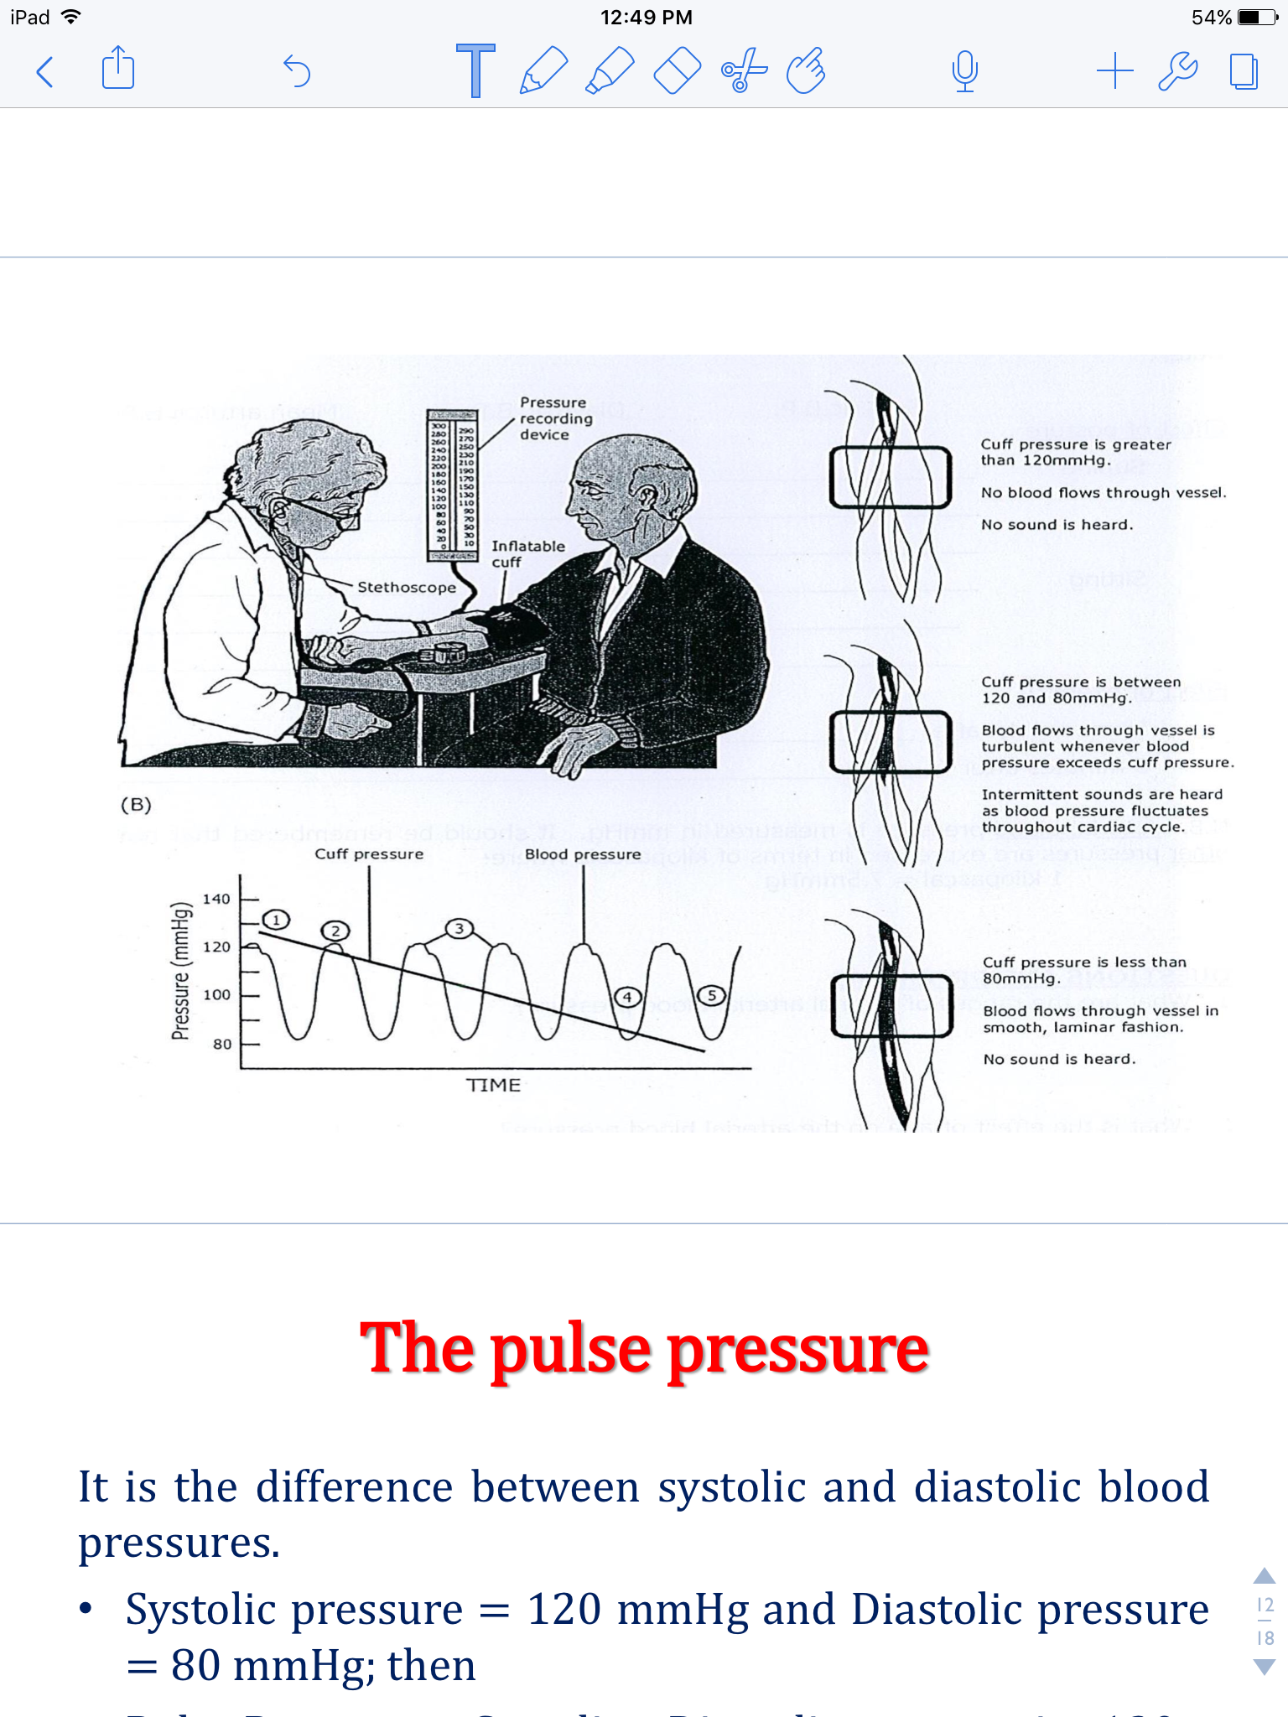
The korotkov sounds
Phase 1 & Phase 5 are the most important because we determine the systolic and diastolic pressure according to it .
These sounds are produced by : brachial artery is partially occluded ( blocked) → the blood flow through it becomes turbulent → produces vibrations that are heard during auscultation.
The sounds are divided to : 5 phases
Phase 1:
-first sound that is heard
- The appearance of a clear tapping sound which is :
the Systolic Pressure.
Phase 2 :
Blowing or swishing sounds
Phase 3 :
The sounds become sharper and crisper
Phase 4:
An abrupt muffling of sounds
Phase 5 :
All sounds disappear.
The point where the sound disappears is the diastolic blood pressure
Explanation for the diagram :
1
1
3
2
3
4
2
5
4
5

Slide 39
The effects of exercise on the systolic & diastolic blood pressures
Another Factors affecting blood pressure
Posture : (erect posture: when we sudden change our position) : the systolic falls a little but soon returns to normal by the compensatory mechanisms
Age : blood pressure increase with age.
  - At birth: 50/30.
  - Adult:120/80.
  - Old age:170/90.
Sex : Blood pressure is lower in females until menopause.
Body build: Obesity increase blood pressure.
Diurnal variation : Blood pressure is lower in the morning.
Digestion: Systolic blood pressure rises by 6-8 mmHg after meals (1 hour).
Temperature: Cold causes vasoconstriction so increase blood pressure due to increase peripheral resistance
Emotions: Increase blood pressure It drops during sleep and excessive hemorrhage.
Exercise and Pregnancy: Blood pressure will be increased due to metabolic demands.
Sleeping : decreased blood pressure.
Exp : Before exercise normal BP = 120/80
 | Mild to Moderate EXERCISE (BP= 140/80) | SEVERE OR HEAVY EXERCISE (BP = 160/60)
Systolic BP | Increase | Increase
Diastolic BP | No change | Decrease
Explanation | Sympathetic Stimulation → the cardiac output increases → increases the systolic BP, but no effect on diastolic BP. | More sympathetic stimulation → increase the Systolic BP and the Diastolic BP drops why ? - The sympathetic stimulation will cause vasodilation of skeletal muscle arterioles and also vasoconstriction of other tissues arterioles. - The vasodilation effect is stronger → decreased TPR *→ drop in diastolic BP
*TPR : total peripheral resistant
Number with this color are just examples
Just Understand it

Slide 40
Hypertension
كلام دكتورة علا : اللي في النظري خليه في النظري
So we think Just Understand it
Mild Hypertension Systolic : 140-160mmHg Diastolic : 90-100 mmHg
Moderate Hypertension Systolic : 160-180mmHg Diastolic : 100-110 mmHg
Severe Hypertension Systolic : 180-200mmHg Diastolic : 110-120 mmHg
Malignant Hypertension When Diastolic BP>140mmHg
Blood Pressure should be measured on more than three occasions (different time) to make a diagnosis of high blood pressure.

Slide 41
Thank you!
اعمل لترسم بسمة، اعمل لتمسح دمعة، اعمل و أنت تعلم أن الله لا يضيع أجر من أحسن عملا.
The Physiology 436 Team:
Contact us:
Physiology436@gmail.com
@Physiology436
Female Members:
Leena Alwakeel
Ruba Ali
Male Members:
Hassan Alshammari
Abdulmajeed Alammar
Mohammad Nasr
Abdullah Abuamarah

