Slide 1
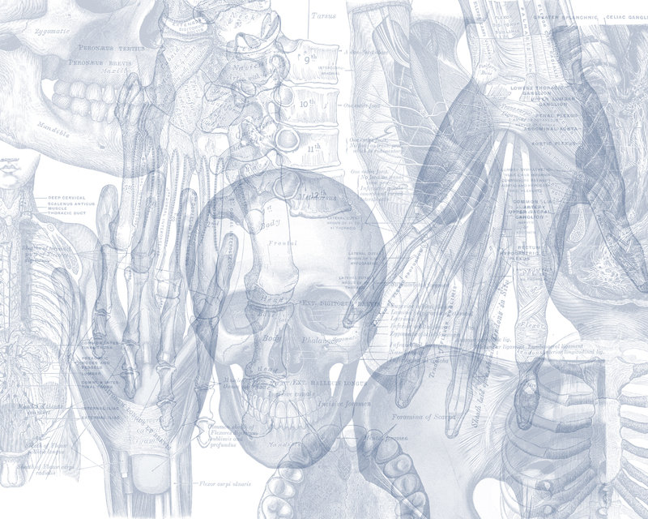
Major Arteries of the Body
Color Code
Important
Doctors Notes
Notes/Extra explanation
Please view our Editing File before studying this lecture to check for any changes.

Slide 2
Objectives
At the end of the lecture, the student should be able to:
Define the word ‘artery’ and understand the general principles of the arterial system.
Define arterial anastomosis and describe its significance.
Define end arteries and give examples.
Describe the aorta and its divisions & list the branches from each part.
List major arteries and their distribution in the head & neck, thorax, abdomen and upper & lower extremities.
List main pulse points.

Slide 3
Arteries
Arteries carry blood from the heart to the body.
All arteries, carry oxygenated blood,
EXCEPT the PULMONARY ARTERY (and the umbilical artery in the fetus) which carry deoxygenated blood to the lungs. (basically whatever brings blood ( with or without O2 )is vein , and what takes blood away from heart ( with or without O2 ) is artery.
General Principles Of Arteries
The flow of blood depends on the pumping action of the heart.
Arteries have ELASTIC WALL containing NO VALVES. unlike veins which need valves to keep the flow against gravity.
The branches of arteries supplying adjacent areas normally ANASTOMOSE with one another freely (especially in places where we need a rich blood supply) providing backup routes for blood to flow if one artery is blocked, e.g. arteries of limbs.
The arteries whose terminal branches do not anastomose with branches of adjacent arteries are called “END ARTERIES”. End arteries are of two types:
Anatomic (True) End Artery: When NO anastomosis exists, e.g. artery of the retina.
Functional End Artery: When an anastomosis exists but is incapable of providing a sufficient supply of blood, e.g. splenic artery, renal artery.

Slide 4
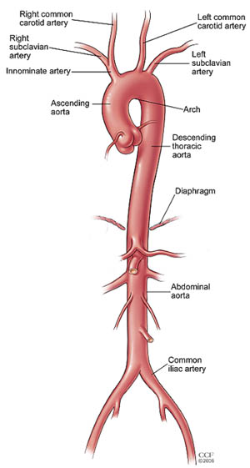
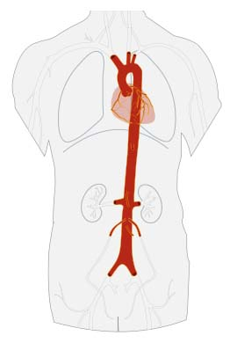
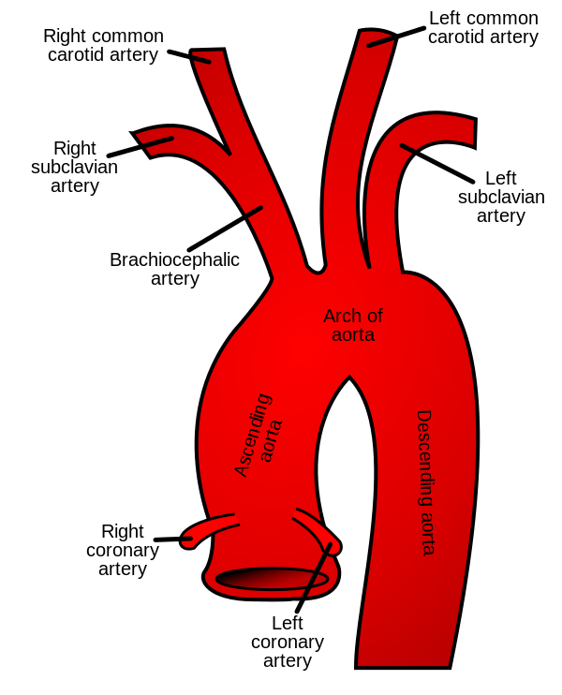
Extra
Aorta
2
1
The largest and longest artery in the body.
Carries oxygenated blood to all parts of the body.
Is divided into 4 parts:
Ascending aorta (The only branches of the ascending aorta are the two coronary arteries which supply the heart)
Arch of aorta (The aortic arch has three branches, the brachiocephalic trunk, left common carotid artery, and left subclavian artery.)
Descending thoracic aorta (It has six paired branches: bronchial arteries, mediastinal arteries, esophageal arteries, pericardial arteries, superior phrenic artery, and intercostal arteries.
Abdominal aorta (Visceral Branches: Coeliac, Superior and inferior Mesenteric, Middle Suprarenals, Renals, Internal Spermatics or ovarian in females. Parietal Branches: Inferior Phrenics, Lumbars ,Middle Sacral. Terminal Branches: Common Iliacs).
3
4
Extra

Slide 5
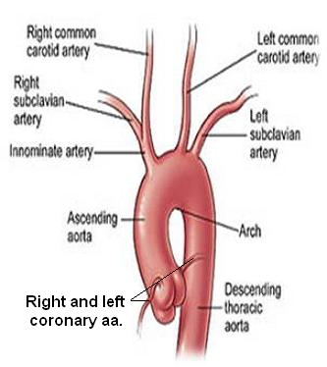
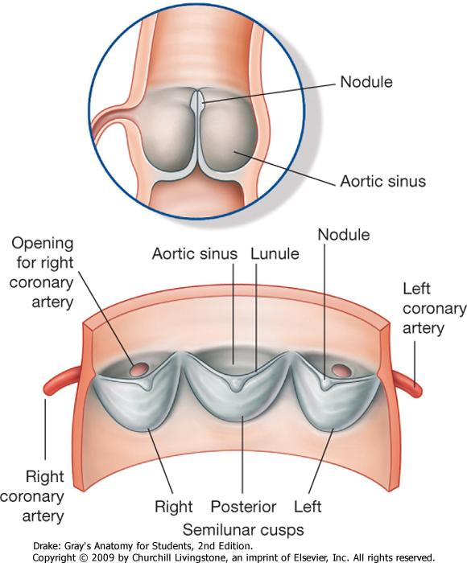
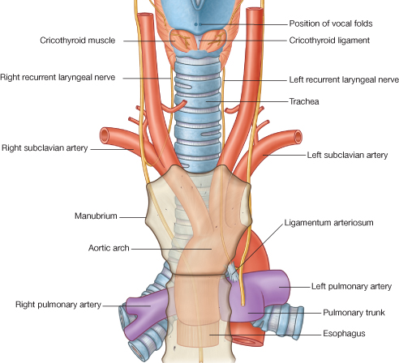
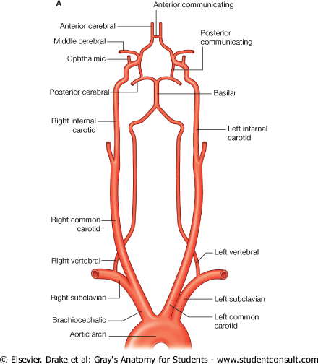
1. Ascending Aorta
2. Arch Of Aorta
2. Arch Of Aorta
Common Carotid Artery
Originates from left ventricle.
Continues as the arch of aorta
Has three dilatations at its base, called aortic sinuses
Branches :
Right & Left coronary arteries (supplying heart), arise from aortic sinuses.
Continuation of the ascending aorta.
Leads to descending aorta.
Located behind the lower part of manubrium sterni and on the left side of trachea.
Branches :
Brachiocephalic trunk.
Left common carotid artery.
Left subclavian artery.
Origin:
LEFT from aortic arch.
RIGHT from brachiocephalic trunk.
Each common carotid divides into two branches:
Internal carotid
External carotid
At the level of the disc between C3 & C4
2
Right external carotid
Left external carotid
1
3

Slide 6
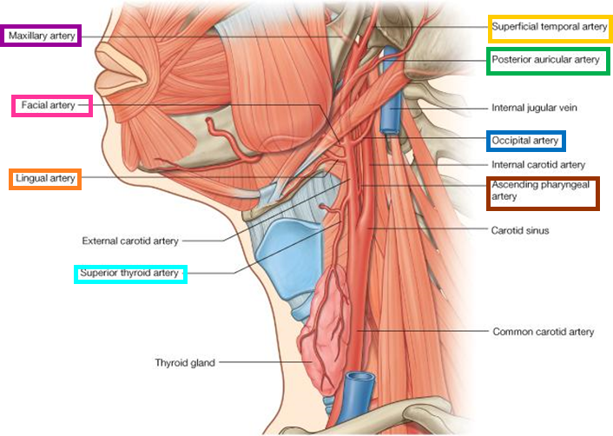
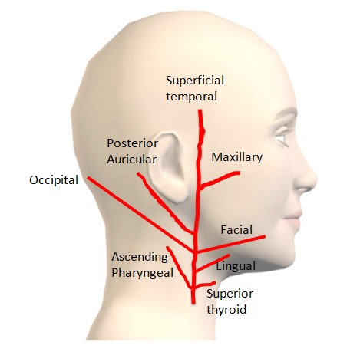
Some American Ladies Found Our Pyramids So Magnificent
2. Arch Of Aorta
External Carotid Artery
Some: Superior temporal artery
American: Ascending pharyngeal artery
Ladies: Lingual artery
Found: Facial artery
Our: Occipital artery
Pyramids: Posterior auricular artery
So: Superior thyroid
Magnificent: Maxillary
It divides behind neck of mandible into:
1. Superficial temporal
2. Maxillary arteries
It supplies:
Scalp*: Superficial temporal, occipital, & posterior auricular arteries
Face: Facial artery
Maxilla & mandible: Maxillary artery
Tongue: Lingual artery
Pharynx: ascending pharyngeal artery
Thyroid gland: Superior thyroid artery
*Scalp = فروة الرأس

Slide 7
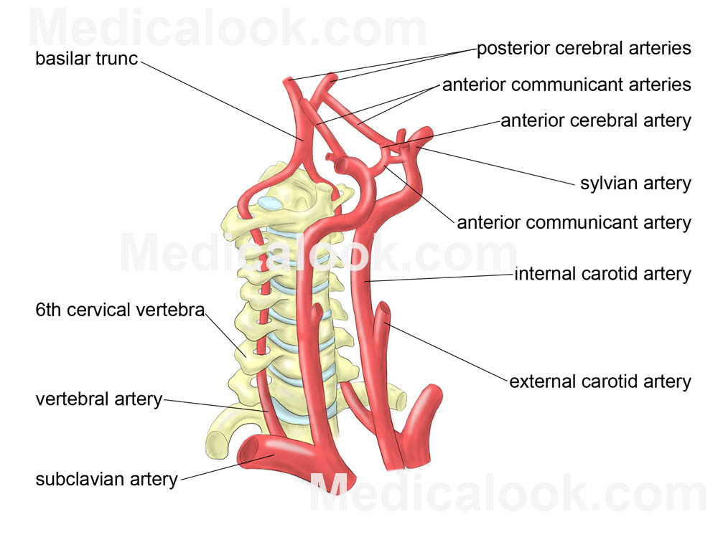
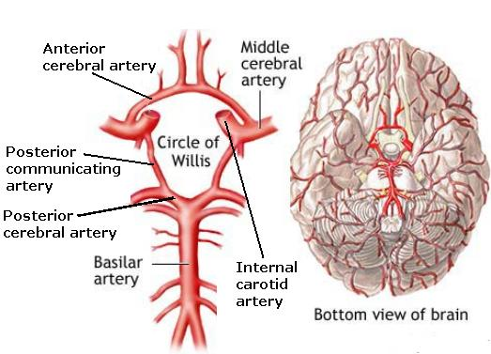
2. Arch Of Aorta
Internal Carotid Artery
Has NO branches in the neck.
Enters the cranial cavity, joins the basilar artery (formed by the union of two vertebral arteries) and forms ‘arterial circle of Willis’ to supply brain.
In addition, it supplies
Nose
Scalp
Eye
Extra

Slide 8
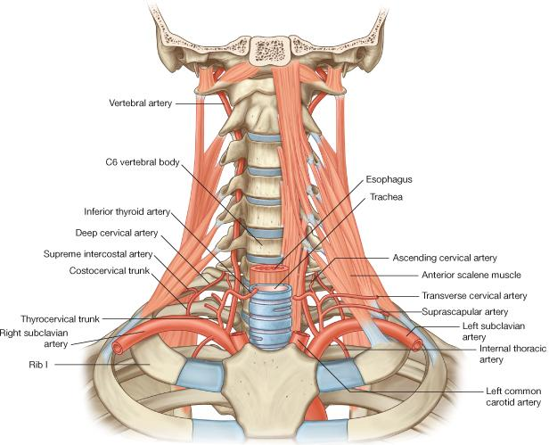
2. Arch Of Aorta
Subclavian Artery
Origin:
LEFT: from arch of aorta
RIGHT: from brachiocephalic trunk
It continues, at lateral border of first rib, as axillary artery (artery of upper limb)
Main branches:
Vertebral artery: supplies brain & spinal cord
Internal thoracic artery: supplies thoracic wall

Slide 9
Arteries of Upper Limb
At lateral border of 1st rib
Recall the arteries of the upper limb:
At the lateral border of the first rib the subclavian artery continues as the axillary artery.
The axillary artery ends at the lower border of teres major and becomes the brachial artery.
The brachial artery bifurcates into radial and ulnar arteries opposite the neck of radius.
At lower border of teres major
Opposite neck of radius

Slide 10
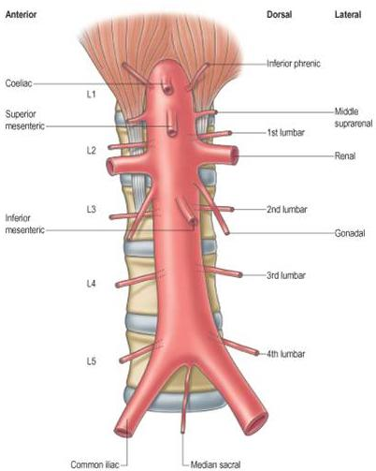
3. Descending Thoracic Aorta
4. Abdominal Aorta
It is the continuation of aortic arch
At the level of the 12th thoracic vertebra, it passes through the diaphragm and continues as the abdominal aorta.
It enters the abdomen through the aortic opening of diaphragm at level of T12.
At the level of lower border of L4, it divides into two common Iliac arteries.
Branches: divided into two groups:
Single branches (supplying GIT)
Coeliac, superior mesenteric, inferior mesenteric
Paired branches
Inferior phrenic, middle suprarenal, renal, gonadal
Branches:
Pericardial
Esophageal
Bronchial
Posterior intercostal

Slide 11
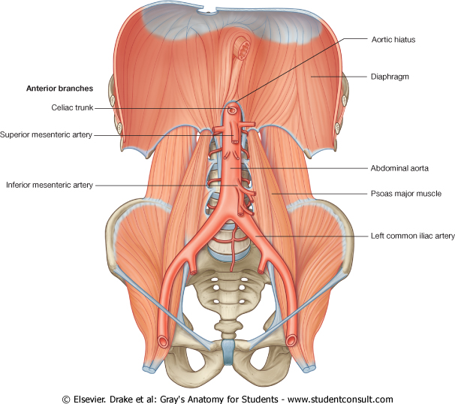
Branches of Common Iliac Artery
Arteries of the Lower Limbs
1- EXTERNAL ILIAC ARTERY:
continues (at midpoint of inguinal ligament) as femoral artery the main supply for lower limb.
2- INTERNAL ILIAC ARTERY:
supplies pelvis.
Femoral Artery:
Is the main arterial supply to lower limb
Is the continuation of external iliac artery behind the midpoint of the inguinal ligament.
Passes through adductor hiatus and continues as:
Popliteal Artery
Deeply placed in the popliteal fossa.
Divides, at lower end of popliteal fossa into:
1-Anterior Tibial Artery
2-Posterior Tibial Artery

Slide 12
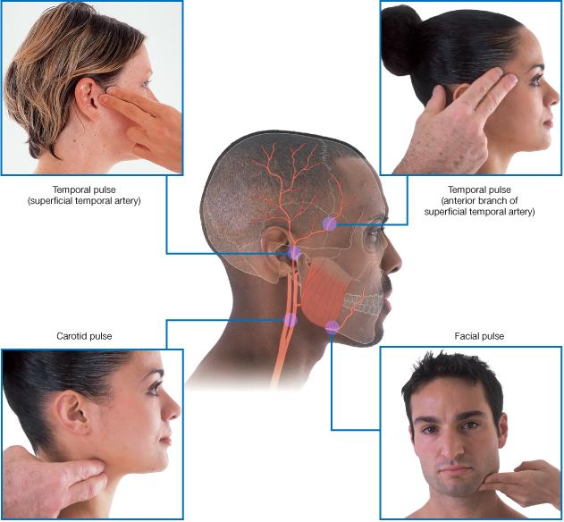
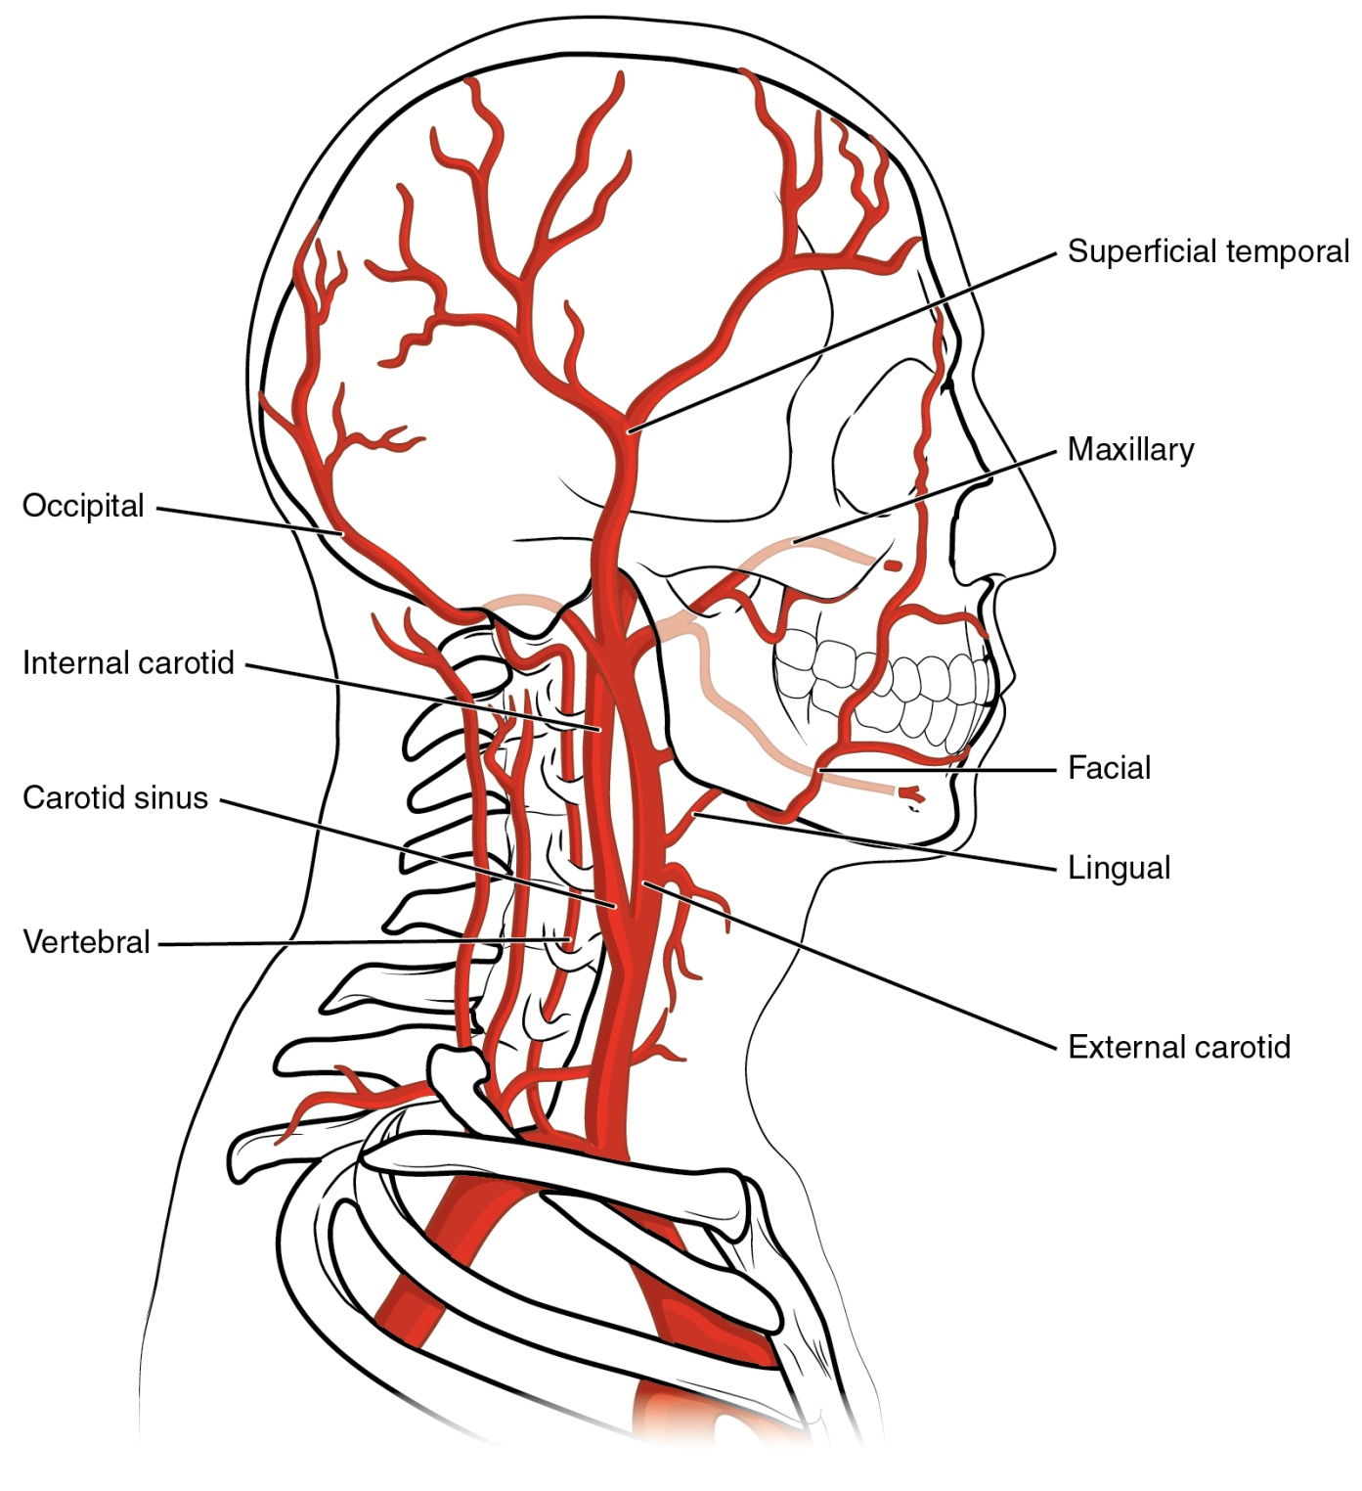
Pulse Points in Head & Neck

Slide 13
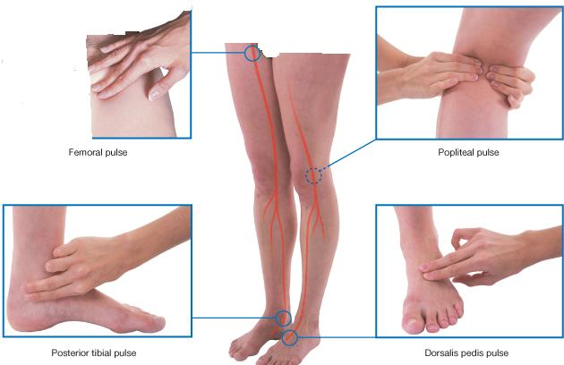
Pulse Points in Upper limb
Pulse Points in Lower limb

Slide 14
Only on the boys’ slides
Principal arteries of the human body:
1 internal carotid artery,
2 external carotid artery,
3 common carotid artery,
4 arch of the aorta,
5 descending aorta,
6 pulmonary vein,
7 left coronary artery,
8 celiac artery,
9 splenic artery,
10 left gastric artery,
11 inferior mesenteric artery,
12 abdominal aorta,
13 common iliac artery,
14 internal iliac artery,
15 external iliac artery,
16 femoral artery,
17 profunda femoris artery,
18 popliteal artery,
19 dorsalis pedis,
20 posterior tibial artery,
21 peroneal artery,
22 anterior tibial artery,
23 digital artery,
24 superficial palmar arch,
25 deep palmar arch,
26 ulnar artery,
27 radial artery,
28 common interosseous artery,
29 superior mesenteric artery,
30 right gastric artery,
31 hepatic artery,
32 right coronary artery,
33 brachial artery,
34 ascending aorta,
35 brachiocephalic artery,
36 axillary artery,
37 anterior circumflex humeral artery,
38 subclavian artery

Slide 15
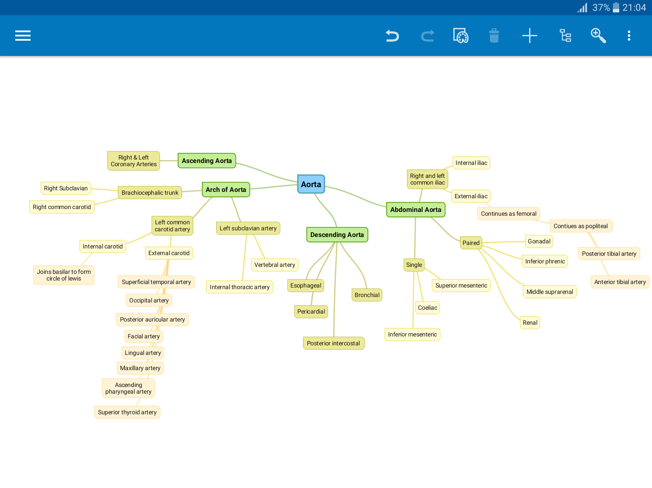
Summary
*
*
*the branches on the right are the same as those on the left

Slide 16
MCQ
5.Which one of the following is a single branch artery that supplies the GIT ?
A. Renal artery
B. Inferior phrenic
C. Superior mesenteric
D. Gonadal artery
1.Which artery that enters the abdomen then divides to two iliac arteries?
A. descending thoracic aorta.
B. abdominal aorta.
C. Bronchial artery.
D. Posterior intercostal.
6. Which of the following pulses can NOT be felt in upper limbs?
A. Axillary pulse
B. Carotid pulse
C. Brachial pulse
D. Ulnar pulse
2. What are the branches of the subclavian artery?
A. Vertebral artery
B. internal thoracic artery
C. Axillary artery
D. A & B
7.Which one of the following is a functional end artery?
Splenic artery
Brachial artery
Central artery of the retina
Superior mesenteric artery
3.Common carotid artery originates from : A-brachiocephalic artery B-arch of aorta C-subclavian artery D- A & B
8.Which one of the following is a branch of external carotid artery?
Vertebral artery
Brachial artery
Basilar artery
Facial artery
4.Which one of the following supplies the pelvis?
A. Internal Iliac artery
B. External Iliac artery
C. Femoral artery
D. Popliteal artery
9.Which one of the following arteries could be palpated opposite the lower border of the mandible?
Facial artery
Lingual artery
Superficial temporal artery
External carotid artery
ANSWERS:
1.B, 2.D, 3.D, 4.A, 5.C, 6.B, 7.A, 8.C, 9.A

Slide 17
SAQ
Q1. How is the circle of Willis formed?
Q2. What are the pulse points in lower limb?
Q3. Mention (A) one Anatomic (True) End Artery and (B) one Functional End Artery:
ANSWERS:
The union of Internal Carotid Artery and the basilar artery.
2. Femoral pulse, Popliteal pulse, Posterior tibial pulse and Dorsalis pedis pulse
3. A-artery of retina .
B-renal artery.

Slide 18
Leaders:
Nawaf AlKhudairy
Jawaher Abanumy
Members:
Khalid Aldakheel
Abdullah Jammah
Essam Alshahrani
Abdulmohsen Alghannam
Abdulmohsen Alkhalaf
Abdulrahman Almalki
anatomyteam436@gmail.com
@anatomy436

