Slide 1


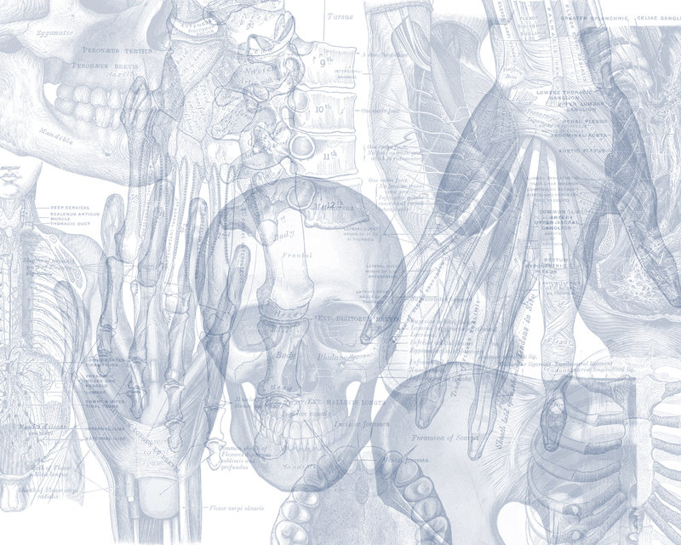


Major Veins of the Body
Color Code
Important
Doctors Notes
Notes/Extra explanation
Please view our Editing File before studying this lecture to check for any changes.

Slide 2
Objectives
At the end of the lecture, the student should be able to:
Define veins and understand the general principle of venous system.
Describe the superior & inferior Vena Cava: formation and their tributaries
List major veins and their tributaries in:
head & neck
thorax & abdomen
upper & lower limbs
Describe the Portal Vein: formation & tributaries.
Describe the Portocaval Anastomosis: formation, sites and importance

Slide 3

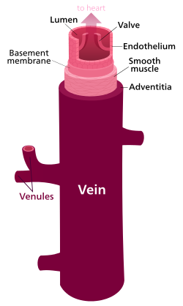
Veins
Veins are blood vessels that bring blood back to the heart.
All veins carry deoxygenated blood except:
Pulmonary veins¹.
Umbilical veins².
There are two types of veins*:
  Superficial veins: close to the surface of the body
    NO corresponding arteries
  Deep veins: found deeper in the body
    With corresponding arteries (venae comitantes)
Veins of the systemic circulation:
  Superior and inferior vena cava with their tributaries
Veins of the portal circulation:
  Portal vein
*Note:
Vein can be classified in 2 ways based on:
Their location (superficial/deep)
The circulation (systemic/portal)
1: are large veins that receive oxygenated blood from the lung and drain into the left atrium.
2: The umbilical vein is a vein present during fetal development that carries oxygenated blood from the placenta into the growing fetus.

Slide 4
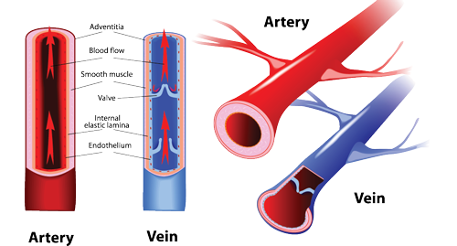
The Histology Of Blood Vessels
Only on the boys’ slides
  The arteries and veins have three layers, but the middle layer is thicker in the arteries than it is in the veins:
    Tunica Intima (the thinnest layer): a single layer of simple squamous endothelial cells.
    Tunica Media (the thickest layer in arteries): is made up of smooth muscle cells and elastic tissue.
    Tunica Adventitia: (the thickest layer in veins) entirely made of connective tissue.
  Capillaries consist of little more than a layer of endothelium and occasional connective tissue.

Slide 5
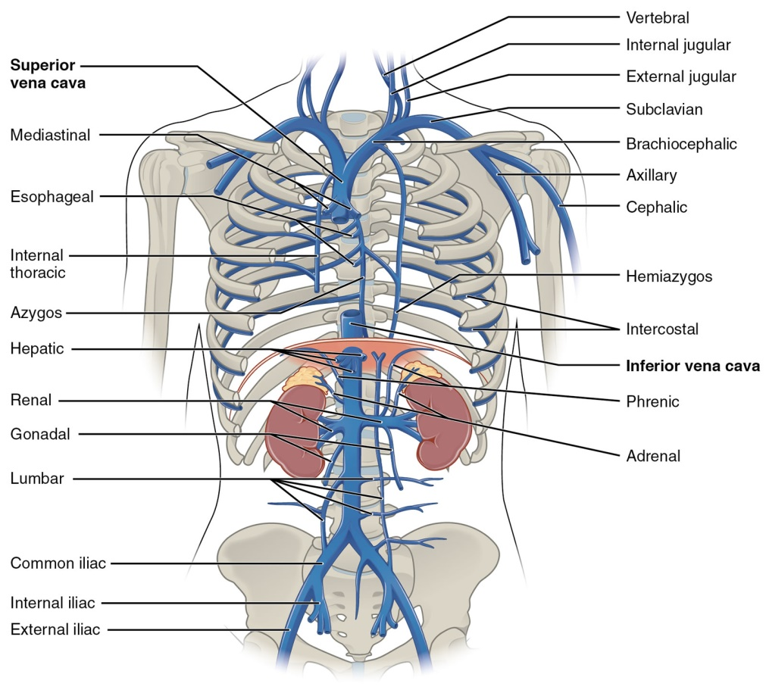
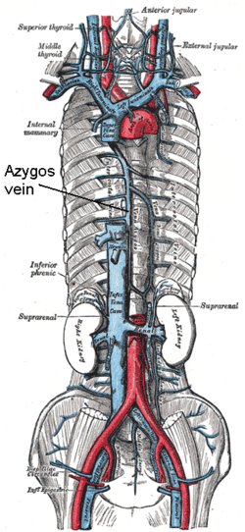
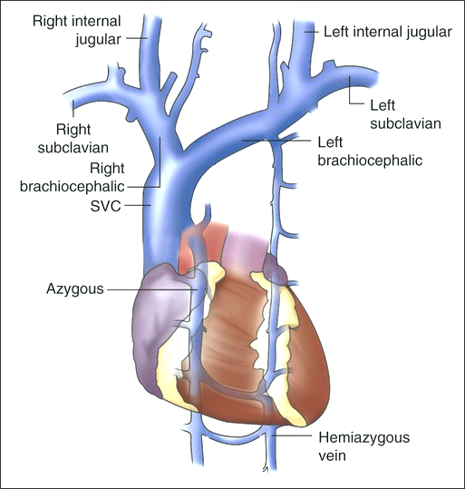
Superior Vena Cava
  Formed by the union of the right and left brachiocephalic veins.
  Brachiocephalic veins are formed by the union of internal jugular and subclavian veins.
  Drains venous blood from:
  Head, neck, thoracic wall & upper limbs.
  It Passes downward and enter the right atrium.
Receives azygos vein on the posterior aspect just before it enters the heart.
Sup

Slide 6
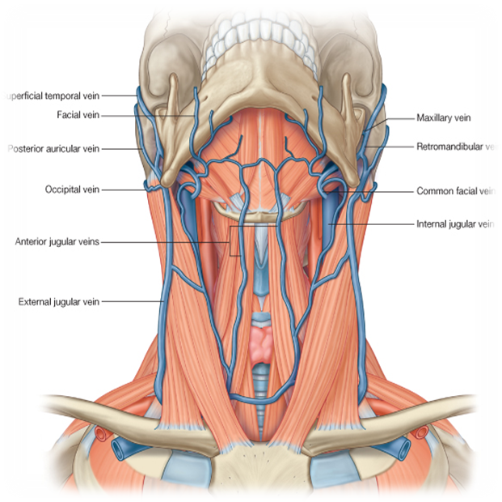
Veins Of Head & Neck
Superficial
External Jugular Vein
Anterior Jugular Vein
Deep
Internal Jugular Vein
Note:
Union: when to veins join together they give rise to a vein with a new name.
Tributary: when one vein drains into another, but no new vein is produced.
Jugular means of the neck.

Slide 7
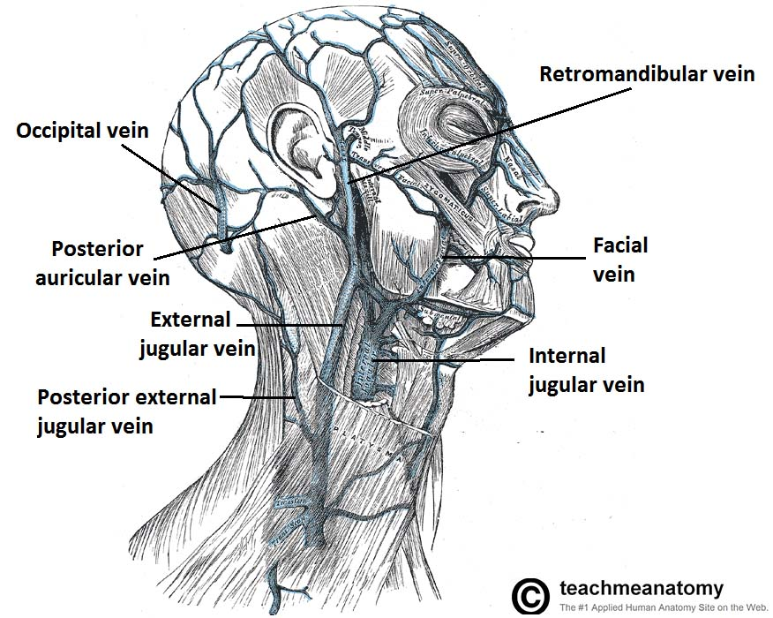
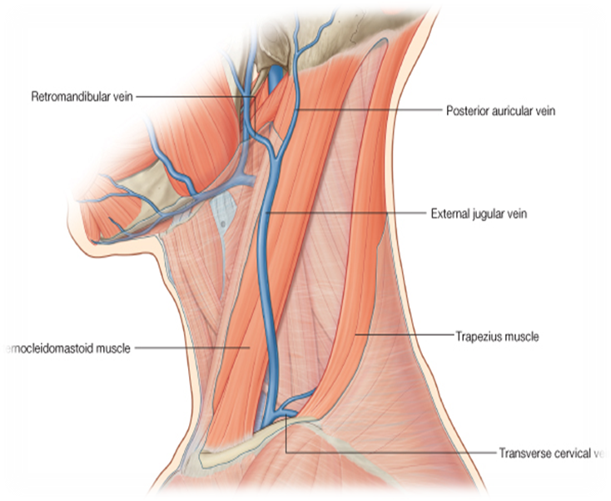
Veins of Head and Neck
External Jugular Vein
    Lies superficial to the sternomastoid (sternocleidomastoid) muscle .
    It passes down the neck and it is the only tributary of the subclavian vein.
    Begins just behind angle of mandible by union of:
    the posterior division of the retromandibular vein (temporomaxillary vein)
    with the posterior auricular vein.
    It drains blood from:
      Outside of the skull
      Deep parts of the face.
Tributaries:
Posterior external jugular vein.
Anterior jugular vein.
Suprascapular vein.
Transverse cervical vein.
To remember: PAST

Slide 8
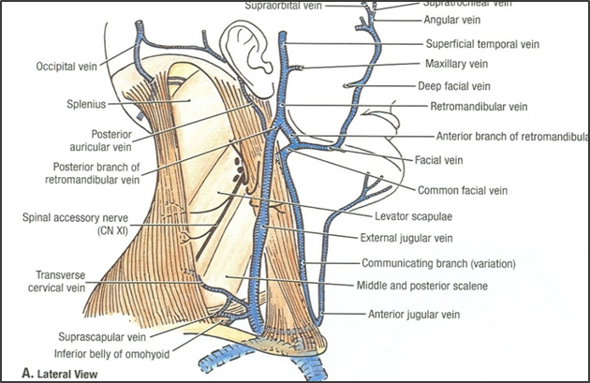

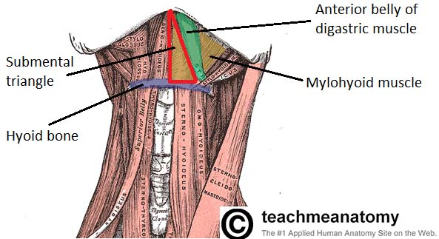
Veins of Head and Neck
Anterior Jugular Vein
It begins in the upper part of the neck by the union of the submental veins (small veins found in an area known as the submental triangle).
It descends close to the median line of the neck, medial to the sternomastoid muscle.
At the lower part of the neck, it passes laterally beneath (deep to) sternomastoid to drain into the external jugular vein.
Just above the sternum the two anterior jugular veins communicate by a transverse vein to form the jugular arch.
Extra

Slide 9
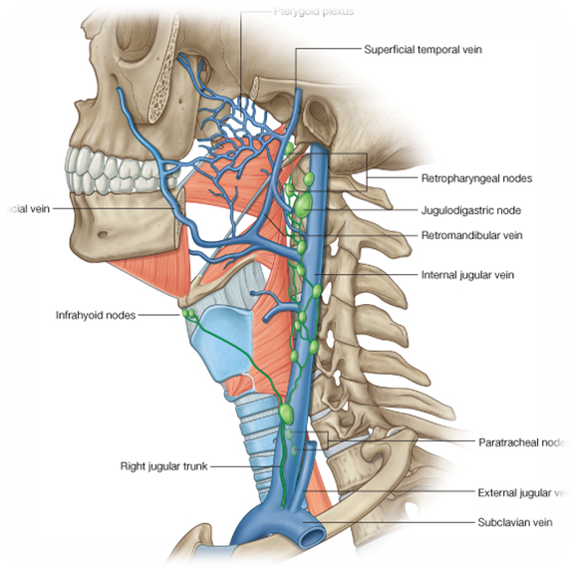
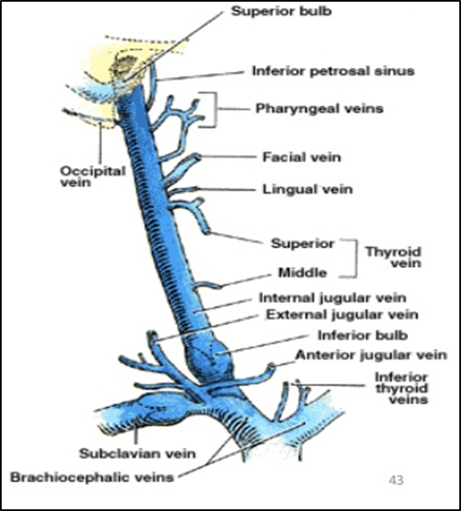
Veins of Face and Neck
Internal Jugular Veins
Drains blood from the head, brain, face & neck.
It descends in the neck along with the internal and common carotid arteries and vagus nerve, within the carotid sheath.
Joins the subclavian vein to form the brachiocephalic vein.
Tributaries:
Superior thyroid
Lingual (in the tongue)
Facial
Occipital veins
Pharyngeal veins
Dural venous sinuses (Inferior petrosal sinus)
Note:
the occipital vein’s drainage can vary.
Dural venous sinuses: these are venous sinuses found between the periosteal and meningeal layer of the dura matter (check next slide).
The inferior part of the internal jugular vein has a dilation known as the inferior bulb. Above the bulb there is a valve.

Slide 10
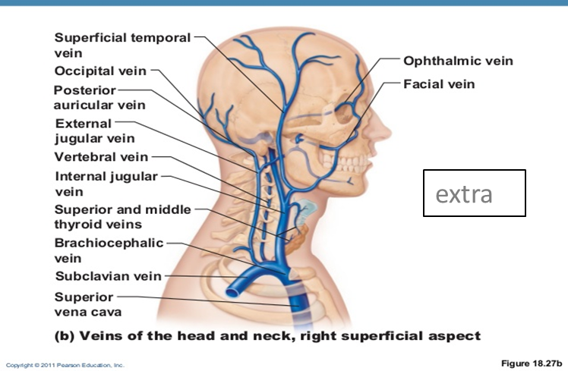
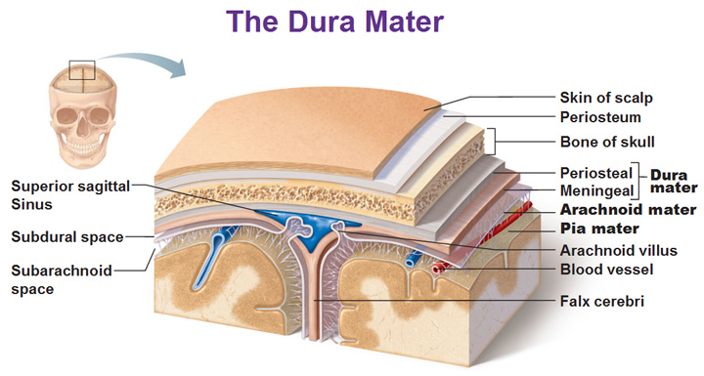
Extra pictures for understanding

Slide 11
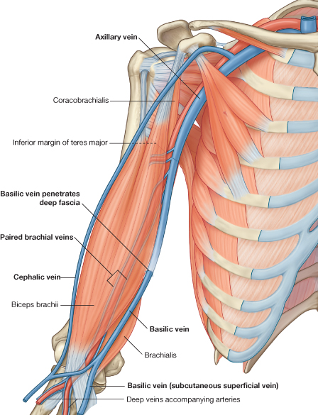
Veins Of Upper Limbs
1- Superficial Veins
A- Cephalic Vein
Ascends in the superficial fascia on the lateral side of the biceps.
Drains into the Axillary vein.
B- Basilic Vein
Ascends in the superficial fascia on the medial side of the biceps.
Halfway up the arm, it pierces the deep fascia
At the lower border of the teres major it joins the venae comitantes of the brachial artery to form the Axillary vein.
2- Deep Veins
A- Venae Commitantes
Which accompany all the large arteries and are usually in pairs.
B- Axillary Vein
Formed by the union of basilic vein and the venae comitantes (brachial veins) of the brachial artery.

Slide 12
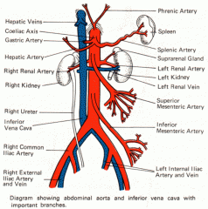
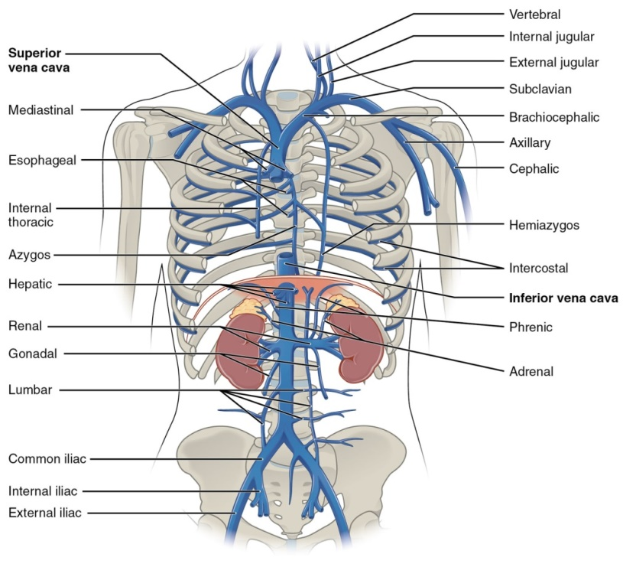
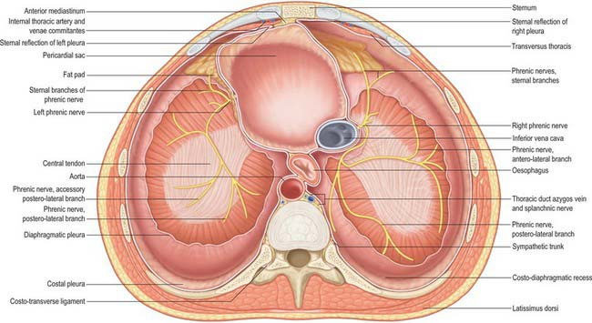
Inferior Vena Cava
Drains most of the blood from the body below the diaphragm to the right atrium.
Formed by the union of the two common iliac veins behind the right common iliac artery at the level of the 5th lumbar vertebra.
Ascends on the right side of the aorta
Pierces the central tendon of diaphragm at the level of the 8th thoracic vertebra*.
*Recall the descending aorta pierced the diaphragm at T12.
To remember:
Mnemonic of major openings of diaphragm: I ate (8) 10 Eggs At 12.
(I 8= inferior vena cava pierce at T8,
10 Eggs= Esophagus pierces at T10 ,
At 12 = Aorta pierces at T12)

Slide 13
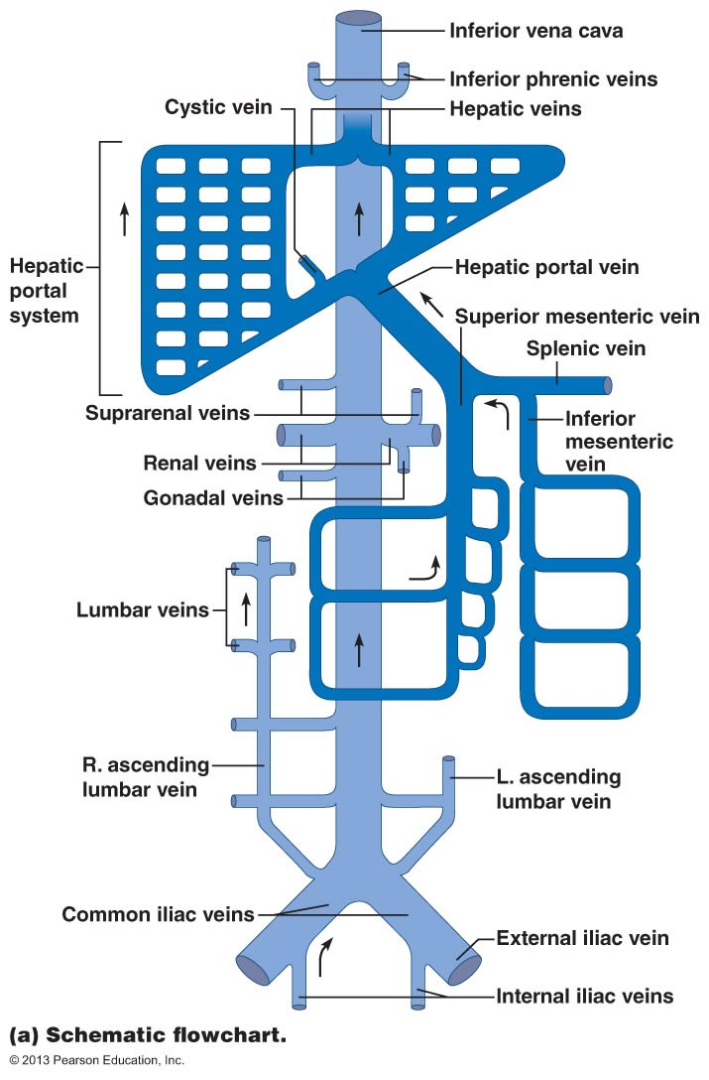
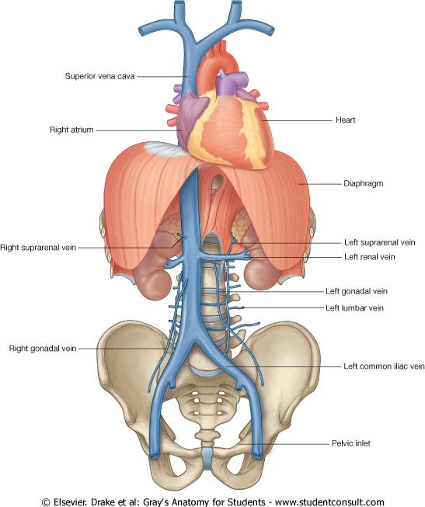
Inferior Vena Cava (Tributaries)
From bottom to top ↑
Median sacral vein
Two common iliac veins
Four paired lumbar veins
Right gonadal vein (the left vein drains into the left renal vein*)
Paired renal veins
Right suprarenal vein (the left vein drains into the left renal vein*)
Hepatic veins
Paired inferior phrenic vein
*Note:
The left gonadal/suprarenal veins drain into the IVC but INDIRECTLY. They first drain into the left renal vein which then drains into the IVC. That’s why we didn’t list them here as part of the tributaries.
Median sacral vein

Slide 14
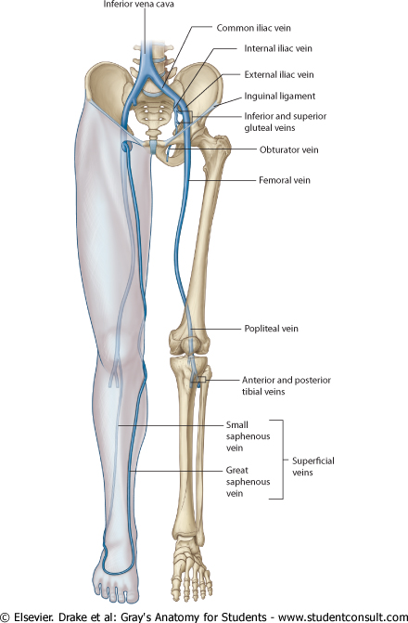
Veins Of Lower Limbs
Form a network in the subcutaneous tissue
SUPERFICIAL VEINS
TWO DIVISIONS:
DEEP VEINS
Pattern is variable
They are the tributaries of the:
Great (long) saphenous vein
Small (short) saphenous vein

Slide 15
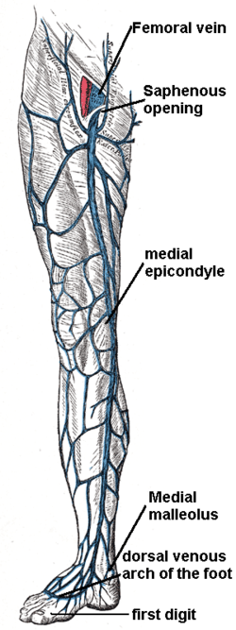
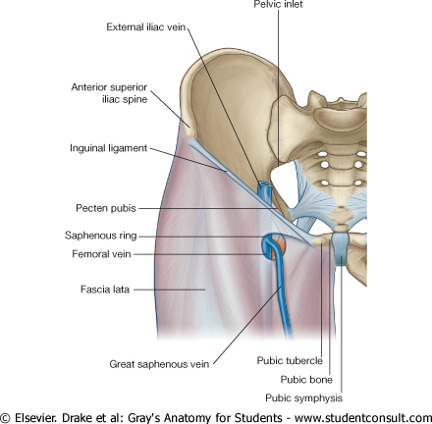
Veins Of Lower Limbs
Great Saphenous Vein
The longest vein.
Beginning:
  from the medial end of the dorsal venous arch of the foot.
Passes upward in front of the medial malleolus (constant position) with the saphenous nerve.
Then it ascends in accompany with the saphenous nerve in the superficial fascia over the medial side of the leg
Ascends obliquely upwards, and lies behind the medial border of the patella.
Passes behind the knee and curves forward around the medial side of the thigh.
Ascending :
Termination :
Hooks through the lower part of the saphenous opening in the deep fascia to join the femoral vein about 1.5 inch (4 cm) below and lateral to the pubic tubercle.

Slide 16
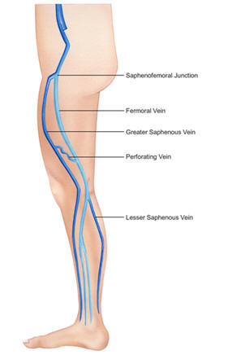
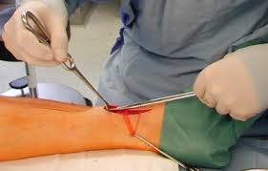
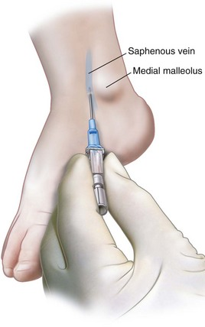
Veins Of Lower Limbs
Great Saphenous Vein
  It is connected to the small saphenous vein by one or two branches that pass behind the knee.
  Numerous perforating veins connect the great saphenous vein with the deep veins (femoral vein).
  The perforating veins have valves which allow blood flow from superficial to deep veins.
The great saphenous vein is used in venous grafting (التطعيم) and saphenous vein cutdown may be necessary for inserting the needle or canula (take care of the saphenous nerve)
Only on the girls’ slides

Slide 17
Veins Of Lower Limbs
Small Saphenous Vein
Beginning:
  from the lateral end of the dorsal venous arch of the foot.
Has numerous valves along its course.
Anastomosis freely with great saphenous vein.
Ascends behind the lateral malleolus in company with the sural nerve.
Follows the lateral border of the tendocalcaneus and then runs up to the middle of the back of the leg.
Pierces the deep fascia in the lower part of the popliteal fossa
Ascending :
Termination:
Drains into the popliteal vein .
Doctor’s note: the small saphenous vein join the venae comitantes and forms the popliteal vein.

Slide 18
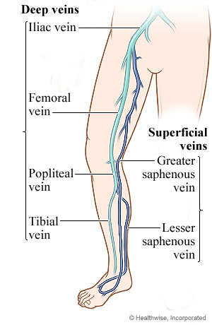
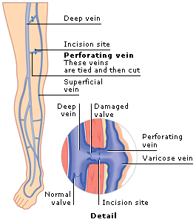
Veins Of Lower Limbs
Deep Veins
    Comprise the venae comitantes, which accompany all the large arteries, usually in pairs.
    Venae comitantes unite to form the popliteal vein, which continues as the femoral vein.
    Receive blood from superficial veins through perforating veins.

Slide 19
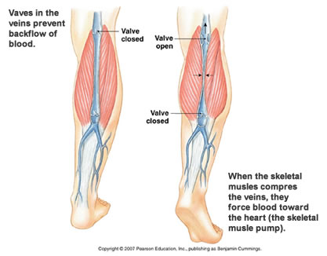
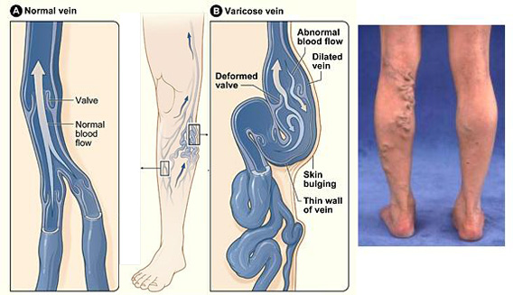
Mechanism Of Venous Return From Lower Limb (For Your Information)
Much of the saphenous blood passes from superficial to deep veins through the perforating veins
The blood is pumped upwards in the deep veins by the contraction of the calf muscles (calf pump).
This action of calf pump is assisted by the tight sleeve of deep fascia surrounding these muscles.
Varicose Veins
    If the valves in the perforating veins become incompetent, the direction of blood flow is reversed and the veins become varicosed.
    Most common in posterior & medial parts of the lower limb, particularly in old people.

Slide 20
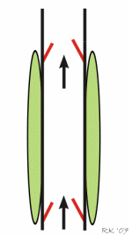
Factors Aiming Blood Return
Only on the boys’ slides
Muscle Contraction.
Rhythmical contraction of limb muscles as occurs during normal locomotory activity (walking, running, swimming) promotes venous return by the muscle pump mechanism.
Respiratory Pump
During respiratory inspiration, the venous return increases because of a decrease in right atrial pressure.
    Decreased Venous Compliance
    Sympathetic activation of veins decreases venous compliance, increases central venous pressure and promotes venous return.
    Gravity
    The effects of gravity on venous return seem paradoxical because when a person stands up hydrostatic forces cause the right atrial pressure to decrease and the venous pressure in the dependent limbs to increase

Slide 21
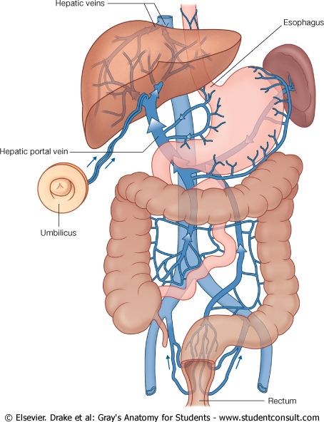
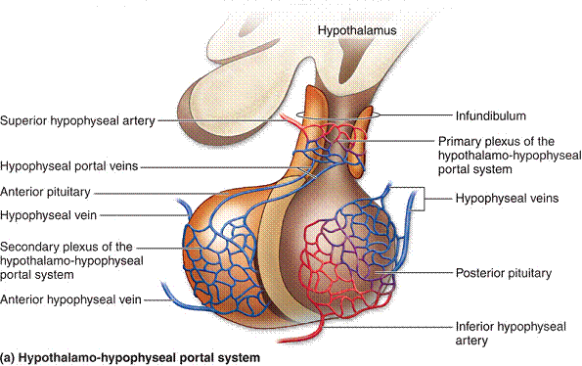
Portal Circulation
A portal venous system is a series of veins or venules that directly connect two capillary beds.
Examples of such systems include the hepatic portal vein and hypophseal portal system.

Slide 22
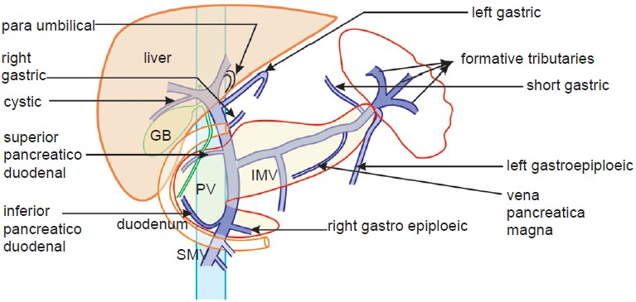
Portal Circulation
Hepatic Portal Vein
Drains blood from the gastrointestinal tract and spleen to the liver.
It is formed by the union of the superior mesenteric and splenic veins behind the neck of pancreas.
Immediately before reaching the liver, the portal vein divides into right and left that enter the liver.
Tributaries:
Right and Left Gastric veins.
Cystic vein from the gall bladder joins its right branch.
Para-umbilical veins that drain veins from anterior abdominal wall to the hepatic portal vein.
splenic

Slide 23
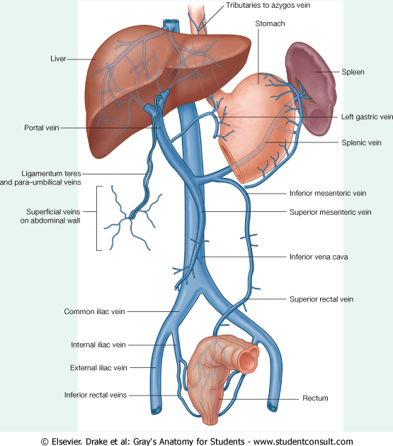
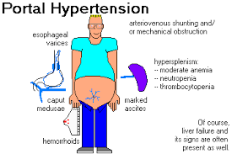
Portal Circulation
Portocaval Anastomosis
A portacaval anastomosis (also known as portal systemic anastomosis) is a specific type of anastomosis that occurs between the veins of portal circulation and those of systemic circulation.
The anastomotic channels become dilated (varicosed) in case of portal hypertension.

Slide 24
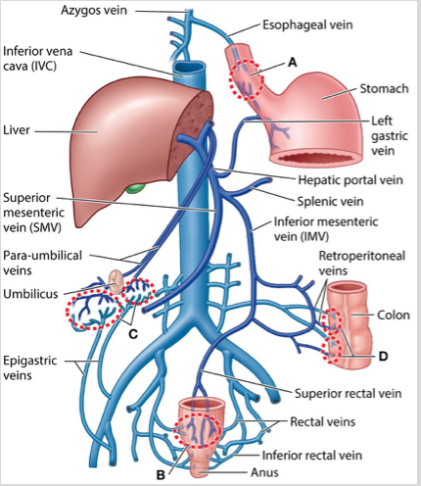
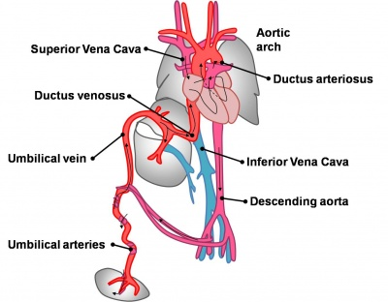
Portal Circulation
Sites Of Portocaval Anastomosis
Site | Portocaval Anastomosis |  | Associated condition
 | Portal Vein | Systemic Vein
Lower end of esophagus | Left gastric vein | Esophageal branch of azygos vein | Esophageal Varices
Lower part of rectum (or upper part of anal canal) | Superior rectal vein | Middle and inferior rectal vein | Hemorrhoids
Para umbilical regoin | Para umbilical veins | Superficial epigastric vein | Caput Medusae
Retroperitoneal | Colic veins | Veins of the posterior abdominal wall (retroperitoneal veins) | --
Patent ductus venosus (intrahepatic) | Umbilical vein + portal vein | Inferior Vena Cava | --
Bare area of liver | There is some anastomosis between portal venous channels in the liver and azygous system of veins above the diaphragm.

Slide 25
MCQs
Which of the following is the thickest layer in the artery ?
Tunica Media.
Tunica Intima.
Tunica Adventitia.
Answer: A
Which of the following veins is the only tributary of the subclavian vein?
External jugular vein
Internal jugular vein
Anterior jugular vein
Occipital vein
Answer: A
which of the following is a tributary for the internal jugular vein?
anterior jugular vein
Transverse cervical vein
facial vein
Suprascapular vein
Answer: C
Which one of the following nerves accompany the great saphenous vein in the medial side of the leg ?
Sural nerve
Sciatic nerve
Saphenous nerve
Tibial nerve
Answer: C
Which one of the following veins can be used in coronary artery bypass ?
Small saphenous vein
Hepatic veins
Renal veins
Great saphenous vein
Answer: D
The anastomotic channels of portocaval become dilated (varicosed) in case of.. ?
portal hypertension
portal hypotension
none of A&B
both of A&B
Answer : A

Slide 26


Leaders:
Nawaf AlKhudairy
Jawaher Abanumy
Members:
Yazeed Alsuhaibani
Abdulmalek Alhadlaq
Hamad Alkhudairy
Mohammed Habib
Talal Alhuqail
Majed Alzain
Mohammed naser
Abdulaziz Alsalman
Abdulhakeem Alonaiq
anatomyteam436@gmail.com
@anatomy436

