Slide 1
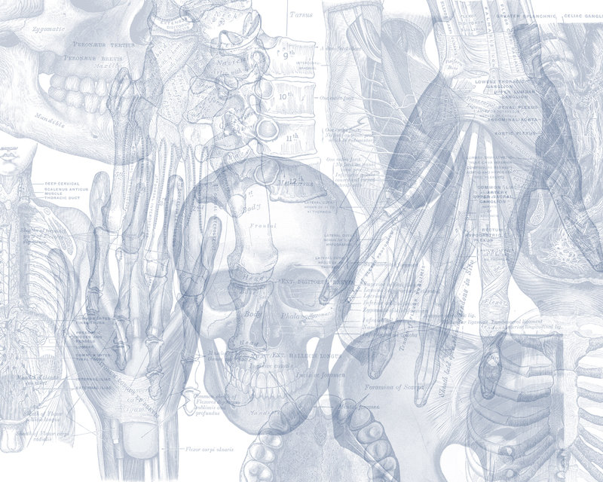
Blood Supply of the Heart
Color Code
Important
Doctors Notes
Notes/Extra explanation
Please view our Editing File before studying this lecture to check for any changes.

Slide 2
Objectives
At the end of the lecture the student should be able to know about;
The arterial supply of the cardiac muscle regarding (origin, course, distribution and branches).
The coronary anastomosis.
The arterial supply to the conducting system of the heart.
The venous drainage of the heart regarding (origin, tributaries and termination).

Slide 3
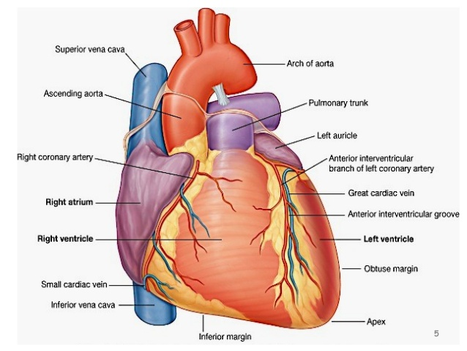
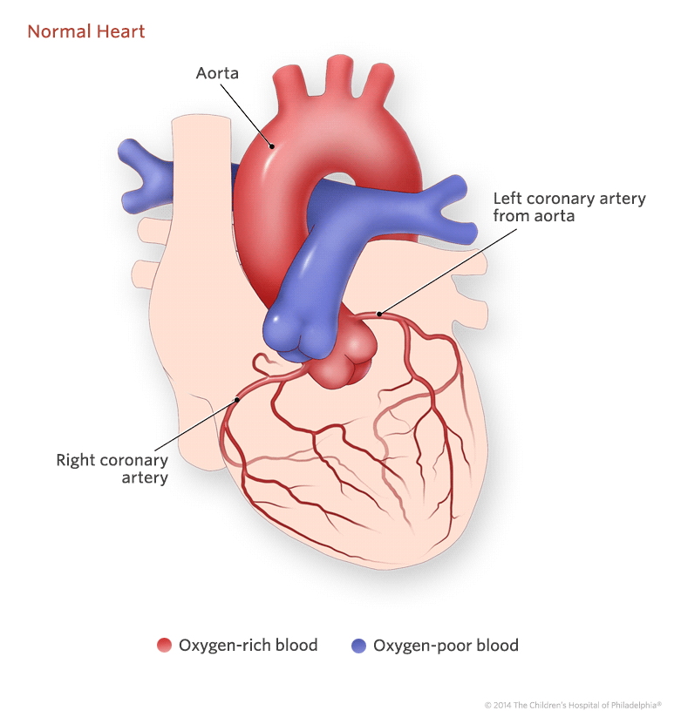
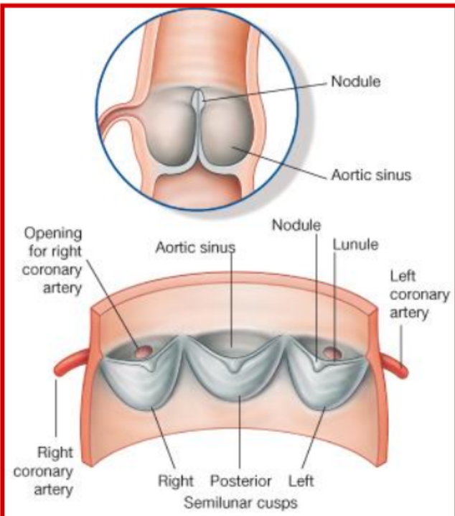
Arterial supply
The arterial supply of the heart is provided by:
Right coronary artery
Left coronary artery
Origin of Coronary Arteries:
They arise from the initial part of the Ascending Aorta (Aortic Sinuses*), immediately above the aortic valve.
Left coronary artery
they are distributed over the cardiac surface, within the subepicardium connective tissue
*The aortic sinuses are 3 dilations at the base of the ascending aorta between the wall of the aorta and each of the three cusps of the aortic valve
Ascending Aorta
the initial part of the Ascending Aorta

Slide 4
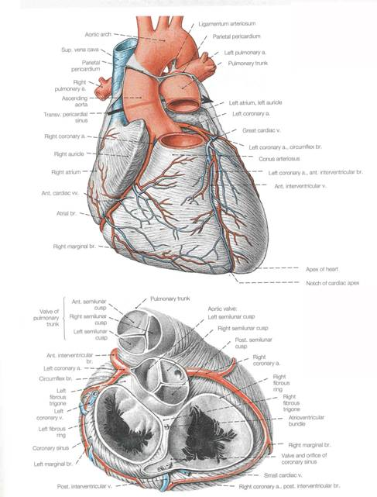
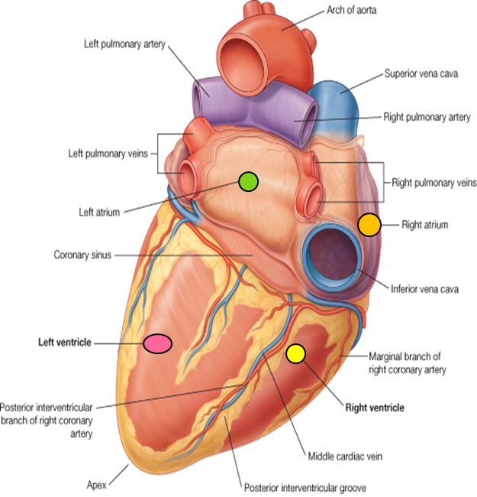
Right Coronary Artery (smaller branch)
Arises from the anterior aortic sinus* of the ascending aorta.
Runs forward and descends in the right atrioventricular groove between the Right Auricle and the Pulmonary trunk.
At the inferior border of the heart it continues posteriorly along the atrioventricular groove or sulcus to anastomose with the left coronary in the posterior interventricular groove.
The Right Coronary Supplies:
Right atrium.
Right ventricle.
Part of the left atrium.
Left ventricle & Atrioventricular septum.
Most of conducting system.
SAN, AVN, AVB and Left branch of AVB
*There are 3 aortic sinuses: 1 anterior and 2 posterior (left and right).

Slide 5
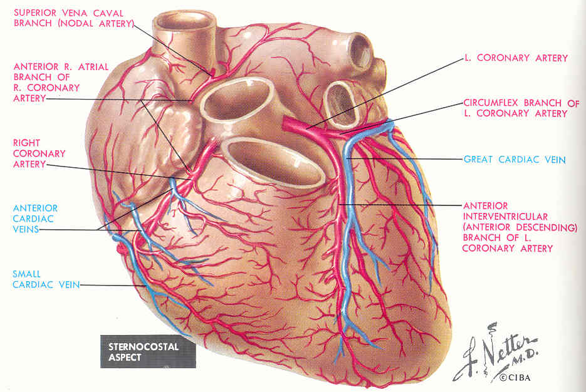
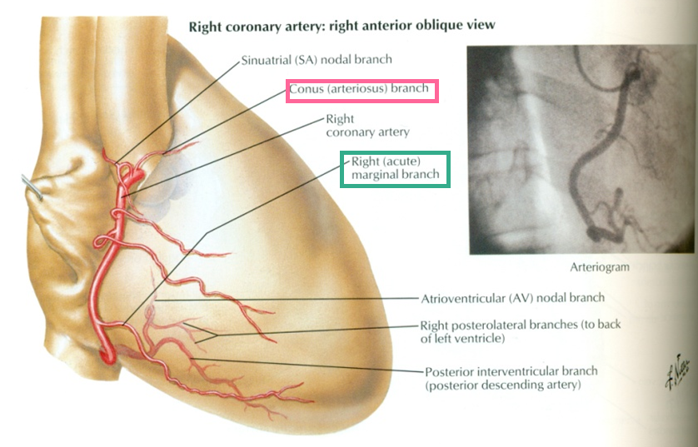
Right Coronary Artery Branches
Right conus
(1) Right Conus artery:
To the infundibulum (upper most part of right ventricle, named conus in embryology) and the upper part of the anterior wall of the right ventricle.
(2) Anterior Ventricular arteries; (2 or 3 branches)
To supply the anterior (sternocostal) surface of the right ventricle.
(3) Marginal artery;
Is the largest branch, runs along the inferior margin (lower margin of the sternocostal surface) toward the apex.
It is accompanied by the Small Cardiac vein.
(4) Posterior ventricular arteries; (2 branches)
To supply the diaphragmatic surface of the right ventricle.
Can you Try to See Most Front Post in the Internet ?
Conus,Atrial,Sinoatrial,Marginal,Anterior=front,Posterior , interventricular

Slide 6
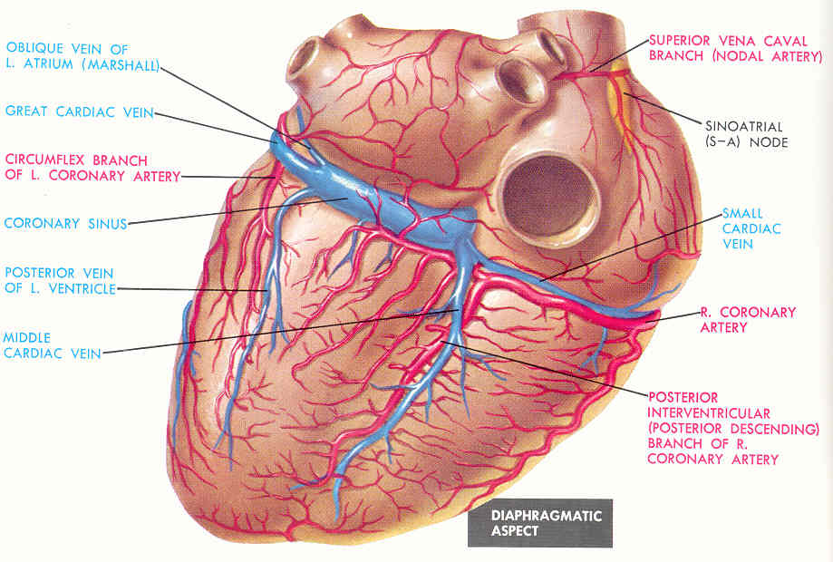
Right Coronary Artery Branches
(5) Atrial branches:
To the right atrium; anterior and lateral surfaces.
One branch supplies posterior surface of both atria
(6)The Artery of the Sinoatrial node:
Supplies the Sinoatrial node and both atria.
In 35% it arises from the left coronary.
(7) Posterior interventricular arteries ;
Accompanied by Middle Cardiac Vein
Lies in the posterior interventricular groove and runs toward the apex, to supply:
a. Diaphragmatic surface of the R & L Ventricles.
b. Posterior part of the IVS (interventricular septum) excluding (NOT) its Apex*.
C. Septal branch to the AVN.
(N.b) in 10% it is replaced by a branch from the left coronary
(also called posterior descending artery)
*The apex is supplied by the left coronary artery (anterior interventricular artery).

Slide 7
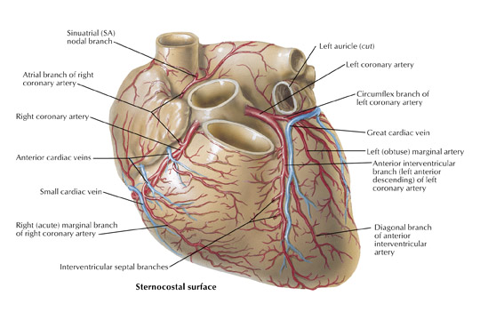
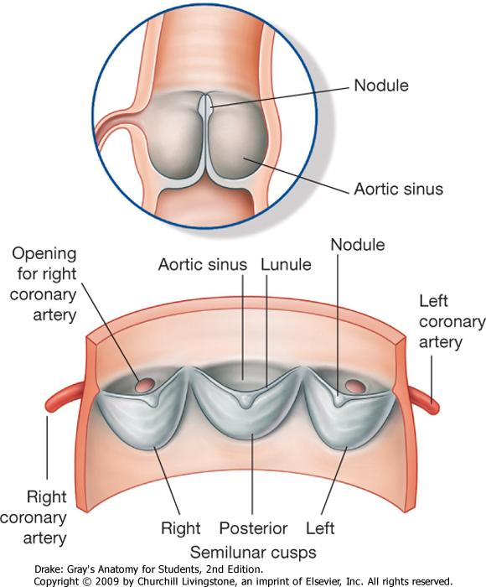
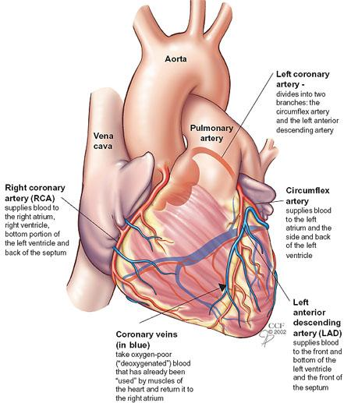
Left Coronary Artery
The Larger branch* of the two coronaries.
Arises from the left posterior aortic sinus** of the ascending aorta.
Descends:
1. Passes forward Between the pulmonary trunk and the left auricle.
2. In the IV (interventricular) groove to the apex of the heart.
Divides into two terminal Branches:
Anterior Interventricular & Circumflex arteries.
* Notice that the right coronary artery is smaller than the left coronary… but the right supplies more parts than the left.
**There are 3 aortic sinuses: 1 anterior and 2 posterior (left and right).
The left posterior gives the left coronary artery, while the right posterior gives no branches.

Slide 8
Left Coronary Artery
Branches
(A) Anterior Interventricular Artery:
Descends in the anterior interventricular groove to the apex of the heart (accompanied by the Great cardiac vein).
in most individuals it passes around the apex to anastomose with terminal branches of the right coronary in the posterior IV groove, in 1\3 it ends at the apex.
It supplies the right and left ventricles and anterior part of ventricular septum.
It gives:
1. Left conus artery for pulmonary conus.
2. Anterior ventricular and Posterior ventricular :
Supply left ventricle
3. Atrial branches:
Supply greater part of left atrium
4. Left diagonal artery:
one of the ventricular branches or may arises from left coronary.
(also called left anterior descending “LAD” artery)
Small cardiac vein | Marginal artery
Middle cardiac vein | Posterior interventricular artery
Great cardiac vein | Anterior interventricular artery

Slide 9
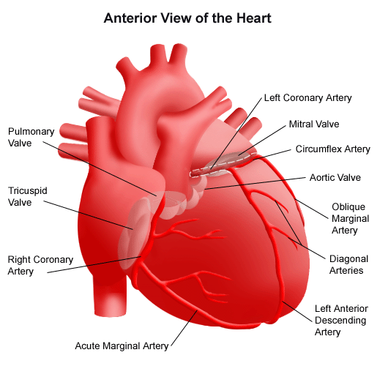
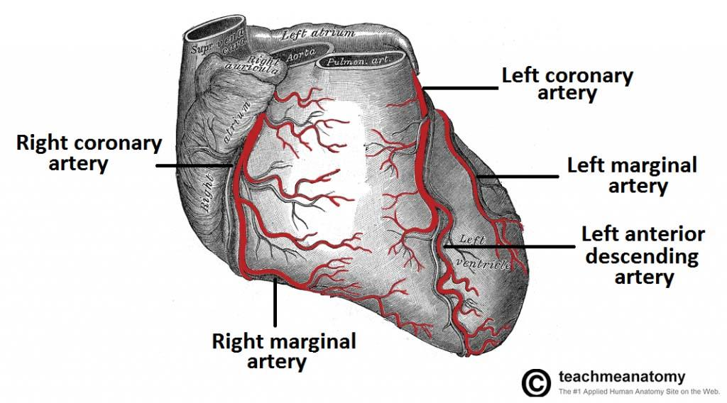
(B) Circumflex Artery:
Winds around the left margin of the heart in the atrioventricular groove. It gives:
Anterior ventricular and Posterior ventricular branches to the left ventricle.
Atrial branches to the left atrium.
(C) Left Marginal artery: (mostly come from circumflex*)
Supplies the left margin of the left ventricle down to the apex.
* The left marginal artery is mostly a branch of the circumflex artery… sometimes it is a branch of the left coronary artery

Slide 10
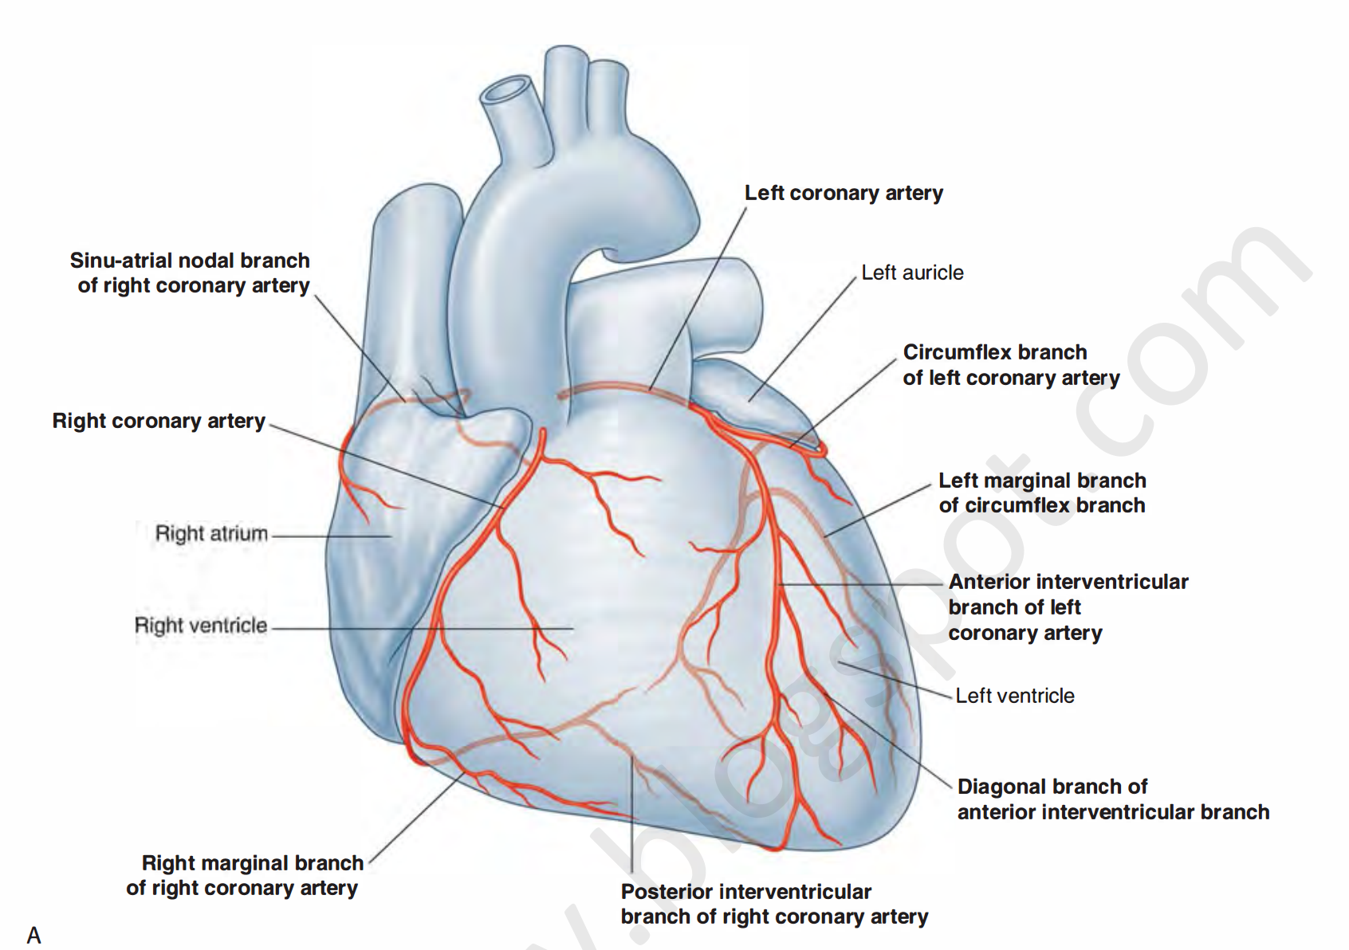
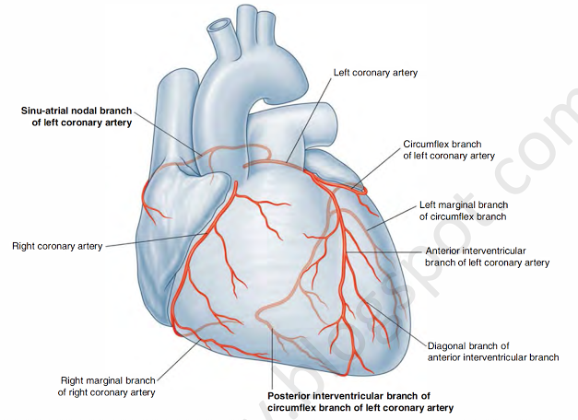
Variations of the Coronary Arteries
Right Dominance:
In (90 %) of population, the Posterior Interventricular artery is a branch of the Right Coronary.
Left Dominance:
In the rest (10%), the Posterior Interventricular artery arises from the Circumflex branch of the Left Coronary Artery.
Extra

Slide 11
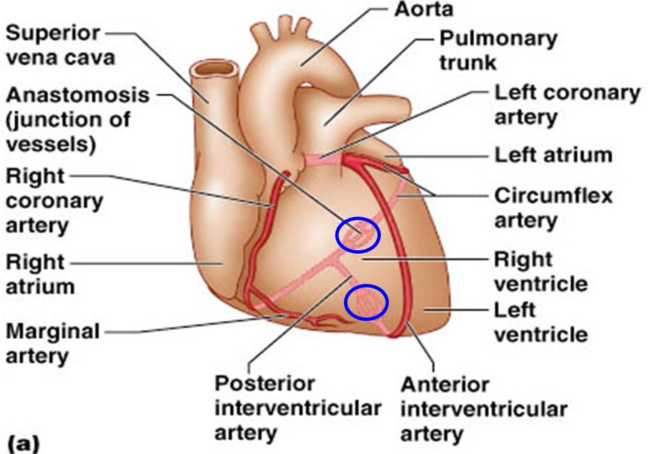
Coronary Anastomosis
Arterial Supply of Conducting System
In MOST of people, the terminal branches of the right and left coronaries anastomose in the posterior part of the IV (interventricular) groove.
However this anastomoses is not large enough to provide adequate blood supply in case of coronary occlusion or blockage, meaning they are Functional End arteries.
SAN, AVN & AVB (atrioventricular bundle) are usually supplied by Right coronary.
Right Bundle Branch (RBB) of AVB is supplied by Left coronary.
Left Bundle Branch (LBB) of AVB is supplied by both Right and Left coronaries.

Slide 12
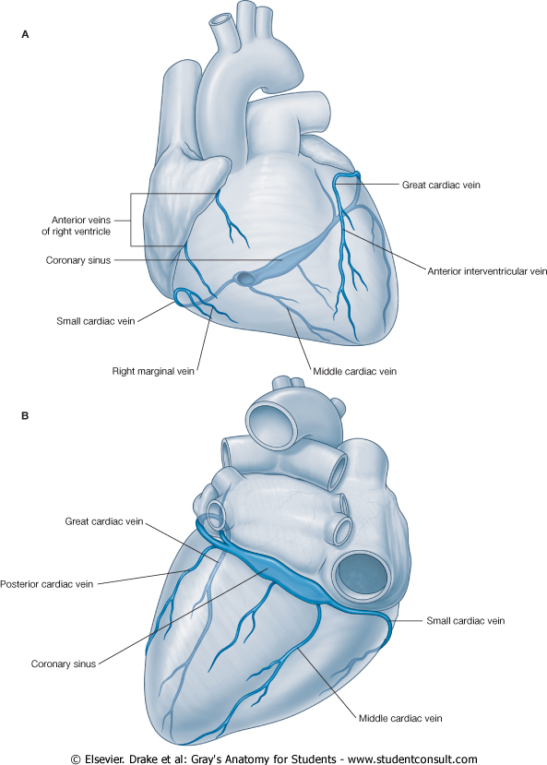
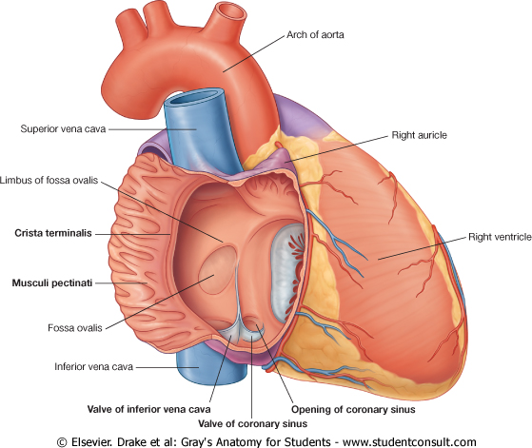
Venous Drainage
Blood of the heart is drained into the right atrium either directly or through the coronary sinus.
Coronary Sinus
Veins draining outside Coronary Sinus (directly into right atrium)
Drains most of the venous blood of the heart.
Lies in the posterior part of the AV groove (coronary sulcus).
Origin: It is the direct continuation of the Great Cardiac Vein.
Tributaries:
Great Cardiac Veins.
Middle Cardiac Veins.
Small Cardiac Veins.
Oblique vein of left atrium (vein of Marshall).
Termination
It empties into Right Atrium. Its opening is to the inferior and left of the IVC opening.
It is guarded by a valve.
1. Anterior cardiac veins: open directly into the Right Atrium.
2. Venae Cordis minimae ; small veins open directly into the heart chambers.
3 cardiac veins

Slide 13
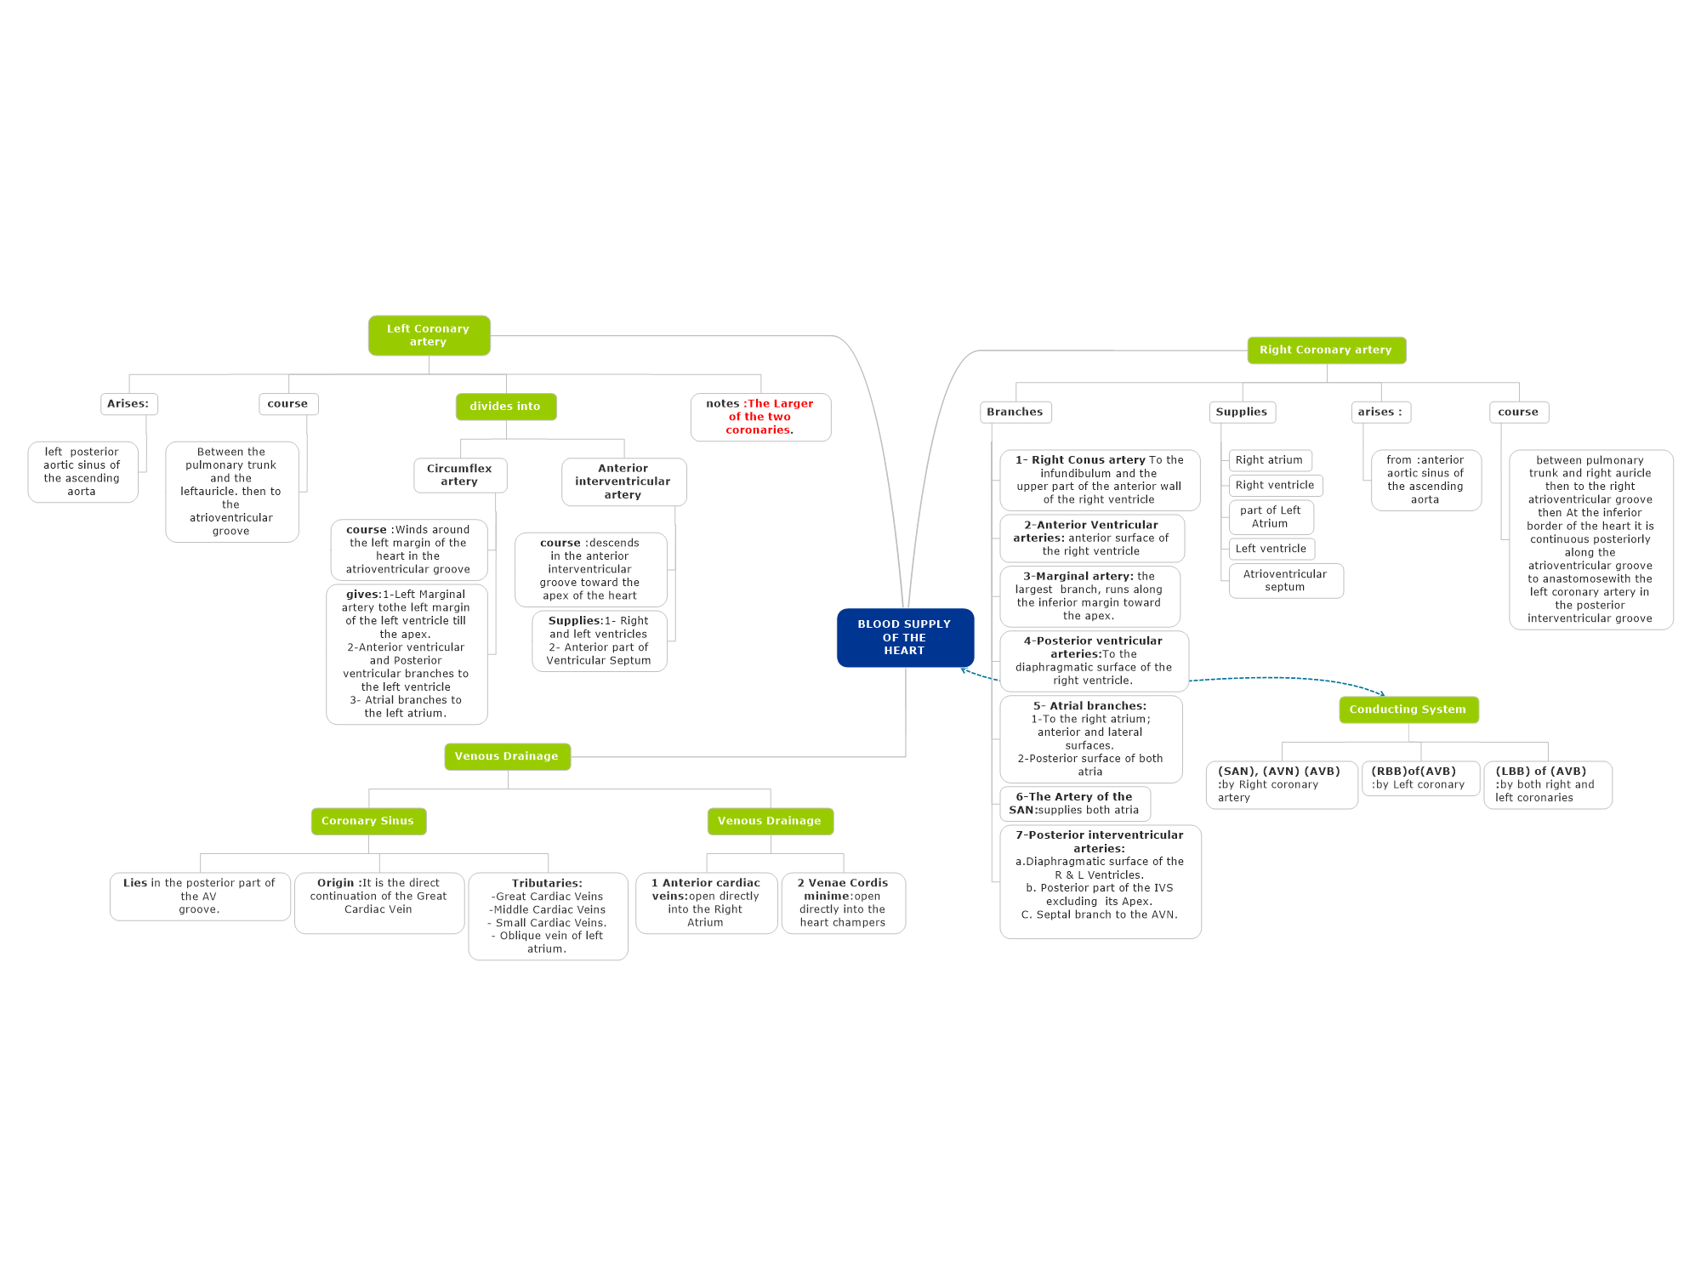
Summary
Most of conducting system

Slide 14
Questions
Which of the following branches supplies the anterior and lateral surfaces of the right atrium?
a. Right conus
b. Atrial branches
c. Marginal artery
d. Artery of Sinoatrial node
Answer: B
Which of the following branches supplies the diaphragmatic surface of the right ventricle?
a. Posterior ventricular branches
b. Anterior ventricular branches
c. Posterior interventricular artery
d. Marginal artery
Answer: A
All of the following are branches from the anterior interventricular branch of the left coronary artery except for:
a. Left conus
b. Anterior and posterior ventricular branches
c. Left diagonal artery
d. Posterior interventricular artery
Answer: D
Which of the following provides the arterial supply of the heart?
a. Left marginal artery
b. Circumflex artery
c. Coronary arteries
d. Ascending aorta
Answer: C
The right coronary artery supplies all the following except:
a. Right atrium
b. Most of the conducting system
c. Atrioventricular septum
d. Interventricular septum
Answer: D
Which of the following branches of the right coronary artery supplies the infundibulum of the heart?
a. Marginal artery
b. Right conus
c. Anterior ventricular branches
d. Atrial branches
Answer: B

Slide 15
Questions
10. The left bundle branch of the conducting system is supplied by: a. left CA. b. right CA.
c. both of them. d. none of them
Answer: C
11. The coronary sinus is located in: a. posterior AV groove. b. anterior AV groove.
c. apex. d. left margin
Answer: A
12. Coronary sinus drains into: a. left atrium. b. left ventricle.
c. right atrium. d. right ventricle
Answer: C
13. Anterior cardiac veins drain into : a. coronary sinus. b. right atrium.
c. right ventricle. d. left atrium
Answer: C
The marginal artery is accompanied by ………. And the posterior interventricular artery is accompanied by ……….:
a. Small cardiac vein – Great cardiac vein
b. Great cardiac vein – Small cardiac vein
c. Small cardiac vein – Middle cardiac vein
d. Middle cardiac vein – Small cardiac vein
Answer: C
8. Anterior Interventricular branch is branch of : a. left coronary. b. right coronary.
c. circumflex branch. d. marginal artery.
Answer: A
9. In most people the terminal branches of the left and right coronaries anastomose in:
a. anterior Interventricular groove.
b. posterior Interventricular groove c. apex of the heart.
d. base of the heart.
Answer: B

Slide 16
Leaders:
Nawaf AlKhudairy
Jawaher Abanumy
Members:
Alanoud Abuhaimed
Allulu Alsulayhim
Dania Alkelabi
Deena AlNowiser
Lama Alfawzan
Lara Alsaleem
Maha Alissa
Nada Aldakheel
Nourah Al Hogail
Safa Al-Osaimi
Wejdan Alzaid
anatomyteam436@gmail.com
@anatomy436

