Slide 1
Biochemistry
Lactic acidosis
Don’t wait for opportunity ..
Create it .
Important.
Extra Information.
Doctors slides
Doctors notes
436 Biochemistry team
1

Slide 2
Overview:
Introduction to metabolic acid-base disorders
Metabolic acidosis and alkalosis.
Lactic acidosis:
Definition.
Lactic metabolism in tissue.
Mechanism involved in lactic acidosis.
Types and causes of lactic acidosis.
Diagnosis and treatment.

Slide 3
Recall what you studied before:
What is lactic acid?
Lactic acid is the end product of anaerobic glycolysis.
Pyruvate is converted to lactate
What is the cause?
The tissues are not receiving enough oxygen instead of producing ATP by going through the normal glycolysis and then TCA cycle, it starts producing lactic acid.
The difference between lactate and lactic acid?
Is the lost Hydrogen ion
What is acidosis?
increased acid in the body and pH decrease

Slide 4
Recall what you studied before:
What is pH?
Negative logarithm of Hydrogen concentration (inversely proportional)
What is the normal pH of the body (physiological pH)?
(7.34 - 7.45)
If pH is above 7.45 it is alkalosis
If pH is under 7.34 it is acidosis
If there were alkalosis or acidosis the body will fight back by the compensatory mechanisms
What is respiratory acidosis?
Increase in CO2 concentration and pH decreases
What is the compensatory mechanism in this case?
Hyperventilation

Slide 5
Metabolic acid base disorders:
They are changes in bicarbonate concentration* in the extracellular fluid (ECF) cause acid-base disorders.
Buffer tries to fight the abnormal change in pH. The physiological buffer in the body is bicarbonate.
Loss of H⁺ ions
Metabolic alkalosis
More than 7.45
Increasing in bicarbonate.
High concentration of H⁺ ions
Metabolic acidosis
Less than 7.34
Decreasing in bicarbonate.
If we want to assess respiratory acidosis or alkalosis, we check CO2 concentration.
If we want to assess metabolic acidosis or alkalosis, we check bicarbonate concentration.
Occur due to:
*Why not in blood? Because it’s not depletion or increase in the ion itself, instead, it is redistribution of the ions between intra and extracellular fluid causing increased concentration in either of them.

Slide 6
Extra explanation:
In diabetes there’s no enough insulin so the tissue can not take glucose from blood so the tissue starts glycolysis by breaking fatty acid causing an increase in ketones bodies acidosis.

Slide 7
Metabolic acid base disorders:
If we suspect the patient has acidosis:
1st measure the concentration of pH (to know if it’s acidosis or alkalosis).
2nd measure bicarbonate ions (to know if it’s metabolic or respiratory)
For example:
If the bicarbonate concentrations are decreased we say it’s metabolic acidosis, but if there weren’t any changes in bicarbonate levels we say it’s respiratory acidosis.
If a patient gets metabolic acidosis, he can get a respiratory compensation. HOW?
Metabolic acidosis by hyperventilation
Metabolic alkalosis by hypoventilation
أعراض الاسيدوسيز هي قلة في مقدار الـ PH وارتفاع في مقدار الهيدروجين (علاقة عكسية), الشي الي يفرق لي اذا كانت ميتابوليك او ريسبايرتوري هي مقدار البايكربونيت حيث انها لا تتاثر في الريسبايرتوري

Slide 8
Metabolic acid base disorders:
It has to be chronic vomiting!
Increased hydrogen production can be caused by some drugs.
Too much of alkali not the daily normal consumption.
loss of bicarbonate can be due to
-Chronic diarrhea
-excessive loss through urine
Very important molecule in metabolic disorders.

Slide 9
Extra Explanation that Dr.sumbul added during the lecture:
Potassium deficiency explanations
Hypertensive patients take diuretics which makes the patients urinate more and can lead to potassium deficiency, when there is potassium deficiency in the cells the hydrogen ions that are present in the extracellular fluid will enter to the cells.
The entrance of hydrogen ions into the cells makes the hydrogen concentration in the extracellular fluid less and this leads to alkalosis.
Furthermore,
Normally when there is sodium reabsorption in the kidney as the sodium is reabsorbed the potassium should be kicked out, but because the potassium levels are already decreased the hydrogen is kicked out instead of potassium and this results in very acidic urine while there is alkalosis in the body and this is called paradoxical urine
That is extra =)

Slide 10
Metabolic acidosis:
Reduction in bicarbonate concentration of ECF.
Increased production of H⁺ ions.
Causes are:
Impaired excretion of H⁺.
Ingestion of H⁺ or drugs metabolized to acids.
Whether it is because of increased lactic acid or ketone bodies production causing an increase in giving off hydrogen ions.

Slide 11
Anion gap:
What is “Anion gap”?
It is the difference between the sum of Na⁺ and K⁺ (cations) and the sum of Cl⁻ and HCO₃⁻ (anions). { Cations (Na+ + K+ ) – Anions (Cl- + HCO3- ) }
What does it help in?
It helps in assessing acid-base problems.
-There are a lot of other cations and anions within the body but in this calculation we consider only those.
-When a molecule donates its hydrogen then it is called anion because it has negative charge
Low anion gap:
< 3 mEq/L
(alkalosis)
Normal anion gap:
3-11 mEq/L
High anion gap:
> 11 mEq/L (acidosis)
Metabolic acidosis (high anion gap)
Occurs in:
Renal disease. Impaired excretion.
Diabetic ketoacidosis. Too much ketone bodies produced.
Lactic acidosis.
Chronic diarrhea.
Renal tubular acidosis.
Poisoning. Aspirin poisoning lead to lactic acidosis, or any salicylate poisoning.

Slide 12
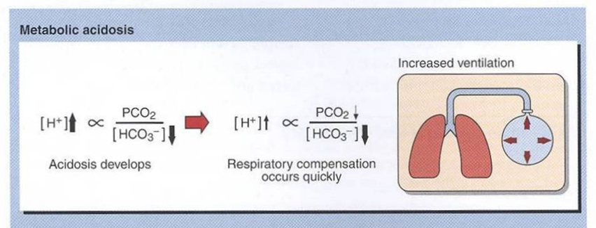
Clinical effects of acidosis:
Kussmaul breathing
Which is exhaling forcefully.
Hyperventilation: deep, rapid, and gasping respiratory pattern
Hyperventilation
is the compensatory physiological response to acidosis.
Increased H+ conc. stimulates respiratory response
Loss of consciousness, coma and death.
When there is a high hydrogen concentration in the extracellular fluid the cells will try to take up the hydrogen and bump out potassium so acidosis is accompanied by hyperkalemia.
Whenever the potassium levels are disturbed this leads to neuromuscular irritability -> muscle weakness, cardiac arrhythmia and cardiac arrest..
Arrhythmia, cardiac arrest

Slide 13
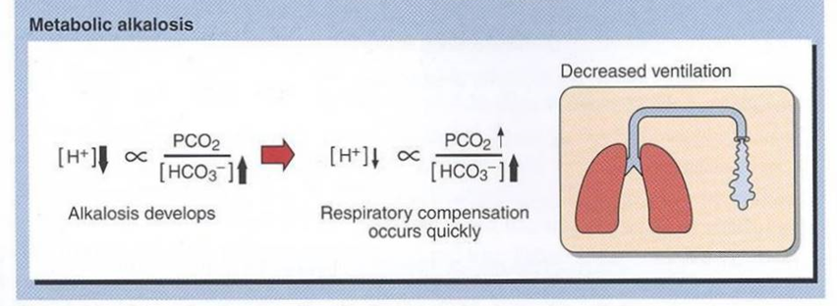
Metabolic alkalosis:
Increase in bicarbonate concentration in ECF
causes:
Loss of H+ ions in gastric fluid due to chronic vomiting
Ingestion of sodium bicarbonate
Potassium deficiency as a result of diuretic therapy
Clinical effects of alkalosis:
Hypoventilation increases CO2
(depressed breathing)
Increases PCO2 to compensate alkalosis
Respiratory arrest
Confusion, coma, death

Slide 14
Lactic Acidosis:
Lactic Acidosis: Elevated concentration of plasma lactate Occurs either due to:
Failure of circulatory system (hypoxia) “Type A”. Anything that causes hypoxia.
Disorders of carbohydrate metabolism “Type B”.
Other causes at the level of circulatory system:
-Cyanide or CO poisoning
-Hb abnormality
-Cardiac arrest (because blood flow is not there)
-Chronically ill patients.
-Hemorrhagic shock.

Slide 15
Lactate metabolism in tissue:
The body tissues produce ~ 1500 mmoles of lactate each day
The lactate enters bloodstream and metabolized
mainly by the liver (Cori cycle)
lactic acid cycle
All tissues can produce lactate under anaerobic conditions
Pyruvate is converted to lactate by lactate dehydrogenase enzyme:
last step in glycolysis
Pyruvate + NADH + H⁺ Lactate + NAD⁺
Lactate dehydrogenase
10

Slide 16
Lactate metabolism in tissue:
The skeletal muscles produce high amounts of lactate during vigorous exercise
Lactate is metabolized in liver (60%) and kidney (30%) to glucose
Some lactate is metabolized to CO2 and water (Krebs cycle)

Slide 17
Mechanisms involved in lactic acidosis:
Lactic acidosis can occur due to:
Normal (5-1) mmols/l
Hyperlactemia can be transient (عابر) or persistent
Excessive tissue lactate production OR
Impaired hepatic metabolism of lactate.
Its has two types A&B ‘’based on the cause’’

Slide 18
*Due to hypoxia in the tissue ( most common).
Hypoxia.
Cell switch to anaerobic glycolysis for ATP synthesis.
Production of lactate as final product.
Impaired oxidative phosphorylation and decreased ATP synthesis.
The amount of oxygen required to recover from oxygen deficiency is called oxygen debt.
Type A:
How ?
Type A is due to inadequate supply of oxygen to tissues in:
does not result in lactic acidosis because we don’t have lactic acid every time we exercise, the body shifts to aerobic if anaerobic is persistant.
13

Slide 19
Due to disorders in carbohydrate metabolism (congenital defect in enzymes).
Type B:
Why?
There are two enzyme what will work on pyruvate
Ether
pyruvate dehydrogenase producing coQ enzyme , or
lactate dehydrogenase producing lactate .
So, if the pyruvate dehydrogenase enzyme is not present All of pyruvate will be converted into lactate by the other enzyme.
Chronic hepatic disease accompanied by shock or bleeding
Drug intoxication
Liver failure
Congenital lactic acidosis is due to deficiency of pyruvate dehydrogenase enzyme
Methanol and alcohol consumption in big amounts.

Slide 20
Diagnosis and treatment:
Diagnosis done by measuring blood lactate levels:
if (2 – 5 mmols/L) : hyperlactemia
If more than 5 mmols/L : severe lactate acidosis (life threatning, can lead to coma and death).
Treatment:
Correcting the underlying conditions.
Restoring adequate tissue oxygen. if type A
3-Avoiding sodium bicarbonate .

Slide 21
Dr.Sumbul Explanation:
If the patient has metabolic acidosis because of diabetes or any other cause than lactic acid then you can treat him by bicarbonate
If the patient has metabolic acidosis because of lactic acid production, then you cannot treat the patient with bicarbonate
Reason?
Acidosis inhibit (PFK) phosphofructokinase kinase 1 which is an enzyme in glycolysis, glycolysis is inhibited as well as the pyruvate and lactate production are decreased. While treating the patient was bicarbonate it will cancel the inhibition and the glycolysis will continue and will lead to further increase of lactic acid.
Metabolic acidosis because of lactic acid cannot be treated by bicarbonate.
Metabolic acidosis because of any other cause (diabetes) can be treated by bicarbonate.

Slide 22
Quiz
SAQ
https://www.onlineexambuilder.com/lactic-acidosis-saq/exam-139442
MCQ’s
https://www.onlineexambuilder.com/lactic-acidosis/exam-139197
Helpful video
https://www.youtube.com/watch?v=gjKmQ501sAg

Slide 23
TEAM
MEMBERS
Talal altokhaim
Amaal Alqarni
Heba Alnasser
Haifa Alwael
Lama Altamimi
Reema Alshaea
Bushra Quqandy
Ruba Barnawy

Slide 24
THANK YOU
https://www.youtube.com/watch?v=gjKmQ501sAg
PLEASE CONTACT US IF YOU HAVE ANY ISSUE

