Slide 1
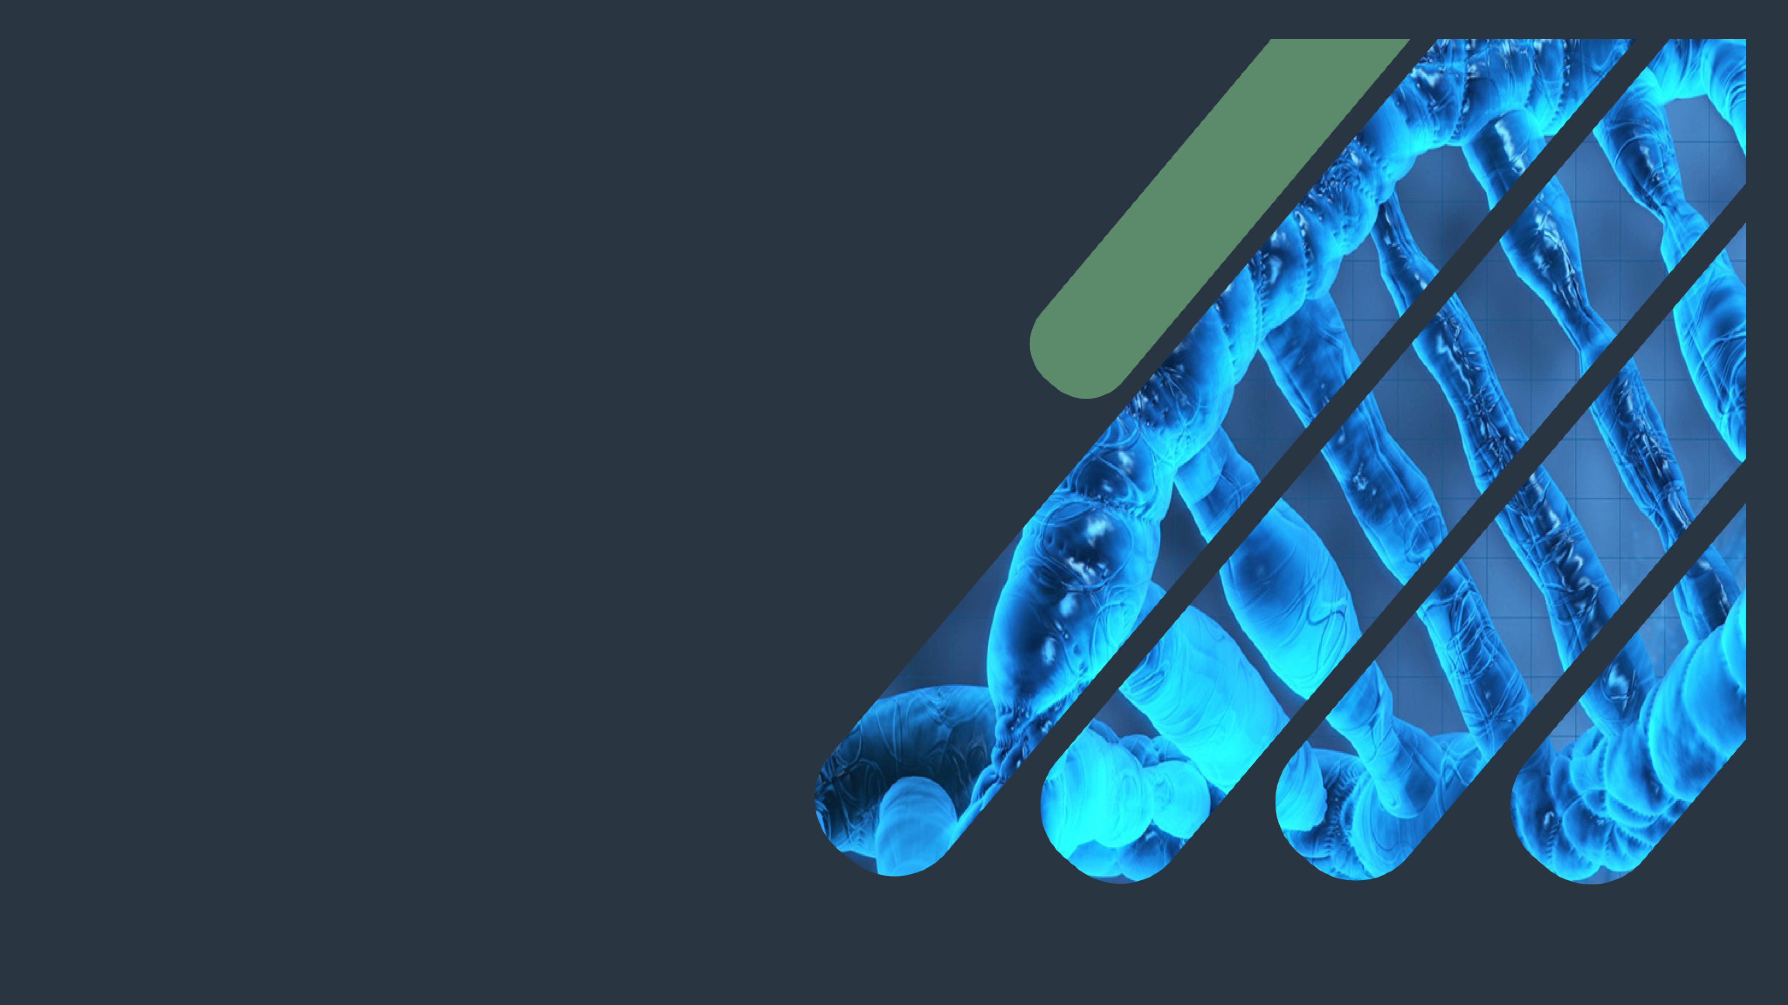
Biochemistry
Cholesterol Metabolism
A little progress each day adds up to big results ..
Important.
Extra Information.
Doctors slides
Doctor’s notes

Slide 2
OBJECTIVES:
By the end of this lecture the students will be able to:
Know the structure and function of cholesterol
Relate hypercholesterolemia and atherosclerosis.
Define cholesterol biosynthesis and its regulation.
List the factors that decrease blood cholesterol level.
Identify bile salt functions and cholesterol excretion.

Slide 3
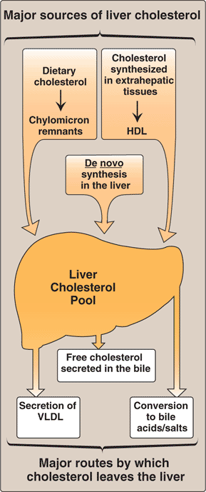
Cholesterol
Liver plays a central role in the regulation of cholesterol homeostasis
Most important animal steroid because it is the structural component of all cell membranes.
Maintains membrane fluidity and integrity which affects permeability and interaction with other cells.
Insulating effect on nerve fibers such as myelin sheath.
Cholesterol is the parent molecule for
Vitamin D3
Bile acids and bile salts
Important for digestion of lipid and fat soluble vitamins such as vitamin A,D,E,K
Cholesterol enters the liver’s cholesterol pool from a number of sources including dietary cholesterol, as well as cholesterol synthesized De novo by extrahepatic tissues and by the liver itself. Cholesterol is eliminated from liver as unmodified cholesterol in the bile, or it can be converted to bile salts that are secreted into the intestinal lumen.
Steroid hormones

Slide 4
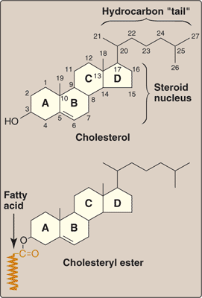
Cholesterol structure
Cholesteryl esters
Four rings called (Steroid nucleus).
At carbon atom no.17
( hydrocarbon tail ) attaches .
Hydrophobic because of the presence of fatty acid.
Most plasma cholesterol is esterified with a fatty acid (the cholesterol found in the body and blood (plasma) is in the form of cholesteryl ester).
CEs are not present in membranes (only free cholesterol).
Present in small amounts in most cells .
More hydrophobic than cholesterol (because of the fatty acid group, so it must be transported in association with proteins as a compound of lipoproteins or be solubilized by bile salts).
Sterols: a class of steroids that contain a hydrocarbon tail on C17 and a hydroxyl group on C3.
You don’t have to memorize the structures

Slide 5
Cholesterol synthesis
Synthesized in all tissues
Major sites for synthesis: liver, adrenal cortex, testes, ovaries and intestine.
All carbon atoms are derived from acetyl CoA (has 2 carbons) .
Enzymes involved in biosynthesis are partly located in ER(smooth endoplasmic reticulum) and partly in cytoplasm or both.

Slide 6
HMG-CoA synthesis
HMG-CoA is a molecule that forms cholesterol after certain reactions.
We need 3 Acetyl CoA to get HMG CoA which has 6 carbon atoms.
In liver
HMG-CoA synthase is present in both cytosol and mitochondria of liver.
In liver’s mitochondria
Its function is ketogenesis (ketone body synthesis).
In liver’s cytosol (cytoplasm)
Its function is cholesterol synthesis.

Slide 7
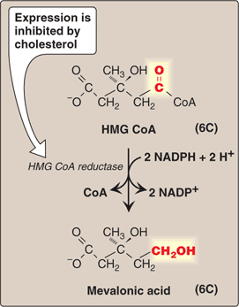
Mevalonic acid Synthesis
Why is it important ?
Rate limiting and key step of cholesterol synthesis. ( step that regulates the whole pathway, which is an irreversible and slow step, and is the target for inhibitors )
Where does it occur ?
It occurs in the Cytosol.
Why does it occur in the cytosol even though HMG CoA reductase is an ER membrane enzyme?
Because it has active (catalytic) unit hanging in the cytosol .

Slide 8
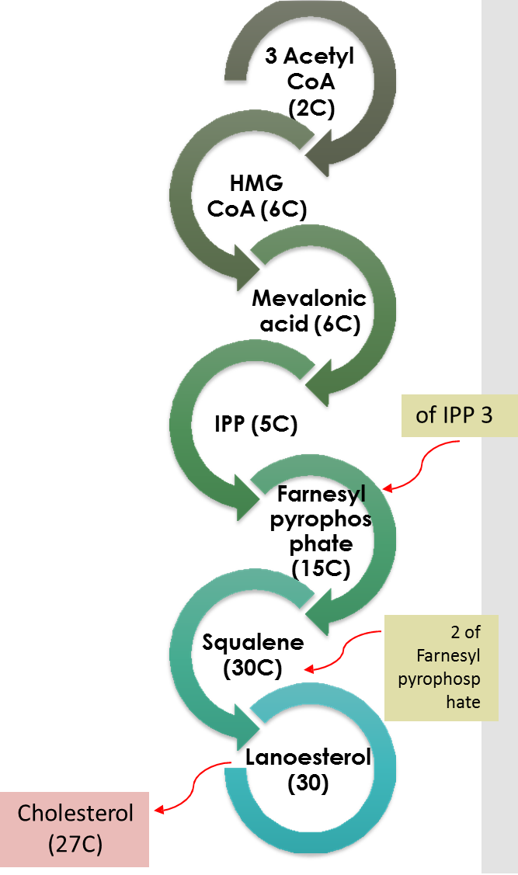
Mevalonic acid Synthesis
After being a Mevalonic acid, the complex undergoes some reactions to become a cholesterol, those steps are :
Production of a 5-carbon unit:
- Isopentinyl pyrophosphate (IPP) (which is the patent sterol for all sterols, and the building block of cholesterol)
Condensation to a 30C compound: squalene (which is an opened ring molecule)
Cyclization of squalene to 30C Lanosterol
Synthesis of 27-Carbon cholesterol (defect in this leads to Smith-Lemli-Opitz Syndrome (SLOS – An autosomal recessive disorder caused by a partial deficiency in 7-dehydrocholesterol-7-reducatse)
Important note: Lanosterol is the first Sterol made by the body .. Because it was a result for cyclization of other non cycled molecule . Check the chemical structure in next page for better understanding .

Slide 9
Mevalonic acid Synthesis – Summary
Step 1: Acetyl CoA + Acetyl CoA = Acetoacetyl CoA (enzyme : thiolase)
Acetoacetyl CoA + Acetyl CoA = HMG-CoA (enzyme : HMG-CoA synthase)
Step 2: HMG-CoA is reduced into mevalonic acid (enzyme : HMG-CoA reductase) – most important step, rate limiting.
Step 3: Mevalonic acid is converted into Isopentinyl pyrophosphate (IPP - 5 carbons)
Step 4: We put 3 IPPs together to get Farnesyl pyrophosphate (FPP - 15 carbons)
Step 5: We put 2 FPPs to get a 30 carbon unit compound : Squalene.
Squalene is then cyclized to give the first sterol in the body with 4 rings: Lanosterol.
Lanosterol is cleaved into a 27 carbon cholesterol.

Slide 10
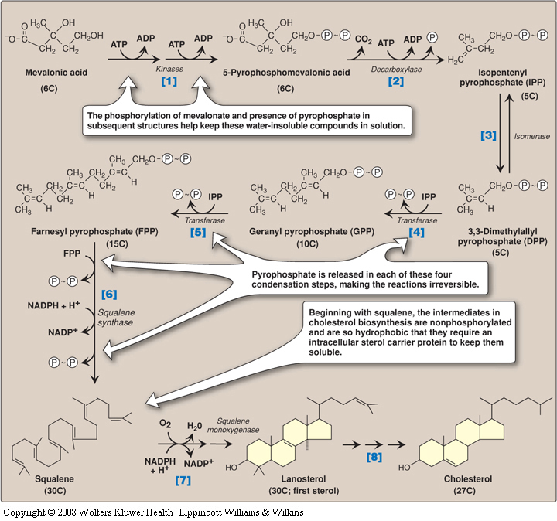
The doctor said this is not required.. Just know the marked steps .
Anchors proteins
3 steps of cleaving lanosterol

Slide 11
Regulation of Cholesterol Synthesis
HMG CoA reductase is the rate-limiting enzyme of cholesterol synthesis
HMG-CoA Reductase Regulation
By four mechanisms
Sterol-dependent regulation of gene expression .
Sterol-accelerated enzyme degradation .
Sterol-independent phosphorylation/dephosphorylation .
Hormonal regulation .
( Next slides will explain them )
(Slide No. 17&18 from Lippincott)

Slide 12
1-Sterol-dependent regulation
of gene expression of HMG CoA
When sufficient cholesterol is present, transcription is suppressed and vice versa (transcription factor is the portion that interacts with DNA either to increase or inhibit cholesterol synthesis).
Sterol Regulatory Element (SRE) is a recognition sequence in the DNA (the area that binds with the transcription factor).
SREBP type 2 (SRE binding protein) binding to SRE is essential for transcription of this gene .
SREBP cleavage-activating protein (SCAP) is an intracellular cholesterol sensor, so when the levels of cholesterol decrease, SCAP will take SREBP to the ER and cleaves it to synthesize more cholesterol, and if cholesterol levels increase the cleavage will be stopped.
(يعني إذا صارت كمية الكوليسترول كافية .. الكوليسترول نفسه راح يثبط الجين المسؤول عن تكوين هذا الإنزيم وتوقف عملية تكوين الكوليسترول بالكامل )

Slide 13
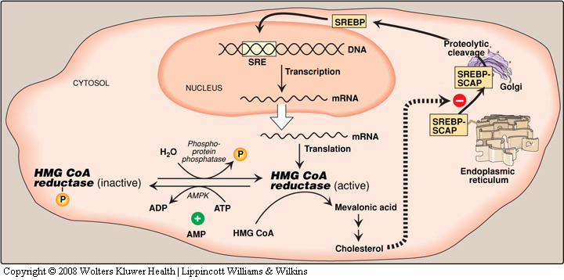
1-Sterol-dependent regulation
of gene expression of HMG CoA
Know the site where this mechanism of regulation takes a place and how

Slide 14
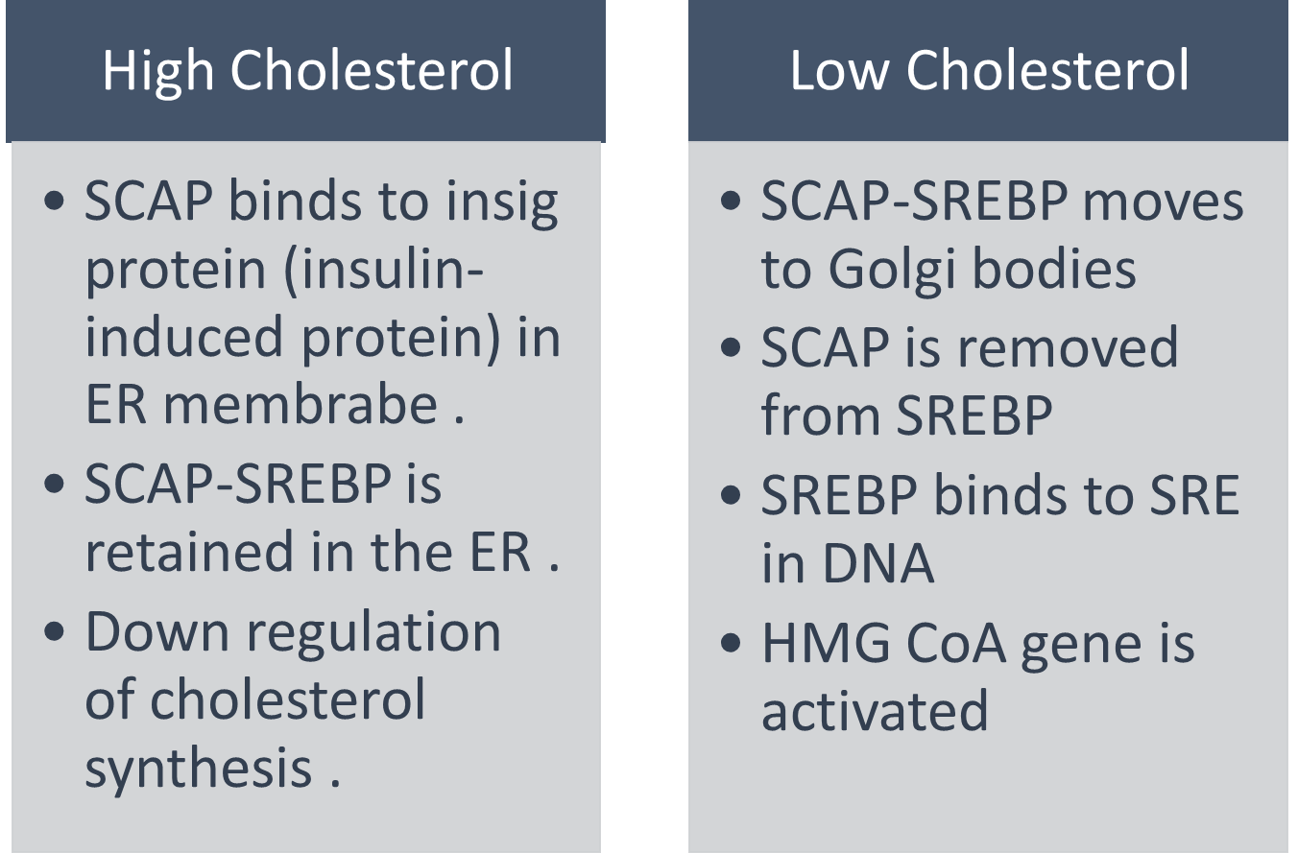
1-Sterol-dependent regulation
of gene expression of HMG CoA

Slide 15
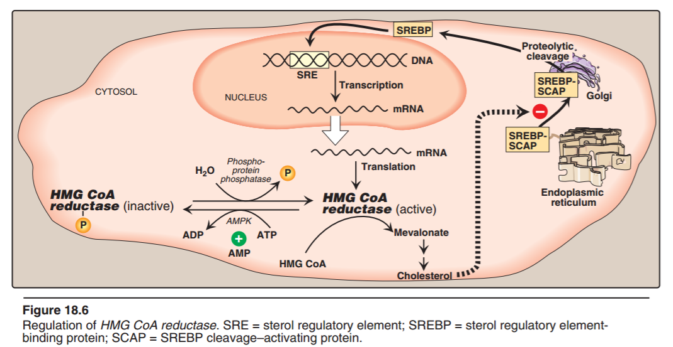
2-Sterol-accelarated enzyme degradation:
When cholesterol is high, HMG-CoA reductase itself binds to insigs.
Leading to degradation of enzyme.
3-Enzyme phosphorylation and dephosphorylation
AMP- activated protein kinase (AMPK) for phosphorylation
Phosphorylated form of enzyme is inactive
Dephosphorylated form is active
Low ATP or High AMP → Cholesterol synthesis decreases ( So we will have more phosphorylation and inactivation in this case ☺ ) ..

Slide 16
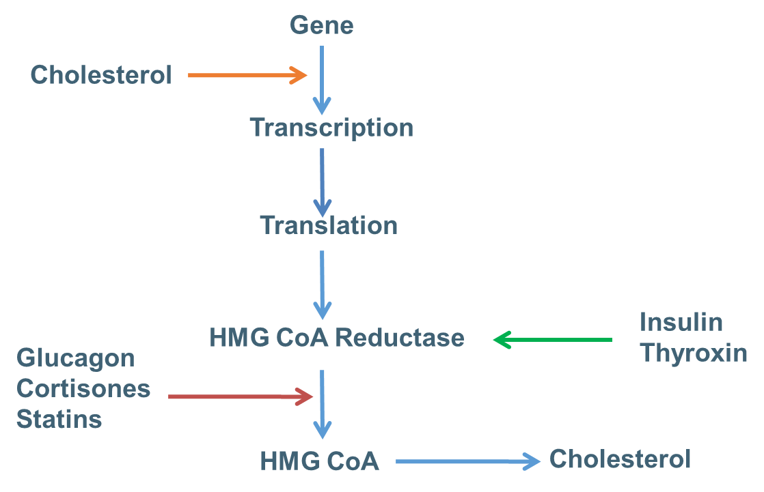
4-Hormonal Regulation
HMG CoA
Reductase Regulation
Inhibition or stimulation
Insulin and thyroxine increase upregulation of enzyme expression . ( They increase enzyme concentration, thus increase cholesterol synthesis, because insulin has a major role in lipogenesis ) .
Glucagon and cortisol have opposite effect .
( Cholesterol concentration itself controlling the gene, while hormones are controlling the enzyme ) .
Stimulation
Further explanation of statins in slide 20
Inhibition

Slide 17
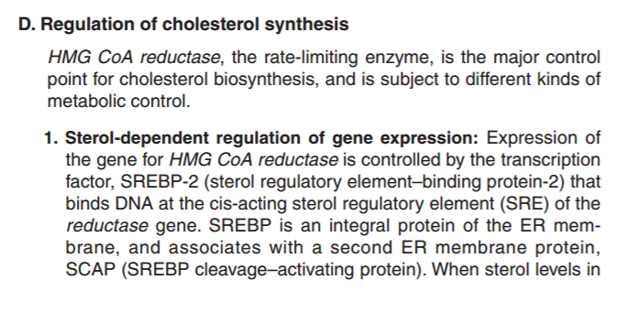
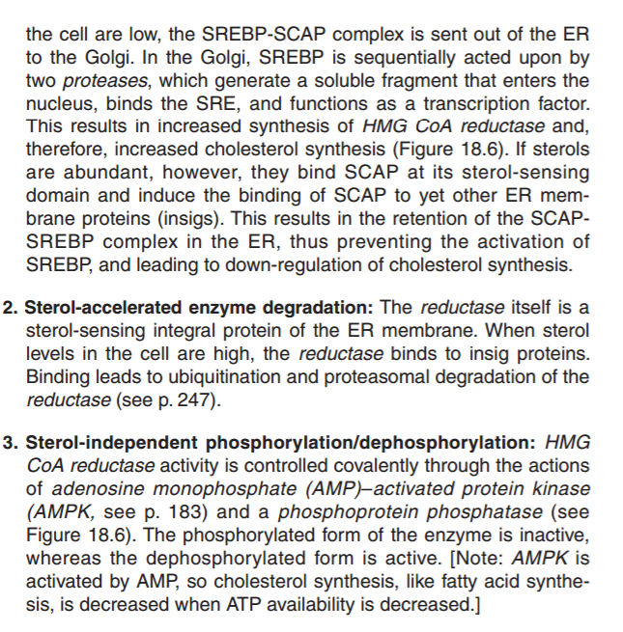
HMG-CoA Reductase Regulation
From Lippincott ( More explanation for the previous slides )

Slide 18
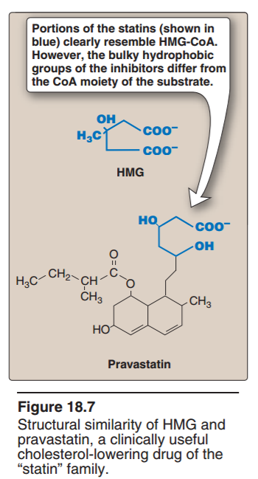
HMG-CoA Reductase Regulation
From Lippincott ( More explanation for the previous slides )

Slide 19
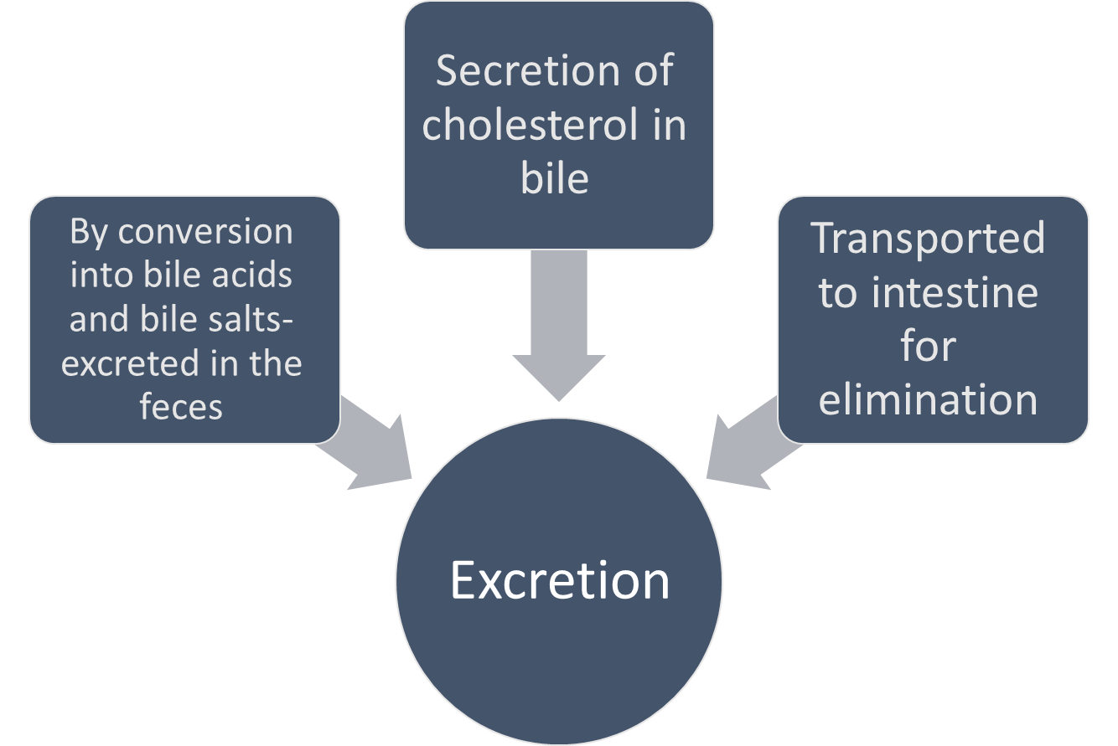
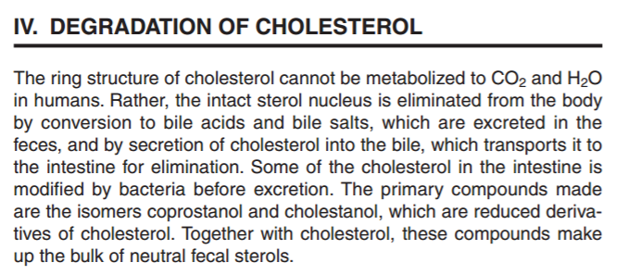
Excretion of Cholesterol
In the intestine, some cholesterol is converted by bacteria into coprostanol and cholestanol (Both are sterols) before excretion, but mainly excreted in Bile .
Further explanation

Slide 20
Hypercholesterolemia
High concentration of cholesterol in blood that can lead to atherosclerosis or shock or hemorrhage. (due to the loss of regulation of cholesterol synthesis )
Treatment:
Statin drugs
They are drugs used to decrease plasma cholesterol levels.
Structural analogs of HMG-CoA (have the same structure as the molecule) and are reversible, competitive inhibitors of HMG-CoA reductase.
β-Sitosterols / Phytosterols
They are plant sterols and are poorly absorbed by human, clinically useful in: the dietary treatment of hypercholesterolemia by decreasing cholesterol levels.
They block the absorption of dietary cholesterol.
Ezetimibe
A drug that reduces the absorption of dietary cholesterol.
It blocks Neimann-Pick C1 like protein (NPC1-L1) which is a protein that partly mediates intestinal uptake of cholesterol.
From lippincott 6th edition and Dr.Sumbul.

Slide 21
Quiz
SAQ
https://www.onlineexambuilder.com/cholesterol-metabolism-saq-s/exam-140473
MCQ’s
https://www.onlineexambuilder.com/cholesterol-metabolism/exam-140410
Helpful video
Cholesterol excretion

Slide 22
TEAM
MEMBERS
مهند الزهراني
طلال الطخيم
فهد العتيبي
عبدالعزيز الصومالي
سعود الشنيفي
صالح التويجري
حمد الحسون
محمد العسيري
هبه الناصر
ربا برناوي
ريما الشايع
رنا باراسين
أمل القرني
هيفاء بن طالب
TEAM LEADERS
Rania Alessa
Mohammad Almutlaq

Slide 23
Review the notes
THANK YOU
PLEASE CONTACT US IF YOU HAVE ANY ISSUE
Lippincott's Illustrated Reviews: Biochemistry, 6th E
@436Biochemteam
Biochemistryteam436@gmail.com

