Slide 1
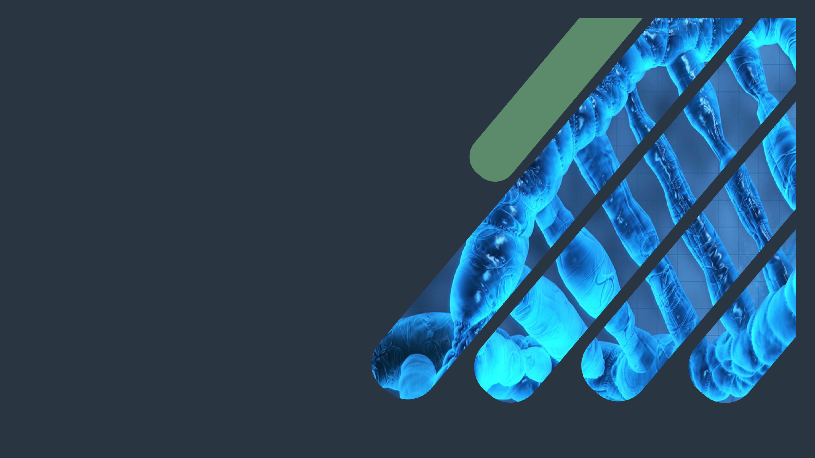
Biochemistry
Oxidative Stress
Stars can’t shine without darkness ..
Important.
Extra Information.
Doctors slides.
Doctors notes.

Slide 2
Objectives:
By the end of this lecture the students will be able to:
Define oxidative stress .
Understand the harmful effects of oxidative stress to the cell and its diseases .
List the types, sources and effects of Reactive Oxygen Species (ROS) .
List various antioxidants in the body .
Understand the role of glutathione system in detoxifying oxidants in the body .
Discuss how G6PD deficiency leads to oxidative stress .
Understand the role of Reactive Nitrogen Species (RNS) in contributing to oxidative stress .
Correlate the role of oxidative stress to pathogenesis of atherosclerosis

Slide 3
Dr.Sumbul recall information which will make the lecture easier to understand:
Oxidative stress are: Oxygen species attack cells, oxygen and nitrogen free radicals.
ETC: is an oxidative phosphorylation and generation of this oxidative species but we don’t have the oxidative stress always , we have antioxidant machinery , there is transferring of electrons and the final acceptor is O2 which gets converted into water.
Some of the antioxidants are vitamins such as C, E and A
When this balance is disturbed between oxidative stress (generation of reactive species) and antioxidant machinery that will lead to the oxidative stress of the body.
Reduction of water:
O2 receives 4 electrons and get reduced to water.
When this water is being reduced the O2 is reduced.
When something gives off the electrons we call it “oxidant” and it’s the reducing agent (it gets oxidized)
When something takes the electron it’s reduced and it’s called the oxidative agent
When reduction of O2 to water is happening it requires 1 molecule of O2 which requires 4 electrons
Sometimes the reduction is not complete “partial reduction” so it receives one electron so it won’t make water it will make free radicals (reactive O2 species)
If it’s 4 it’s a neutral molecule (water) but if it’s partial reduction of O2 it will lead to the production of reactive O2 and that can cause oxidative damage.
Reactive oxygen species can also have nitrogen reactive species which can cause oxidative damage

Slide 4
Dr.Sumbul recall information which will make the lecture easier to understand:
Recall what you studied in chemistry:
S arpital
P arpital the electron is present as pairs so if you have electrons which are not present as pairs and that electron become highly reactive and that is what is present in the free radicals so when that happens this electron tries to find a pair if you have a free radical species it will try to attack a protein, lipid and the other molecules to get that electron so when it attacks it will try to take an electron so it will oxidize to take the other things
If the lipid was in the cell it will cause damage to the cell
If it was a protein such as an enzyme the enzyme will get loss and that’s how it attacks the DNA
Affecting the genes at the basic level which will complicate to cause cell death
Reduction is the gain of hydrogen or loss of oxygen
Recall what you studied in foundation:
Xomonophosphate shunt the role of it is:
1- Generation of NADPH (reducing Co-enzymes and it’s required in the glycolysis).
Other cells have other enzymes and can make NADPH even if their HMP is not working but when it comes to your RBCs the only way to generate NADPH is by HMP pathway
2- production of 5 carbon molecules (ribose -5- phosphate) the only way to produce it is by xomonophosphate and it’s required in the synthesis of nucleotide

Slide 5
Dr.Sumbul recall information which will make the lecture easier to understand:
Recall what you studied about NO in respiratory block:
It’s a vasodilator that prevents the contraction of smooth muscles.
It’s produced in the endothelium.
It increases the cyclic GMP production by the action of the enzyme guanylate cyclase which activates protein kinase G and that acts on calcium channels and then close the Ca channels so they can not get inside the smooth muscle cells so the contraction can not start.
Recall what you studied in MSK block:
G6PD deficiency is common in saudi arabia

Slide 6
Oxidative stress:
We don't have it always because we have natural antioxidants in our bodies like vitamins.
We have the oxidizing molecule that are being produced which are the reactive oxygen species and they are the reactive nitrogen species and the body has its own antioxidants machinery (the different sets of enzymes) we call them scavenger molecules like these Vitamins or Carotene so they can eat up these free radicals so if there is imbalance it will lead
to oxidative stress
Diseases due to Oxidative stress:
A condition in which cells are exposed to excessive levels of :
Inflammatory diseases (rheumatoid arthritis)
Reactive Oxygen Species (ROS)
Reactive Nitrogen Species (RNS)
Cells are unable to neutralize their deleterious effects with antioxidants .
Atherosclerosis
Oxidative stress is implicated in:
CAD ( Coronary Artery Disease )
Aging
CAD
Atherosclerosis
Obesity
Cancer
Cellular imbalance of oxidants and antioxidants damages:
G6PD deficiency hemolytic anemia
DNA
Proteins
Lipids
Targets of ROS

Slide 7
Reactive Oxygen Species (ROS):
Incomplete reduction of oxygen to water produces ROS.
ROS are continuously formed:
As byproducts of aerobic metabolism.
Not just by the oxidative phosphorylation that is one place
where lots of reactive oxygen species are produced
and a lot of enzymes when they are doing their
Normal function like xanthine oxidase (which
Participates in purine metabolism - gout) which
Produces hydrogen peroxide
Through reactions with drugs and toxins. +radiation
When cellular antioxidant level is low.
Creating oxidative stress in a cell.
Cells have protective antioxidant mechanisms that neutralize ROS.
ROS normally is produced by the body and then utilized after doing their job
ROS can damage:
DNA
Proteins
Unsaturated lipids
Cell death

Slide 8
Reactive Oxygen Species (ROS)
Formation of reactive intermediates from molecular oxygen. e-= electrons
This is showing you the O2 is receiving an electrons
The final product is water
The dot means the electron
the negative means it received an electron.
O2 is not paired and that’s why it’s a free Radical
H2O2 is not a free radical but it is a reactive oxygen species that can cause oxidative damage.
Hydroxyl radical is the most reactive radicals.
Hydroxyl radical is more reactive than H2O2 but the good thing that it’s short lived.
Free radicals are more reactive than hydrogen peroxide

Slide 9
Reactive Oxygen Species (ROS)
Actions of antioxidant enzymes. G-SH= reduced glutathione. G-S-S-G= oxidized glutathione
This picture shows the antioxidant machinery that’s there in the system.
H₂O₂:can be taking care of by catalase enzyme which will break it down into oxygen and water so 2 neutral molecules
Glutathione peroxidase: is going to take care of the hydrogen peroxide and It’s short lived
Superoxide dismutase : it can take care of superoxide free radical which will attach on it and produce the o2 and H₂O₂
They change the structure of the molecule they react with to abnormal structure causing damage and dysfunction
So incomplete reduction of O₂ leads to ROS Formation

Slide 10
Types and sources of ROS
Types of ROS
Free, aggressive and non stable until reacting with substances to make it stable
Cells have protective antioxidants mechanisms that neutralize ROS
Sources:
Aerobic metabolism.
Partial reduction of molecular oxygen in ETC.
Ingestion of drugs, toxins, chemicals.
Non-free radicals
Free radicals
Hydrogen peroxide (H2O2)
Superoxide (O2•-)
Hydroxyl radical (OH•)

Slide 11
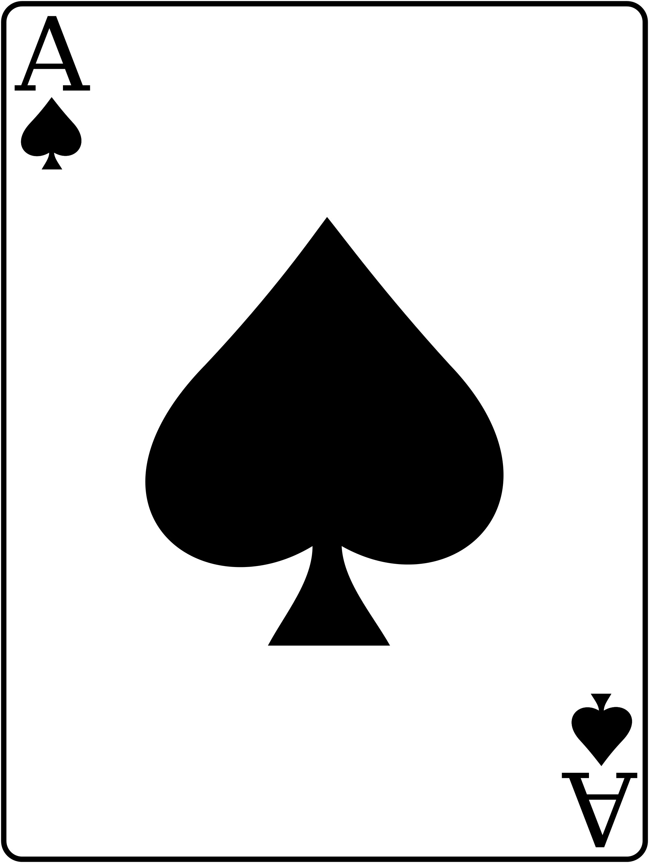
Antioxidants
Utilization of oxidants
Enzymes:
Superoxide dismutase
Catalase
Glutathione system
Imbalance between oxidants and antioxidants in the cells can result in the development of many diseases including atherosclerosis.
Selenium is an anti oxidant trace element ..
Vitamins:
Vitamins A, C, E
β-Carotene

Slide 12
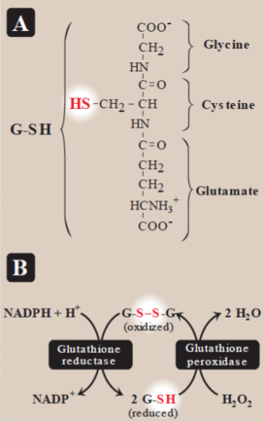
Glutathione system:
Present in most cells
Chemically detoxifies H₂O₂
Catalyzed by glutathione reductase
Produces NADPH that reduces H₂O₂
You need an enzyme called glutathione reductase to convert NADP+ to NADPH then it will be oxidized to GSSG to reduce glutathione and the advantage of this to reduce G-SH which can take care of the hydrogen peroxide and this’s the antioxidant machinery which is present in the RBCs.
So in this system you need glutathione reductase and glutathione peroxidase .
Redox reactions
بعد ما حولنا الـ H2O2، إلى نتائج أقل ضررا على الخلية ، نحتاج نرجع ( G-SH )زي ماكان عشان نستخدمه مرة ثانية ، كيف؟ عن طريق ( Glutathione reductase )اللي راح يأخذ هيدروجينز من NADPH ويحوله من Oxidized form إلى Reduced form اللي ينفعنا ونحتاجه ..

Slide 13
G6PD deficiency
Leads to NADPH deficiency . Because you need the enzyme to produce it.1- ATP synthesis is going to be defected. 2-they are not going to protect the RBCs from oxidative damage so if the oxidative damage continues because of the free radicals the cellular proteins DNA and lipids get oxidized. they get targeted by this free radicals and that leads to the death of RBCs which cause hemolytic anemia for G6PD deficiency.
Cells are unable to reduce free radicals.
Oxidation of cellular proteins is increased causing impaired cell functions.

Slide 14
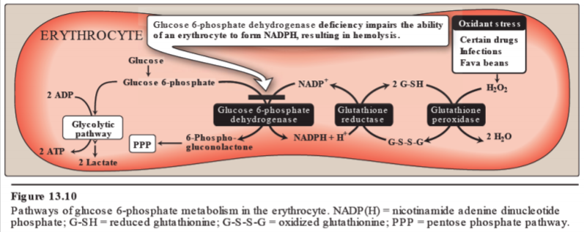
Utilization of oxidants
HMS or mentose phosphate pathway you have G6P that is acted upon by the enzyme G6PD and that’s how its producing NADPH.
This is one of the early steps of HMP pathway.
And as a byproduct you are making NADPH which is going to be used by glycolysis in the RBCs at the same time this NADPH can be utilized in the antioxidants machinery in the RBCs which is the glutathione system so if there is oxidative stress and that could be because of certain drugs or infections and lead to the production of H2O2

Slide 15
Effects of ROS
Lipid peroxidation (polyunsaturated fatty acids) the preferable target is where you have the double bonds because you are sharing the electrons between 2 atoms they are not so tightly held together by the atom itself so they are softer target for this free radicals the more double bond you have the more lipid peroxidation will happen. So if you eat unsaturated fatty acid in your diet you are protecting your body from free radicals.
DNA damage
Protein denaturation
Cytoskeletal damage
Chemotaxis
Cell signaling effects
Release of Ca2+ from intracellular stores
Altered vascular tone
Increased endothelial cell permeability
(that’s why there is usually an inflammation and edema with oxidative stress)

Slide 16
Nitric oxide (NO)
Endothelial-derived relaxing factor (EDRF)
NO with Oxygen or Superoxide will give :
Nitrates
Nitrites
Peroxynitrite (O=NOO-)
Peroxynitrite is one of Reactive Nitrogen Species (RNS)
Causes vasodilation by relaxing vascular smooth
muscle
NO is a gas with short half-life (3-10 seconds)

Slide 17
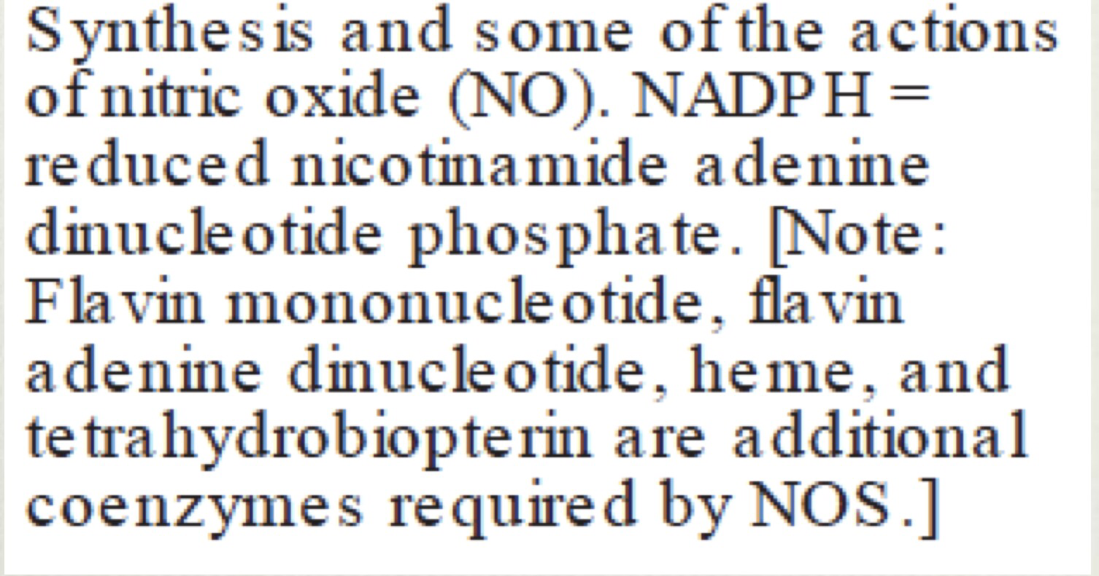
Nitric Oxide
NO is produced by nitric oxide synthase from L-arginine
L-Arginine + NADPH + O2 make NO and L-Citrulline

Slide 18
Nitric Oxide they are synthesized in different locations by different enzymes
n-NOS in the neural tissue (neurotransmission) in both central and peripheral nervous system
Activated macrophages produce O2●-radical
Type 1
e-NOS in endothelium (vaso-relaxation)
Interacts
with NO
Type 2
i-NOS I for inducible in macrophages, neutrophils (infection)
Normally in macrophages the I-NOS activity is very low when it gets activated by TNF-alpha, IL-6 and the bacterial micropolysacharide so it gets activated when there is infection or tumor etc …
No synthesis increases so the enzyme is induced
i-NOS activity (normally low) increased by infection and
pro-inflammatory cytokines . Most reactive O2 free radicals
Forms OH● radical which is
highly bactericidal .
Type 3
Increased i-NOS activity → free radicals → oxidative stress
b-NOS (bacterial) not present in the human being because it’s protective for the bacteria itself so if you target it you develop .
Type 4

Slide 19
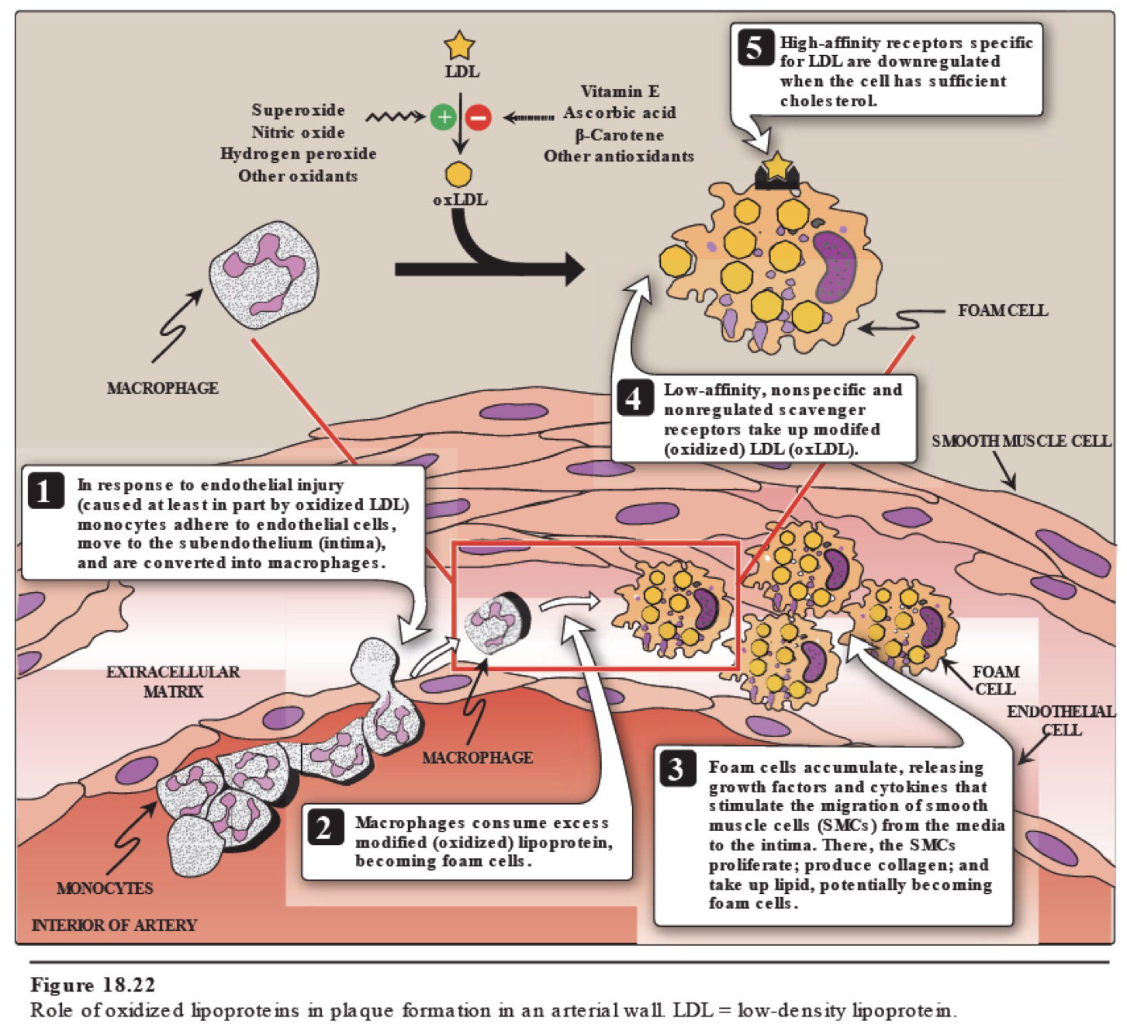
Oxidative stress and atherosclerosis :
Extra explanation for memory
refreshing:
If the superoxide, NO, hydrogen peroxide, or other oxidants are increased, LDL will turn to oxidized LDL.
Then, it will bind to scavenger receptors type A.
After that, the cell will be filled of cholesterol , so the macrophage will turn to foam cell.
Foam cells secrete growth factors and cytokines.

Slide 20
Quiz
SAQ
https://www.onlineexambuilder.com/oxidative-stress/exam-144499
MCQ’s
https://www.onlineexambuilder.com/oxidative-stress-saq-s/exam-144511
Helpful video
https://www.youtube.com/watch?v=dlZ5ROca0KI&feature=youtu.be

Slide 21
TEAM
MEMBERS
هبه الناصر
نورة الشبيب
طلال الطخيم
فهد العتيبي
عبدالعزيز الصومالي
سعود الشنيفي
صالح التويجري
محمد العسيري
TEAM LEADERS
محمد المطلق
رانيا العيسى

Slide 22
Review the notes
https://www.youtube.com/watch?v=dlZ5ROca0KI&feature=youtu.be
THANK YOU
PLEASE CONTACT US IF YOU HAVE ANY ISSUE
Lippincott's Illustrated Reviews: Biochemistry, 6th E
@436Biochemteam
Biochemistryteam436@gmail.com

