Slide 1
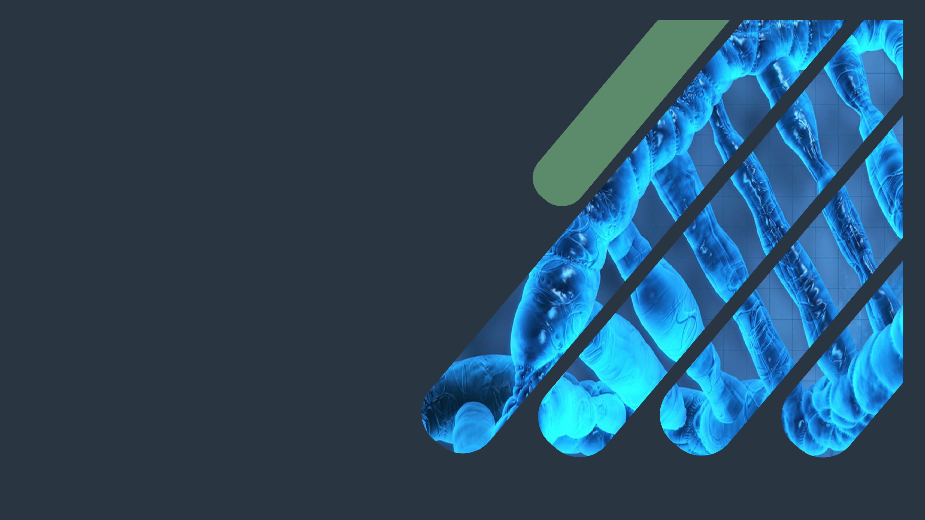
Biochemistry
Lipoprotein Metabolism
Cry a river.
Build a bridge.
Get over it !!
Important.
Extra Information.
Doctors slides
Doctors notes
436 Biochemistry team

Slide 2
Objectives:
By the end of this lecture, the First Year students will be able to:
Define and list the types, structure and composition of lipoproteins
Understand various functions of lipoprotein particles
Compare the functions of lipoprotein particles and their implications in disease
Understand the metabolism of chylomicrons, VLDL and LDL particles
List the diseases due to imbalance in the metabolism of lipoproteins

Slide 3
Lipoproteins:
It means they have Lipids + Proteins
due to this they have to be
Solubilized
Lipids are hydrophobic molecules
Transported in plasma as lipoproteins particles
Team 436 : why do we need lipoproteins compounds?
Lipid compounds are relatively water insoluble, therefore, they are transported in the plasma (aqueous) as “Lipoproteins”.
Lipoproteins keep lipid contents soluble while transporting them to and from tissues

Slide 4
Types of lipoproteins:
Types of lipoproteins:
Chylomicrons (lowest density, largest)
VLDL (very low density lipoproteins)
LDL (Low density lipoproteins)
قاعدة لتسهيل حفظ المكونات :
High density = High % of proteins
Low density = high % of Lipids
Lipoproteins differ in:
Lipid and protein composition
Size
Density
Site of origin
HDL (high density lipoproteins)

Slide 5
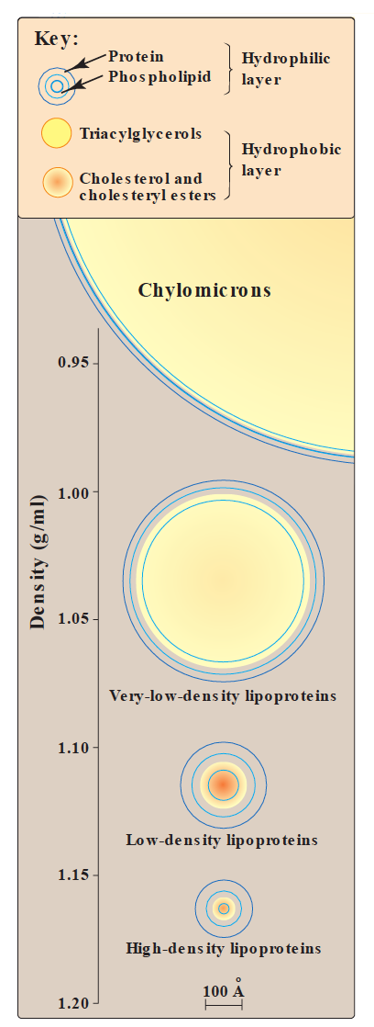
Types of lipoproteins:
-density depends on the amount of portions .
-high density = more weight = High % of proteins
If you are going to put 2 particles inside the water one has a high density and the other one has a very low density what will happen ?
one will sink and the other one will float.
Chylomicron which has the least density and HDL has the highest density, what is making these lipoproteins particles more or less dense that’s the amount of protein in them.
Which means chylomicrons has proteins and lipids.
Another thing when we said that HDL has more protein than Chylomicron we didn't mean the amount itself but the percentage of the whole complex ( lipid + protein ) so its relative .

Slide 6
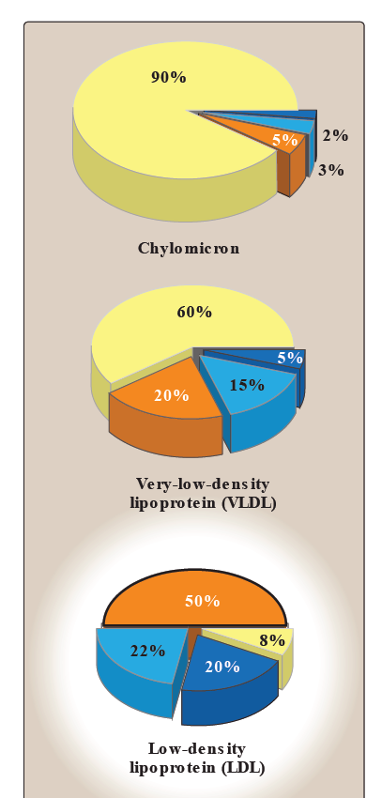
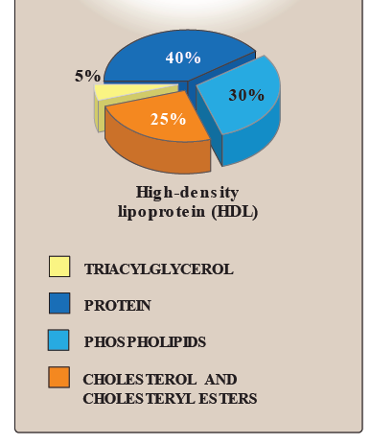
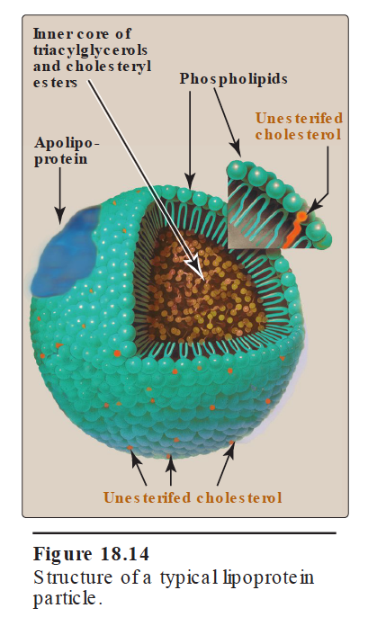
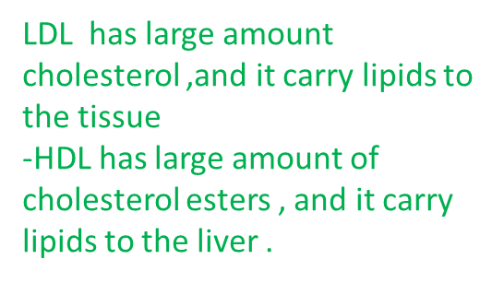
Composition of lipoproteins:
Composition of lipoproteins:
Neutral lipid core (hydrophobic):
Hydrophilic shell:
Triacylglycerols (TAGs)
Cholesteryl esters
Amphipathic apolipoprotein
Phospholipids
amphipathic
Free cholesterol
TAGs are mainly transported by:
Chylomicrons
VLDL
Cholesterol mainly transported by:
LDL (Bad cholesterol)
It carries cholesterol from the liver to
The tissues
HDL (Good cholesterol)
It carries cholesteryl ester
ملاحظة : مو مطلوب منا نحفظ النسب لكن الدكتورة نبهت على معرفة المكون الأكثر في كل مركب .

Slide 7
Apolipoproteins: it’s present in the lipoprotein particles
Types:
Apo B48 and Apo B100
Apo A
Apo C-l, C-ll, C-lll
Apo E
Provide structure to lipoprotein particles (stability of the structure)
Provide recognition sites for cell-surface receptors ( they are required for proper function for the enzyme )
Activators or coenzymes for the enzymes involved in lipoprotein metabolism .
Functions:

Slide 8
Chylomicrons:
Assembled in the intestinal mucosal cells.
The milky appearance of plasma after a meal is due to chylomicrons.
Transport to peripheral tissue:
Dietary TAGs (90%)
Cholesterol
Fat- soluble vitamins
Cholesteryl esters
If you take the blood of a person after 2 hours of taking food and then separate the plasma, the plasma will have milky appearance because of the presence of chylomicrons.
The enterocytes take up the metabolized fat as fatty acids and they have also the fat soluble vitamins there. Once they are inside the enterocyte they are assembled into lipoprotein particles and then these lipoprotein particles are secreted out into the blood.

Slide 9
VLDL
Peripheral tissue degrade TAGs by lipoprotein lipase enzyme
Imbalance in hepatic TAG synthesis and secretion of VLDL leads to fatty liver and occurs in:
1- Obesity
2- Type 2 diabetes mellitus
The liver produces TAG and they have to be transported out so in conditions when you have too much of lipids present in the blood and that’s why there’s too much of TAG and these fatty acids go to the liver and in the liver they are synthesized into TAG and this TAG is packaged as VLDL so it has to come out. If the balance between TAG synthesis and the secretion of VLDL is disturbed there will be an accumulation of TAG or the fat deposition happens in the liver itself in the liver so we call it fatty liver.
it’s present in the extracellular surface of the membrane so when lipoprotein comes near the cell it acts on the lipids on triacylglycerol present in that lipoprotein and it takes that lipid inside and digest it.
Produced and secreted by the liver composed of:
Mainly endogenous TAGs (60%)
Some cholesterol (free and esterified)
Carry these lipids from the liver to peripheral tissues.
نفس المعلومات بصياغة المرجع:
VLDLs are produced in the liver .They are composed predominantly of endogenous triacylglycerol (approximately 60%), and their function is to carry this lipid from the liver (site of synthesis) to the peripheral tissues. There, the triacylglycerol is degraded by lipoprotein lipase.
[Note: “Fatty liver” (hepatic steatosis) occurs in conditions in which there is an imbalance between hepatic triacylglycerol synthesis and the secretion of VLDL. Such conditions include obesity, uncontrolled diabetes mellitus, and chronic ethanol ingestion.]

Slide 10
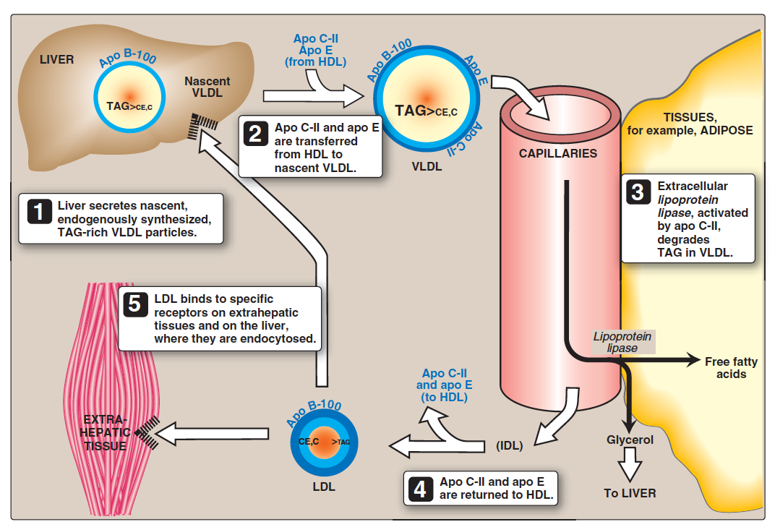
VLDL metabolism:
1)Nacsent VLDL molecule is secreted to blood stream by the liver and after interacting with HDL , HDL give it APO C-ll and APO E turning it into mature VLDL.
2)VLDL reaches to peripheral tissue . APO C-II acts as a co enzyme for LPL and activates it so it can degrade the TAGs in the VLDL, the remaining particle is now called IDL.
3) IDL can either go straight to the liver where it will be recognized through APO E OR it can give up its APO E and APO C-II back to HDL and the remaining product will be LDL
( product of VLDL degradation)

Slide 11
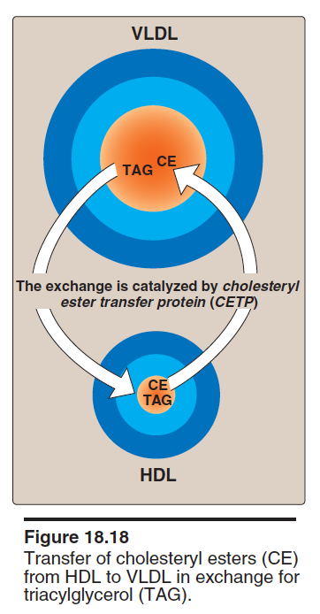
VLDL metabolism:
Release from the liver:
They are secreted into the blood by the liver As nascent particles containing:
-TAGs and cholesterol
-Apo B-100
They must Obtain apo C-II and apo E from circulating HDL particles
(mature VLDL) .
Apo C-II is required for activation of LPL .
2. Modification in the circulation:
TAGs in VLDL are degraded by lipoprotein lipase (LPL)
VLDL becomes smaller and denser
Surface components (apo C and E) are returned to HDL
VLDL transfers TAGs to HDL in exchange for cholesteryl esters
This exchange is catalyzed by cholesteryl ester transfer protein (CETP)

Slide 12
VLDL metabolism:
3. Conversion to LDL
After modifications, VLDL is converted to:
LDL
IDL (taken up by liver cells thru apo E)
VLDL remnants
Apo E exists in three isoforms:
Apo E-2 (Poorly binds to receptors)
Apo E-3
Apo E-4
1. Release of VLDL: VLDL are secreted directly into the blood by the liver as nascent VLDL particles containing apo B-100. They must obtain apo C-II and apo E from circulating HDL . As with chylomicrons, apo C-II is required for activation of lipoprotein lipase.
2. Modification of circulating VLDL: As VLDL pass through the circulation, triacylglycerol is degraded by lipoprotein lipase, causing the VLDL to decrease in size and become denser. Surface components, including the C and E apoproteins, are returned to HDL, but the particles retain apo B-100. Finally, some triacylglycerols are transferred from VLDL to HDL in an exchange reaction that concomitantly transfers some cholesteryl esters from HDL to VLDL. This exchange is accomplished by cholesteryl ester transfer protein .
3. Production of LDL from VLDL in the plasma: With these modifications, the VLDL is converted in the plasma to LDL. Intermediate- sized particles, the intermediate-density lipoproteins (IDL) or VLDL remnants, are observed during this transition. IDLs can also be taken up by cells through receptor-mediated endocytosis that uses apo E as the ligand.

Slide 13
Lipoprotein lipase (LPL):
Extracellular enzyme that degrades lipids
Anchored by heparin sulfate to the capillary walls of most tissues
Manly present in adipose tissue, cardiac and skeletal muscle
Requires ApoC-II for activation
Degrades TAGs into free fatty acids and glycerol
Insulin stimulates LPL synthesis
Deficiency of LPL or apo C-II causes:
Type 1 hyperlipoproteinemia (familial LPL deficiency)
Explained in slide 15

Slide 14
VLDL diseases:
Hypolipoproteinemia:
A-beta-lipoproteinemia is due to inability to load apo B with lipids
Few VLDLs and chylomicrons are formed
TAGs accumulate in liver and intestine
Steatohepatitis (Fatty liver disease):
Imbalance between:
TAG synthesis in the liver and
Secretion from the liver
Leads to accumulation of TAGs in the liver (fatty liver)
MTTP microsomal triglyceride transfer protein

Slide 15
VLDL diseases:
Type I hyperlipoproteinemia
A rare, autosomal recessive disease
Due to familial deficiency of LPL or its coenzyme (Apo C-II)
Causes excessive accumulation of chylomicrons in plasma (≥1000 mg/dl) (hyperchylomicronemia)
High fasting plasma TAGs are observed in these patients .
Type III hyperlipoproteinemia
Also called familial dysbetalipoproteinemia, or broad beta disease
Individuals homozygous for apo E-2 are deficient in clearing:
Chylomicron remnants and
IDL from the circulation
Leads to hypercholesterolemia and premature atherosclerosis
Chylomicron remnants and IDL from the circulation will stay in the blood due to deficiency in apo E-2.

Slide 16
Take Home Messages:
Lipoproteins are important for transportation of lipids to and from liver and peripheral tissues .
Different types of lipoproteins perform different functions in the body .
Imbalance in the metabolism of lipoproteins leads to accumulation of lipids in the tissues and circulation increasing the risk for atherosclerosis and coronary heart disease

Slide 17
Quiz
SAQ
https://www.onlineexambuilder.com/lipoprotein-metabolism-saq/exam-145439
Good Luck
MCQ’s
https://www.onlineexambuilder.com/lipoprotein-metabolism/exam-145436

Slide 18
TEAM
MEMBERS
ريما العتيبي
أمل القرني
شذى الغيهب
زينة الكاف
ربا برناوي
ريما الشايع
TEAM LEADERS:
رانيا العيسى
محمد المطلق

Slide 19
Review the notes
THANK YOU
PLEASE CONTACT US IF YOU HAVE ANY ISSUE
Lippincott's Illustrated Reviews: Biochemistry, 6th E
@436Biochemteam
Biochemistryteam436@gmail.com

