Slide 1
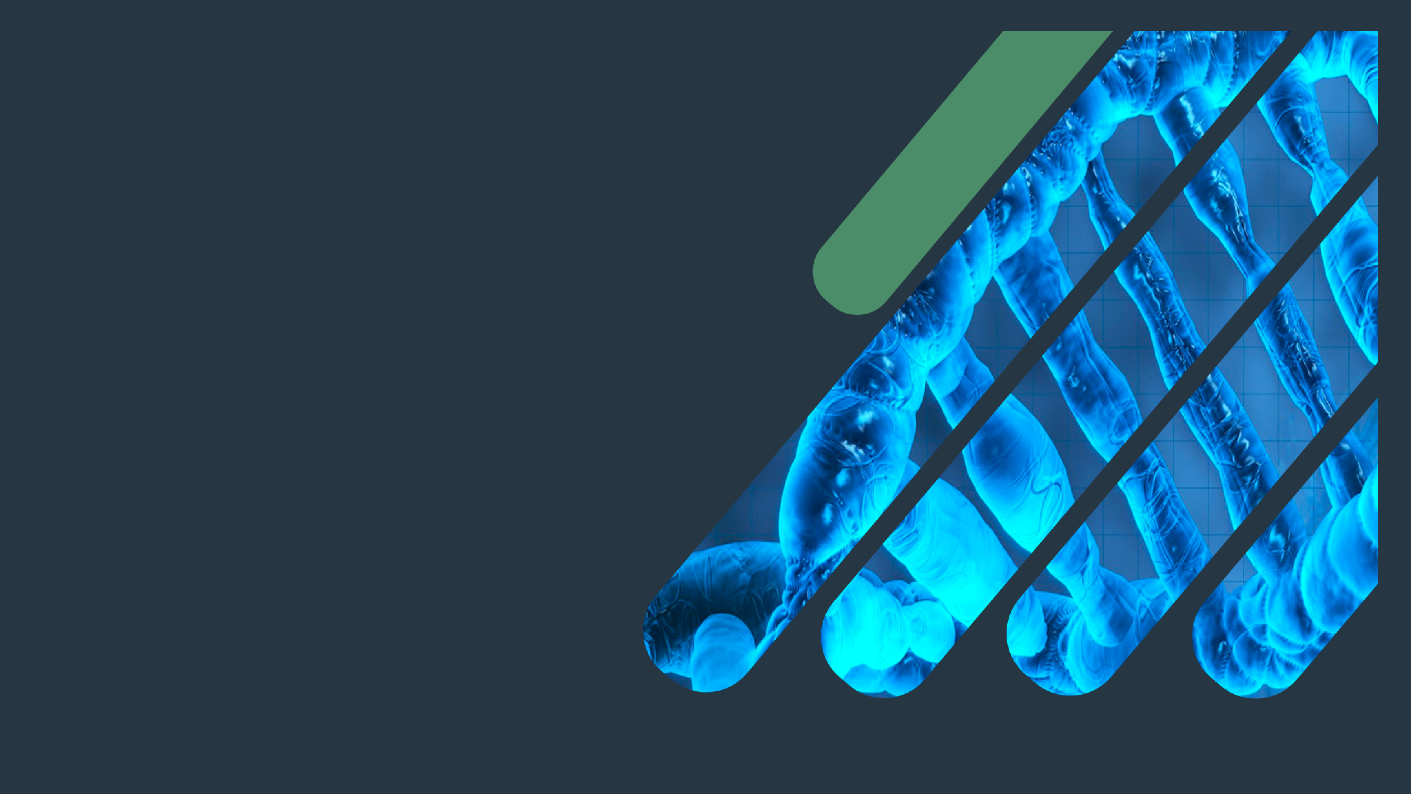
Biochemistry
Lipoprotein and atherosclerosis
Important.
Extra Information.
Doctors slides
436 Biochemistry team

Slide 2
Objectives:
By the end of this lecture, the First Year students will be able to:
1-Correlate the imbalance in lipoprotein metabolism with the development of atherosclerosis
2-Understand the functions and metabolism of LDL and HDL cholesterol
3-Describe the receptor-mediated endocytosis of LDL and its regulation
4-Recognize how LDL is considered a bad cholesterol whereas HDL a good cholesterol
5-Understand the biochemistry of atherosclerosis and its laboratory investigations
6-Discuss the role of lipoprotein(a) in the development of heart disease

Slide 3
Recall what you studied in the previous lectures:
Lipoproteins carry cholesterol and TAGs so if there’s a problem there will be accumulation of these structures.
Cholesterol deposition starts with the monocytes and get larger in the intima and then move to the media and then effect the cytokines that are released and other smooth muscle cells which leads to narrowing blood vessels and that’s lead to Atherosclerosis
chylomicron transports TAG to the liver.
VLDL transports TAG from the liver to the adipose tissues.
After the delivery of TAG the chylomicron becomes chylomicron remnant which has mainly cholesterol.
These molecules they are not clear from the circulation and they will increase the amount of cholesterol in the blood and the other molecule is HDL , all these 3 to be clear from the circulation they are recognized by ABO-e ABO-B100 BY the liver cells receptors .

Slide 4
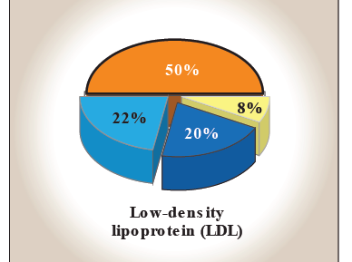
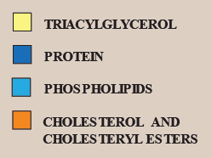
Low density lipoprotein (LDL):
LDL particles mainly contain cholesterol and cholesteryl esters
Produced from VLDL particles
Contain Apo B-100 lipoprotein
Provides cholesterol to peripheral tissue
LDL binds to cell surface receptors thru Apo B-100 receptor-mediated endocytosis.
cholesterol blood level indicates the level of these lipoprotein only; since no free floating cholesterol in the blood .
Leading to

Slide 5
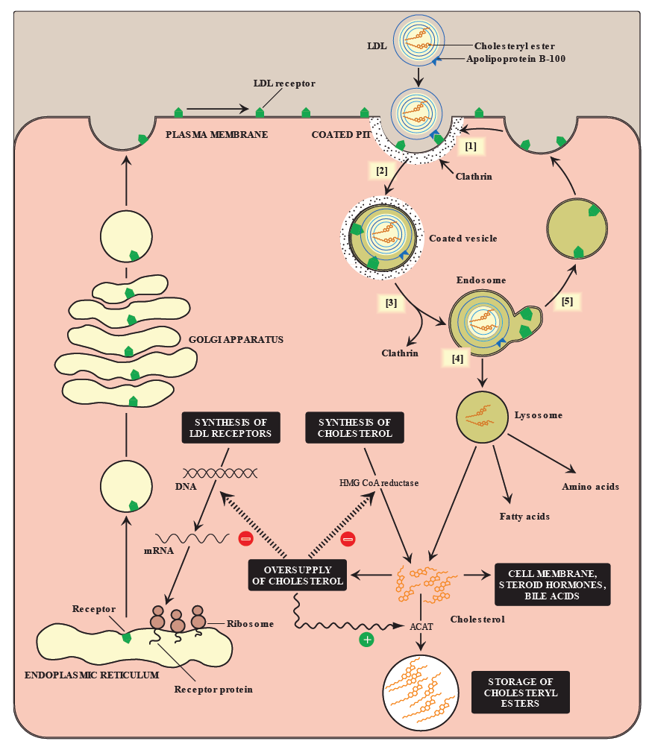
Receptor-mediated endocytosis of LDL particles:
Major steps

Slide 6
Cellular up take & regulation of LDL particals:
This slide and the following one shows detailed explanation (Dr. Sumbul explained it in a similar way)
Receptor mediated endocytosis:
Binding of Apo B-100 to LDL receptor glycoprotein.
1 . LDL receptors are clustered in pits (depressions on the cell surface) which is coated with the protein Clathrin.
2 . After binding, LDL receptors is taken in by endocytosis.
3 . The vesicle containing LDL loses its Clathrin coat, forming an endosome (Clathrin is responsible for maintaining and protecting the vesicle from being degraded or detached).
4 . The PH of the endosome falls (due to the proton pumping activity of endosomal ATPase), which allows the separation of the LDL from its receptor.
5 . The receptors can be recycled.

Slide 7
Cellular up take & regulation of LDL particals:
After the separation of LDL receptors and the vesicle, the remnants in the endosome are transferred to lysosomes and degraded by its enzymes into its primary components: The proteins into amino acids, the triacylglycrides into fatty acids and free cholesterol. Theses components can be reutilized (re-used) by the cell.
b) Effect of endocytosed cholesterol on cellular cholesterol homeostasis:
1. Inhibition of the gene expression for HMG CoA reductase.
2. Reduction of new LDL receptor synthesis.
3. Use for cell requirements. If not or there is excess amount, it is esterified by (ACAT) producing a cholesterol ester that can be stored in the cell.
ACAT= acyl CoA: cholesterol acyltransferase.
HMG CoA= hydroxymethyl-glutaryl coenzyme A.

Slide 8
Regulation of LDL endocytosis:
 | Down regulation: | Up regulation:
 | High intracellular cholesterol level causes: | Low intracellular cholesterol level causes:
LDL receptors: | Degradation | Recycling
Receptor synthesis at gene level | Inhibited | Increased
cell surface receptors | Reduction | Synthesis
uptake of LDL by cells | Decreased | Increased
de novo synthesis of cholesterol | Decreased | Increased

Slide 9
LDL is bad cholesterol:
Transports cholesterol to peripheral tissues.
Elevated LDL levels →increased accumulation of cholesterol →increased risk for atherosclerosis / heart disease .
Deficiency or defects in LDL receptors results in:
Decreased uptake of cholesterol by cells
Increased accumulation of cholesterol in blood vessels
This type of deficiency is called Familial Hypercholesterolemia
Patients are unable to clear LDL from blood
Premature atherosclerosis and heart disease
(when cholesterol is transported to the liver, by HDL, it can be converted to bile acid or disposed via the bile but when in it transported to the tissues it only accumulates there).

Slide 10
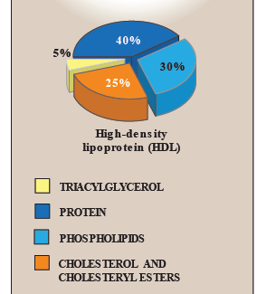
High density lipoprotein (HDL):
HDL particles mainly contain:
Protein, phospholipids, cholesterol, cholesteryl esters
Produced in the blood (mainly), liver and intestine
Contains Apo A-1 (70%), C-2 and E lipoproteins
Take up cholesterol from peripheral tissues to the liver.
(therefore less cholesterol accumulates there. This decreases
the risk of atherosclerosis; hence HDL is the “good cholesterol”)

Slide 11
High density lipoprotein (HDL):
When HDL is first produced it is in the form of Nascent HDL:
Disk-shaped
Contains apo A-I, C-II and E lipoproteins
Mainly contains phospholipids
How does it become Mature HDL?
Nascent HDL + cholesteryl esters (CE) →HDL₃ (CE poor)
HDL₃ + more cholesteryl esters →spherical HDL₂ (CE rich)
HDL₂ transfers cholesterol to the liver.

Slide 12
Functions of HDL:
Apo C-II : (the apolipoprotein that is transferred to VLDL and chylomicrons and is an activator of LPL)
Apo E (the apolipoprotein required for the receptor mediated endocytosis of ILDs and chylomicron remnants).
Reservoir of apoproteins:
Apo C-II
Apo E
Transports cholesterol to liver from:
Peripheral tissues
Other lipoproteins
Cell membranes
Suitable for cholesterol uptake due to:
High content of phospholipids
Phospholipids solubilize cholesterol and provide fatty acids for cholesterol esterification.
Note: HDL particles are excellent acceptors of unesterified cholesterol as a result of their high concentration of phospholipids, which are important solubilizers of cholesterol.

Slide 13
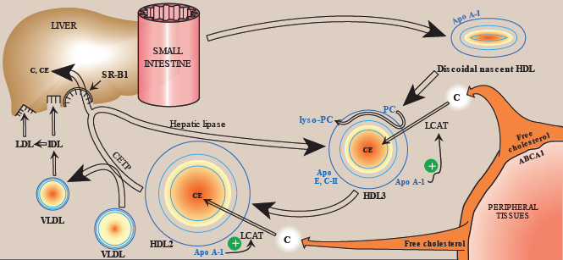
HDL metabolism:
1
7
3
2
8
6
5
4
ABCA1 = Transport protein, C = Cholesterol, CE= Cholesteryl Ester, LCAT = Lecithin Cholesterol Acetyl Transferase, CETP = Cholesteryl Ester Transfer Protein, SR-B1 = Scavenger Receptor B1

Slide 14
HDL metabolism:
Nascent HDL is present in the circulation.
Free cholesterol from the peripheral tissues is taken up by HDL with the help of ABCA1.
The free cholesterol is converted (inside HDL) into an ester through LCAT* (or PCAT) by adding a fatty acid. The source of the fatty acid is PC (phosphatidylcholine) which becomes lyso-PC after losing the fatty acid. HDL is now CE-poor HDL3.
*note: LCAT is activated by Apo – A1
It takes up more cholesterol which is also esterfied by LCAT and becomes CE-rich HDL2.
CETP moves some of the cholesteryl esters from HDL to VLDL in exchange for TAG.
VLDL is then converted to IDL and LDL
When HDL reaches the liver, the scavenger receptors (SR-B1) will take up the CE and C from the HDL to the liver.
Hepatic lipase will then act on the TAG in the HDL (which it got from the VLDL). This converts HDL2 back to HDL3 and the cycle continues.

Slide 15
HDL is a good cholesterol:
HDL transports cholesterol from peripheral tissues to the liver for degradation
High HDL levels have inverse correlation with incidence of atherosclerosis
Why? HDL will transport cholesterol from the tissues to the liver, then the liver will excrete it as bile so, it is percentage will decrease and the risk of atherosclerosis as well .
Reverse cholesterol transport
Reduces cholesterol level in tissues and circulation
Includes the following
Cholesterol efflux from peripheral tissues to HDL
Binding and transfer of cholesteryl ester-rich HDL₂ to liver
Release of lipid-depleted HDL₃
Cholesterol esterification
esterification : transform into ester by the reaction between an acid and an alcohol with elimination of water
HDL2 LARGE
HDL3 SMALL

Slide 16
Atherosclerosis:
Important receptors
LDL receptors
Scavenger receptors called scavenger receptor class A (SR-A)
On body cell
On macrophages
Chemically-modified LDL contains oxidized lipids and Apo B
mediates the endocytosis and uptake of LDL
recognize chemically modified LDL then take it up by endocytosis
It is down-regulated in response to high intracellular cholesterol
SR-A is not down-regulated in response to high intracellular cholesterol
High affinity, specific
Low affinity, non specific

Slide 17
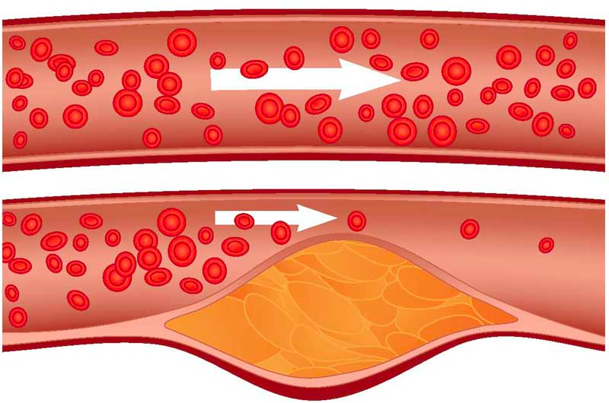
Atherosclerosis overview:
Imbalance between LDL and HDL
Cholesterol deposition in the walls
(LDL) particles in blood plasma become oxidized
invade the endothelium
Foam cells accumulate and release cytokines and growth factors
Cholesteryl esters accumulate in macrophages converting to foam cells
Inflammatory response:
Monocytes converted into macrophages and consumes the oxLDL
Causes damage or injury to the endothelium
Migration of smooth muscle cells and formation of fibrous cap
Plaque formation
Atherosclerosis

Slide 18
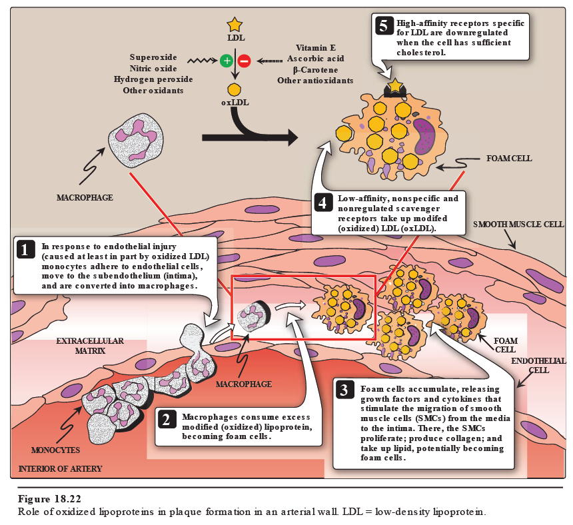

Slide 19
Lab investigations of atherosclerosis:
Fasting serum lipid profile:
TAG level (reflects chylomicron and VLDL levels)
LDL, HDL levels
Total cholesterol level (reflects LDL, HDL and cholesterol levels)
Other tests:
Serum lipoprotein electrophoresis
Serum apoprotein levels (e.g., apo-B)

Slide 20
Lipoprotein (a):
Lp (a) is identical in structure to LDL particle. Its distinguishing feature is > It contains apo (a) in addition to apo B-100
Circulating levels of Lp (a) are determined by:
Genetics (mainly)
Diet (trans fatty acids increase Lp (a) levels)
Estrogen (decreases Lp (a) levels)
A risk factor for CAD
High plasma Lp (a) level is associated with increased risk of coronary heart disease
Plasminogen (pro-enzyme) > Plasmin (active enzyme)
Plasmin: is a nonspecific protease capable of breaking down fibrin and other circulating proteins including fibrinogen, clotting factor V & factor VIII.)
Why?
It slows the break down of blood clots that trigger heart attacks
How?
because the apo(a) protein is structurally similar to plasminogen, it competes with plasminogen for binding to fibrin

Slide 21
Take home message:
Imbalance in the LDL and HDL metabolism causes increased accumulation of lipids in the body .
LDL is bad cholesterol whereas HDL is good cholesterol .
The pathogenesis of atherosclerosis includes the uptake of oxidized LDL by macrophages through scavenger receptor class A (SR-A) producing foam cells and atherosclerotic plaque .
Individuals with high level of plasma Lp (a) are at higher risk for coronary heart disease .

Slide 22
Quiz
SAQ
https://www.onlineexambuilder.com/lipoproteins-saq/exam-145844
MCQ’s
https://www.onlineexambuilder.com/lipoproteins/exam-145842
Good Luck ..

Slide 23
TEAM
MEMBERS
Hanin bashaikh
Leen altamimi
Abeer almotairi
Jawaher abanmy
Lama altamimi
Reem alserjani
Bushra quqandy
AMAL ALQarni
Norah alshabib
TEAM LEADERS
Rania Alessa
Mohammad Almutlaq

Slide 24
Review the notes
THANK YOU
PLEASE CONTACT US IF YOU HAVE ANY ISSUE
Lippincott's Illustrated Reviews: Biochemistry, 6th E
@436Biochemteam
Biochemistryteam436@gmail.com

