Slide 1
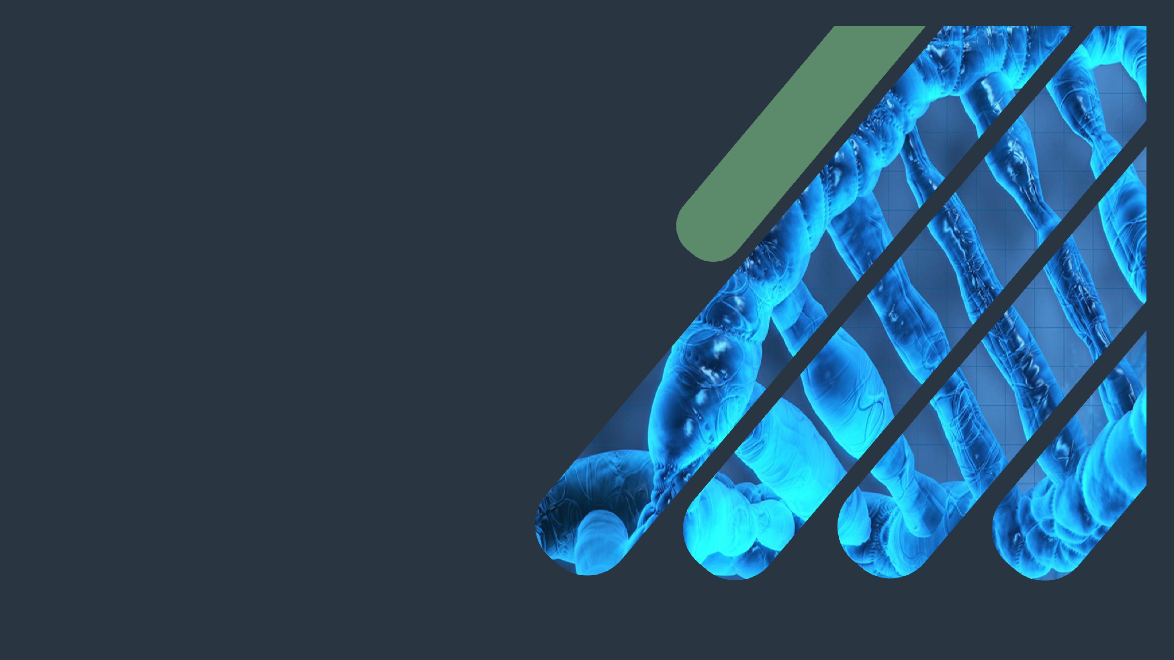
Biochemistry
MI Biomarkers
You never lose.
Either you win
or you learn ..
Important.
Extra Information.
Doctors slides.
Doctors notes.

Slide 2
OBJECTIVES:
By the end of this lecture the students will be able to:
• Describe the general sequence of events of myocardial infarction (MI)
• List the criteria for diagnosis of MI
• Discuss the features of an ideal MI marker
• Understand the significance of changes in plasma marker levels over time
• Identify the properties and diagnostic value of cardiac troponins,
Creatine kinase, h-FABP and BNP
• Know about markers with potential clinical use

Slide 3
Pathological information that Dr.Sumbul recalled:
Irreversible Ischemia leads to infraction
Infraction is the necrosis (cell death) because of the ischemia.
If it’s with cardiac cells we call it myocardial infraction.
The underline pathology of myocardial infraction:
Atherosclerosis
Atheroma blocking the artery.
Blood clot formation if it’s big enough, it is going to completely acclot the artery which leads to ischemia.
The blood will not reach the the region it will supply that part of the artery is suppling to and that will lead to the death of those cells

Slide 4
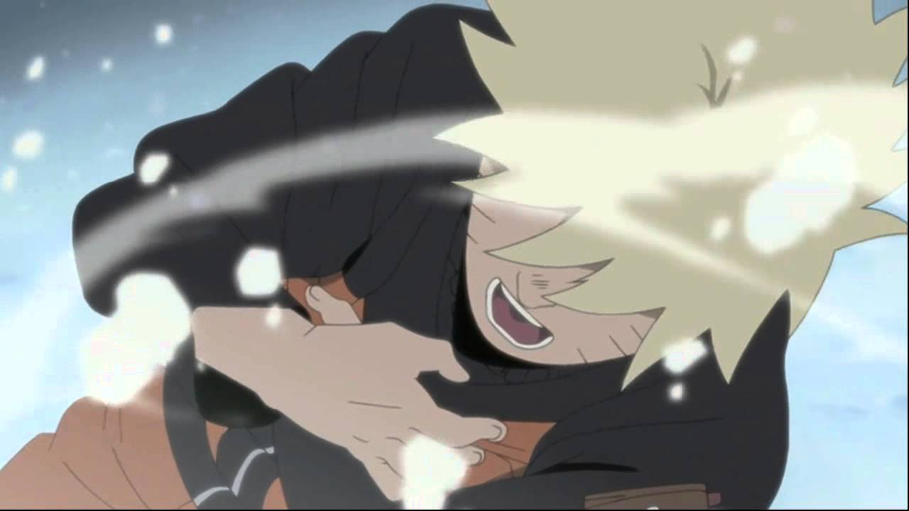
MI Steps
Occlusion of the coronary arteries
Damage to the heart tissue
Release of enzymes and proteins into the blood
Restricted blood supply to the heart tissue
Ischemia Because O2 supply is restricted.
Infarction
And these become the target to select the biomarker

Slide 5
Criteria of diagnosing MI
This criteria is recommended by the European Society of Cardiology and American College of Cardiology .
Requires presence of at least two of the following characteristics:
Typical heart attack symptoms
Characteristic rise and fall pattern of a cardiac marker in plasma
Rise and gradual fall of cardiac troponins
More rapid rise and fall of CK-MB
Typical ECG pattern
Which means the patient history such as: chest pain, shortness of breath, tightness of the jaws.
Sometimes we see it and sometimes we don't
Myocardial infarction can be present with:
ST elevation -> STEMI
without ST elevation -> NSTEMI (non-ST elevation myocardial infarction)

Slide 6
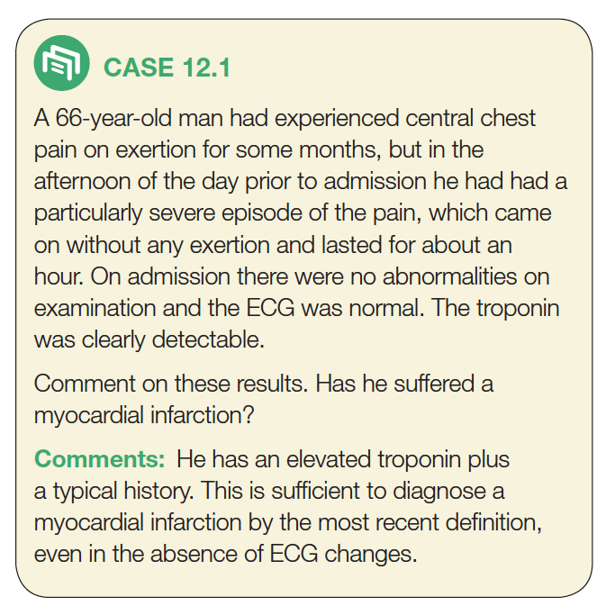
1. Typical heart
attack symptoms
2. Characteristic
Pattern of a cardiac
biomarker
So we have 2 of the 3

Slide 7
Features of an ideal marker
What makes some markers better than others that they have more of these features :
High concentration in the myocardium .
High sensitivity (detected even in low concentration at early stages of the disease) .
High specificity (specifically detecting damage of cardiac tissue, and is absent in non-myocardial tissue injury) .
Rapid release into plasma following myocardial injury .
Easily measured (detectable by rapid, simple and automated assay methods) .
Good prognostic value (strong correlation between plasma level and extent of myocardial injury) .

Slide 8
Plasma cardiac markers
Plasma cardiac markers
CURRENT MI MARKERS
Cardiac troponin T (cTnT)
Cardiac troponin I (cTnI)
MARKERS WITH POTENTIAL CLINICAL USE
Heart fatty acid binding protein (h-FABP)
Creatine kinase-MB (CK-MB)
MARKERS NO LONGER USED
Aspartate Transaminase (AST)
Lactate dehydrogenase (LDH)
Ischemia modified albumin (IMA)
Myoglobin
(for detecting heart tissue ischemia)
If ischemia is for 20 minutes you will have cell death.
If ischemia is short-lived like few seconds or minutes, then the changes can be reversed.
As soon as ischemia happen Heart fatty acid binding protein are released, and you will be able to pick it in plasma within 30 minutes.

Slide 9
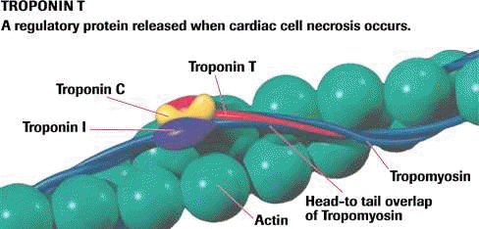
QUICK REVIEW
Troponin is formed of 3 subunits:
T: binds to tropomyosin.
C: binds to Ca.
I: inhibitory protein, masking the active site (where the myosin has to come and bind when the active site is not inhibited)
When the T subunit binds to tropomyosin, they form troponin-tropomyosin complex. You have actin filament and myosin filament, for contraction to happen actin and myosin must make a cross bridge, only then the contraction will happen.
When cardiac troponin C binds to Ca it causes conformational change in the cardiac troponin I which gets removed from the site of the actin protein.

Slide 10
Plasma cardiac markers
Heart failure: inability to meet metabolic requirements of the body, as compensation, the heart increases in extent and the cardiac muscle becomes weakened.
The enlargement of the heart ventricles will lead to the release of B-type natriuretic peptide.
Plasma cardiac marker
Markers of diagnostic value in heart failure
B-type Natriuretic Peptide (BNP)
Cardiac troponins T and I
Markers of diagnostic value in ischemia
Creatine kinase (CK-MB)
Heart fatty acid binding protein
(h-FABP)
Markers of diagnostic value in MI
Creatine kinase catalyzes creatine to creatine phosphate (which is the energy source when starting an exercise)
Troponins are present in skeletal muscle and the cardiac muscle.
The cardiac troponins are structurally different where the body can make specific antibodies to them, and make specific antibodies for skeletal muscle troponins too.

Slide 11
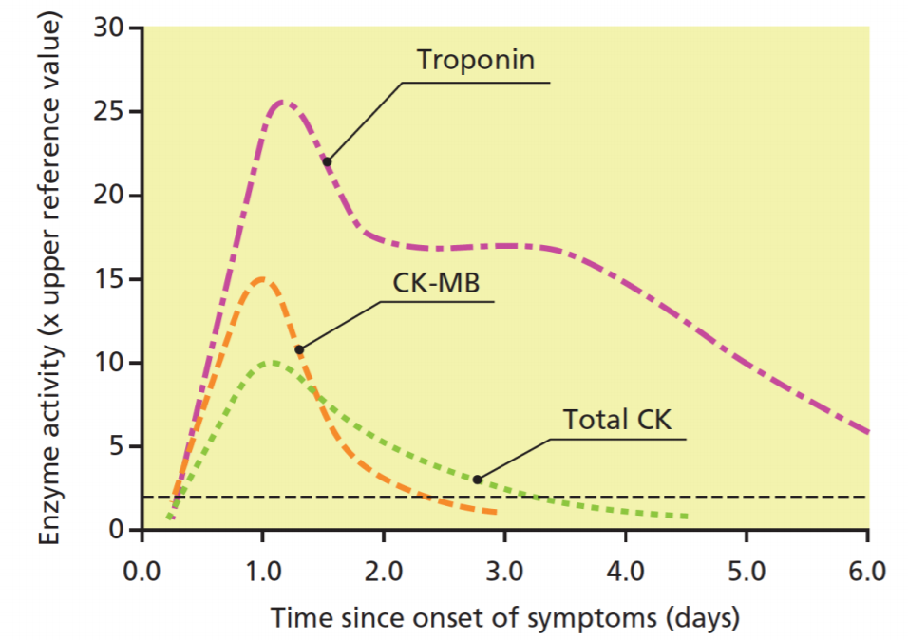
Time-course of plasma enzyme changes:
Plasma enzymes follow a pattern of activities after MI .
The initial lag phase* lasts for about 3 hours .
Enzymes rise rapidly to peak levels in 18-36 hours .
The levels return to normal based on enzyme half-life .
Rapid rise and fall indicates diagnostic value .
*Lag phase : a phase where plasma enzymes conc. are not changed yet ..
Lag Phase
الفترة ما بين حصول الضرر في النسيج والمقدرة على حساب تركيز المادة المُفرَزة في الدم
Lag phase
المحور الرأسي: الحد الطبيعي الأعلى للانزيم مضروب في عدد تضاعفه
يعني اقول: تضاعف التروبونين ٢٥ مرة، أو ارتفع التروبونين ٢٥ مرة ضعف المعدل الطبيعي الأعلى

Slide 12
Blood samples collected after MI
Time-course of plasma
marker changes after MI
The types of blood samples taken depends on the time :
Baseline (upon admission).
Between 12 and 24 hours after the onset of symptoms.
Enzyme | Abnormal activity detectable ( Hours ) | Peak value of abnormality ( Hours ) | Duration of abnormality ( Days )
Troponin T , I | 4 – 6 | 12 – 24 | 3 – 10
CK-MB | 3 – 10 | 12 – 24 | 1,5 – 3
Total CK | 5 – 12 | 18 – 30 | 2 – 5
Check the figure in the previous slide ..

Slide 13
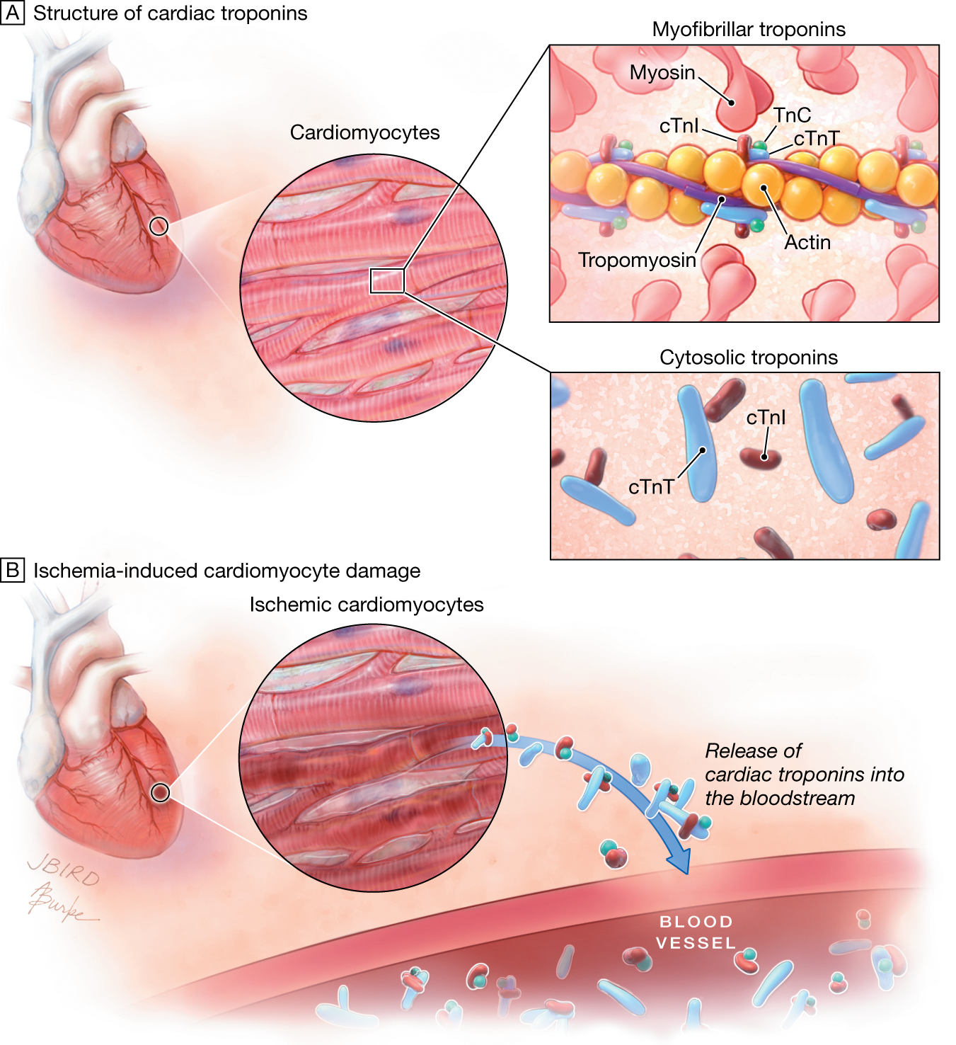
Troponins
Troponins are structural proteins in cardiac myocytes and in skeletal muscle.
Involved in the interaction between actin and myosin fibers for muscle contraction.
Cardiac troponins (cTn) are structurally different from muscle troponins.

Slide 14
Troponins
cTn ( cardiac troponins ) are mainly bound to proteins, with small amount soluble in the cytosol.
Highly specific markers for detecting MI.
Two main cardiac troponins (cTn):
cTnI: inhibitory protein.
cTnT: binds to tropomyosin.

Slide 15
Troponins
Detectable in plasma in 4-6 h. after MI.
Level peaks in 12-24 h.
Remain elevated for up to 10 days.
After MI, cytosolic troponins are released rapidly into the blood
(first few hours).
Structurally bound troponins are released later for several days.

Slide 16
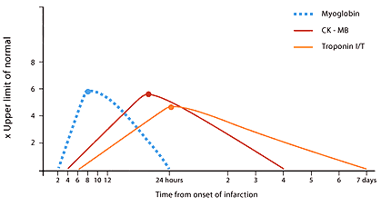
Creatine Kinase CK
Three main CK isoenzymes with two polypeptide chains B or M.
Creatine kinase MB are less specific than troponins; because creatine kinase MB is present at 2% in skeletal muscle too!
CK-MB can be found in the plasma in case of skeletal muscle injury ..

Slide 17
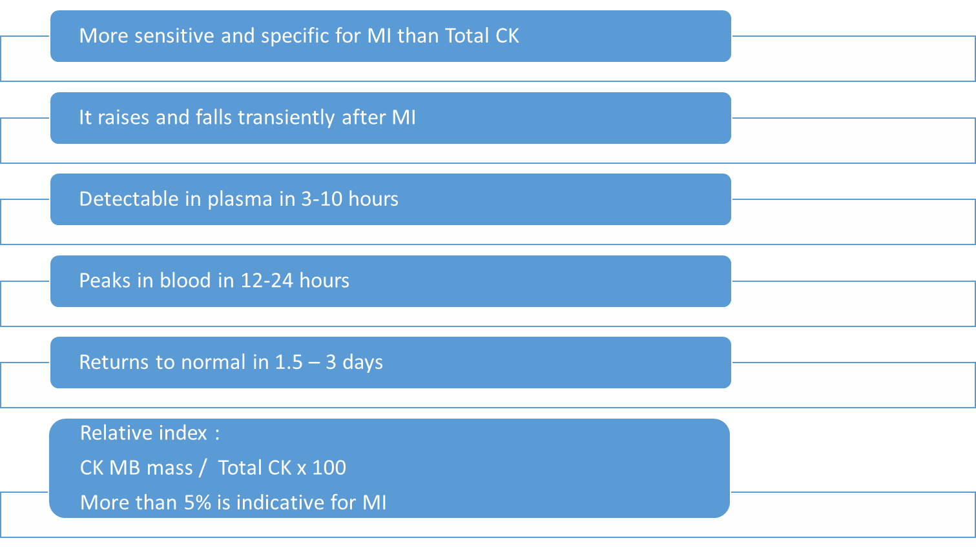
CK-MB

Slide 18
CK-MB
Creatine kinase MB is released to blood earlier than troponin.
It is expected for a MI patient to have recurrent MI. Because troponin can be present in blood for 10 days, then we can't tell if the patient had another MI or not! But because the CK-MB falls within 3 days, we can detect that it fell down and re-raised again which tells us that the patient had another MI.

Slide 19
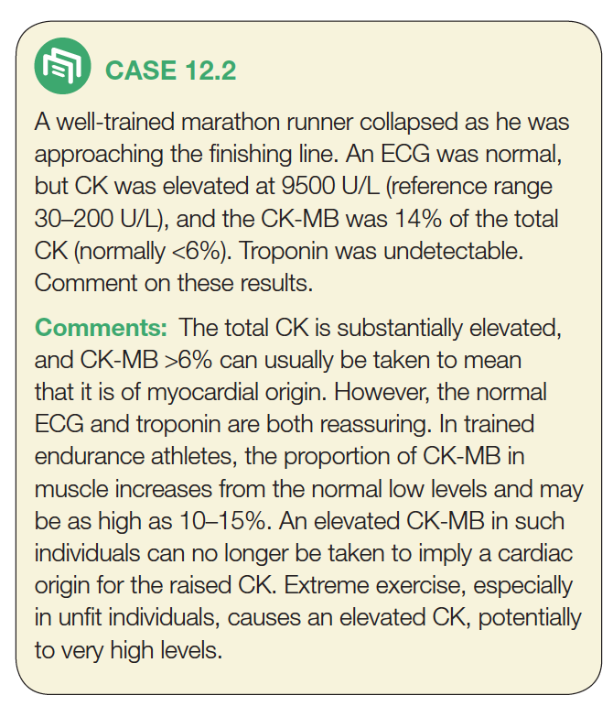

Slide 20
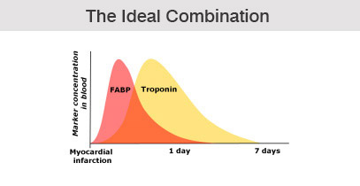
Heart fatty acid binding protein (h-FABP) (Heart tissue ischemia marker)
A cytosolic protein involved in fatty acid transport and metabolism .
A promising marker to be used in combination with troponins .
Higher amounts in myocardium than in brain, kidney and skeletal muscle
Appears in plasma as early as 30 min. after acute ischemia
Peaks in blood in 6-8 h. (Due to rapid renal clearance of this marker)
Returns to normal levels in 24-30 h.

Slide 21
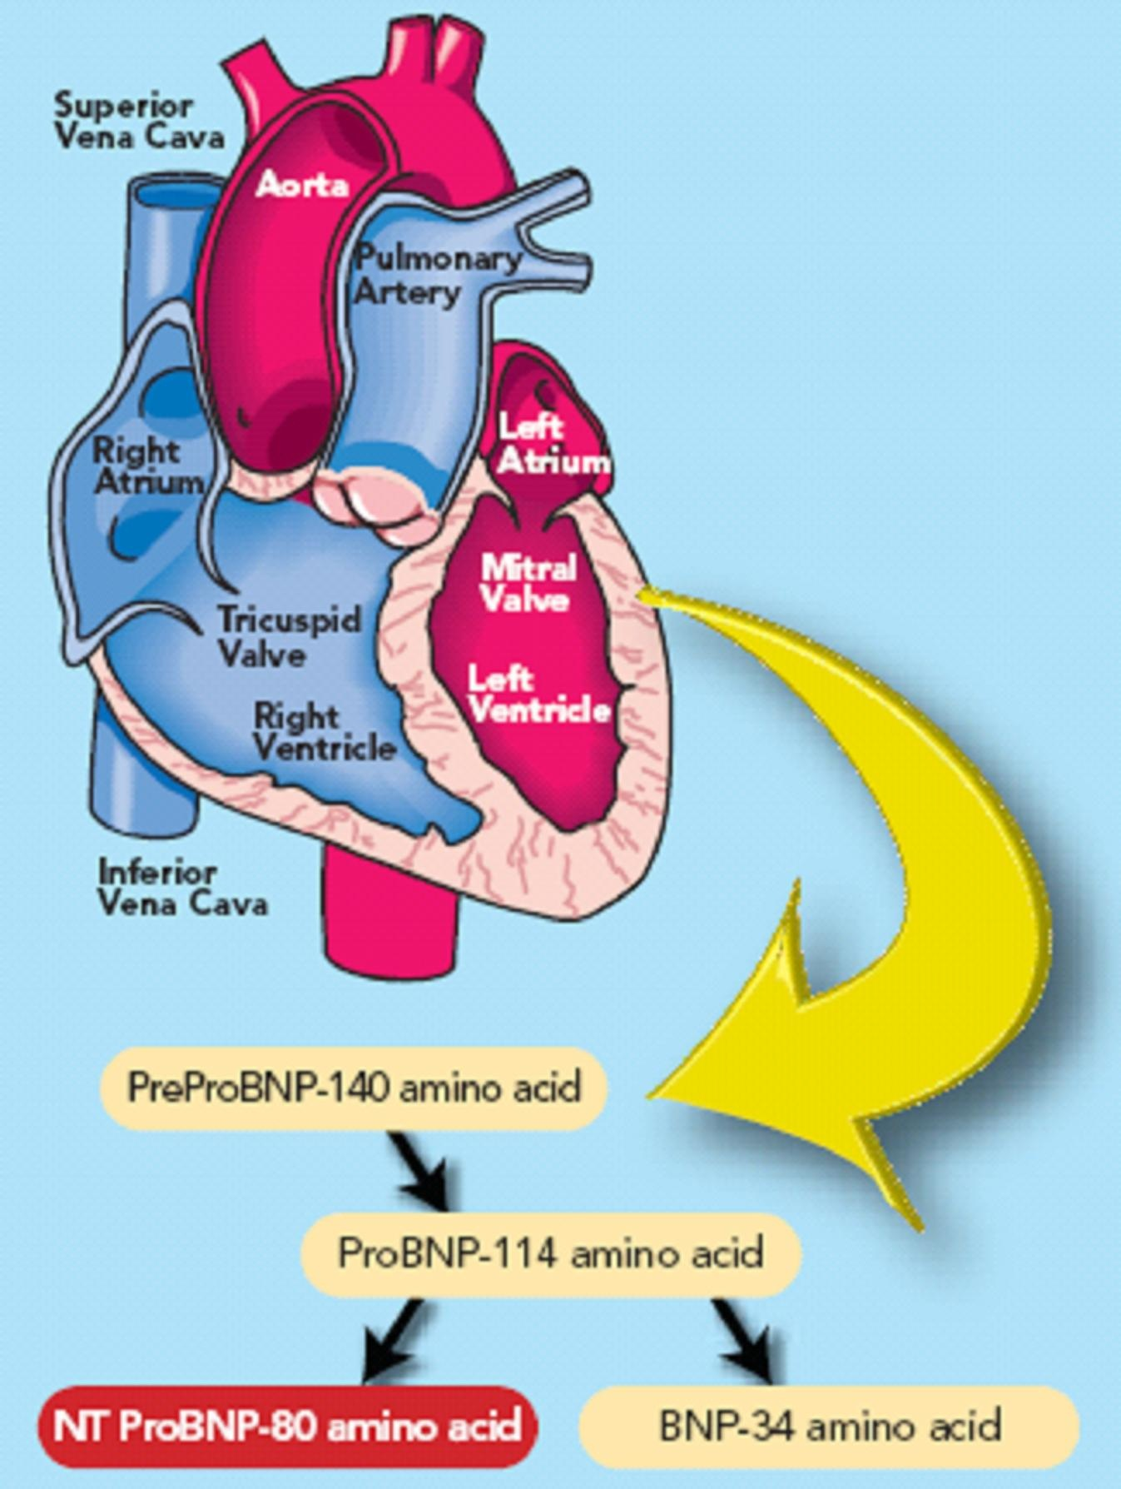
B-type natriuretic peptide (BNP) (Heart failure marker)
A peptide produced by the ventricles of the heart in response to:
Myocardial stretching and ventricular dysfunction after MI
Causes : vasodilation, sodium and water excretion and reduces blood pressure .
A marker for detecting Congestive heart failure .
Its serum levels are high in some pulmonary diseases .
But in heart failure its levels are markedly high .
An important marker for differential diagnosis of pulmonary diseases and congestive heart failure .

Slide 22
Pathogenesis of MI
Atherosclerotic Plaque
Diagnosis of MI
Plaque Rupture
Thrombosis
Typical heart attack symptoms
Typical ECG pattern(changes)
Typical rise and fall pattern of a cardiac marker in plasma
H-FABP
Tissue Ischemia
Tissue Necrosis
cTn CK-MB
Myoglobin
More rapid rise and fall of CK-MB
Typical rise and gradual fall of cardiac troponins
BNP
Myocardial Dysfunction
Heart Failure
BNP
NOTE: Requires presence of at least two of these characteristics

Slide 23
Quiz
SAQ
https://www.onlineexambuilder.com/mi-biomarkers-saq-s/exam-144724
MCQ’s
https://www.onlineexambuilder.com/mi-biomarkers/exam-144722
See you next block ☺
Helpful video
https://www.youtube.com/watch?v=kO8-RPIkuLE

Slide 24
TEAM
MEMBERS
مهند الزهراني
طلال الطخيم
عبدالعزيز الصومالي
سعود الشنيفي
صالح التويجري
محمد العسيري
بشرى قوقندي
زينة الكاف
TEAM LEADERS
محمد المطلق
رانيا العيسى

Slide 25
Review the notes
https://www.youtube.com/watch?v=kO8-RPIkuLE
THANK YOU
PLEASE CONTACT US IF YOU HAVE ANY ISSUE
Lippincott's Illustrated Reviews: Biochemistry, 6th E
@436Biochemteam
Biochemistryteam436@gmail.com

