Slide 1
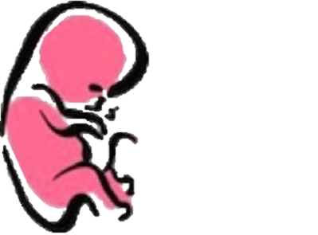
DEVELOPMENT OF THE HEART
﴿ إِنَّا خَلَقْنَا الإنسان مِنْ نُطْفَةٍ أَمْشَاجٍ نَبْتَلِيهِ فَجَعَلْنَاهُ سَمِيعًا بَصِيرًا ﴾ [الإنسان: 2].
Embryology
436
Important
Dr. notes Explanation
M E D I C I N E
KING SAUD UNIVERSITY
- We recommend you to study anatomy of the heart lecture first.

Slide 2
O B J E C T I V E
Describe the site, formation, union, and division of the of the heart tube.
Describe the formation and fate of the sinus venosus.
Describe the formation of the interatrial and the interventricular septae.
Describe the formation of the two atria and the two ventricles.
Describe the partitioning of the truncus arteriosus and formation of the aorta and pulmonary trunk.
List the most common cardiac anomalies.

Slide 3
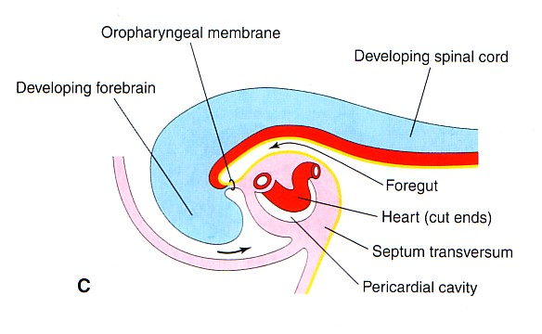
Formation of the heart tube
The cvs (heart) is the first functional major organ to develop, It begins to beat at 22 to 23 days. (from fertilization)
-لما تروح الحامل تسوي الالتراسوند اول شي ينسمع هو دقات قلب الجنين
- It develops from splanchnic mesoderm *the origin of the heart in the wall of the yolk sac (cardiogenic area)
-cranial to the developing mouth and nervous system .
- ventral to the developing pericardial sac.
-The heart primordium is first evident at 18 days (as an angioplastic cords which soon canalize to form the 2 heart tubes).
After completion of the head fold, the developing heart tubes change their position and become lie in the ventral aspect of the embryo and dorsal to the developing pericardial sac.
Angioplastic : means give rise of blood vessel

Slide 4
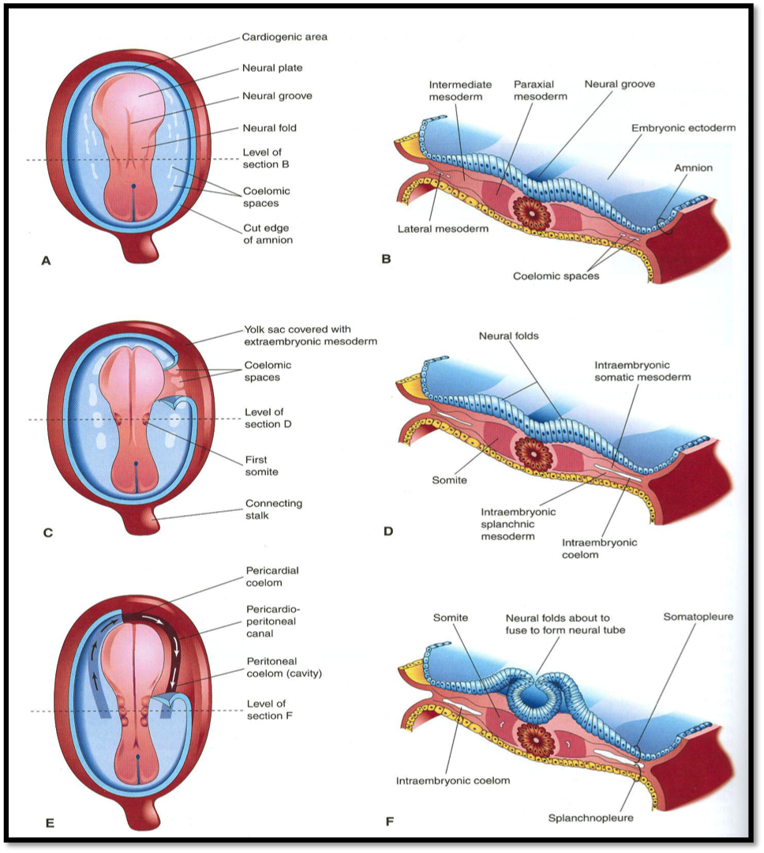
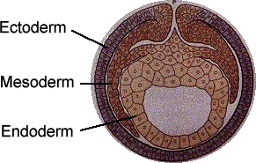
Extra explanation:
Only on girls’ slides
Notochord this line is the axis of the embryo, it divide the body into right and left sides, each side has: 1- endoderm, 2- mesoderm ( intraembryonic mesoderm ), 3- ectoderm
The mesoderm is divided into somatic(from paraxial), intermediate and lateral
Within lateral mesoderm appears a cavity divide it into 1- somatic mesoderm (nearer to the ectoderm ), 2- splanchnic mesoderm (nearer to the endoderm).
In this phase the embryo is flat, has a cranial end ( ) and caudal end ( ). We can see the developing brain and cranial to it the the developing mouth. More cranial to the developing mouth will appear two tubes made of splanchnic mesoderm. This area is called cardiogenic area. Behind the the tubes will appear the pericardial cavity This all appear in the 18th day of pregnancy. | The embryo’s developing head will fold (head fold), The heart tubes will change: 1- canalization of the tubes after they were close. 2- they will be ventral to the developing brain and mouth, and dorsal to the pericardial cavity.
فوق
تحت
يعني على مستوى
أعلى منه بس كلهم في خط مستقيم واحد
يعني
الانبوبين يكونون امام التجويف هذا.
*as you see the mesoderm is between the ectoderm and the endoderm
*cranial:
*ventrica:.
*dorsal: <
يقترب لأعلى الجسم
يقترب لجهة البطن
يقترب لجهة الظهر

Slide 5
Extra explanation
بإختصار : اول عضو يتطور القلب . يجي من splanchnic mesoderm
اول مرحلة يكون القلب فوق الفم و النيرف «اقرب للراس) ويكون القلب فنترال (امام) البريكارديال ساك( ثم يبدا الانطواء. .بعد18 يوم القلب نقدر نشوفه بعد اتمام طوية الراس المرحلة ٢ , التيوب حق القلب تصير اماميه بنسبه الامبريو . وتكون خلفيه بالنسبه للبردي كارديال ساك . بعدين طوي جانبي للامبريو الانبوبين يلتحمان ويكونون single endocardial heart tube . يبدا النبض في اليوم 22-23
https://www.youtube.com/watch?v=5DIUk9IXUaI
HELP YOU TO UNDERSTAND
https://www.youtube.com/watch?v=OArR67aFze0

Slide 6
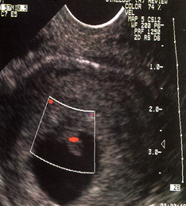
Development and blood flow
- Blood flow begins during the beginning of the fourth week *equal the 22 day after fertilization * and can be visualized by Ultrasound Doppler.
- (معنى كذا ان القلب أولا يبدا ينض ثم في الأسبوع الرابع يبدا ضخ و تدفق الدم)
Watch it first
https://www.youtube.com/watch?v=pxtnxwqNpOU&feature=youtu.be
- After lateral folding of the embryo, the 2 heart tubes approach each other and fuse in a craniocaudal*From top to bottom* t direction to form a single endocardial heart tube within the pericardial sac.
-(بإختصار بيكون عندنا 2tube راح يندمجوا مع بعض من الاعلى الى الاسفل ويصير 1tube ).
-Important note: the fusion starts from the cranial parts (craniocaudal direction)
*the head fold changes the position of the heart tubes
*and the lateral fold will make the two tube a single one tube.

Slide 7
Count.
- The heart tube (vertical) grows faster than the pericardial sac, so it shows 5 alternate dilations separated by constrictions (تضيقات).
These are :
Sinus Venosus. )Two tubes because as we mentioned it is the last part to get fused( .
Truncus Arteriosus.
Bulbus Cordis.
Common Ventricle.
Common Atrium.
The endocardial heart tube has 2 ends:
1. Venous end(Caudal) : Sinus Venosus.
2. Arterial end(Cranial) : Truncus arteriosus.
https://www.youtube.com/watch?v=oNMdqBUsGoY
(memorise them by their mentioned order).
Grow faster than other parts

Slide 8
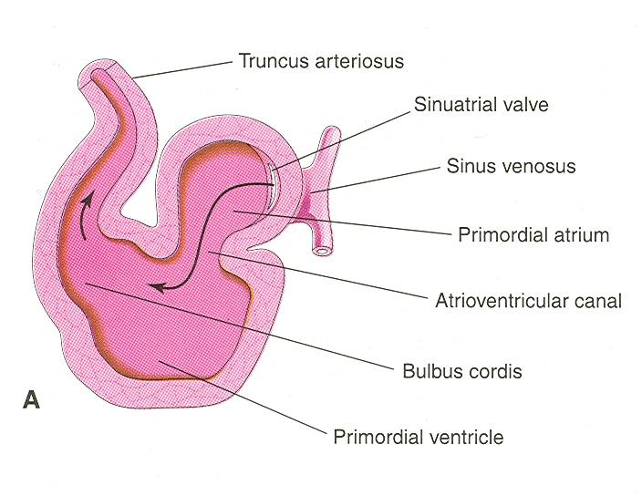
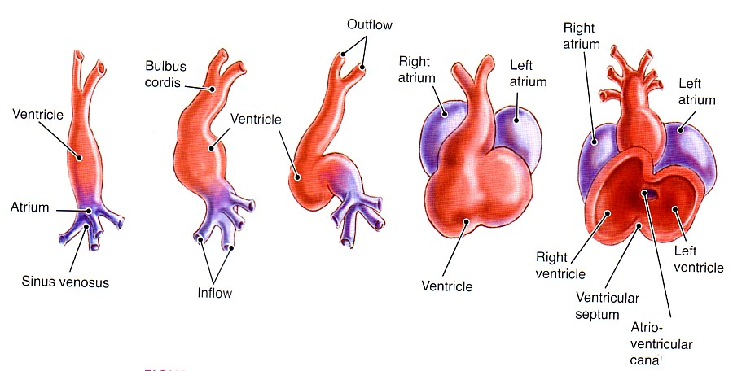
U and S-shaped heart tube
- Bulbus cordis and ventricle grow faster than the other chambers.
So the heart bends upon itself forming what is called:
The U-shaped heart tube, or (Bulboventricular loop).
القلب ينحني على نفسه ) ),
Loop formation (S-Shaped Heart Tube):
With further development the heart tube bends upon itself
and forms S-shaped heart tube:
- SO, the atrium and sinus venosus become Cranial in position and dorsal to the truncus arteriosus, bulbus cordis, and ventricle.
By this stage the sinus venosus (opens in the dorsal wall of the atrium) has developed 2 lateral expansions (ends) called the 2 horns ( right and left horns) and a body.
)القلب ينحني على نفسه )

Slide 9
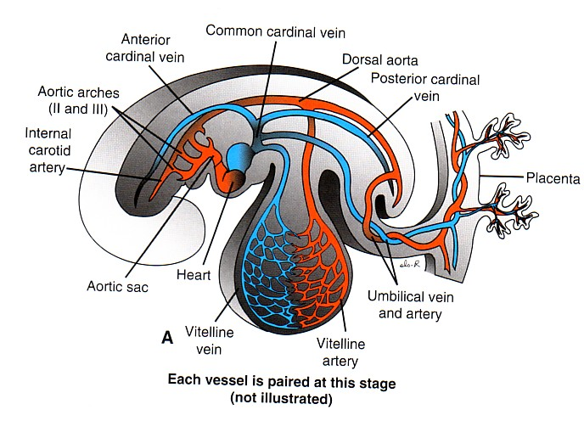
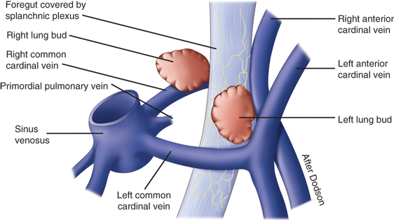
Veins associated with heart development
Each horn of the sinus venosus (opens in the dorsal wall of the atrium) receives 3 vein pairs:
1- Common Cardinal vein from the fetal body.*it’s fuse of posterior& Anterior cardic vein *
2- Vitelline from the yolk sac.
3- Umbilical from the placenta.
Sinus )
2ends
2horn (left and right ) each one has three veins. )
(هو عبارة عن جيب عنده
تمثل
Each vessel is paired at this stage
*Common Cardinal vein and Vitelline carry venous blood (deoxygenated) while Umbilical carries oxygenated blood.
and they all open in sinus venosus so it has mixed blood.

Slide 10
Fate of sinus venosus
- The right horn of the sinus venosus forms the smooth posterior wall of the right atrium.
-The left horn and the body of the sinus venosus atrophy and form the coronary sinus (which open in the right atrium).
- The left common cardinal vein forms the oblique vein of the left atrium in the coronary sinus.
*All veins will degrade except Umbilical vein will form al ligament , and the left common cardinal vein which is the only vein that remains as a vein.

Slide 11
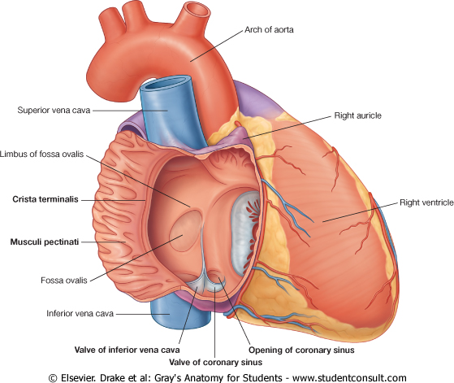
Right atrium
- The right horn of the sinus venosus forms the smooth posterior part of the right atrium.
- Rough (Trabeculated) anterior part (musculi pectinati) of the right atrium is derived from the primordial common atrium.
- These two parts are demarcated by the crista terminalis internally and sulcus terminalis externally.

Slide 12
Left atrium
-Rough Trabeculated part:
derived from the primitive or common primordial atrium.
-The smooth part:
derived from the absorbed part of the Pulmonary Veins*.
*the pulmonary vein:
كان وريد واحد لما دخل الليفت اتريم انقسم لاثنين و لما دخل زيادة في القلب صار أربعة عشان يعطيني ال smooth part .

Slide 13
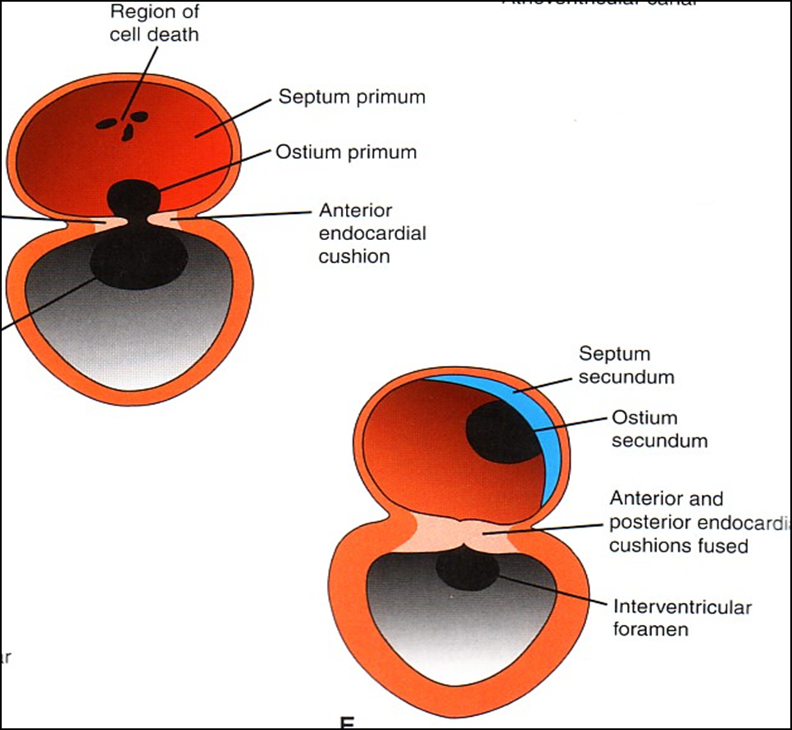
Partitioning of primordial heart
- Partitioning of:(تقسيم)
1- Atrioventricular canal.
2- Common atrium.
3- Common ventricle.
4- Bulbus cordis
5- Truncus Arteriosus.
- It begins by the middle of 4thweek. (24-28 days)
-It is completed by the end of 5th week.
*اي مشكلة تصيب الام في هذي الفترة ممكن تأثر على الجنين و تخليه يُولد اما ب ventricle واحد او atrium واحد.

Slide 14
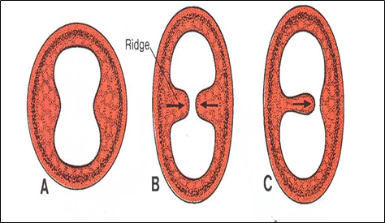
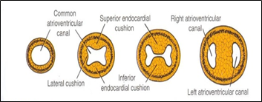
Endocardial Cushions
- They appear around the middle of the 4th week as Mesenchymal Proliferation* They participate in formation of:
1- A.V canals and valves.
2- Atrial septa.
3- Membranous part of Ventricular septum.
4- Aortic and Pulmonary channels (Spiral septum).
*they are tissue cells that can proliferate, they appear on the atrium or ventricle walls or bulbous.

Slide 15
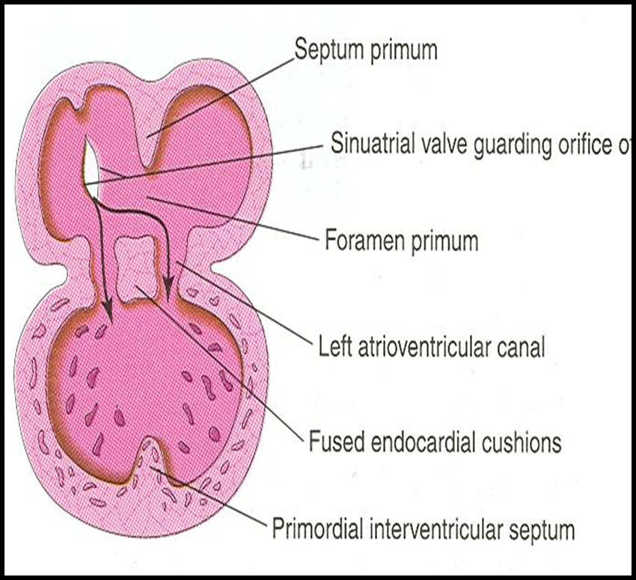
Partitioning of atrioventricular canal
Two dorsal and ventral Endocardial Cushions are formed on walls of the AV canal.
The AV endocardial cushions approach each other and fuse together to form the septum intermedium.
Dividing the AV canal into right & left canals.
These canals partially separate the primordial atrium and primordial ventricle.
AV = Atrioventricular.
-كأن الدورسال وول و الفينترال وول يضموا بعض بينهم هتتكون
Septum
وجوانبهم (كأنها يدهم ) هتتكون
Right and left canal
ventral
Dorsal
يدهم كأنها
Right canal
ومن الجهة الثانية هتكون left
Septum intermedium بينهم ال

Slide 16
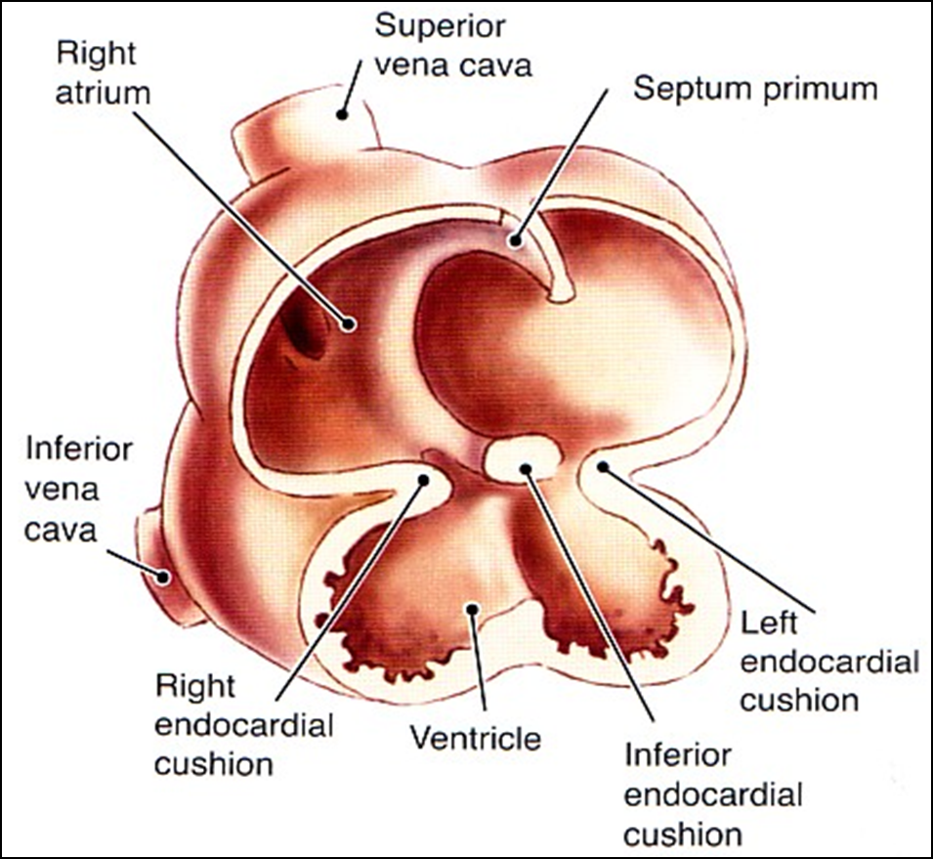
Partitioning of common atrium
Septum Primum
A sickle- shaped(شكل هلال) septum grows from the roof of the common atrium towards the fusing endocardial cushions (septum intermedium).from above downward
(كل ماتقترب سيبتم بريمم من السبتم انترميديام ال اللي بينهم يقل)
اخر شي يصير فيه فتحة صغيرة بسبب الفراغ الي بينهم نسميها
So it divides the common atrium into right & left halves.
space
Ostium primum

Slide 17
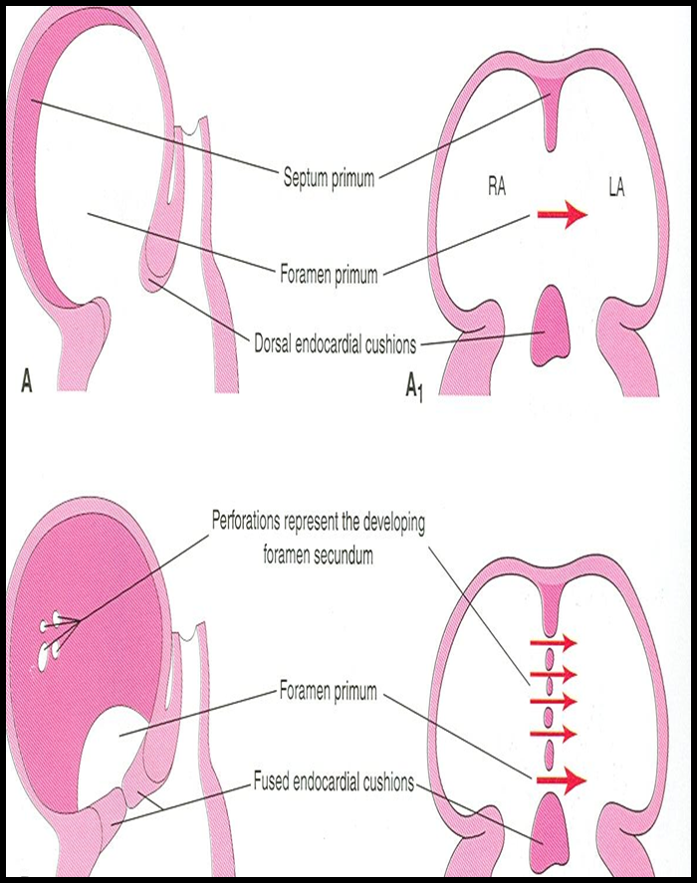
Ostium primum
At first the two ends of the septum primum reach to the growing subendocardial (endocardial)cushions before its central part.
now the septum primum bounds a foramen called ostium (opening) primum.
It serves as a shunt(قناة), enabling the oxygenated blood to pass from right atrium to left atrium.
(فائدتها بما ان مافي ف هي فتحة تسمح بمرور الاكسجنيتد بلود من الرايت تو الليفت سايد)
The ostium primum become smaller and disappears as the septum primum fuses completely with subendocardial cushions (septum intermedium) to form the interatrial septum (AV septum).
lung

Slide 18
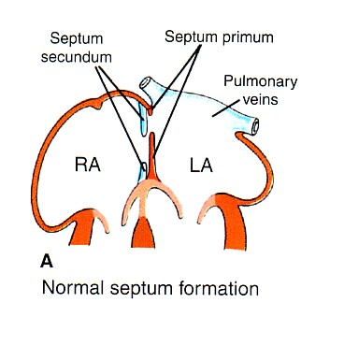
Septum secondum
The upper part of septum primum that is attached to the roof of the common atrium shows gradual resorption forming an opening called ostium secundum.
Another septum descends on the right side of the septum primum called septum secundum.
It forms an incomplete partition between the two atria.
Consequently a valvular oval foramen forms(foramen ovale).
بعد ما ينشد ال septum
علشان يغطي الفتحه اللي تحت اللي اسمها ostium primum ينقطع من فوق ويكون فتحه جديده واسمها ostium secundum
عشان كذا يبدا يتكون ال septum secundum عشان يغطيها .
primum

Slide 19
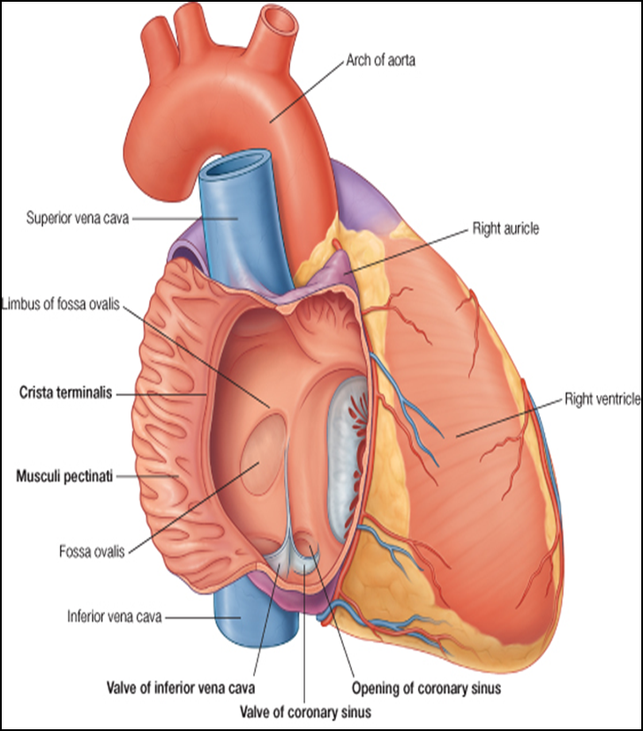
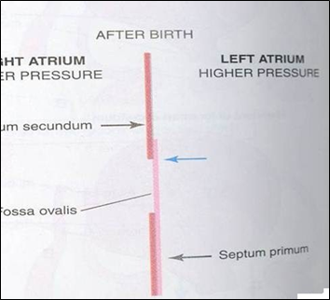
Fate of foramen ovale
At birth when the lungs inflated and pulmonary circulation begins the pressure in the left atrium increases and exceeds that of the right atrium.
The valve of the foramen ovale is pressed against the septum secumdum and obliterates the foramen ovale.
So the two septae oppose each other.
Its site is represented by the Fossa Ovalis.
Its Floor represents the persistent part of the Septum primum
The septum secondum forms the margin of the fossa ovalis which is called the limbus ovalis or annulus ovalis.
يعني( الفورامين اوفالس) هي الفتحة الي بين سبتم سيكاندم و سيبتم بريمم
*اول ما ينولد الطفل تبدا الرئتين تشتغل والضغط يبدا يزيد في Left atrium ويضغط على ويلتصق في ال ويكون ال
صارت مكان الفورامين اوفاليس
septum secondum
septum primum
fossa ovalis

Slide 20
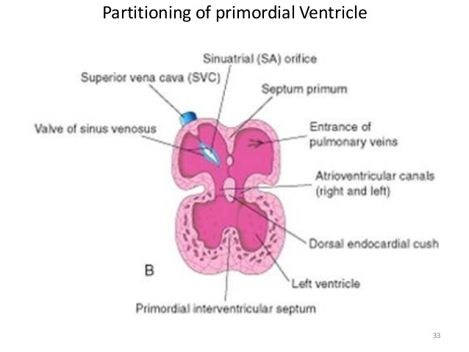
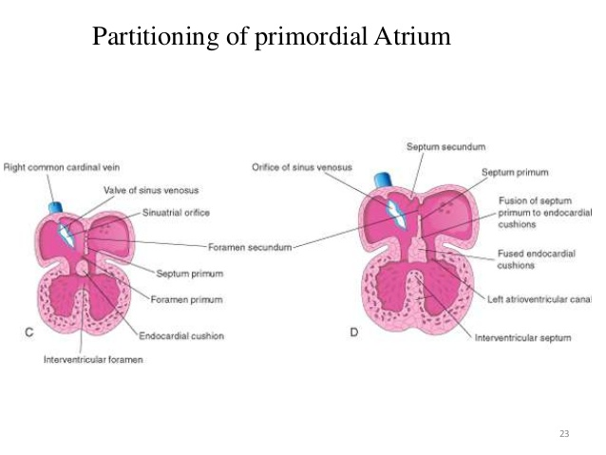
Partitioning of Primordial Ventricle
Muscular part of the interventricular septum.
Division of the primordial ventricle is first indicated by a median muscular ridge, the primordial interventricular septum.
It is a thick crescentic fold which has a concave (left ventricle)upper free edge. (right ventricle is convex )
This septum bounds a temporary connection between the two ventricles called (IVF) interventricular foramen.

Slide 21
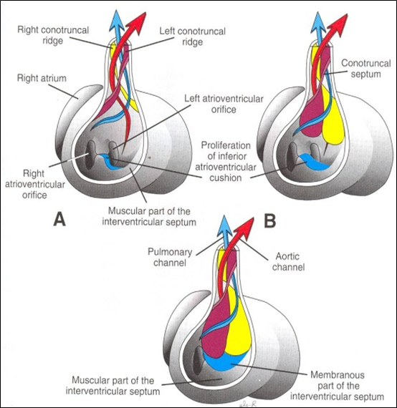
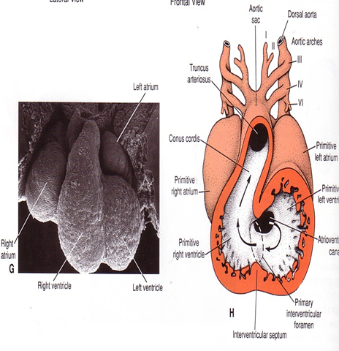
Interventricular Septum
The membranous close upper part of the IV septum is derived from:
1- A tissue extension from the right side of the endocardial cushion.
2- Aorticopulmonary septum.
3- Thick muscular part of the IV septum.
-فايدة الممبرين يقفل الفتحة الي بين ال2 فينتركالز

Slide 22
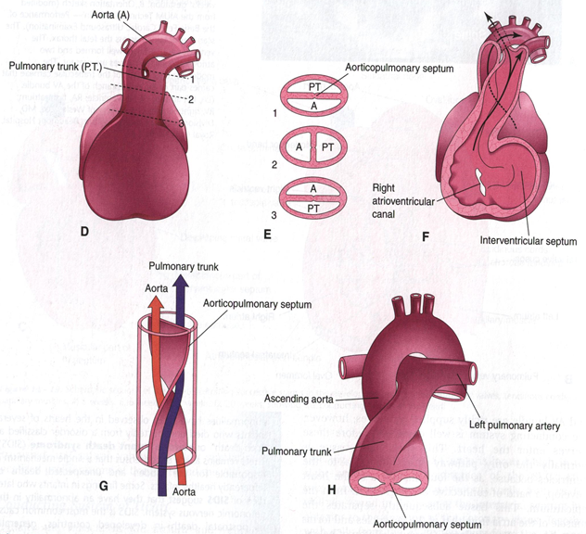
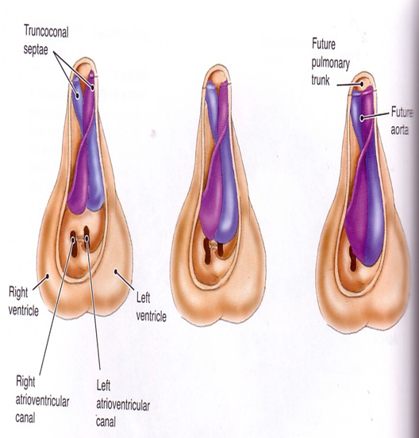
Spiral Aorticopulmonary Septum
Only in boys’ slides
•A spiral septum develops in the Truncus arteriosus dividing it into aorta and pulmonary trunk.
•So, now the pulmonary artery joins the right ventricle while the aorta joins the left ventricle.

Slide 23
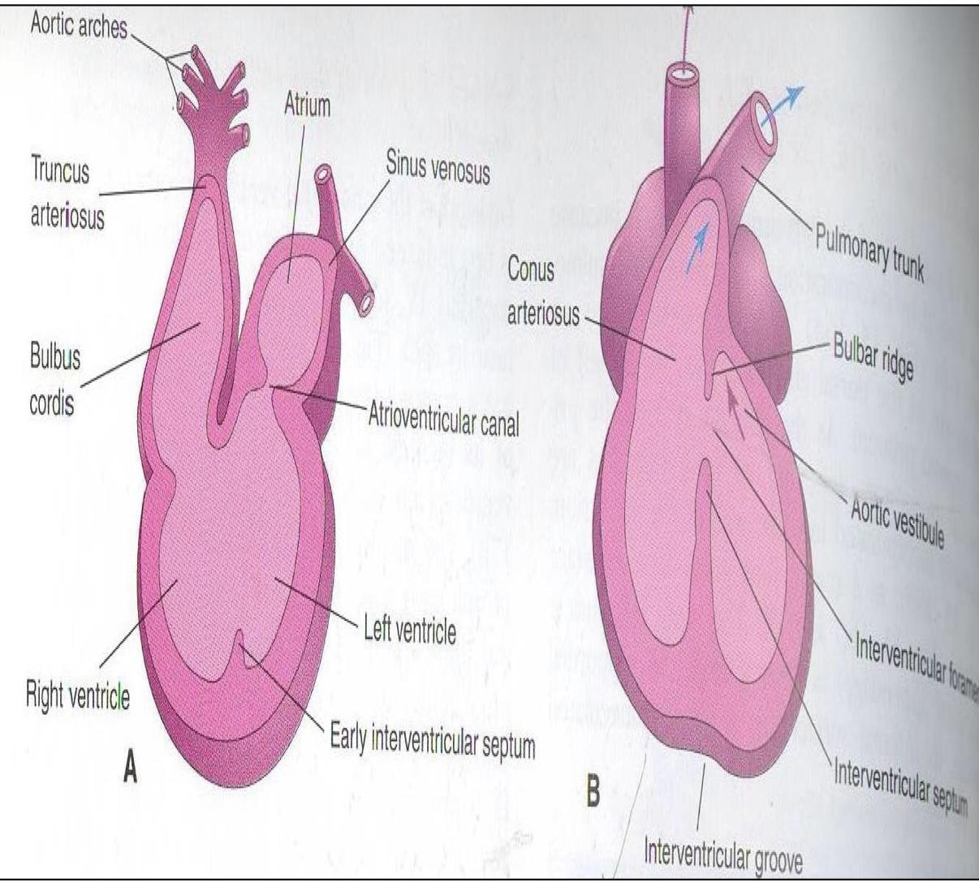
Bulbus Cordis
•The bulbus cordis forms the smooth upper part of the two ventricles.
•Right Ventricle:
Conus Arteriosus or (Infundibulum): which leads to the pulmonary trunk.
•Left ventricle:
Aortic Vestibule: leading to ascending aorta.

Slide 24
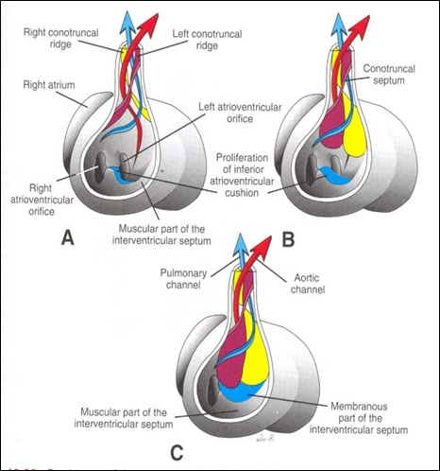
Partition of Truncus Arteriosus
•In the 5th week, proliferation of mesenchymal cells (Endocardial Cushions) appear in the wall of the truncus arteriosus ,they form a Spiral Septum:
•A. It divides the Lower part of the TA into Right & Left parts
•B. It divides the Middle part of TA into Anterior & Posterior parts.
•C. It divides the Upper part of the TA into Left & Right parts.
•This explains the origin of pulmonary trunk from Right ventricle & ascending aorta from Left ventricle & their position to each other.

Slide 25
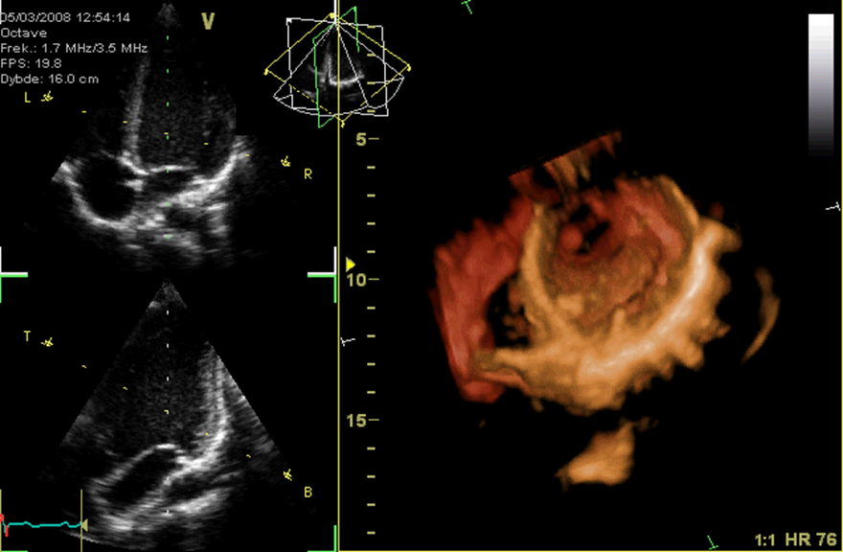
Major Cardiac Anomalies
ـ MAJOR CARDIAC ANOMALIES:
1-Tetralogy of fallot
2-Transposition of great arteries(TGA)
3-Persistent truncus arteriosus

Slide 26
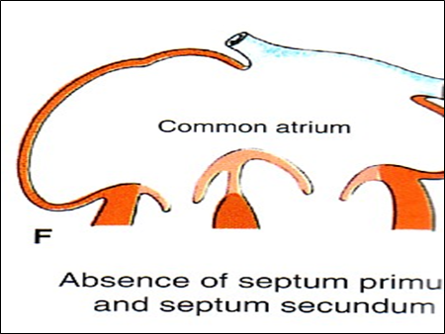
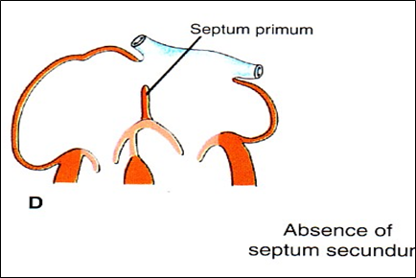
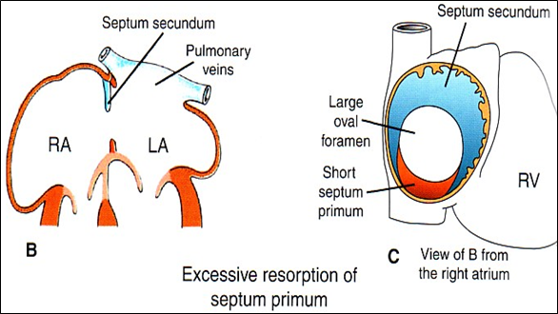
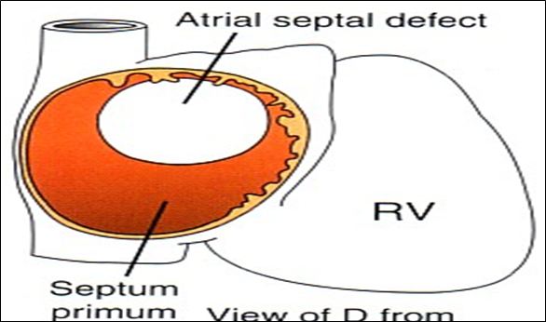
Atrial Septal Defects (ASD)
There are three types:
Absence of septum primum and septum secundum, leads to common atrium.
Absence of Septum Secundum
Large (Patent) foramen ovale( (فتحة تكون اكبر من اللازم
Excessive resorption of septum primum

Slide 27
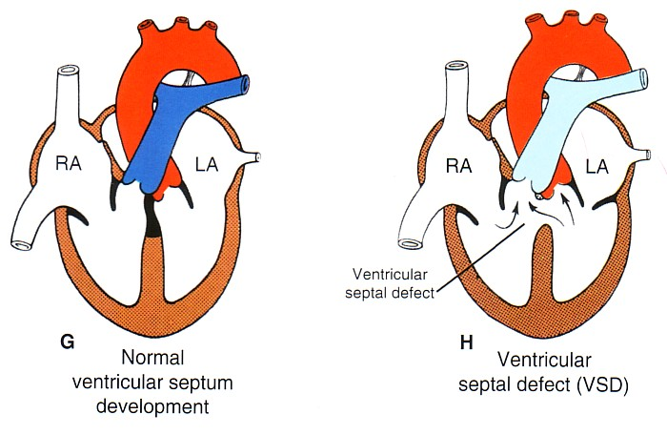
Ventricular septal defect(VSD)
Roger’s disease:
1- Absence of the membranous part of interventricular septum (presistent IV formen)
(There is a space between 2 ventricles , so it leads to
mix of Venus and arterial blood )
2- Usually accompanied by other cardiac defects.

Slide 28
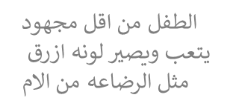
1-Tetralogy of fallot
Fallot’s Tetralogyh) very common) includes four heart malformations present together:
1-ventricular septal defect(VSD). (Absence of the membranous part )
2- Pulmonary stenosis(narrowing of pulmonary valves , so the aorta will be larger than pulmonary).
3-Right ventricular hypertrophy (Enlarge) (resistance
4-overriding of aorta (blood enters the aorta from both ventricles).
(الرباعي فالوز)
(بولمنري ترنك يكون ضيق فيحدث
(Cyanosis)

Slide 29
2-Transposition of great arteries(TGA)
- TGA is due to abnormal rotation or malformation of the aorticopulmonary septum (spiral), so the right ventricle joins the aorta, while the left ventricle joins the pulmonary artery.
One of the most common cause of cyanotic heart disease in the newborn(blue baby).
Often associated with ASD(atrial septal defect) or VSD(ventricular septal defect).
great arteries : 1- aorta 2- pulmonary trunk
because of abnormal rotation or malformation of the aorticopulmonary septum
المفروض الاورتا يطلع من و ا لبولمنري من
رح تتبدل أماكنهم
Right side
Left side
Pulmonary form left and aorta from right side

Slide 30
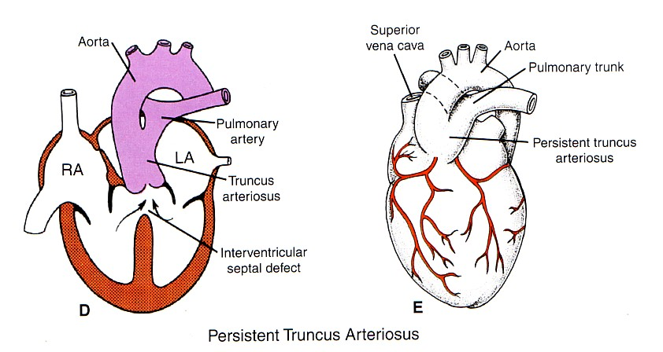
3-Persistent truncus arteriosus
It is due to failure of the development of the aorticopulmonary
(spiral) septum
It is usually accompanied with VSD.
It forms a single arterial trunk arising from the heart and supplies the systemic , pulmonary and coronary circulations
*single artery arising from the two ventricles which gives rise to both the aortic and pulmonary vessels.
-ماتكونت عندي اساسا سبايرال سبتمز
هيطلع فيسلز واحد فقط (ارتري)
و البلود سيركيوليشن رح تجي من هذا الفيسلز الواحد
That has mixed blood ,so it is ( very Difficult to treat)

Slide 31
Summary
Event | Date
Heart begins to beat | 22nd-23rd
Heart primordium is the first evident | at day 18
Partitioning of Primordial Heart | It begins by the middle of 4th week. It is completed by the end of 5th week.
Endocardia Cushions | around the middle of the 4th week
Partition of Truncus Arteriosus | In the 5th week

Slide 32
Summary
Disease | Information
Atrial septal defects (ASD) | 1)Excessive resorption of septum primum 2)Patent foramen ovale 3) Absence of septum secundum 4) Absence of septum primum and septum secundum lead to common atrium
VENTRICULAR SEPTAL DEFECT (VSD) | -Roger’s disease . -Absence of the membranous part of interventricular septum.
TETRALOGY OF FALLOT | 1.Pulmonary stenosis. 2.Right ventricular hypertrophy. 3.VSD (absent of membrane IV septum) 4.Overriding of the aorta
(TGA) OR TRANSPOSITION OF GREAT ARTERIES | -TGA is due to abnormal rotation or -malformation of the aorticopulmonary septum. -It is one of the most common cause of cyanotic heart disease
Persistent Truncus Arteriosus | due to failure of the development of the aorticopulmonary (spiral) septum

Slide 33
MSQs
ANY SUGGESTION OR ISSUE
https://www.onlineexambuilder.com/development-of-the-heart/exam-137724
USEFUL VIDEOS
https://www.youtube.com/watch?v=FgTk57vE3A4&feature=youtu.be
https://www.youtube.com/watch?v=RpZHiwkFUM4&feature=youtu.be
https://www.youtube.com/watch?v=cY2H7X05lfM
Embryology
@Embryology436
436
Editing file
Embryology436@gmail.com

Slide 34
TEAM MEMBERS
TEAM LEADERS :
B O Y S :
SAAD ALRUSHOUD
Abdulrahman Alharbi
Abdulrahman Alrasheed
Rayan Alqarni
Abdulkarim Alharbi
NEHAL BEYARI
G I R L S :
Razan Alotaibi
Thikrayat Omar
Do’aa Walid
Ohood Abdullah
Nouf Aloqili
MUHANNED ALZAHRANI
EDITING By:

