Slide 1
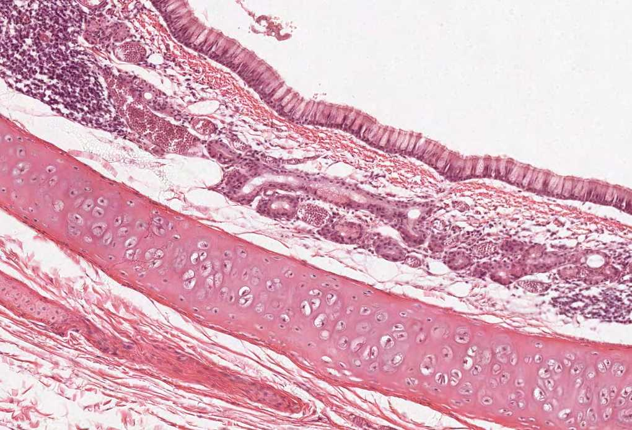
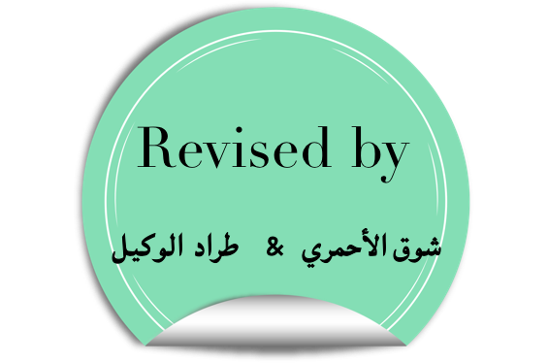
WALL OF THE HEART AND CARDIAC VALVES
Color index:
Slides.. Important ..Notes ..Extra..

Slide 2
Objectives:
The microscopic structure of:
Wall of the heart.
Endocardium
Myocardium
Epicardium
Cardiac valves.

Slide 3
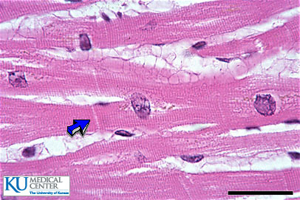
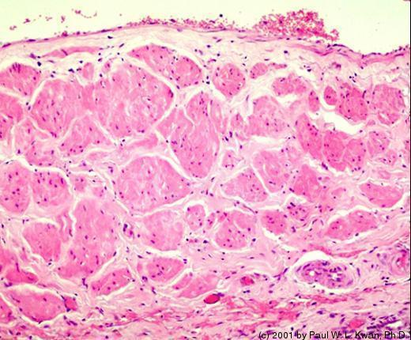
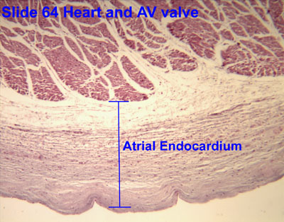
WALL OF THE HEART
The wall of heart is composed of:
Endocardium
Epicardium
Mesothelium
C.T. layer
Myocardium
Convictive tissue
Endothelium
Subendocardial layer
Subendothelial C.T.
Dense C.T. layer
The inner layer should be very smooth (for the lumen of the heart) so it is endothelium.
the organ should be covered in a membrane, as the pleura covers the lung, the epicardium covers the heart, it is the visceral layer.

Slide 4
WALL OF THE HEART
Myocardium
Epicardium
Walls of the heart
Endocardium
The innermost layer
Bloodstream flow in this layer
Is formed of:
A- Endothelium:
Simple squamous epithelium.
B- Convictive tissue:
There are three different layers of C.T :
Subendothelial C.T (Lose C.T rich in elastic fiber & collagen fiber)
Dense C.T. layer ( Rich in collagen fiber Type I)
Subendocardial layer:
Loose C.T. layer that contains Purkinje fibers, small blood vessels and nerves.
It attaches to the endomysium of the cardiac muscle. (penetrates)
t is the middle layer.
It is the most thick layer.
It contains:
A- Bundles of cardiac muscle fibers.
B- Endomysium (loose C.T & it’s in continuation with the Subendocardial layer of the endocardium).
(Visceral layer of pericardium)
Is formed of:
A- Mesothelium:
Simple squamous epithelium.
B- Subepicardial C.T. layer:
Loose C.T. contains the coronary vessels, nerves, ganglia & fat cells.
do not get confused between the epicardium and the pericardium .
Pericardium is formed of a fibrous layer and a serous layer , and since it’s serous layer it’s composed of a partial and a visceral layer * remember the pleura ? * .
the epicardium is simply the visceral layer of the serous pericardium

Slide 5
different layers of the heart wall
Important features of the heart

Slide 6
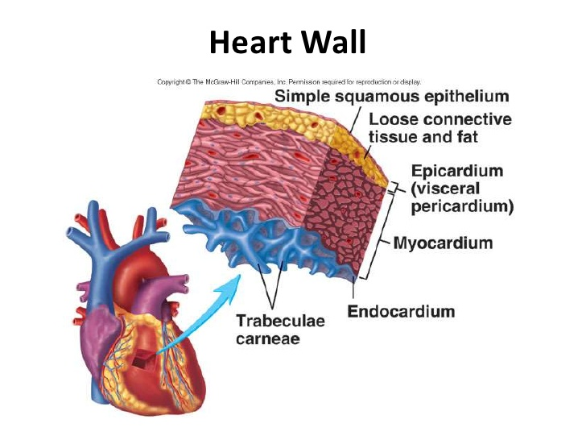
CARDIAC MUSCLE
Found in the myocardium.
Striated and involuntary.
L.M. Picture of Cardiac Muscle Fibers | E.M. Picture of Cardiac Muscle Fibers
Cylindrical in shape. Intermediate in diameter between skeletal and smooth muscle fibers. Branch and anastomose. Covered by a thin sarcolemma. Mononucleated. Nuclei are oval and central. Sarcoplasm is acidophilic and shows non-clear striations (fewer myofibrils). Divided into short segments (cells) by the intercalated discs. | Few myofibrils. Numerous mitochondria. Less abundant SR. T-tubules come in contact with only one cisterna of SR forming “Diads” (not triads). Glycogen & myoglobin. Intercalated discs: are formed of the two cell membranes of 2 successive cardiac muscle cells, connected together by junctional complexes (desmosomes and gap junctions).
Gap junctions are the channels between the cells because we want the impulses to reach the all the cells at the same time.
Desmosome كأنها دباسة

Slide 7
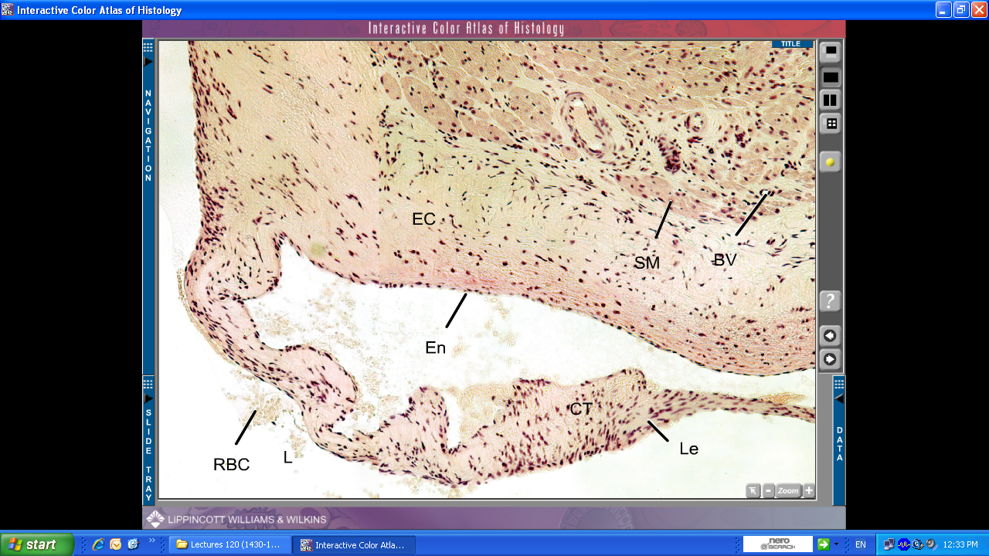
HEART VALVES(CARDIAC VALVES)
LEAFLET (CUSP) OF HEART VALVE
Formed of : | characteristics
(1) A core of Dense irregular C.T. The central part of the core is dense fibrous C.T. and covered by loose C.T. | Leaflets are normally AVASCULAR, but blood capillaries can be found only in the base or root of the leaflet. It doesn’t need blood capillaries because the cusp is surround by blood stream in the heart .
(2) This core is covered by: Endocardium (simple squamous epithelium)
Myocardium
Endocardium
LEAFLET

Slide 8
Extra Explanation for desmosomes and gap junctions
So briefly , desomsomes are the structures by which two adjacent cells are attached. and the gap junctions allow the communication and passage of impulses between cardiac muscle cells.

Slide 9
Wall of the heart
Endocardium
Myocardium
Endothelium
Sub-endothelial C.T.
Dense C.T. Layer
Sub-endocardial layer
Simple squamous epithelium
Loose C.T. layer
It attaches to the endomysium of the cardiac muscle
1- The middle layer
2- The thickest layer
3- Contains cardiac muscle cells with endomysium (loose C.T)
Cardiac Muscle Fibers (Striated and involuntary)
L.M. Picture
1- Cylindrical
2- Intermediate in diameter 3- Branched and anastomose
4- Covered by a thin sarcolemma
5- Mononucleotide (oval and central)
6- Sarcoplasm is acidophilic and shows non clear striations
7- Divided into short segments by intercalated discs
E.M. Picture
1- Few myofibrils
2- Numerous mitochondria
3- Less abundant Sarcoplasmic Reticulum
4- T-tubules come in contact with only one cisterna of SR forming (diads)
5- Glycogen & myoglobin
6- Intercalated discs
Epicardium
( Visceral layer of pericardium)
Mesothelium
Subepicardial C.T. Layer
Simple squamous epithelium
Loose C.T
The coronary vessels
Nerves
Ganglia
Fat cells
Purkinje fibers
Small blood vessels
Nerves
HEART VALVES (CARDIAC VALVES)
Each leaflet (cusp)
(AVASCULAR)
of heart valve is formed of:
A core of Dense irregular C.T.
(Covered by endocardium)

Slide 10
MCQ :
1- what’s the type of epithelium found in endothelium and mesothelium are :
A- simple cuboidal epithelium
B-simple columnar epithelium
C-simple squamous epithelium
D- all above
2- Endothelium and Mesothelium are found in :
A-Endocardium-Epicardium
B-Endocardium-Epicardium
C-Epicardium-myocardium
D-Endocardium-myocardium
3- Purkinje fibers are found in :
A-Endocardium
B-Epicardium
C-Myocardium
D-all above
4 -Coronary vessels are found in :
A-Endocardium
B-Epicardium
C-myocardium
D-all above
5- the core of the valves is covered by:
A-Endocardium
B-Epicardium
C-myocardium
D-all above
6- The most thick layer in the wall of the heart is :
A-Endocardium
B-Epicardium
C-myocardium
D-all above
1-C
2-B
3-A
4-B
5-A
6- C

Slide 11
Thank you & good luck
- Histology team
Done by :
Ahmed Badahdah
Mutasem Alhasani
Omar Turkistani
Nawaf Aldarweesh
Mohammed Khojah
Team leaders:
Rana Barasain
Faisal Alrabaii
Please if you need anything or even further explanation contact us on :
HistologyTeam436@gmail.com
@histology436

