Slide 1
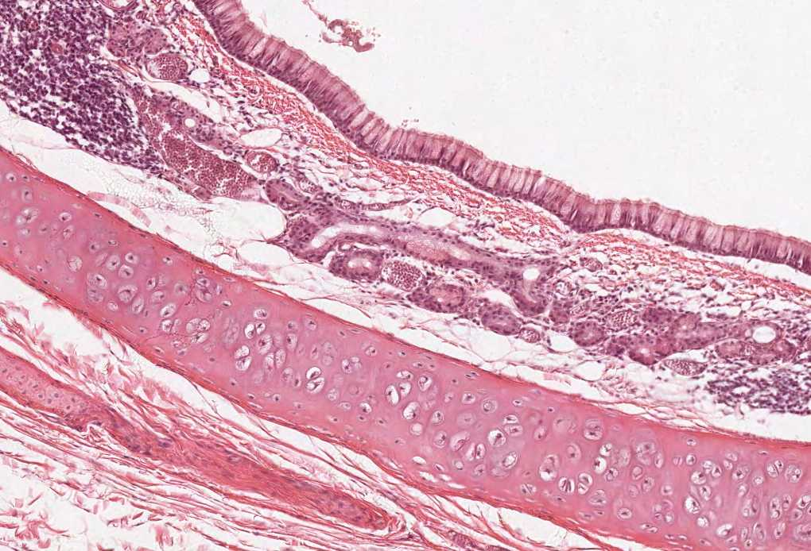



HISTOLOGY OF THE
BLOOD VESSELS
Color index:
Slides.. Important ..Notes ..Extra..

Slide 2
Objectives:
The microscopic structure of the wall of the blood vessels including:
Elastic arteries.
Muscular (medium-sized) arteries.
Medium-sized veins.
Blood capillaries.

Slide 3
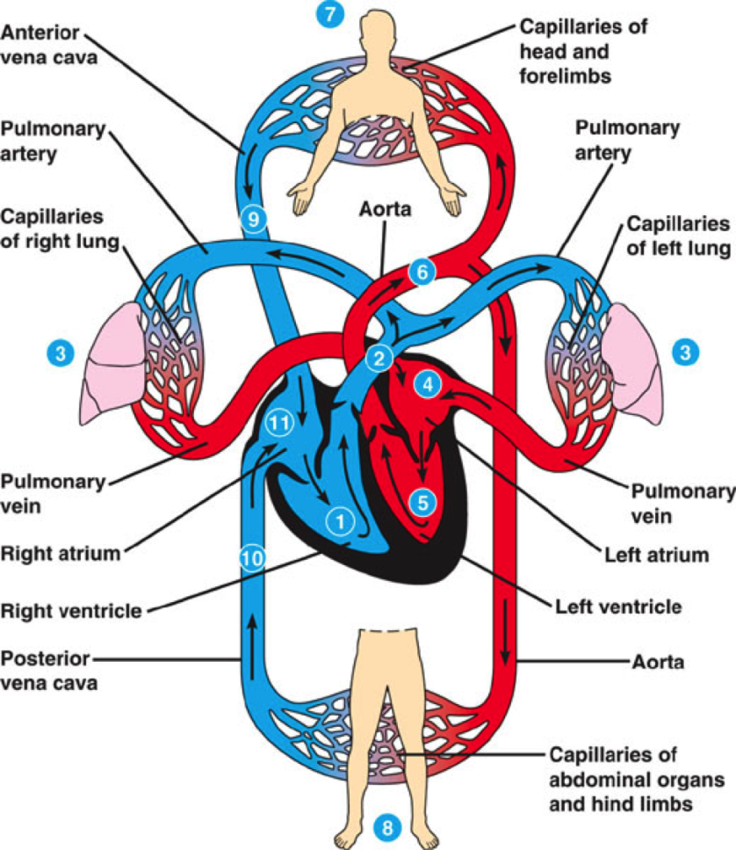
Blood vessels
Since the blood vessels are a continuation of the heart, so the structure of their walls should be similar with difference in thickness.
1- Arteries :
Elastic artery.
Muscular (distributing) (medium-sized) artery.
Arterioles.
2- Blood capillaries
3- Veins :
Venules
Small veins
Medium-sized veins
Large veins

Slide 4
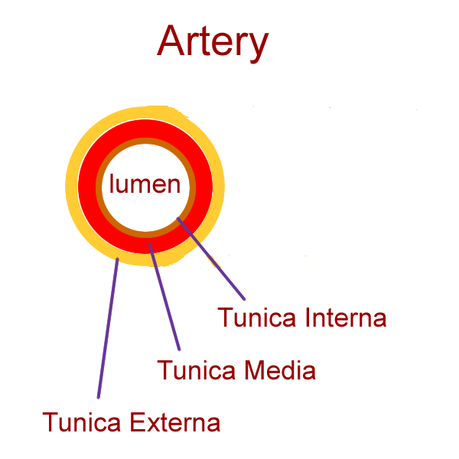
General Structure of Blood Vessels:
The wall is made of three concentric layers
Tunica intima
Is the innermost layer
Composed of:
1- Endothelial cells:
Simple squamous epithelium
2- Basal Lamina
3- Subendothelial layer: loose C.T.
4- Internal elastic lamina: fenestrated elastic sheet
fenestrated يعني في فتحات
Tunica adventitia
Outermost layer
Composed of connective tissue containing:
Vasa vasorum
They are small arterioles in tunica adventitia and the outer part of tunica media.
They are more prevalent in the walls of veins than arteries because venous blood contains less oxygen and nutrients than arterial blood
Greater numbers of Vasa Vasorum are found in the veins than the ones found in arteries , because the arteries carry oxygenated blood which can be beneficial for them as nutrition source unlike the veins so they need another source of blood which is the Vasa Vasorum
Tunica media
Intermediate layer
Composed of:
1- Smooth muscles.
2- Elastic fibers.
3- Type III collagen (reticular fibers).
4- Type I collagen
* Large muscular arteries have external elastic lamina, separating the tunica media from the tunica adventitia.
But the internal elastic lamina is in all arteries.
Tunica means Layer.

Slide 5
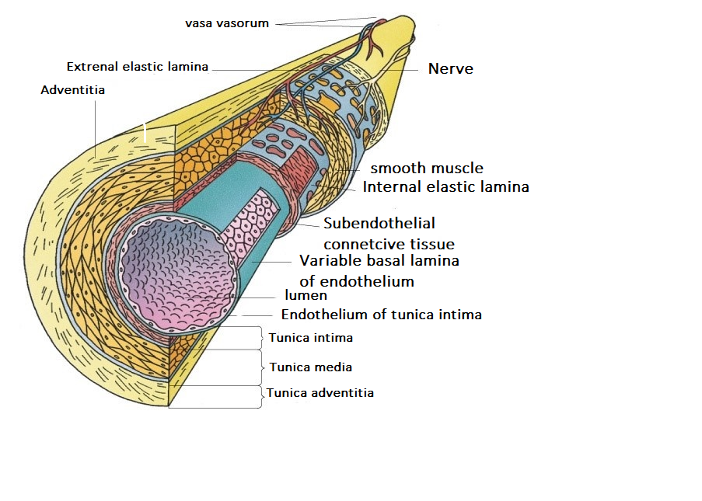
Tunica adventitia
(vasa vasorum)
Tunica media
Tunica intima

Slide 6
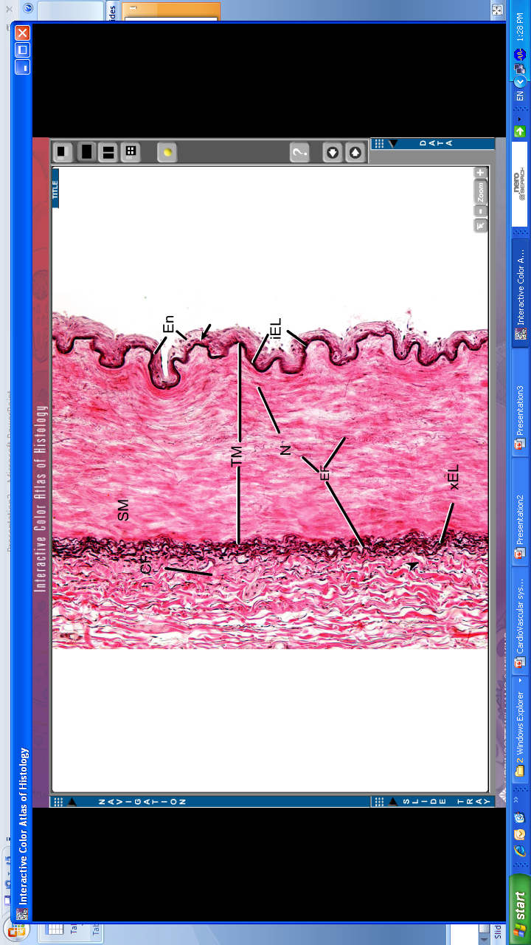
Elastic Arteries | Muscular Arteries (Medium-sized Artery)
Examples: Aorta - Common Carotid Artery - Subclavian Artery - Common Iliac Artery - Pulmonary Trunk. | Examples: Brachial - Ulnar – Renal.
Microscopic structure: 1. T. Intima: - Endothelium and basal lamina. - Subendothelial C.T. Internal elastic lamina: (not prominent) (indistinct). Why the internal elastic lamina is not prominent ? Because the entire layer is rich in elastic fibers forming a lamina and this is the main distinguish feature between the elastic and muscular arteries 2. T. Media: *It Consists Of: A- Fenestrated elastic membranes (sheets) (lamellae): - It is the main component of T.M. Also here the elastic fibers are enormous in number and form a membrane ( lamina ) B- In between, there are: 1- Smooth muscle cells. 2- Collagen fibers (type I collagen). 3- Reticular fibers (type III collagen). 4- Elastic fibers. 3. T. Adventitia: Much thinner than T.M. (Tunica media) It is composed of loose C.T. Contains vasa vasorum → send branches to the outer part of T.M. | Microscopic structure: 1. T. Intima: Endothelium. Subendothelial C.T. layer. Internal elastic lamina: Is prominent. Displays an undulating surface 2. T. Media: (Thicker than T. Adventitia or similar in thickness) *Components: A- Smooth muscle cells (SMCs): are the predominant component. B- In between there are: - Elastic fibers. - Type III collagen fibers. - Type I collagen fibers. C- External elastic lamina: may be identifiable. 3. T. Adventitia: Loose C.T

Slide 7
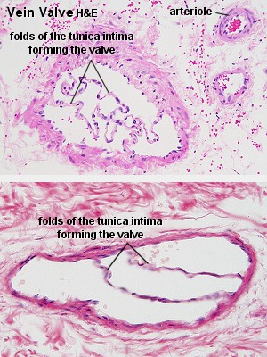
Medium-sized Vein
Thickness of the wall: thinner than the accompanying artery.
T. Intima: *Usually forms valves. *No internal elastic lamina. T. Media: - Thinner than T. Adventitia. - Consists of: 1- Fewer SMCs. 2- Types I & III Collagen fibers. T. Adventitia: - Thicker than T. Media.
Valves Of Veins
Valve of a vein is composed of 2 leaflets. Each leaflet has a thin fold of the T. Intima.
Components: 1- Endothelium 2- Core of C.T.

Slide 8
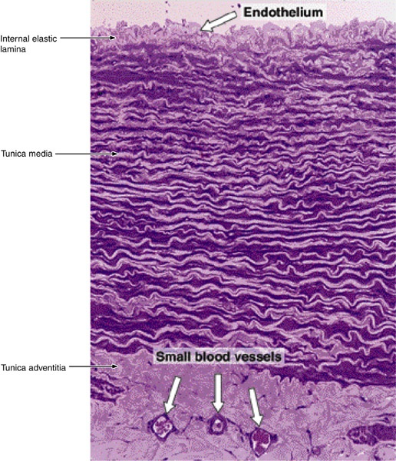
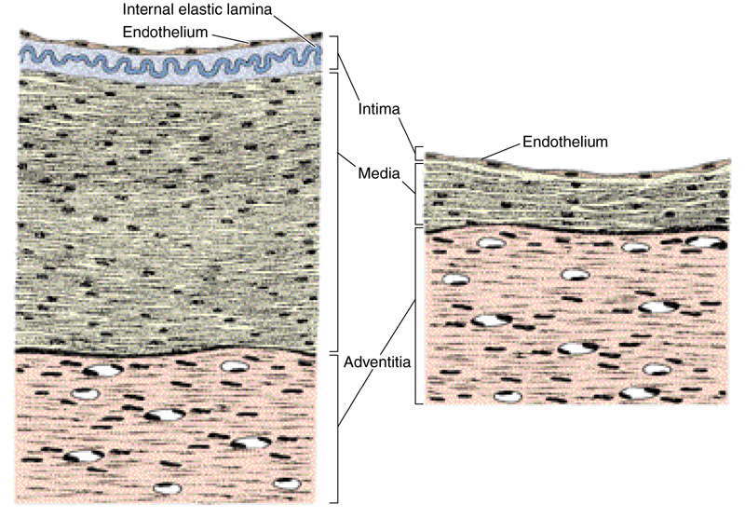
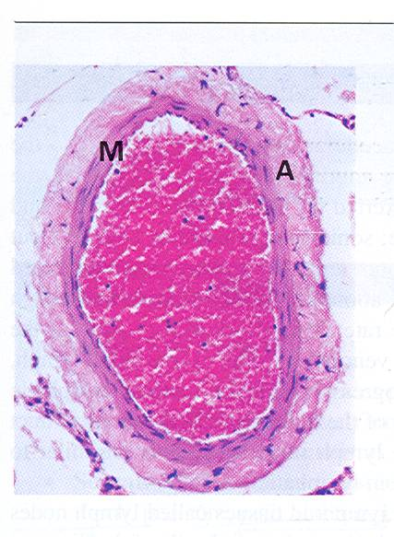
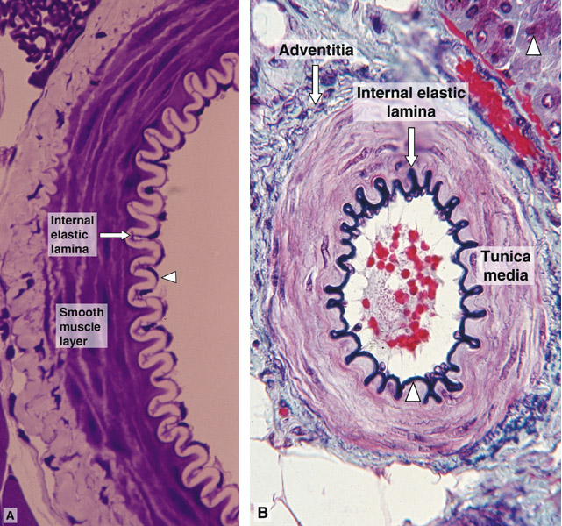
MEDIUM-SIZED ARTERY
AND MEDIUM-SIZED VEIN
we see blood in the lumen of veins (unlike arteries) because the blood is not pushed.

Slide 9
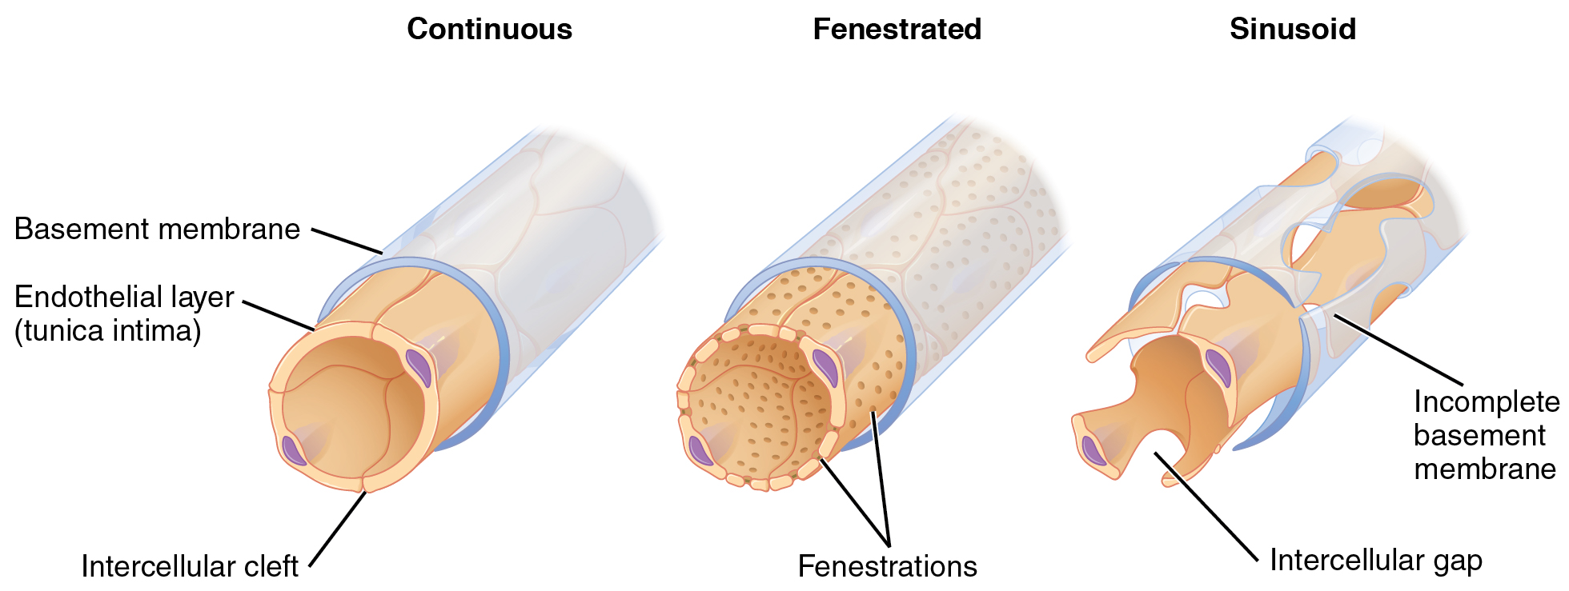
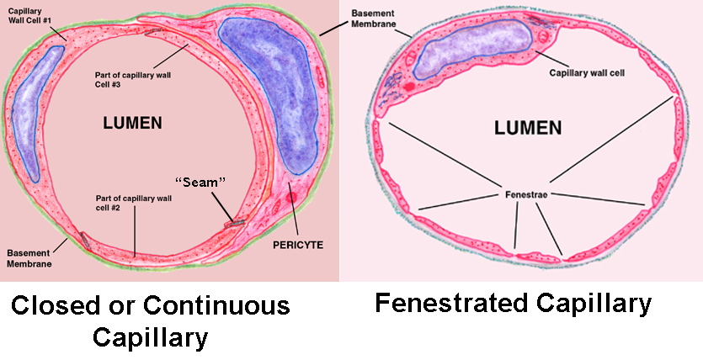
BLOOD CAPILLARIES
Diameter: usually 8-10 µm.
Microscopic structure:
  Single layer of squamous endothelial cells.
  Basal lamina: surrounds the external surface of the endothelial cells.
  Pericytes:
    Have processes.
    Share the basal lamina
    of the endothelial cells .
3 Types of BLOOD CAPILLARIES
Fenestrated blood
capillaries
without diaphragms
Sinusoidal blood capillaries
Continuous blood capillaries
with diaphragms

Slide 10
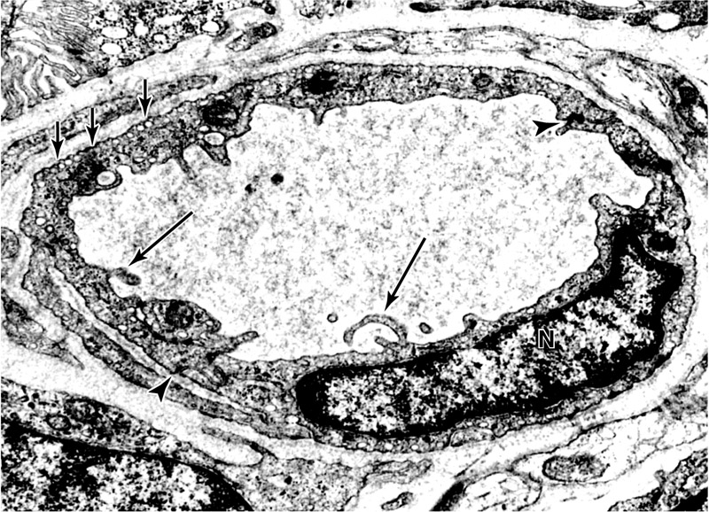
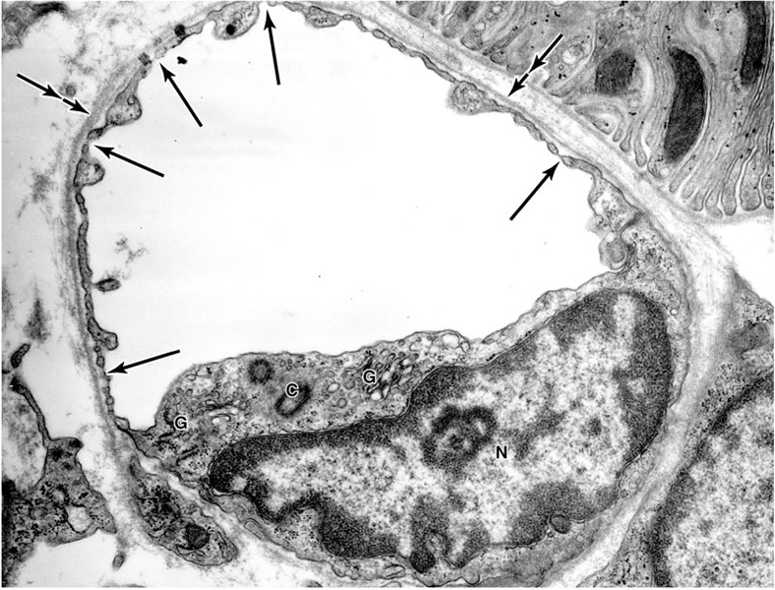
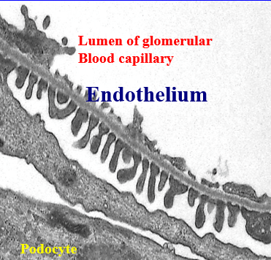
Type of blood capillary: | Continuous Blood Capillaries | Fenestrated Blood Capillaries with Diaphragms | Fenestrated Blood Capillaries without Diaphragms | SINUSOIDAL CAPILLARIES
Microscopic structure: | No pores or fenestrae in their walls. This type of capillaries do not contain fenestrae why ? Because the fluid leakage could damage organs such as lungs and brain | The walls of their endothelial cells have pores (fenestrae). These pores are covered by diaphragm. | The walls of their endothelial cells have pores (fenestrae). These pores are NOT covered By diaphragm. | Diameter: irregular (30-40 µm). Their endothelial cells have fenestrae without diaphragms. They possess: - Discontinuous endothelial cells. - Discontinuous basal lamina. Macrophages may be located in or along the outside of the endothelial wall.
Distribution: | In muscles ,pulmonary capillaries, C.T, and nervous tissue. | In intestine, pancreas and endocrine glands | In renal glomerulus. | Red bone marrow, liver, spleen and certain endocrine glands. here the entire wall contain fenestrae why ? Because areas like the red bone marrow they make RBCs and WBCs and therefore the wall of the its capillaries must contains large pores so these large cells can diffuse
EM:

Slide 11
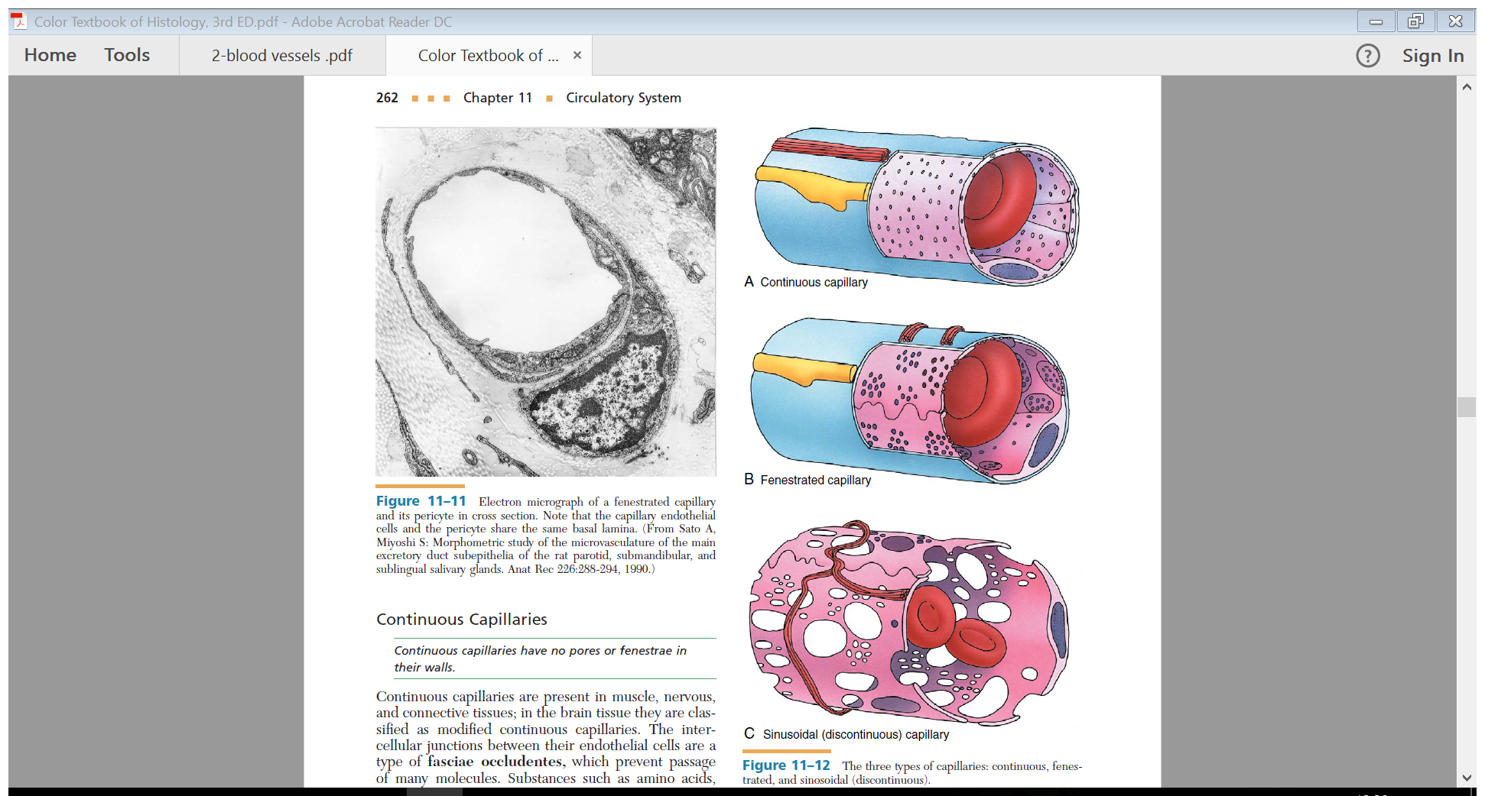
Extra picture for understanding the types of capillaries

Slide 12
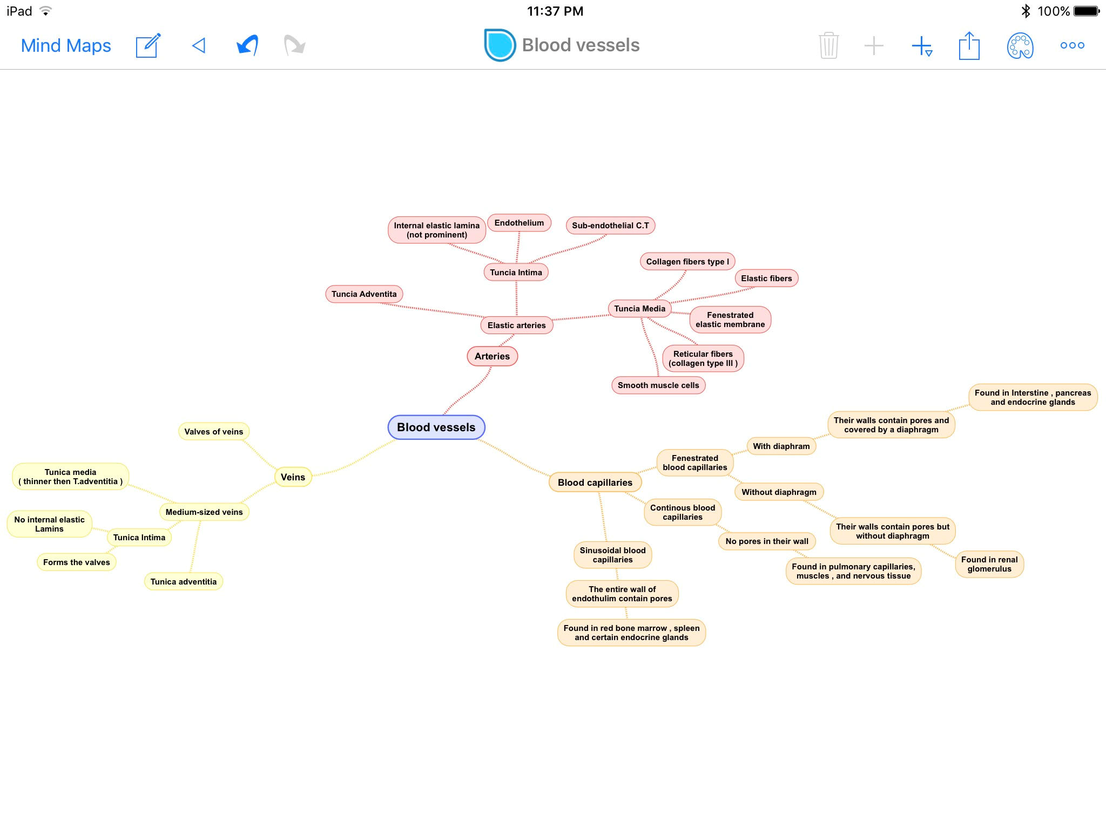
Summary

Slide 13

MCQ’S
5- The Microscopic structure of Continuous Blood Capillaries?
a. Have pores (fenestrae).
b. No pores or fenestrae in their walls.
c. Pores are covered by diaphragm.
1- The medium sized vein:
a. The wall is thicker than medium sized artery
b. Have internal elastic lamina
c. Form valves
2-The T.adventitia in muscular artery is composed of?
a. Loose connective tissue
b. Vasa vasorum
c. Macrophages
6- Vasa vasorum are small arterioles in:
a. T. Adventitia and outer T.Media
b. T. Media only
c. T. intima
7- The internal elastic lamina found in elastic arteries is:
Prominent
Not prominent
None of them
8- Which of the following contains sinusoidal capillaries?
A- Pulmonary capillaries
B- Endocrine glands
C- Red bone marrow
3-Squamous endothelial cells of blood capillaries are?
a. Douple layer
b. Single layer
c. Triple layer
4- The Distribution of Fenestrated Blood Capillaries without Diaphragms ?
a. Intestine
b. Pancreas
c. Renal glomerulus.
1-C
2-A
3-B
4-C
5-B
6-A
7- B
8-C

Slide 14


Thank you & good luck
- Histology team
Done by :
Reema Albarrak
Shahad Alanzan
Do’aa Walid
We’am Babaier
Amal AlQarni
Team leaders:
Rana Barasain
Faisal Alrabaii
Please if you need anything or even further explanation contact us on :
HistologyTeam436@gmail.com
@histology436

