Slide 1
Lecture :
Myocarditis and pericarditis
important
Extra notes
Doctors notes
"لا حول ولا قوة إلا بالله العلي العظيم" وتقال هذه الجملة إذا دهم الإنسان أمر عظيم لا يستطيعه ، أو يصعب عليه القيام به .

Slide 2
Objectives:
Describe the epidemiology, risk factor for myocarditis.
Explain the pathogenesis of myopericarditis.
Differential between the various types of myocarditis and pericarditis.
Name various etiological agents causing myocarditis and pericarditis.
Describe the clinical presentation and differential diagnosis of myocarditis and pericarditis.
Discuss the microbiological and non microbiological methods for diagnosis of myocarditis and pericarditis.
Explain the management ,complication and prognosis of patient with myocarditis and/or pericarditis.

Slide 3
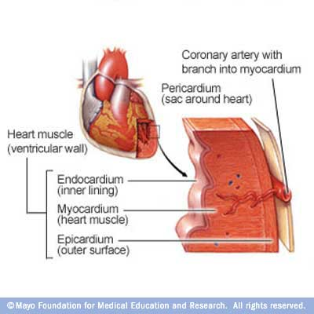
Myocarditis:
Introduction:
Myocarditis : is inflammatory disease of the heart muscle.
Mild & self-limited with few symptoms OR severe with progression to congestive heart failure & dilated cardiac muscle.
Very localized or diffuse
Myocarditis can be due to a variety of infectious and non infectious causes eg. Toxins, drugs & hypersensitivity immune response.
Viral infection is the most common cause
Inflamed heart
virus

Slide 4
Myocarditis:
Epidemiology \ Etiology \ Risk Factors
Epidemiology :
no accurate estimate of incidence as many cases are mild & brief and diagnosis is not made.
Etiology :
(in the next slide as a table)
Giant cell myocarditis due to Thymoma, SLE (systemic lupus erythromatosis ) or Thyrotoxicosis.
(*the patients don’t usually go to the hospital because : they either present with flu-like symptoms or they die suddenly 10%)

Slide 5
Infectious | Noninfectious
Viruses: | Systemic Diseases
Coxsackie virus B (an RNA) is the most common cause. HIV Other virus : Coxsackie virus A, Echoviruses, Adenoviruses ,Influenza, EBV, Rubella, Varicella, Mumps, Rabies, Hepatitis viruses | SLE Sarcoidosis Vasculities(Wegener’s disease) Celiac disease
Bacterial: | Neoplastic infiltration
1. Corynebacterium diphtheriae (cause diphtheria) (cause heart block) 2. Treponema pallidum (cause Syphilis داء الزهري) 3. Borrelia burgdorferi (cause Lyme disease) it’s Spirochete* 4. or as a complication of bacterial endocarditis
Parasite: | Drugs & Toxins
1. Trypanosoma cruzi (cause Chagas disease) 2. Trichinella spiralis 3. Taxoplasma gondii (from cats) 4. Echinococcus (prevalent in Africa) | Ethanol Cocaine Radiation Chemotherapeutic agents : Doxorubicin
Others organisms :
Rickettsiae*, Fungi, Chlamydia*, enteric pathogens (salmonella typhi), , Legionella* and Mycobacterium tuberculosis.
C. Diptheria: gram positive bacilli
T. Pallidum: spirochete
B. Burgdorferi: spirochete
* Gram negative non spore forming

Slide 6
Clinical Presentation of myocarditis
Myocarditis:
Highly variable :may occur days to weeks after onset of acute febrile (with fever) illness or with heart failure without any known antecedent symptoms .
Fever, headache, muscle aches, diarrhea, sore throat and rashes similar to most viral infections
Presenting symptoms: Chest pain, arrhythmias ,sweating , fatigue and may present with congestive heart failure.
Differential Diagnosis
(They have the same symptoms as myocarditis)
Acute Myocarditis
Vasculitis
Cardiomyopathy ( due to drugs or radiation)

Slide 7
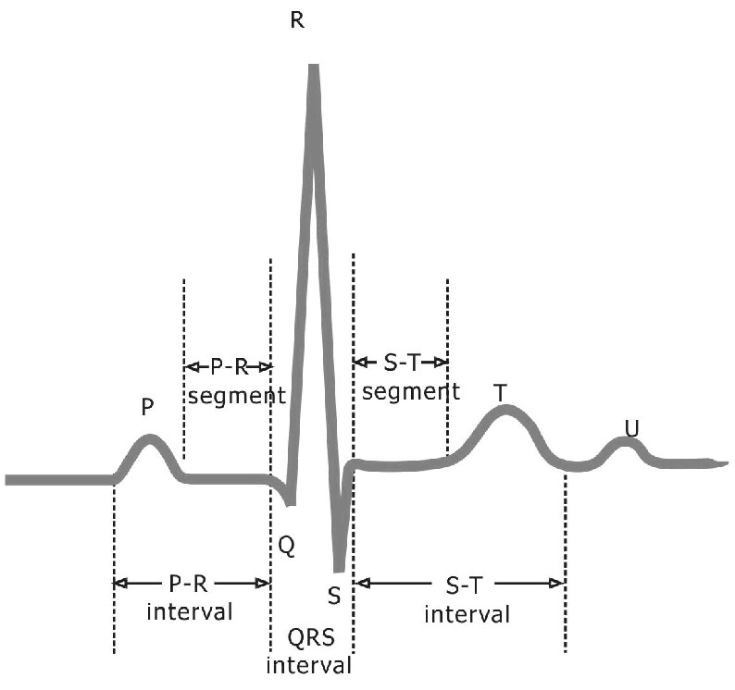
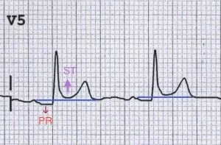
Diagnosis of myocarditis
Myocarditis:
Hematology :WBCs, ESR, CBC
biochemistry :Troponin and CK-MB* usually elevated ECG (nonspecific ST-T changes and conduction delays are common)
microbiology :Blood cultures / Viral serology (blood sample to look for antibodies IgM,IgG) and other specific test for Lyme disease, diphtheria and Chagas disease may be indicated on a case by case basis.
Radiology : Chest X-rays shows cardiomegaly (enlarged cardiac size) / ECG changes (but not specific like in pericarditis) / MRI and Echocardiogram
Heart muscle biopsy (the last step)
Normal:
Abnormal:
ECGs of normal heart & heart with myocarditis
*CK-MB : Creatine Kinase – Muscle and Brain. CK-MB is specific for heart (cardiac marker) // CBC and Serology commonly done to detect Virus

Slide 8
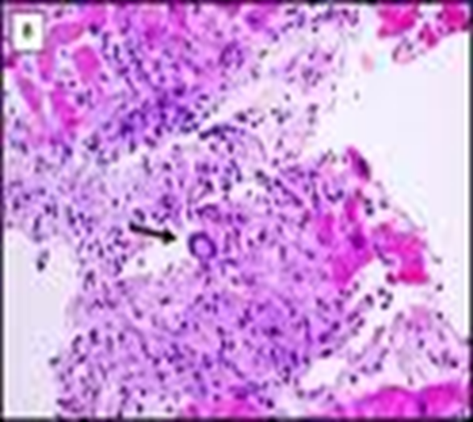
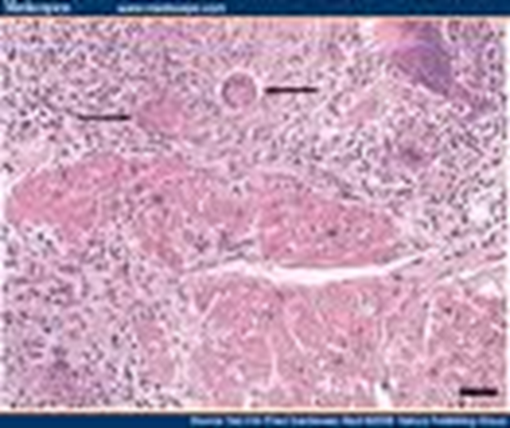
Endomyocardial Diagnosis
Myocarditis:
Pathologic examination is not sensitive because of the patchy areas of distribution. . It may reveal lymphocytic inflammatory response with necrosis.
“Giant cells” may be seen
“Dallas” criteria for histopathologic diagnose (only in males slides).

Slide 9
Management of myocarditis
Myocarditis:
Often supportive: restricted physical activity in heart failure.
Specific antimicrobial therapy is indicated when an infecting agent is identified.
Treatment of heart failure arrhythmia
Other drugs indicated in special situations like anticoagulant, NSAID (nonsteroidal antiinflammatory drugs) , steroid or immunosuppressive immunomodulatory agents.
Heart transplant (last option)
Most cases of viral myocarditis are self limited.
Isolate and bed-rest
One third of the patients are left with lifelong complications, ranging from mild conduction defects to severe heart failure.
Patient should be followed regularly every 1-3 months.
Sudden death may be the presentation of myocarditis in about 10% of cases.
Coxsackie virus B is usually self limiting there is no need for antiviral.
Notes:
Heart transplant in patient with intractable heart failure and cardiomyopathy.

Slide 10
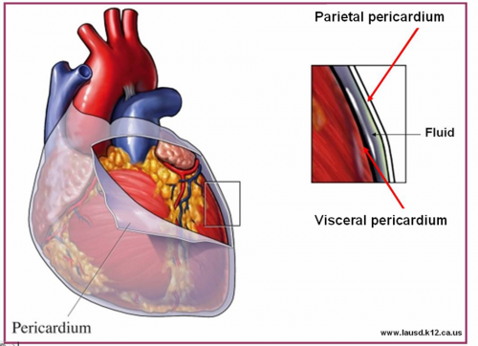
Pericarditis:
Pericarditis: is an inflammation of the pericardium usually of infectious etiology ( viruses, bacterial, fungal or parasitic)
Etiology :
Viral Pericarditis:
Coxsackie virus A and B, Echovirus are the most common causes.
Other viruses includes Herpes viruses, Hepatitis B , Mumps, Influenza, Adenovirus ,Varicella and HIV.
Bacterial Pericarditis:
usually a complication of pulmonary infections (e.g. pneumonia ,empyema):
organisms :S. pneumonia (gram positive cocci) , M. tuberculosis (the most common) , S. aureus (gram positive cocci), H. influenza (gram negative coccobacilli), K. pneumoniae (gram negative bacilli) & Legionella.
HIV patients may develop pericardial effusions caused by: M.tuberculosis or M. avium complex .
Disseminated fungal infection caused by: * usually affect immunosuppressed patients*
Histoplasma, Coccidioides.
Parasitic infections :
eg.disseminated toxoplasmosis*, contagious spread of Entamoeba histolytica - are rare causes.
*(طفيليات تنتقل عن طريق القطط)

Slide 11
Pathophysiology:
Pericarditis:
Contiguous (directly) spread:
lungs, pleura, mediastinal lymph nodes, myocardium, aorta, esophagus, liver.
Hematogenous (blood) spread:
septicemia, toxins, neoplasm, metabolic
Lymphangetic spread:
Traumatic or irradiation
spread
Inflammation provokes a fibrinous exudate with or without serous effusion
The normal transparent and glistening pericardium is turned into a dull, opaque, and “sandy” sac Can cause pericardial scarring with adhesions and fibrosis ( for that it will not move ).
*Within time of inflammation fibrosis occur , cause restriction during diastole = heart can't expand
* If there is pus in the pericardium effusion that means it’s a bacterial infection.

Slide 12
Types of Pericarditis:
Pericarditis:
Caseous Pericarditis: commonly tuberculous in origin.
Serous Pericarditis: due to autoimmune diseases (rheumatoid arthritis, SLE).
Fibrous Pericarditis: a chronic pericarditis usually suppurative, caseous, or encased in a thick layer of scar tissue.*it causes destruction of the heart *
Types of Effusive Fluid:
Serous:
Transudative - heart failure
Suppurative: )discharge pus(
Pyogenic infection with cellular debris and large number of leukocytes
Hemorrhagic:
Occurs with any type of pericarditis especially with infections and malignancies
Serosanguinous: (suppurative + serous)

Slide 13
Constrictive Pericarditis:
Pericarditis:
Clinical presentation of pericarditis:
Causes:
Idiopathic
Radiotherapy
Cardiac surgery
Connective tissue disorders
Dialysis
Bacterial infection
Acute pericarditis*:
Sudden pleuritic chest pain (stabbing pain) prominent ( positional retrosternal)
Dyspnea
Fever
Friction rub
On examination : Pericardial rub, exaggerated pulses , paradoxus JVP and tachycardia.
As the pericardial pressure increases, palpitations , presyncope or syncope may occur.
Chronic pericarditis:
Patient with Tuberculous pericarditis has insidious onset of symptoms .
*Very severe pleural pain which generate from the back and goes away if he sit down .

Slide 14
Tuberculous Pericarditis :(chronic)
Pericarditis:
Incidence of pericarditis in patients with pulmonary TB ranges from 1 – 8 %
Clinical findings: fever, pericardial friction rub, hepatomegaly
Tuberculin skin test usually positive
Fluid smear for acid fast bacilli (AFB ) often negative
Pericardial biopsy more definitive
Pericardial biopsy : to detect granuloma.
(If not caused by virus, it can be commonly TB (it can affect any organ including commonly pericarditis , after lung and extrapulmonary)
(In TB, Pericarditis fluid is -ve of the mycobacterium because it contains mycolic acid that have a waxy material that causes it to stick to the tissues )
Tuberculin skin test : to detect pre-exposure to TB but It can cross reactions if the patient had vaccine.

Slide 15
Acute Pericarditis:
Pericarditis:
Investigations & Diagnosis:
ECG (specific) will show ST elevation, PR depression and T-wave inversion may occur later.
Echocardiogram
Blood culture
Leukocytosis and an elevated ESR are typical
Other routine testing : urea and creatinine.
Tuberculin (PPD) skin test is usually positive in tuberculous pericarditis.
Chest x-ray may show enlarged cardiac shadow or calcified pericardium and CT scan show pericardial thickening >5mm.
Pericardial fluid or pericardial biopsy specimens for fungi.
Immunology /Serology : Antinuclear antibody tests and Histoplasmosis complement fixation indicated in endemic area.
Differential Diagnosis:
Aortic dissection
Acute myocardial infarction
Pulmonary embolism
Pneumonia
BUT the identified symptom of acute pericarditis is the pericardial rub.

Slide 16
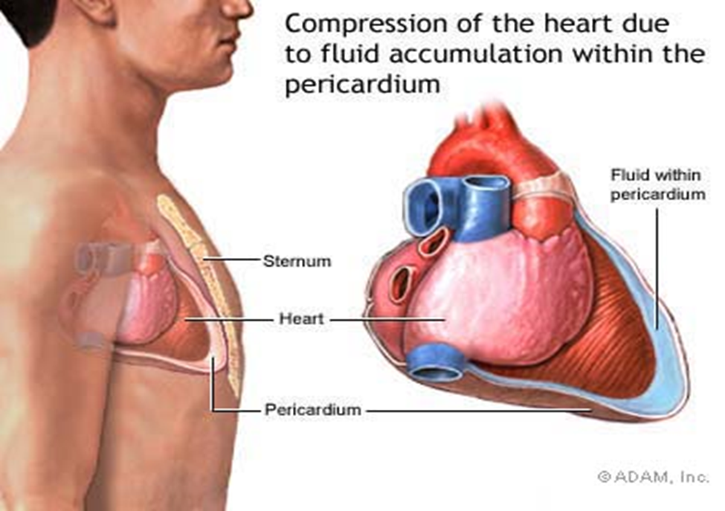
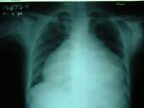
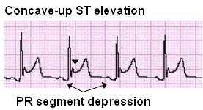
Management of pericarditis:
Pericarditis:
Management is largely supportive for cases of idiopathic and viral pericarditis including bed rest , NSAIDS and Colchicine.
Corticosteroid use is controversial and anticoagulants usually contraindicated.
Specific antibiotics must include activity against S. aureus and respiratory bacteria.
Antiviral: Acyclovir for Herpes simplex or Varicella . Ganciclovir for CMV .
Accumulation of Fluid will cause restricted movement of heart and dyspnea

Slide 17
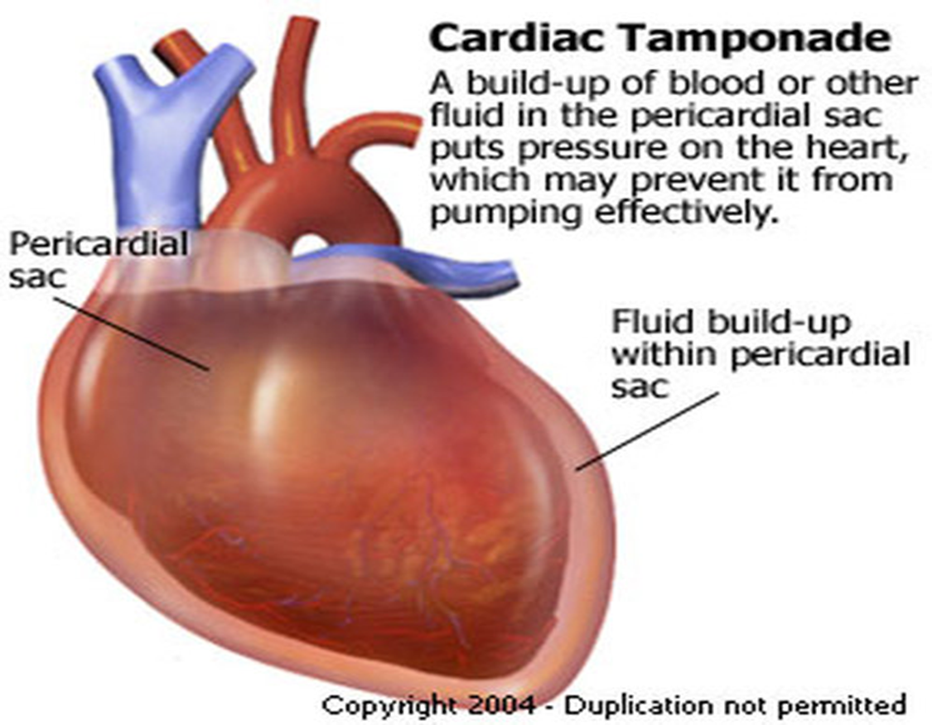
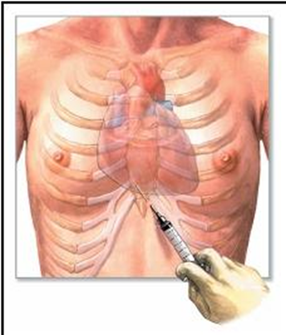
Management of pericarditis
Pericarditis:
Pericardiocentesis : a therapeutic procedure to remove fluid from the pericardium (to relief Tamponade).
Patients who recovered should be observed for recurrence.
Symptoms due to viral pericarditis usually subsided within one month.
Uremic, rheumatic, collagen in 30% of patients include pericardial effusion and tamponade, constrictive Pericarditis and pleural effusion.
Restrictive Pericarditis and heart failure.
Pericardiocentesis
*Management similar to Myocarditis But steroid more effective here

Slide 18
GOOD LUCK!
MICROBIOLOGY TEAM:
Waleed Aljamal (leader)
Ibraheem Aldeeri
Ibrahim Fetyani
Abdulaziz almohammed
Abdulmalik alghannam
Omar albabtain
Turki maddi
Mohammad alkahil
Meshal Eiaidi
Khalid Alhusainan
Khalid Alshehri
Nasir Aldosarie
Shrooq Alsomali (leader)
Jawaher abanumy
Ohoud Abdullah
jawaher Alkhayyal
Ghadah almazrou
Hayfaa Alshaalan
Razan Alotaibi
The Editing File
We are waiting for your feedback
@microbio436
436microbiologyteam@gmail.com

