Slide 1
Lecture :
Infective Endocarditis
important
Extra notes
Doctors notes
"لا حول ولا قوة إلا بالله العلي العظيم" وتقال هذه الجملة إذا دهم الإنسان أمر عظيم لا يستطيعه ، أو يصعب عليه القيام به .

Slide 2
Introduction:
Endocarditis, irrespective of the underlying cardiac condition,
is a serious, life-threatening disease that was always fatal in the preantibiotic era.
Advances in antimicrobial therapy
Early recognition and management of complications of IE
Improved surgical technology have reduced the morbidity
and mortality of IE.
Numerous comorbid factors, may complicate IE such as
older age + young age group (these two categories always at high risk)*
diabetes mellitus
immunosuppressive conditions or therapy
dialysis. غسيل الكلى
* The immune system in elderly become weak while in children not complete developed yet )

Slide 3
Definition:
Infectious Endocarditis (IE): it is a serious infection or colonization of the heart’s endocardial surface (endocardium) ,heart valves (that is associated with low grade bacteremia ) by (Congenital defects\bacteria\rickettsiae\fungi) , it damages the heart and other organs
Epidemiology:
Incidence: 1.7— 6.2 / 100 000 person years
M:F 1.7
mortality : 30 % - Damage of heart or other organs
Median age: Before antibiotics era 35y but
Now 58y
Becoming a disease of the elderly
Due to two factors:
The decline of rheumatic heart disease
The increasing proportion of elderly
Classified into four groups:
1-Native Valve IE (natural human valve) . 3-Prosthetic Valve IE (Artificial valve).
2-Intravenous drug abuse (IVDA) IE(affect the right side –tricuspid valves) 4-Nosocomial IE (Acquired from hospitals).
Further Classification:
 | Acute: Affects normal heart valves Highly ​ virulent organisms Rapidly destructive. Metastatic foci If not treated, usually fatal within 6 weeks Commonly Staphylococcus species
Subacute:
Often affects damaged heart valves(E.g. as a complication of Rheumatic Fever)
Weakly​ virulent organisms
Indolent (lazy) nature.
If not treated, usually fatal by one year
Commonly Streptococcus viridans (Most common cause of subacute endocarditis)
زمان كان الاندوكاردايتس منتشر اكثر بسبب انتشار الروماتك هارت دزيز لانه يسبب دستركشن او ذا فالف بعدين يجيهم اندوكاردايتس لما يكبروا
ممكن تختلف صياغة التعريف من محاضرة لمحاضرة لكن المعنى واحد

Slide 4
Risk factors: Host factors
General
Other risks: -Poor dental hygiene¹ -Hemodialysis² -Diabetes.M -HIV(**) | Injection drug use: -Increase risk in young to be effected by Staph.aureus
Structural cardiac abnormality*: -75% of pts will have a preexisting structural cardiac abnormality -10-20% have congenital heart disease | IV drug use : -Higher among patients with known valvular heart disease -IE usually effect the right side of heart in IV drug user because they inject into a vien draining in Rt atrium
Cardiac abnormalities or (local)
Low/no risk: -Atrial septal defect (ASD) -Coronary artery bypass grafting (CABG) | Moderate risk : -mitral valve prolapse or regurgitation -Mitral stenosis -Tricuspid valve problems -Pulmonary stenosis -Hypertrophic obstructive cardiomyopathy (HOCM)
High risk: -Previous IE -Aortic valve disease -Rheumatic valve disease (*) -Prosthetic valve -Coarctation -Complex cyanotic congenital
+ heart surgery
(*)Rheumatic valve disease:
-Predisposition for young in some countries 37%-76% of cases
-effects :Mitral 85%, Aortic 50%
-Degenerative valvular lesions
-MV (mitral valve) Prolapse and associated mitral regurgitation - 5 to 8 times higher IE risk
-Aortic valve disease (stenosis or/and regurgitation) is present in 12 to 30 % of cases
(**)HIV infection:
-A number of cases of IE have been reported in patients with HIV infection
-It has been suggested that HIV infection is a independent risk factor for IE in IDU
الأرقام والإحصائيات للفهم وليست للحفظ
There is a lot of abbreviations, try to be familiar ☺
ما راح يسألك عن درجة الخطورة
¹: معدات تنظيف الاسنان
²: أجهزة تستخدم لتنظيف الدم يستخدمونها للغسيل الكلوي

Slide 5
Risk factors: Host factors (cont.)
Risk factors : bacteria factors
Drugs
self- inflicted: -alcoholism -addiction (injected drugs ) | Iatrogenic : -Immunosuppressive treatment -cytotoxic agents
protective factors: -antimicrobial chemotherapy
1-virulence
2- number of bacteria in the blood
virulent bacteria`, staph. aureus and strept. Pneumoniae can infect normal heart
Predisposing*factors:
A- cardiac lesions | B. systemic factors
Chronic rheumatic valvular disease Congenital heart disease and defects Atherosclerosis Prosthetic valves : Immediate or Delayed | Immunosuppressive treatment Immune defects ( disease) Alcoholism Iv. Drug abuse
*Predisposing: means “make susceptible”

Slide 6
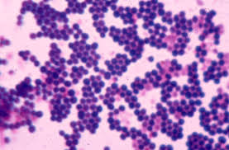
CAUSATIVE ORGANISMS:
Streptococcus ( gram +ve in chains) | Staphylococcus (gram +ve in clusters)
Viridans streptococci is the Most common cause of sub- acute bacterial endocarditis (SBE) | Staphylococcus aureus (pyogen) Cause Acute endocarditis
Produce glucagons* → adhere to endocardium E.g : Streptococcus mutans Streptococcus sanguis | Staphylococcus epidermidis Cause Prosthetic heart valves
Others: Streptococcus faecalis Streptococcus faecium Streptococcus pneumoniae
streptococcus
Others:
Brucella species / Actinobacillus actinomycetes comitans/Rickettisae/Fungi/Coxiella burneti /Candida albicans
staphylococcus
*Produce polysaccharide layer which help the organism to stick to the valves

Slide 7
Sources of infection:
Doctor’s note:
the cause of endocarditis is disturbance of the blood flow in the heart which will lead to damage of endothelium.
مثل الفلو حق الموية ممكن ينخر الحجر نفس الشي مع الدم ..اول شي بيصير دستركشن اوف ذا تيشو بعدين الاورنقزم سهل انه يدخل الدم زي لما الواحد يفرش اسنانه راح يصير له تلوث في الدم (بكتيريما) لاكن ما يصير له اندوكردايتس لان قلبه طبيعي
How the organism get there: The Bacteremia- infection of the lung -direct from pericarditis
Dental extraction* and other dental procedures:
(Rheumatic heart disease /Congenital heart disease)
Cardiac surgery ( prosthetic valves)
Intravenous medication
Iv. Drug addiction
Intracardiac or intravenous catheters
Obstetric or gynaecologic procedures
Portal of entry:
Dental extraction bleeding bacteraemia:
Rocking the tooth in the socket pumping effect on the vessels of periodontal ligament , forces bacteria from gingival pockets into blood stream 40 – 80 % bacteraemia
Sensitivity of blood culture techniques
Severity of gingival infection
Oral irrigation device.
*Or could be from simple tooth brushing(bleeding during brushing)

Slide 8
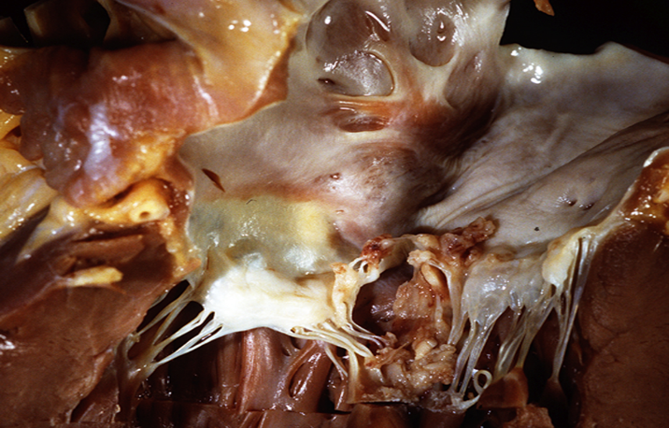
Pathophysiology:
1.Turbulent blood flow disrupts the endocardium making it “sticky”. 2. Bacteremia delivers the organisms to the endocardial surface. 3. Adherence of the organisms to the endocardial surface. 4. Eventual invasion of the valvular leaflets.
Distorted shape causes stasis of blood flow and settee of bacteria on the endocardium
PATHOGENESIS: after 1- settee of bacteria on the endocardium
2- Formation of vegetations :
Fibrin , platelets (thrombi) , bacteria colonies Attached to heart valves
Break off → infected emboli → distant organs ( kidney , brain )
Immune complex formation causes glomerular damage → haematuria
Valves infection → destruction → heart failure .
Drug addicts → tricuspid,pulmonary valves of right side of heart → lung emboli → pneumonia
*IE often occurs when there is an underlying cardiac abnormality that creates a high-low pressure gradient.
*The resultant turbulent blood flow disrupts the endocardial surface by peeling away the endothelium.

Slide 9
Sypmtoms
Acute
High grade fever and chills
Shortness of breath (SOB)
Arthralgias¹/myalgias²
Abdominal pain
Pleuritic chest pain
Back pain
Acute
Low grade fever
Anorexia³
Arthralgias/ myalgias
Wight loss and fatigue
Abdominal pain
Nausea and vomiting (n/v)
-The onset of symptoms is usually ~2 weeks or less from the initiating bacteremia ⁴
Diagnostic approach:
The things make you include Infective endocarditis as the diagnosis
1- History of prior cardiac lesions
2- A recent source of bacteremia
native valve >acute >most common staph aureus (bad Symptoms)
Prosthetic Valve > Subacute > most common viridans (Flu like Symptoms )
rheumatic heart disease> most common viridans
¹: Arthralgias (joint pain) ²:myalgias (muscle pain)
³: loss of appetite for food
⁴:the presence of bacteria in the blood.

Slide 10
Case Definition of Infective Endocarditis:
Also Duke criteria
In 1994 investigators from Duke University modified the previous criteria to include
The role of echocardiography in diagnosis
They expanded the category of predisposing heart conditions to include intravenous drug use
Modified Duke criteria:
Proposed: 2000, Addresses TEE, Broad “possible catergorie.
S.aureus risks (13-25% S.aureus bacetremia have IE )
Definite IE
Microorganism (via culture or histology) in a valvular vegetation, embolized vegetation, or intracardiac abscess
Histologic evidence of vegetation or intracardiac abscess
Possible IE
2 major
1 major and 3 minor
5 minor
Rejected IE
Resolution of illness with four days or less of antibiotics
*It is important to know that duke criteria in general is important in the diagnosis in endocarditis
Duke criteria are a collection of major and minor criteria used to establish a diagnosis of infective endocarditis

Slide 11
Major criteria | Minor criteria
1-microbiology Typical organism from 2 separate cultures OR Microorganism from persistently positive Blood culture OR Single Blood culture + for Coxiella burnetii, or titer >1:800 | 1-Predisposition (heart condition or IV drug use)
 | 2-Fever 38oC or more
2-endocardial involvememt New (not changed) murmur of regurgitation | 3-Vascular phenomenon (excludes petechia, splinter hemorrhage)
 | 4-major arterial emboli Mycotic aneurysm, intracranial or conjunctival hemorrhages. Janeway lesions
3-positive echo (TEE if prosthetic valve, complicated, or pretest probability possible IE | 5- Immunologic phenomena RF,.Roth’s spots glomerulonephritis, Osler’s nodes
 | 6-Microbiologic evidence Not meeting major criteria single BC not CNS serology
Major :Cardiac change > murmur of regurgitation / Microbiology tests

Slide 12
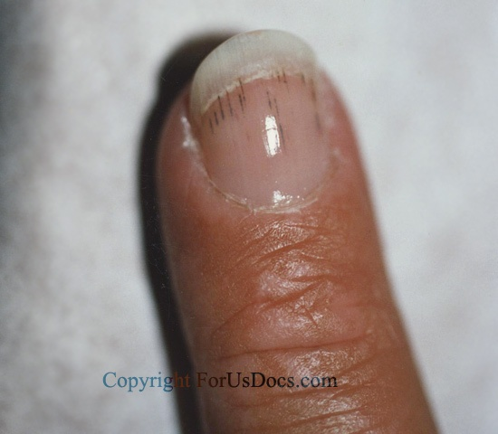
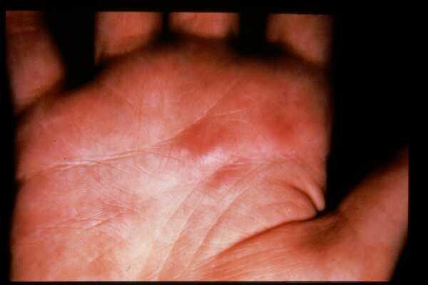
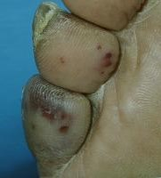
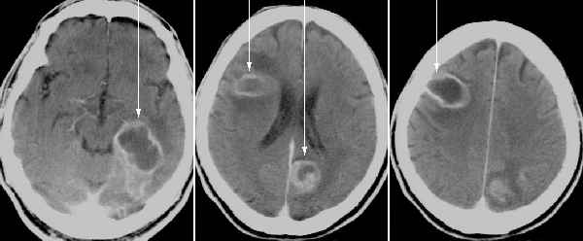
CLINICAL FEATURES:
Petechiae: 1.Nonspecific 2.Often located on extremities or mucous membranes | Splinter haemorrhage 1.Nonspecific 2.Nonblanching 3.Linear reddish-brown lesions found under the nail bed 4.Usually do NOT extend the entire length of the nail Subungal hemorrhages that extend the entire length of the nail or are primarily located at the proximal end of the nail (near the cuticle) are like due to trauma.
Osler's Nodes Important symptom in the diagnois 1.More specific 2.Painful and erythematous nodules 3.Located on pulp of fingers and toes 4.More common in subacute IE | Janeway lesions 1.More specific 2.Eryhtematous, blanching macules 3.Nonpainful 4.Located on palms and soles
Embolic manifestations | CNS manifestations of endocarditis
Onset is insidious ( SBE) – 3 weeks after extraction
Fever ( mild and prolonged )
Malaise , weight loss , weakness and Changing murmurs
Anaemia , leucocytosis and Hypergammaglobulinaemia
Microscopic haematuria and Spleenomegaly
Hemotourea → because there is immune response → antigen-antibody complex which will accumulate in the glamour and cause glamournephritis

Slide 13
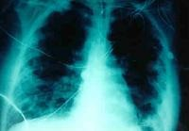
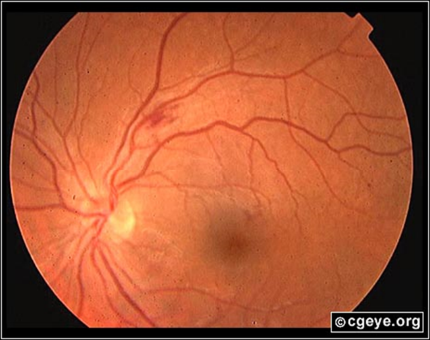
Complications:
Four etiologies:
Embolic
Local spread of infection
Metastatic spread of infection
Formation of immune complexes – glomerulonephritis and arthritis
Septic Pulmonary Emboli
Septic Retinal embolus
Embolic complications
Occur in up to 40% of patients with IE
Predictors of embolization
Size of vegetation
Left-sided vegetations
Fungal pathogens, S. aureus, and Strep. Bovis
Incidence decreases significantly after initiation of effective antibiotics
Stroke
Myocardial Infarction
Fragments of valvular vegetation or vegetation-induced stenosis of coronary ostia
Ischemic limbs
Hypoxia from pulmonary emboli
Abdominal pain (splenic or renal infarction)
*Systemic emboli are among the most common complications of IE, occurring in up to 40% of patients. Subclinical emboli are often found on autopsy.

Slide 14
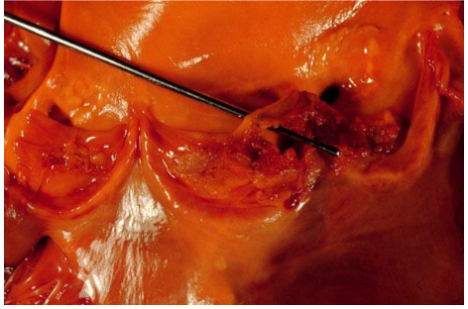
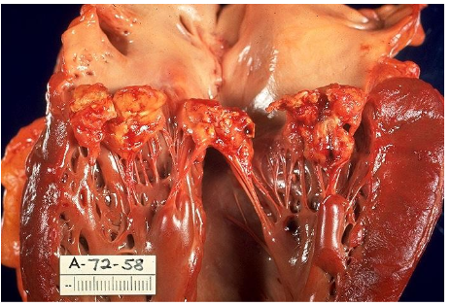
Local Spread:
Heart failure: Extensive valvular damage.
Paravalvular abscess (30-40%):
- Most common in aortic valve, IVDU, and S. aureus
- May extend into adjacent conduction tissue causing arrhythmias
- Higher rates of embolization and mortality
Pericarditis
Fistulous intracardiac connections
Acute S. Aureus IE with perforation of the
aortic valve and aortic valve vegetations* .
Metastatic Spread of Infection
Metastatic abscess:
-Kidneys, spleen, brain, soft tissues
Meningitis and/or encephalitis
Vertebral osteomyelitis
Septic arthritis
Acute S. Aureus IE with mitral valve ring
abscess extending into myocardium.
*Abnormal growth made of fibrin, fused platelets, and some microorganisms, all adherent (ملتصقة) to a valve.

Slide 15
Culture Negative IE:
د.الصميلي يقول غالبا ما راح يسال عنها او الاورقانيزم المسبب.
How hard did you look?
(50% culture neg are due to previous antibiotics)
HACEK: 2-3 wk incubation, subculturing
Tend to see subacute w/ valve destruction/CHF
If you culture for 3 days and nothing appears, and they were sure it is IE, it is culture negative IE
HACEK is :
Hemophilus paraphrophilus, aphrophilus.
Parainfluenzae
Aggregatibacter(Actinobacillus) actinomycetemcomitans
Cardiobacterium hominis
Eikenella corrodens
Kingella spp.
Lab Diagnosis! Etiologies“Culture Negative” IE Based on clinical setting :
اذا جاء للاب المايكرو صمام كان فيه اندوكاردايتيس و يبون يعرفون المسبب و لا طلع في الكلتشر العادي لازم نسوي كلتشر 10 ايام للدم مو 5 ايام, و نسوي كلتشر في سبيشال ميديا و نطلب سيرولوجي.
PCR of vegetation/emboli: Tropheryma whippelei, bartonella
Histology/stain /culture of vegetation/emboli: Fungus
Prolonged, enriched cultures: HACEK
Lysis centrifugation system (Isolator): Bartonella, legionella (BCYE),fungal
Serology: Endemic fungi, bartonella, Q fever, brucella, legionella, chiamydia
Thioglycolate or cysteine supplemented media: S.aureus satellitism: Abiotrophia (NVS)
*Some times the organism is culture negative In the culture for endocarditis it has to be kept for 14 days

Slide 16
Laboratory Diagnosis:
1-serial blood culture:
( 2-3 sets before antibiotic therapy )
Aerobic
Anaerobic
2-serological tests:
CFT ( coxiella burniti )
3-sensitivity test.
5-Imging :
Chest x-ray:
Look for multiple focal infiltrates and calcification of heart valves
ECG:
Rarely diagnostic
Look for evidence of ischemia, conduction delay, and arrhythmias
Echocardiography:
looking for vegetation
4-Additional tests :
CBC, ESR and CRP, Complement levels (C3, C4, CH50)
RF
Urinalysis

Slide 17
Additional laboratory tests:
abnormal urinalysis
the combination of RBC casts on urinalysis and a low serum complement level may be an indicator of immune-mediated glomerular disease.
ECG
New AV, fascicular, or bundle branch block ,PERIVALVULAR INVAVSION ­monitoring.
Classification of Endocarditis Depending upon where the infection is located:
1- Native Valve IE:
-Strep. (55%), mostly S.viridans
-Staph. (30%), mostly S.aureus
-Enterococci (5-10%),
-HACEK (5%),
-Fungi
2- Prosthetic Valve IE:
-Early (1-2 months) (1 - 3.1%)
50% Staphylococci S.epidermidis > S.aureus, gnb, enterococci
-Late (more than 12 months) 2 - 5.7%
3- IE in IV drug abusers:
-Staph. Aureus (50-60%)

Slide 18
Endocarditiis causes: continuous Bacteraemia
There are three clinical patterns of bacteremia:
Transient:
lasts minutes to hours:
1-following manipulation of infected tissues(abscess,furuncle,or during a surgical procedure)
2-instrumentation of contaminated mucosal surfaces (dental procedures,cytoscopy,or sigmoidoscopy)
3-at the onset of bacterial pneumonia,arthritis,osteomylitis,and meningitis.
Intermittent:
commonly occurs with undrained abscesses.
Contineous:
reflects an endovascular infection such as endocarditis or endarteritis,suppurative thrombophlebitis,or an infected aneurysm.
It also occurs in the first two weeks of typhoid fever and brucellosis.

Slide 19
Technique for collection of blood for culture:
Blood for culture contaminated by normal skin flora e.g.
Staphylococcus epidermidis
Diphtheriods and
Propioniobacteria(anaerobic diphtheroides)
So first we have to clean the site (mainly anticubital fossa)with alcohol 70%and leave for (1-1.5 minutes) or cholorhexidine or iodine
Blood culture by automated machines e.g. Bactec or Bactalert-upto 5 days when signal positive, the specimen is gram stained
reported to clinician then cultured identified and tested for antimicrobial susceptibility
NOTE: *from females slides*
Bacteraemia may follow scaling , tooth brushing, endodontic therapy .
Lack of clinical effect of many bacteraemia is due to small number or low virulence
They are rapidly cleared by normal body defence ( leucocytes )
Strept. Faecalis may cause endocarditis after genitourinary or gut procedures
Staph (arues / epidermis) → drug abusers

Slide 20
TREATMENT:
MORTALITY:
With antibiotic treatment 30%
High mortality
Virulance of organism or sever infection
Presence of underlying disease
Elderly
Inadequate treatment
poor prognosis
Candidal
Staphylococcus
Gram-negative
Disk diffusion test ( not sufficient )
MIC , MBC.
Criteria of antibiotic:
Bactericidal
Parenteral
High dose
Prolonged
*we use bactericidal drugs only
Viridans streptococci:
Benzyl penicillin I.V (4 MU الدوز) every 4 hrs for 4 weeks*
(OR) penicillin + gentamicin
Streptococcus faecalis
ampicillin + gentamicin I.V
Recurrence after cure is common in:
(drug addicts / immunodeficient patients)
Doctor’s notes
1- Duration must be sufficient 2- We have to do MBC test ( minimum bacteriocidal Concentration) to determine the lowest concentration of antibacterial agent "antibiotic" required to kill this pathogen. 3- Also we need to do MIC test ( minimum inhibitory concentration ) to determine the lowest concentration of chemicals needed to stop the growth of pathogen. (bacteriostatic) 4- We need prolonged + combination therapy to treat endocarditis

Slide 21
Notes: doctor’s notes
important
S. viridans | Penicillin G + gentamycin
MSSA / MRSA (most common) | Cloxacillin + vancomycin (we can use gentamycin or rifampicin instead of vancomycin لكن باختلاف فترة العلاج)
Q fever (coxiella burant) | Doxycylin (from tetracyclin family)
HACEK | Cephalosporin 3rd generation
Burotonella | Aminoglycoside + flouroquinolones
خذ في عين الاعتبار أن فترة العلاج الزمنية تختلف باختلاف الفالف.
Native valve or prosthetic valve (needs more time or even surgery)
Prophylaxisis :
In case he has prosthatic valve or abnormal valve he is more susciptable to be infected .
We give prophylaxis for certain people
يعني مانعطي أي شخص لازم أشخاص معينين بحالات معينة ونعطيهم قبل العملية (غالبا) بساعة – نص ساعة
Mainly gram +ve bacteria → clindamycin , amoxicillin , cephalexine (oraly) , ampicillin (IM)
We give prophylaxis for :
1- previous history with cardiac disease (previous endocarditis)
2- dental extraction
3- bronchoscopy and others..

Slide 22
Notes: doctor’s notes
important
- Infective endocarditis has 2 types Native , prosthetic:
1-native Acute: staph aureus (most common) , sub acute: streptococci viridians
2-Prothetic : staph epidermis
- General Risk factors: old age , HIV , Cardiac (valvular Heart diseases) , bad dental hygiene , DM, IV drug uses , congenital heard disease.
- Moderate Risk factors: stenosis , prolapse.
- High Risk factors : Rheumatic valve , prosthetic valve
- There has to be bacteremia in order for endocarditis to occur , YOU MUST do a minimum of 3 blood cultures
- Physical examination signs Fever , Murmur , Positive Blood cultures , thrombus
-Left valves are more serious
Treatment :
1- streptococci viridians; Penicillin , gentamycin
2-Staph Areus : Colaxcillin , Vancomycin
Prophylaxis is used usually for Dental , Rigid Bronchoscopy , Esophageal procedures , GI mucosal procedures , Cystoscopy , Prostate surgery. Antibiotics used for prophylaxis Clindamycin, Cephalexin , clarithromycin.
متى نحتاج نسوي سيرجيري عشان نأخذ عينة من الفالف؟
1) Heart Failure 2) not Responding to medical treatment
3) Recurrent systemic emboli (we have stop it by the surgrey )
also in case some pathogen ------> pseudomonas , fungi ,coxiella and Entrococci
هنلك بعض السلايدات ما ضفناها لعدم شرح الصميلي لها

Slide 23
SAQ:
A 68 year old Patient is presented to you with a Rheumatic valve disease , on examination you find Degenerative valvular lesions , with high grade fever , abdominal pain , Back pain , pleuritic chest pain , arthralgia and heart murmurs , he tells you that symptoms began 2 weeks ago and they were progressing ever since.
1-Based on the information what is the causative bacteria?
ANS: Staph Aureus
2- How would you confirm your diagnosis?
ANS: by obtaining at least 3 Blood cultures , ECG , (elevated ESR or CRP usually present and maybe high WBC)
3- What is the treatment needed?
ANS: cloxcillin , vancomycin
4-if a patient has a prosthetic valve what is the most likely causative bacteria?
ANS: Staph epidermis
5-Name other organisms that could cause Endocarditis:
ANS: streptococci viridians , staph epidermis , HACEK (Haemophilus , Actinobacillus , cardiobacterium , Eikenella ,kingella)

Slide 24
GOOD LUCK!
MICROBIOLOGY TEAM:
Waleed Aljamal (leader)
Ibraheem Aldeeri
Ibrahim Fetyani
Abdulaziz almohammed
Abdulmalik alghannam
Omar albabtain
Turki maddi
Mohammad alkahil
Meshal Eiaidi
Khalid Alhusainan
Khalid Alshehri
Nasir Aldosarie
Shrooq Alsomali (leader)
Shatha Alghaihab
Ruba Barnawi
Reem Alshathri
Lama Altamimi
Aseel Nasser
Lama Al musallam
Reema Albarrak
The Editing File
We are waiting for your feedback
@microbio436
436microbiologyteam@gmail.com

