Slide 1
Sympatholytic & adrenergic blockers α-receptor Antagonists
OBJECTIVES:
Describe the different classifications for drugs that can block sympathetic nervous system.
Describe the kinetics, dynamics, uses and side effects of alpha adrenergic drugs.
Identify Difference between selective and non selective alpha blockers.
Know the difference between tamsulosin and other selective alpha receptor blockers.
Identify the different classifications for beta receptors blockers.
Describe the kinetics, dynamics, uses and side effects of beta adrenergic drugs.
Know the preferable drug for diseases as hypertension, glaucoma, arrythmia, myocardial infarction, anxiety, migraine and ect....

Slide 2
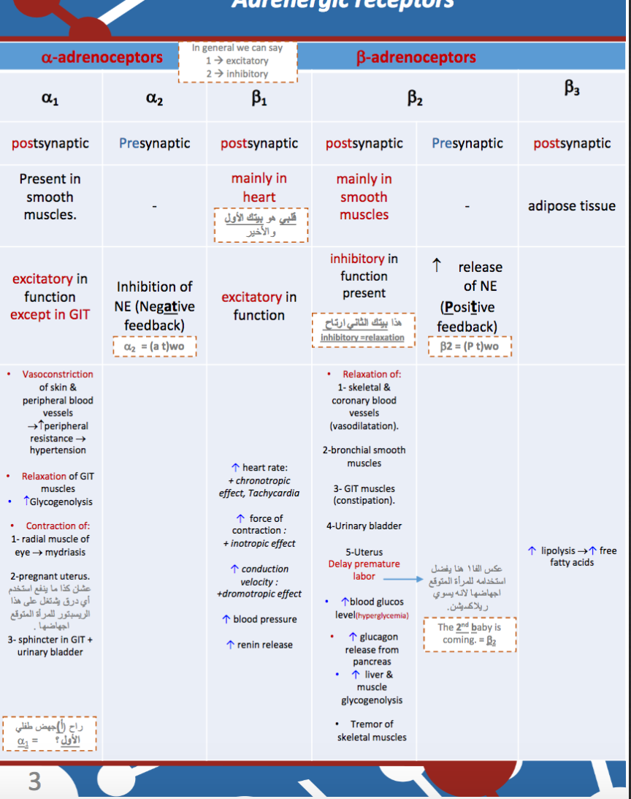
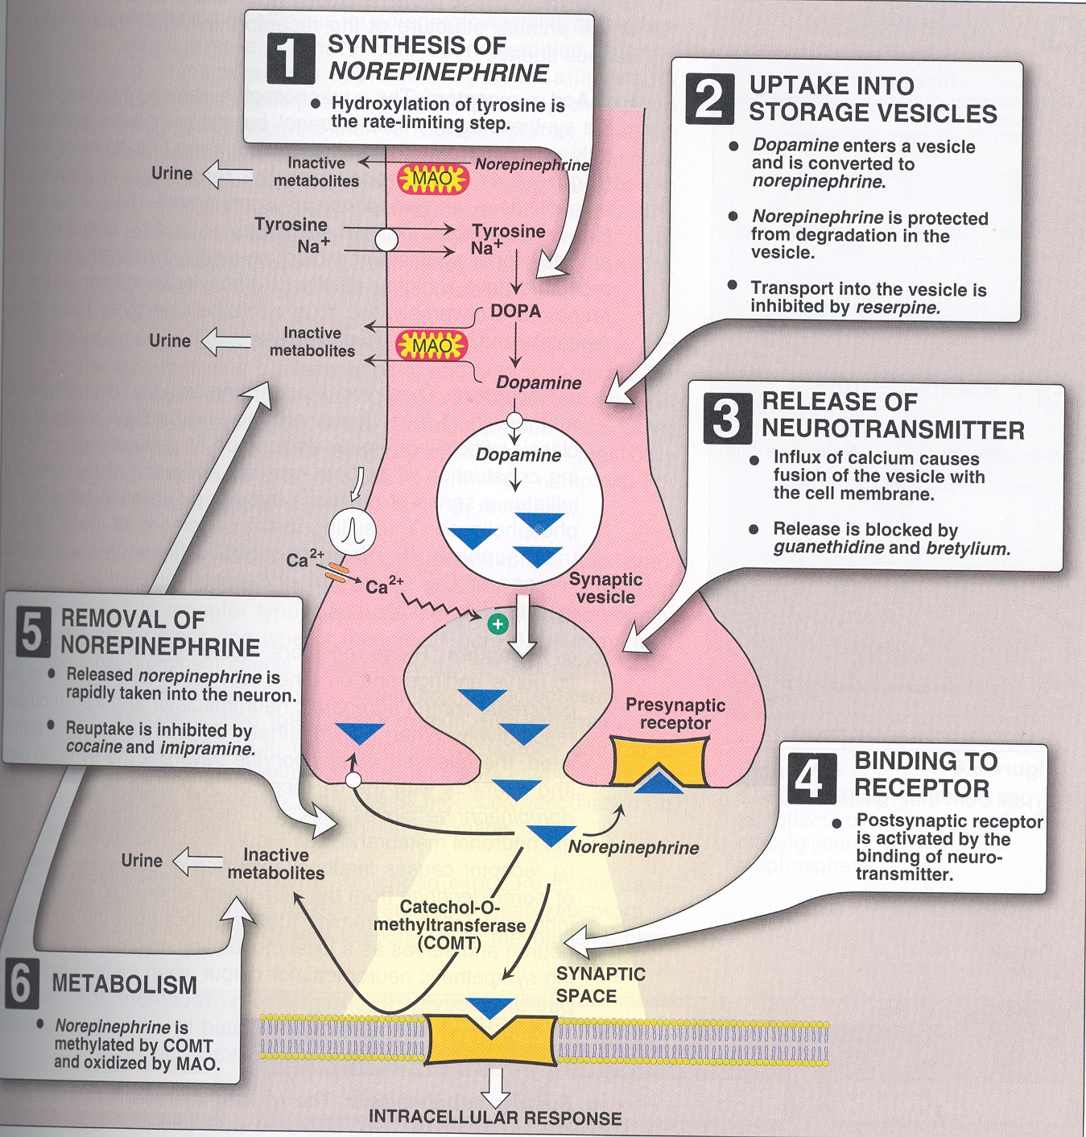
Remember these from the respiratory block? Yes just go through them for a better understanding of the first two lectures.

Slide 3
Adrenergic drugs
Adrenergic stimulants
((sympathomimetic
Adrenergic Depressants
Adrenoceptor Blockers
Adrenergic Neuron Blockers
α-adrenergic receptor blockers
β-adrenergic receptor blockers
α&β adrenergic receptor blockers
Sympatholytic
Adrenergic neuron blockers
Formation of false transmitters
e.g: α-Methyl Dopa
Depletion of storage sites
e.g. reserpine
Adrenergic receptor blockers
Inhibition of release and enhance uptake
e.g. guanethiidine
Stimulation of presynaptic α2 receptors
e.g. clonidine
α-methyl dopa
It gives alpha methyl norepinephrine (false neurotransmitter) > no action
Complete removal of NE (no NE stored) the vesicles are empty (no NE release after stimulation)
Inhibit the release & prevent reuptake
-Block neurotransmitter release
-Acts pre-synaptically
Inhibit sympathetic system (inhibit the release if NE)
Lytic=inhibition
-Block receptor itself

Slide 4
Adrenergic neuron blockers
Apraclonidine | Cloindine | α-methyl dopa
Used locally as eye drops . Acts by decreasing aqueous humor formation | Acts centrally as α2 receptor agonist to inhibit NE release. Supresses sympathetic outflow activity from the brain . | Forms false transmitter that is released instead of norepinephrine Acts centrally as α2 receptor agonist to inhibit NE release Stimulation of the pre-synaptic α2 receptor | Mechanism Of Action
Treatment of open angle glaucoma | Management of withdrawal symptoms of: Opiate treatment. (morphine) Alcohol withdrawal. Benzodiazepines . (Sleeping pills) Necotine dependence. (Smoking) | Drug of choice in treatment of hypertension in pregnancy. With no teratogenic action (pre-eclampsia / gestational hypertension ). | Uses
 | Little used as antihypertension agent due to rebound hypertention upon abrupt withdrawal. Hypertension comes back and even more severe. |  | More information
ممكن نربط اسم الدرق بمعجزة من معجزات عيسى عليه السلام اللي هي إبراء الأكمه، والأكمه من ولدوا وهم عمي
ممكن نقرأ اسم الدرق “ مثل دوبا ” والدوبامين موجود بجسمنا طبيعي عشان كذا ما نخاف على الحامل منه
الممثل الأمريكي جورج كلوني يخطط يعتزل (ينسحب من) التمثيل لأنه صار مدمن
→ Apraإبراء
→ Glaucoma may lead to blindness الأكمه

Slide 5
Adrenergic receptor blockers
Adrenergic receptor blockers or adrenolytics. They block sympathetic actions by antagonizing α or B-receptors.
Types:
α-receptor antagonists.
β -receptor antagonists in details in the next lecture.
Classification of α-receptor Antagonists:
Non-selective antagonists. both α₁ and α₂ not α and β
e.g. phenoxybenzamine & phentolamine.
α₁-selective antagonists. post-synaptically
e.g. prazosin, doxazosin, tamsulosin, terazosin.
α₂- Selective antagonists. pre-synaptically
e.g. yohimbine
ما يدرون فين ( phen) يشتغلون بالضبط !

Slide 6
Non-Selective α- Adrenoceptor Antagonists
 | Phentolamine | Phenoxybenzamine
Mechanism Of Action | Reversible blocking of α1 & α2 receptors. | Irreversible block of both α₁ & α₂ receptors Forms stable bond with receptor that’s why its irreversible and has a long duration of action.
Duration of Action | Short acting (4 hrs). | Long-acting (24 hrs). *To remember long name>long duration
Pharmacological Actions | Vasodilatation of blood vessels (α₁ block). Decrease peripheral vascular resistance Postural hypotension. Increase cardiac output (α₂ block). Reflex tachycardia. Increase in GIT motility and secretions Reflex tachycardia occurs by two mechanisms: Stimulation of *baroreceptor reflex that increase NE release. In heart only α2 blockade in heart that abolishes (removes) pre-synaptic negative feedback for NE release. NE will increase baroreceptor is sensitive to changes in the pressure *blood pressure*, so it’ll send signals to CNS to either stimulate or inhibit the Sympathetic NS according to the changes….so in case of hypotension which is decrease in pressure it’ll stimulate Sympathetic to increase cardiac output as a result. only in the heart!
ممكن نقرأ الدرق الفينتو لمين ؟
فينتو=فيمتو ، والفيمتو اذا توسخت فيه الملابس ممكن يروح Reversible اسرع Short acting من البنزين او الدهن.
”مجرد للربط"
بينما البنزين اذا توسخت فيه الملابس ممكن ما يروح Irreversible ويأخذ وقت Long-acting عشان ينظف ”مجرد للربط"

Slide 7
Therapeutic Uses:
Pheochromocytoma (benign tumor in adrenal medulla): Before surgical removal to protect against hypertensive crisis.
For preparation before surgery we give these drugs and sometimes beta-blockers because of high release of E and NE during the surgery that may lead to hypertensive crisis (disaster).
Adverse Effects
-Postural hypotension and syncope.
-Tachycardia.
-Headache. Due to vasodilation
-Nasal stuffiness or congestion, Due to vasodilatation
-Vertigo & drowsiness.
-Male sexual dysfunction (inhibits ejaculation). because of increased blood flow
Contraindications
precipitate (worsen):
-arrhythmias
-Angina oxygen supply is low and with increased cardiac output it’ll make it worse.
contra-indicated in: patients with decreased coronary perfusion.
Non-Selective α- Adrenoceptor Antagonists

Slide 8
Selective α₁- adrenoceptor Antagonists
Drugs as: Prazosin, doxazosin, terazosin.
Duration of Action
Prazosin has short half-life.
Doxazosin, terazosin have long half lives.
pharmacological Actions:
Vasodilatation due to relaxation of arterial and venous smooth muscles.
Fall in arterial pressure with less tachycardia than with non-selective α- blockers. because α2 isn’t blocked here
Therapeutic Uses:
Treatment of hypertension
Urinary retention associated with benign prostatic hyperplasia. relaxation of urinary bladder’s smooth muscles and stopping retention.
Reynaud's disease causes some areas of your body such as your fingers and toes to feel numb and cold in response to cold temperatures or stress).
اطلع برا بسرعة او نقرا اسم الدرق كذا Pra as soon as you can
ترى(Tera) الكلاب (Dox=dogs) اللي بالشارع آذوا(Azo) ولدي(my son=sin) ، لهم فترة طويلة long acting
TERA the DOX AZO my SIN for a LONG time
Azosin = Azo my son
His name is Reyn aud بالكويتي اسمه ريان العود

Slide 9
Selective α_{1A}–antagonist Tamsulosin
α₁ has two subtypes either α_{1A} which is located mainly in prostate and bladder neck and α_{1B} which is located in the blood vessels. So if we say α₁ we mean both of them like the previous slide but here we mean only α_{1A}
A selective α_{1A}–antagonist.
α_{1A} receptors present in prostate and bladder neck.
Tamsulosin pharmacological Actions:
relaxation of smooth muscles of bladder neck & prostate →improve urine flow.
Has minimal effect on blood pressure.
Tamsulosin
Tam is a male who has (BPH) ,finally he find a Solution for that.
USES:
Treatment of benign prostatic hypertrophy (BPH).
Help with the passage of kidney stones. size of stones should be less than 4 mm.
Adverse effects of α1- Antagonists
as before with non selective but to a lesser degree.
BPH

Slide 10
α₂-selective antagonists
e.g. yohimbine
Used as aphrodisiac in the treatment of erectile dysfunction.
Increase nitric oxide (vasodilator) released in the corpus cavernosum (tissue of penis) thus producing vasodilator action and contributing to the erectile process. because of increased blood flow

Slide 11
Editing file

