Slide 1
Drugs for Hyperlipidemia

Slide 2
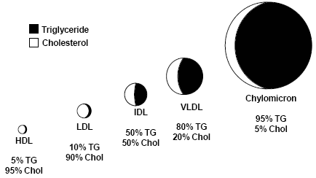
Hyperlipidemia: it is an abnormal increase in blood lipids and/or Lipoproteins that includes:
Cholesterol (C).
Triglycerides (TG).
Phospholipids (PL).
Cholesterol esters (CE).
Non-esterified fatty acids (NEFA).
Hyperlipidemia is a major cause of atherosclerosis which may lead to coronary artery diseases and ischemic cerebrovascular diseases.
Lipids originate from two sources:
Endogenous lipids: synthesized in the liver.
Exogenous lipids: ingested and processed in the intestine.
Lipoproteins are classified into five major families which differ in the amount of cholesterol, triglycerides and types of Apo-proteins they contain:
Chylomicrons (CM).
Very low density lipoprotein (VLDL).
Intermediate - density lipoproteins (IDL)
Low density lipoprotein (LDL).
High density lipoprotein (HDL).
Lipoprotein:
Endogenous molecules that contain both proteins and lipids in their structures.
They transport lipid around the body in the blood.
Atherogenic particles:
Low density lipoprotein (LDL).
Very low density lipoprotein (VLDL).
Intermediate - density lipoproteins (IDL)
Chylomicrons (CM).
While the high density lipoprotein considered as a good cholesterol carrier.

Slide 3
Normal lipid levels: (Lipids levels are detected in serum after a 12-hour fast)
Cholesterol (C) < 200 mg/dl.
Triglycerides (TG) < 220 mg/dl.
Low density lipoprotein (LDL) < 130 mg/dl (bad cholesterol).
High density lipoprotein (HDL) > 50 mg/dl (good cholesterol).
Type of hyperlipoproteinemia | Increased lipoprotein | Increased lipids | Risk
Type I | CM | TGs | -
Type IIa | LDL | C | 
Type IIb | VLDL & LDL | TG & C | 
Type III | IDL | TGs & C | 
Type IV | VLDL | TGs | 
Type V | VLDL & CM | TGs & C | _
Factors promoting elevated blood lipids:
Family history of coronary artery diseases.
Smoking (reduces levels of HDL, cytotoxic effect on the endothelium, increased oxidation of lipoproteins and stimulation of thrombogenesis).
Hypertension.
Obesity.
Diabetes mellitus (increases generation of VLDL and free fatty acids presented to the liver).
Inactivity and lack of exercise.
Alcohol intake (increases triglycerides).
Therapeutic life style: (Can achieve a fall in LDL-C of 8-15%, but long-term compliance is a problem)
Healthy diet: optimal quantitative and qualitative fat content:
Diet has 30% less calories as fat, <7% less saturated fat, <200mg less cholesterol/day.
Avoid trans-fatty acids and acute increase in cholesterol intake.
Use vegetable oils rich in unsaturated fatty acids like oleic acid and linoleic acid.
Diet should also contain plant stanols which interferes with the formation of micellar cholesterol and soluble fibers.
Diet should contain food with antioxidants vitamins.
Regular exercise.
Cessation of hazards habits like smoking, alcohol abuse, and others.
Loss of weight.
Familial hyperlipoproteinema:
Type IIa.
Type IIb.

Slide 4
Anti-hyperlipidemic agents which are classified according to:
target
mechanism of action into:
Agents that inhibits cholesterol absorption in the intestine
Agents that sequesters bile acid in the intestine
Agents that inhibits synthesis of cholesterol by inhibiting hydroxymethylglutaryl coenzyme A reductase
Alter relative levels and patterns of different plasma lipoproteins
Ezetimide.
exchange resins.
statins.
fibrates
nicotinic acids
Agents targeting exogenous cholesterol.
Agents targeting endogenous cholesterol.
Adjuvant agents
Ezetimide
Cholestyramine
Colestripol
Statins
Fibrates
Nicotinic acids
Omega-3-fatty acids
Stanols
Acid bile make the cholesterol absorption easier

Slide 5
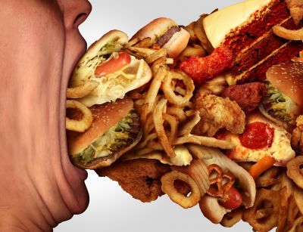
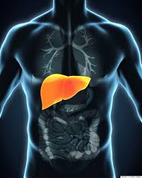
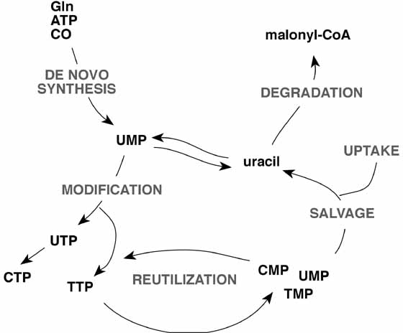
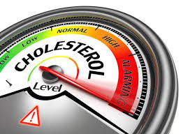
Hepatic Cholesterol Metabolism
As we studied in biochemistry, this shows the three ways Cholesterol enters the liver, and three ways it is excreted from it.
Absorption of dietary content
In
De novo synthesis
Out
Free cholesterol in bile
Conversion to bile salt/acids
Cholesterol synthesized in extrahepatic tissues
All pictures are extra

Slide 6
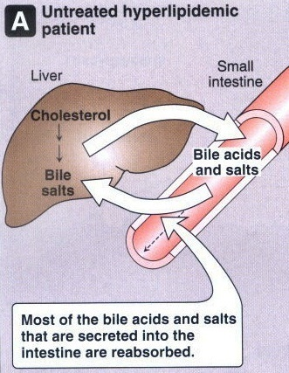
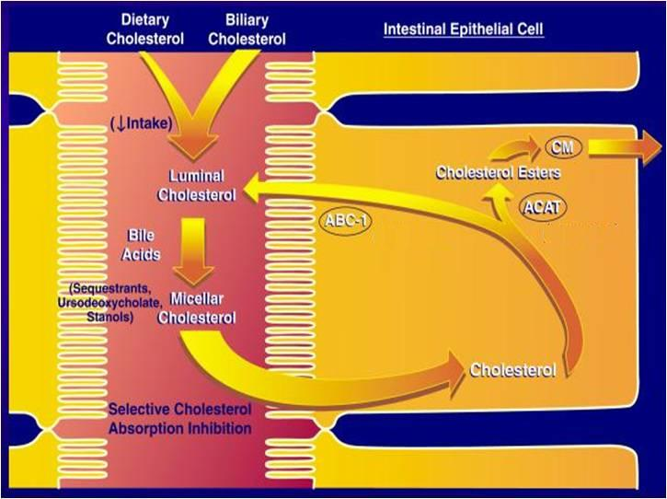
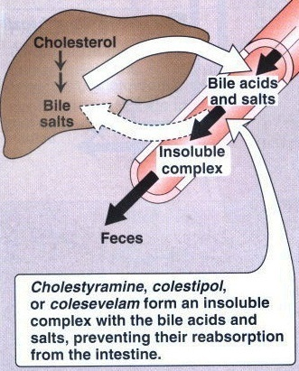
I- Agents targeting exogenous cholesterol
This diagram shows the mechanism of action of
1- resins: which inhibit bile acid reabsorption into intestines
2- ezetimibe: which inhibits cholesterol absorption
This picture shows what normally happens without drugs.
Colestipol
Cholestyramine
This picture shows the mechanism of action of resins.
Ezetimibe
NPC1L1

Slide 7
Bile Acid Sequestrants
Drug type | Exchange Resins: 1. Colestipol 2. Cholestyramine 3. Colesevelam
Mechanism of action | Bile acid sequestrants (stopping bile acid) in intestines. (bile acid makes the absorption easier) They form an insoluble complex with bile acids and salts, preventing their reabsorption from the intestines. They disrupt enterohepatic circulation of bile acids.
Adverse effects | Resins are clinically safe as they are not systemically absorbed GIT upset: abdominal discomfort, bloating, constipation Decreased absorption of: fat soluble vitamins (Vitamin A, D, K) and bile acids and other drugs The concentration of HDL is unchanged
Drug interactions | Interfere with the absorption of: Statins, Ezetimibe Chlothiazides, Digoxin, Warfarin N.B: if we were gonna give them together, wait 1 hour before or 4 hrs after administration of resins Colesevelam has not been shown to interfere with the absorption of other drugs and is a better choice for patients on multiple drug regimens.
Contraindications | 1- Complete biliary obstruction ( because bile is not secreted into the intestine) 2- Chronic constipation 3-Severe hypertriglyceridemia (TG >400 mg/dL) why? The bile acid binding resins can raise triglycerides modestly ( about 5%) and cannot be used if the triglycerides are elevated. Resins are the only drugs that increases TG
وهنا يشبه له بالإسم ويعاكسه بالفعل constipation يستخدم في علاج raisins الزبيب
كلي زي ما انتي عاوزه مش حيتغير طولك
كلي بسلام
Colesevelam = cool and safe
Resins can = raise TGder
Or كلي (cole)قد ما تقدري(TGdre) عليه عشان تزيدي (increase)

Slide 8
Continue: Resins mechanism of action
Large MW polymers which bind to bile acids, and the acid-resin complex is excreted so the fecal excretion is increased 10 folds.
1- This prevents enterohepatic cycling of bile acids.
2- and obligates the liver to synthesize replacement bile acids from cholesterol.
The liver increases the number of LDL receptors (upregulation) to obtain more cholesterol (from blood)
The levels of LDL-C in the serum are reduced as more cholesterol is delivered to the liver. (as a compensatory mechanism for the liver)
Moderately effective with excellent safety record
So, it is an excellent choice for people that cannot tolerate other types of drugs

Slide 9
Cholesterol Absorption Inhibitors
Ezetimibe
Pharmacology action | LDL 20% ,  TG 8% ,  HDL 1-4% No effect on steroids, lipid-soluble vitamins, bile acids.
Mechanism of action | Ezetimibe reduces C absorption. Therefore, ezetimibe reduces the flux of C from the intestine to the liver. Because this C is packaged and resecreted by the liver into the blood as VLDL (precursor of LDL in plasma), reduced flux of C to VLDL particles will lower LDL-C.
Pharmacokinetics Doctor said it’s not very important | Absorbed & conjugated in intestine (and liver) to active glucuronide Reaches peak blood level in 12–14 hours Undergoes enterohepatic circulation Its half-life is 22 hours (once daily ) Most of the drug is excreted in feces Patients with moderate to severe hepatic insufficiency should not be treated with ezetimibe
Indications Doctor said it’s very important | As Monotherapy; Primary prevention of low risk of CHD which needs modestLDL As Combination Therapy ; safe -With statins; synergistic* in moderate/severe  LDL -Or If must  statin dose because of side effects -Or with other lipid lowering drugs; as fibrates *statins effects the endogenous pathway while ezetimibe effects exogenous pathway (important)
ADRs | Not common GIT disturbance, headache, fatigue, arthralgia (pain in the joints) & myalgia (pain in muscles)

Slide 10
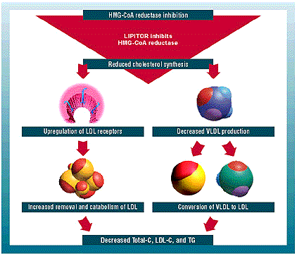
HMG-Co A Reductase Inhibitors
3-Hydroxy-3-methylglutaryl coenzyme A reductase inhibitors or statins are the most effective and best-tolerated agents for treating hyperlipidemia. Statins are considered as first-line drugs when LDL-lowering drugs are indicated .
Statins Mechanism of action
Statins are potent competitive inhibitors of 3-hydroxy-3-methyl glutaryl coenzyme A (HMG-CoA) reductase, which catalyzes an early, rate-limiting step in do-novo hepatic C synthesis. Thus, HMG-Co A is not converted to mevalonic acid.
1- Statins lower blood C levels by inhibiting de novo hepatic C synthesis
2- The liver compensates by the increasing number of LDL receptors on the surface of hepatocytes (upregulation of LDL-R)
3- This results in increasing removal of LDL from the blood and lowering of serum LDL- C levels
4- Because C is required for the synthesis of (the precursor of LDL-C), production of VLDL decrease
5- Statins cause decreasing modest in plasma TG and slight increasing in HDL-C,
يعني ببساطة statins يمنع تصنيع الكوليسترول فيقل ال supply داخل الخلية لذلك كيف الخلية تعوض هذا النقص ؟
تروح تزيد عدد المستقبلات الخاصة بـLDL فيقوم ينسحب من الدم عشان يصير له catabolism وتقل نسبة تواجده وكذا حلينا المشكلة

Slide 11
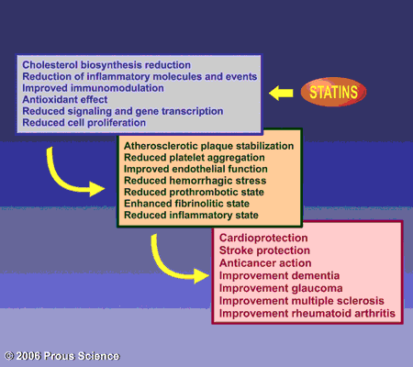
PLEIOTROPIC EFFECTS OF STATINS
Beyond cholesterol lowering , recent studies indicate that some of the cholesterol-independent or "pleiotropic" effects of statins involve:
improving endothelial function,
enhancing the stability of atherosclerotic plaques,
decreasing oxidative stress and inflammation,
inhibiting the thrombogenic response.
Furthermore, statins have beneficial extrahepatic effects on the immune system, CNS, and bone.

Slide 12
Statins
Pharmacokinetics | Most statins have a high first-pass clearance by the liver. Greater than 95% of most of these drugs are bound to plasma proteins with short half-life. Drug-drug interactions involve specific interactions with the cytochrome P-450 drug metabolizing system, especially CYP3A4. All statins are taken orally at bedtime because of hepatic C synthesis is maximal between midnight and 2:00 a.m. , except atorvastatin taken at any time because of its long half-life (14 hours)
Indications | As monotherapy: Secondary Prevention: In all ischemic insults [stroke, AMI*,etc.]  So given from the 1st day of ischemic attack Primary Prevention: 1. Patients with hyperlipidemia and with other risks for ischemic insults. 2. Type IIa Hypolipoproteinemia. If no control ,combine (sequestrants / ezetimibe, niacin,.. ) to decrease C As Combination therapy: Mixed dyslipidemias; added to fibrates or niacin if necessary. In diabetics and patients with insulin resistance [metabolic syndrome] because these patients will possess small dense LDL (severely atherogenic) + evident endothelial dysfunction + increased thrombotic profile *Acute Myocardial Infarction
ADRs | Common side effects: Headache , myalgia, fatigue, GI intolerance, and flu-like symptoms Hepatotoxicity, raised concentrations of liver enzymes (serum aminotransferases) every six months do blood test for aminotransferase + creatine kinase level Myopathy (increased creatine kinase [CK] released from muscles) Teratogenicity, statins should be avoided during pregnancy
Drug Interactions | Statins potentiate the action of oral anticoagulant and anti-diabetic drugs (by displacement from plasma protein binding sites). Drugs that increase the risk of statin-induced myopathy include : - Other antihyperlipidemics ( fibrates ). - Drugs metabolized by 3A4 isoform of cytochrome P450: erythromycin, verapamil, cyclosporin, ketoconazole. Pravastatin and fluvastatin are the statins of choice in patients taking other drugs metabolized by cytochrome 3A4 system.
Atorvastatin → At 2 a.m. Or 2 p.m. it does not matter can be given at any time.
Prava = Bravo نقول برافو لهالدرق لانه عاقل ولا يتمشكل مع غيره من الدرقز
Fluva = Flavour
كل واحد يأخذ النكهة اللي يبغاها بلا مشاكل
Drug-Drug interaction

Slide 13
Cont. Statins
Preparations
“ The common name is not important ”
Rosuvastatin (Crestor)
Atorvastatin (Lipitor)
Simvastatin (Zocor)
Pravastatin (Pravachol)
Lovastatin (Mevacor)
Used alone or with other anti-hyperlipidemic drugs ( ezetimibe ) for treatment of drug-resistant dyslipidemia (abnormal amount of lipids)
Statin-induced myopathy
Muscle aches, soreness, or weakness associated with an elevation of creatine kinase (CK) , are the best indicator of statin-induced myopathy.
Failure to recognize myopathy and to discontinue drug therapy can lead to rhabdomyolysis, myoglobinuria, and acute renal necrosis.
serum transaminase  can progress to evident hepatotoxicity So lab investigations recommended every 6 month  if levels  up to 3 folds at any time, statin must be stopped then dose adjusted.
 creatine kinase activity (index of muscle injury)  Measured only if myalgia or myositis develops  if  3-5 folds  we  statin doses / omit combination with fibrates

Slide 14
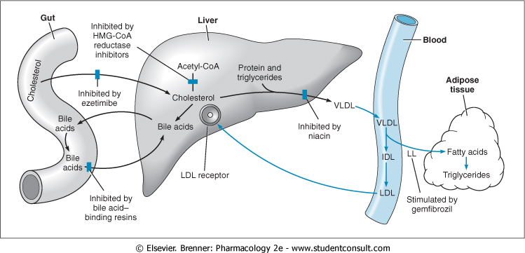
Niacin (Nicotinic Acid)
Water soluble B-complex vitamin with multiple actions.
Niacin is the most effective medication for increasing HDL cholesterol levels and it has positive effects on the complete lipid profile.
It is useful for patients with mixed dyslipidemias.
Niacin exerts greatest beneficial effects on wide range of lipoprotein abnormalities.
Niacin increase the nicest lipoprotein(HDL)
Sites and mechanism
of drugs for hyperlipidemia

Slide 15
Niacin (Nicotinic Acid)
1- In adipose tissue: it binds to adipose nicotinic acid receptors, this will lead to decrease in free fatty acids mobilization from adipocytes to the liver resulting in ↓ TG and thus VLDL synthesis 2- In liver: niacin inhibits hepatocyte diacylglycerol acyltransferase-2, a key enzyme for TG synthesis Thus, it decreases VLDL production (decreased TG synthesis and estrification) 3- In plasma: it increases LPL activity that increases clearance of VLDL & chylomicron ((Niacin also promotes hepatic apoA-I production and slows hepatic clearance of apoA-I and HDL)) the protein which covers HDL, so that will HDL | Mechanism of action:
Effect on VLDL:  VLDL by: 1-  synthesis in liver 2- increased clearance in plasma 3-  mobilization of free fatty acids from adipose tissue Effect on LDL:  LDL due to reduction in its precursor (VLDL) Effect on HDL: Induces modest increase in HDL-C (The catabolism of HDL can be inhibited by nicotinic acid through a mechanism that is largely unknown) | Pharmacological actions
1- The most common side effect is cutaneous flushing, (which is prostaglandin -mediated , can be avoided by low dose aspirin ½ h before niacin) 2- GIT disturbances: Dyspepsia , nausea , vomiting , reactivation of peptic ulcer ( can be decreased if taken after meal) High doses: Reversible  liver enzymes hepatotoxicity. Impairment of glucose tolerance  overt diabetes.  uric acid | Adverse Effects
- Monotherapy or in combination with fibrate, resin or statin - Type IIa, IIb hypercholesterolemia & any combined hyperlipidemia - Patient with hypertriglyceridemia & low HDL-C | Indications
1-Gout. 2-Peptic ulcer. 3-Hepatotoxicity. 4-Diabetes mellitus. | Contraindications

Slide 16
Fibric acid Derivatives (Fibrates)
Fibrates are agonists of peroxisome proliferator activated receptors (PPARα) which are a class of intracellular receptors that modulate fat metabolism. They increase genes transcription for lipoprotein lipase (LPL) leading to increased catabolism of TG in VLDL and chylomicrons. Examples: Clofibrate & Gemfibrozil & Fenofibrate | Mechanism of action:
LPL activity, which increases clearance of VLDL & chylomicron in plasma - A marked reduction in TG (due to stimulation of catabolism of VLDL) FFA uptake by the liver LDL-C uptake by the liver in HDL-C (by increasing the production of the apoprotein components of HDL)  excretion of hepatic C in bile , thus endogenous hepatic C synthesis may be decreased | Pharmacological actions
1- GIT (indigestion, abdominal pain, diarrhea) 2- Myositis: can occur resulting in weakness and tenderness of muscles, use of fibrates with statins is generally inadvisable 3- Gallstones: Clofibrate increases C content of bile, predisposes to gallstones, and its use is therefore limited to patients who have cholecystectomy. | Adverse Effects
1st-line defense for: - mixed dyslipidemia (i.e. raised serum TG and C) - Patients with low HDL and high risk of atheromatous disease (often type 2 diabetic patients) - Patients with severe treatment- resistant dyslipidemia (combination with other lipid-lowering drugs). | Indications
this isn’t important

Slide 17
Cont. Fibric acid Derivatives (Fibrates)
ADRs | 1. G.I.T upset, headache, fatigue, weight gain 2. Rash, urticaria, hair loss 3. Myalagia, Myositis, Rhabdomyolysis Acute renal failure  Occurs > -In alcoholics, -If combined with statins (each –ve metabolism of other ) -Or In impaired renal function 4. fibrates should be used with caution in patients with biliary tract disease, as they increase the risk of cholesterol gallstones as a result of an increase in the cholesterol content of bile.
Interactions | They displace warfarin from their protein binding sites   bleeding tendency  anticoagulant dose must be adjusted They  metabolism of statins  toxicity  myalgia, myositis, …….etc. Give lower doses Usually I don’t give fibrates with statins, but if I give I should  the dose
Drug interactions | Increased risk of myopathy when combined with statins. Displace drugs from plasma proteins (e.g.oral anticoagulants and oral hypoglycemic drugs)
Contraindications | Patients with impaired renal functions Pregnant or nursing women Preexisting gall bladder disease

Slide 18
Medications for Hyperlipidemia
Drug Class | Agents | Effects (% change) | Side Effects
HMG CoA reductase inhibitors | Lovastatin Pravastatin | ↓LDL (18-55), ↑ HDL (5-15) ↓ Triglycerides (7-30) | Myopathy, increased liver enzymes
Cholesterol absorption inhibitor | Ezetimibe | LDL( 14-18), ↑ HDL (1-3) ↓Triglyceride (2) | Headache, GI distress
Nicotinic Acid |  | ↓LDL (15-30), ↑ HDL (15-35) ↓ Triglyceride (20-50) | Flushing, Hyperglycemia, Hyperuricemia, GI distress, hepatotoxicity
Fibric Acids | Gemfibrozil Fenofibrate | ↓LDL (5-20), ↑HDL (10-20) ↓Triglyceride (20-50) | Dyspepsia, gallstones, myopathy
Bile Acid sequestrants | Cholestyramine | ↓ LDL ↑ HDL No change in triglycerides | GI distress, constipation, decreased absorption of other drugs
Antihyperlipedemic combinations
Indications:
Severe hypertriglycerdemia or severe hypercholesterolemia
To take lower doses of each drug
High LDL or VLDL not normalized with a single drug.
Resins:
decreases the absorption of statins and ezetimibe
Statin & ezetimibe: (synergistic combination)
Statin blocks synthesis of endogenous cholesterol while ezetimibe blocks exogenous cholesterol
Eze timi be in united state?ازأي تيمي صارت بالولايات
Statins & Fibrates:
Contraindicated (in full dose) because the incidence of myopathy may increase
So, use not more than ¼ maximum dose of statin and use pravastatin

Slide 19
Adjuvants in hyperlipidemia
 | Mechanism | Pharmacological Effects | Indications
Omega -3-FA found in fish oils containing highly unsaturated FA | ◉ enzymes involved in TG synthesis  beta-oxidation of FFA | ◉ TGs | Approved as adjunctive for treatment of very high TGs
 | ◉ platelet function Prolongation of bleeding time Anti-inflammatory effects | Some vascular protection
β-Sitosterol found in harmless plants with structure similar to C | Compete with dietary & biliary C absorption  levels LDL levels +10% |  | Given as food supplement before meal in hypercholestrolemia

Slide 20
entertaining videos to help you :
https://www.youtube.com/watch?v=fTA5HOa87pM

Slide 21
Editing file

