Slide 1
Antianginal drugs
OBJECTIVES:
-Recognize variables contributing to a balanced myocardial supply versus demand.
-Differentiate between drugs used to alleviate acute anginal attacks and those meant for prophylaxis & improvement of survival.
-Detail the pharmacology of nitrates and other drugs used as antianginal therapy.

Slide 2
Types of angina pectoris:
Signs and symptoms of angina pectoris:
Exertional angina
Classical angina
Crescendo angina
1-A clinical syndrome of chest pain (varying in severity) caused by ischemia of heart muscle. (the pain can radiate to left shoulder and arm)
2-pain due to the accumulation of metabolites (K+,PGs, kinins, adenosine) secondary to ischemia
3-pain due to either obstruction or spasm.
Vasospastic angina
Constriction of coronary arteries
What is the mechanism of angina pectoris?
Is a consequence of myocardial oxygen demand exceeding myocardial oxygen supply (that means that the blood supply of oxygen is less than what body needs)
(obstruction lead to ischemia).
There is an imbalance between oxygen demand and oxygen supply

Slide 3
What are the determinants of oxygen demand and supply?

Slide 4
What are the determinants of oxygen demand?
Systolic stress: when the left ventricle pressure increases more than the aortic pressure, the blood will flow.
Systolic stress is determined by the afterload.
Diastolic stress: Volume of blood in the ventricles depends on the capacitance of the veins (inverse relation)
Diastolic stress is determined by preload.

Slide 5
What are the determinants of oxygen supply ?
Because the blood flows in the coronary arteries only during diastole

Slide 6
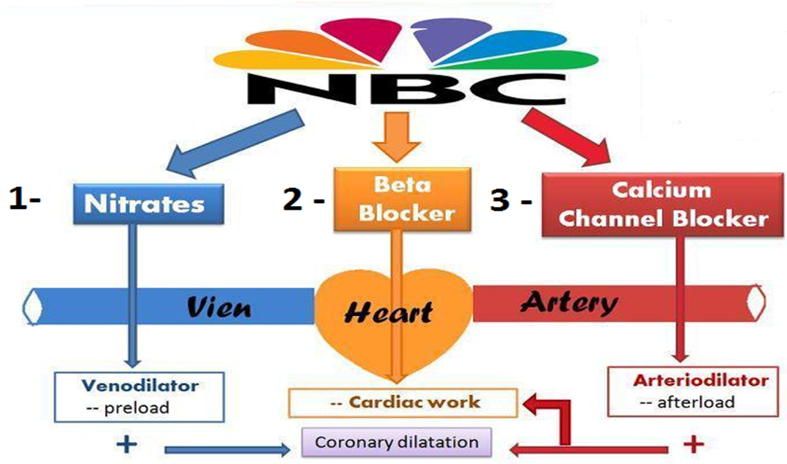
Treatment of angina pectoris
1-agents that improve symptoms and ischemia:
NBC
Potassium channels openers.
Late Na+ current inhibition :ranolazine.
Sinus node inhibition. ex: Ivibradine.
Reduction of afterload
Reduction of force of contraction and heart rate
They are fatty acid oxidation inhibitors
So they decrease oxygen demand
Increase perfusion and increase oxygen supply
Reduce oxygen demand
1) Decreasing afterload by dilating arteries
2) increasing oxygen supply by dilation coronary arteries
3) Decreasing contractility and heart rate, therefore decreasing the workload, therefor decreasing demand

Slide 7
Treatment of angina pectoris
2- Agents that Improve Prognosis:
Halt progression, prevent acute insult, improve survival
Aspirin / other antiplatelet agents
ACE inhibitors
Statins
β -blockers

Slide 8
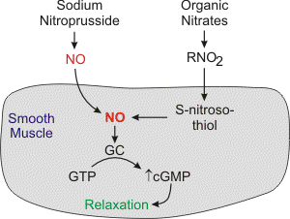
Organic nitrates
Classification | Long acting | Short acting
Drug | Isosorbide mononitate and dinitrate | Nitroglycerine or glyceride dinitrate
Preparations | Isosorbide Dinitrate Isosorbide mononitate Sublingual tablets (fastest onset of action) Mononitrate Oral sustained release Oral sustained (extended) release (delayed onset, longer duration) Infusion Preparations | Sublingual tablets spray Transdermal patch Oral or bucal sustained release I.V. Preparations
pharmacokinetics | Oral isosorbide Very well absorbed & 100% bioavailability The dinitrate undergoes denitration to two mononitrates both possess antianginal activity (both pharmacologically active) (t1/2 1-3 hours) Further denitrated metabolites conjugate to glucuronic acid in liver. Excreted in urine. | Significant (high) first pass metabolism occurs in the liver (10-20%) bioavailability Given sublingual or via transdermal patch, or parenteral (routes of administration which bypass portal circulation)
Mechanism of action | By enzymes: Organic nitrase is reduced into nitride into nitrosothiol which will release nitric oxide. Nitric oxide binds to guanylate cyclase in vascular smooth muscle cell to form cGMP. cGMP activates PKG to produce relaxation. Difference between organic nitrates and sodium nitroprusside: nitroprusside doesn’t need enzymes to release Nitric oxide. (spontaneously)
Hemodynamic effects | Venous vasodilatation (Decrease the preload) at low dose Coronary vasodilatation (Increase the myocardial perfusion) Arterial vasodilatation (decrease afterload) at high dose Shunting (diverting) of flow from normal area to ischemic area by dilating collateral vessels
Indications | In stable angina: Persistant prophylaxis Chronic Heart Failure: Second line treatment is isosorbide mononitrate + hydralazine When there is ACE inhibitor contraindications | In stable angina: Acute symptom relief (sublingual) Situational prophylaxis: for example before climbing mountain, before physical stress IN VARIANT ANGINA (sublingual) IN UNSTABLE ANGINA (IV) Acute Heart Failure Refractory AHF and AMI (IV)
ADRs Mostly due to vasodilation | Throbbing headache Flushing in blush area Postural hypotension, dizziness & syncope Tachycardia & palpitation Rarely Met-hemoglobinema (iron is in ferric state instead of ferrous)
contraindications | Known sensitivity to organic nitrates Glaucoma. nitrates increase synthesis of aqueous humor formation. Head trauma or cerebral haemorrhage = Increase intracranial pressure. Uncorrected hypovolemia Concomitant administration of PDE5 Inhibitors (phosphodiesterase type 5 inhibitor )(Slidenafil) Sildenafil + nitrates → Severe hypotension & death
tolerance | Loss of vasodilator response of nitrates on use of long-acting preparations (oral, transdermal) or continuous intravenous infusions, for more than a few hours without interruption. The Mechanism: 1-Compensatory neurohormonal counter-regulation 2-Depletion of free-SH (sulfahydrate) groups which is required for activation of nitrates. To decrease tolerance, the patient can take the drug but with a drug free period. Nitrate tolerance can be overcome by:Smaller doses at increasing intervals (Nitrate free periods twice a day).Giving drugs that maintain tissue SH group e.g.Captopril.
صوص أو بيض

Slide 9
Effects of nitrates in treatment of angina and their results
Effects | Results
↓Arterial pressure | ↓ O2 demand “ By decreasing the afterload”
Reflex ↑ in contractility | ↑ O2 demand “due stimulation of sympathetic activity after high dose which dilate arteries”
↑Collateral flow | Improved perfusion to ischemic myocardium
↓Ventricular volume | ↓ O2 demand “By decreasing the preload”
Reflex tachycardia | ↑ O2 demand “due stimulation of sympathetic activity after high dose which dilate arteries”
↓Left ventricular diastolic pressure | Improve subendocardial perfusion
↓Diastolic perfusion time due to tachycardia | ↓ myocardial perfusion
Vasodilation of epicardial coronary arteries | Relief of coronary artery spasm
Notes:
Relief of coronary artery spasm

Slide 10
CALCIUM CHANNEL BLOCKER | Drug | Classifications: | Selectivity :
 |  | Dihydropyridines: Nifedipine ,Nicardipine (short acting) Amlodepine (long acting) | Nifedipine :Vascular smooth muscle
 |  | Phenylalkylamines e.g. Verapamil | Cardiomyocytes
 |  | Benzthiazepines e.g. Diltiazem | Intermediate “action on both but less degree “
 | Mechanism | Binding of calcium channel blockers [CCBs] to the L-type Ca channels their frequency of opening in response to depolarization entry of Ca  Ca release from internal stores  No Stimulus-Contraction Coupling RELAXATION
 | Pharmacodynamics Antianginal actions | Cardiomyocyte Contraction cardiac work through their –ve inotropic & chronotropic action (verapamil & diltiazem) myocardial oxygen demand
 |  | VSMC Contraction Afterload cardiac work myocardial oxygen demand
 |  | Coronary dilatation  myocardial oxygen supply
 | Therapeutic Uses | IN VARIANT ANGINA : Attacks prevented (> 60%) / sometimes variably aborted IN UNSTABLE ANGINA: Seldom added in refractory cases IN STABLE ANGINA: useful regular prophylaxis if with CHF
نايف نكر بسرعة
نايف دا باني عضل
بالمصري .. أمل أُعدي”اقعدي” باين حنطول
فيه رابر اسمها أمل قلبها رهيف
دليتي عازم
دليتي عازم؟ دايم ضايع يشتغل هنا وهناك
كلهم يحبوا يشربوا حليب
Short acting dihydropyridine should be avoided ? Can be combined to b-AR blockers ? Yes, we can use dihydropyrdine. But we can not combine Phenylalkylamines such as Verapamil which is work on the heart because beta blocker works on the heart also but we can give something works on the blood vessel like the dihydropyrdnes Can be combined with nitrates? Dihydropyridenes useful antianginal if with CHF ? Yes especially dihydropyrdine which reduce the afterload by vasodialtation and thus decreasing the workload of the heart and decrease in demand . verapmil and diltizam useful as antianinal in case of hypotension?

Slide 11
β Adrenergic Blockers | Type | Selective β1 blocker
 | Examples | Atenolol, Bisoprolol , Metoprolol
 | Antianginal Mechanism | Decrease heart rate & contractility thus: -Increase duration of diastole > increase coronary blood flow > increase oxygen supply -Decrease workload > Decrease O2 consumption > Decrease oxygen demand
 | Indications in angina | Stable | Regular prophylaxis, selective are prefered. First choice for chronic use? Can be combined with nitrates? Can be combined with dihydropyridine CCB? Verapamil ?
 |  | variant | Contraindicated
 |  | Unstable | Halts progression to MI, improve survival
 |  | Myocardial infarction | Reduce infarct size Reduce morbidity & mortality →reduce O2 demand →reduce arrhythmias
I Met Biso At Ten
b- blockers should be withdrawn gradually? Because of the upregulation of the receptors. Given to diabetics with ischemic heart disease? Because it covers the symptoms of hypoglycemic state.

Slide 12
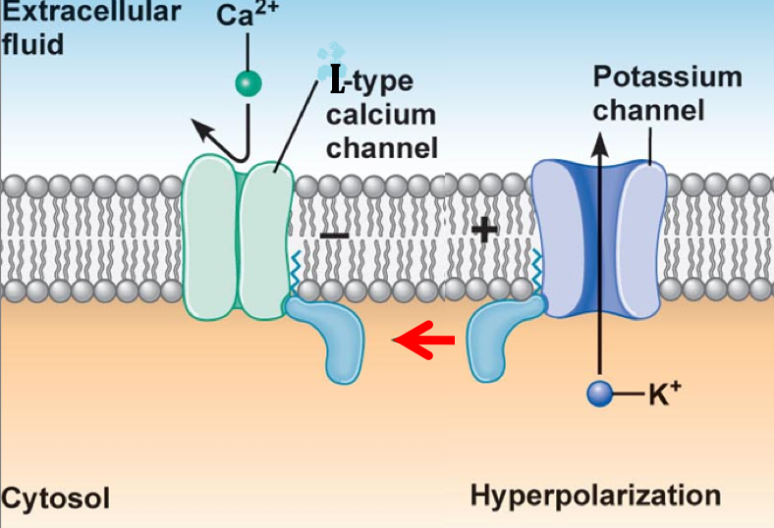
POTASSIUM CHANNEL Openners | Drug | Nicorandil
 | Mechanism | has dual mechanism of action: 1. Opens potassium ATP channels (arteriolar dilator) 2. NO donor as it has a nitrate moiety (venular dilator)
 | Pharmacodynamics Antianginal actions | As K channel opener | On vascular smooth muscles: opening K channels> hyperpolarization>vasodilation. On cardiomyocytes: opening K channels> repolarization> decrease cardiac work.
 |  | As NO donor | Increase in cGMP/PKG which leads to vasodilation.
 | Therapeutic Uses | 1.Prophylactic 2nd line therapy in stable angina 2.Refractory variant angina
 | Adverse Reactions | Flushing, headache, Hypotension, palpitation, weakness Mouth & peri-anal ulcers, nausea and vomiting.
In stable angina
cardioselective are prefered?
Prolong use reduces incidince of sudden death?
In Unstable angina
Halts progression to AMI, improve survival
In Variant Angina
contraindicated ?
IN AMI
Reduce infarct size, reduce morbidity and mortality

Slide 13
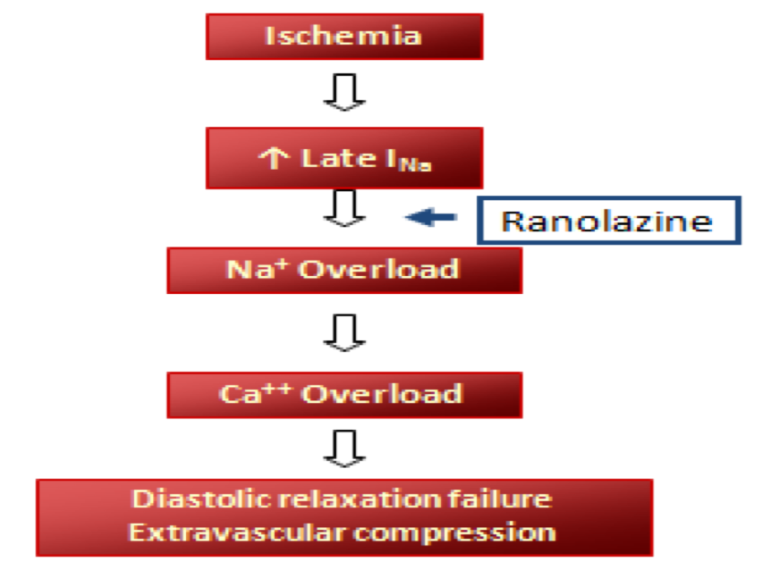
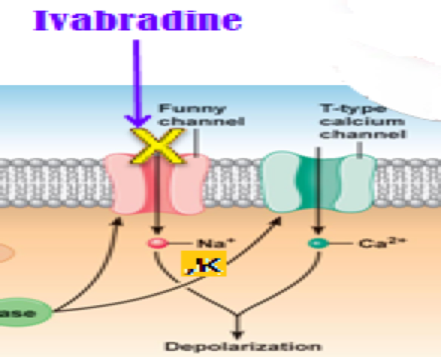
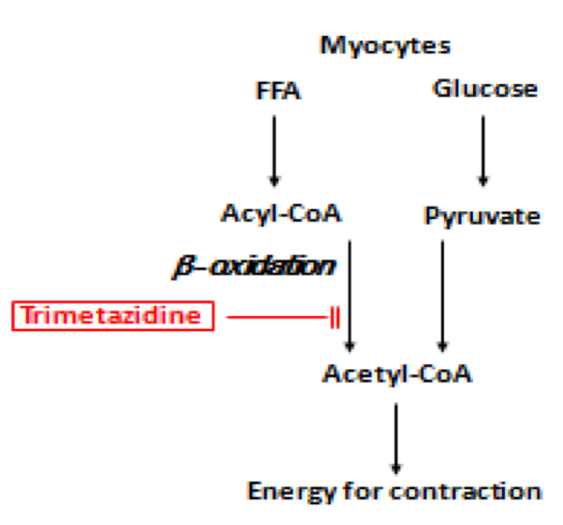
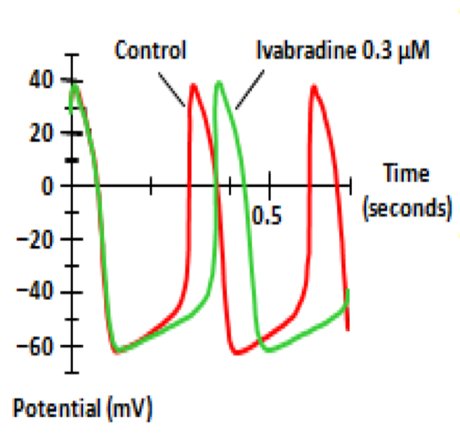
Metabolically acting agents:
Ranolazine → No=Na
قالوا رنا لزين قالت لا
Trimetazidine
Oxygen requirement of glucose pathway is lower than FFA, during ischemia oxidized FFA levels rise, blunting the glucose pathway. Trimetazidine reduces oxygen demand without altering hemodynamics
Indications: as add on therapy
Ranolazine
Inhibits late sodium current which increases during ischemia
Prolongs QT intervals so contraindicated with class Ia and III antiarrhymatics
Adverse Reactions: GIT disturbances
contraindications: hypersensitivity , pregnancy, and lactationرضاعة
Toxicity develops due to interaction with CYT 450 inhibitors as diltiazem, verapamil, ketoconzole, macrolides, antibiotics, and grapefruit juice
Ivabradine
reduces slope of depolarization, slowing HR, reducing myocardial work, and oxygen demand
I_{f} current is an inward Na/K current that activates pacemaker cells of the SA node, ivabradine selectively blocks it
ADRs:- dizziness , constipation
Used in chronic angina concommitanly with other drugs
ADR:- luminous phenomena
Used in treatment of chronic stable angina in Patients with normal sinus rhythm who cannot take b-blockers
Used in combination with beta blockers in people with heart failure with LVEF lower than 35% inadequately controlled by beta block whose heart rate exceeds 70/min
Trimetazidine = Triacylglycerol (FA)
Ivabradine → I_{v} = I_{f}

Slide 14
Editing file

