Slide 1
β- Adrenoceptors blockers
OBJECTIVES:
Describe the different classifications for drugs that can block sympathetic nervous system.
Describe the kinetics, dynamics, uses and side effects of alpha adrenergic drugs.
Identify Difference between selective and non selective beta blockers.
Identify the different classifications for beta receptors blockers.
Describe the kinetics, dynamics, uses and side effects of beta adrenergic drugs.
Know the preferable drug for diseases such as hypertension, glaucoma, arrhythmia, myocardial infarction, anxiety, migraine and ect....

Slide 2
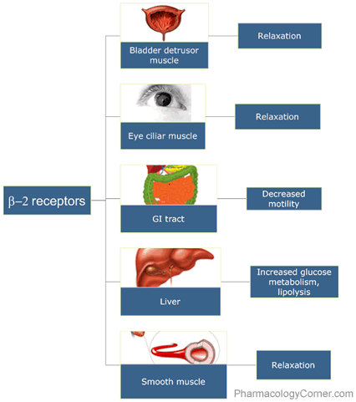
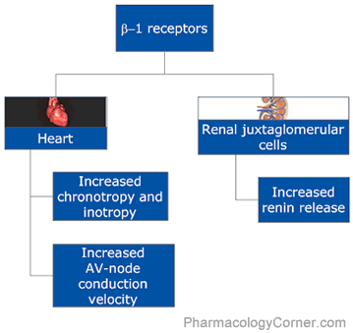
β–Adrenergic receptors
Beta 3 | Beta 2 | Beta 1
Adipose tissue | Smooth muscle | Heart | Site
↑ Lipolysis. | Relaxation of smooth muscles. Hyperglycemia due to: ↑ Release of glucagon from pancreas. Glycogenolysis & gluconeogenesis in liver (With α1) | Increase heart Rate (Positive chronotropic effect). Increase in contractility (Positive inotropic action). Increase in conduction velocity (Positive dromotropic). | Action

Slide 3
According to the selectivity
Non-Selective
Mixed α, β blockers
Selective
Propranolol**
Sotalol
Timolol *
Labetalol* * *
Carvedilol *
Atenolol
Bisoprolol
Metoprolol *
Esmolol
Classification of β- Adrenoceptors Blockers
تسب (TSP)هالدرقز لانها non selectiveولها many side effect
T → Timolol
S → Sotalol
P → Propranolol
هل قابلت ( meto =meet) اللي اسمو(Esmo)بيسو(Biso) الساعة ١٠(At ten =Aten) وبما اني حددت وقت so selective drugs
Did you meto elly Esmo Biso Aten
CARvedilol → car needs benzene(lipid soluble).
Labetalol = L(α)(beta)LOL → so Mixed α, β blockers
CarveDILOL → DI mean two so mixed blocker..
Labetalol is an example of ISA effect
رجع عيسى(ISA) لبيته (LABETAlol)
*It has Intrinsic Sympathomimetic Activity (ISA) , which mean it gives initial agonist action.
*They produce local anesthesia by removing the pain by blocking the NA channels which leads stabilization to the cell membrane of the nerve, so it won’t respond to the stimulation
(No pain sensation) (Quinidine-like action Antiarrhythmic action)
*Lipid soluble
According to presence of membrane stabilizing effects i.e. Propranolol, labetalol.
برب البيت انه ثابت

Slide 4
Pharmacokinetic of β–blockers
Pharmacological actions of β–Adrenergic blockers
Most of them are lipid soluble:
Well absorbed orally.
Are rapidly distributed.
Cross readily BBB.
CNS depressant effects i.e. Sedative effect Anxiety.
Short t1/2.
Metoprolol, propranolol, timolol, labetalol, carvedilol.
Some of them are hydrophilic:
Irregular Oral absorption.
Doesn’t cross readily BBB.
Long t1/2.
Low CNS side effects.
Atenolol, Bisoprolol, Esmolol, Sotalol.
Most of them have half-life from 3-10 hrs
except Esmolol (10 min. given intravenously).
(Because it gets removed by esterase enzyme in the blood that’s why its name start with ESM which refer to ester methyl)
Most of them metabolized in liver & excreted in urine.
Metabolic effects:
Hypoglycemia due to:
↓ glycogenolysis in liver
↓ glucagon secretion in pancreas
↓ lipolysis in adipocytes
Na+ retention 2ndry to BP renal perfusion.
All β–Adrenergic blockers mask (hide) hypoglycemic manifestations (familiar symptoms) in diabetic patients  COMA
Anti-arrhythmic effects:
↓ excitability, ↓ automaticity & ↓ conductivity, due to:
its sympathetic blocking.
Respiratory tract: β₂
Bronchoconstriction
Contraindicated in asthmatic patients.
Eye:
↓ Aqueous humor production from ciliary body
↓ Reduce intraocular pressure (IOP)
e.g. timolol as eye drops
Tim(Timolol) came Labeta (Labetalol) by the car (Carvedilol) to prepare(propranolol) the meat (Metoprolol) with oil (Lipid soluble).
لما نعطي الانجيكشن (IV) نسمي ونقول اسم الله (Esmolol)عليك وكل شيء يتيسر و يصير بسرعة(rapid action10min)
It is the time(timolol) for eye dropsيله جاء وقت قطرة العين .....

Slide 5
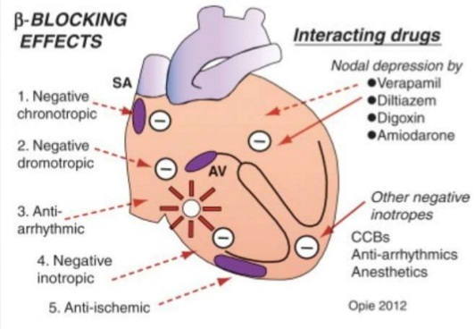
Con. Pharmacological actions of β–Adrenergic blockers
Cardiovascular system:
Negative (inotropic, chronotropic, dromotropic)   CO
Blood vessels: β₂
 peripheral resistance (PR) by blocking vasodilatory effect β₂
blood flow to organs  cold extremities
contraindicated in peripheral diseases like Reynaud's disease (Cold and numb feeling in fingers an toes due to vasospasm in response to cold or stress )
Blood pressure:
Antihypertensive   BP in hypertensive patients due to it effects on:
Inhibiting heart properties   cardiac output (β₁)
β Blockade  renin secretion  Ang II & aldosterone secretion (β1).
Presynaptic inhibition of NE release from adrenergic nerves
Intestine:
 Intestinal motility
Antianginal effects (ischemic heart disease):
↓ Heart rate (bradycardia)
↓ force of contraction
↓ cardiac work
↓ Oxygen consumption due to bradycardia
Angina is chest pain or discomfort caused when your heart muscle doesn't get enough oxygen-rich blood. It may feel like pressure or squeezing in your chest. The discomfort also can occur in your shoulders, arms, neck, jaw, or back. Angina pain may even feel like indigestion. But, angina is not a disease. It is a symptom of an underlying heart problem, usually coronary heart disease (CHD).

Slide 6
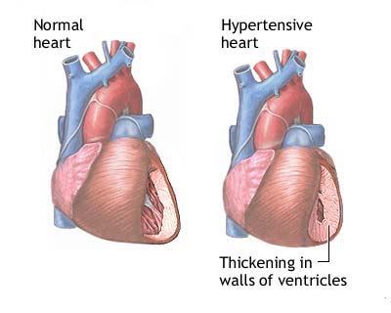
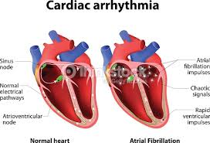
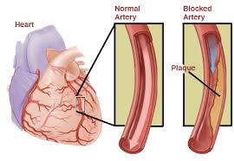
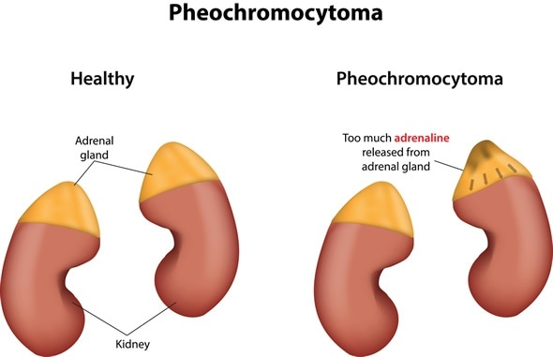
Clinical Uses of β–receptor blockers
Cardiovascular disorders
Hypertension
Arrhythmia
Angina pectoris
Myocardial infarction (used as secondary prophylactic)
Congestive heart failure (used with another drug)
Pheochromocytoma
Chronic glaucoma
Hyperthyroidism (thyrotoxicosis)
(increase in thyroid hormone which may lead to tachycardia)
Migraine prophylaxis
Anxiety التوتر
In Hypertension:
Propranolol, atenolol, bisoprolol : β blockers
Labetalol (I.V.): α, β blockers, Used in
*hypertensive pregnant & hypertensive crisis.
*Remember: α-methyl dopa does this too
In cardiac arrhythmias:
In supraventricular & ventricular arrhythmias.
Bisoprolol and carvedilol* are preferred
*(مضاد للأكسدة ويستخدم أيضا ك (antiaging
Angina pectoris:
↓ heart rate, ↓ cardiac work & oxygen demand.
↓ the frequency of angina episodes.
Pheochromocytoma:
used with α-blockers (never alone)*
α-blockers lower the elevated blood pressure.
β-blockers protect the heart from NE.
*(ما يستخدم لحاله عشان مايصير ارتفاع حاد في ضغط الدم، في المقابل نقدر نستخدم الفا لحاله بدون بيتا )

Slide 7
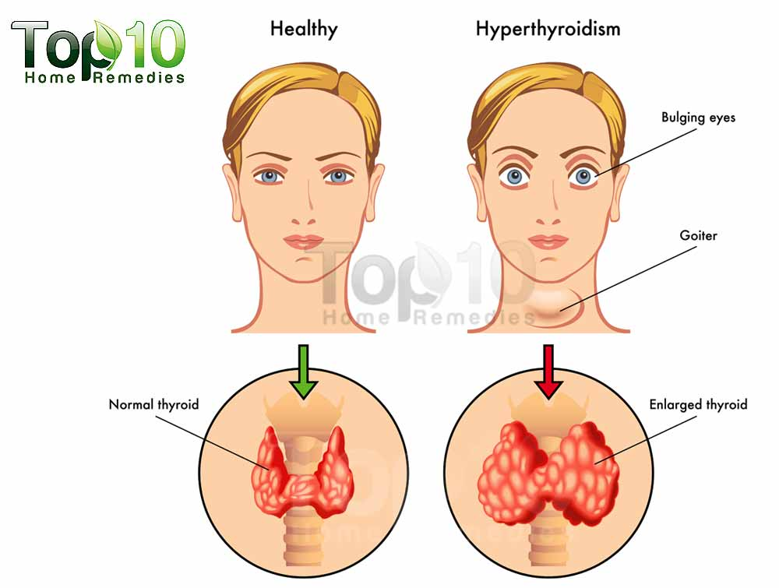
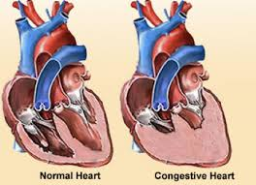
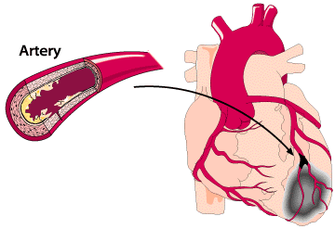
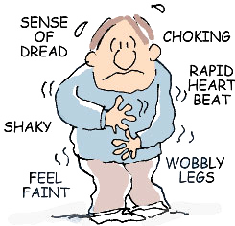
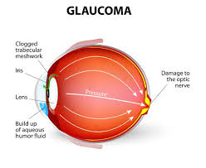
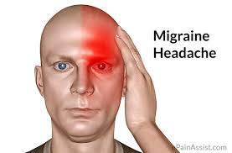
Con. Clinical Uses of β–receptor blockers
All the pictures are extra
In Hyperthyroidism
Protect the heart against
sympathetic over stimulation
Controls symptoms; tachycardia,
tremors, sweating.
Congestive heart failure:
e.g. carvedilol:
antioxidant and non selective α,B blocker
myocardial remodeling & ↓ risk of sudden death.
Myocardial infarction*:
Have cardio-protective effect.
◉ infarct size
morbidity & mortality 
◉ myocardial O2 demand.
Anti-arrhythmic action.
◉ incidence of sudden death.
*(عادة يصيب مرضى السكر، اللي ضغطهم مرتفع وما ياخذون ادوية واللي عندهم مشكلة في تخثر الدم )
In anxiety (Social and performance type)
e.g. Propranolol
Controls symptoms; tachycardia,
tremors, sweating.
تخيلوا شخص عنده رهاب اجتماعي او رهاب مسرح وكل ما سنحت له الفرصة يقول برب (PROPranolol) عشان يتهرب منهم.
Migraine:
Prophylactic
reduce episodes of chronic migraine
catecholamine-induced vasodilatation in
the brain vasculature
e.g. propranolol
In glaucoma
e.g. Timolol as eye drops
It is the time(timolol) for eye dropsيله جاء وقت قطرة العين .....
شخص عنده مرض الشقيقة ومن ألمها يمشي ويقول بربك هذا آلم يستحمل!

Slide 8
Adverse Effects of β- Adrenoceptors blockers
Contraindications of β- Adrenoceptors blockers
Due to blockade of β1- receptor:
Bradycardia, hypotension, heart failure
Due to blockade of β2- receptor:
only with non-selective β blockers
Hypoglycemia
Bronchoconstriction (# Asthma, emphysema).
Cold extremities & intermittent claudication (cramping pain in the leg is induced by exercise, due to obstruction of the arteries.) by vasoconstriction(# Reynaud’s disease)
Erectile dysfunction & impotence
 TG hypertriglycerides
All β–Adrenergic blockers mask hypoglycemic manifestations i.e. tachycardia, sweating,…  COMA
Depression, and hallucinations.
Gastrointestinal disturbances.
Sodium retention
Heart Block (beta blockers can precipitate heart block).
Bronchial Asthma (safer with cardio-selective* β-blockers).
Peripheral vascular disease (safer with cardio-selective β-blockers).
Diabetic patients  Masking of hypoglycemia / GIVEN CAUSIOUSLY
Hypotension
Alone in pheochromocytoma (must be given with an α-blockers).
*(يعني خاص ب البيتا 1 )
Precautions
Sudden stoppage will give rise to a withdrawal syndrome*:
Rebound angina, arrhythmia, myocardial infarction &
Hypertension WHY ?  **Up-regulation of β-receptors.
To prevent withdrawal manifestations  drug withdrawn gradually.
*(لازم اذا جاء يوقف الدواء يكون تدريجي عشان ما يصير عنده اعراض الانسحاب)
** (زي الواحد لما يكون مكبوت أو مسجون وفجاءة يفكون عنه يبدأ يسوي كل شيء بالهبل وبزيادة ، نفس الفكرة هنا بيتا ريسبتور يكون مكبوت بالبلوكرز فلما أوقف الدرق فجاءة يبدأ يتحرر ويطلع او يعرض ريستبتورز بالهبل او بزيادة).

Slide 9
Propranolol
Non-selective competitive blocker of β₁ & β₂
It also has a membrane stabilizing action (quinidine-like) with a local anesthetic effect and may cause some sedating effect too.
Kinetics:
Its lipid soluble so that it’s completely absorbed but 70% could be destroyed during 1st pass hepatic metabolism.
90-95% is protein bounded.
Can cross the BBB. Because its lipid soluble
Given p.o (Per os =by mouth or orally) or parenteral.
Dynamics:
Beta-blocking effect:
Membrane stabilization: it blocks Na channels which leads to direct depressant of the myocardium (anti-arrhythmic effect).
CNS effect: has sedative effect. Also it decreases the tremor and anxiety thus used to protect against social anxiety and performance anxiety.
Uses:
Hypertension.
Arrhythmia.
Angina.
Myocardial infarction.
Migraine as a prophylactic therapy.
Pheochromocytoma (used in combination with alpha blocker and never used alone.
Chronic glaucoma.
Tremors.
Anxiety specially social and performance type.
Hyperthyroidism.

Slide 10
Cont…. Propranolol
Actions:
Heart: by blocking β₁
Inhibit heart properties which leads to decrease in cardiac output.
Has anti-ischemic action. (decrease cardiac work thus prevent more oxygen consumption.)
Has anti-arrhythmic effect. Decreases excitability, automaticity and conductivity by membrane stabilizing action.
Blood pressure by block beta 1 and 2:
Has anti-hypertensive action by many ways:
Decrease cardiac output by inhibiting heart properties.
Decrease renin and RASS system.
Presynaptic inhibition of nor-epinephrine release form adrenergic nerves.
Inhibiting sympathetic outflow in CNS.
Blood vessels by blocking Beta2:
Vasoconstriction which leads to decrease blood flow mainly to muscles and the other organs (causes cold extremities).
Blood flow to the brain is not affected at all.
Bronchi by blocking Beta2:
Bronchospasm specially in susceptible patients. As in asthma and COPD.
Intestine by blocking Beta2:
Increase intestinal motility.
On peripheral and central nervous system:
Has local anesthetic effect which then decreases tremor and anxiety.
Metabolism by blocking mainly Beta2:
In liver:: decrease glycogenolysis thus causing hypoglycemia.
In pancreas: decrease glucagon secretion.
In adipocytes: decrease lipolysis.
In skeletal muscles: decrease glycolysis.

Slide 11
Carvedilol
Block Alpha1 and Beta.
Non selective with no ISA and no local anesthetic effect.
Has anti-oxidant action.
Favorable metabolic action.
Used in:
Effectively in congestive heart failure by reversing its pathophysiological changes.
ADRs:
Edema.
CarveDILOL → DI mean two so mixed blocker..
Labetalol
Blocks alpha1 and beta.
Rapid acting and non-selective with ISA.
Local anesthetic effect.
Do not alter serum lipid or blood glucose.
Given p.o of IV.
Used in:
Severe hypertension in pheochromocytoma.
Hypertension crisis (e.g. during abrupt withdrawal of clonidine).
Used in pregnancy-induced hypertension.
ADRs:
Orthostatic hypotension.
Sedation.
Dizziness.
Labetalol = L(α)(beta)LOL → so Mixed α, β blockers
رجع عيسى(ISA) لبيته
Selective beta1-receptor blockers
Selectivity in low doses but lost at high doses.
Such as (Atenolol / bisoprolol / Esmolol / Metoprolol )
No change in lipid or glucose.
No bronchoconstriction.
Are preferable in patients with:
Asthma and COPD.
Raynaud’s phenomenon and PVD.
Diabetics and other dyslipidemias.
Variant angina.

Slide 12
Drug | features | Uses
Propranolol | Non-selective. Β_{1,} β₂ blocker. | Migraine prophylaxis.
 |  | Hyperthyroidism (thyrotoxicosis).
 |  | Relieve anxiety (specially social and performance types).
Timolol | Non-selective. Β_{1,} β₂ blocker. | Glaucoma.
Atenolol | Selective . Β₁ blocker. | Myocardial infarction.
bisoprolol
 |  | Hypertension.
Metoprolol
Esmolol | Selective. Β₁ blocker. Ultra short acting. | Cardiac arrhythmia.
Carvedilol | Non selective. α, B blocker. | Congestive heart failure.
Labetalol | Non-selective. α, B blocker. | Hypertension in pregnancy.
 |  | Hypertension emergency.

Slide 13
Editing file

