Slide 1

Antiarrhythmic drugs
OBJECTIVES:
Understand definition of arrhythmias and their
different types
describe different classes of Antiarrhythmic drugs
and their mechanism of action
understand their pharmacological actions, clinical
uses, adverse effects and their interactions with
other drugs.

Slide 2
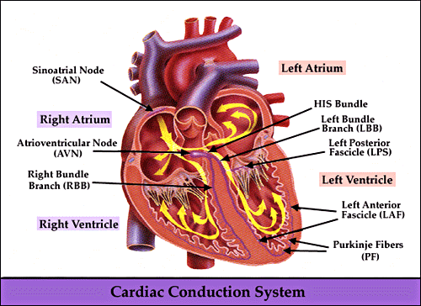
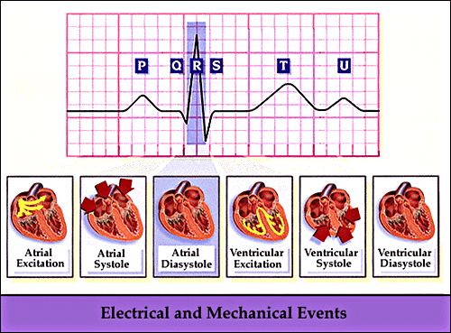
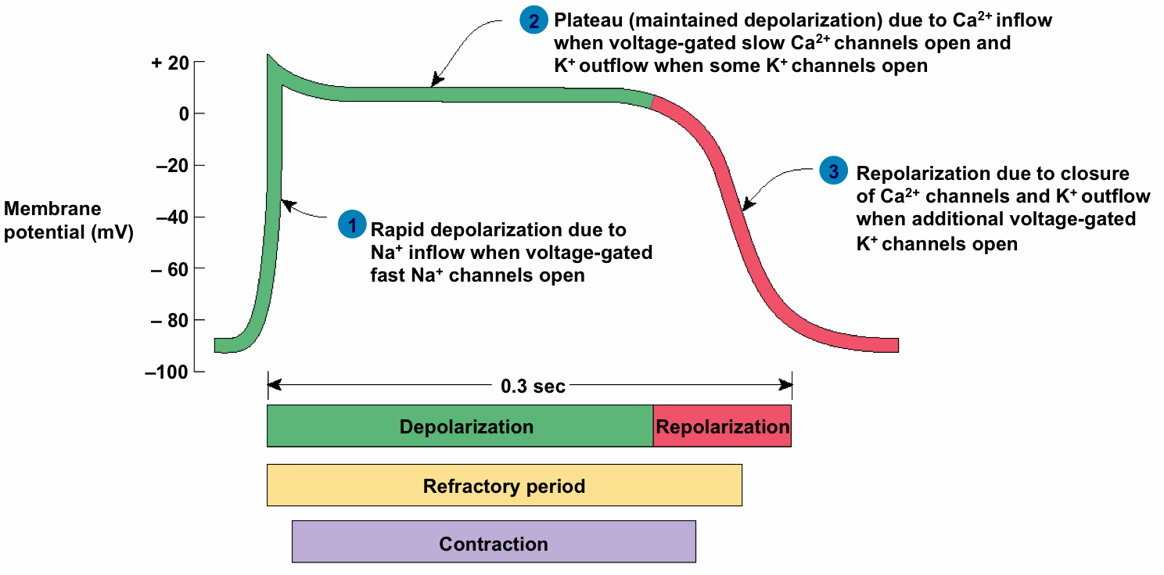
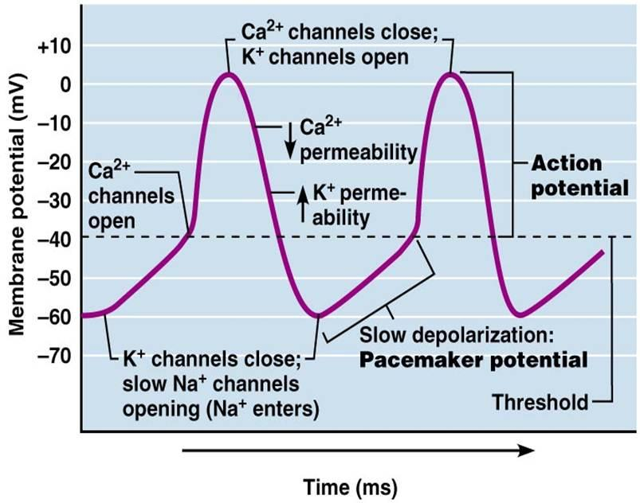
Physiology(For more understanding revise the Physiology lectures).
1- CARDIAC CONDUCTION SYSTEM:
S.A. node.
Inter-nodal pathways.
A.V. node.
Bundle of His and branches.
Purkinje fibers.
3- Fast response vs slow response:
2- Electrocardiogram(ECG):
Slow response AP
Fast response AP

Slide 3
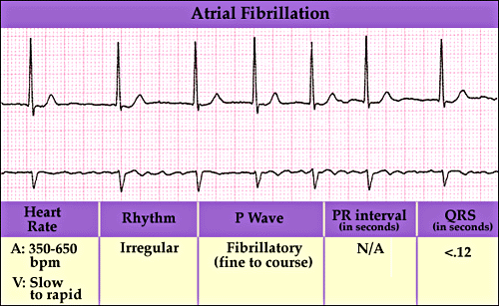
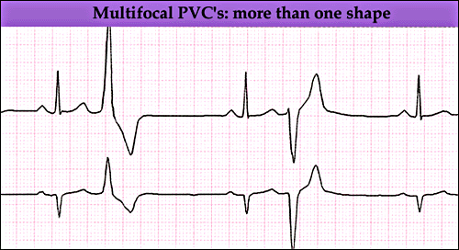
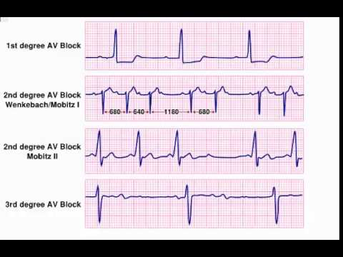
What is arrhythmias ?
An abnormality in the :
Rate:
high= tachycardia (more than 100 beats/min).
low = bradycardia (less than 60 beats/min).
Regularity: extrasystoles (PAC,PVC). (Premature atrial contraction, Premature ventricle contraction)
Site of origin: ectopic pacemakers or disturbance in conduction.
Examples:
The ultimate goal of therapy
⬇
Restore normal rhythm & conduction
⬇ ⬇
Maintenance of Prevention of more
normal rhythm serious arrhythmias
How antiarrhythmic drugs produce these effects?
Slow conduction velocity.
Altering the excitability of cardiac cells by prolonging the effective refractory period.
Suppressing ectopic pacemaker activity by inhibiting phase 4 slow depolarization.

Slide 4
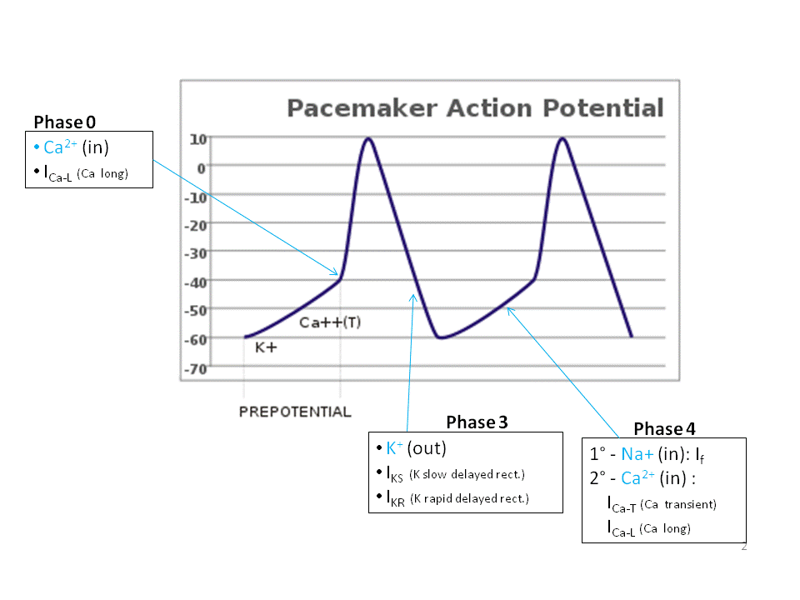
Classification of the antiarrhythmic drug:
depolarization phase
Effect on pacemaker action potential | MECHANISM OF ACTION | Vaughn-Williams CLASSIFICATION The most accepted classification
Slow phase 0,4 in & prolong phase 3 | Na+ channel blocker (Membrane stabilizing drugs) | IA
Slow phase 0,4 & shorten phase 3 |  | IB
Markedly Slow phase 0 |  | IC
Slow phase 4 depolarization | β- adrenoceptor blockers | II
Prolongs Phase 3 | Drugs that prolong action potential duration K+ channel blocker | III
Slow Phase 4 spontaneous depolarization and conduction | Calcium channel blocker | IV
Repolarization phase
pacemaker potential phase
No bad boy keeps clean.=
Na – beta– K – Ca

Slide 5
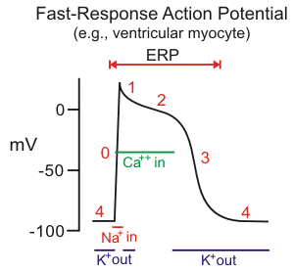
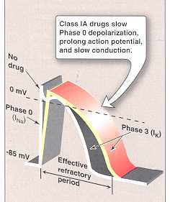
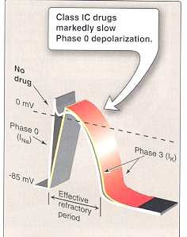
Class I:
Drugs that block the influx of Na ions through Na channels (membrane stabilizing effect).
Either partial or complete block, as a result decrease of rise of phase 0
have the following effects on the pacemaker action potential :
decrease the rate of rise of rapid depolarization (Phase 0).
decrease phase 4 slow depolarization (suppress pacemaker activity).
Sub classified according to their effect on action potential duration (phase 3):
IA : prolongs action potential duration: IB : shorten action potential duration: IC : no effect on action potential duration:
A for Active people who have potential for more duration
B for Bored, not active people; have less or shortened potential.

Slide 6
CLASS IA
Procainamide | Quinidine |  | Drug
Similar to Quinidine except : less toxic on the heart. there is No anticholinergic or α-blocking actions. | Actions on ANS (indirect) | Cardiac effects (direct) | Pharmacological action
 | Anticholinergic effect: atropine like effect Increase conduction through the A.V. node (risk of ventricular tachycardia) α-adrenergic blocking effect: cause vasodilatation & reflex sinus tachycardia (seen more after I.V dose) | Membrane stabilizing effect. ECG changes: prolongs P-R and Q-T interval. widens QRS complex.
More effective in ventricular than in atrial arrhythmias. | Atrial flutter & fibrillation. Maintaining sinus rhythm after cardioversion (conversion from arrhythmia to a normal rhythm using electricity or drugs) |  | Therapeutic uses:
In long term therapy causes reversible lupus erythematosus-like syndrome (SLE). Hypotension. Torsades de pointes arrhythmia. Hallucination & psychosis. | quinidine syncope: episodes of fainting due to Torsades de pointes arrhythmia. Unlike other drugs, this side effect can occur even in therapeutic dose Anticholinergic adverse effects: can be tolerated Dry mouth - Blurred vision - Urinary retention – Constipation. Hypotension - due to depressing contractility & vasodilatation. |  | ADRs
I.V. | GIVEN ORALLY (Rarely given I.V.). |  | Administration
Pro =Professional ; cause its less toxic, No anticholinergic or α-blocking actions.
Atrial = عطر
العطر So the queen like
SLE = سلي نفسك ب الروك ميوزك Prokainamide
في الأغلب Caine = IV الا الQuinidine
لانه unique

Slide 7
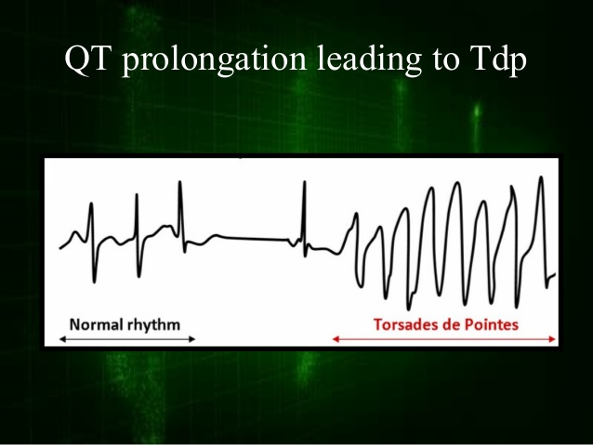
torsades de pointes arrhythmia (twisting of the spikes):
It is the cause of quinidine syncope which is episodes of fainting develop at therapeutic plasma levels.
May terminate spontaneously or lead to fatal ventricular fibrillation. Its lethal

Slide 8
CLASS IC | CLASS IB |  | CLASS
Flecainide | Mexiletine | Lidocaine | Drug
The most potent membrane stabilizer available Supraventricular arrhythmias. Wolff-Parkinson-White syndrome (WPW). (explained next slide) Very effective in ventricular arrhythmias, but very high risk of pro-arrhythmia. Should be reserved for resistant arrhythmias. | Ventricular arrhythmia. Digitalis-induced arrhythmias. (Digitalis are drugs used for congestive heart failure and atrial arrhythmias, yet cause ventricular and other types of arrhythmia as side effect) | Treatment of emergency ventricular arrhythmias e.g.: During surgery Following acute myocardial infarction. Should be available in ER & ICU NOT effective in atrial arrhythmias. | Therapeutic uses:
Pro-arrhythmia. CNS : dizziness, tremor, blurred vision, abnormal taste sensations (Dysgeusia), paraesthesia. heart failure due to -ve inotropic effect. | GIT: Nausea , Vomiting. CNS: since it’s similar in action to Lidocaine Tremor, Drowsiness, Diplopia (Double-vision). CVS: Arrhythmias & Hypotension. | Hypotension. depresses contractility CNS ADRs (similar to other local anesthetics): Paresthesia. تنميل بالاصابع Tremor. رعشة Dysarthria (slurred speech). ثقل باللسان Tinnitus. طنين بالاذن Confusion. Convulsions. تشنجات | ADRs
- | Effective ORALLY. | Given I.V. bolus (small amount given by syringe in mins) or slow infusion (mixing drug with saline and attaching it to a pump that infuse it drop by drop within hrs) (NOT effective orally due to only 3% bioavailability). | Administration
- | 10 Hours. | 2 Hours. | t_{1/2}
Lidocaine = (Lee do what u can) ( to save people in ER )
ابطال الديجيتالwas excellent (Digitalis) (Mexiletine)
WPW = iNi Flecainide
Effective orally, Mexiletine = tongue

Slide 9
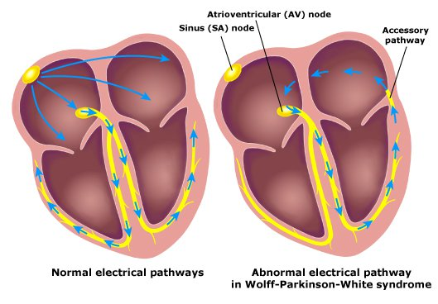
Wolff-Parkinson-White syndrome:
Pre-excitation of the ventricles due to an accessory pathway known as the Bundle of Kent.(the electrical signal re-enters the AV node)
In normal heart the only connection between atria and ventricles is the AV node, some people have congenital abnormality that there’s an accessory piece of pathway called bundle of kent. In this case, the impulses will re-enter and there will be a circle.

Slide 10

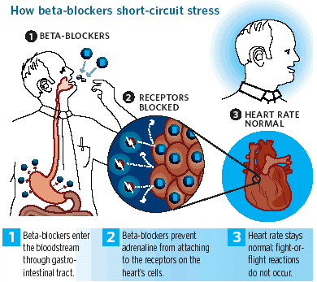
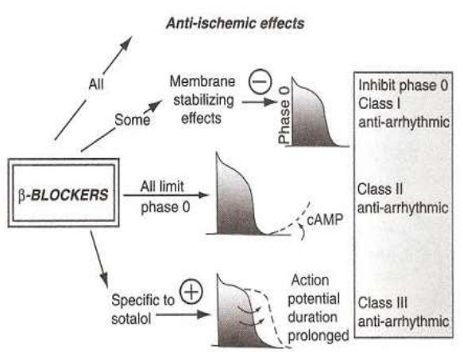
Class II Drugs
β- Adrenoceptors Blockers
Pharmacological actions:
(protect the heart from the arrhythmogenic effect of the sympathetic N.S.)
  Block β1- receptors in the heart
        ⬇
  Reduce the sympathetic effect on the heart
        ⬇
    Decrease automaticity of S.A. node and ectopic pacemakers.
    Prolong refractory period (slow conduction) of the A.V node.
Drugs | Esmolol | Propranolol, Atenolol, Metoprolol
Therapeutic Uses (general) | Atrial arrhythmias associated with emotion: After exercise. Thyrotoxicosis (↑ thyroxine). Wolff-Parkinson-White syndrome (WPW). Digitalis-induced (digoxin) arrhythmias.
Therapeutic Uses (specific) | Very short acting (half-life = 9 min). Given I.V. for rapid control of ventricular rate in patients with atrial flutter or fibrillation. | Used in patients who had myocardial infarction to reduce incidence of sudden death due to ventricular arrhythmias.
بيتك (beta blockers) مليان الكترونيات (digitalis)
لما نعطي الانجيكشن (IV) نسمي ونقول اسم الله (Esmolol)عليك وكل شيء يتيسر و يصير بسرعة(rapid action9 min)
half-life = 10 min in beta blockers lecture

Slide 11
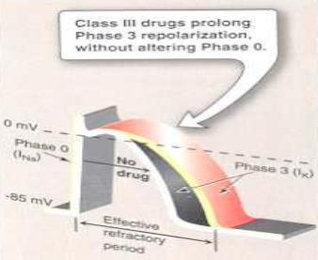
Class III Drugs →
Prolong the action potential duration and refractory period.
Prolong phase 3 repolarization.
Pharmacological effect:
Prolongs action potential duration and therefore prolongs refractory period. (Main effect).
Additional class IA, II & IV effects. (special feature of Amiodarone).
Vasodilating effects: (due to its α & β-adrenoceptor blocking effects and its calcium channel blocking effects).
Drug | Amiodarone (prototype)
Therapeutic Uses | Main use: serious resistant ventricular arrhythmias Maintenance of sinus rhythm after cardioversion Resistant supraventricular arrhythmias (e.g. W.P.W.)
Pharmacokinetics | Extremely long t_{1/2} = 13 - 103 days (causes difficulty in controlling the dose) Metabolized by CYP3A4 and CYP2C8 to its major active metabolite: N-desethylamiodarone (stronger than Amiodarone itself) Eliminated primarily by hepatic metabolism Cross placenta and appear in breast milk (must be careful with pregnant and lactating patients)
ADRs | Exacerbation of ventricular arrhythmias (with high dose) (proarrhythmic) Bradycardia and heart failure Hyper- or hypothyroidism (due to Iodine found in the drug’s structure) Photodermatitis & skin deposits (patients should avoid exposure to the sun) | Neurological: e.g. Tremors and Peripheral neuropathy Nausea, Vomiting and Constipation Corneal micro deposits. Hepatocellular necrosis. Pulmonary fibrosis. (very common, 15% incidence)
Drug Interactions | Co-administration of amiodarone with drugs that prolong the QT interval increases the risk of Torsades de Points arrhythmia. e.g.: - Macrolide antibiotics (Clarithromycin, Erythromycin) - azole antifungals (Ketoconazole). (pharmacodynamic interaction) | Drugs (or substances) that inhibit these enzymes (CYP3A4 and CYP2C8) Cause increase in serum concentration of amiodarone e.g. : Loratadine, Ritonavir , Trazodone, Cimetidine, Grapefruit juice Drugs that induce these enzymes (CYP3A4 and CYP2C8) Cause decrease in serum concentration of amiodarone e.g. : Rifampin (pharmacokinetic interaction)
أمي تدير كل شي
آمي حالتها خطيرة
أمي الله يطول بعمرها long half life
أمي حملتنا وارضعتنا
آمي عندها بلاوي كثيرة cause of many ADRs
آمي صاحبة مشاكل cause of many drug interactions

Slide 12
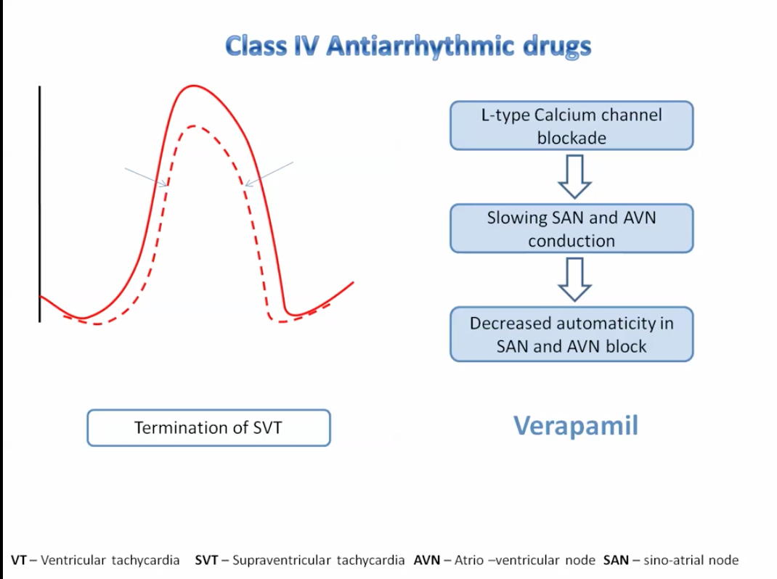
Pure class III: (no additional effects, unlike amiodarone)
Ibutilide:
  Given by rapid I.V. infusion.
  Used for the acute conversion of atrial flutter or fibrillation to normal sinus rhythm.
  Causes QT interval prolongation (may cause torsades de pointes).
Class IV:
Calcium channel blockers
Verapamil, Diltiazem.
  Main site of action on the A.V. node & S.A. node cause:
    Slowing of conduction
    Prolongation of effective refractory period
Therapeutic uses:
  Atrial arrhythmias.
  Re-entry supraventricular arrhythmias e.g. WPW.
NOT effective in ventricular arrhythmias. (contraindicated).
اي بطلت احط عطر و عطر = Atrium
فيه raper اسمها أمل
دليتي عازم ؟
Used only for atrial
عازم وامل يحبون العطر
New Antiarrhythmic Drugs
Dronedarone
  A non-iodinated congener (similar structure) of amiodarone.
  Has antiarrhythmic properties belonging to all four classes.
  Used for maintenance of sinus rhythm following cardioversion in patients with atrial fibrillation.
WARNINGS: (contraindications)
Should not be used in patients with severe (class IV) heart failure. Risk of death may be increased in these patients.
Should not be used in patients with permanent atrial fibrillation. Risk of death and stroke, may be increased in these patients.

Slide 13
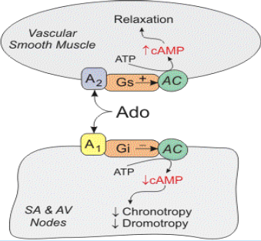
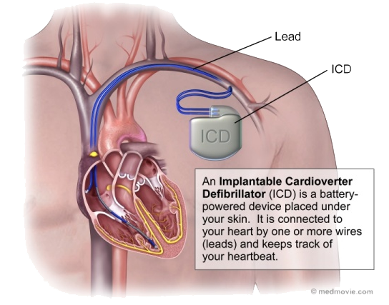
Adenosine
Mechanism of Action:
Inhibits cAMP by binding to adenosine A1 receptors causing the following actions:
Opening of potassium channels (hyperpolarization) (-110 instead of -90 → more difficult to produce action potential)
Decreasing conduction velocity mainly at AV node (negative dromotropic* effect).
Inhibiting phase 4 pacemaker action potential at SA node (negative chronotropic* effect).
Therapeutic Uses | Drug of choice for acute management of paroxysmal (متقطعة) supraventricular tachycardia. Preferred over verapamil (calcium channel blockers have a very strong Inotropic effect) adenosine → safer and does not depress contractility.
Half-life | Less than 10 sec (ideal in emergency).
ADRs | Flushing (dilatation of superficial blood vessels) in about 20% of patients. Shortness of breath and chest burning in 10% of patients (due to bronchospasm). Brief AV block → contraindicated in heart block (because it slows conduction velocity in A.V. node).
Inotropic: effect on contractility.
Dromotropic: effect on conduction velocity.
Chronotropic: effect on heart rate.
Bradyarrhythmias
Atropine
  Used in sinus bradycardia after myocardial infarction and in heart block.
  In emergency heart block Isoprenaline may be combined with atropine (CAUTION) (could cause serious tachycardia)
Nonpharmacologic therapy of arrhythmias:
Implantable Cardiac Defibrillator (ICD):
  Can automatically detect and treat fatal arrhythmias such as ventricular fibrillation.

Slide 14
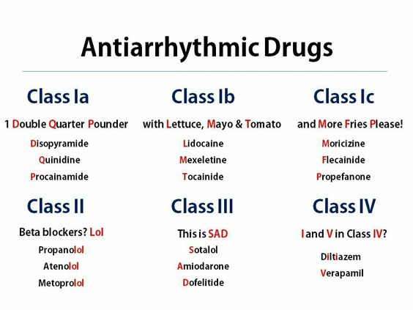
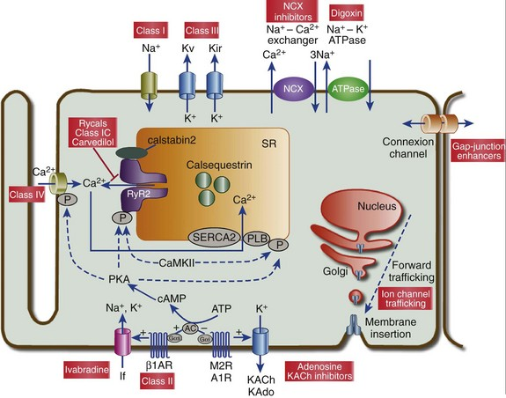
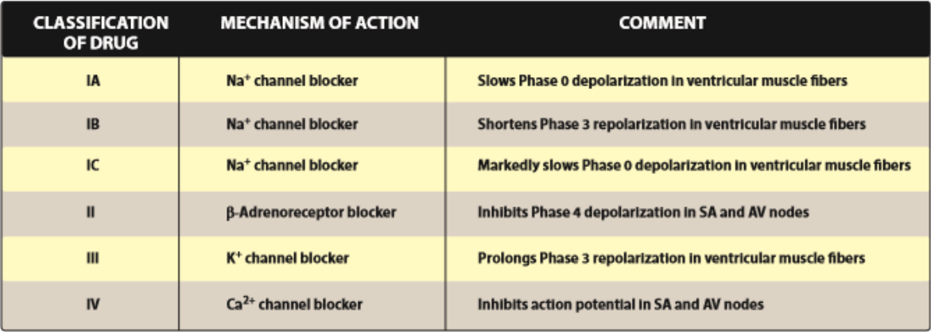

Slide 15
Editing file

