Slide 1
Drug therapy of heart failure
OBJECTIVES:
By the end of this lecture, students should be able to:
- Describe the different classes of drugs used for treatment of acute & chronic heart failure and their mechanism of action
Understand their pharmacological effects, clinical
uses, adverse effects and their interactions with
other drugs

Slide 2
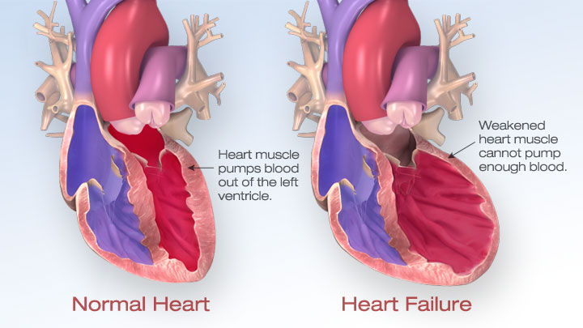
Definition:
Tachycardia.
Decreased exercise tolerance (rapid fatigue).
Dyspnea (pulmonary congestion).
Peripheral edema (usually in the ankle and the feet).
Cardiomegaly (Dilatation and enlargement of the muscle because of blood accumulation).
Heart failure is the Inability of the heart to maintain an adequate cardiac output to meet the metabolic demands of the body.
Causes of HF:
Diseases in the heart such as ( Cardiomyopathy – Heart valve disorder – Abnormal heart rhythm).
Excessive load such as ( Disorder of coronary arteries – High blood pressure).
Symptaoms
Of
Heart Failure

Slide 3
Factors affecting cardiac output and heart failure
Cardiac Contractility (decrease)
Afterload (increase)
Preload (increase)
Pathophysiology of CHF*:
Reduce of Force of contraction which will lead to → low cardiac output
↓ Renal blood flow
↓ Carotid sinus firing
Activate renin-angiotensin-
Aldosterone system
Activate sympathetic system
↑ Sympathetic discharge
ALDOST.
Ag. II
*First there’ll be a reduce of Force of contraction which will lead to low cardiac output, and as a result of this there’re two mechanisms the body will do:
Reduction in cardiac output leads to unloading of baroreceptor ** reflex that, in turn, increases heart rate through vago-sympathetic.
Activatation of renin-angiotensin-Aldosterone system and as a result of this activation the Ag.I will be activated into Ag.I which cause a vasoconstraction . And the aldosterone will cause Salt & Water retention
which will increase the volume.
Remodeling
Salt & Water
Retention
Volume expansion
Vasoconstriction
↑ Force of
Cardiac .cont.
Venous VC
Arterial VC
↑ HR
↑ Preload
↑ Preload
↑ Afterload
**Baroreceptors (pressoreceptors) are sensors located in the blood vessels of all vertebrate animals. They sense the blood pressure and relay the information to the brain, so that a proper blood pressure can be maintained.

Slide 4
Drugs used in treatment of heart failure:
IV- Drugs that increase contractility:
II- Drugs that decrease afterload:
III- Drugs that decrease both preload & afterload:
I- Drugs that decrease preload:
3 -Venodilators
2 -Aldosterone antagonists
1 -Diuretics
(Chlorothiazide – Furosemide)
(Spironolactone – Eplerenone)
(Nitroglycerine Isosorbide dinitrate)
1 - Arteriodilators
(Hydralazine)
1- Angiotensin converting enzyme (ACE) inhibitors
2- Angiotensin receptor antagonists
3- α1-adrenoceptor antagonists
4- Direct vasodilators
(Captopril, Enalapril, Ramipril )
(Losartan, Valsartan, Irbesartan)
Prazosin
Sodium nitroprusside
1- Cardiac glycosides (digitalis)
Digoxin
2- β- adrenoceptor agonists
Dobutamine
3- Phosphodiesterase inhibitors
Milrinone
In heart failure we either give a drug that decreases the preload or the afterload (or a drug that decreases both at the same time) or a drug that increases the cardiac output.
Notes:
( Combined arteriolo- & venodilators )

Slide 5
I- Drugs that decrease preload: |  |  |  |  | II- Drugs that decrease afterload
1-Diuretics: |  | 2-Aldosterone antagonists: |  | 3-Venodilators: | 1-Arteriodilators
Chlorothiazide | Furosemide | Spironolactone | Eplerenone | Nitroglycerine Isosorbide dinitrate | Hydralazine
first-line agent in heart failure therapy. used in volume overload ( pulmonary and/ or peripheral edema ). used in mild congestive heart failure. | a potent diuretic. used for immediate reduction of pulmonary congestion & severe edema associated with: acute heart failure. moderate & severe chronic failure. | Nonselective antagonist of aldosterone receptor. - a potassium sparing diuretic (This drug block the action of a hormone called aldosterone and this causes the kidney to pass out more fluid and keep potassium). - improves survival in advanced heart failure. | - a new selective aldosterone receptor antagonist. (does not inhibit other hormones such as estrogens & androgens). - indicated to improve survival of stable patients with congestive heart failure. | Used I.V. for severe heart failure when the main symptom is dyspnea due to pulmonary congestion. Dilates venous blood vessels and reduce preload. | - used when the main symptom is rapid fatigue due to low cardiac output. - reduce peripheral vascular resistance (decrease afterload).
Mechanism of action in heart failure : reduce salt and water retention ⬇ decrease ventricular preload and venous pressure ⬇ reduction of cardiac size ⬇ Improvement of cardiac performance

Slide 6
III- Drugs that decrease both preload & afterload (most common) |  | Pharmacological actions | Pharmacokinetics |  | Adverse effects | Contraindications
 | 1-Angiotensin converting enzyme (ACE) inhibitors: - considered as first-line drugs for chronic heart failure along with diuretics - first-line drugs for hypertension therapy | 1- Decrease peripheral resistance ( Afterload ) 2- Decrease Venous return (Preload) 3- Decrease sympathetic activity 4- Inhibit cardiac and vascular remodeling associated with chronic heart failure* ⬇ Decrease in mortality rate *الHeart failure اذا طول يغير شكل القلب ، الدواء هذا يمنع هذا التغير | Captopril, Enalapril and Ramipril | Enalapril , Ramipril | 1- Acute renal failure, especially in patients with renal artery stenosis *تضيق في الشرايين اللي بالكلية 2- Hyperkalemia, especially in patients with renal insufficiency or diabetes . 3- Severe hypotension in hypovolemic (decrease in the circulation) patients (due to diuretics, salt restriction or gastrointestinal fluid loss) الشي هذا راح يسبب تطريش واسهال حاد 4- Dry cough sometimes with wheezing. 5- Angioneurotic edema ( swelling in the nose, throat, tongue, larynx). 6- Dysgeusia (reversible loss or altered taste) *فقدان لحاسة التذوق، يرجع طبيعي اذا وقف استخدامه | - During the second and third trimesters of pregnancy الحامل ما تستخدمه طوال فترة حملها (due to the risk of : fetal hypotension renal failure & malformations) - Renal artery stenosis. ( acute renal failure)
 |  |  | - rapidly absorbed from GIT after oral administration - food reduce their bioavailability يأخذ الدواء قبل الاكل | - prodrugs, converted to their active metabolites in liver. - have long half-life & given once daily
 |  | Drugs | Mechanism of action
 | 2- Angiotensin receptor blockers (ARBs) | Losartan, Valsartan , Irbesartan | block AT₁ receptors. ¹Direct in the wall of blood vessel decrease action of angiotensin II
 | 3- α-Adrenoceptor Blockers | Prazosin | blocks α- receptors in arterioles and venules decrease both afterload & preload
 | 4- Direct acting vasodilators1 | Sodium nitroprusside² ²يعتبر الدواء المثالي في حالات الطوارئ لانه يأثر بشكل سريع جدا | given I.V. for acute or severe heart failure acts immediately and effects lasts for 1-5 min.

Slide 7
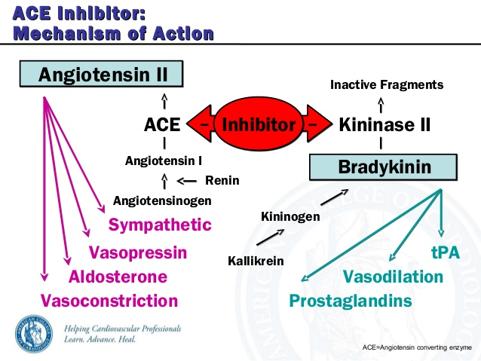

Slide 8
 | IV- Drugs that increase contractility
 | 1- Cardiac glycosides ( digitalis*) *اسم النبتة اللي نستخرج منها الدواء |  | 2- β-Adrenoceptor agonists: | 3- phosphodiesterase -III inhibitors:
Drug | Digoxin - Increases the force of myocardial contraction. ( +ve inotropic effect ) |  | Dobutamine | Milrinone
Mechanism of Action | - Inhibit Na+ / K+ ATPase enzyme ( the sodium pump ) |  | Selective b1 agonist | Inhibits phosphodiesterase -III (present in the heart & B.Vessels) which inhibits cAMP degradation (↑ cAMP ) which leads to: Increase cardiac contractility Dilatation of arteries & veins (reduction of preload & afterload )
Therapeutic uses: | - Congestive heart failure - has narrow therapeutic index |  | Treatment of acute heart failure in cardiogenic shock (Only in acute heart failure because when it is used repeatedly the body adapts to the continued presence of it) | Used only intravenously for management of acute heart failure Not safe or effective in the longer ( > 48 hours) treatment of patients with heart failure
Adverse effects: | Factors that increase its toxicity: - Renal diseases - Hypokalemia - Hypomagnesemia - Hypercalcemia |  |  | Hypotension and chest pain (could be associated with angina) Chemical interaction: Furosemide should not be administered in I.V. lines containing milrinone due to formation of a precipitate مايصلح تعطيهم في نفس الآي في لاين لأن يصير بينهم تفاعل كيميائي)) Enoximone & Vesnarinone New drugs in clinical trials (After trying the drugs on the animals they give Them to some patient to try them)
 | Cardiac: *اخطر من اللي تاثر على الاجهزة الثانية Digitalis-induced arrhythmias - Extra-systoles - Coupled beats (Bigeminal rhythm) - Ventricular tachycardia or fibrillation - Cardiac arrest* *ما فيه أي نشاط كهربائي في القلب تماما | Non cardiac:GIT : Anorexia, Nausea, Vomiting, Diarrhea CNS: Headache, Visual disturbances*, Drowsiness. *ما يتحمل الضوء

Slide 9
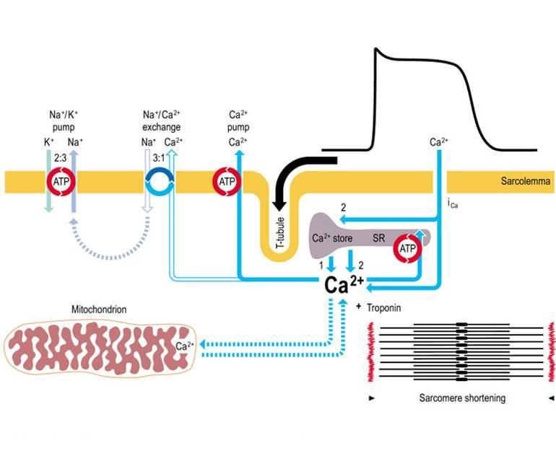
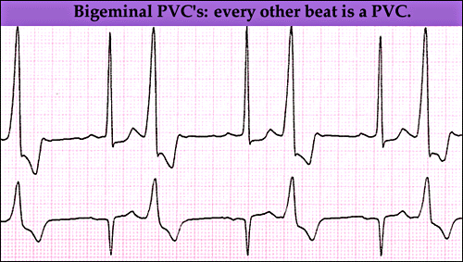
Normal beat
Extra systole
الدواء هذا يسوي تثبيط للصوديوم بمب، نتيجة لذلك راح يزيد الكالسيوم في الخلية، فاذا زاد الكالسيوم راح تزيد الكونتراكتلتي

Slide 10
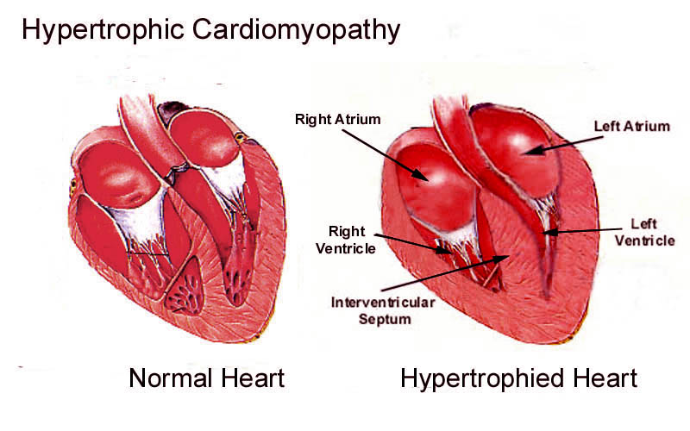
The use of β-adrenoceptor blockers in heart failure:
The elevated adrenergic activity in chronic heart
failure patients cause structural remodeling of the heart
(cardiac dilatation & hypertrophy)*
β-blockers:
- reduce the progression of chronic heart failure
not used in acute heart failure
Mechanism of action of β-blockers in HF:
1- attenuate cardiac remodeling.
2- slow heart rate, which allows the left ventricle to fill more completely.
3- decrease renin release .
(All these factors reduce mortality & morbidity of patients with HF)
The use of β-adrenoceptor blockers in heart failure:
β-adrenoceptor blockers are classified into:
First generation:
Has nothing to do with HF
e.g. propranolol
Second generation:
cardioselective ( β1-receptors )
e.g. Bisoprolol, Metoprolol
- Third generation:
have vasodilator actions ( α- blocking effect)
e.g. Carvedilol , Nebivolol
* For along time (20-30 years ago) β-blockers were contraindicated in patient with heart failure, because they reduce the contractility and the patient already has weak cardiac contractility.
But now after the clinical trials, they found that the adrenergic activities on chronic heart failure cause s cause structural remodeling of the heart (cardiac dilatation & hypertrophy).
And they found that patients who received β-blockers reduced the cardiac remodeling.

Slide 11
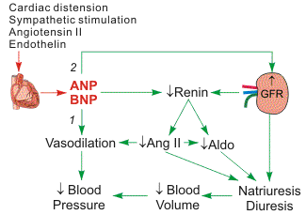
New drugs for heart failure:
1- Natriuretic Peptides:
There are to types of Natriuretic Peptides:
ANP (Atrial Natriuretic Peptides)
BNP ( When they discovered it for the first time they thought that the brain secrets it so they called it Brain Natriuretic Peptides, but then they noticed that it is secreted by the ventricules, so they called it the B-type Natriuretic Peptides)
Nesiritide
BNP is secreted by the ventricules in response to stretch
elevated BNP is associated with advanced
heart failure ( compensatory mechanism in HF )
a purified preparation of human BNP, manufactured by recombinant DNA technology*
↑ cyclic-GMP in vascular smooth muscle, leading to smooth
muscle relaxation & reduction of preload and afterload
indicated for the treatment of patients with Acute Decompensated Heart Failure (ADHF) who have dyspnea at rest or with minimal activity
*All the drugs are synthesized by producing chemical molecules.
Now they can do some drugs by DNA technology using natural substances from the human body

Slide 12
New drugs for heart failure:
Heart Failure Functional Classification
2- Calcium sensitisers:
Levosimendan
mechanism of action:
Calcium sensitization (improves cardiac contractility without
Increasing oxygen consumption)
potassium-ATP channel opening
(cause vasodilation, improving blood flow to vital organs)
These effects reduce the risk of worsening CHF or death compared with dobutamine
NYHA Class | Symptoms
I | Cardiac disease, but no symptoms and no limitation in ordinary physical activity, e.g. no shortness of breath when walking, climbing stairs etc.
II | Mild symptoms (mild shortness of breath and/or angina), slight limitation during ordinary activity.
III | Marked limitation in activity due to symptoms, even during less-than-ordinary activity, e.g. walking short distances (20–100 m).Comfortable only at rest.
IV | Severe limitations. Experiences symptoms even while at rest. Mostly bedbound patients.

Slide 13
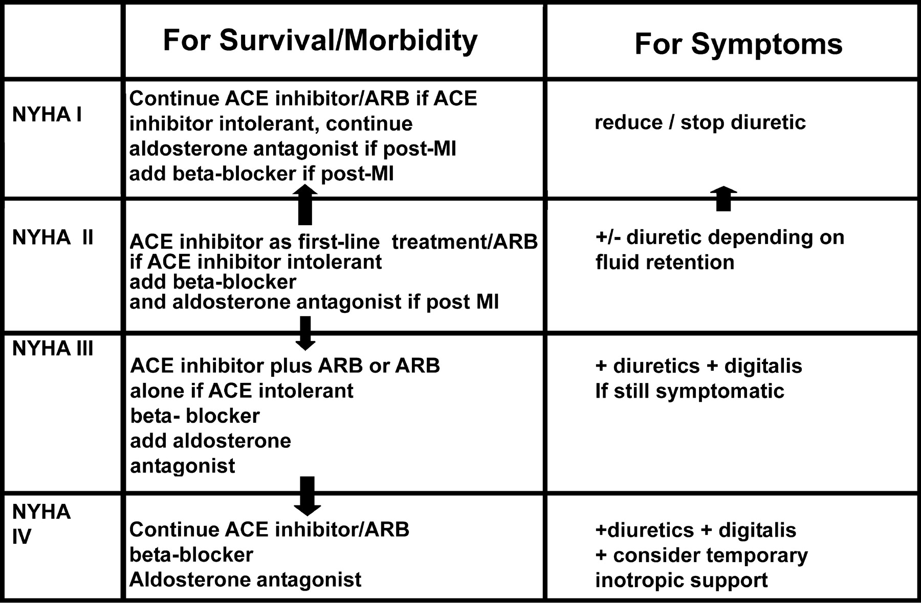
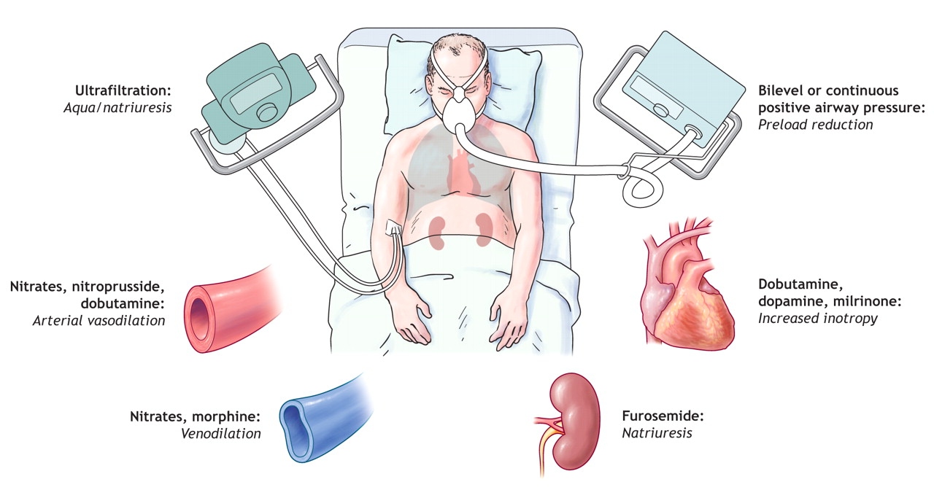
Management of chronic heart failure
Reduce work load of the heart
- Limit patient activity
- Reduce weight
- Control hypertension
Restrict sodium
Stop smoking
Congestive Heart Failure in Black patients
Hydralazine/isosorbide dinitrate
fixed dose combination
FDA approved to add to standard therapy for
black Americans with congestive heart failure
( due to poor response to ACE inhibitors )
should be considered for patients intolerant
to ACE inhibitors & ARBs due to
renal dysfunction

Slide 14
Editing file

