Slide 1

Antihypertensive drugs
OBJECTIVES:
-Identify the factors that control blood pressure.
-Outline the pharmacological classes of drugs used in treatment of hypertension.
-describe mechanism of action, therapeutic uses and common adverse effect and contraindication of each class of drugs.
-select the suitable antihypertensive drug used to treat a specific patient according to efficacy, safety and cost.

Slide 2
High blood pressure (hypertension) :
is a common condition in which the force of the blood is too high that can cause damage and health problem.
Epidemiology:
prevalence: 25-30% of adult population, only 6% of diagnosed hypertension patient have a goal BP even after correct treatment.
It is usually asymptomatic and that’s why it is called silent killer. Untreated hypertension, hypotension will lead to target organ damage. The damage occurring in major organs fed by the circulatory system (heart, kidneys, brain, eyes).
Number One cause of death
Classified into 2 types:
1-primary (essential): no identifiable cause, tends to develop gradually.
2-secondary: *secondary to another disease (kidney disease, adrenal gland tumors) it occurs suddenly.
*drug-induced hypertension, caused by a response to medication, as Estrogens, NSAIDs, corticosteroid, caffeine.
*rebound hypertension occurs after you stop taking or lower the dose of drug e.g.clonidine.

Slide 3
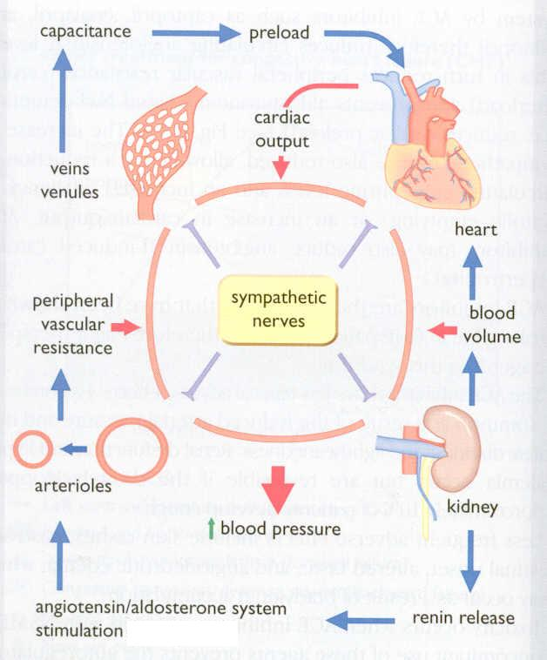
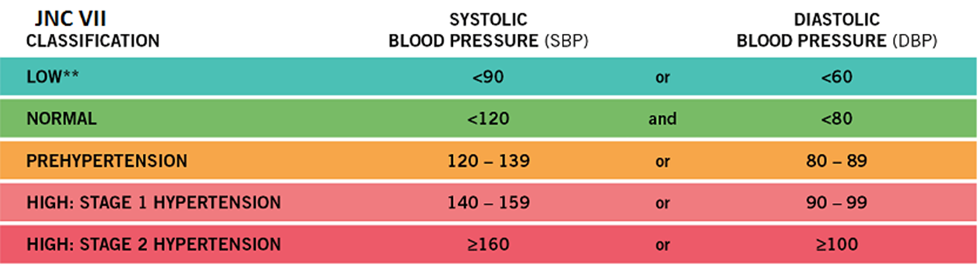
The rule of halves of Hypertension
For every 800 adults in the community
400 are hypertensive (either ↑ SBP or ↑ DBP or both)
Of them only 200 are diagnosed HT
Of them only 100 are started on treatment
Of them only 50 are on correct drug
Of them in only 25 the goal B.P. is attained
Means 25 ÷ 400 = 6% only have goal BP
FACTORS IN BLOOD PRESSURE CONTROL
-Not important to know, mostly related to physiology.
-Target BP for diabetics is <130/80
Stages of hypertension:

Slide 4
1-lifestyle modification:
Risk factor : *old age, obesity, tobacco smoking, lack of physical activities
*chronic condition such as kidney disease and diabetes.
*increased salt (sodium) intake, decrease the potassium. decrease V6
So the patient should follow the lifestyle modification to decrease these risk factor.
2-drug thereby:
The target BP = < 140/90 mmHg
Diabetes melitus = < 130/80 mmHg
3-Classification of Antihypertensive drugs (drug management):
*diuretics.
*ACE Inhibitors.
*ARB.(angiotensin rceptors blockers)
*calcium channel blockers.
*vasodilators.
*drugs acting on the sympathetic nerves system.

Slide 5
Diuretics
Potassium-sparing diuretics | Loop diuretics | Thiazides | Group
Aldosterone antagonists. | Furosmide. | Hydro-chlorothiazide, Chlorthiazide, Chlorthalidone (longer duration of action) | Examples
minimal effect in lowering BP | *hypertension with renal impairment. *in heart failure to manage the symptoms (edema) more potent diuresis but with a smaller decrease in PVR | Use as initial drugs therapy for mild to moderate hypertension According to ALLHAT trial, chlorthalidone is superior to an ACE inhibitor, a calcium channel blocker and an alpha1-adrenergic antagonist in preventing one or more CVD events. | uses
the action will last for 4-6 weeks and then replaced by a decrease in PVR(Peripheral vascular resistance). The diuretics will lower the BP by increasing sodium and water excretion which will decrease the blood volume, resulting in a decrease in Cardiac output and renal blood flow. With long term treatment it will cause a hypotension effect by decreasing the Peripheral resistance by Na+ in vessel wall then Na+ Ca++ exchange which Ca++ in smooth muscles cell wall while the blood volume approaches a normal value. Important |  |  | Mechanism
ممكن نقرأه كذا “ ذا يزيد” اليورينيشن
Thi azide the urenation
ممكن نقرأه كذا “ تمت التحلية” المويه والاملاح Thali done ..

Slide 6
Thiazide diuretics
Long- term
Na⁺ in vessel wall
initial
sodium
& water loss
Na⁺-Ca²⁺ exchange
blood volume
Ca²⁺ in smooth muscle cell
Cardiac
output
Peripheral resistance
Decrease in BP

Slide 7
Drugs acting on the renin- angiotensin - aldosterone (RAAS) system
 | Examples | pharmacokinetics | Mechanism of action | Clinical uses | ADRS | contraindications
Angiotensin-converting enzyme inhibitors | Lisinopril Captopril Ramipril | Polar, excreted in urine =Do not cross BBB Have a long half-life & given once daily / Rapidly absorbed from GIT / after oral administration Food reduces their bioavailability / It takes 2-4 weeks to notice the full antihypertensive effect of ACEIs . Enalapril & ramipril are prodrugs | The antihypertensive effect of ACE inhibitors results primarily from vasodilatation ( reduction of peripheral resistance ) with little change in cardiac output; a fall in aldosterone production may also contribute Particularly effective when hypertension results from excess renin production ( renovascular hypertension, white & young) | -Treatment of essential hypertension. -Hypertension in patients with chronic renal disease, ischemic heart disease, diabetes. -Treatment of heart failure | -Dry cough. -Acute renal failure, especially in patients with renal artery stenosis -Severe hypotension in hypovolemic patients -Cause renal agensia refers to a congenital absence of one or both kidneys/failure in the fetus resulting in oligohydraminosis -Angioneurotic edema, swelling of the nose, throat, tongue, larynx (caused by inhibition of bradykinin metabolism which accumulate in bronchial mucosa) -First dose effect (severe hypotension) - give at bed time -starts with small dose and increase the dose gradually. -specific to captopril; Skin rash, fever, Dysgeusia = reversible loss or altered taste , Proteinuria and neutropenia. These effects are due to a sulfhydryl group in the molecule of captopril | -During the second and third trimesters of pregnancy due to the risk of: fetal hypotension, anuria ,renal failure & malformations. -Renal artery stenosis. -Potassium-sparing diuretics . -NSAIDs impair their hypotensive effects by blocking bradykinin-mediated vasodilatation . Hypovolemic Pregnant women Renal problem Hyperkalemia is a possible complication of treatment with an ACE inhibitor due to its effect on aldosterone. Suppression of angiotensin II leads to a decrease in aldosterone levels. Since aldosterone is responsible for increasing the excretion of potassium, ACE inhibitors can cause retention of potassium. Hyperkalemia may decrease the velocity of impulse conduction in the nerves and muscles, including cardiac tissues. This leads to cardiac dysfunction and neuromuscular consequences, such as muscle weakness, paresthesia, nausea, diarrhea, and others.
 | Enalapril | Enalaprilat is the active metabolite of enalapril given by i.v. route in hypertensive emergency
Angiotensin receptors blockers (ARBs) | CandesatranTelmisartan Losartan, Valsartan, | Losartan; Has a potent active metabolite, Long half-life, taken once daily, Orally effective, Do not cross BBB. | -Cause selective block of AT1 receptors. -No effect on bradykinin, no cough, no angioedema. -Produce more complete inhibition of angiotensin as there are other enzymes ( not only ACE) that can generate angiotensin. |  | Same ADRs, except for dry cough & angioneurotic edema | Same contraindications as ACEI.
 |  | Valsartan; No active metabolites.
ACE=ICE=Snow
Ice in APRIL
نزل ثلج بشهر ابريل
Listen Capto Rami Ena lalah, in APRIL
اسمع كبتوا رامي انا لله وان اليه لراجعون، في شهر ابريل
ان علاء ورامي غير ناضجين
Ena lalah, انا لله وان اليه لراجعون دخلوه الطوارىء
Sartan ARBs سرطان العرب
Cande Tell me LoVal has Sartan

Slide 8
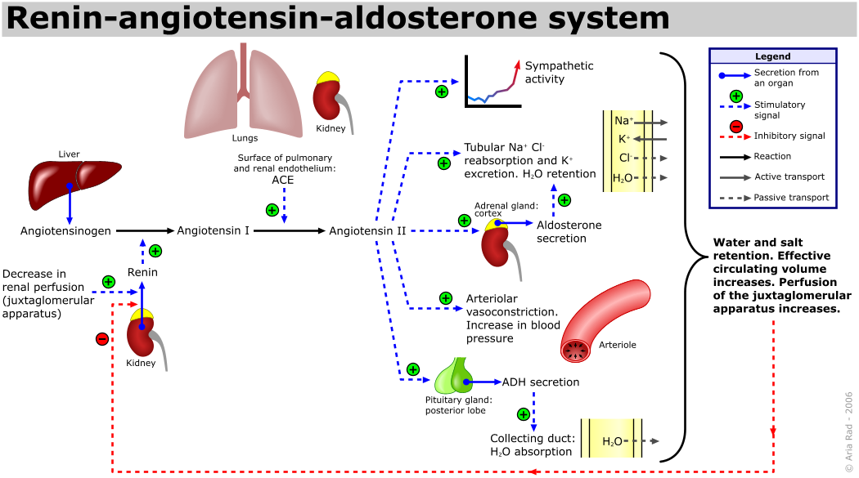
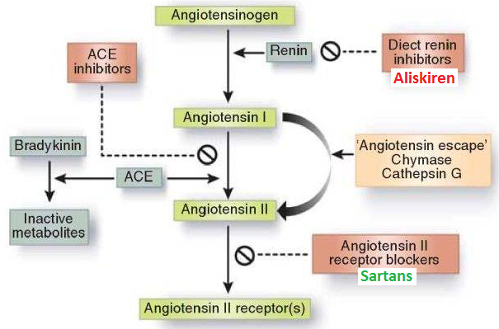

Slide 9
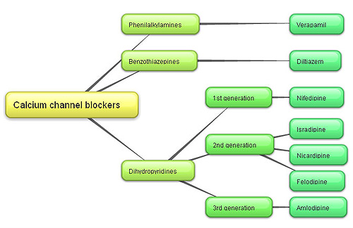
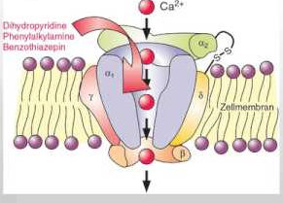
3- Calcium Channel Blockers (CCBs)
or calcium antagonists
Pharmacokinetics
Given orally (onset 0.5-2hr) or IV in emergency (onset 1-3 min)
Well absorbed
Verapamil and nifedipine are highly bound to plasma protiens (more than 90%) while diltiazem is less (70-80%)
Verapamil & diltiazem have active metabolites, but nifedipine has not. nifedipine is Dihydropyridine , its particularly beneficial in treating hypertension.
Sustained-release preparations can permit once-daily dosing.(are preferred for the treatment of hypertension due to the short half- life of CCBs )
V ery (Verapamil)
N ice (Nifedipine)
D rugs (Diltiazem)
أمل ونايف وعازم يحبوا يشربوا حليب
Verapamil
Nifedipine
Diltiazem
Calcium channel Blocker
Verapamil acts more on myocardium.
Dihydropyridine group act mainly on smooth muscle, Nifedipine
It is more selective as vasodilator than a cardiac depressant. This group is used for
treatment of hypertension.
Diltiazem has intermediate effect
Verpamil and Diltiazem are Non-Dihydropyridine, they used in treatment of
atrial fibrillation.
فيه رابر اسمها أمل قلبها رهيف
نايف دا باني عضل
Clinical Use
Treatment of chronic hypertension. Usually the hypertension patient with diabetes or angina.
Nicardipine can be given by I.V. route in hypertensive emergency.
Sustained- release formulations are preferred for the treatment of hypertension due to the short half- life of CCBs (they maintain a constant concentration with less side effects)
Nicardipine = Cardiac shock
Mechanism
Block the influx of calcium through calcium channels (and block excitation-contraction coupling) resulting in:-
1- Peripheral vasodilatation
2- Decrease cardiac contractility
ADRs
Headache, flushing, hypotension (due to vasodilation)
Most of the drugs that treat hypertensive will cause hypotension
Nifedipine: Tachycardia
Verapamil & Diltiazem: peripheral edema (ankle edema*)
Verapamil: constipation (VERY IMPORTANT)

Slide 10
Vasodilators
 | Hydralazine | Minoxidil |  | Diazoxide | Sodium nitroprusside
Site of action | Arteriodilator |  |  |  | Arteriodilator& venodilator
Mechanism of action | Direct ) Release of nitric oxide ( NO)( | Opening of potassium channels in smooth muscle membranes by minoxidil sulfate ( active metabolite ) |  | Opening of potassium channels (potassium comes inside the smooth muscle during relaxation, so the blood vessel will relax ‘dilate’ and that will decrease the blood pressure) | Release of nitric oxide (NO) which is vasodilator
Route of administration | Oral |  |  | Rapid intravenous | Intravenous infusion
Therapeutic uses | Moderate to severe hypertension. Hypertensive pregnant woman (not the first choice) |  | Moderate –severe hypertension Baldness (because it cause growth of hair) | Hypertensive emergency (because it’s administer as IV) Treatment of hypoglycemia due to insulinoma (tumor of the pancreas that secrete insulin) | Hypertensive emergency (because it’s administer as IV) Severe heart failure (it increase the preload and afterload and decrease the resistant)
Adverse effects | Hypotension, reflex tachycardia, palpitation, angina, salt and water retention ( edema) (sometimes we combine these drugs with diuretics to relive the edema) |  |  |  | Severe hypotension Headache, palpatation which dissapear when infusion is stopped
Specific adverse effects | lupus erythematosus like syndrome | Hypertrichosis (increase growth of hair) thus Contraindicated in females |  | Inhibit insulin release from β cells of the pancreas causing hyperglycemia thus contraindicated in diabetics | Methemoglobin during infusion Cyanide toxicity (caused by cyanide accumulation and leads to metabolic asidosis, arrhythmias, sever hypotension and death) Thiocyanate toxicity
Important note | In combination with diuretics & β-blockers (fall in blood pressure produced will activate the sympathetic system and RAAS, to inhibit these 2 mechanisms we use β-blockers ‘inhibit sympathetic’ and diuretics or ACE inhibitors ‘inhibits RAAS’)
ممكن نقرأه “حيدر علاء الزين” يحب الفن(Arteriodialiator)
Na-nitroprusside release NO
الأجانب يقولون لا بطريقتين
No or na
مش حيضر علاء الزين وهو ببطن امه
هيدرا تحب زين، ودايم اللي حولها يقولون هيدرا لَ زين (باللبناني) وهي تحمر من الخجل لمن تسمع هالكلام lupus erythematosus أو الذئبة الحمراء
Hydralazine
Minoxidil = used only for men
Diazoxide= contraindicated in diabetes.

Slide 11
Sympatholytic drugs
β-adrenoceptor blockers
drugs | Propranolol Non selective | Atenolol Selective | Metoprolol Selective
Uses | Mile to Moderate hypertension in sever cases in combination with other drugs They should not be the primary agent for primary prevention but are effective as add-on therapy may take 2 weeks to optimal therapeutic response evidence support using it with patient has concomitant coronary artery disease.
Mechanism of action | Decrease blood pressure by: 1- Decreasing cardiac output (blocking β₁ which is in cardiac muscles) 2- Decreasing renin release (blocking β₁ which is in kidney) 3- Central Mechanism (blocking β-receptors in CNS ‘presynaptic receptors)
Adverse effects | Hypoglycemia Fatigue Mask the symptoms of hypoglycemia in diabetes (contraindicate in diabetes patients) Increase triglycerides Aggravate peripheral arterial disease (as Reynaud's disease) Erectile dysfunction
Note | When discontinued, β- blockers should be withdrawn gradually (to avoid rebound hypertension) Beta blockers cause retention of sodium and water. Diuretics can cause mild volume reduction that leads to an increase in renin secretion by the kidney. The rationale for combining beta blockers with diuretics is twofold: beta blockers blunt the increase in the plasma renin level that is induced by diuretics, and diuretics decrease the sodium and water retention that is caused by beta blockers.
α-adrenoceptor blockers
Drugs | Prazosin | Doxazosin (better or drug for choose , because of duration of action)
Site of effect | α- receptors in arterioles and venules
Mechanism of action | Reduce blood pressure by decrease preload and afterload
Duration of action | Short duration of action | Long duration of action (preferred)
Side effect | causes first dose hypotension & postural hypotension انخفاض الضغط لمن يوقف فجأة | -
Central acting
Drugs | Clonidine | α- methyldopa
Mechanism of action | α2-agonist, diminishes central adrenergic outflow & ↑ parasympathetic outflow by decreasing heart rate & contractility | An α- 2 agonist, is converted to methyl noradrenaline centrally to diminish the adrenergic outflow from the CNS Lead to reduced total peripheral resistance, and a decrease in blood pressure
Uses | hypertension complicated by renal disease (because it Does not decrease renal blood flow or glomerular filtration) resistant hypertension | first line treatment of hypertension in pregnancy
Adverse effect | Abrupt withdrawal may lead to rebound hypertension (more sever than in beta-blockers) | -

Slide 12
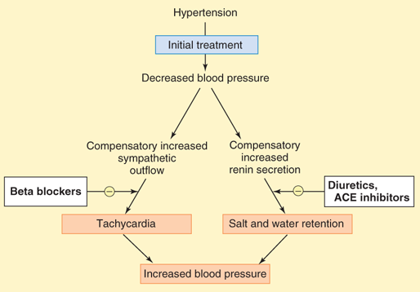
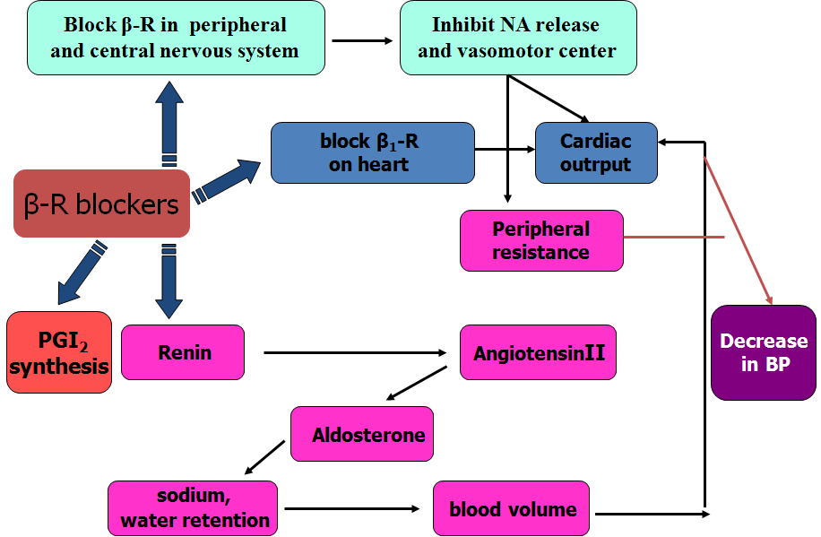
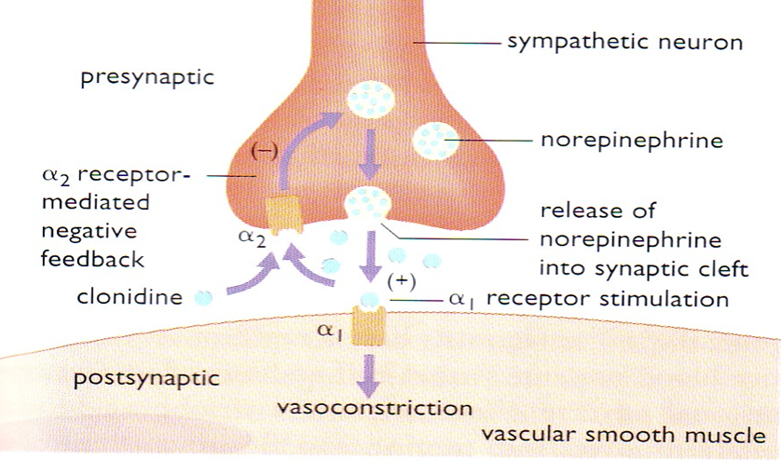
This is a very helpful picture to show you the mechanism of action of the vasodilator and why we use the combination (beta blockers and the diuretics or ACE inhibitors)
blocking of B2 receptor which is found pre-synaptically will inhibit the release of NE so it will inhibit the sympathetic outflow, plus blocking of B1 receptor will decrease renin secretion > decrease Ang II & aldosterone secretion thus decrease BP.
This picture show you the mechanism of action of beta blockers
As we mentioned they decrease BP by blocking:
(blocking β₁ which is in cardiac muscles so decrease the sympathetic stimulation → decrease heart rate
(blocking β₁ which is in kidney → inhibit renin system → decrease BP
Non-specific beta blockers will block all beta blockers ‘post-synaptic or peripheral receptors and pre-synaptic receptors’ which at the end decrease BP
This picture show you the mechanism of action of central acting blockers:
Clonidine: the α2 receptors works by reuptakes the NE, so low sympathetic effect. The drug will increase the receptors' work, so more uptake of NE and more less of sympathetic effect
The vesicles (the circles with white-blue droplet) has methyl noradrenaline which will converted into norepinephrine, the drug will come and convert the methyl noradrenaline into α- methyldopa which cannot produce sympathetic effect

Slide 13
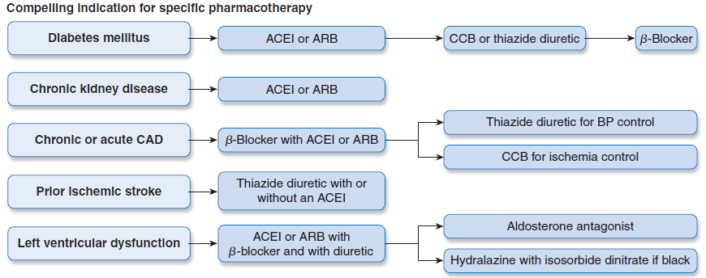
*
Last one isn’t important

Slide 14
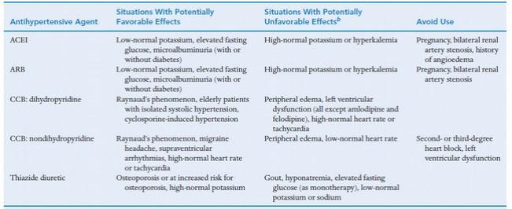
The next few slides are clinical cases, the doctor said it wont be in the exam, but you should go through them.

Slide 15
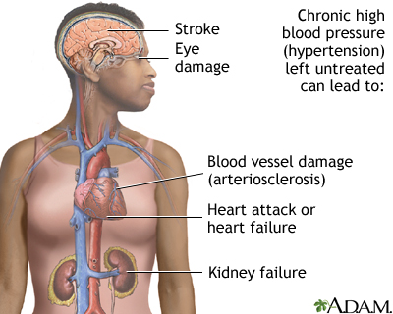
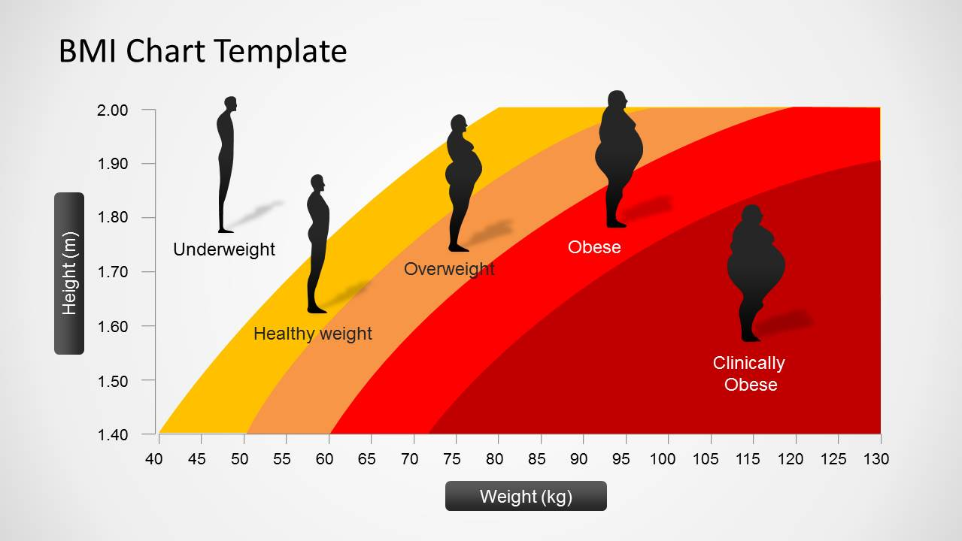
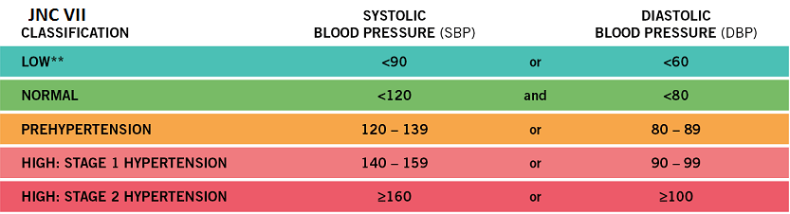
Osman a 51-year-old man (95 Kg weight, 176 cm tall) is referred for evaluation of his BP. He is diabetic for 5 years and hypertensive since 12 years, with no history of hypertension target-organ damage. Examination revealed normal heart sounds, no peripheral edema, and mild arteriolar narrowing in the fundus. His BP was 156/90 mmHg, similar in both arms and did not change on standing. Urine analysis showed an unremarkable dipstick evaluation. The patient was suspected as having drug- resistant hypertension.
His medications are listed in the accompanying table.
Name | Dose | Frequency
Hydrochlorothiazide | 25mg | Daily
Valsartan | 160mg | Daily
Diltiazem, long-acting | 300mg | Daily
Clonidine | 0.2mg | Twice daily
Metoprolol, long acting | 100mg | daily
Simvastatin | 40mg | Daily
Fenofibrate | 145mg | Daily
Metformin | 1g | Twice daily
Osman has no history of hypertension- target organ damage. What are organs affected adversely by persistent high BP?
Osman is 95 kg. Is this weight proper for his length (176cm)?
The seated BP of Osman was 156/90, what are the target BP values for treatment of hypertensive patients?
<140/90 mm Hg
Osman is diabetic, what are the target BP values for a diabetic?
130/80 mm Hg
Weight loss
DASH plan
Sodium reduction
Physical Activity
Moderation of alcohol intake
Smoking Cessation
What are the lifestyle modifications, a hypertensive patient should follow?
What are the classes of hypertension?

Slide 16
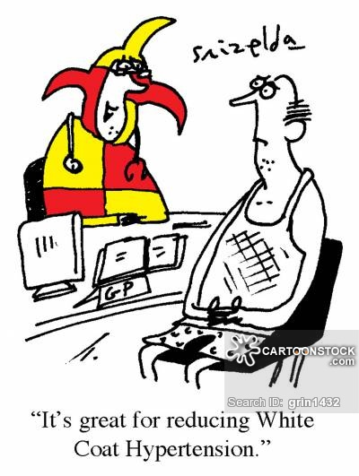
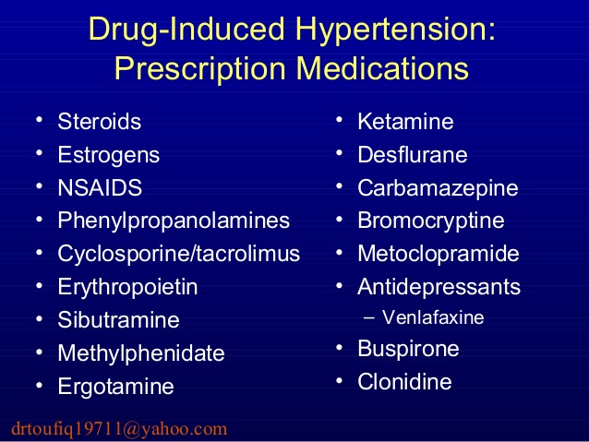
Could the “white coat phenomenon” be the cause for Osman’s high blood pressure readings?
In a Turkish study involving 438 patients, 43% were found to be white coat hypertensives (high pulse rate)
Could the failure of control of Osman BP be due to secondary drug – induced effects?
Which drugs elevate blood pressure?
By causing volume and sodium depletion, thiazide diuretics stimulate the production of renin and angiotensin. This leads to a relative increase in blood pressure and sodium retention, which counteracts some of the other antihypertensive effects of the thiazide diuretics. ACE inhibitors interfere with the conversion of angiotensin I to angiotensin II and thereby decrease angiotensin II levels. These effects lead to decreased sodium retention and an enhanced antihypertensive effect.
A 63-year-old hypertensive woman had been receiving an
antihypertensive drug for 15 days. The following serum
values were obtained from the patient before and after drug therapy.
Which drug the woman has been receiving?
Osman was prescribed thiazides & diltiazem. What is the benefit of combining thiazides and diltiazem? (ankle edema)
Thiazides cause increase secretion of salts and water which treats the ankle edema caused by diltiazem.
The BP of Osman did not change on standing. What is your conclusion?
No postural hypertension. (On standing the vessels constrict to maintain blood supply to the head)
The BP of Osman was almost the same in both arms. What does that imply?
A slight fluctuation below 5 mmHg is normal between two arms, and can be explained by asymmetrical differences in muscles and tissue in each arm. But a big difference in BP could be a result of atherosclerosis, stenosis, of a large artery.
Plasma level | Before | After
Aldosterone | High | Low
Potassium (mEq/l) | 3.5 | 4.3
Renin | Normal | High
Angiotensin II | High | Low
Osman was prescribed hydrochlorthiazide &
valsartan.What is the rationale for combining hydrochlorothiazide and valsartan?

Slide 17
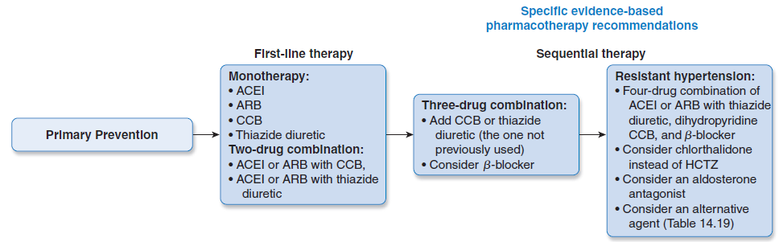
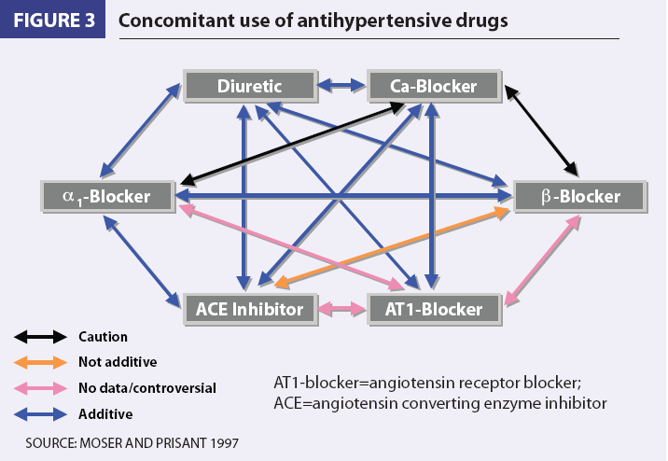
List the reasons, why Osman failed to respond to antihypertensive therapy?
Could the failure of Osman control of BP be due to the use of inappropriate combinations of drugs?
Use of combinations→↓ individual dose→↓ ADRs
Select a drug that ↓ the ADR of another, e.g. thiazides versus ACEI
Select a drugs that act by different mechanisms

Slide 18
Editing file

