Slide 1
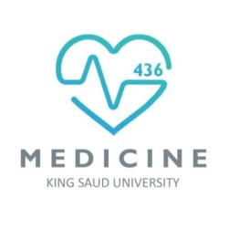
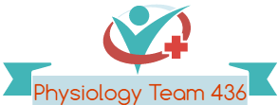
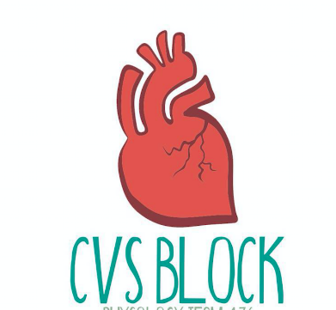

Contractile Mechanisms in Cardiac Muscle
Red: very important.
Green: Doctor’s notes.
Pink: formulas.
Yellow: numbers.
Gray: notes and explanation.
Physiology Team 436 – Cardiovascular Block Lecture 1
Lecture: If work is intended for initial studying.
Review: If work is intended for revision.

Slide 2
Objectives
Study Smart: focus on mutual topics.
From the guide:
Define cardiac muscle contractility
Describe the mechanism of excitation contraction coupling
Understand the mechanism of isovolumetric and isometric contraction
Factors affecting cardiac contractility
From slides:
Describe the general features and overall design of the cardiovascular system.
Explain how the heart accomplishes its function as the central pump of the cardiovascular system.
Understand the phases of cardiac action potential and the ionic bases
Describe the structure of a typical myocyte.
Explain sliding-filament mechanism of contraction.
Summarize the effects of sympathetic and parasympathetic stimulation on cardiac contractility.
Discuss the role of calcium ions in the regulation of cardiac muscle function

Slide 3
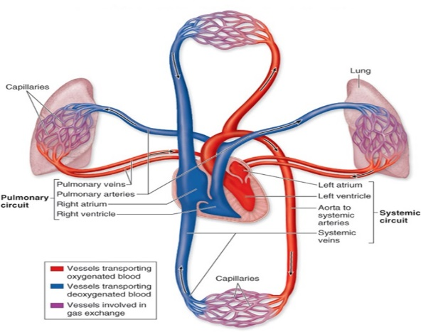
Components and Functions of Cardiovascular System
Introduction:
ONLY IN MALES’ SLIDES
Components of CVS:
CVS consists of the heart and blood vessels.
It is a closed system in which blood circulates. Therefore, we call it circulatory system.
Main functions of CVS:
Delivery of O2, glucose and other nutrients to active tissues.
Removal of CO2, Lactate and other waste products (by-products of metabolism) from active tissues.
Participate in homeostatic mechanisms.
Adjustment of oxygen and nutrient supply in different physiologic states.
Transport of metabolites and other substances to and from storage sites.
Transport of hormones, antibodies and other substances to site of action.
Defense.
Thermoregulation.
(Mainly transport functions)

Slide 4
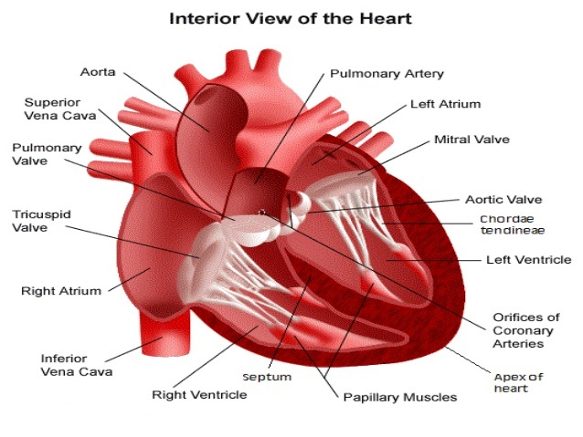
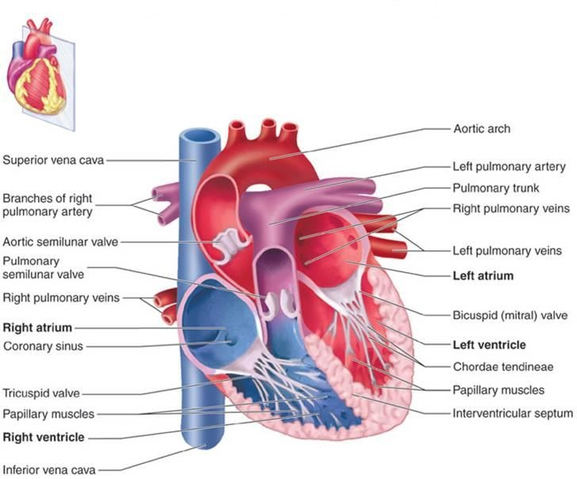
The Heart as a Central Pump
Introduction:
ONLY IN MALES’ SLIDES
The right and left atria | The right and left ventricles
Thin-walled, low pressure chambers.
They function as blood reservoirs for their respective ventricles.
Under normal conditions, the atria are not important as pumps.
Are the principle pumps of the cardiovascular system. They are capable of generating flow with pressure.
The right ventricle is considerably thinner than the left ventricle.
The thickness of the ventricular wall is related to pressure generated. LV has higher pressure and a thicker wall than RV
‎The flow in left and right ventricle is the same; however, pressure is higher in the left ventricle.
Systole (contraction phase) + Diastole (relaxation phase) = Heart beat (cardiac cycle).

Slide 5
The Heart as a Central Pump
Introduction:
ONLY IN MALES’ SLIDES
Cardiac valves:
The atrio-ventricular valves (AV valves)
1. Tricuspid valve (between RA & RV)
2. Mitral valve(bicuspid valve). (between LA & LV)
The semilunar valves are:
1. Aortic valve (between LV & aorta)
2. Pulmonary valve (between RV & pulmonary trunk)
The edges of the AV valves are attached to ventricular papillary muscle by the chordae tendineae. (why) In order to prevent eversion* of valves during ventricular systole (contraction phase).
For effective pumping, the heart must be functioning properly in five basic respects:
The contractions of individual cardiac muscle cells (myocytes) must occur at regular intervals and be synchronized (not arrhythmic).
The valves must open fully (not stenotic**).
The valves must not leak (not insufficient or regurgitant).
The ventricular contractions must be forceful (not failing).
The ventricles must fill adequately during diastole.
1
2
3
4
5

Slide 6
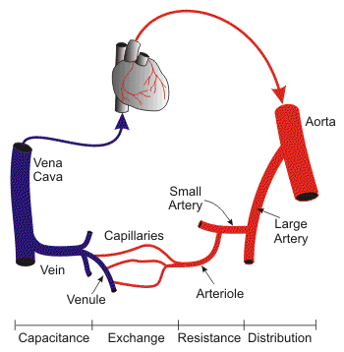
Introduction:
ONLY IN MALES’ SLIDES
Blood Vessels (Explanation)
Heart → aorta → large artery → small artery → arterioles
Vena Cava ← Vein ← Venule ← Capillary ← Arteriole
Aorta and large arteries have high pressures so their function is DISTRIBUTION.
Small arteries and arterioles have low pressure so their function is RESISTANCE.
(Arterioles have the highest resistance in circulation → significant drop in pressure in order to decrease the pressure of the blood going to capillaries )
لو كان الدم الي جاي للكابيلاريز ضغطه عالي بتتفجر الكابيليريز

Slide 7
Introduction:
ONLY IN MALES’ SLIDES
Blood Vessels
HEART
VEINS
Are also called (Volume reservoirs)
(HIGH COMPLIANCE)
(LOW PRESSURE)
MORE BLOOD VOLUME
VEINS
CAPACITY
VESSELS
ARTERIES
Are also called (Pressure reservoirs)
(LOW COMPLIANCE)
(HIGH PRESSURE)
LESS BLOOD VOLUME
Recall
COMPLIANCE: is the property of undergoing elastic deformation , as change in volume when subjected to an applied force.
CAPILLARIES

Slide 8
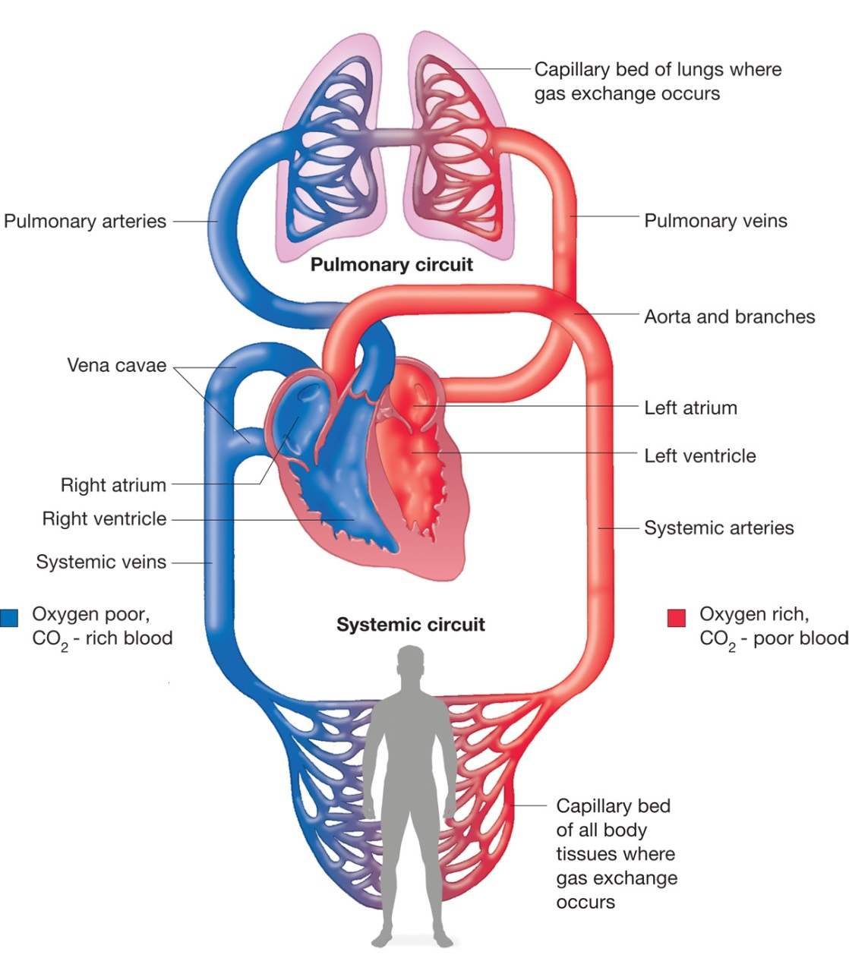
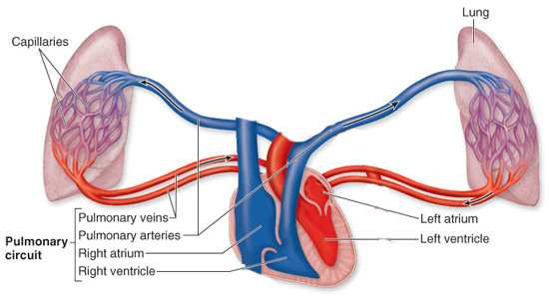
Introduction:
ONLY IN MALES’ SLIDES
Systemic and Pulmonary Circulations
Systemic Circulation:
Pulmonary Circulation:
Starts at LEFT VENTRICLE and ends at RIGHT ATRIUM
Starts at RIGHT VENTRICLE and ends at LEFT ATRIUM
These 2 circulation are connected in series.

Slide 9
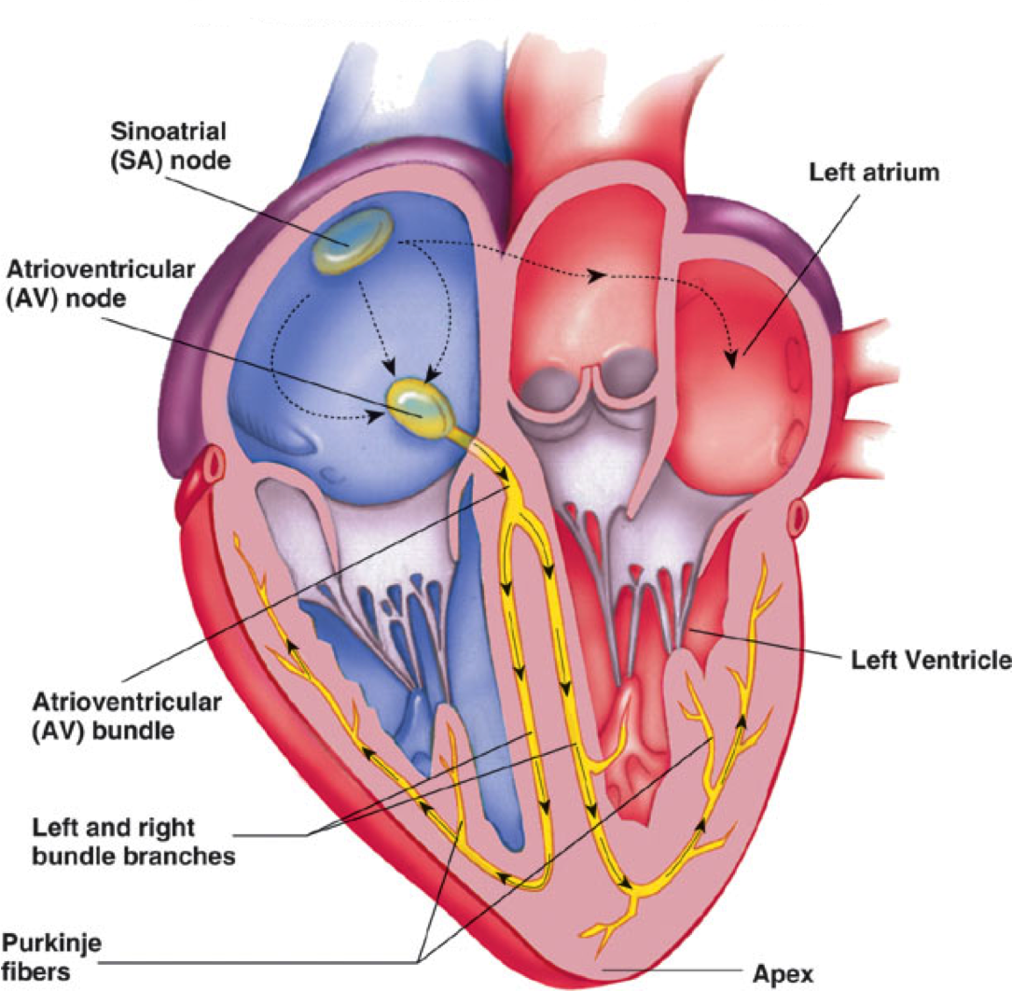
How the Heart Performs its Function as the Central Pump of the CVS
ONLY IN MALES’ SLIDES
The heart has four basic properties which are essential for its functioning as the central pump of the CVS. These are:
Autorhythmicity
Conductivity
Excitability
Contractility
There are 2 main types of cells in the heart:
Cells of the specialized conduction system. (SA node, AV node, AV bundle, Left & Right Bundle Branch, Purkinje fibers)
Contractile cells (myocytes; working cells). (wall of atria & inter-arterial septa and wall of ventricle & inter-ventricular septa)

Slide 10
Ultrastructure of myocyte (the contractile, working cell)
The cardiac muscle cells (fibers; myocytes) branch and interdigitate, but each is a complete unit surrounded by a cell (plasma) membrane (sarcolemma).
Where the end of one muscle fiber abuts (adjoin) on another, the membranes of both fibers parallel each other through an extensive series of folds. These areas are called intercalated disks (intercalated discs: cell membranes, separate individual cardiac muscle cells from one another).
Thus, each fiber is separated from its neighboring fibers by its sarcolemma (laterally) and by the intercalated disks (end-to-end).
Cardiac muscle cell contains large amounts of mitochondria to provide continuous ATP for the cell.
Cardiac muscle has a rich capillary supply: about 1 capillary per fiber.
T-tubule
Sarcolemma
Mitochondria
SR
Fibrils
NOTE: unlike Skeletal muscles , the cardiac muscle fiber DOES NOT mean muscle cell , the cardiac fiber consists of several cardiac muscle cells

Slide 11
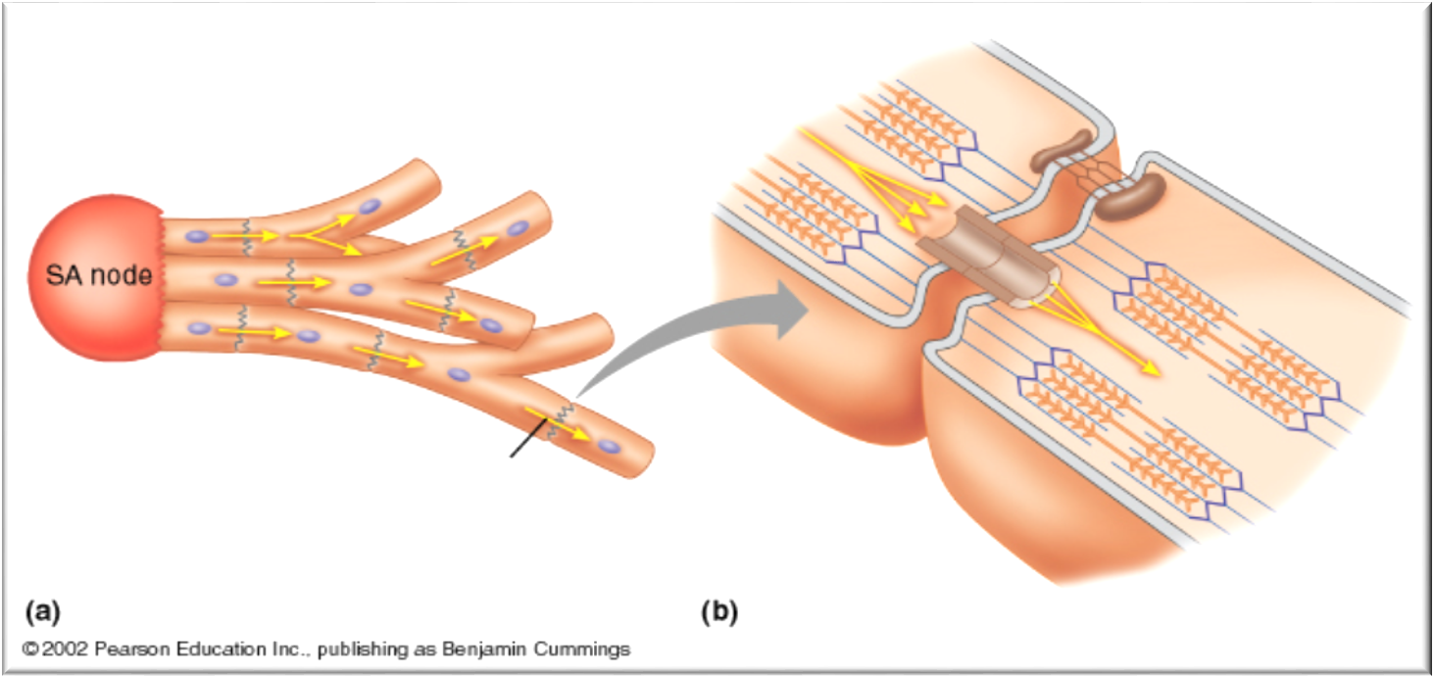
Mechanical Coupling and Electrical Coupling
Gap junctions: are trans-membrane channel proteins, connecting the cytoplasm of the neighboring cardiac muscle cells.
They allow free diffusion of ions between neighboring cells.
Action potentials can also travel from one cardiac muscle cell to another.
So intercalated discs allow passage of current through cells, this mechanism ensures electrical coupling of the cells.
intercalated discs enable synchronization of contraction of cardiac muscle by:
Providing mechanical coupling
Providing electrical coupling
Allows free diffusion of ions between neighboring cells. Action potentials can also travel from one cardiac muscle cell to another.
Desmosomes resist stretching and prevent detachment of the cardiac fibers during contraction.

Slide 12
Cardiac Muscle is a Syncytium
Cardiac muscle functions as a syncytium* as each muscle cell is electrically connected to its neighboring cells through the gap junctions.
Thus, stimulation of a single myocyte:
  → the action potential spreads from cell to cell through the gap junctions.
  → synchronous** contraction of all the myocytes.
The atrial syncytium is separated from the ventricular syncytium by the fibrous tissue surrounding the valvular openings (fibrous skeleton of the heart).
Differences between cardiac and skeletal muscles
Cardiac Muscle
T system in cardiac muscle is located at the Z lines of the sarcomeres
The sarcoplasmic reticulum makes complexes with the transverse tubular membrane at dyad junction
Skeletal Muscle
T system in skeletal muscle is located at the A–I junction
The sarcoplasmic reticulum makes complexes with the transverse tubular membrane at triad junctions.
Cardiac muscle cells (myocytes) typically resemble skeletal muscle in also having:
(a) Myofibrils packed in the cytoplasm (sarcoplasm), (b) specialized transverse tubular and sarcoplasmic reticular membrane systems.
Syncytium*: a group of cells in which the cytoplasm of one cell is continuous with that of adjoining cells.
Synchronous**: existing or occurring at the same time.

Slide 13
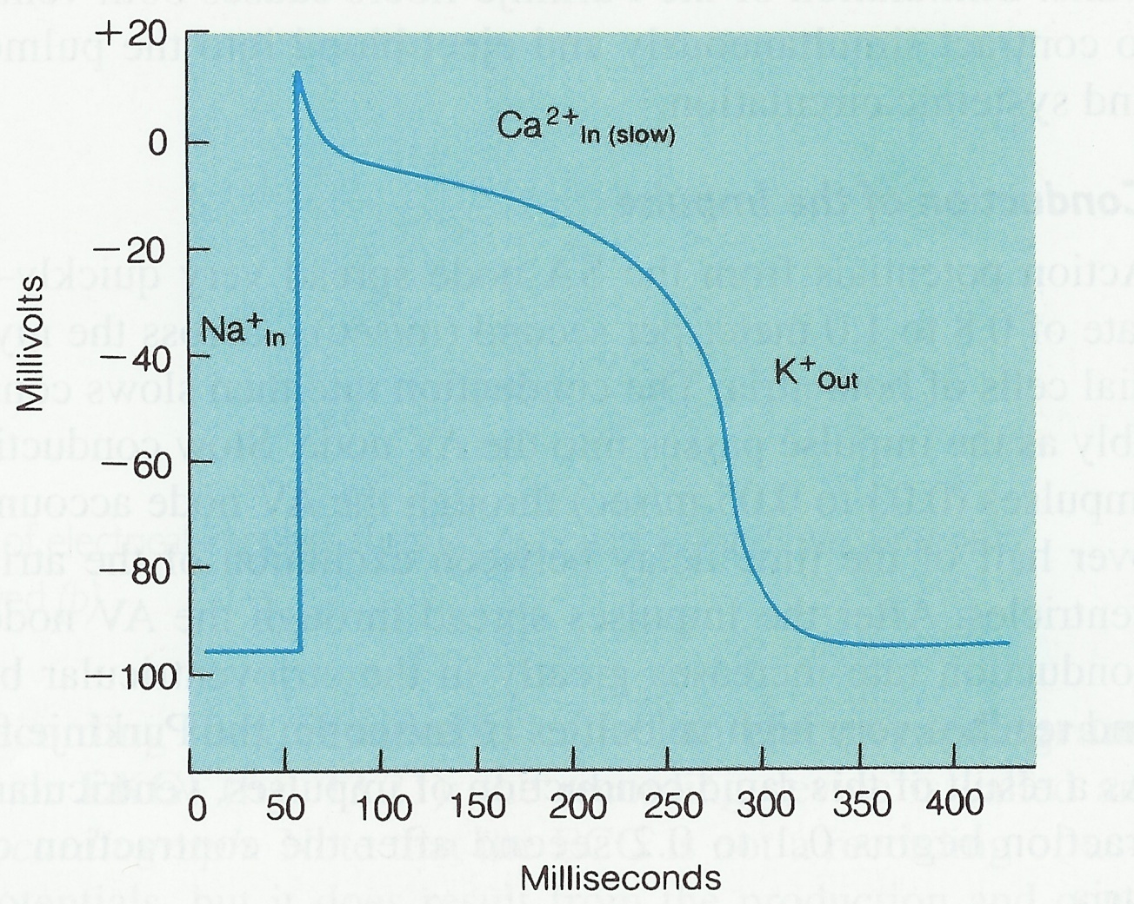
Action Potential in Cardiac Muscle
ONLY IN FEMALES’ SLIDES
Resting membrane potential -90 mV (it is more negative inside the cell comparing to the ECF)
Duration of cardiac action potential is 0.4 seconds
Phases of cardiac Action Potential | Ionic changes
0- Rapid depolarization (+20 mV) | Fast sodium channels opens → Na⁺ influx
1- Partial repolarization (5-10mV) | Opening of K⁺ channels → K⁺ out
2- Action potential plateau (0 mV) In this phase the membrane potential will stay steady | Slow calcium channels opens → Ca²⁺ influx وقناة البوتاسيوم لاتزال مفتوحة لكن تقل النفاذية
3- Repolarization (back to RMP) | K⁺ out
1
2
0
3
stimulus
4

Slide 14
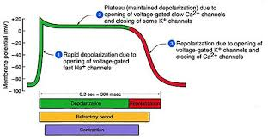
Action Potential in Cardiac Muscle
ONLY IN FEMALES’ SLIDES
What causes the Plateau in the Action Potential?
The main cause is slow calcium channels: slow to open & remain open for several tenths of a second → Large quantity of calcium ions flow into the interior of the cardiac muscle fiber → maintains prolonged period of depolarization → causing the plateau in the action potential.
Another factor to maintain the plateau phase is the decreased permeability of the cardiac muscle membrane for potassium ions → decrease outflux of potassium ions during the action potential plateau.
When the slow calcium channels close at the end of the plateau, the membrane permeability for potassium ions increases rapidly, and this returns the membrane potential to its resting level, thus ending the action potential.
الكالسيوم شحنته موجبة أكثر من البوتاسيم . فيكون هو يدخل والبوتاسيوم يطلع في نفس الوقت فيكون ما في تغير في الشحنة داخل وخارج الخلية = تظل متساوية وفي الرسم تكون عند الصفر

Slide 15
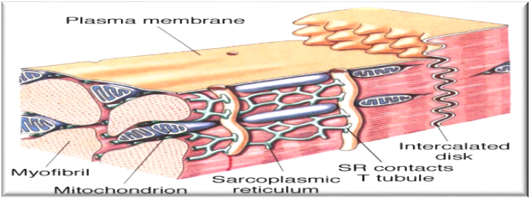
Calcium-induced Calcium Release through the
Ryanodine Receptors (RyR) at the Sarcoplasmic Reticulum
ONLY IN MALES’ SLIDES
In the myocytes, a significant Ca²⁺ influx comes from extracellular space during the plateau phase of the action potential.
The role of Ca²⁺ in excitation–contraction coupling in myocytes is similar to its role in skeletal muscle; (the term “excitation-contraction coupling” refers to the mechanism by which the action potential causes the myofibrils of the muscle cell to contract).
However, it is the influx of extracellular Ca²⁺ through the voltage-sensitive Dihydropyridine receptors (DHPR) in the T system (L-type calcium channels), which triggers calcium-induced calcium release through the ryanodine receptors (RyR) at the sarcoplasmic reticulum*.
Cardiac ryanodine receptors are different from the skeletal muscle ryanodine receptors.

Slide 16
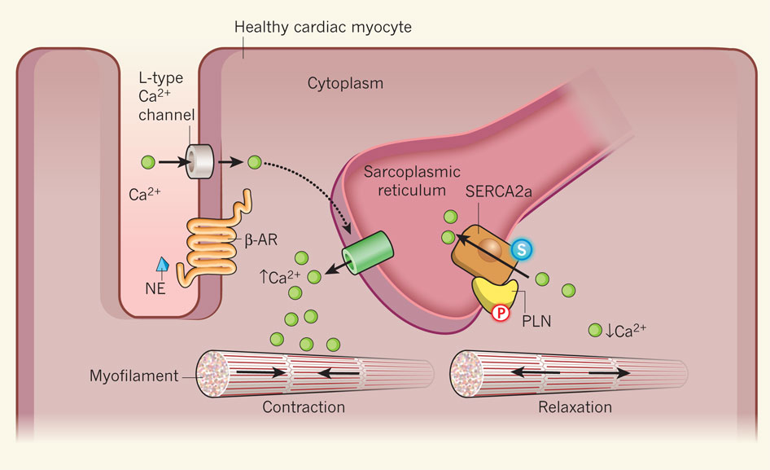
Mechanism of Calcium-induced Calcium Release through the Ryanodine Receptors (RyR) at the Sarcoplasmic Reticulum
ONLY IN MALES’ SLIDES
When the myocytes are excited, the action potential spreads through sarcolemma and travels down to the transvers tubules.
The action potential will open Voltage-gated L-type calcium channels (dihydropyridine receptors DHPR), then Ca²⁺ ions move inside the cell (from extracellular fluid).
Ca²⁺ ions bind to the ryanodine receptor of the sarcoplasmic reticulum to trigger releasing the stored Ca²⁺ in the sarcoplasmic reticulum.
The ryanodine receptors are now opened, the stored Ca²⁺ are released.
The increased intracellular Ca²⁺ level will cause contraction of the myocytes.
شرح:
لما يكون فيه excitation , ال action potential راح ينشر في sarcolemma & T-tubules الى ما يوصل لل DHPR , راح يفتحها و الكالسيوم راح يدخل جوا الخلية.
لما يدخل الكالسيوم راح يرتبط في ryanodine receptor و راح يحفز ال Ca²⁺ releasing , هذا الكالسيوم راح يسبب انقباض عضلات القلب.

Slide 17
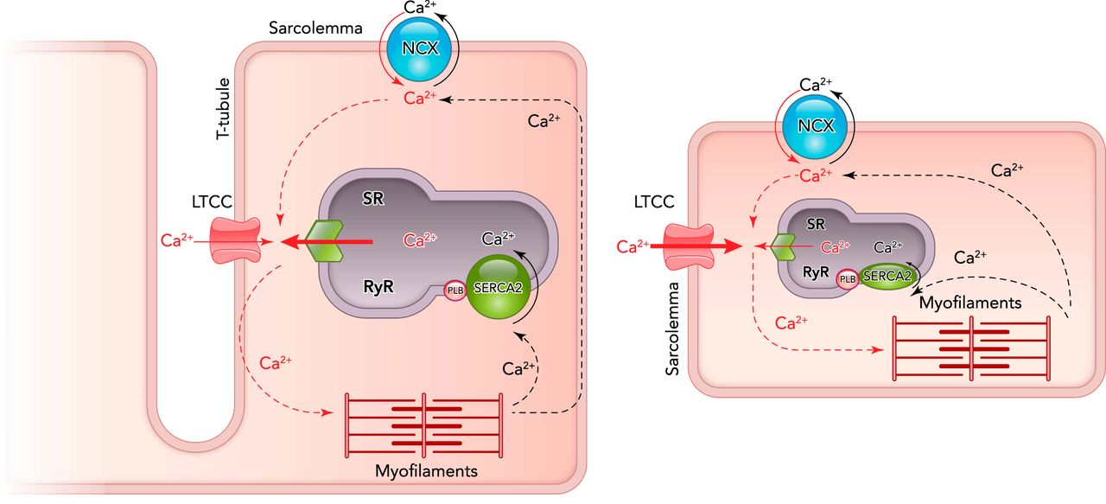
Cont.
ONLY IN MALES’ SLIDES
External Ca²⁺ (Ca²⁺ influx) is required for the excitation-contraction coupling in the heart, but is not sufficient to produce contraction by itself. It is used as a trigger for Ca²⁺ release from the sarcoplasmic reticulum.
This calcium-induced calcium release is pH sensitive, showing strong inhibition at pH 6.5 and maximal release at pH 7.4.
Voltage-gated L-type calcium channels are present on the sarcolemma as well as the T-tubules.
The Voltage-gated calcium channels are usually very near to the ryanodine receptors, so that Ca²⁺ influx will induce high local levels of Ca²⁺.
الكالسيوم اللي يدخل للخلية غير كافي لحاله انه يسبب انقباض عضلات القلب, عشان كذا راح نحتاج ال sarcoplasmic reticulum لأنها راح تفرز كمية كالسيوم اكبر كافية انها تسبب انقباض عضلات القلب .

Slide 18
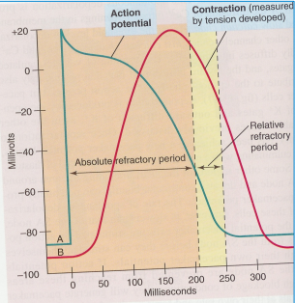
Refractory Period of Cardiac Muscle
ONLY IN FEMALES’ SLIDES
Video of (cardiac AP &refractory period)
Duration: (7)mins
Cardiac muscle is refractory to re-stimulation during the action potential.
The refractory period of the heart: is the interval of time during which a normal cardiac impulse cannot re-excite an already excited area of cardiac muscle.
 | Absolute Refractory Period | Relative Refractory Period
Definition | Cardiac muscle cannot be excited while it is contracting | Cardiac muscle can be excited by strong stimulus
Benefit | Long ARP | -
Time | Depolarization and 2/3 repolarization | Repolarization
Duration | 0.25 - 0.3 sec | 0.05 sec
In SKm | Longer than that of SKm

Slide 19
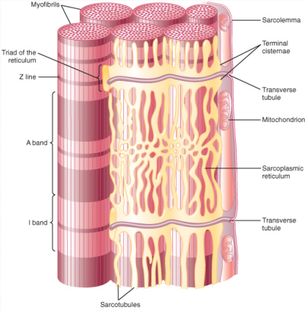
Excitation Contraction Coupling
ONLY IN FEMALES’ SLIDES
Excitation – Contraction Coupling: is the mechanism by which the action potential causes muscle contraction.
Action potential spreads to the interior of the cardiac muscle fiber along the transverse (T) tubules.
The T tubules of cardiac muscle have a diameter 5 times as great as that of the skeletal muscle tubules.
The strength of contraction of cardiac muscle depends to a great extent on the concentration of calcium ions in the extracellular fluids.
At the end of the Plateau of the action potential → calcium ions are pumped back into the sarcoplasmic reticulum and the T-tubules → contraction ends (repolarization)
Action Potential spreads along the T-tubules
1. Release of calcium ions from sarcoplasmic reticulum into the sarcoplasm 2. Large quantity of extra calcium ions diffuses into the sarcoplasm from the T tubules
Calcium ions diffuse into the myofibrils
Ca2+ binds to troponin causing sliding of actin and myosin filaments
Contraction of cardiac muscle

Slide 20
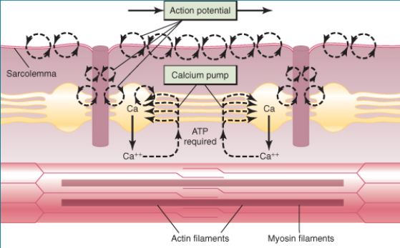
Excitation Contraction Coupling
ONLY IN FEMALES’ SLIDES
Each contraction involves the hydrolysis of an ATP molecule for the process of contraction and sliding mechanism.
Cardiac muscles are continually contracting and require substantial amounts of energy.
The energy is derived from ATP generated by oxidative phosphorylation in the mitochondria.
The myocytes contain large numbers of mitochondria.

Slide 21
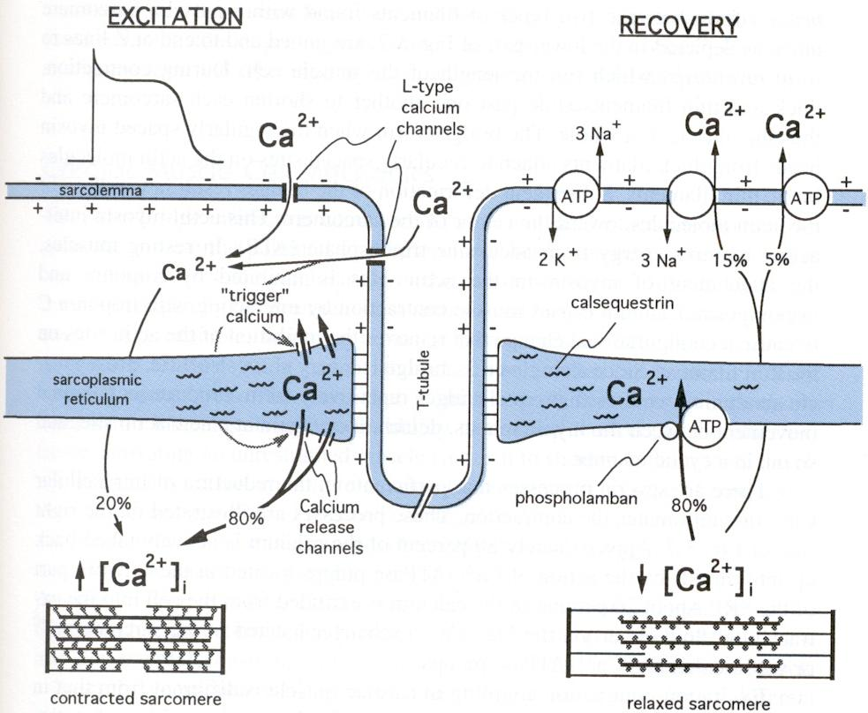
Excitation Contraction Coupling
ONLY IN MALES’ SLIDES
Excitation-contraction coupling is similar in cardiac and skeletal muscles. Increased intracellular Ca²⁺ triggers contraction by binding to troponin C on the thin filament.
Tension generation in cardiac, but not in skeletal muscle is profoundly influenced by:
  Extracellular calcium levels.
  For example: doubling the extracellular calcium concentration may nearly double the maximum cardiac contractile force.
  Factors that affect the magnitude of the inward calcium current.
  For example: Sympathetic nervous system will increase the contraction by increasing the calcium influx. And visa versa with parasympathetic.
  Drugs which reduce calcium influx have profound negative inotropic effects on the myocardium (↓ contractility), but affect skeletal muscle only when present in massive overdose.

Slide 22
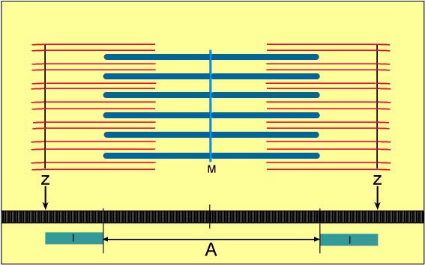
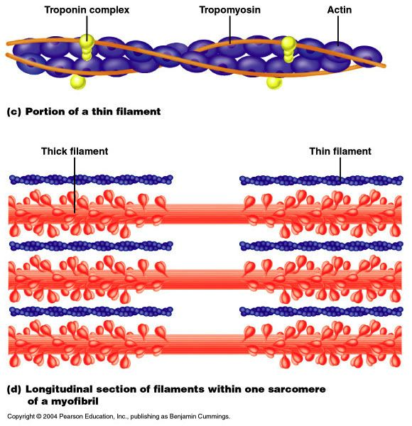
Excitation Contraction Coupling
ONLY IN MALES’ SLIDES
The myocardial fibers (cells) contain many myofibrils.
The myofibrils consist of thick myosin filaments and thin actin filaments.
When the myocyte is relaxed the sarcomere is long, while when the myocyte is contracted the sarcomere is short.
The calcium released from sarcoplasmic reticulum by calcium-induced calcium release process will trigger the Contraction cycle. (will be discussed in the next slides)
Animation

Slide 23
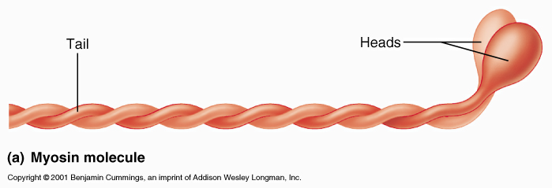
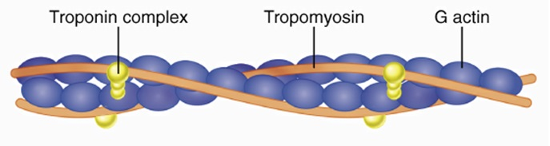
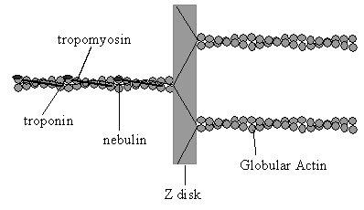
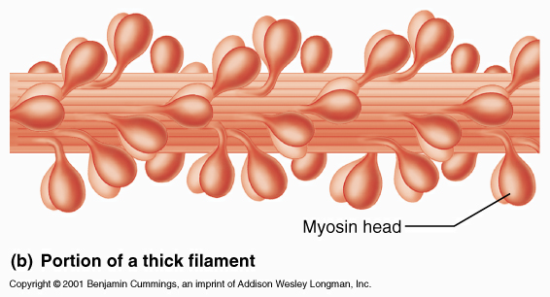
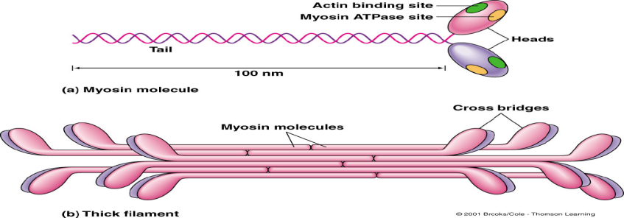
Thick Filaments (Myosin)
ONLY IN MALES’ SLIDES
Thin Filaments
Sliding-filament Mechanism of Contraction
Excitation rises calcium level.
In the relaxed state, myosin binding sites on actin molecules are covered by tropomyosin.
Ca-troponin C complex interacts with tropomyosin → uncovering the myosin binding sites on actin molecules.
Ca²⁺ binds to troponin C.
Myosin head binds to actin.
Each myosin molecule has a tail and 2 globular heads.
The myosin molecules combine to form a Thick filament (myosin filament)
KEY POINT: The heads of each myosin molecule have an ACTIN binding site and an ATPase site (splits ATP)
Actin binding site binds to actin.
Atpase site binds to Atp and splits it to Adp +p.

Slide 24
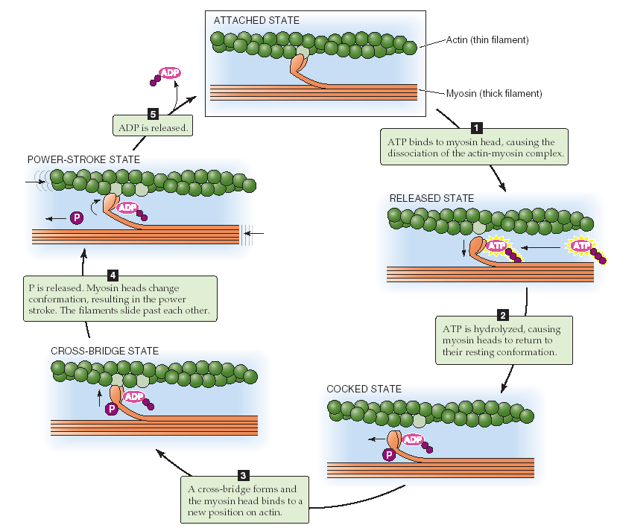
Contraction Cycle
ONLY IN MALES’ SLIDES
Contraction cycle: it is the continuous cycling of cross-bridges.
As long as calcium concentrations remain high, actin and myosin cross-bridges interact to produce contraction of the muscle, similar to that seen in skeletal muscle.
↑ Ca → ↑ contraction ↓ Ca → ↓ contraction
Skeletal muscle is susceptible to rigor (تيبس) if no ATP is present in the muscle cell to bind to the myosin head and allow it to detach from the actin filament.
Cardiac muscle is unlikely to ever undergo rigor, due to the large amounts of mitochondria producing ATP.
Example: in death (rigor mortis) happens which is the absolute stiffness of the skeletal muscle due to the loss of ATP.
In normal states, ATP binds to myosin to cause attachment and detachment of myosin head to/from actin

Slide 25
Mechanisms Maintaining Low Intracellular Ca2+
Between Successive Action Potentials
ONLY IN MALES’ SLIDES
1. Calcium-ATPase pumps: SERCA
2. Sodium-Calcium exchanger:
Found in plasma membrane (sarcolemma)
(sarco/endoplasmic reticulum Ca²⁺-ATPase)
Found in Sarcolemma and Sarcoplasmic Reticular membrane (SR)
No block in Sodium-Potassium pump:
Sodium potassium pump pumps Na outside the cell creating low intracellular Na concentration.
The exchanger uses the electrochemical gradient (created by sodium potassium pump) to remove 1 Ca2+ ion (efflux) for every 3 Na+ ions which enter the cell.
Block in Sodium-Potassium pump:
High Na inside the cell, the exchanger will work to bring in 1 Ca2+ ion for every 3 Na+ ions removed.
Catecholamines → increase Adenylyl Cyclase → increase cAMP → activation of cAMP protien kinase
Activation of cAMP protien kinase will lead to:
1-Phosphorylation of phospholamban → speed up action of SERCA (faster calcium removal from cytoplasm to SR).
2-Phosphorylation of DHPR→ more influx of Ca → more release of Ca → stronger contraction.

Slide 26
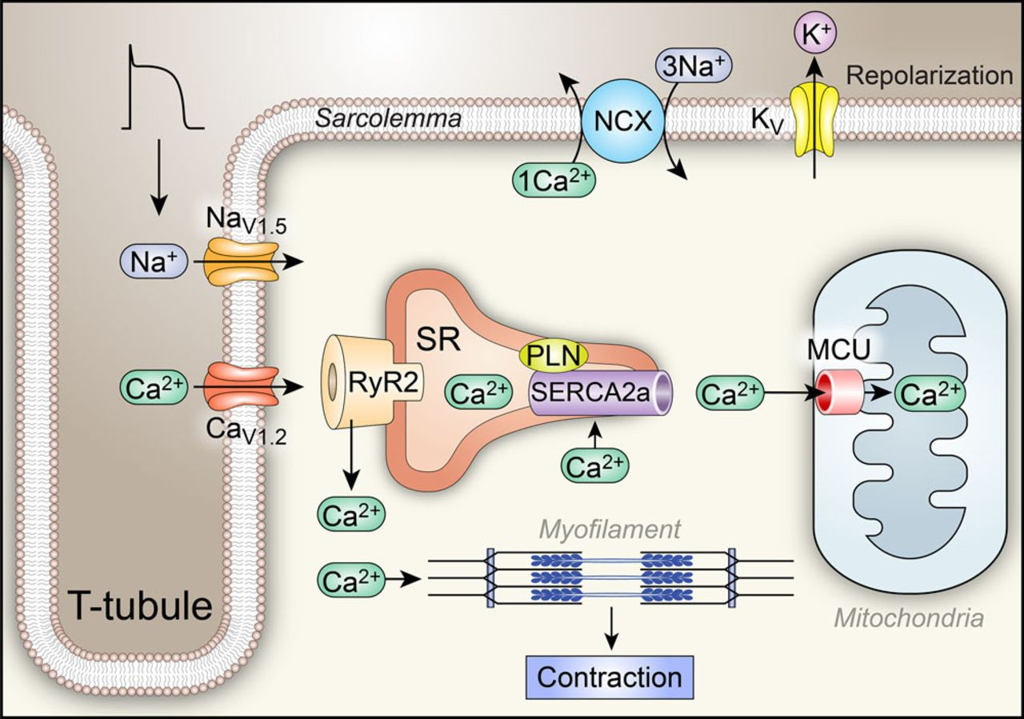
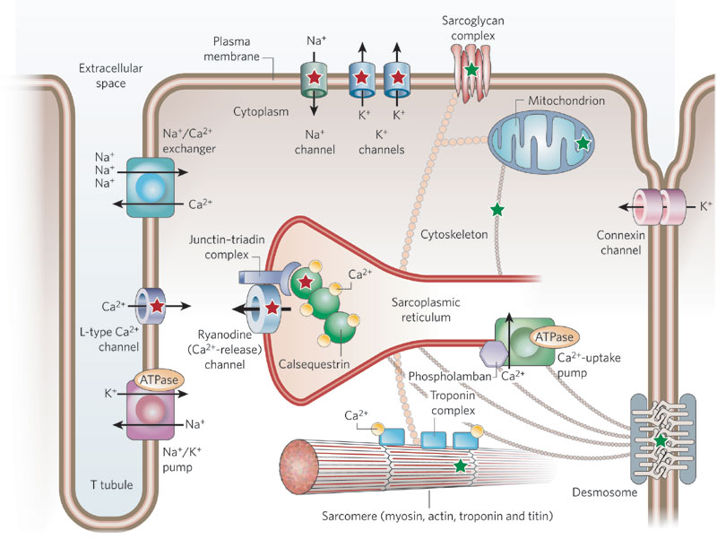
Cont.
ONLY IN MALES’ SLIDES
Mechanism of action of digitalis (digoxin) used in the management of cardiac failure: These agents block the sodium pump and thereby allow such an increase in intracellular sodium concentration → reverse Na+-Ca2+ exchanger.
If there’s a high intracellular sodium concentration, the electrochemical gradient driving sodium ion entry decreases. This results in removal of Na and an increased internal calcium concentration and contractile force.

Slide 27
Factors Affecting Cardiac Contractility
Cardiac contractility is an intrinsic property of the contractile cardiac muscle cells and is defined as the force of contraction of the heart. It is essential for the pumping action of the heart.
In physiological terms, cardiac contractility is referred to as the inotropic state of the myocardium. An inotropic effect is an effect or a mechanism that affects cardiac contractility.
Positive ionotropic effects: | Negative Ionotropic effects:
These are the factors/mechanisms that increase the cardiac contractility. Sympathetic stimulation (catecholamines) Calcium ions | These are the factors/mechanisms that decrease the cardiac contractility. Parasympathetic stimulation (vagal –of the vagus nerve- stimulation) Acetylcholine

Slide 28
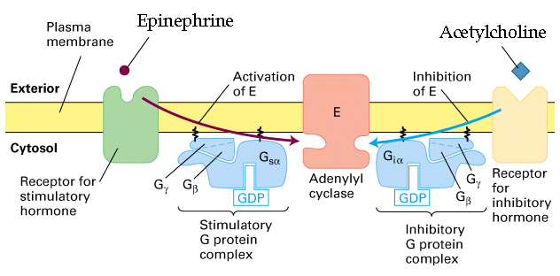
Factors Affecting Cardiac Contractility
ONLY IN MALES’ SLIDES
1. Sympathetic stimulation:
Catecholamines interact with beta-adrenergic receptors → activation of adenylyl cyclase. This increases intercellular levels of cAMP.
cAMP activates protein kinases which promote the phosphorylation of L-type Ca2+ channels.
Phosphorylation of L-type Ca2+ channels increases the influx of Ca2+ during the action potential and hence more Ca2+ is released from the sarcoplasmic reticulum.
2. Parasympathetic stimulation:
Interaction of acetylcholine with muscarinic receptors on cardiac muscle cell, and Inhibition of the release of norepinephrine from neighboring sympathetic neurons.
Interaction of acetylcholine with muscarinic receptor inhibits adenylyl cyclase → ↓ intracellular levels of cAMP.
The reduction in cAMP leads to a reduction in Ca2+ influx during the action potential , and thus a decrease in contractility.
The reduction in contractility induced by parasympathetic stimulation is seen primarily in the atria.

Slide 29
Link to Editing File
(Please be sure to check this file frequently for any edits or updates on all of our lectures.)
Quiz
https://www.onlineexambuilder.com/contractile-mechanisms-in-cardiac-muscle/exam-136425
References:
Girls’ and boys’ slides.
Guyton and Hall Textbook of Medical Physiology (Thirteenth Edition.)

Slide 30
Thank you!
اعمل لترسم بسمة، اعمل لتمسح دمعة، اعمل و أنت تعلم أن الله لا يضيع أجر من أحسن عملا.
The Physiology 436 Team:
Female Members:
Sumaya AlGhamdi
Ghadah AlMazrou
Lama Alfawzan
Nouf Aloqaili
Munirah aldofyan
Male Members:
Faris Nafisah
Fouad Bahgat
Faisal Alfawaz
Hassan Alshammari
Mohammad Nusser
Fahad AlFayez
Team Leaders:
Qaiss Almuhaideb
Lulwah Alshiha
Contact us:
Physiology436@gmail.com
@Physiology436

