Slide 1
Heart Sounds and Murmurs
Red: very important.
Green: Doctor’s notes.
Pink: formulas.
Yellow: numbers.
Gray: notes and explanation.
Physiology Team 436 – Cardiovascular Block Lecture 10
Lecture: If work is intended for initial studying.
Review: If work is intended for revision.

Slide 2
Objectives
Study Smart: focus on mutual topics.
Normal heart sounds and its leading causes
Causes of abnormal heart sounds
Describing abnormal heart sounds
Different examples of abnormal heart sounds
List the standard positions of stethoscope placement for cardiac auscultation.
Distinguish between the 1st, 2nd, 3rd and 4th heart sounds.
Explain physiological splitting of the 2nd heart sound and depict the pathophysiology of fixed and paradoxical splitting of the 2nd heart sound.
Define and classify cardiac murmurs and list cause of heart murmurs.
Outline how heart murmurs are described and graded.
Outline the haemodynamic changes and murmurs in conditions of:
Aortic stenosis
Aortic regurgitation
Mitral stenosis
Mitral regurgitation
Mitral valve prolapse
Ventricular septal defect
Patent ductus arteriosus

Slide 3
Heart Sounds
Detected over anterior chest wall using either auscultation (Stethoscope) or Phonocardiography (sound recording device)
Best heard at 4 certain areas: (actually we can hear the heart sound anywhere, but these windows provide more obvious sounds)
1. Pulmonary area: 2nd (2nd – 3rd in boys’ slides) left intercostal space
2. Aortic area: 2nd (2nd – 3rd in boys’ slides) right costal cartilage
3. Mitral area: 5th left intercostal space crossing mid-clavicular line (9 cm (2.5-3 in) from sternum)
4. Tricuspid area: lower part of sternum towards right side.
Tricuspid area: Left lower sternal border. (in boys’ slides)
4 heart sounds can be detected: 1st & 2nd hear sounds are usually audible 3rd & 4th heart sounds sometimes detected .
Phonocardiogram is a graphic recording of the heart sounds.
It involves picking up the sonic vibrations from the heart through a highly sensitive microphone. Such waves are then converted into electrical energy and fed into a galvanometer, where they are recorded on paper.
Generally the sounds produced by each valve is best heard over a particular region of the chest.
In general both the first and the second heart sounds can be heard at all areas.
ONLY IN MALES’ SLIDES

Slide 4
Normal Heart Sounds:
S1 is soft when the heart rate is low, because the ventricles are well filled with blood and the leaflets of the AV valves float together before systole.
S2 is loud and sharp when the diastolic pressure in the aorta or pulmonary artery is elevated, causing the respective valves to shut briskly at the end of systole.
S1:
Due to closure of the atrio-ventricular valves.
It marks beginning of ventricular systole.
Recorded at the beginning of the ‘isovolumemetric contraction’ phase.
Long in duration ( 0.15 sec.) longest duration of all sounds.
Of low pitch and loud (LUB).
Frequency range (25-35) (25-45 in boys' slides) Hz.
Best heard at Mitral & Tricuspid areas.
S2:
Due to closure of semilunar valves.
Marks the beginning of ventricular diastole and end of ventricular systole.
Recorded at the beginning of the ‘isometric relaxation’ phase.
Short in duration (0.11-0.125 sec.) (0.12 sec. in boys' slides).
Of high pitch, soft, and sharp (DUB).
Frequency : 50Hz.
Best heard at Aortic & Pulmonary areas.
ONLY IN MALES’ SLIDES
Usually the left side closes before the right side, for example semilunar aortic valve closes before semilunar pulmonary valve, but because the duration between them is very short I heard them as one sound (DUB)
ventricular systole is between S1 and S2, and ventricular diastole is between S2 and the new S1

Slide 5
Normal Heart Sounds
S2:
S2 splits physiologically into 2 sounds during INSPIRATION (physiological splitting)
This splitting occurs due to delay in closure of pulmonary valve
S3:
Recorded during the ‘rapid filling’ phase, due to rush of blood into the ventricle.
Duration 0.05 sec.
S3 is usually not audible(soft and very low pitch)
heard in children and young individuals.
Best heard at Mitral area.
S4:
Recorded during ‘atrial systole.’
Duration 0.04 sec.
S4 is usually not audible (very low pitch)
Usually heard in elderly.
Best heard at Mitral area.
Normally, only S1 and S2 are heard with the stethoscope
S3 and S4 are detectable by phonocardiogram.
S3 coincides with the period of rapid ventricular filling and occurs during transition between rapid filling and slow filling of ventricle, It’s probably due to vibrations set up by the inrush of blood.
S3 is heard about one third of the way through diastole in children and many normal young individuals.
S4 is caused by oscillations of the ventricles during atrial contraction.
Occasionally S4 is heard in normal individuals.
ONLY IN MALES’ SLIDES

Slide 6
Splitting of S2
ONLY IN MALES’ SLIDES
It has four types:
During inspiration the Intra pleural pressure becomes more negative and that triggers stronger blood suction from systemic circulation thus increase Venous return. More venous return will increase blood in RV, RV takes longer time to eject blood (pulmonary valve’s closure is delayed)
1-Physiological
2-Fixed
During inspiration, the aortic valve closes before pulmonary valve → reduplication (physiologic splitting of S2.
The increased venous return to the right side of the heart delays closure of the pulmonary valve. The right ventricle has more blood than usual to eject and it thus takes more time.
No splitting of the second heart sound is normally seen during expiration.
Splitting of S2 is heard both during inspiration and expiration, with the aortic valve closing before the pulmonary valve.
This is heard in cases of ASD.

Slide 7
ONLY IN MALES’ SLIDES
3-Wide
4-Paradoxical (Reversed)
A split in the second heart sound during inspiration may become wider and the split may also be seen during expiration if:
There is a delay in the closure of the pulmonary valve (as would be seen in right bundle branch block due to delay in right ventricular depolarization and contraction).
The aortic valve closes earlier than normal (this is seen with either mitral regurgitation or ventricular septal defect).
Reversed (paradoxical) splitting of the second heart sound is typically heard during expiration, with the pulmonary valve closing before the aortic valve. No splitting is apparent during inspiration, since the pulmonary valve is closing earlier (relative to the aortic valve) than normal.
This may be caused by the following:
Delayed onset of left ventricular systole (example: left bundle branch block).
Prolonged left ventricular systole (examples: aortic stenosis, severe hypertension, left-sided congestive heart failure).
Early onset of right ventricular systole (example: Wolff-Parkinson White syndrome).
What causes pulmonary valve to close later ( later than the physiological splitting)
Right bundle branch block → Late depolarization of RV → pulmonary valve takes more time to close
Pulmonary stenosis RV takes more time to eject
pulmonary hypertension
What causes aortic valve to close faster
Mitral regurgitation: during systole of LV, blood is ejected into LA and aorta → finishes systole faster → aortic closes faster
VSD ( ventricular septal defect ) defect between LV and RV, LV started systole blood is ejected into aorta and RV → finishes systole faster → aortic closes faster
Pulmonary valve closes before aortic valve
What causes it?
What happened to RV? Finished its systole faster, how?
Accessory pathway from RA to RV (without passing AV) → faster depolarization of RV → finishes systole faster → pulmonary valve closes faster
What happens to LV? Systole takes longer, How?
Left bundle branch block → depolarization is slower →
Or aortic stenosis ( LV will take more time to eject → aortic valve closure is delayed) / or high aortic pressure

Slide 8
Significance of Heart Sounds
Important for diagnosis of abnormal heart sounds (murmurs).
They are abnormal extra heart sounds heard during heart beat cycle.
They are produced by turbulence (abnormal patterns) of blood flow through the heart and its valves.
Murmurs are longer than heart sounds.
What makes noises in the heart:
1. Valves closing (normal heart sounds)
- atrioventricular (S1)
- Semilunar (S2)
2.Increased intra-cardiac hemodynamics (murmurs):
-Blood striking left ventricle (S3,S4)
-Increased blood flow across normal valves
-Turbulent flow through abnormal valves
-Turbulent flow through septal defect
Problems in the valve: either complete closer of the valve, or stenosis or dilatation of the valve.

Slide 9
Causes of Murmurs
Physiological murmurs(normal murmurs)
Increased blood flow across normal valves
Due to pregnancy, fever, anemia, hyperthyroidism, and children
المقصد هنا هم صح مريضين لكن ما عندهم مشكلة بالقلب، فبالتالي الأصوات الغير الطبيعية اللي بأسمعها ما تكون بسبب وجود مشكلة بالقلب
Physiological
Pathological
Innocent murmurs: common in children and young adults.
ONLY IN MALES’ SLIDES
Pathological murmurs
Turbulent flow through abnormal valves
Septal defect
Congenital
Tight valves (stenosis)
Leaky valves (regurgitation or insufficiency
Combination of Stenosis and Insufficiency.

Slide 10
How to Describe Heart Murmurs
1-Timing (systolic or diastolic)
2-Shape
Systolic
between S1 and S2
classified as early, mid, late, and holosystolic (pansystolic)
Diastolic
between S2 and next S1
classified as early, mid, and late .
Continuous
Crescendo (grows louder, increasing intensity)
Decrescendo (decreasing intensity)
Crescendo-decrescendo (diamond-shaped): (increasing then immediate decreasing intensity).
Plateau (uniform): the intensity of the murmur remains uniform throughout.
Systolic murmurs:
Early→ very rare ( we can neglect them)
mid → occurs in rapid ejection phase, mid systolic murmurs = ejection systolic murmurs
Pansystolic (holosystolic)→ heard through out the whole systole ( S1-S2)
Diastolic murmurs:
Early, Mid, Late.
Continuous murmurs: are heard through systole and diastole
ONLY IN MALES’ SLIDES

Slide 11
Cont.
Variation with respiration:
If murmur is louder (increases intensity) in inspiration → originated from right side (pulmonary or tricuspid).
If murmur is louder (increases intensity) in expiration → it originated from left side (aortic or mitral).
ONLY IN MALES’ SLIDES

Slide 12
Cont.
8-Intensity
هذا معناته إن القلب بدا يتكون عنده مشكلة وبدا يطلع أصوات غير طبيعية
Graded on 6 point scale according to Levine Scale
ONLY IN FEMALES' SLIDES
A thrill is a slight palpable vibration felt by the hand over the chest wall.
ONLY IN MALES’ SLIDES
أحس بالمرمر بيدي كأنه خربشة جايه على يدي
Grade 1: Grade I/VI
Grade 2: Grade II/VI
Grade 3: Grade III/VI
Grade 4: Grade IV/VI
Grade 5: Grade V/VI
Grade 6: Grade VI/VI
يعني لو حطيت السماعات جزء منها على الصدر (مايله) أقدر أسمع

Slide 13
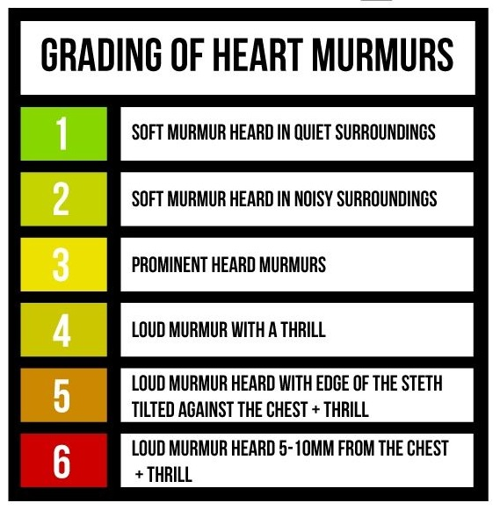
Heart Murmur Intensity
ONLY IN FEMALES' SLIDES
ONLY IN MALES’ SLIDES

Slide 14
Pathophysiology of Systolic Murmurs
Derived from harsh & ↑ turbulence in blood flow during systole.
Associated with:
↑ flow across normal valve.
↑ flow into a dilated great vessel.
↑ flow across an abnormal valve, or narrowed ventricular outflow tract - e.g. aortic /pulmonary stenosis.
↑ flow across an incompetent AV valve - e.g. mitral/tricuspid regurgitation.
↑ flow across the inter-ventricular septum - e.g. VSD.
مرحلة systolic معناته إن الAV valve مسكرة وaortic valve مفتوحة، فأي خلل في هالاثنين بسبب لي murmur طيب أيش الخلل اللي ممكن يصير؟
يا يكون عندي تضيق في الصمام المفتوح stenosis (يعني هو الصمام مفتوح عادي لكن لأي سبب كان هو متضيق فكذا راح أسمع صوت)
أو يكون عندي فتحة صغيرة في الصمام المسكر regurgitation (يعني يكون عندي فتحة لأي سبب كان بالتالي الدم يدخل جوا البطين خلال ما البطين جالس يرسل الدم بالتالي بيصير فيه حوسه وتبدا تطلع أصوات غير طبيعية) ..

Slide 15
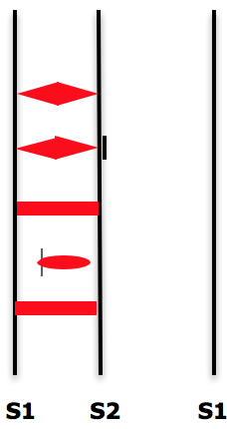
Common Systolic Murmurs and Timing
ONLY IN FEMALES' SLIDES
Aortic Stenosis
ejection murmur
Pulmonary Stenosis
ejection murmur
Splitting of S2
Mitral/tricuspid
regurgitation
Ventricular Septal Defect (VSD)
holosystolic
Mitral valve prolapse
May cause S2 to become quieter or absent
holosystolic
Mid-late systole
You will hear click first
For further information to help you understand heart murmurs and their various causes click here.

Slide 16
Systolic Murmurs
Ejection (mid-systolic) Murmur:
Most common kind of heart murmur.
Usually Crescendo-decrescendo (diamond shaped).
It may be:
1. Innocent: as in children and young adults.
2.Physiological: in hyper-dynamic states (increased intra-cardiac hemodynamics) such as anemia, pregnancy, fever, and hyperthyroidism.
3.Pathological: secondary to structural CV abnormalities such as aortic/pulmonary stenosis or hypertrophic cardiomyopathy, and mitral prolapse.
Pan-Systolic (Holosystolic) Murmurs:
Pathological.
Begins with S1 immediately and continues until S2.
Heard with: Mitral/tricuspid regurgitation and ventricular septal defect (VSD).

Slide 17
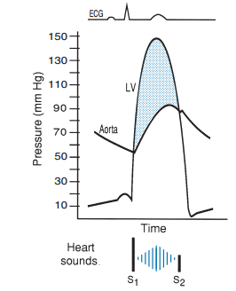
Cont.
Aortic Stenosis:
Narrowing of aortic outflow tract causing obstruction of flow from left ventricle into ascending aorta.
Timing: mid-systolic (ejection) murmur.
Location: best heard at aortic area and it radiates along carotid arteries )going to neck).
Character: harsh, loud, may have associated thrill, ejection click.
Association: older age as a result of wear and tear of the aortic valve, bicuspid aortic valve, Scarring of the aortic valve due to rheumatic fever as a child or young adult.
The ESM of aortic stenosis has a crescendo-decrescendo contour and a gap between the end of the audible sound and S2 (Splitting of S2).
The narrow orifice of the aortic valve increases resistance of the aortic valve and slows the rate at which SV (stoke volume) is ejected.
Ventricular systolic pressure increases to overcome the increased resistance of the aortic valve.
Thus, there is a pressure gradient between the left ventricle and aorta during ejection.
AS may result in concentric hypertrophy of the LV.
Aortic stenosis causes reversed splitting of S2 sound
ONLY IN MALES’ SLIDES

Slide 18
Mitral Prolapse & Regurgitation
Mitral Prolapse:
Bulging of one or both mitral valve leaflets in left atrium during left ventricular systole
Timing: mid-late systolic murmur
Location: best heard at the apex region
Character: mid systolic click
Association: 5% normal population, asymptomatic, sudden death
من محاضرة cardiac cycle كنا قلنا إن في فترة isometric contraction بيكون عندي Bulging بجهة AV يعني كأنه صايرة عندي prolapse لكن هذي حالة طبيعية وما فيها أي مرض، لأنها بس فترة isometric contraction وخلاص بتنتهي
Mitral Regurgitation:
Retrograde flow from left ventricle to left atrium through an incompetent mitral valve.
Timing: holosystolic murmur.
Location: best heard at apex radiates to left axilla.
Character: soft, high pitched, blowing.
Association: Mitral valve prolapse, mitral valve myxomatous degeneration*, myocardial infarction, rheumatic heart disease, cardiomyopathy, endocarditis.
The sound is of reasonably constant intensity throughout the ejection period.
*يعني يتكون عندي تجمع للبلازما وplatelets في منطقة الصمام المتضرر، هذا التجمع ممكن ينقطع جزء منه ويتحرك مع الدم ويؤدي إلى stroke in the brain
ONLY IN MALES’ SLIDES
Left atrial volume and pressure are increased during ventricular systole.
Left ventricular volume and pressure are increased during diastole, but there is NO pressure gradient between the LA and the LV.

Slide 19
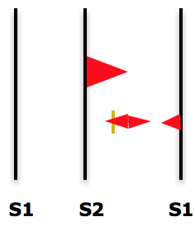
Diastolic Murmurs
Almost always indicates heart disease
Two basic types:
ONLY IN FEMALES' SLIDES
Early decrescendo diastolic murmurs
Signify regurgitation flow through an incompetent semilunar valve
i.e. aortic/pulmonary regurgitation
Rumbling diastolic murmurs in mid or late diastole
Suggests stenosis of AV valve
i.e. mitral/tricuspid stenosis
Common murmurs and timing:
soft, blowing, gurgle
Aortic regurgitation: early diastole
Mitral stenosis: mid to late (pre-systolic) diastole

Slide 20
Cont.
Aortic regurgitation:
Retrograde flow from aorta into LV through incompetent aortic cusps
Timing: diastolic (early) murmur
Location: best heard at 2nd – 4th left intercostal spaces with the patient sitting up, leaning forward, at end expiration.
Character: high pitched, loud blowing, decrescendo, it wanes with time as aortic pressure falls.
Association: aortic root degeneration, rheumatic heart disease, VSD w/aortic valve prolapse (kids.)
مرحلة diastole معناته إن الsemilunar valve مسكرة وAV valve مفتوحة، فأي خلل في هالاثنين بيسبب لي murmur طيب أيش الخلل اللي ممكن يصير؟
يا يكون عندي تضيق في الصمام المفتوح stenosis (يعني هو الصمام مفتوح عادي لكن لأي سبب كان هو متضيق فكذا راح أسمع صوت)
أو يكون عندي فتحة صغيرة في الصمام المسكر regurgitation (يعني يكون عندي فتحة لأي سبب كان بالتالي الدم يدخل جوا البطين خلال ما البطين جالس يرسل الدم بالتالي بيصير فيه حوسه وتبدا تطلع أصوات غير طبيعية)
The aortic valve does not close properly at the beginning of diastole.
As a result, there is retrograde flow of blood from the aorta into the ventricle during diastole.
The amount of the blood regurgitated into the left ventricle may be as much as 60-70% of the amount ejected during systole.
Thus, there is:
Decreased aortic diastolic pressure.
increased left ventricular and aortic systolic pressures.
Increased aortic pulse pressure.
ONLY IN MALES’ SLIDES

Slide 21
Cont.
Mitral Stenosis:
Obstruction of flow from LA to LV during diastole because of a narrowed mitral orifice (Valve becomes thickened & calcified).
Timing: diastolic (mid-diastolic or presystolic) murmur with (opening snap) after closure of aortic valve.
Location: best heard at apex.
Characteristic: low pitched (heard with bell of stethoscope).
Association: Rheumatic fever.
Narrowing of the mitral valve orifice impairs emptying of the left atrium into the left ventricle during diastole.
Left atrial pressure greatly exceeds left ventricular pressure when the stenotic valve is open. This generates a pressure gradient between the left atrium and the left ventricle during filling.
Thus, pressure and volume can be dramatically elevated in the left atrium.
However, in most cases of MS, LV pressure curve is normal, and similarly, the aortic pressure curve is also normal.
The murmur is often heard with an opening snap (OS) This gives the murmur a decreschendo-creschendo profile.
It begins early after the OS. Its timing is thus mid-diastolic or pre-systolic.
It is a low-frequency (low pitched) blowing sound and thus heard with the bell of the stethoscope.
ONLY IN MALES’ SLIDES

Slide 22
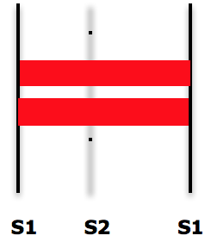
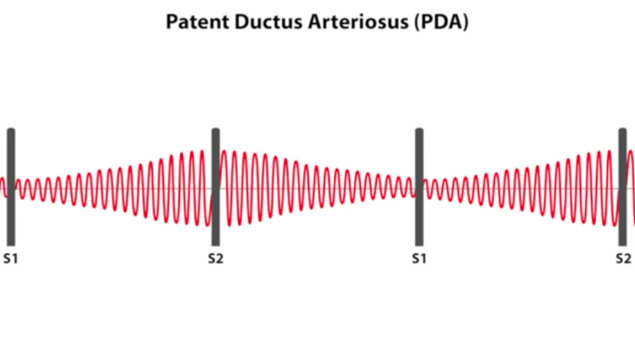
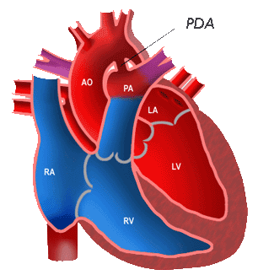
Continuous Murmurs
Begin in systole, peak near S2 & continue into all or part of diastole.
Heard with:
1. Patent ductus arteriosus (PDA)
2. Ventricular septal defect (VSD)
Common murmurs and timing:
1.Patent ductus arteriosus (PDA)
2.Ventricular Septal defect (VSD)
Patent Ductus Arteriosus:
Failure of closure of the duct between pulmonary artery & aorta.
Timing: continuous murmur.
Location: best heard at upper left sternal border.
Characteristics: machine-like.
Association: left to right shunt, cyanosis.
بالحالة ما راح أسمع LUB ولا DUB كل اللي أسمعه murmur

Slide 23
Pressures In Valvular Abnormalities
ONLY IN MALES’ SLIDES
In AS:
LV systolic pressure increases
Aortic systolic pressure decreases ( less SV)
There’s a pressure gradient between LV and aorta which isn’t normal during systole
In AR:
LV diastolic and systolic pressure increases.
Aortic diastolic pressure decreases (blood is flowing into LV).
Aortic systolic pressure increases (increased SV).
In MR
Systole → LA pressure increased.
Diastole→ LV pressure increased
(no pressure gradient).
In MS:
LA pressure increases.
LV pressure and aortic pressure are normal.

Slide 24
Heart Murmurs
Systolic murmur | Early | -
 | Mid (Ejection) | Aortic stenosis: Narrowing of aortic outflow tract causing obstruction of flow from left ventricle into ascending aorta | Best heard at aortic area, radiates along Carotid arteries | Harsh ,loud, may have associated thrill, “ejection click.” | Older age, bicuspid aortic valve, rheumatic fever.
 | Late | Mitral Prolapse: Bulging of one or both mitral valve leaflets in left atrium during left ventricular systole (it’s mid-late systole) | Best heard at the apex region | Mid systolic click | 5% normal population, asymptomatic, sudden death
 | Holo (Pan) | Mitral Regurgitation: Retrograde flow from left ventricle to left atrium through an incompetent mitral valve | Best heard at apex radiates to left axilla | Soft, high pitched, blowing | Mitral valve prolapse, mitral valve myxomatous degeneration, myocardial infarction, rheumatic heart disease, cardiomyopathy, endocarditis.
Diastolic murmur | Early | Aortic Regurgitation: Retrograde flow from aorta into LV through incompetent aortic cusps | Best heard at 2nd – 4th left intercostal spaces | High pitched, blowing, decrescendo | Aortic root degeneration, rheumatic heart disease, VSD w/aortic valve prolapse (kids.)
 | Mid | Mitral Stenosis: Obstruction of flow from LA to LV because of a narrowed mitral orifice (Valve becomes thickened & calcified) (it’s mid-late systole) | Best heard at apex | Low pitched (heard with bell of stethoscope), opening snap after closure of aortic valve | Rheumatic fever
 | Late | -
Continuous murmur |  | Patent Ductus Arteriosus: Failure of closure of the duct between pulmonary artery & aorta | Upper left sternal border | Machine like | Left to right shunt, cyanosis
Location
Character
Association

Slide 25
Link to Editing File (Please be sure to check this file frequently for any edits or updates on all of our lectures.)
Quiz
https://www.onlineexambuilder.com/heart-murmurs/exam-141803
References:
Girls’ and boys’ slides.
Guyton and Hall Textbook of Medical Physiology (Thirteenth Edition.)

Slide 26
Thank you!
اعمل لترسم بسمة، اعمل لتمسح دمعة، اعمل و أنت تعلم أن الله لا يضيع أجر من أحسن عملا.
The Physiology 436 Team:
Female Members:
Amal Alshaibi
Allulu Alsulayhem
Najd AlTheeb
Ghada Alskait
Heba Alnasser
Male Members:
Mohammad Almutlaq
Team Leaders:
Qaiss Almuhaideb
Lulwah Alshiha
Contact us:
Physiology436@gmail.com
@Physiology436

