Slide 1
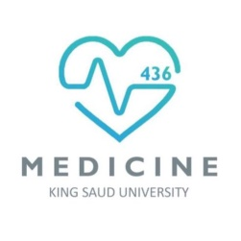
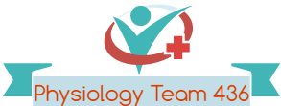
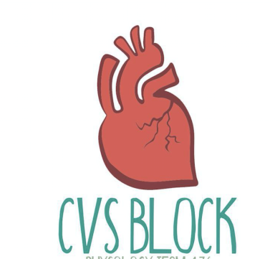
Shock
Red: very important.
Green: Doctor’s notes.
Pink: formulas.
Yellow: numbers.
Gray: notes and explanation.
Physiology Team 436 – Cardiovascular Block Lecture 11
Lecture: If work is intended for initial studying.
Review: If work is intended for revision.

Slide 2
Objectives
Study Smart: focus on mutual topics.
Types and causes of shock.
Define circulatory shock.
Mechanisms responsible for the irreversible phase of hemorrhagic shock.
Body compensatory mechanisms during reversible phases of hemorrhagic shock.
Define shock and state the pathophysiological classification of shock.
Describe the pathways leading to shock and decreased tissue perfusion.
Discuss the stages of a hypovolemic shock.
Explain how stage III hypovolemic shock might result in major organs failure.
Discuss the different compensatory mechanisms during a hypovolemic shock.
Describe the positive feedback mechanisms in the irreversible stage of a hypovolemic shock.

Slide 3
Shock
The cell is the basic unit of life and it needs oxygen to produce energy.
No oxygen → No energy → No life
Circulatory shock: When the circulatory system is unable to provide adequate circulation & tissue perfusion → decreased availability of oxygen and nutrients → failure to deliver oxygen to the tissues & vital body organs relative to its metabolic requirement → cellular hypoxia and energy deficit .
Result: organ dysfunction and cellular damage. (not death)
If not quickly corrected: whole body failure → leads to irreversible shock and death.
Shock may be defined as a pathophysiological state in which there is :
1-widespread
2- serious reduction of tissue perfusion
which if prolonged :leads to generalized impairment of cellular function.
ONLY IN MALES’ SLIDES
Video of (Shock)
Duration: (9;10 mins)
Video of (Shock)
Duration: (16:28 mins)

Slide 4
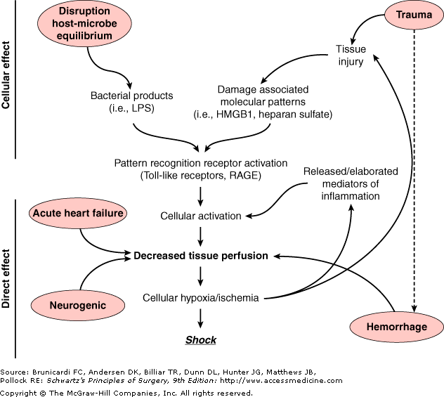
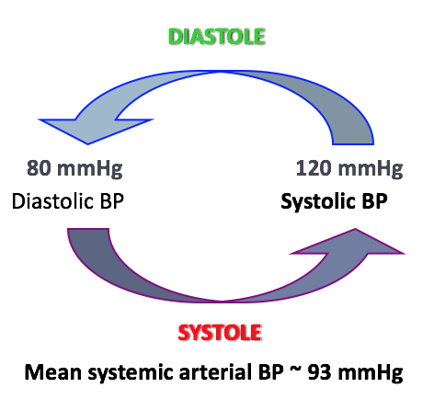
ONLY IN MALES’ SLIDES
Pathways Leading to Decreased Tissue Perfusion and Shock
Decreased tissue perfusion
Causes: hemorrhage / hypovolemia - cardiac failure - neurologic injury.
Result: immune and inflammatory responses.
Alternatively, elaboration of microbial products during infection or release of endogenous cellular products from tissue injury → cellular activation → influences tissue perfusion and the development of shock .
Systemic hypotension
NORMAL BP : 120/80
LOW BP < 90/60
Arterial pressure = cardiac output x systemic vascular resistance
Reduction in either component (cardiac output or vascular resistance) without a compensatory elevation of the other will result in hypotension.

Slide 5
Types of Shock
Circulatory Shock
Low output shock
Hypovolemic
Cardiogenic
High/Normal output shock
Distributive
Obstructive
Vasogenic: Septic/ toxic, Anaphylactic, Psychogenic
Spinal: neurogenic
- Is associated with loss of 40% or more of left ventricle myocardial function.
- Mortality rate: 60%-90%
MAP = CO X PR
(the problem is low cardiac output)
MAP = CO X PR
(the problem is in peripheral resistance)
Full playlist of Khan Academy’s Shock-related videos

Slide 6
Causes and Classification of Shock
TYPE | CAUSES | SYMPTOMS AND SIGNS
Hypovolemic shock (most common) | Bleeding/ Hemorrhage (internal/external) (Most Common) dehydration (sever vomiting, sever diarrhea, excess sweating) plasma loss (as in burns , trauma) → low blood volume Lead to: Reduced venous return (preload)→ loss of 15-25% of CO / 1-2 L→ hypotension | Hypotension (≤ 85/40mmHg) ; weak but rapid pulse . Tachycardia (Compensation for↓ MAP sensed by Baroreceptors) Rapid, weak, & thready pulse (140/min). Cool, clammy skin Tachypnea “rapid respiration” (Compensation for hypoxia sensed by Chemoreceptors) shallow breathing , anxiety Restlessness due to hypo-perfusion. Altered mental state Oliguria (low urine output)/ Anuria (no urine output). Blood test: Lactic acidosis.
Cardiogenic shock | Heart problems (e.g., myocardial infarction(Most common), heart failure , cardiac dysrhythmias) → despite adequate ventricular filling pressure →↓ contractility →↓in stroke volume →↓cardiac output → hypotension Myocarditis, cardiomyopathy, cardiac tamponade, congestive heart failure Acute valvular dysfunction (e.g., rapture of papillary muscles post MI) Sustained arrhythmias (e.g. heart block, ventricular tachycardia) pulmonary embolism Is associated with loss of > 40% of LV myocardial function, mortality rate is high 60-90% | Just like symptoms of a hypovolemic shock + Distended jugular veins Cardiomegaly Congestion of lungs & viscera: Chest X-ray (CXR): Interstitial pulmonary / Alveolar edema . May be absent pulse
Obstructive shock | Obstruction of venous return: like Vena Cava syndrome (usually neoplasms) Compression of heart: like hemorrhagic pericarditis > cardiac tamponade Obstruction of outflow: like aortic dissection*, massive pulmonary embolism, pneumothorax. Circulatory obstruction (e.g., constrictive pericarditis ) Lead to : reduced blood flow to lungs →↓ cardiac output → hypotension | Just like symptoms of a hypovolemic shock + Distended jugular veins Pulses paradoxes (in cardiac tamponade).
* Aortic dissection: aorta is weak, a cyst becomes a parallel vessel to aorta and makes it rupture > sudden death.

Slide 7
Causes and Classification of Shock
High/Normal Cardiac Output Shock (Distributive)
MAP = CO X PR
(the problem is in vascular/peripheral resistance)
TYPE | CAUSES | SYMPTOMS AND SIGNS
Distributive shock 1- Vasogenic (Valvular Obstruction) 2- Low-resistance shock | Septic shock: infection → release of bacterial toxins → activation of NOS in macrophages → production of NO → vasodilation + endothelial injury → decreased vascular resistance→ hypotension Anaphylactic shock: allergy (release of histamine) → IgE Mediated hypersensitivity (histamine triggers peripheral vasodilation and an increase in capillary permeability → decreased vascular resistance→ hypotension Neurogenic shock: / Spinal Shock (venous pooling): spinal injury →↓ peripheral vasomotor tone → loss of autonomic and motor reflexes → vasodilation → Blood volume remains normal →↓in peripheral vascular resistance →↓ cardiac output as blood is pooled in peripheral veins → ↑ Capacity of blood →↓ Venous return → hypotension (Behaves like hypovolemic shock) Psychogenic shock : stress, pain, or fright → ↓ HR & vessels dilate → Brain becomes hypo perfused → Loss of consciousness. | Septic shock: Patient flushed & warm due to his hyperdynamic state - Severe drop in BP or hemoglobin- fever – warm- sweaty skin and hypotension Anaphylatic shock: hypotension- skin eruptions- breathlessness- coughing - localized edema- weak - rapid pulse Neurogenic shock: as for hypovolemic except warm, dry skin Psychogenic shock : Simple fainting (syncope)

Slide 8
Pathophysiology of Shock
Reduce capillary perfusion
Inadequate tissue oxygen
Shift to anaerobic metabolism
Metabolic acidosis
Release of free radical and oxidative stress
- Reactive Oxygen Species
(ROS)
Tissue damage
Apoptosis
(programed cell death)

Slide 9
Metabolic Changes & Cellular Response to Shock
ONLY IN FEMALES’ SLIDES
1- Reduced capillary perfusion:
2- After 3-5 hours of shock:
3- granulocytes accumulation at injured vessels: ( Free radical release and further tissue damage).
4- damage in GIT mucosa : allows bacteria into circulation.
Spasm of pre-post capillary sphincters
Hypoxic tissue damage
(oxidative stress)
Anaerobic metabolism
( anaerobic glycolysis)
Lactic acid production
Metabolic acidosis
(intracellular acidosis)
Failure of Na/k pump
( Na & Ca inside the cell)
Lysosomes, nuclear membranes & mitochondrial breakdown
Precapillary sphincters dilate
Venules are still constricted.
Blood stagnation in capillaries.
Hypoxia continue +Fluid leaves extra vascular compartment.
(which will drain in lymphatic vessel)
Further reduction in circulating blood volume.
بيقل الفوليوم لانه يروح للمفاتيك

Slide 10
ONLY IN FEMALES’ SLIDES
Cont.
5- cerebral ischemia
6- Myocardial ischemia depressed contractility+ myocardial damage(more shock and acidosis).
7- respiratory distress syndrome occurs : due to damage of capillary endothelial cells & alveolar epithelial cells with release of cytokines.
8- multiple organ failure and death.
depression of vasomotor center
(sympathetic)
vasodilation+ HR
further decrease in blood pressure

Slide 11
Compensatory Mechanisms During Hypovolemic Shock
ONLY IN MALES’ SLIDES
Regulation of BP
Short term mechanisms
Baroreceptor reflex
CNS ischemic response
Intermediate and long term mechanisms
Hormonal
Renal
Catecholamines
ADH
Chemoreceptor reflex
Atrial reflexes
Other
Capillary shift
Increased 2,3 DPG
Restoration of plasma volume
Restoration of RBCs
Restoration of plasma proteins
Cardiovascular.
Respiratory.
Endocrine.
Renal.
Others.
Video of (Compensatory Mechanisms of (Medical) Shock)
Duration: (18:48 mins)
Short-term compensatory reactions:
are rapid and act within seconds to minutes
Intermediate-long term compensatory reactions:
are activated within hours or From hours to days
Other compensatory reactions:
are activated within hours From hours to days

Slide 12
Compensatory Mechanisms (The Important Ones)
ONLY IN FEMALES’ SLIDES
Compensatory mechanism
Sympathetic stimulation
Release of antidiuretic
hormone (vasopressin)
Plasma protein synthesis
Renin-Angiotensin mechanism stimulation
Water retention
Vasoconstriction and thirst stimulation
Fluid shift mechanism
Chemoreceptors reflex by acidosis
Baroreceptor reflex by decreased blood pressure
Aldosterone: Na & water retention
Angiotensin II +III: powerful vasoconstrictors

Slide 13
ONLY IN FEMALES’ SLIDES

Slide 14
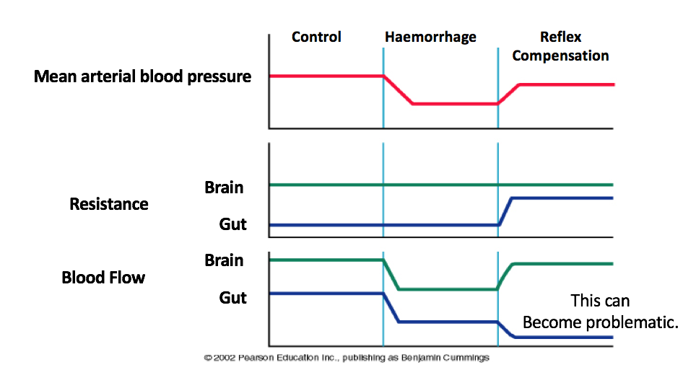
Short-Term Compensatory Mechanisms; 1- Arterial Baroreceptor Reflex
ONLY IN MALES’ SLIDES
Flow to the heart and brain is maintained; reductions in flow to other organs.
Fully explained in arterial pressure regulation lecture.

Slide 15
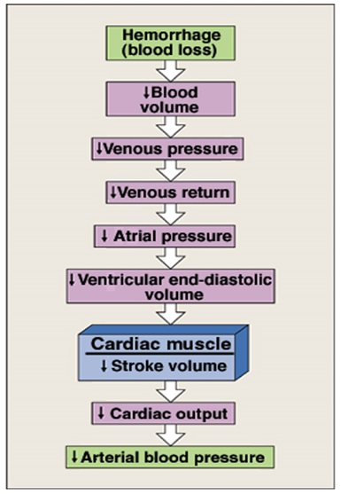
Cont.
ONLY IN MALES’ SLIDES
Total physical resistance
Mean Arterial pressure
Fully explained in arterial pressure regulation lecture.

Slide 16
ONLY IN MALES’ SLIDES
Short Term Compensatory Mechanisms;
2- Arterial Chemoreceptor Reflex
Reductions in mean arterial blood pressure (MAP) below 60:
do not evoke any additional responses through the baroreceptor reflex.
stimulates peripheral chemoreceptors (aortic bodies, carotid bodies, heart) that sense changes in pO2, pCO2, and pH through tissue hypoxia and lactacidosis.
This results in:
Enhancement of the existing tachycardia and vasoconstriction
Respiratory stimulation → tachypnea
Fully explained in arterial pressure regulation lecture.

Slide 17
ONLY IN MALES’ SLIDES
Compensatory Mechanisms During Hypovolemic Shock
Arterial Baroreceptor and Chemoreceptor Reflexes
Vasoconstriction
(arteriolar constriction): this increases TPR and hence MAP.
It is produced by:
Baroreceptor reflex.
Chemoreceptor reflex.
Noreadrenaline-adrenaline vasoconstrictor mechanism (due to activation of adrenal medulla).
Vasoconstriction is also produced by vasopressin-vasoconstrictor mechanism (in subsequent slides).
Marked in:
Skin: cold, pale.
kidneys: drop in GFR & urine volume.
Viscera.
Flow to the heart and brain is maintained; reductions in flow to other organs.
Important in:
Shifting blood from the venous reservoir into the circulation.
Maintaining filling pressure of the heart.
Tachycardia
Produced by:
Baroreceptor reflex.
Chemoreceptor reflex.
Increased sympathetic activity.
Tachypnea
Caused by : activation of chemoreceptor reflex and sympathetic over activity.
Importance:
Increase O₂ delivery.
Increase thoracic pump activity→ help venous return.
The increased sympathetic activity also causes restlessness → ↑ skeletal muscle activity → help venous return.

Slide 18
Compensatory Mechanisms During Hypovolemic Shock; Endocrine and Renal
ONLY IN MALES’ SLIDES
Mechanism:
Release of hormones that initiate vasoconstriction.
Renal conservation of salt and water.
Stimulation of hematopoeisis by erythropoietin
These compensatory reactions are activated:
Within hours
From hours to days
Endocrine and Renal Compensatory Mechanisms
↑ Circulating vasoconstrictors | Stimulation of sympathetic nervous system → release of epinephrine, norepinephrine from the adrenal medulla (sympatho-adrenal axis) . Epinephrin is released almost exclusively from adrenal medulla where as norepinephrin is released from adrenal medulla and sympathetic nerve endings. → Vasoconstriction.
 | ADH is actively secreted by the posterior pituitary gland in response to hemorrhage. Thus, hemorrhage → stimulates posterior pituitary → synthesis and release of vasopressin (ADH). ADH is potent vasoconstrictor. It also stimulates reabsorption of water.
 | ↓ renal perfusion → secretion of renin from juxtaglomerular apparatus → generates angiotensin II → Angiotensin II is a powerful vasoconstrictor

Slide 19
ONLY IN MALES’ SLIDES
Cont.
Endocrine and Renal Compensatory Mechanisms
↑ secretion of glucocorticoids by adrenal cortex | This helps to maintain blood glucose
Stimulation of hematopoiesis | ↓ blood volume & hypoxia → synthesis of erythropoeitin (EPO) → hematopoiesis.
Endocrine and Renal Compensatory Mechanisms
Renal conservation of salt and water | Vasopressin → ↑ water reabsorption → ↑ blood volume → ↑ arterial pressure. Angiotensin II → release of aldosterone → ↑ salt reabsorption → ↑ blood volume → ↑ arterial pressure. ↓ arterial pressure in kidney → ↓ decreases glomerular filtration rates and thereby decreases the excretion of water and electrolytes directly

Slide 20
Other Compensatory Mechanisms During Hypovolemic Shock
ONLY IN MALES’ SLIDES
These compensatory reactions are activated within hours or from hours to days
1. Responses activated: within hours
Increased movement of interstitial fluid into capillaries (capillary fluid shift).
Increased 2,3 DPG concentration in RBCs: This is important to help Hb deliver more O2 to the tissues (shift O2 dissociation curve to the right).
2. Responses activated: within hours-days
Restoration of circulatory plasma volume: takes 12-72 hrs after moderate hemorrhage.
Restoration of plasma proteins: this occurs in 2 stages:
Rapid entry of preformed albumin from extracellular stores.
Hepatic synthesis of proteins over 3-4 days.
Restoration of RBCs: this occurs in 2 stages:
Increase RBCs count in response to erythropoietin within 10 days.
Restoration of red cell mass within 4-8 weeks.

Slide 21
In Normal Microcirculation
ONLY IN FEMALES’ SLIDES
Hydrostatic Pressure = 0 mmHg
Osmotic Pressure = 3 mmHg
NFP = - 5 to -7mmHg
Interstitial fluid
NFP = +5 to +10 mmHg
Interstitial Fluid
Venous Blood
Blood Capillary
Arterial Blood
Hydrostatic Pressure
18-20 mmHg
Colloid Osmotic Pressure
25 mmHg
Hydrostatic Pressure
30-35 mmHg
At arterial end: Water moves out of the capillary with a NFP of +5 to +10 mmHg Hydrostatic pressure dominates at the arterial end & net fluid flows out of the circulation.
(Arterial pressure - Colloid osmotic pressure = + NFP filtration to interstitial fluid)
At venous end: Water moves into the capillary with a NFP of -5 to -7 mmHg. Oncotic pressure dominates at the venous end & net fluid will flow into the bloodstream.
( Venous pressure - Colloid osmotic pressure = - NFP filtration to blood stream)
NFP = Net Filtration Pressure

Slide 22
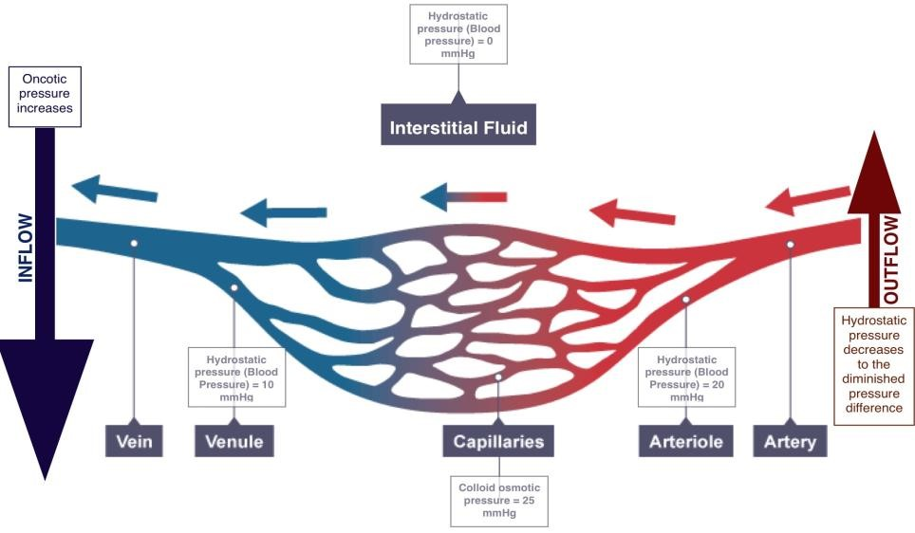
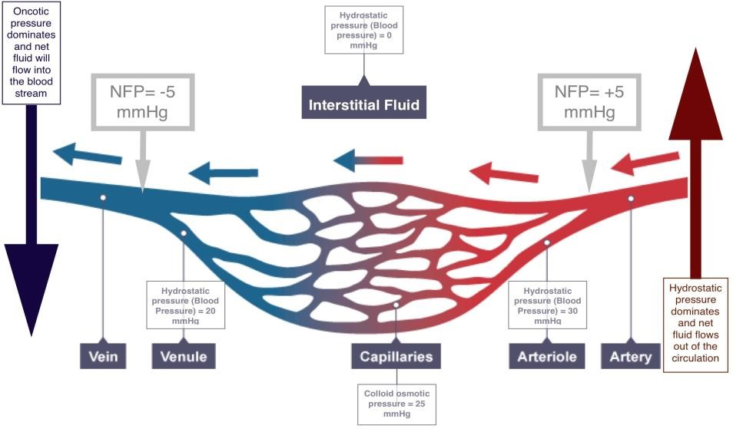
Fluid-Shift Mechanism
ONLY IN FEMALES’ SLIDES
In shock, the hydrostatic pressure decreases & oncotic pressure is constant, as a result:
The fluid exchange from the capillary to the extracellular space decreases.
The fluid return from the extracellular space to the capillary increases.
That will increase the blood volume & will increase BP helping to compensate shock.
The capillary fluid shift mechanism means simply that anytime capillary pressure falls too low, fluid is absorbed from the tissues through the capillary membranes and into the circulation, thus building up blood volume and increasing the pressure in the circulation.
Normally
During Fluid-Shift

Slide 23
Fluid-Shift Mechanism in Shock
ONLY IN FEMALES’ SLIDES
Hydrostatic Pressure 0mmHg
Venous Blood
Arterial Blood
Interstitial fluid
Increase inflow
Decrease outflow
Hydrostatic Pressure
10mmHg
Blood Capillary
Hydrostatic pressure
20mmHg
Colloid Osmotic Pressure
25mmHg

Slide 24
ONLY IN MALES’ SLIDES
Stages of Shock
Stage 1 → pressure and cardiac output are maintained (in recumbent position)
Stage 2 → pressure and cardiac output are not maintained ( 10-20 mmHg drop)
Stage 3 → pressure and cardiac output decrease is life threatening
During Hypovolemic Shock :
Pressure decreases , HR increases
Bicarbonate decrease, Lactic acid increases

Slide 25
Stages of Shock
Possible Mechanism in the
Development of Irreversible Shock
Reversible shock: (Compensated)
Changes can be reversed by compensatory mechanism
Progressive
Defense mechanisms begin to fall.
(neurohormonal activation) or by treatment.
Defense mechanisms are successful in maintaining perfusion.
Multi-organ failure.
Irreversible shock:
Complete failure of compensatory mechanisms.
Can lead to death.
Non-progressive
Shock Stimulus
Irreversible Shock
Splitting of Plasma Proteins
Lysosomal Activation, Release Proteases
Vasoactive Peptides, Amines, etc.
Hypotension, Fluid Loss

Slide 26
Stages of Shock
ONLY IN MALES’ SLIDES
Stage 1 (Compensatory Stage)
Happen in: In healthy individuals, acute blood loss of 10 – 15 % of the normal blood volume (e.g., blood donation)
Results in : activation of the sympathetic nervous system.
Symptoms:
Arterial pressure is maintained
Pressure decline when the patient assumes the erect position
Increase in heart rate, Paleness and Anxiety
Compensation is achieved acutely by:
Increase in heart rate.
Constriction of the arterioles.
Thus, cardiac output is normal or slightly reduced especially when the patient assumes the erect position
Stage 2 (Progressive Stage)
Happen if: When 20-40% of blood volume are lost, cardiac output cannot be maintained and falls markedly, even in the recumbent position.
Result in:
1- Fluid also moves from the interstitial to the intravascular compartment (i.e., reabsorption of tissue fluids).
2- there will be massive activation of the sympathetic nervous system → Leading to:
→ intense arteriolar constriction in the vascular beds of the kidney, gut, and skin → redistribution of blood flow (i.e., centralization of blood flow) with larger fractions going to the vital organs (heart and brain) and smaller fractions going to the kidney, gut, and skin. Despite intense arteriolar constriction, systolic arterial BP declines by 10 to 20 mm Hg.
→ generalized vasoconstriction (increasing blood volume in the central circulation and tending to sustain venous return)

Slide 27
Cont.
ONLY IN MALES’ SLIDES
Stage 2
(maximal mobilization of compensatory mechanisms)
Symptoms, signs and complications:
Systolic arterial blood pressure declines by 10-20 mmHg
Tachycardia (heart rate increases and pulse is thready and weak)
Skin is pale and cool (peripheral pallor is common)
Deterioration of the mental state because the brain is getting less oxygen. Patient looks weak, tired and drowsy. Patient may show anxiety, aggressiveness, and restlessness.
Thirst.
Oliguria (urine output is decreased).
Angina may occur in patients who have intrinsic coronary vascular disease.
pH drops and metabolic acidosis develops due to increased anaerobic glycolysis
Stage 3
The compensatory mechanisms are maximally mobilized in stage II. Thus,
Happen during : small additional losses of blood (>40 %) can result in life-threatening reduction in cardiac output, BP and tissue perfusion.
Blood flow to heart, brain and kidney is further reduced → severe ischemia and irreversible tissue damage → this may result in impaired organ function and death.
The severe vasoconstriction may itself become a complicating factor and initiate a vicious cycle
The factors that determine the ultimate outcome include:
Duration of stage III.
Severity of tissue anoxia.
Age and condition of the patient.

Slide 28
ONLY IN MALES’ SLIDES
Irreversible Stage of Hypovolemic Shock (Stage 3)
Mechanism In the irreversible stage of hypovolemic shock, a series of positive feed back mechanisms take place, leading to →
1- further deterioration in cardiac output and MAP
2- more tissue hypoxia
Depending on: the amount of blood lost
How : When blood loss is excessive and not immediately replaced, and proper treatment is delayed, this stage is reached and the patient dies.
In this stage, there is also failure of compensatory mechanisms.
The severe vasoconstriction may itself become a complicating factor and initiate a vicious cycle. It could happen also during irreversible stage of hypovolemic shock
Mechanism:
1- Impaired coronary perfusion → cardiac ischemia → depression of cardiac function → further lowering of cardiac output.
2- Reduced blood flow to the vasomoter centers in the medulla depresses the activity of compensatory reflexes → vasomotor failure → depression of the activity of compensatory reflex → depression of cardiac function → further lowering of cardiac output.
3- Prolonged renal ischemia → acute tubular necrosis → may lead to prolonged post-shock renal insufficiency.
4- Bowel ischemia → breakdown of the mucosal barrier . This may lead to entry of bacteria and toxins into the circulation → depression of cardiac function → further lowering of cardiac output
Generalized cellular deterioration:
↓ Mitochondrial activity inside the cells →↓ in ATP.
↓ of cellular metabolism, especially glucose →↓ in ATP.
↓ in active transport of Na⁺ and K⁺ across the cell → Na⁺ accumulation inside the cell.
Rupture of many lysosomes.

Slide 29
Link to Editing File (Please be sure to check this file frequently for any edits or updates on all of our lectures.)
Quiz
https://www.onlineexambuilder.com/shock/exam-142187
References:
Girls’ and boys’ slides.
Guyton and Hall Textbook of Medical Physiology (Thirteenth Edition.)

Slide 30
Thank you!
اعمل لترسم بسمة، اعمل لتمسح دمعة، اعمل و أنت تعلم أن الله لا يضيع أجر من أحسن عملا.
The Physiology 436 Team:
Female Members:
Rana Barasain
Ashwaq Almajed
Amal AlQarni
Reema Alotaibi
Leena Alwakeel
Hayfaa Alshaalan
Male Members:
Faris Alnafeesah
Nasser Abu-dujeen
Team Leaders:
Qaiss Almuhaideb
Lulwah Alshiha
Contact us:
Physiology436@gmail.com
@Physiology436

