Slide 1
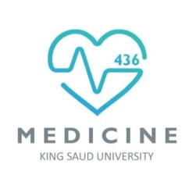

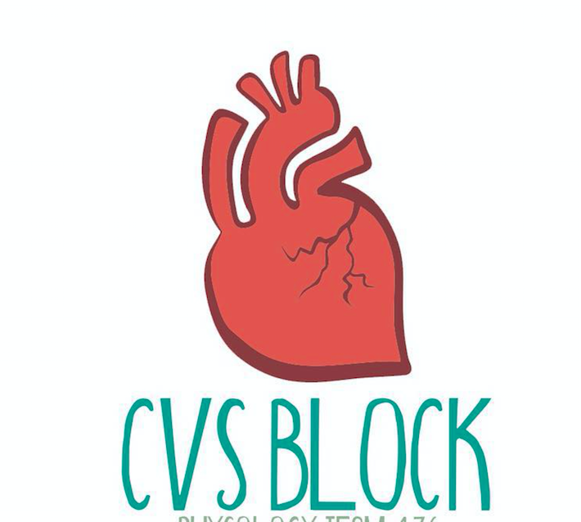

Arterial Blood Pressure
and
Regulation of Blood Pressure
Red: very important.
Green: Doctor’s notes.
Pink: formulas.
Yellow: numbers.
Gray: notes and explanation.
Physiology Team 436 – Cardiovascular Block Lecture 12&13
Lecture: If work is intended for initial studying.
Review: If work is intended for revision.

Slide 2
Objectives
ONLY IN MALES’ SLIDES
(Since their Doctor combined the two lecture)
Study Smart: focus on mutual topics.
Describe systemic and pulmonary vascular resistances and explain physiological significance if arterial blood pressure in overcoming the vascular resistance.
Compare and contrast measurement of arterial blood pressure in systemic and pulmonary circulations and state normative data for pulmonary and systemic circulations.
Describe physiological variation in arterial blood pressure.
Explain the effect of gravity on arterial blood pressure.
Define mean arterial blood pressure and describe how it is calculated.
Define pulse pressure and state how it is affected in aortic stenosis, aortic regurgitation and arteriolosclerosis.
List factors which determine arterial blood pressure and explain how they influence arterial blood pressure.
Outline synthesis of NO and state its physiological significance.
Explain the physiological importance of regulating arterial blood pressure.
Discuss short-, intermediate- and long-term regulation of blood pressure; nervous, hormonal and renal regulation of arterial blood pressure.
Define systemic hypertension and state its complications.

Slide 3
Arterial Blood Pressure (ABP)
ONLY IN MALES’ SLIDES
Blood pressure is defined as the force exerted by the blood against a vessel wall.
Blood pressure is an important characteristic of our body since it is the force that drives blood along blood vessels after it has left the heart.
Without blood pressure, nutrients, oxygen, and proteins could not travel from the arterial side of the body to the venous side.
عموما انتقال الدم بالجسم يكون باختلاف الضغوط
Physiological significance of blood pressure:
As blood flows through the systemic and pulmonary circulations friction develops between the moving fluid and the stationary walls of the blood vessels. Thus, the vessels tend to resist fluid movement through them. Such resistance is known as vascular resistance.
The resistance to the flow of the blood through the systemic circulation is known as systemic vascular resistance and the resistance to the flow of the blood through the pulmonary circulation is known as pulmonary vascular resistance.
The ratio of pulmonary to systemic vascular resistance is approximately 1:6.
It is because the vascular resistance to flow that we need the heart in the cardiovascular system to generate flow with pressure to overcome the vascular resistance.
Why is resistance in systemic circulation higher? Because it is longer.

Slide 4
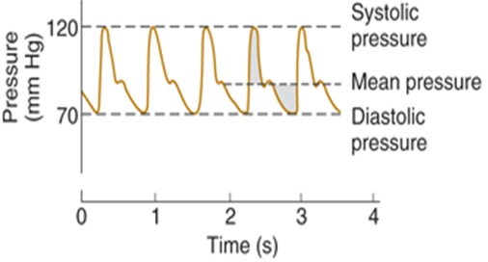
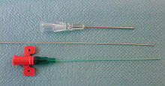
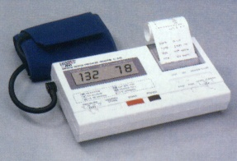


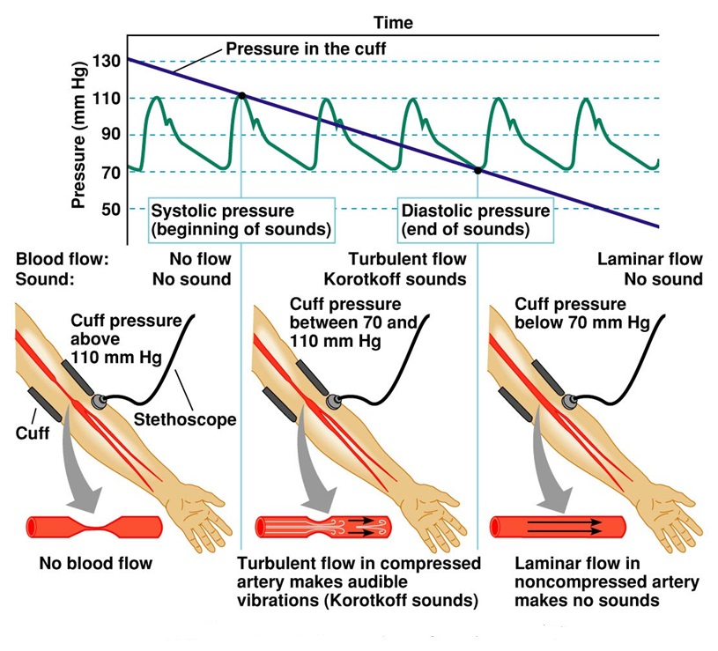
Measurement of ABP In The Systemic Circulation
Sphygmomanometer:
Indirectmethod, "Estimate of pressure"
Many types:
  Mercury sphygmomanometer (most acurite)
  Aneroid equipment
  Automatic equipment
Blood Pressure Cuff Size:
  Small – children & small adults
  Average
  Large – overweight & large adults
Two methods: Direct & indirect
Direct (e.g. arterial catheter):
In the direct method: we use central IV line to invade the blood vessel and measure the BP (it is very accurate but it has complications: e.g. it may cause inflammation, so we use it in emergency situations such as: surgery or in the ICU.
Indirect (e.g. stethoscope and pressure cuff):
“note that there are three different typesof sphygmomanometers: mercury, aneroid, and digital”

Slide 5
Arterial Blood Pressure (ABP)
What is meant by Arterial Blood Pressure?
Lateral pressure created by the heart as it pumps blood, against any unit area of the vessel wall.
In normal adult ≈ 120/80 mmHg
Top number (Systolic): = Pressure while the heart is beating.
Bottom number (Diastolic): = Pressure while the heart is relaxing.
ONLY IN FEMALES’ SLIDES
ONLY IN MALES’ SLIDES
Systolic blood pressure:
Is the maximum level of arterial blood pressure. It is reached during the
rapid ejection phase of ventricular systole.
For a normal adult, it is about 120 mmHg
(normal range: 90-140 )
Diastolic blood pressure:
Is the minimum level of arterial blood pressure. It is reached during the isovolumetric contraction phase of ventricular systole. For a normal adult,
it is about 80 mmHg
(normal range: 60-90 )

Slide 6
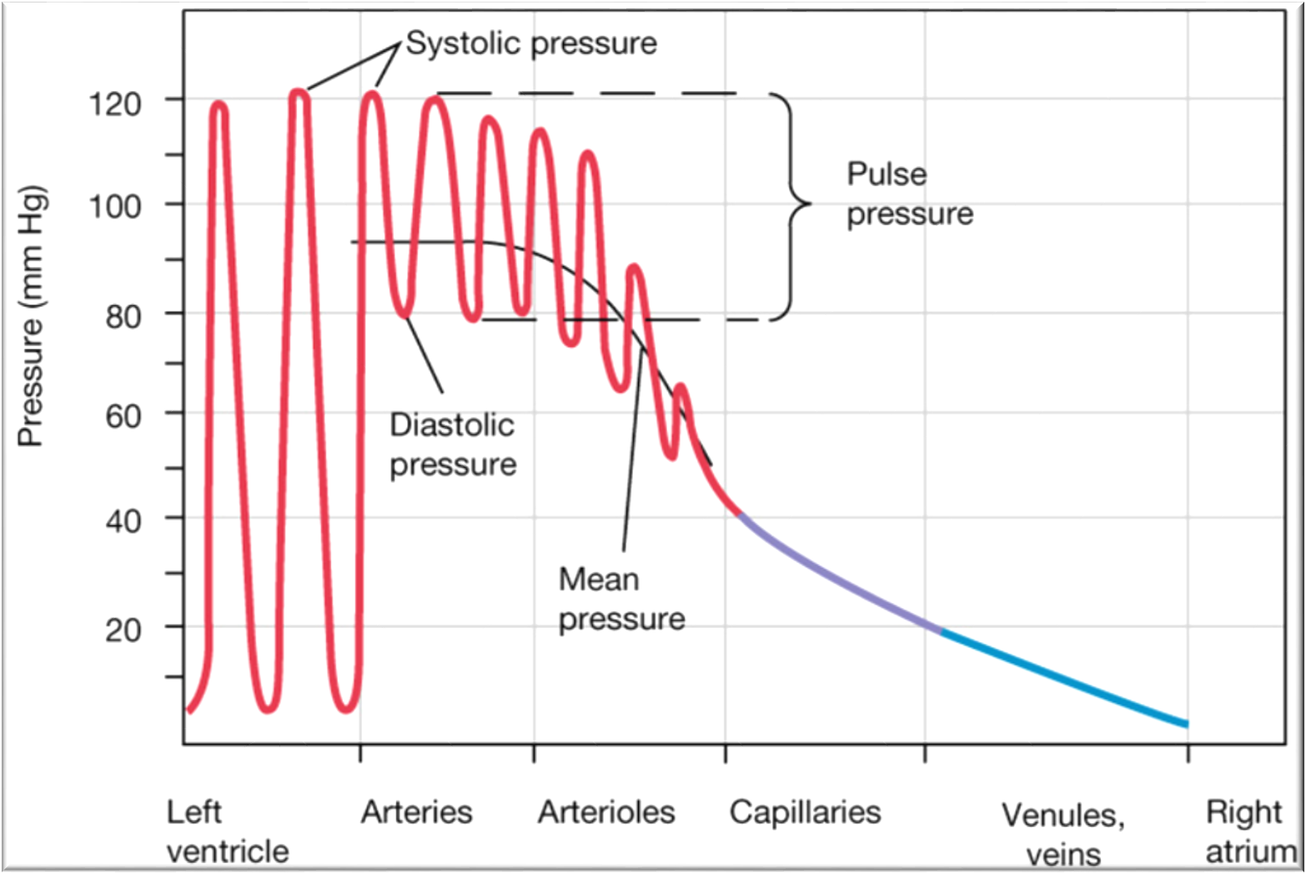
Cont.
Significant drop in pressures happens in arterioles.
By the time blood reaches RA pressure= 0 mmHg
Variations in Arterial Blood Pressure:-
Aortic pressure:
120 mmHg systolic.
80 mmHg diastolic.
Normal arterial pressure:
110 – 130 mmHg systolic.
70 – 85 mmHg diastolic.
ONLY IN FEMALES’ SLIDES

Slide 7
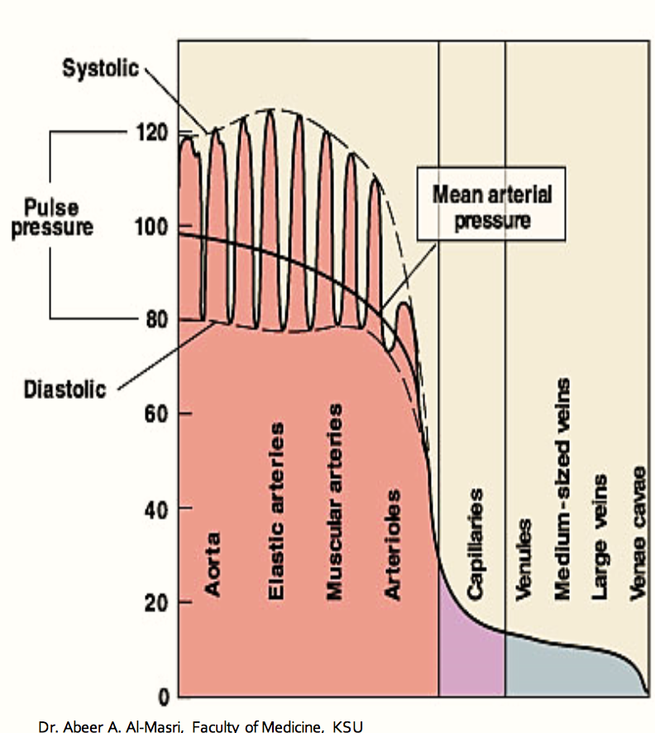
Pressure Changes Throughout the Systemic Circulation
ONLY IN FEMALES’ SLIDES
Blood flows down a pressure gradient.
Highest at the heart.
↓ over distance.
↓ 90% from aorta to vena cava.
Greatest drop in pressure occurs in arterioles.
No large fluctuations in capillaries & veins.
BP averages 120 mmHg in aorta & drops to 0-2 mmHg in RA.

Slide 8


















American Heart Association
ONLY IN FEMALES’ SLIDES
Recommended Blood Pressure Levels:
Adult BP range 110 – 130 / 70 – 85 mmHg
BP
Category
Systolic (mmHg)
Diastolic (mmHg)
Follow-up
يعني القيمة المثالية لضغط الدم، بس لو ما كان الضغط نفسها عادي ممكن يظل الضغط في الحد الطبيعي
Optimal
< 120
&
< 80
Recheck 2 years
Normal
< 130
&
< 85
Recheck 2
years
High Normal
(Pre-hypertension)
130-<140
or
85-<90
Recheck
1 year
No treatment required

Slide 9
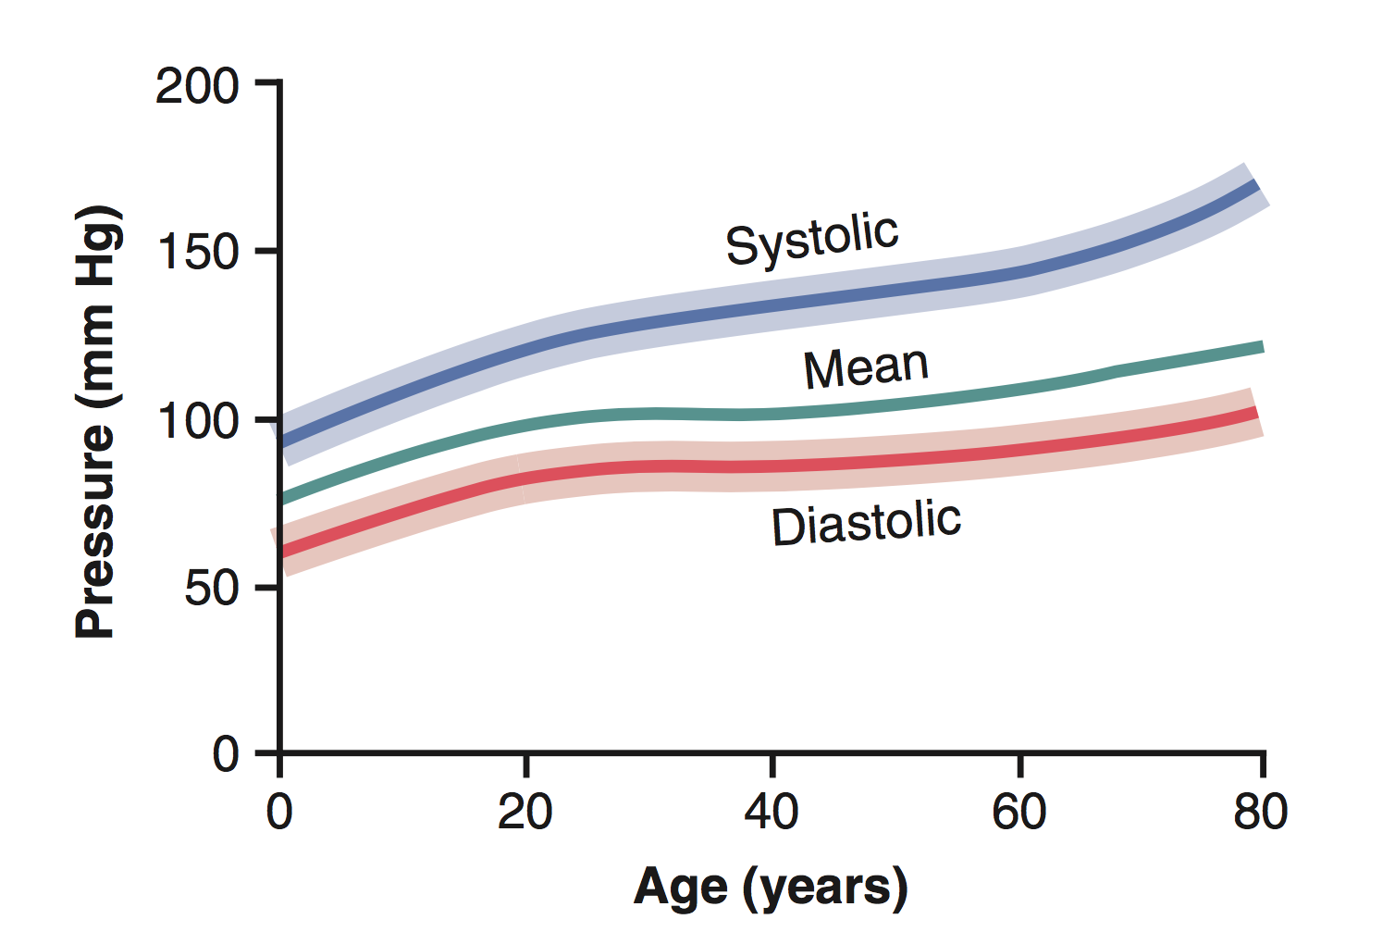
Mean Arterial Pressure (MAP)
ONLY IN MALES’ SLIDES
MAP is the average pressure responsible for driving blood into the tissues throughout the cardiac cycle.
MAP is not halfway between systolic and diastolic pressures because arterial pressure remains closer to diastolic than to systolic pressure for a longer period of each cardiac cycle.
A good approximation of the MAP can be determined using the following formula :
MAP = Diastolic pressure + 1/3 pulse pressure
Extra
Mean arterial pressure tends to increase with age because of an age-dependent increase in total peripheral resistance which is controlled primarily by arterioles.

Slide 10
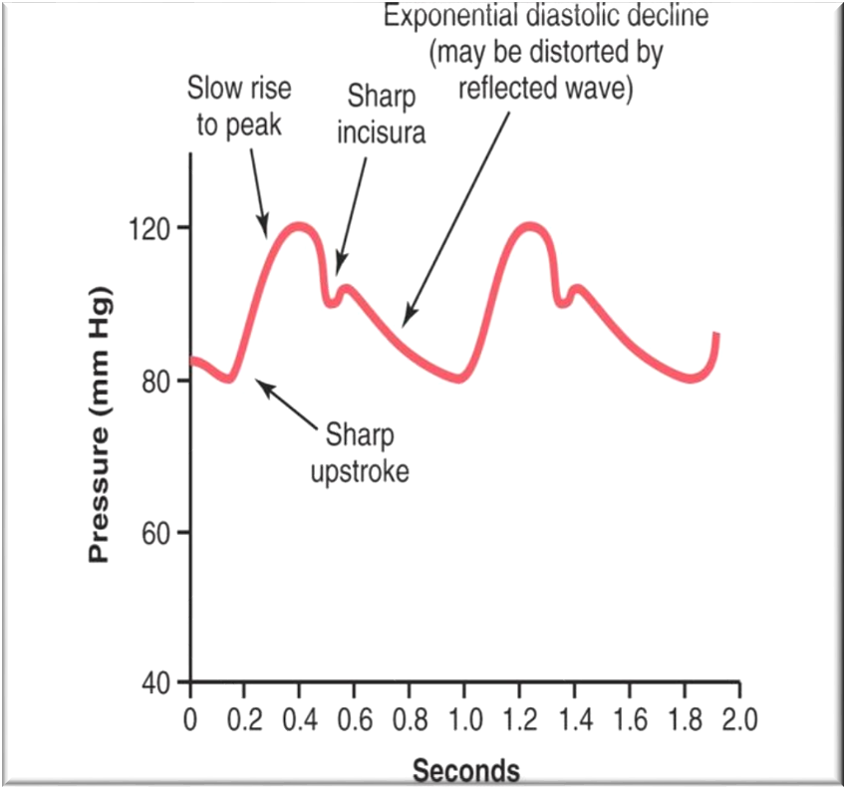
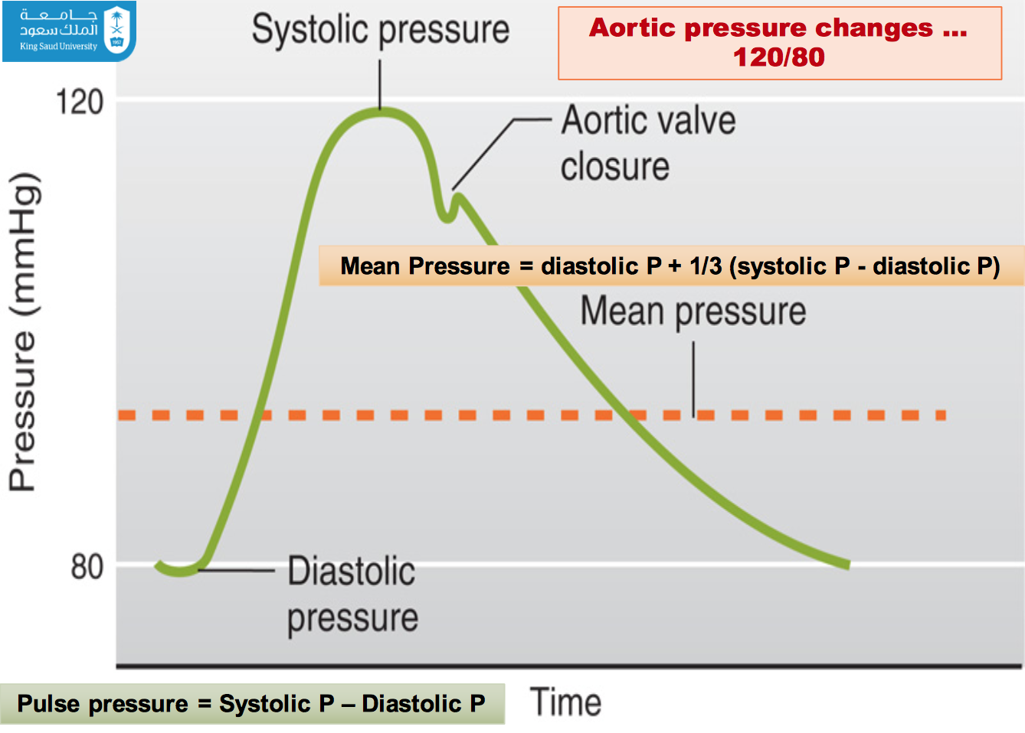
Arterial Pressure Pulsations; Pulse Pressure
ONLY IN MALES’ SLIDES
Pulse pressure: Is the difference between the systolic and diastolic blood pressure values. For a normal adult the pulse pressure = 120 – 80 = 40 mmHg.
Pulse pressure is determined by two parameters:
Change in volume (ΔV)
could be approximated as stroke volume
Compliance
In effect, pulse pressure is the ratio of stroke volume output to compliance of the arterial tree. Any condition of the circulation that affects either of these two factors also affects the pulse pressure:
Pulse pressure ≈ Stroke volume/arterial compliance.

Slide 11
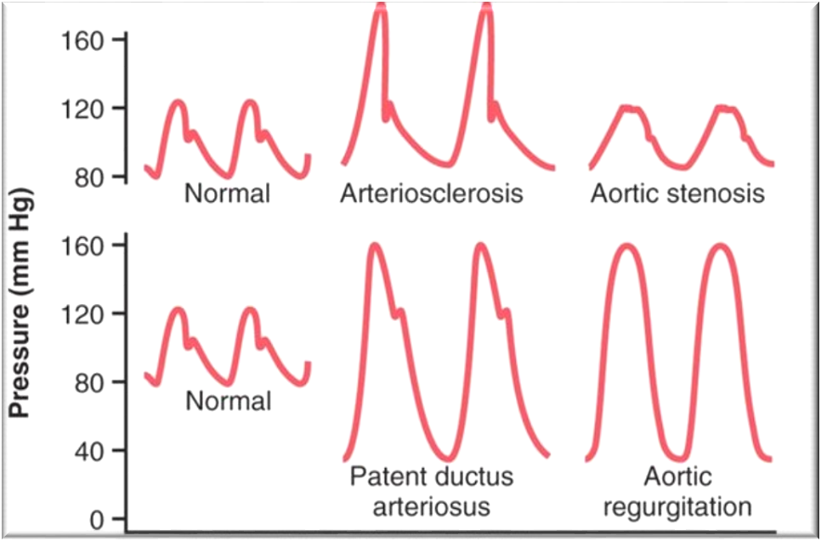
Abnormalities In Pulse Pressure
ONLY IN MALES’ SLIDES
Atherosclerosis:
Pulse pressure tends to increase with ageing because of a decrease in arterial compliance.
("hardening of the arteries").
Aortic regurgitation:
In early diastole, blood leaks back into the ventricles. As a result, diastolic pressure falls to very low levels.
Also, there is no incisura in the aortic pulse contour because there is no aortic valve to close.
In atherosclerosis systolic pressure increase and diastolic pressure decreases (main change in systolic pressure).
Aortic regurgitation: drop in aortic diastolic pressure (blood leaks into ventricles)
(blood is going from aorta to LV and from LA to LV) → LV ejects huge amount of blood → increase in systolic pressure.

Slide 12
Pressures in the Systemic and Pulmonary Circulations
ONLY IN MALES’ SLIDES
You can memorize only the systemic circulation pressure and divide it by 6, because the left ventricle generates a pressure six times more than right ventricle.
Pressures in the pulmonary circulation | Pressures in the systemic circulation
Right ventricle = 25/0 mm Hg | Left ventricle = 120/0 mm Hg
Pulmonary artery = 25/10 mm Hg | Aorta = 120/80 mm Hg
Mean pulmonary artery = 15 mm Hg | Mean arterial BP = 93 mm Hg
Capillary (pulmonary) 7-9 mm Hg | Capillary: skeletal = 30 mm Hg renal glomerular = 45-50 mm Hg (It is different from tissue to another)
Pulmonary veins = 5 mm Hg | Peripheral veins = 7-15 mm Hg
Left atrium = 5-10 mm Hg | Right atrium (CVP) (central venous pressure) =0 mm Hg
Pressure gradient: 15-5 = 10 mm Hg | Pressure gradient=(MAP-CVP): 93-0 = 93 mm Hg

Slide 13
Physiological Variation In Blood Pressure/Factors Affecting ABP
Notes about previous table in previous slide:
- Why is renal glomerular capillaries’ pressure higher than skeletal muscle capillaries?
High pressure is needed for filtration (blood is pushed through nephron so it gets filtered)
- Why is pulmonary capillaries’ pressure lower than systemic capillaries’ pressure? Any increase in pulmonary capillary pressure can cause flirtation which can lead to pulmonary edema
BP range: 90-140/60-90 mmHg.
Age: elderly > children (due to atherosclerosis, diabetes, ...)
At birth: 50/30
Adult : 120/80
Old age: 170/90
Sex: males have higher BP than female (Equal at menopause).
Body built: increase in obese.
Emotions: (↑ BP) due to neural and hormonal factors.
Exercise: (↑ BP) due to ↑ venous return.
Meals: (↑ BP).
Sleep: (↓ BP) due to ↓ venous return.
Hormones: (adrenaline, noradrenaline & thyroid H) → increase BP
Gravity: BP is higher in lower limbs than upper limbs. (whenever we go away from the heart 1cm the BP will change 0.77mmHg (increase if we go down and decrease if we go up due to the gravity), so if we measure the BP we should take it near to the heart)
Race, dietary factors or stress
Pregnancy: BP (↑) due to ↑ in metabolism
Temperature: BP (↓) with heat due to vasodilatation, & (↑) with Cold due to vasoconstriction
ONLY IN MALES’ SLIDES
Measurement of arterial blood pressure in the pulmonary circulation:
Right Heart Pressures are measured by: Swan-Ganz / PA Catheter (the only way to measure the pressure in pulmonary circulation)

Slide 14
Factors Determining ABP
ONLY IN FEMALES’ SLIDES
If one of these factors are missing then there will be NO blood pressure:
Cardiac output (Flow).
Peripheral Resistance.
Blood volume.
Blood Pressure(MABP) = Peripheral Resistance(PR) X Cardiac Output (CO)”Blood Flow Q”
Is the amount of blood pumped by ventricles(output) per minute. ≈ 5 L/min (av. 5-6 L/min)
CO= Stroke Volume X Heart Rate
Factors Determining C.O:
Under the affect of parasympathetic
= Output of ventricles / beat
≈ 70ml/beat (av.70-80 ml/beat)
= Beats/ minute
≈ 70-75beats/min
(Normally. 60-100 beats/min)

Slide 15
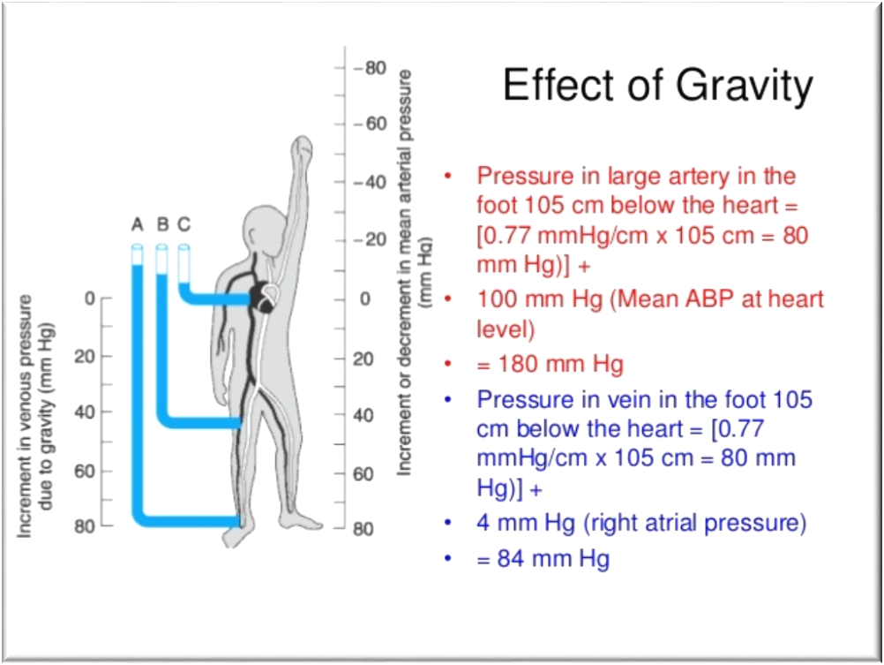
Effect of Gravity on Blood Pressure
ONLY IN MALES’ SLIDES
The pressure increases in any vessel below the level of the heart, while it decreases in any vessel above the level of the heart due to the effect of Gravity.
Gravitational effect = 0.77 mmHg/cm at the density of normal blood.
In an adult human in the upright position, if mean MAP at heart level = 100 mmHg, the MAP in an artery at the head (50 cm above heart) = 100-[0.77X 50] = 62 mmHg.
Arteries above level of heart have a pressure lower than the pressure of arteries below the level of the heart
Multiply the distance from the heart by 0.77
If point above the heart → -100
If point below heart → + 100

Slide 16
Determinant of Blood Pressure in the Systemic Circulation
Blood Flow Q) = ∆P/R
(CO = The blood pumped per minute (ml/min).
All of the CO flows through the systemic circulation. (Amount of blood moving through a vessel in a given time period)
Therefore, CO = Flow. (Generally blood flow is equal to Cardiac output CO)
Affected by: pressure & resistance.
MAP – Venous Pressure (right atrial pressure) = MAP
MAP drives blood flow in the systemic circulation.
Therefore, MAP = ∆P.
R = TPR
Q is directly proportional to ∆P and inversely proportional to R (Resistant)
CO = MAP / TPR
In the systemic circulation:
CO = MAP / TPR
MAP = CO X TPR
MAP = SV X HR X TPR (CO=SV X HR)
Thus, the main determinant of arterial blood pressure are:
Cardiac output
TPR
Blood volume
Elasticity
ONLY IN MALES’ SLIDES
MAP = mean arterial pressure
CO = cardiac output
TPR = total peripheral resistance

Slide 17
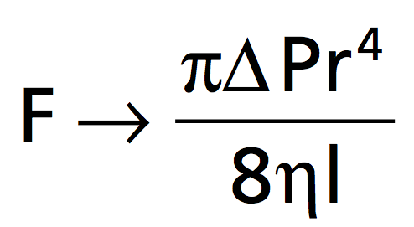
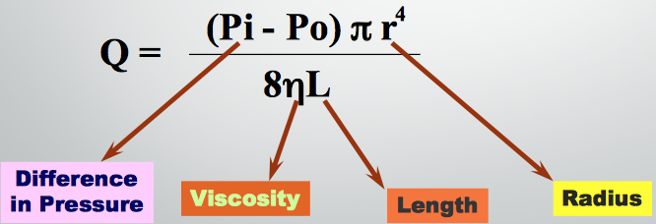
Factors Affecting Vascular Resistance
Doctor said this is very important!
Poiseuille’s law R = 8Lη / πr⁴
L= vessel length
η =viscosity of blood
r = radius
Fluid Flow (Q) through Cylindrical Tubes.
Flow decreases (↓) when resistance increases.
Flow resistance decreases (↓) when vessel diameter increases.
Flow = ΔP/R
Resistance is tendency of vascular system to oppose flow. Flow = 1/R
Influenced by: Length of the tube (L), radius of the tube (r), & viscosity of the blood (η)
In a normal human, length of the system is fixed, so blood viscosity & radius of the blood vessels have the largest effects on resistance.
If η increases, R increases and flow decreases. The viscosity of blood is dependent on the haematocrit and plasma protein concentration.
If the radius of a vessel increases, R decreases and flow increases.
Vessel radius can have a tremendous influence on blood flow because resistance is dependent upon r⁴ not just r. If r is doubled, TPR is reduced by 16, and flow increases 16 times.
Determinants of resistance are (Length, Viscosity and Radius)
Radius is most important why? Because radius changes (constriction or dilation ), Length doesn't change, Viscosity doesn't change ( physiologically ) Anemia lowers viscosity
Note: polycythemia: lead to increase blood cell which lead to increase viscosity which lead to increase resistance.
Anemia : lead to decrease blood cell which lead to decrease viscosity which lead to decrease resistance.

Slide 18
Total Peripheral Resistance (TPR)
ONLY IN FEMALES’ SLIDES
Systemic Circulation:
Pulmonary Circulation:
∆PQ
R =
عملية الطرح هذي عشان الدم بيطلع من الأورطا وبيمشي لكل الجسم لحد ما ينتهي في الright atrium
TPR =
Aortic Pressure - RAP Flow
120 - 2 mmHg
83.3 ml/sec (5 L/min)
Pul. R. = Pulmonary Art. P. - LAP
Flow
15 - 3 mmHg
83.3 ml/sec (5 L/min)
0.12 (PRU’s)
TPR =
Pul. R. =
Using Poiseuille’s law
TPR =
1.2 (PRU’s)
Pul. R. =
(Pi - Po) π r⁴
Q =
RAP= Right Atrial pressure.
LAP= Left Atrial Pressure.
8ηL
Just understand from this slide that ‘systemic circulation has higher resistance than pulmonary circulation, due to the higher pressure difference in systemic circulation’

Slide 19
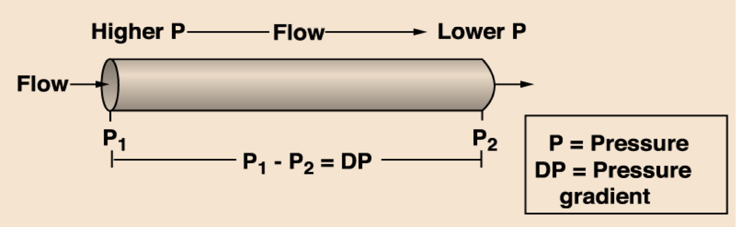
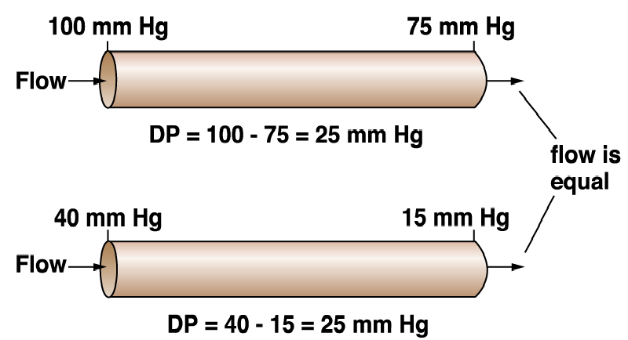
Blood Flow and Pressure
ONLY IN FEMALES’ SLIDES
P directly proportional to F
Blood flows down a pressure gradient.
Absolute value of pressure is not important to flow, but the difference in pressure (DP or gradient) is important to determining flow.
*What happens to pressure if we decrease the fluid volume? As in ventricles during systole.
Resulting pressure is called the driving pressure in vascular system.
How does the flow differ in these two vessels?
Flow outcome is equal due to the changes in pressure and diameter.

Slide 20
Resistance to Flow in the Cardiovascular System
ONLY IN FEMALES’ SLIDES
Higher resistance
Basic Concepts:
Rt = R1 + R2 + R3….
1/Rt = 1/R1 + 1/R2 + 1/R3 ….
Series Resistance
R1
R2 R3
R1 R2 R3
Parallel Resistance
What Really Happens in the CVS?
Lower R
Higher R
Lower R
Artery
Arterioles
Capillaries
Just understand from this slide that ‘the resistance is higher in series, and arterioles have the highest resistance’

Slide 21
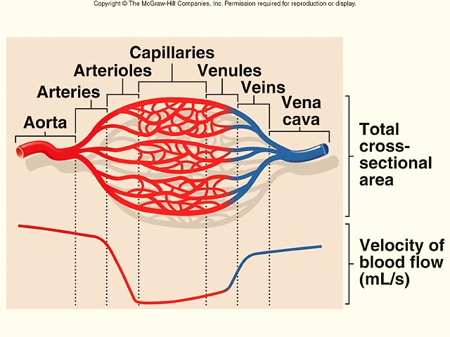
Resistance to Flow in the Cardiovascular System
ONLY IN FEMALES’ SLIDES
Cross-Sectional Area
If: R₁ = 2;
R₂ = 4;
R₃ = 6
Peripheral Resistance Units (PRU’s)
Series arrangement gives:
R_{T} = R₁ + R₂ + R₃ R_{T} = 12 (PRU’s)
Parallel arrangement gives:
1
R_{T} =
= 1.94 (PRU’s)
As diameter of vessels ↓, the total cross-sectional area
↑ & velocity of blood flow ↓
*So the velocity in capillaries is less
1 ₊ 1 1
R₁ R₂ R₃
+

Slide 22
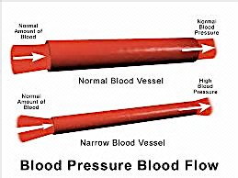

Velocity and Cross Sectional Area/Effect of Radius on Pressure
ONLY IN FEMALES’ SLIDES
Velocity and Cross Sectional Area
Effect of Radius on Pressure
A = 2cm² 10cm² 1cm²
Q =10ml/s
a
b
c
V = 5cm/s 1cm/s 10cm/s
V = Q / A

Slide 23
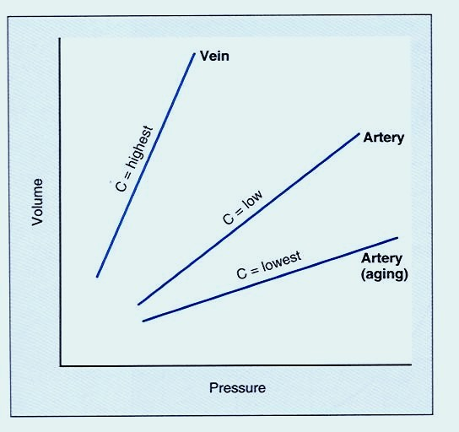
Compliance of Blood Vessels
ONLY IN FEMALES’ SLIDES
Compliance = distensibility.
Compliance is the volume of blood that the vessel can hold at a given pressure.
C = Compliance
V = Volume
P = Pressure
C = V
P
Venous system has a large compliance & acts as a blood reservoir (high volume & low pressure).
Veins have higher compliance unlike arteries which are thicker and more strict.

Slide 24
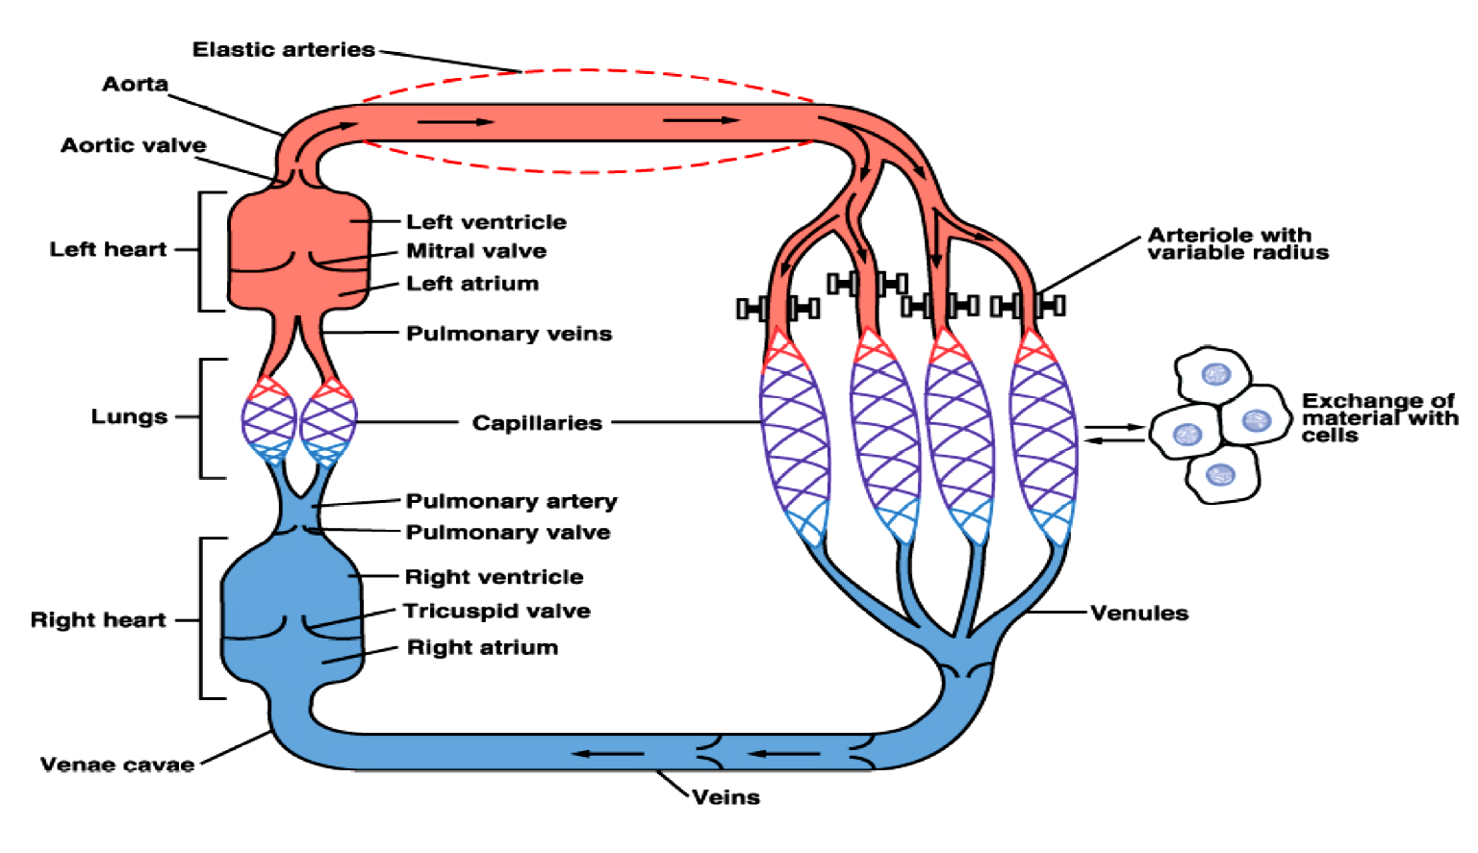
Vascular System Possesses Different Mechanisms for Promoting Continuous Flow of Blood to the Capillaries
ONLY IN FEMALES’ SLIDES
1)Elastic recoil (Arteries)
2)Smooth muscle regulation of diameter (arterioles)
3)Sphincters (capillaries)
4)Valves (veins and the heart)

Slide 25
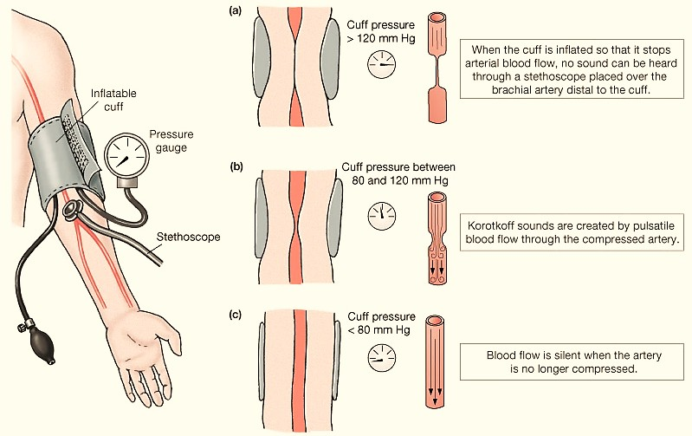
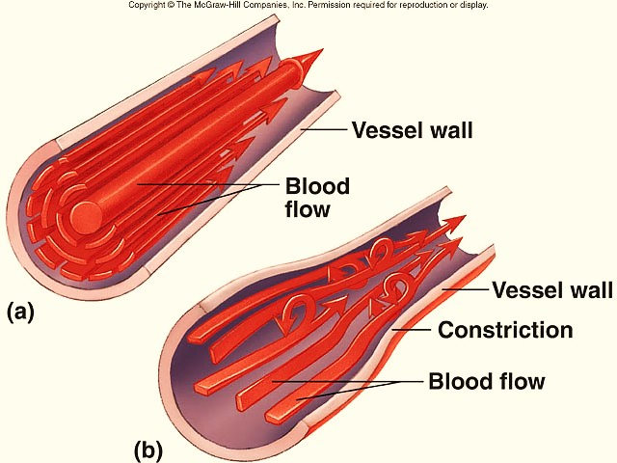
Laminar and Turbulent Flow/BP
ONLY IN FEMALES’ SLIDES
Laminar flow
Stream-lined
Outermost layer moving slowest & center moving fastest
Turbulent flow
Interrupted
Fluid passes a constriction, sharp turn, rough surface
Rate of flow exceeds critical velocity
Blood Pressure (BP): Measurements
(Normally the flow is laminar and it is the fastest flow.)
BP is measured by listening for Korotkoff sounds produced by turbulent flow in arteries:
Systolic pressure:
when 1st sound is heard.
Diastolic pressure:
when last sound is heard.

Slide 26
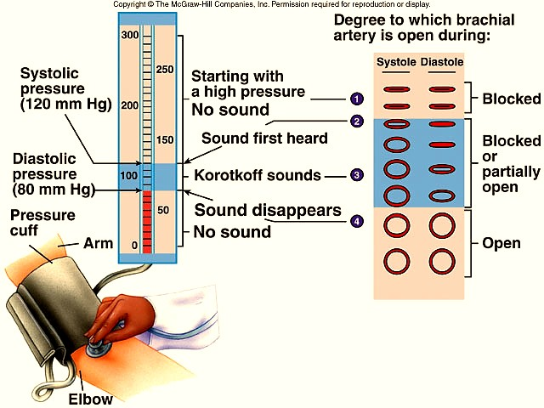
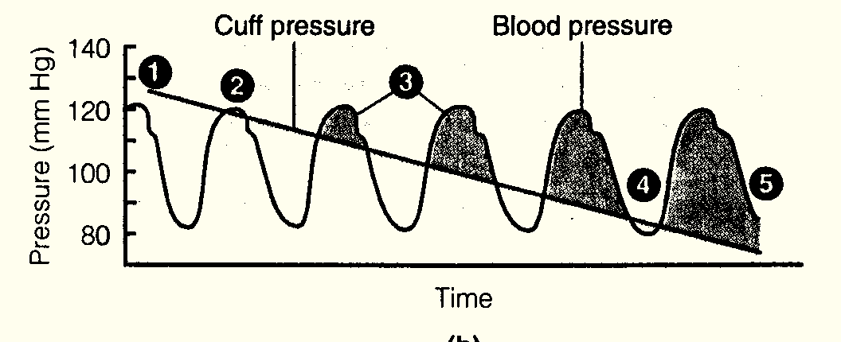
Measuring Blood Pressure Turbulent Flow
ONLY IN FEMALES’ SLIDES
1. Cuff pressure > systolic blood pressure: No sound
2. The first sound is heard at peak systolic pressure.
3. Sounds are heard while cuff pressure < blood pressure.
4. Sound disappears when cuff pressure < diastolic pressure

Slide 27
Factors Affecting Vessels Diameter
ONLY IN MALES’ SLIDES
Vasodilating agents:
Nitric oxide
Histamine
Atrial natriuretic peptide (ANP)
PROSTACYCLIN;PGL2
Vasoconstricting agent
Norepinephrine
Angiotensin 11
Endothelin-1
Vasopressin
Thromboxane A2
Vasopressin = ADH

Slide 28
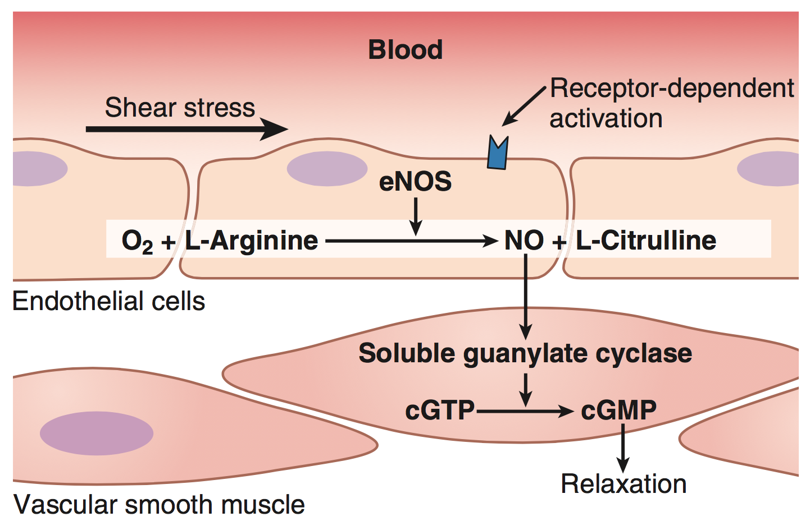
NIOTRIC OXIDE (NO)
ONLY IN MALES’ SLIDES
Shear stress causes the endothelium to release NO.
NO allows large blood vessels like aorta to regulate flow in absence of any metabolic signals.
Increased velocity of flow increases shear stress → ↑ release of vasodilators.
Mechanism of action of agonists, which work through production of nitric oxide:
  Agonist binds to receptor on endothelial cell.
  Binding stimulates production of nitric oxide synthase.
  Nitric oxide synthase catalyzes production of nitric oxide from L-arginine.
  Nitric oxide diffuses through endothelial cell wall and acts to stimulate a guanylate cyclase in vascular smooth muscle.
  The stimulated guanylate cyclase catalyzes the production of cGMP from GTP.
  cGMP is an important smooth muscle relaxer, resulting in vasodilation
    Viagra works by blocking the breakdown of cGMP, thereby increasing flow.
    Overproduction of nitric oxide is dangerous, and can result in hypotension.

Slide 29
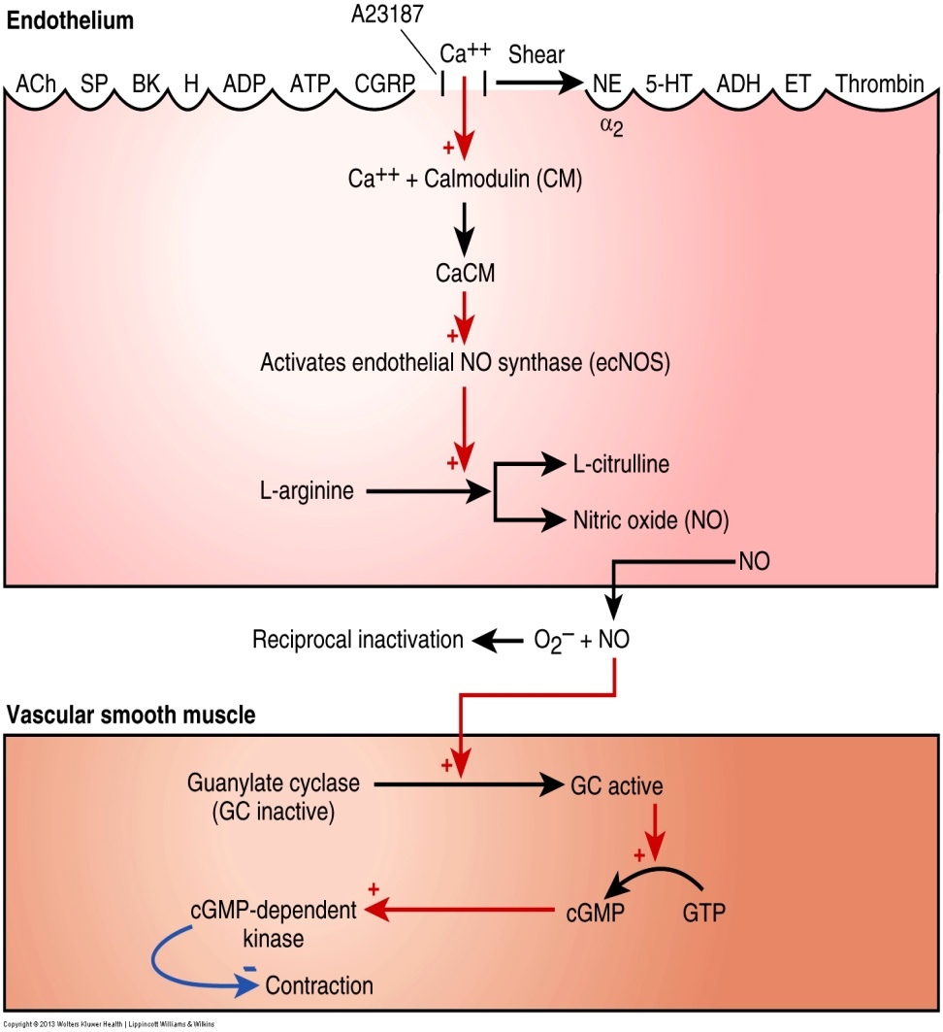
Other Factors Determining Blood Pressure
ONLY IN MALES’ SLIDES
Niotric Oxide (NO)
3.Blood volume:
An increase in blood volume → ↑cardiac output (CO ) → ↑arterial blood pressure (ABP).
A decrease in blood volume as in hemorrhage, dehydration → ↓venous return (VR) → ↓ cardiac output (CO) → ↓ arterial blood pressure( ABP).
4. Elasticity of blood vessels:
Changes in the elasticity of great vessels affects ABP.
In atherosclerosis, there is decrease in arterial compliance ("hardening of the arteries"). This makes arteries like a tube, so during systole, as blood is ejected into the arteries, they don’t distend as normal and pressure increases significantly → ↑ PP.
(endothelium)
L arginine → NO ( by an enzyme called NO synthase)
(smooth muscle)
NO stimulates GC → GTP to cGMP → vasodilation

Slide 30
Regulation of Blood Pressure
ONLY IN MALES’ SLIDES
Blood pressure varies over 24 hours:
It is lower during sleep.
It is higher during waking, especially in stress.
Blood pressure is well regulated due to various reasons:
To provide organs (especially the brain) with adequate perfusion pressure*.
To optimize cardiovascular work.
Inability to regulate blood pressure can contribute to diseases.
If the regulation is disturbed
Hypertension:
Increase COP or increased resistance
Treatment:
Lower COP → give diuretics → less volume → less venous return
Reduce resistance ( by vasodilators )
Hypotension
Too low a value of arterial blood pressure
Hypertension
Too high a value of arterial blood pressure
blood flow to the tissues will be reduced.
This may cause excessive capillary pressures and damage
e.g., heart (myocardial infarction) kidneys, brain (stroke) and eyes
e.g., the brain (and induce a faint).
Perfusion pressure*: is pressure that drives the passage of fluid through the circulatory system or lymphatic system to an organ or a tissue, usually referring to the delivery of blood to a capillary bed in tissue.

Slide 31

Regulation of Blood Pressure
Short term mechanisms (seconds to minutes): are largely neural. They regulate cardiac function and arteriolar diameter.
Intermediate and long term mechanisms (minutes to days): are largely renal and hormonal. They regulate blood volume.
Regulation of BP
Short term mechanisms
Baroreceptor reflex
CNS ischemic response
long term mechanism
Hormonal
Renal
Catecholamines
ADH
Chemoreceptor reflex
Atrial reflexes
thermo-receptors
pulmonary receptors
Intermediate term mechanisms
Renin-Angiotensin-Aldosterone System
other
ANP
EPO (erythropoietin)
Renin-angiotensin vasoconstrictor mechanism
Stress-relaxation of the vasculature
Fluid Shift mechanism
Factors that affect BP:
Cardiac output.
Peripheral resistance.
Blood volume.

Slide 32
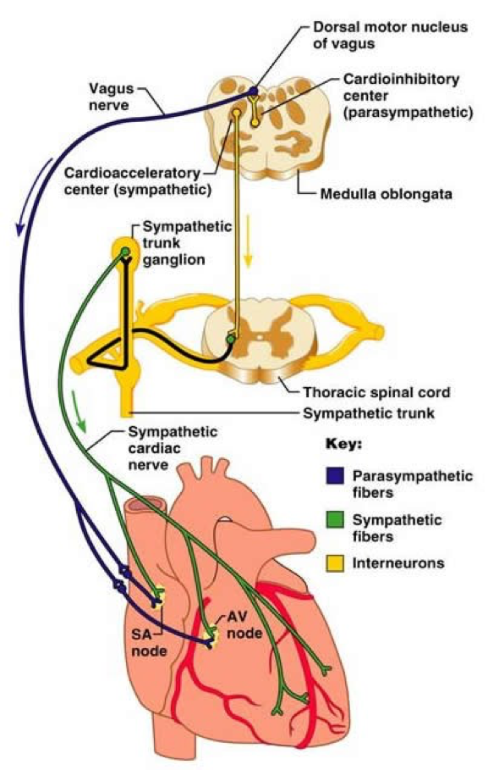
Rapidly Acting Control Mechanisms
ONLY IN FEMALES’ SLIDES
Acts within seconds/ minutes.
Concerned with regulating cardiac output & peripheral resistance.
Reflex mechanisms that act through autonomic nervous system:
Centers in Medulla Oblongata:
      Vasomotor Center (VMC): for Sympathetic nervous system.
      Cardiac Inhibitory Center (CIC): for Parasympathetic nervous system.
-They never work together when the sympathetic system gets stimulated, parasympathetic system will get inhibited and act like the sympathetic system and vice versa.

Slide 33
1. The Arterial Baroreceptors (Increase and decrease blood pressure)
Changes in MAP are detected by baroreceptors (pressure receptors) in the carotid and aortic arteries. (Stimulated in response to blood pressure changes)
Fast + neurally mediated
Mechano-stretch receptors
These receptors provide information to the cardiovascular centers in the medulla oblongata about the degree of stretch because of pressure changes.
Carotid baroreceptors are located in the carotid sinus on both sides of the neck. Aortic baroreceptors are located in the aortic arch.
Provide powerful moment-to-moment control of arterial blood pressure
The cardiovascular center is located on medulla oblongata and are stimulated in response to blood pressure changes. It consists of:
1- cardioacceleratory = vasomotor center ( sympathetic )
2- cardioinhibitory center (vagal / parasympathetic)
Why is it called cardioaccleratory center → because it gives sympathetic innervation to heart
Why others call it vasomotor center → because it gives sympathetic innervation to vessels
Medulla oblongata will activate one center, if one center is activated the other one is inhibited

Slide 34
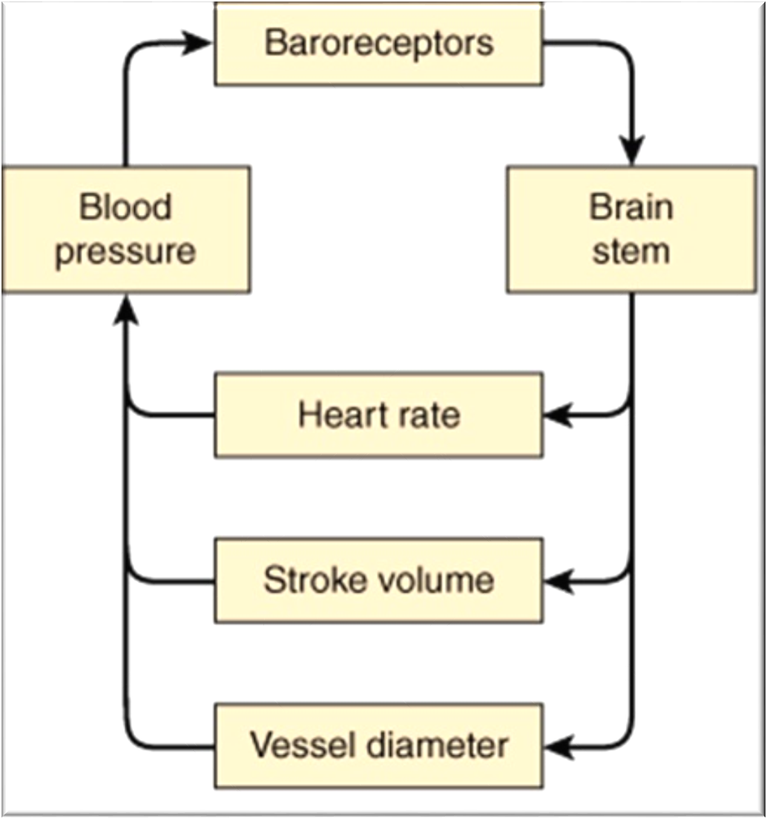
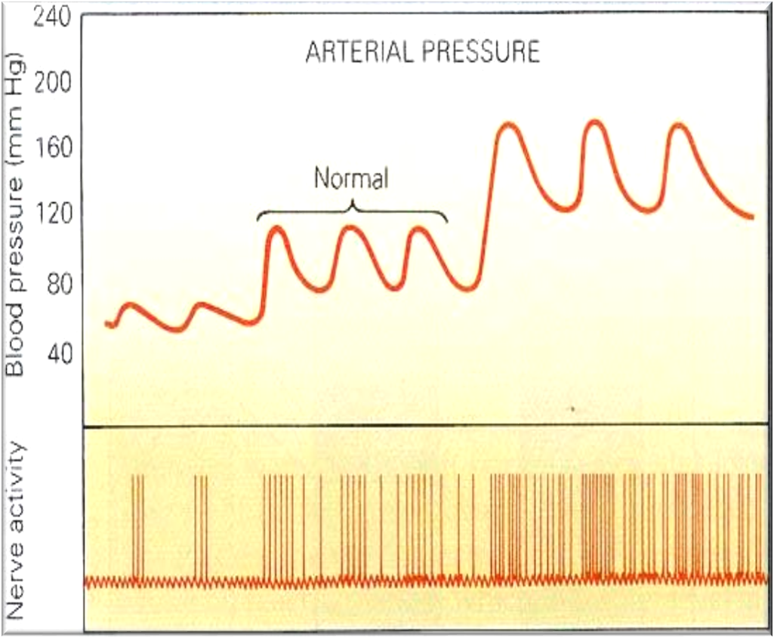
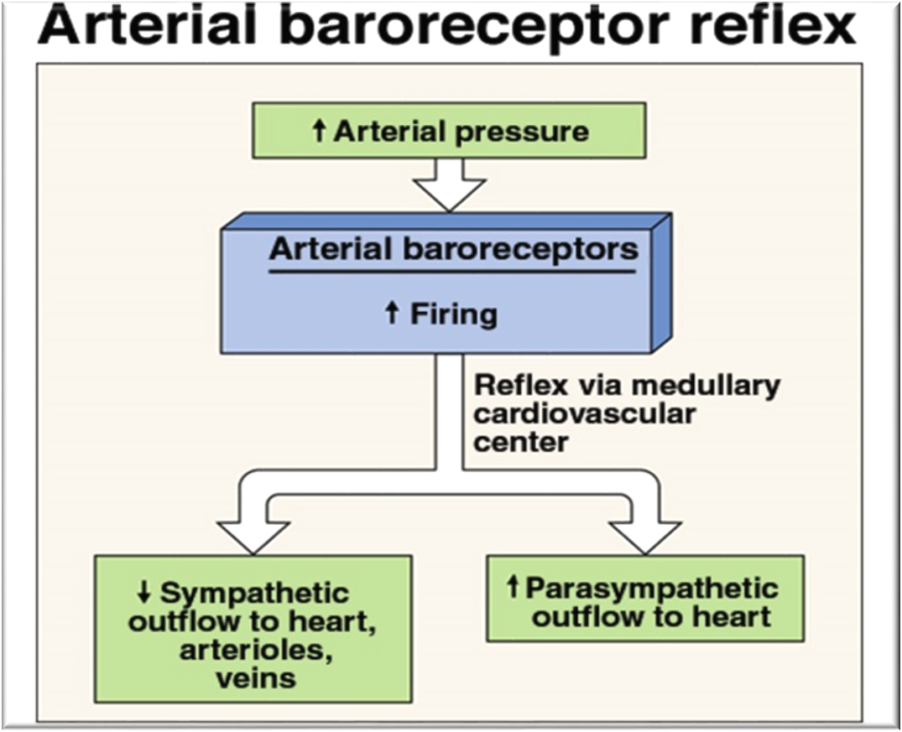
Increased Arterial pressure Increases Baroreceptor activity
ONLY IN MALES’ SLIDES
At normal arterial pressure the baroreceptors are active.
Increased pressure increases their rate of fire, while decreased pressure decreases the rate of fire.
They play an important role in maintaining relatively constant blood flow to vital organs (such as brain) during rapid changes in pressure, such as standing up after lying down. That is why they are called “pressure buffers”.
As the arterial pressure increase as shown in the graph, the nerve activity increases(the baroreceptor firing rate increases)

Slide 35
Arterial Baroreceptor Reflex
• Flow to the heart and brain is maintained; reductions in flow to other organs.
The cerebral arteries are relatively insensitive to adrenergic neural stimuli.
↑ Mean Arterial Pressure (MAP)
↓ Mean Arterial Pressure (MAP)
Baroreceptor Reflex
Baroreceptor Reflex
↑ Parasympathetic (vagal) activity
↓ Sympathetic activity
↓ Parasympathetic (vagal) activity
↑ Sympathetic activity
↓ HR
↓ HR
↓ SV
↓ TPR
↑ HR
↑ HR
↑ SV
↑ TPR
↓ MAP (becomes normal)
↑ MAP (becomes normal)
Note:
↓ Sympathetic activity → vasodilatation → ↓ TPR.
Note:
↑ Sympathetic activity → vasoconstriction → ↑ TPR.

Slide 36
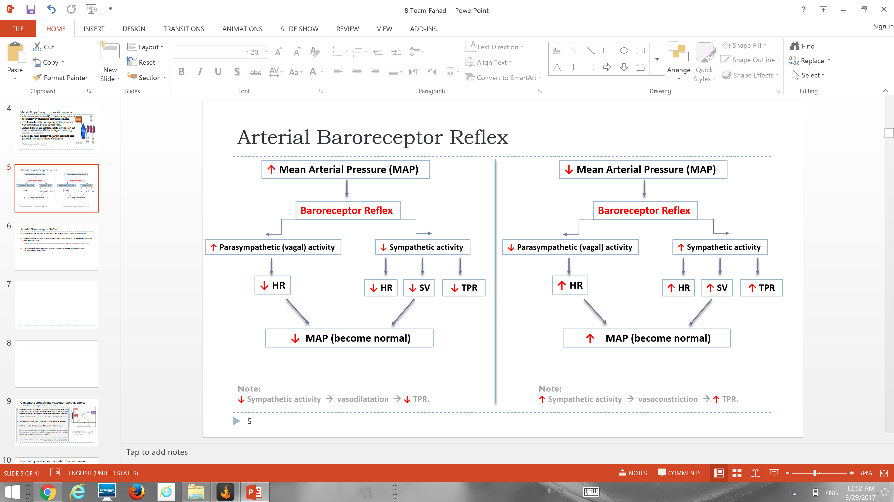
Arterial Baroreceptor Reflex
ONLY IN MALES’ SLIDES
Baroreceptors are important in maintaining MAP constant during changes in body posture.
When you change your posture from supine to erect, a drop in the MAP in the head and upper part of the body will occur.
The baroreceptor reflex is activated → strong sympathetic impulses → vasoconstriction. This minimizes the drop in MAP.
Posture from supine to erect → Accumulation of blood in the lower extremities (due to gravity) → ↓ Venous Return → ↓ Cardiac Output → ↓ MAP.
Remember
we mentioned the exact mechanism in the. previous slide

Slide 37
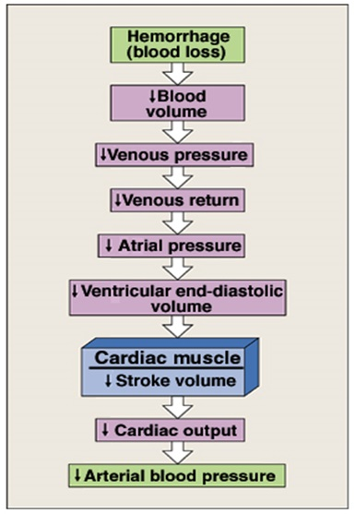
Cardiovascular Changes Initiated by The Baroreflex in Hemorrhage
ONLY IN MALES’ SLIDES
Because of hemorrhage: the arterial blood pressure (MAP) decreased. Then, the body will restore the normal MAP by the mechanism below:
Less blood volume → less MCP → less VR → less preload → less CO → less pressure (MAP)

Slide 38
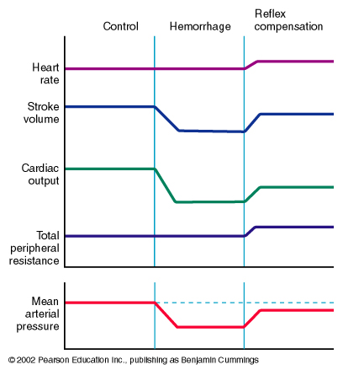
Cont.
ONLY IN MALES’ SLIDES
↓ SV during hemorrhage but after reflex compensation (Sympathetic) → ↑ SV
HR is normal during hemorrhage but after reflex compensation ( sympathetic ) → ↑HR
TPR is normal during hemorrhage but after reflex compensation ( sympathetic ) → Vasoconstriction → ↑ TPR
↓ CO during hemorrhage (due to blood loss ) but after reflex compensation (Sympathetic) → ↑ CO
↓ MAP during hemorrhage but after reflex compensation (Sympathetic) → ↑ CO → ↑ MAP
Control
Hemorrhage
Reflex
Compensation
HR
SV
CO
TPR
MAP
Control = before bleeding - Hemorrhage = bleeding - Reflex = Baroreceptor reflex

Slide 39
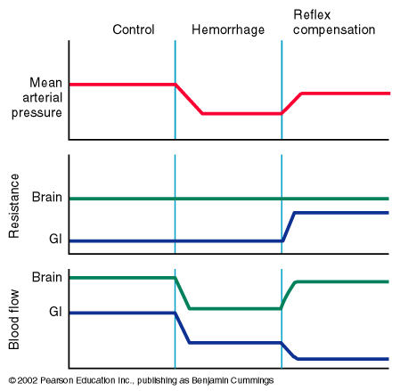
Cont.
ONLY IN MALES’ SLIDES
Brain’s blood vessels’ resistance are normal during hemorrhage and also after the reflex compensation
↓ MAP during hemorrhage but after reflex compensation (Sympathetic) → ↑ CO → ↑ MAP
Hemorrhage → ↓ CO → ↓ Blood flow to brain → Reflex compensation (sympathetic) → ↑ CO → ↑ Blood flow to brain
Gut’s blood vessels’ resistance are normal during hemorrhage but after reflex compensation (sympathetic )→ vasoconstriction → ↑ Resistance (see note below)
Hemorrhage → ↓ CO → ↓ Blood flow to GUT → Reflex compensation (sympathetic) → Vasoconstriction → ↓ Blood flow to Gut
Control
Hemorrhage
Reflex
Compensation
MAP
Brain Resistance
Gut Resistance
Brain Blood Flow
Gut Blood Flow
Remember: sympathetic activity will not cause vasoconstriction to the blood vessels of the brain.

Slide 40
Baroreceptors Reflex Mechanism During Changes in Body Posture
ONLY IN FEMALES’ SLIDES
Immediately on standing, AP in the head & upper part of the body tends to fall which can cause loss of consciousness.
Falling pressure at the baroreceptors elicits an immediate reflex, resulting in strong sympathetic discharge throughout the body.
This minimizes the decrease in pressure in the head & upper body.

Slide 41
ONLY IN MALES’ SLIDES
Unimportance of Arterial Baroreceptors in Long-Term Pressure Control
The baroreceptor reflex mechanism functions primarily as a short-term regulator of MAP. It is activated at once by any blood pressure change and attempt to restore blood pressure rapidly toward normal.
Yet, if MAP deviates from its normal operating point for more than a few days, the arterial baroreceptors adapt to this new pressure and reset their activity. Adaptation of receptors means decrease in impulse discharge from the receptors despite persistence of the stimulus.
This adaptation of the baroreceptors obviously prevents the baroreflex from functioning as a long-term blood pressure control system.
If pressure is elevated or decreased for a long time 2-3 days → baroreceptors have no affect
Baroreceptors think that this new pressure is the normal one

Slide 42
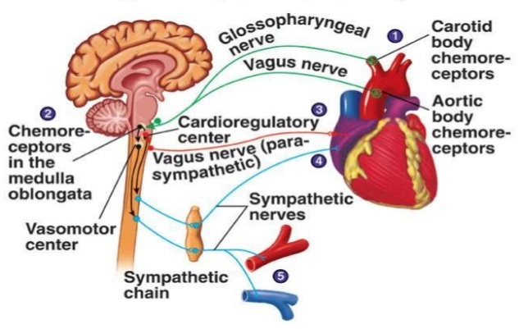
Arterial Chemoreceptor Reflex (only increases blood pressure!)
ONLY IN MALES’ SLIDES
Supply of O₂ to tissues depends on both respiratory and cardiovascular factors.
Chemoreceptors have a very high blood flow (1200 ml/min/g tissue). This makes it easy for these cells to detect changes in O₂, CO₂, and H⁺. Reduced blood flow (due to reduced MAP) stimulates the chemoreceptors through oxygen lack, increased hydrogen ions or carbon dioxide. Chemoreceptors are stimulated when the MAP is lower than 60 mmHg.
Response is excitatory, NOT inhibitory; mainly through activation of sympathetic nervous system.
They reduce blood flow to unessential areas and protect vital tissues like brain and heart.
ONLY IN FEMALES’ SLIDES
Closely associated with the baroreceptor pressure control system.
Chemoreceptor reflex operates in much same way as the baroreceptor reflex, EXCEPT that chemoreceptors are chemo-sensitive cells instead of stretch receptors.
First line for pressure regulation → baroreceptor reflex
Second line for pressure regulation → chemoreceptor reflex
Third line for pressure regulation → CNS ischemic response

Slide 43
Chemoreceptor Reflex
ONLY IN FEMALES’ SLIDES
Peripheral chemoreceptors:
Sensory receptors located in carotid & aortic bodies.
Sensitive to O2 lack , CO2 (decrease or increase) & pH (decrease or increase)
Chemoreceptors’ stimulation excite nerve fibers, along with baroreceptor fibers.
Central Chemoreceptors:
Sensory receptors located in the medulla itself.
Very sensitive to CO2 excess increase & decrease pH in medulla.
↓ BP
Haemorrhage
Chemoreceptor reflexes usually act to increase BP
Hypoxia
+ Chemoreceptors
+ vasomotor center
- CardioInhibitory Center
+ sympathetic
- parasympathetic
+ Adrenal medulla
↑ cardiac output (CO)
↑ heart rate (HR)
Vasoconstriction + ↑ total peripheral resistance (TPR)

Slide 44
3-CNS Ischemic Response (Last Ditch Stand); Cushing Reaction
It is not one of the normal mechanisms for regulating ABP.
CNS ischemic response operates as an emergency arterial pressure control system that acts rapidly and powerfully to prevent further decrease in MAP whenever blood flow to the brain decreases to lethal levels.
It is one of the most powerful activators of the sympathetic vasoconstrictor system.
When MAP < 20 mmHg → cerebral ischemia of vasomotor center → strong excitation of vasomotor center (due to accumulation of CO2, lactic acid,….) → strong vasoconstriction of blood vessels including the kidney arterioles.
Brain is enclosed within the cranium, which is a rigid structure. Thus, ↑ intracranial pressure (e.g., due to tumour or oedema) → compress cerebral blood vessels → ↓ cerebral blood flow with consequent hypercapnia (PCO₂).
This will directly stimulate the pressor area of the vasomotor centre → systemic vasoconstriction with resultant rise in mean arterial pressure (MAP). (PCO₂ has an extremely potent effect in stimulating the sympathetic vasomotor nervous control areas in the brain’s medulla.)
The resultant rise in MAP coupled with local cerebral vasodilation will tend to restore cerebral blood flow back to normal.
At the same time, the rise in MAP will reflexly decrease heart rate via baroreceptors.
This is called Cushing’s reflex.
If ↑ intracranial pressure was due to oedema caused by brain concussion: damage to capillaries) → ↑ cerebral blood flow → ↑ cerebral capillary pressure → further oedema (vicious circle).

Slide 45
Further Explanation
Tumor → increased intracranial pressure → constrict blood vessels → less blood to brain → accumulation of CO2 → stimulate pressor area of vasomotor center (cardioaccelartory center) → vasoconstriction of vessels → increased pressure
(not in brain) → blood goes to brain
Baroreceptors notice increase in pressure (don’t know that there’s increases in intracranial pressure) → stimulate parasympathetic → drops HR
(That is why you see a person with increased intracranial pressure and bradycardia)
----
Vicious cycle
If elevated intracranial pressure is due to concussion (damaged capillaries), more blood flow to brain capillaries will result in more edema ( due to the damaged capillaries leaking )
---
Pressor area = part of vasomotor center (cardioaccelartory center) that gives sympathetic innervation to vessels

Slide 46
ONLY IN MALES’ SLIDES
4-Atrial Volume Receptors
There are receptors in the large veins close to the heart and in the walls of the atria.
They are sensitive to blood volume. The following mechanisms occurs to prevent excess elevation in blood pressure upon response to an increase of body fluid volume:
An increased blood volume → stretch of atria → activate atrial volume receptors → sensory afferent nerves to medulla →inhibiting the cardiovascular centre → This results into decreased blood volume through:
  (a) → ↓ sympathetic drive to kidney:
  1) dilate afferent arterioles → ↑ glomerular capillary hydrostatic pressure →↑ GFR → ↓ blood volume (towards normal).
  2) ↓ renin secretion (Renin is an enzyme which activates angiotensinogen in blood). Hence inhibition of renin secretion → inhibit RAAS → inhibit aldosterone production → ↓ Blood volume (towards normal)
  (b) → ↓ ADH secretion → ↓ blood volume (towards normal).
  (c) → ↑ Atrial Natriuretic Peptide (ANP) causes loss of blood volume.
Afferent arterioles: group of blood vessels that supply the nephrons.
Remember Atrial natriuretic peptide (remove sodium in urine → reduces blood volume),

Slide 47
Other Vasomotor Reflexes (Not as strong)
ONLY IN FEMALES’ SLIDES
Atrial stretch receptor reflex:
increase in venous return stimulates atrial stretch receptors which in turn produces reflex vasodilatation & decrease in ABP.
Thermo-receptors (in skin / hypothalamus):
Exposure to heat > vasodilatation.
Exposure to cold > vasoconstriction.
Pulmonary receptors:
Lung inflation > vasoconstriction.

Slide 48
Long – term regulation of atrial blood pressure
ONLY IN FEMALES’ SLIDES
Hormonally mediated.
Takes few hours to begin showing significant response.
Mainly renal (acts if BP is too low):
      Renin-Angiotensin-Aldosterone System.
      Vasopressin [Anti-diuretic hormone (ADH)] Mechanism.
Others:
      Atrial Natriuretic Peptide Mechanism (Low-pressure volume receptors).
      EPO (erythropoietin).

Slide 49
ONLY IN MALES’ SLIDES
Hormonal Regulation of Blood Pressure
A. Catecholamines (Adrenaline and Noradrenaline)
↓ MAP
α-adrenoceptor stimulation promotes vasoconstriction
β -adrenoceptor stimulation promotes vasodilation
↑ Sympathetic Activity
Splanchnic nerve
Adrenaline released from the adrenal medulla circulates in the blood and can bind to both α and β adrenoceptors.
Noradrenaline released from the sympathetic nerves binds primarily to α adrenoceptors.
Adrenal Medulla
↑ Adrenaline Secretion
↑ HR (SA node) and ↑ SV (ventricular myocardium)

Slide 50
ONLY IN MALES’ SLIDES
Adrenaline Binding to α- and β-Adrenoceptors
Adrenaline has a greater affinity for β-adrenoceptors than for α-adrenoceptors
At low [Adrenaline]
→ Preferential binding to β-adrenoceptors
→ Vasodilation
At high [Adrenaline]
→ Binding to both α and β-adrenoceptors
→ Vasodilation and/or vasoconstriction?
In cardiac and skeletal muscle: number of β-receptors more than the number of α-receptors ➔ vasodilation
In most other tissues: number of α-receptors more than the number of number of β -receptors ➔ vasoconstriction
Norepinephrine → Alpha 1 receptors → vasoconstriction
Epinephrine higher affinity → Beta 2 receptors
Epinephrine lower affinity → alpha 1 receptors

Slide 51
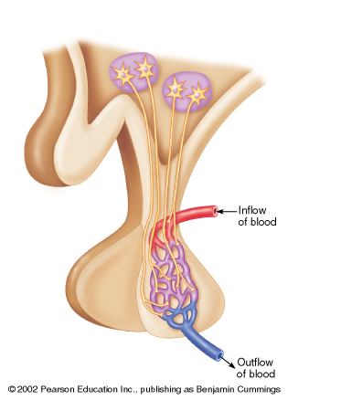
B. Vasopressin (Antidiuretic hormone; ADH)
Hormonal Regulation of Blood Pressure
ADH (vasopressin) is synthesized in the Paraventricular nucleus of the hypothalamus, then it is stored in the posterior pituitary.
It has two major functions which will lead to Increase in BP:
1- Vasoconstriction, in order to ↑ ABP (that is why it is called vasopressin)
2- Promotion of water retention by the kidney (at kidney tubules to ↑ blood volume + thirst stimulation
This is how it is secreted.
hypothalamus
Paraventricular nucleus
1- Increased Osmolarity.
This happens with dehydration, salt intake, or hypovolemia.
Osmolarity means increased conc. of solutes in the blood.
2- Osmoreceptor Stimulation.
Receptors in the hypothalamus sense the increased osmolarity in the blood.
3- ADH release.
The pituitary gland releases ADH.
Usually, when it is secreted aldosterone is secreted.
pituitary
Vasoconstriction → increased TPR → increased BP

Slide 52
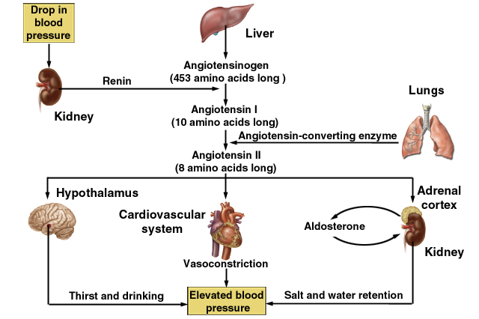
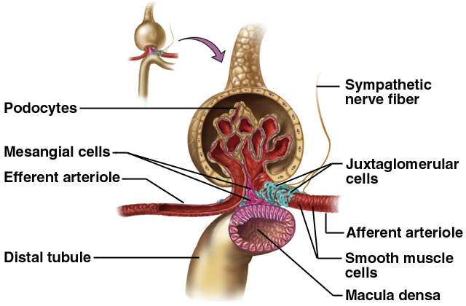
Renal Regulation of Blood Pressure
ONLY IN MALES’ SLIDES
1- Renin secretion with decreased perfusion (blood flow) to kidneys.
2- Renin converts Angiotensinogen to Angiotensinogen 1
3- ACE converts Angiotensinogen 1 to Angiotensinogen II
Baroreceptors reflex → Short term control of BP.
Blood volume control → Long term control of BP.
Blood volume is controlled by the kidney which has sensors called Juxtaglomerular cells that secrete Renin with decreased blood flow to them.
Efferent arterioles

Slide 53
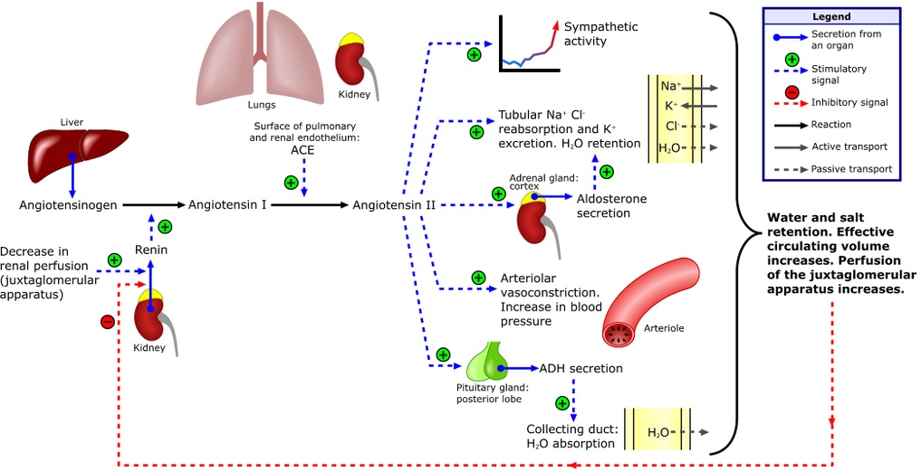
Renal Regulation of Blood Pressure
(Please make sure to understand this.)

Slide 54
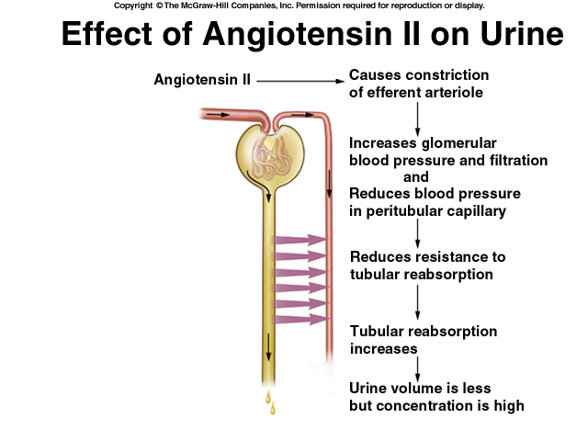
Effects of Angiotensin II
ONLY IN MALES’ SLIDES

Slide 55
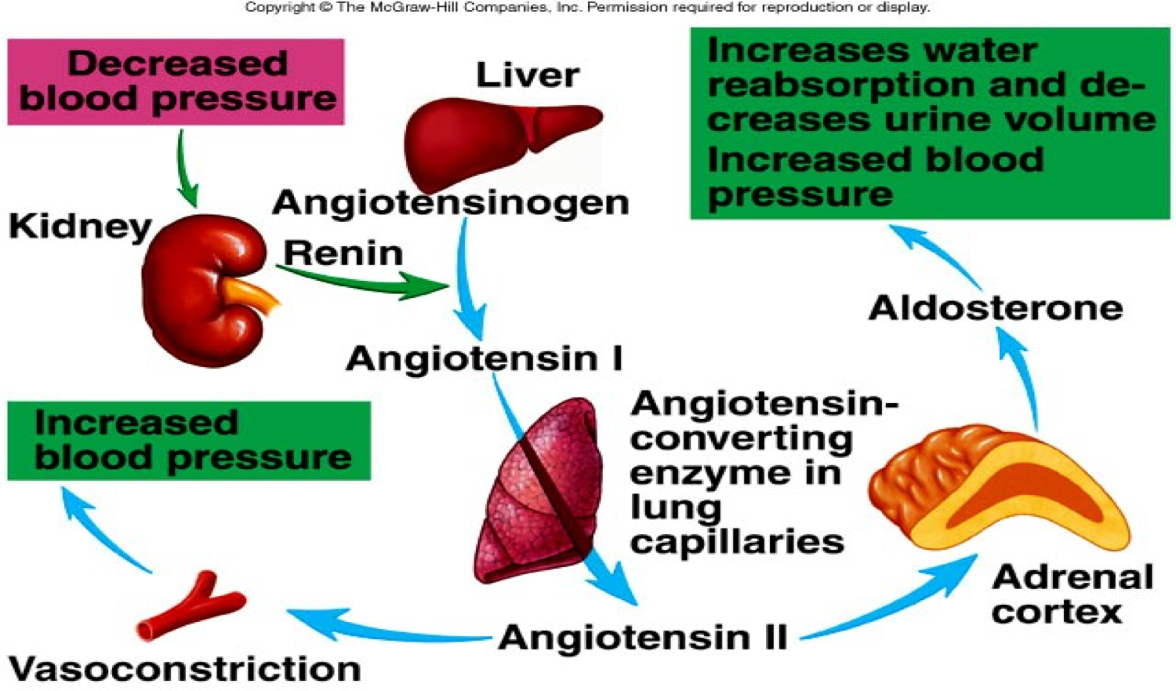
Renin – Angiotensin Aldosterone System
ONLY IN FEMALES’ SLIDES
Decreased renal blood flow (or/and) decrease in sodium activates Juxtaglomerular apparatus of kidneys (volume receptors)
Renin system is activated and converts angiotensin (plasma protein) to angiotensin I (lungs)
Through converting enzymes Angiotensin I is converted to II (vasoconstrictor) to Ag III
In adrenal cortex corticosterone is converted to aldosterone which promotes Na retention
Angiotensin II stimulates the secretion of the hormone aldosterone from the adrenal cortex.

Slide 56
Other Regulation Mechanisms
ONLY IN FEMALES’ SLIDES
Long term:
Atrial Natriuretic Peptide (ANP) hormone:
Hormone released from cardiac muscle cells (wall of right atrium) as a response to an increase in ABP.
Simulates an ↑ in urinary production, causing a ↓ in blood volume & blood pressure.
Erythropoietin (EPO)
Secreted by kidney when blood volume is too low.
Leads to RBC formation which increases blood volume.
Intermediate (activated within 30 mins to several hrs)
During this time, the nervous mechanisms usually become less & less effective
Renin-Angiotensin vasoconstrictor mechanism (mentioned previously)
Fluid shift mechanism:
Movement of fluid from interstitial spaces into capillaries in response to ↓ BP to maintain blood volume.
Conversely, when capillary pressure too high, fluid is lost out of circulation into the tissues, reducing blood volume as well as all pressures throughout circulation.
Stress Relaxation mechanism:
When pressure in blood vessels becomes too high, they become stretched & keep on stretching more & more for minutes or hours; resulting in fall of pressure in the vessels toward normal.
This continuing to stretch of the vessels can serve as an intermediate-term pressure “buffer.”

Slide 57
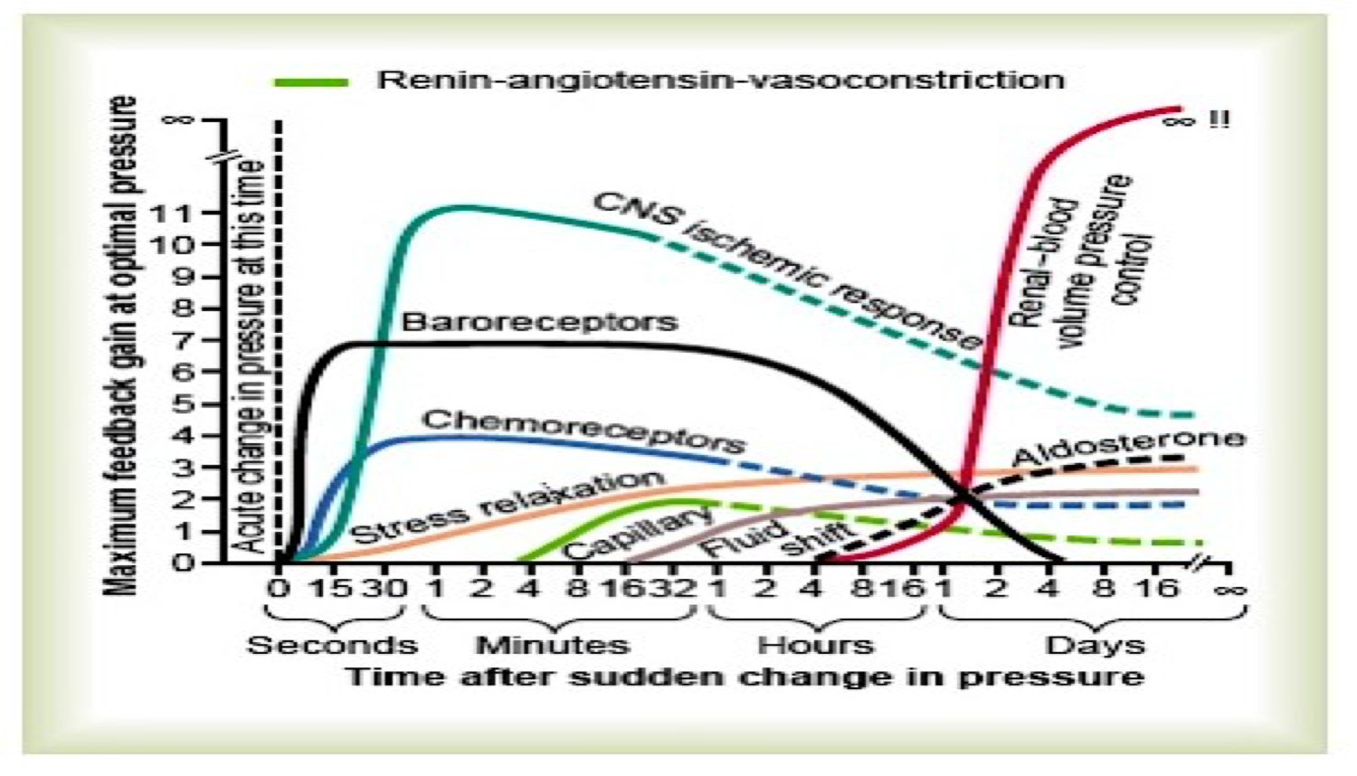
Control Mechanisms at Different Time Intervals After the Onset of Disturbance
ONLY IN FEMALES’ SLIDES
*Not important

Slide 58
Hypertension
ONLY IN MALES’ SLIDES
Hypertension could result from increase in:
Cardiac output
Total peripheral resistance
Both
Most cases are caused by increased TPR caused by reduced arteriolar radius.
Sometimes blood-pressure control mechanisms do not function properly or unable to completely compensate for changes that have taken place.
Blood pressure may be:
Hypertension is either:
Primary (essential or idiopathic) which (about 90% of all hypertension cases)
Secondary to another primary problem (about 10% only)
Above the normal range (hypertension if above 140/90 mm Hg).
Below normal (hypotension if less than 100/60).
4-Renal diseases
account for over 80% of the case of secondary hypertension.
5-Endocrine causes
Conn’s syndrome.
- Adrenal hyperplasia.
-Phaeochromocytoma.
- Cushing’s syndrome.
- Acromegaly.
1-Drugs
2-Coarctation of the aorta
3- Pregnancy

Slide 59
Complications of Hypertension (Mentioned in the Objectives)
What was mentioned in class:
Cardiac remodeling.
LV hypertrophy.
Heart failure.
Further complications and their explanation:
The excessive pressure on your artery walls caused by high blood pressure can damage your blood vessels, as well as organs in your body. The higher your blood pressure and the longer it goes uncontrolled, the greater the damage.
Uncontrolled high blood pressure can lead to:
Heart attack or stroke. High blood pressure can cause hardening and thickening of the arteries (atherosclerosis), which can lead to a heart attack, stroke or other complications.
Aneurysm. Increased blood pressure can cause your blood vessels to weaken and bulge, forming an aneurysm. If an aneurysm ruptures, it can be life-threatening.
Heart failure. To pump blood against the higher pressure in your vessels, your heart muscle thickens. Eventually, the thickened muscle may have a hard time pumping enough blood to meet your body's needs, which can lead to heart failure.
Weakened and narrowed blood vessels in your kidneys. This can prevent these organs from functioning normally.
Thickened, narrowed or torn blood vessels in the eyes. This can result in vision loss.
Metabolic syndrome. This syndrome is a cluster of disorders of your body's metabolism, including increased waist circumference; high triglycerides; low high-density lipoprotein (HDL) cholesterol, the "good" cholesterol; high blood pressure; and high insulin levels. These conditions make you more likely to develop diabetes, heart disease and stroke.
Trouble with memory or understanding. Uncontrolled high blood pressure may also affect your ability to think, remember and learn. Trouble with memory or understanding concepts is more common in people with high blood pressure.

Slide 60
Link to Editing File
(Please be sure to check this file frequently for any edits or updates on all of our lectures.)
Quiz
Arterial BP: https://www.onlineexambuilder.com/pressure/exam-141425
Regulation of BP: https://www.onlineexambuilder.com/regulation-of-pressure/exam-141423
References:
Girls’ and boys’ slides.
Guyton and Hall Textbook of Medical Physiology (Thirteenth Edition.)

Slide 61
Thank you!
اعمل لترسم بسمة، اعمل لتمسح دمعة، اعمل و أنت تعلم أن الله لا يضيع أجر من أحسن عملا.
The Physiology 436 Team:
Female Members:
Amal AlShaibi
Najd Altheeb
Allulu Alsulayhem
Ghada Alhadlaq
Ghada Alskait
Heba Alnasser
Male Members:
Faris Nafisah
Nasser Abu dujain
Abdullatif Alabdullatif
Mohammed Baqais
Faisal Alfawaz
Hassan Alshammari
Fouad Fathi
Abdulmajeed Alamar
Ali Alsubaie
Team Leaders:
Qaiss Almuhaideb
Lulwah Alshiha
Contact us:
Physiology436@gmail.com
@Physiology436

