Slide 1
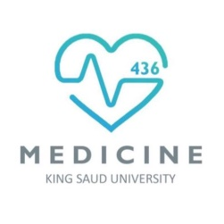
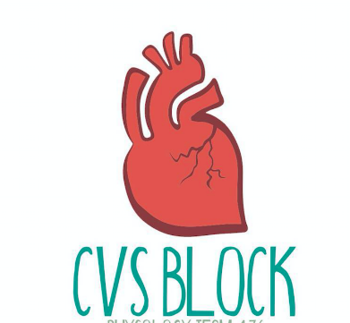
Capillary Circulation
Red: very important.
Green: Doctor’s notes.
Pink: formulas.
Yellow: numbers.
Gray: notes and explanation.
Physiology Team 436 – Cardiovascular Block Lecture 14
Lecture: If work is intended for initial studying.
Review: If work is intended for revision.

Slide 2
Objectives
Study Smart: focus on mutual topics.
Outline the parts of the microcirculation, and list types of blood capillaries and differentiate between them.
Explain regulation of flow in the capillary beds.
Compare and contrast diffusion and filtration.
State Starling forces acting on the capillary wall.
Define edema, state its causes and discuss its mechanisms.
Describe the role of the microcirculation in temperature regulation.

Slide 3
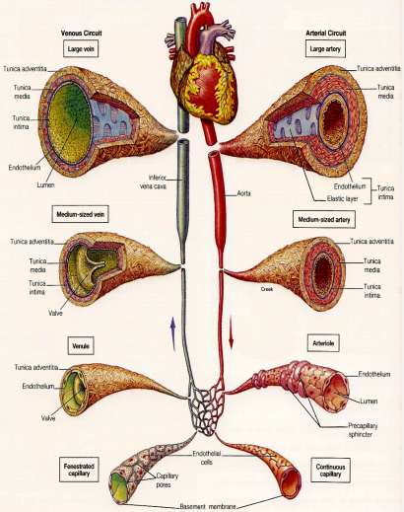
Classification of The Vascular System
Introduction:
ONLY IN FEMALES’ SLIDES
1. Aorta: elastic recoil
2. Arteries: muscular, low resistance vessels
3. Arterioles: high resistance vessels
4. Capillaries: exchange vessels
5. Venules
6. Veins: capacitance vessels

Slide 4
Blood Vessel Comparison
Introduction:
ONLY IN FEMALES’ SLIDES

Slide 5
Distribution Of Blood Within the Circulatory System at Rest
Introduction:
ONLY IN FEMALES’ SLIDES

Slide 6
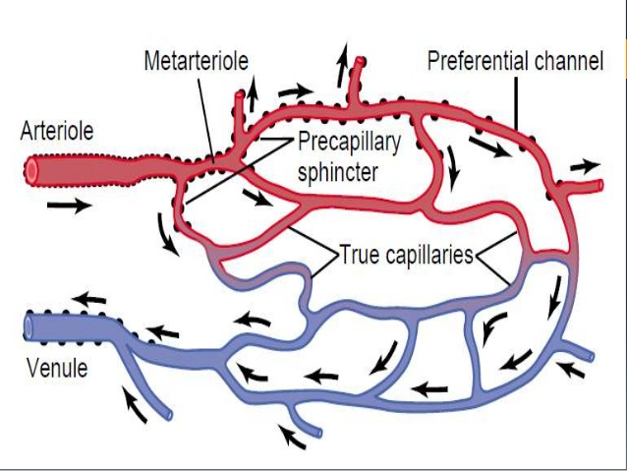
The Microcirculation
ONLY IN MALES’ SLIDES
The microcirculation refers to the microscopic divisions of the vascular system that function to:
1. Bring materials (nutrients and oxygen) to various body tissues.
2. Drain waste products from tissues to blood.
3. Temperature regulation
The capillary bed is where adequate exchange of gases, nutrients and waste products take place. It’s composed of:
Arterioles
Meta-arterioles and AV-shunt
Capillaries
NOTE:
These are present in slide 12
Females : only mentioned
AV-shunt and capillaries

Slide 7
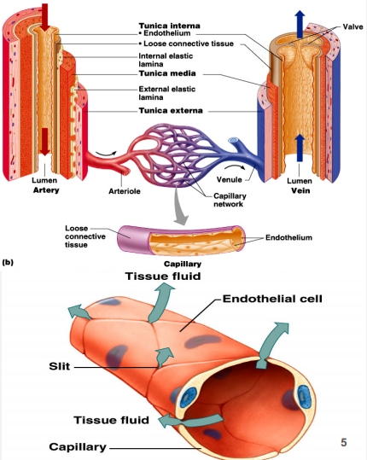
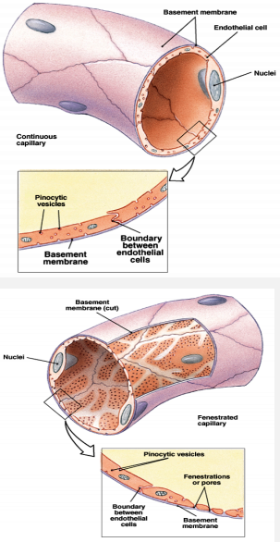
Capillaries
Introduction:
Smallest blood vessels.
One endothelial cell thickness and no smooth muscles.
They are called exchange vessels. Why?
Because:
-They provide direct access to cells.
-Most permeable.
-Permits exchange of nutrients & wastes.
Types of capillaries:
They are classified by diameter/permeability:
1. Continuous: Do not have fenestrae (for gas exchange)
2. Fenestrated: Have pores (for normal molecules)
3. Sinusoidal: Large diameter with large fenestrae (for large molecules)

Slide 8
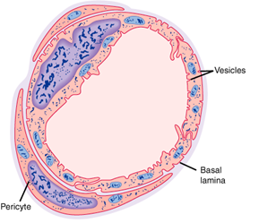
Continuous Capillaries
ONLY IN MALES’ SLIDES
These capillaries are present in most body tissues, e.g., muscle, lung, and adipose tissue.
Video of (continuous capillary) Duration: (1 min)
They have continuous endothelial lining and adjacent endothelial cells are closely joined together by tight junctions.
There are thin intercellular slits (clefts) 2-10 nm in width in-between the endothelial cells which are gaps in tight junctions that allow diffusion and bulk flow of water and water soluble small ions (e.g., Na+, Cl-, and glucose).
Tight junctions are continuous in brain and do not allow passage of water soluble molecules. They form part of the blood-brain barrier.
Continuous type of capillary

Slide 9
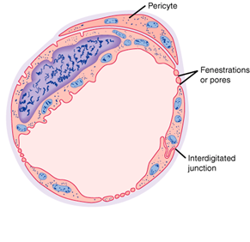
Fenestrated and Sinusoidal Capillaries
ONLY IN MALES’ SLIDES
Fenestrated capillaries are found in the kidney glomeruli, small intestine, and endocrine glands
Some endothelial cells have wide pores (fenestrations).
They are very permeable: they allow even large substances to pass but not plasma proteins.
Video of (Fenestrated & Sinosoidal Capillaries)
Duration: (1 mins)
Fenestrated type of capillary
In these capillaries the endothelial cell are widely spaced.
These have large irregular lumens that slows blood flow.
Few tight junctions that allow large molecules (e.g., proteins) to pass through.
Located in liver, spleen, bone marrow, lymphoid tissue, some endocrine glands
Sinusoidal or discontinuous capillaries

Slide 10
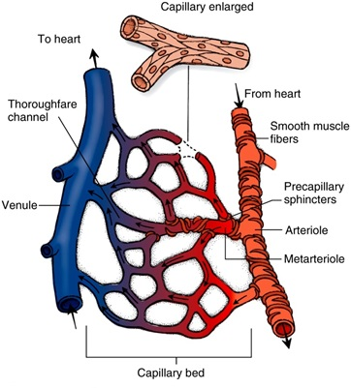
Capillary Bed: Arterioles
ONLY IN MALES’ SLIDES
Arterioles are resistance blood vessels which may restrict flow to capillaries or allow greater flow.
Arteriolar diameter is generally 5 – 100 micrometers.
They have a thick smooth muscle layer and endothelial lining.
They have precapillary sphincters
When the sphincters are open → nutritional flow.
When the sphincter are closed → non-nutritional flow or shunt flow.

Slide 11
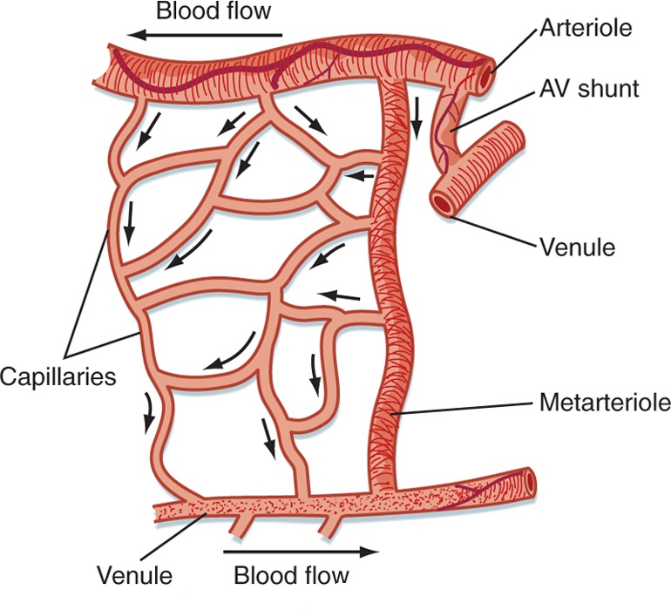
Capillary Bed: Metarterioles and A-V Shunt
ONLY IN MALES’ SLIDES
Metarterioles are intermediate resistance blood vessels found in some capillary beds
An A-V shunt is a small vessel with direct connection between an arteriole and a venule.
(They have a diameter of 10-20 micrometer.).
They arise from arterioles and give rise to capillaries.
They have pre-capillary sphincters.
They can connect with venules and/ or supply capillaries.
An A-V shunt allows bypass of capillaries if precapillary sphincters are closed.
In this case, the flow is 100% non-nutritional.

Slide 12
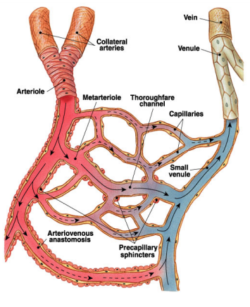
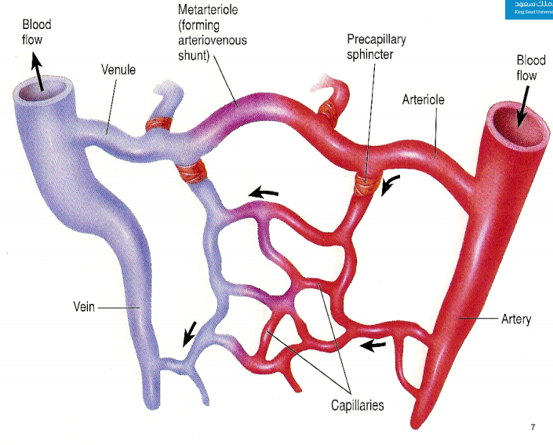
Capillary Network
Blood flows from arterioles through metarterioles*, then through capillary network Venules drain network.
What regulates the blood flow?
1. Smooth muscle in arterioles.
2. Metarterioles.
3. Precapillary sphincters.
Metarteriole* is a short vessel that links arterioles and capillaries.

Slide 13
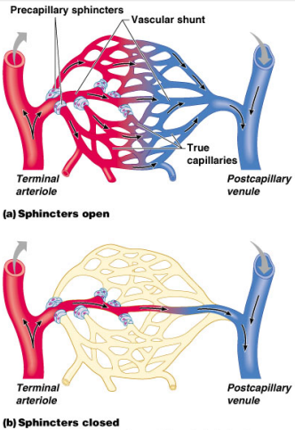
Capillary Beds
Capillary beds consist of two types of vessels:
Vascular shunt: directly connects an arteriole to a venule .
True capillaries: exchange vessels.
• Oxygen & nutrients cross to cells.
• Carbon dioxide & metabolic waste products cross into blood.
The capillary bed consists of a vascular shunt which is a direct way from the arterioles to the venules, and true capillaries (network) which are helpful for exchanging nutrients لأنهم متفرعين فهم أفضل بتوزيع المواد الغذائية للأنسجة المحيطة فيهم

Slide 14
Capillary Bed: Capillaries
ONLY IN MALES’ SLIDES
Capillary density in organs or tissues is indicative of the metabolic activity.
Capillaries diameters are not uniform.
Sufficient blood must moves through capillaries for oxygen demand in tissue or circulatory failure (or shock) may occur.
Structure: They are small blood vessels ≈ 0.5-1 mm long, and ≈ 0.01 mm (10 micrometers) diameter. There are no smooth muscle cells in the capillary walls. The walls of the capillaries are only a single endothelial cell thick. This permits rapid diffusion of water, solutes and gases.
Function: Sites of exchange between blood and tissues. The arterial system delivers blood to > l billion capillaries throughout the body. Total capillary surface area=1000 m2.
High density
Heart, brain, liver, and kidney.
Low density
Skin and cartilage.
Some capillaries have diameter less than that of a red blood cell
temporary deformation of blood cell as they pass through these capillaries.

Slide 15
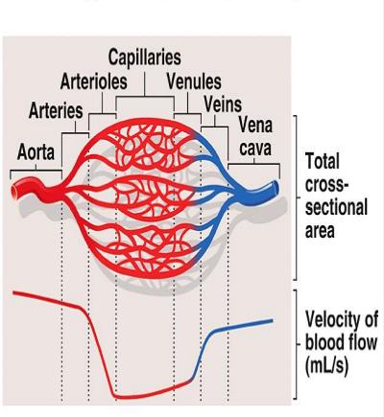
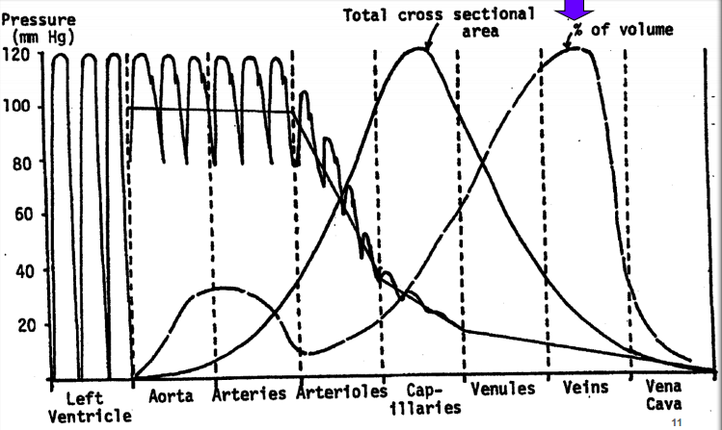
Cross-Sectional Area
As diameter of vessels decreases, the total cross-sectional area increases & velocity of blood flow decreases.
Much like a stream that flows rapidly through a narrow gorge but flows slowly through a broad plane.
NOTE: In males’ slides there is only a picture without any explanation.
Total Cross Sectional Area
Capacity Vessels
Remember: Distribution of blood within the circulatory system at rest (S:6)

Slide 16
Regulation of Flow in Capillary Beds and Mechanisms of Capillary Exchange
ONLY IN MALES’ SLIDES
Regulation of flow in capillary beds
The arterioles and the precapillary sphincters function as control valves in the tissue they feed:
During the “fight or flight” response, flow to non-essential organs (kidney, skin, etc.) is clamped off → increased flow to skeletal muscle.
Metabolic waste products act as vasodilators to relax precapillary sphincters.
Vasomotion: intermittent flow through capillary, in response to altering metabolic needs.
Mechanisms of capillary exchange.
Transport of substances across the capillary wall occurs by 3 major mechanisms:
1- Diffusion (according to concertation gradient)
2- Filtration (according to concertation gradient)
3- Transcytosis (vesicular transport)
Keep in mind that capillary permeability is not the same in all tissue.
It is specialized for different tissues:
Liver sinusoids have discontinuous endothelium → ↑ permeability → allows exchange of solutes and proteins.
Blood brain barrier capillaries have tight junctions = low permeability.
Kidney and intestinal capillaries contain fenestrations (pores) → ↑ permeability.
Clefts or pores only cover 0.02% of capillary surface area.

Slide 17
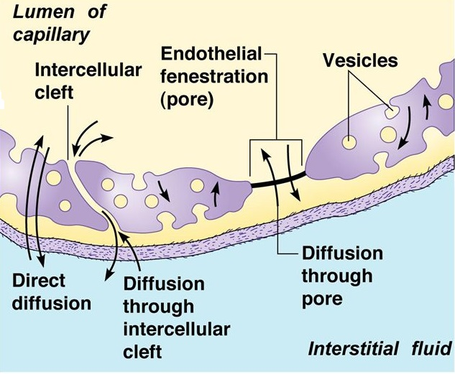
Diffusion
ONLY IN MALES’ SLIDES
It is a major process by which most nutritional substances and waste products move between the blood and the interstitium across the capillary wall according to the concentration gradients.
Capillary Diffusion using modified Fick’s Law:
J = P (CB – CT)
P: permeability coefficient; CB: conc. of solute in the blood.
CT : conc. of solute in the tissue.
P is affected by lipid solubility and molecular diameter. (constant for each type of tissue)
Lipid solubility affects speed of diffusion:
O₂ and CO₂ are highly lipid soluble and permeable.
Molecular diameter impacts solute diffusion:
It must be small enough for the clefts and pores in most tissues.
Glucose and NaCl have relatively high permeability, but albumin does not).
In liver, proteins (such as albumin) can move through the discontinuous endothelium easily.
Conc. Gradient impacts permeability. (substances are exchanged from a high to low conc.)
Permeability coefficient depends on lipid solubility and MW:
Increase Lipid solubility → increases permeability → increases diffusion
Increase MW → decrease permeability → decreases diffusion

Slide 18
Transcytosis (Vesicular Transport)
ONLY IN MALES’ SLIDES
This is an active process by which large molecules can be transported across the capillary membrane.
It includes the formation of vesicles from the endothelial membrane to surround the required particle (endocytosis). The vesicle separates and migrates across the cell to release its contents to the other side (exocytosis).
e.g. Peptide hormones are moved this way.

Slide 19
Filtration
ONLY IN MALES’ SLIDES
Filtration is the process by which plasma and its dissolved crystalloids (electrolytes and glucose) can filter across the capillary according to pressure gradient.
Filtration is determined by Starling’s forces.
It is called bulk flow as movement of water drags along with it dissolved substance to which the membrane is permeable.
Although the amount of materials exchanged by filtration are small compared to diffusion (rate of diffusion is 4000 times as the rate of filtration-reabsorption), however, filtration aids diffusion by keeping the fluid across the capillary membrane in a state of continuous motion.
Filtration forces
Four pressure are involved in fluid exchange in the capillary bed.
Also called starling forces:
1- Capillary hydrostatic pressure. (force fluid out)
2- Plasma colloid osmotic pressure. (sucks fluid in)
3- Interstitial fluid pressure. (almost 0 which means 1atm)
4- Interstitial fluid colloid osmotic pressure (suck fluid out)
2 out : which are capillary hydrostatic pressure and interstitial fluid colloid osmotic pressure.
2 in : which are plasma colloid osmotic pressure and interstitial fluid pressure¹. (interstitial fluid pressure does not count because its too low)
1: Interstitial fluid pressure may be in or out depending on the tissue. Because some times it is negative = out or positive = in

Slide 20
Hydrostatic Pressure
ONLY IN MALES’ SLIDES
Hydrostatic Pressure (P_{c}) is needed to push substances through slits and pores.
P_{c} is equivalent to P_{lat} (pressure exerted by the blood laterally on the capillary walls)
❖ ↑ resistance in arterioles through the action of norepinephrine and epinephrine on precapillary sphincter → ↓P_{c} and ↑ the pressure before the arterioles.
❖ This is not true for capillary beds which have predominately beta receptors in the capillary sphincters: these would be dilated or have reduced resistance. (not affected by NE or E)
❖ ↓ resistance in arterioles → ↑P_{c} .
❖ P_{c} varies from tissue to tissue. In the renal glomeruli, it is about 60 mm Hg (filtering capillaries). In contrast, it is only about 8-10 mm Hg in those of the intestine and the pulmonary circulation absorptive capillaries).
❖ P_{c} varies as blood moves along the capillary. P_{c} is highest at the arteriolar end and lowest at venular end of capillary.
Add*↑P_{c} → ↑filtration; can lead to edema.
❖ The interstitial fluid generally has very low hydrostatic pressure (P_{if}), usually given a value near zero.
Things which increase P_{if}, such as support hose, can reduce edema in legs.

Slide 21
Oncotic or Osmotic Pressure (π)
ONLY IN MALES’ SLIDES
Oncotic or osmotic pressure in the capillaries is a pressure which is mainly related to the presence of plasma proteins which can’t cross the capillary wall.
Albumin contributes to 65% of the osmotic pressure, whereas globulin contributes to only 15%.
However, an increased solute concentration → an increased osmotic pressure.
Proteins in the surrounding interstitial fluid contribute to the tissue osmotic pressure (π_{if}).
The π_{c}
Leads to reabsorption of water near the venular end of the capillaries, and thus recovers blood volume.
During the process of filtration and reabsorption, there is generally a loss of about 15% of the blood volume.
This is recovered by the lymphatic system.

Slide 22
Exchange of Fluid Between Capillaries and Tissues
Capillary exchange and interstitial fluid volume regulation:
What affects the movement of fluid from capillaries?
Blood pressure, capillary permeability & osmosis:
A net movement of fluid occurs from blood into tissues.
Fluid gained by tissues is removed by lymphatic system. (see slide 14)

Slide 23
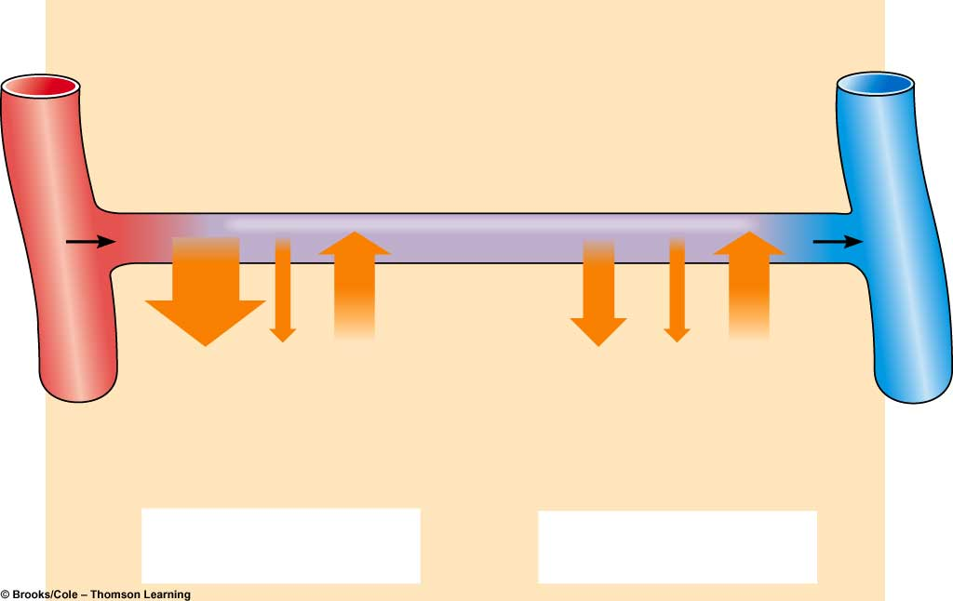
Transcapillary Fluid Dynamics
ONLY IN MALES’ SLIDES
Arterial end
of capillary
Venous end
of capillary
Osmotic
pressure
of plasma
(- 28)
Osmotic
pressure
of plasma
(- 28)
Blood
pressure
(+40)
Blood
pressure
(+15)
Osmotic
pressure
of interstitial
fluid
(+3)
Osmotic
pressure
of interstitial
fluid
(+3)
(40 + 3) - 28 = +15
(15 + 3) - 28 = - 10
Net filtration
Net absorption
We can see that the net reabsorption is less than the net filtration meaning that there is a loss of fluid from the blood.
This lost fluid will be returned through the lymphatic system which will be explained later.

Slide 24
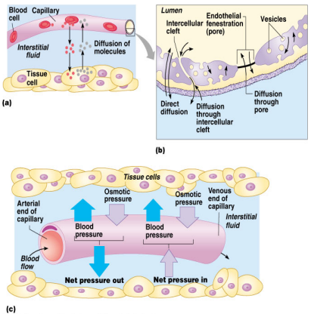
Diffusion at Capillary Beds (Fluid Balance)
Outward Forces:
Capillary blood pressure (Pc = 30-35 to 10-15 mmHg)
Interstitial fluid pressure (PIF = 0 mmHg)
Interstitial fluid colloidal osmotic pressure (µIF = 3 mmHg)
TOTAL = 38 to 18 mmHg
Inward Force:
Plasma colloidal osmotic pressure (µC = 25- 28 mmHg)
Numbers are not important since they vary from one tissue to another.
Video of (Capillary Circulation and Tissue Fluid)
Duration: (13 mins)

Slide 25
Fluid Filtration and Reabsorption in Normal Microcirculation
Hydrostatic Pressure = 0 mmHg
Osmotic Pressure = 3 mmHg
NFP = +5 to +10 mmHg
NFP = - 5 to -7 mmHg
Interstitial Fluid
Blood Capillary
Colloid Osmotic Pressure= 25 mmHg
Venous Blood
Hydrostatic Pressure = 18-20mmHg
Arterial Blood
Hydrostatic Pressure = 30-35 mmHg
At arterial end:
Water moves out of the capillary with a NFP of +5 to +10 mmHg.
Hydrostatic pressure dominates at the arterial end & net fluid flows out of the circulation.
At venous end:
Water moves into the capillary with a NFP of -5 to -7 mmHg.
Oncotic pressure dominates at the venous end & net fluid will flow into the bloodstream.

Slide 26
Explanation of the Previous Slide
Explaination:
*The osmotic pressure is constant and doesn't change in both side and it has an inward force (لان البروتينز تسحب الدم لها)
In the arterioles,
the hydrostatic pressure which is produced by the blood pressure on the vessel walls is higher than venules because their wall is thicker. And when we compare the hydrostatic to the osmotic pressure it's clear that the hydrostatic is higher (remember that's the hydrostatic has an outward force) so the the outward force will overcome the inward force and the fluid will goes out of the capillaries (NFP= 30-25= +5) لما نطرح الضغط من بعض رح يكون النت فيلتريشين بريشور موجب يعني اتجاه الفلود رح يكون لبرا نفس اتجاه الهايدروستاتك
Meanwhile in the venous blood the hydrostatic pressure is less than the osmotic pressure, so the inward force will overcome the outward force and the fluid will go inside the capillaries (NFB= 20-25=-5) لما نطرح الضغط من بعض الناتج بيطلع سالب معناته اتجاه الفلود رح يكون معاكس لاتجاه الهايدروستاتك (يعني قاعد يدخل لجوا)

Slide 27
ONLY IN MALES’ SLIDES
Starling’s Equation for Net Fluid Flow Across Capillaries
Fluid movement = K (filtration forces – reabsorption forces).
Fluid movement = K [(Pc + πIF) – (πc + PIF)].
K is determined by:
Blood viscosity.
Wall thickness.
Surface area.
Permeability of capillary wall to water.
K is high in liver and kidneys, while it is low in the blood-brain barrier.
Normally the amount filtered slightly exceeds the amount reabsorbed and is eventually returned to the circulation via the lymphatics
Using Starling equation, we can calculate fluid movement at the arteriolar and venular ends of the capillary:
Filtration: (arterial end) = 20ml fluid/min
reabsorption: (venous end) = 18ml fluid/min
Hence: there is net filtration of about 2ml/min for entire body:
This is removed by the lymphatics (prevent oedema)
K = filtration coefficient
At arteriolar end
↓
_{Net filtration}
At venular end
↓
Net reabsorption
Via
lymphatics

Slide 28
ONLY IN MALES’ SLIDES
Clinical Significance of Capillary Filtration
In blood loss, vasoconstriction of arterioles → decrease capillary hydrostatic pressure. Hence osmotic pressure of plasma proteins favours absorption of interstitial fluid →↑ blood volume.
In congestive heart failure, venous pressure rises → build-up of blood in capillaries →↑ capillary hydrostatic pressure →↑ filtration → oedema.
In hypoproteinemia (e.g., starvation, liver disease) → ↓ plasma protein colloid osmotic pressure → loss of fluid from capillaries → oedema.
In inflammation: the gaps between the endothelial cells increase because of the inflammatory mediators →↑ movement of proteins into the interstitium → oedema.

Slide 29
ONLY IN MALES’ SLIDES
Lymphatic Vessels: Lymphatic Capillaries
Lymphatics: These originate as lymph capillaries that unite to form larger vessels
- They resemble veins in structure but with thinner walls, less muscle, less connective tissue, and more valves.
- They connect to lymph nodes at various intervals.
Lymphatic trunks: These are formed by the union of lymphatics. They carry lymph to lymphatic ducts.
Lymphatic ducts: these are formed by the union of lymphatic trunks. They empty into large veins (right and left subclavian veins) just before they join the superior vena cava.
Theses are blind sacs that collect excess tissue fluid.
They consist of simple squamous epithelium (endothelium).
Cells overlap to form one-way valves within lumen.
The gaps between the endothelial cells are very large. They lack tight junctions.
They possess fine filaments which anchor them to the connective tissue
With contractions, these filaments can pull on the endothelial cells, and thus allowing protein, large particles or cells to enter lymph system.
Lymph capillaries
Lymphatics
Lymphatic Trunk
Lymphatic Duct
Drain into Subclavian veins

Slide 30
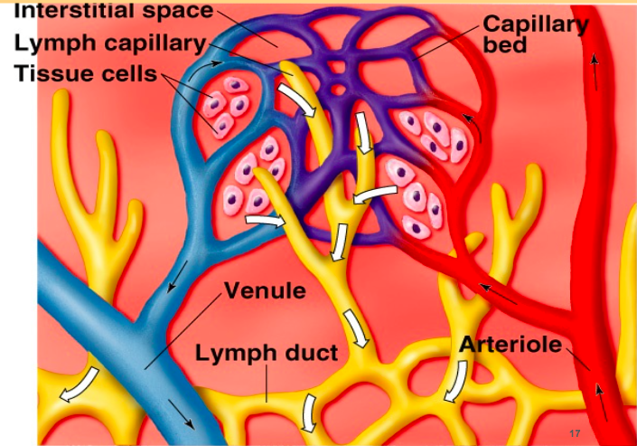
Lymphatic System and Lymph Circulation
Lymphatic System
Lymphatic vessels present between capillaries.
3 basic functions:
Drain excess interstitial (tissue) fluid back to the blood, in order to maintain original blood volume.
Transports absorbed fat from small intestine to the blood.
Helps provide immunological defenses against pathogens.
Lymphatic Circulation
Lymph moves along pressure gradient; about 2-4 liters/day.
Valves in the lymph vessels keep flow moving in one direction.
The mechanisms that may contribute to pressure gradient are:
“milking” by skeletal muscle (contraction of skeletal muscle puts pressure on lymphatic to move fluid forward).
pressure changes during breathing (inspiration lowers pressure in thoracic cavity and increases pressure in abdominal cavity).
Pulsating of neighboring elastic arteries.
contraction of smooth muscle in walls of larger lymphatic vessels and ducts.
ONLY IN FEMALES’ SLIDES
Lymphatic System
ONLY IN MALES’ SLIDES

Slide 31
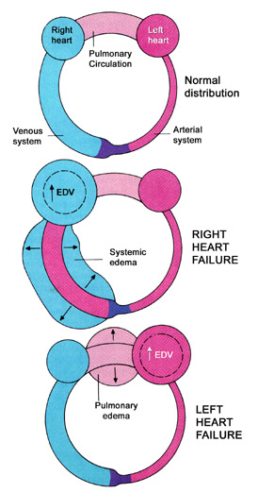
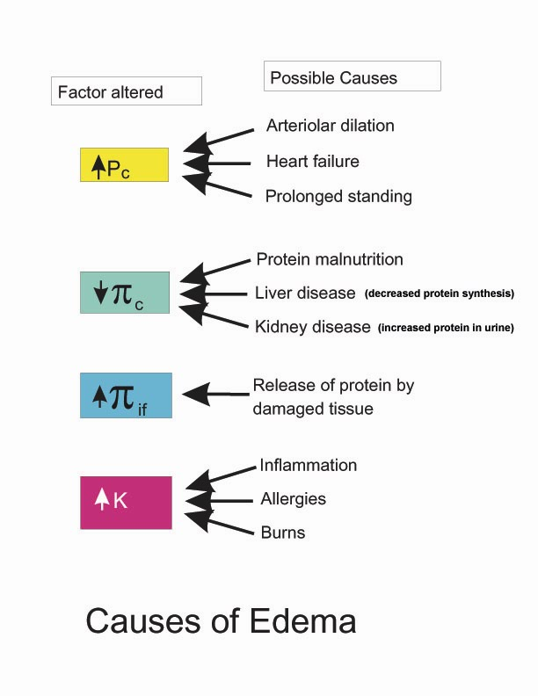
Lymph
ONLY IN MALES’ SLIDES
Edema
Contents:
Definition:
(Swelling in Greek) abnormal increase in interstitial fluid volume.
Lymph contents
Proteins | Less than plasma proteins. ½ compared to blood.
Lipids | Cholesterol & phospholipids (lipoproteins) Neutral fats (chylomicrons)
Electrolytes | Similar to plasma
Cells | Lymphocytes (all sizes & maturity) Rare monocytes/macrophages Granulocytes (only present following infection)
Important:
Video of (Lymph Content) Duration: (9 mins)

Slide 32
Causes Of Edema
ONLY IN MALES’ SLIDES
1. Increased capillary hydrostatic pressure:
Excess retention of salt and water by kidney:
Renal failure
Excess aldosterone.
Heart failure.
Increased venous pressure:
Heart failure.
Venous obstruction. e.g. thrombus, pregnancy, tumor, local venous occlusion, compression etc..
Failure of venous pump e.g. varicose veins.
Arteriolar dilatation and decreased arteriolar resistance:
Vasodilator drugs.
Excess body heat.
2. Decreased capillary colloid osmotic pressure:
Decreased protein intake (starvation or nutritional edema).
Liver cirrhosis.
Nephrotic syndrome.
Loss from skin (burns).
3. Increased capillary permeability:
Destruction of the endothelium (burns).
Allergic release of histamine.
Infections (bacterial toxins).
Vitamin C deficiency.
4. Impaired lymphatic drainage and lymphatic obstruction:
Destruction of lymphatics (trauma, irradiation).
Obstruction of lymph flow (e.g., filariasis, cancer).

Slide 33
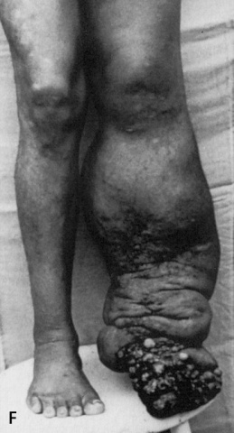
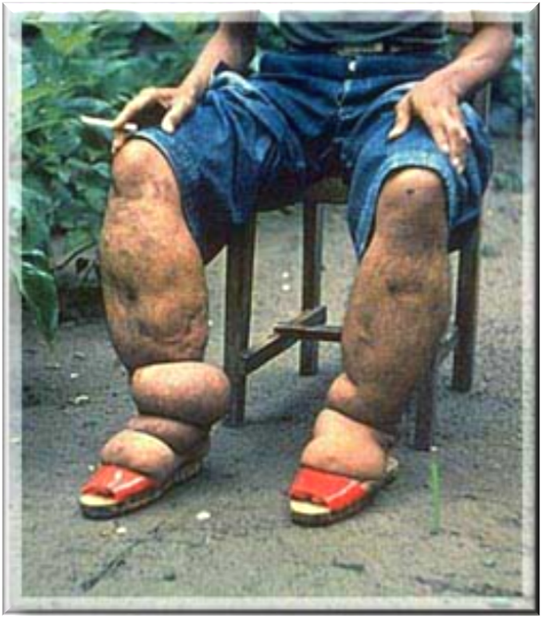
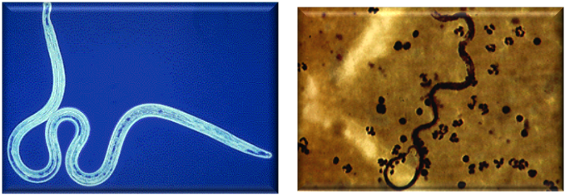
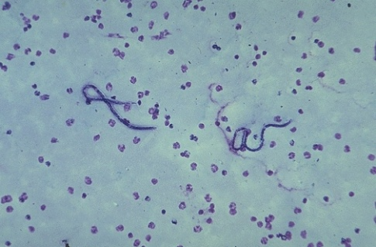
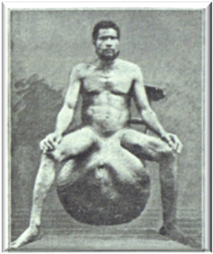
Lymphatic Filariasis (Elephantiasis)
ONLY IN MALES’ SLIDES
Parasitic Worms block the lymphatic system.
By blocking the lymphatic system causes fluid accumulation in the lower extremities and causes massive edemas.
Transmitted by mosquitoes.
Video of (Lymphatic Filariasis) Duration: (3 mins)
33

Slide 34
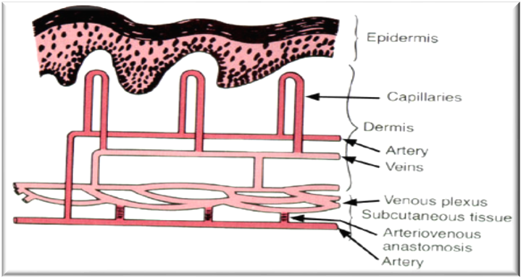
Role of Microcirculation in Temperature Regulation
ONLY IN MALES’ SLIDES
Capillaries of the skin are arranged perpendicular to the surface.
The cutaneous circulation is characterized by low density of capillaries.
There are other unique features:
Venous plexus: responsible for heat transfer to the skin.
Arteriovenous anastomosis: opens or closes in response to changes in temperature.
34

Slide 35
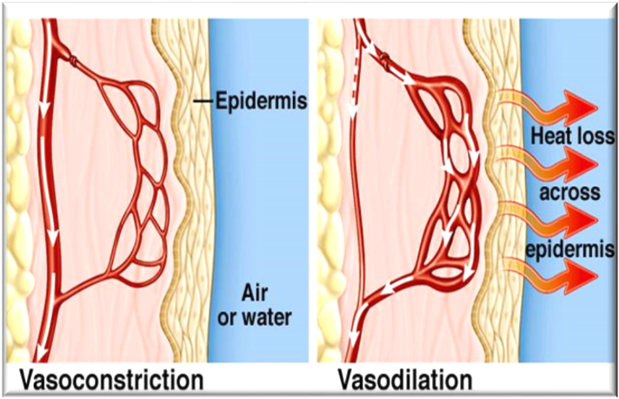
Cont.
ONLY IN MALES’ SLIDES
Hypothalamic temperature centers respond to temperature sensors in skin:
If core (blood) or surface temp is low → increased sympathetic outflow to skin → closure of the arteriovenous anastomoses → reduced blood flow in venous plexus and capillaries.
If temperature falls below 50 F° degrees, then smooth muscle in cutaneous circulation can’t maintain contraction and an overall dilation is seen. This is responsible for red appearance of exposed skin on a cold winter day.
If core or surface temp high → decreased sympathetic outflow to skin → opening of the arteriovenous anastomoses → increased flow in venous plexus. This allows for a lot of blood in venous plexus, as well as the capillaries.
Blood in venous plexus is used to radiate heat to the skin.
35

Slide 36
Link to Editing File (Please be sure to check this file frequently for any edits or updates on all of our lectures.)
Quiz
https://www.onlineexambuilder.com/microcirculation/exam-142417
References:
Girls’ and boys’ slides.
Guyton and Hall Textbook of Medical Physiology (Thirteenth Edition.)

Slide 37
Thank you!
اعمل لترسم بسمة، اعمل لتمسح دمعة، اعمل و أنت تعلم أن الله لا يضيع أجر من أحسن عملا.
The Physiology 436 Team:
Female Members:
Ghadah Almazrou
Sumaya AlGhamdi
Nouf Aloqaili
Lama Alfawzan
Munirah aldofyan
Male Members:
Ali Alsubaei
Abdulmajeed alamar
Team Leaders:
Qaiss Almuhaideb
Lulwah Alshiha
Contact us:
Physiology436@gmail.com
@Physiology436

