Slide 1
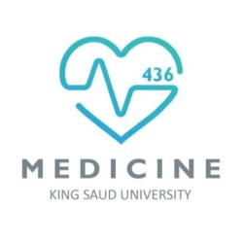
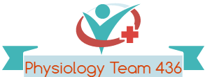
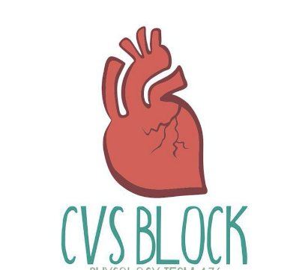

Coronary Circulation
Red: very important.
Green: Doctor’s notes.
Pink: formulas.
Yellow: numbers.
Gray: notes and explanation.
Physiology Team 436 – Cardiovascular Block Lecture 15
Lecture: If work is intended for initial studying.
Review: If work is intended for revision.

Slide 2
Objectives
Describe the control of tissue blood flow and state its physiological importance.
Outline the distribution of cardiac output during rest and exercise.
Explain the mechanisms of intrinsic and extrinsic regulation of tissue blood flow.
Summarize the unique features of cardiac metabolism.
Discuss autoregulation and nervous control of coronary blood flow.
List the risk factors for coronary artery disease and outline ECG changes in myocardial ischemia and myocardial infarction.
Coronary dominance.
Collateral circulation.

Slide 3
Importance of Control of Tissue (Local) Blood Flow
ONLY IN MALES’ SLIDES
Each tissue receives only a fraction of the total cardiac output.
Each tissue must receive sufficient blood flow for its metabolic needs or necrosis will occur.
Increasing cardiac output increases the work done by the heart to pump blood.
By controlling tissue perfusion so each tissue receives just enough blood, cardiac output and heart work are minimised.
توضيح المكتوب اذا تبغى تقراه ☺ :
كل خلية في الجسم يجيها الجزء اللي تحتاجه من الدم الخارج من القلب واذا ما صار هذا الشيء بتموت الخلية يصيرلها نكروسز
لما نزيد الدم اللي يخرج من القلب يخلي القلب ينقبض بطريقة اقوى (هذا الشيء المنطقي)
لما نتحكم بتزويد الأنسجة بالأشياء اللي يحتاجها (الأوكسجين مثلًا) نصير نقدر نتحكم بعمل القلب وهذا اللي يسويه جسمك
اتمنى انه تم توضيح الكلام

Slide 4
Distribution Of Cardiac Output During Rest And Exercise
ONLY IN MALES’ SLIDES
Rest
(5 L/min)
Exercise
(25 L/min)
Brain
Heart
Liver/Gut
Kidneys
Skeletal Muscle
Skin
Skeleton/Fat
13-15%
4-5%
20-25%
20%
15-20%
3-6%
10-15%
3-4%
4-5%
3-5%
2-4%
80-85%
1-2%
Tissues with high metabolic demands require more oxygen so a higher percentage of CO is needed.
Does that mean that the metabolic activity of the kidney is higher than the brain? No, this is an exception to the rule; kidney needs more blood for filtration

Slide 5
ONLY IN MALES’ SLIDES
Control Of Tissue (Local) Blood Flow
Control of tissue (local) blood flow
Intrinsic regulation of blood flow (autoregulation)
Paracrine regulation of blood flow
Extrinsic regulation of blood flow
Paracrine regulation means:
paracrine regulators are molecules produced by one tissue and help to regulate another tissue of the same region.
Extrinsic regulation means:
neural and hormonal regulation. Thus, extrinsic regulation of blood flow refers to control by the autonomic nervous system and endocrine system).
باختصار الاثنين هرمونات لكن واحد من نفس التيشو ياثر باللي جنبه والثاني من نفس الغدد والنيورونز

Slide 6
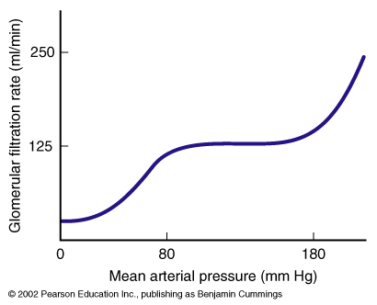
Intrinsic Regulation of Blood Flow; (Autoregulation)
ONLY IN MALES’ SLIDES
Intrinsic mechanisms of control of tissue blood flow are “built-in” mechanisms within individual organs that provide a localized regulation for vascular resistance and blood flow.
The brain and kidneys in particular, utilize these intrinsic mechanisms to maintain relatively constant flow despite fluctuations in blood pressure.
Two main mechanisms have been suggested to explain acute autoregulation:
  Myogenic mechanisms.
  Local metabolites (metabolic regulation).
X axis → pressure.
Y axis → flow (GFR depends on flow).
Myogenic regulation has limit, above 180
When pressure increase arterioles constrict, at the pressure of 180 arterioles are fully constricted ( to the max ) any increase in pressure will arterioles to dilate drastically causing a linear increase in flow
Utilize = make a use of something Fluctuations= changes up and down

Slide 7
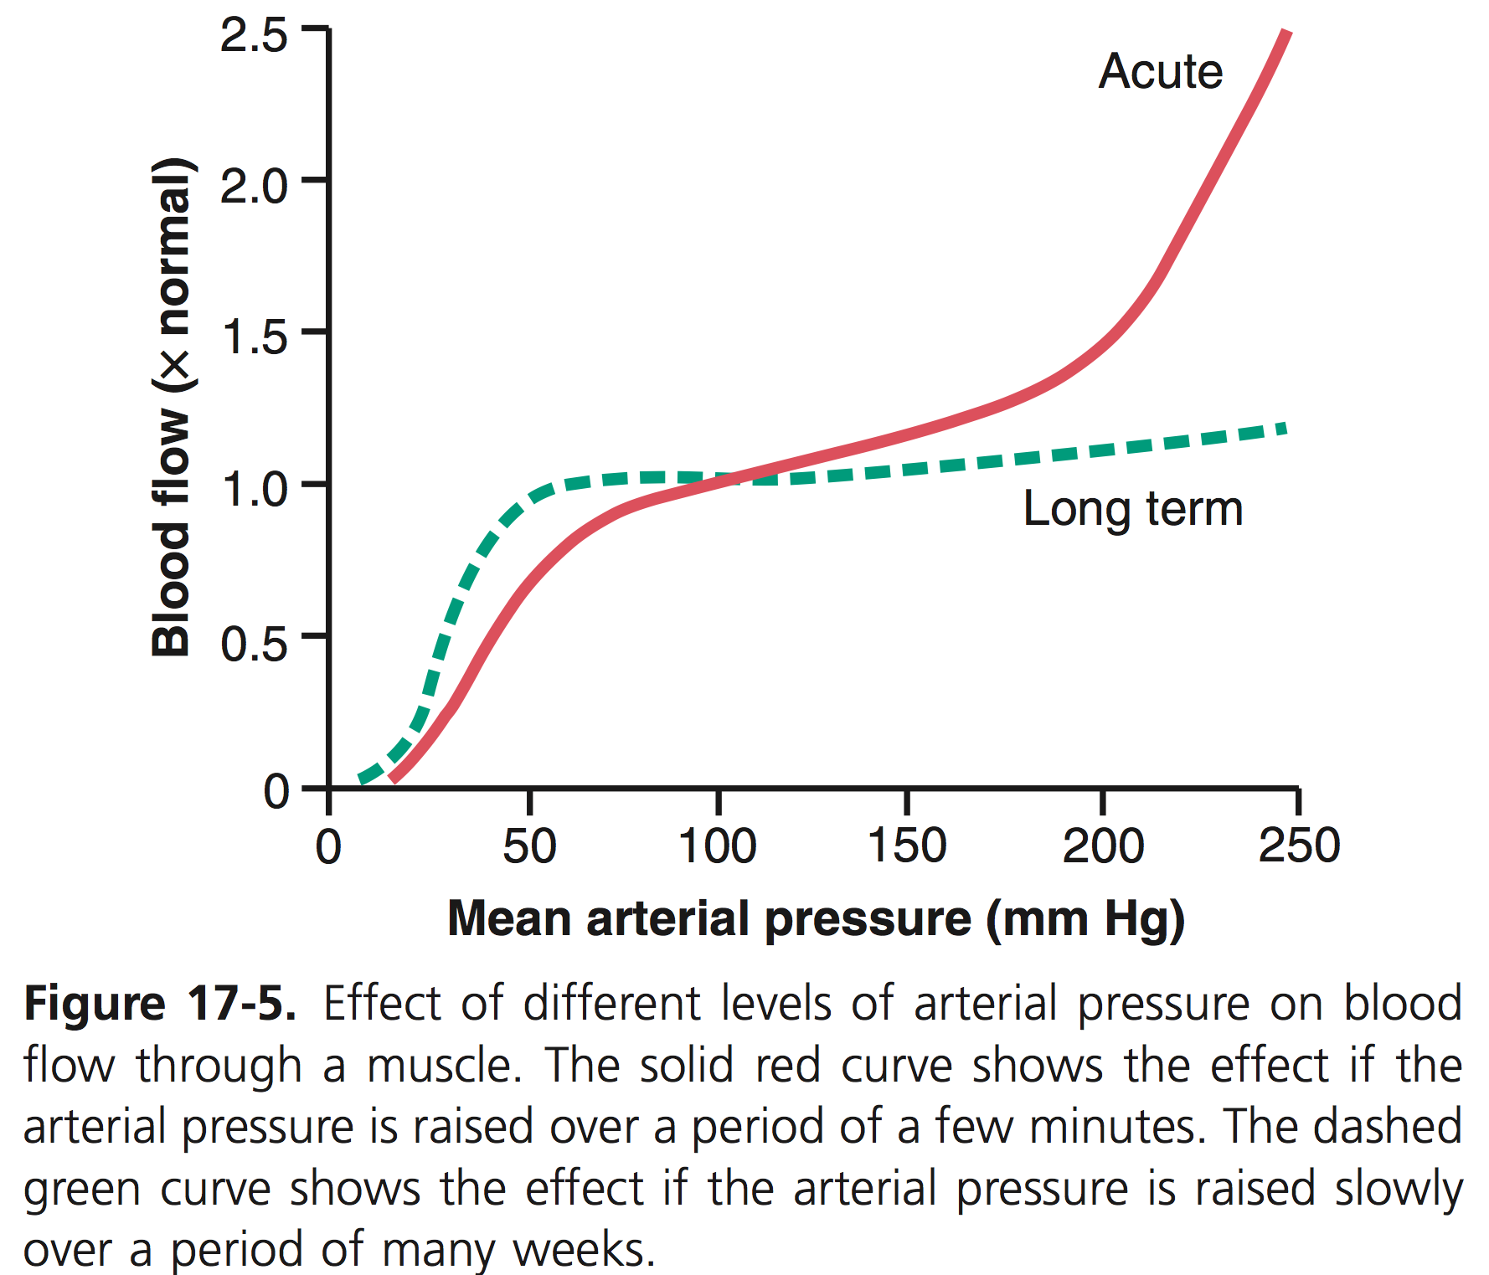
Autoregulation of Blood Flow During Changes in Arterial Pressure
In any tissue of the body, a rapid increase in arterial pressure causes an immediate rise in blood flow. However, within less than a minute, the blood flow in most tissues returns almost to the normal level, even though the arterial pressure is kept elevated. This return of flow toward normal is called autoregulation. After autoregulation has occurred, the local blood flow in most body tissues will be related to arterial pressure approximately in accord with the solid “acute” curve in Figure 17-5.
Note that between arterial pressures of about 70 mm Hg and 175 mm Hg the blood flow increases only 20 to 30 percent even though the arterial pressure increases 150 percent. In some tissues, such as the brain and the heart, this autoregulation is even more precise.
For almost a century, two views have been proposed to explain this acute autoregulation mechanism. They have been called (1) the metabolic theory and (2) the myogenic theory.

Slide 8
I- Myogenic Mechanism or Response
ONLY IN MALES’ SLIDES
This is a direct response of vascular smooth muscle to changes in pressure and can occur in the absence of neural or hormonal influences.
This action is purely myogenic, no mediators required.
This involves stretch sensitive ion channels on the cell membrane.
BP ↑
Flow = ΔP/R
BP ↓
Smooth muscle contracts
Smooth muscle relaxes
Vessels constrict
Vessels dilate
هذا الاكشن يكون على طول من نفس الخلية العضلية مافي شيء ثاني يتحكم فيه وهذي التغييرات تغير الضغط في نفس العضلات حقت الاوعية الدموية
Protects small vessels
from damage
(important in the brain)
Maintain blood flow

Slide 9
Autoregulation of Blood Flow During Changes in Arterial Pressure—“Myogenic” Mechanism
This theory is based on the observation that sudden stretch of small blood vessels causes the smooth muscle of the vessel wall to contract. Therefore, it has been proposed that when high arterial pressure stretches the vessel, this in turn causes reactive vascular constriction that reduces blood flow nearly back to normal. Conversely, at low pressures, the degree of stretch of the vessel is less, so that the smooth muscle relaxes, reducing vascular resistance and helping to return flow toward normal.
The myogenic response is inherent to vascular smooth muscle and can occur in the absence of neural or hormonal influences. It is most pronounced in arterioles but can also be observed in arteries, venules, veins, and even lymphatic vessels. Myogenic contraction is initiated by stretch-induced vascular depolarization, which then rapidly increases calcium ion entry from the extracellular fluid into the cells, causing them to contract. Changes in vascular pressure may also open or close other ion channels that influence vascular contraction. The precise mechanisms by which changes in pressure cause opening or closing of vascular ion channels are still uncertain but likely involve mechanical effects of pressure on extracellular proteins that are tethered to cytoskeleton elements of the vascular wall or to the ion channels themselves.
The myogenic mechanism appears to be important in preventing excessive stretching of blood vessels when blood pressure is increased. However, the role of the myogenic mechanism in blood flow regulation is unclear because this pressure-sensing mechanism cannot directly detect changes in blood flow in the tissue. Indeed, metabolic factors appear to override the myogenic mechanism in circumstances in which the metabolic demands of the tissues are significantly increased, such as during vigorous muscle exercise, which can cause dramatic increases in skeletal muscle blood flow.

Slide 10
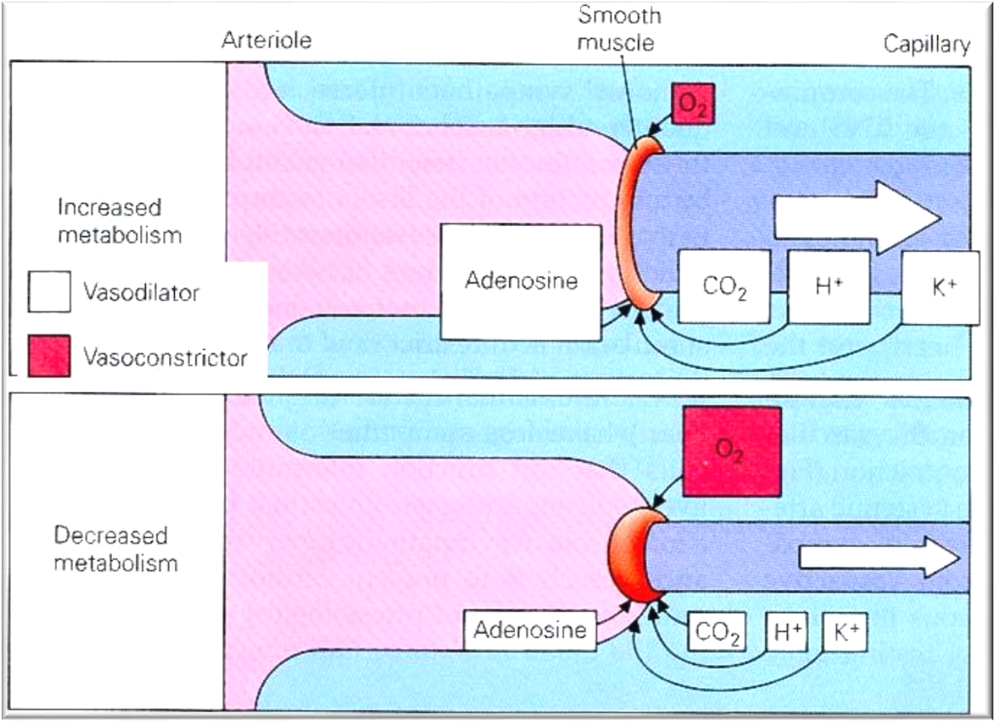
II- Metabolic Regulation (Metabolic Mediators)
ONLY IN MALES’ SLIDES
Reduced blood flow or increased metabolic rate (MR), allows metabolic products to accumulate.
One or more of the accumulated metabolic products acts as a vasodilator.
Vasodilatation increases local blood flow.(R = 8Lη / πr4 flow = ∆P/R)
Oxygen may act in the opposite manner, i.e. oxygen acts as a vasoconstrictor. (when accumulate)
Reduced blood flow or increased metabolism reduces oxygen concentration.
Reduced oxygen concentration inhibits oxygen mediated vasoconstriction.
Metabolic regulation is the most important!

Slide 11
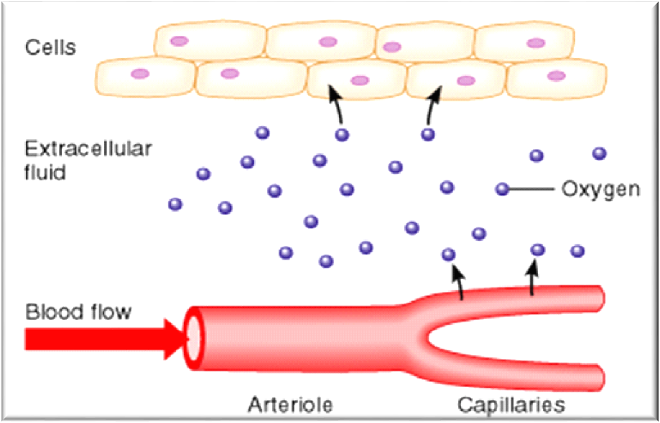
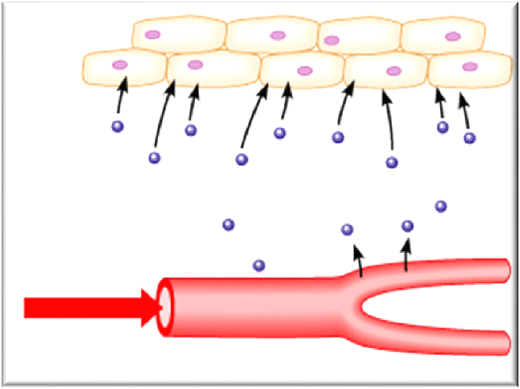






II- Metabolic Regulation: Effects of Oxygen
ONLY IN MALES’ SLIDES
1
3
oxygen
1. Under resting conditions, O2 delivered to a tissue by blood is matched by removal to the metabolizing tissue (Steady state O2 delivery to the tissues)
4. O2 levels in the ECF decrease
5. ↓ [O2] causes vascular smooth muscle to relax: vasodilation
2
tissue
4
Extra cellular fluid
oxygen
Blood flow
capillaries
arterioles
2. Increase in metabolic rate.
3. O2 consumption by the tissues increases.
6. Increased blood flow
7. Increased O2 delivery

Slide 12
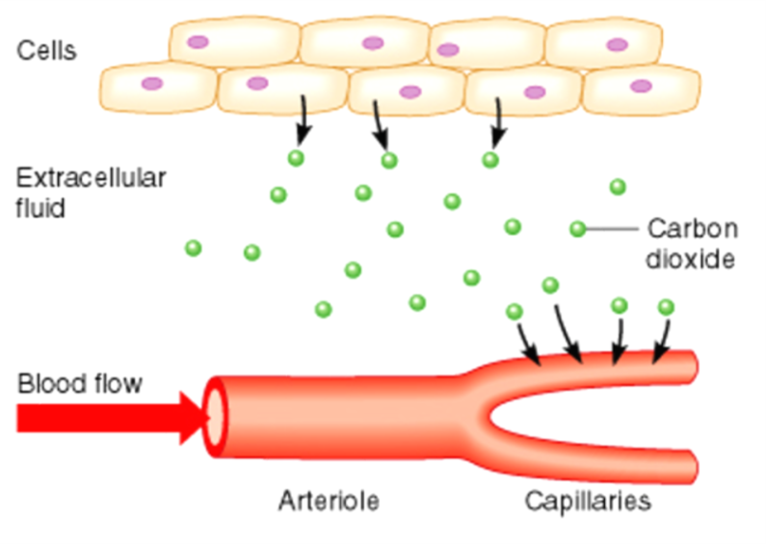
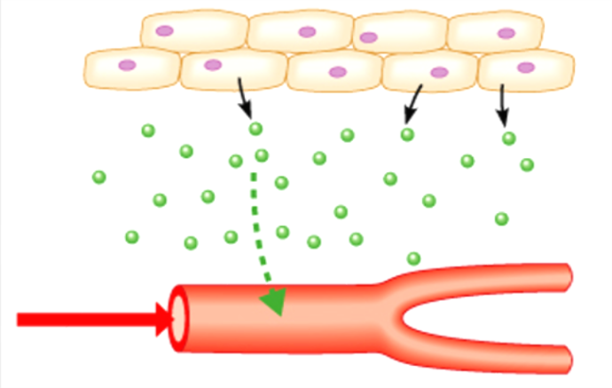

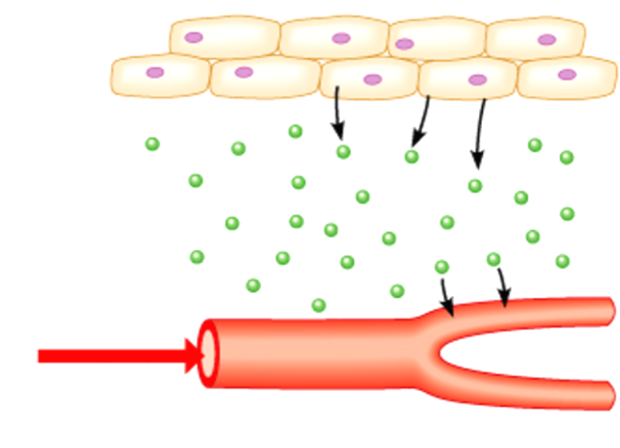
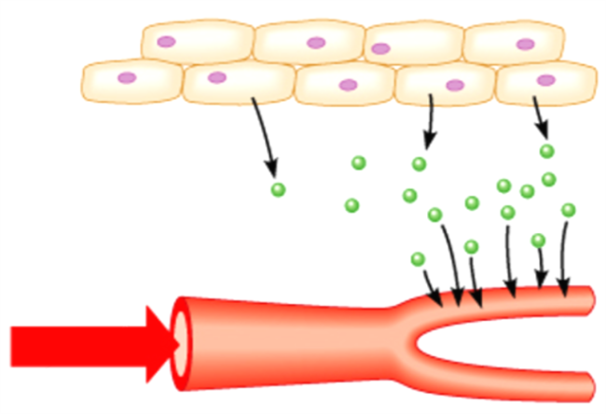

II- Metabolic Regulation: Effects Of CO2
ONLY IN MALES’ SLIDES
1
3
CO2
Steady State:
CO2 production = CO2 removal
↑[CO2]: Vasodilation
↓ pH; ↑ K+; ↑ lactic acid vasodilation
2
tissue
4
Extra cellular fluid
CO2
Blood flow
capillaries
arterioles
Increased metabolic rate or ↓ Blood Flow:
CO2 production > CO2 removal
Increased Blood Flow:
CO2 removal increases to match CO2 production.

Slide 13
ONLY IN MALES’ SLIDES
Extrinsic Control of Tissue Blood Flow
I-Sympathetic neural control
II – Circulating adrenaline
Most vascular beads are under resting sympathetic constrictor tone.
Increasing the level of sympathetic tone constricts vascular smooth muscle.
Reducing the level of sympathetic tone reduces the level of vascular smooth muscle constriction.
Most sympathetic fibres release noradrenaline that acts on a1-receptors on the smooth muscle producing contraction.
Thus, stimulation of a1-receptors by noradrenalin produces vasoconstriction.
The coronary blood vessels and the cerebral vessels in the brain are little altered by sympathetic nerves and are predominantly regulated by local metabolic factors.
Adrenaline stimulating a1-receptors contracts vascular smooth muscle.
Blood vessels also contain β2-receptors which produce vasodilatation when activated.
The blood vessels in most tissues have more a1-receptors than β2-receptors so adrenaline (and NA) contracts vascular smooth muscle.
Blood vessels in skeletal muscle have many β2-receptors so the constrictor actions of adrenaline are minimal.
Blood vessels in the myocardium.
No parasympathetic to arterioles ONLY SYMPATHETIC!!!

Slide 14
ONLY IN MALES’ SLIDES
Unique Characteristics of Cardiac Metabolism
At rest, oxygen consumption by the beating heart is ≈ 9ml/100 g/min. Obviously, more amounts of oxygen are needed during exercise.
Thus, the heart has the largest metabolic demand per gram of any organ in the body.
Energy production in the heart is almost completely dependent on aerobic metabolism.
The heart extracts a very high fraction (60% - 70%) of the O2 content of the arterial blood flowing through the myocardium even at resting conditions. That is equal to the percentage extracted by skeletal muscles during severe exercise.
Therefore, the heart is characterized by a low venous O2 reserve.
Thus, the extra O2 requirements for cardiac work upon stress must be obtained by enhancement of the myocardial blood flow.
In contrast, most other tissues under resting conditions extract only about 25% of the O2 content of the arterial blood flowing through them, leaving a considerable O2 reserve that can be drawn on when a tissue has increased needs.
Every 100 ml of blood going to tissues carry 20 ml of o2.
tissues extract 5 so 15 left in veins (oxygen extraction in tissues other than heart = 25%) So venous blood has extra o2 15 ml / 100 ml if tissues need extra oxygen it will take it from veins
HEART IS NOT LIKE THIS!!
In heart: Oxygen extraction is High; cells extract 12 ml / 100 around 60% so little o2 is remaining in veins. So if blood needs more oxygen ( for instance in exercise) heart has to increase the blood flow ( it cant take o2 from veins)

Slide 15
ONLY IN MALES’ SLIDES
Cont.
O2 consumption by the heart is determined by:
    Intra-myocardial tension.
    Contractile state of the myocardium.
    Heart rate.
    An increase in afterload causes greater increase in O2 consumption than an increase in preload does.
    Thus, angina due to deficient delivery of O2 to the myocardium is more common in aortic stenosis than in aortic regurgitation.
Increase HR → increased work of heart → increase o2 consumption
Increased contractility → increases o2 consumption
Heart dilates ( as in Heart Failure)→ tension in myocardial walls is high → requires more o2
Increased afterload → increased work → increased o2 consumption
Increased preload → increased work → increased o2 consumption
(however increasing afterload causes a larger increases in o2 consumption in comparison to an increase in preload)

Slide 16
ONLY IN MALES’ SLIDES
Cont.
Adequate amounts of chemical fuel, namely adenosine triphosphate (ATP), must be generated to support the contractile demands of the heart and maintain its viability.
Fatty acids, ketone bodies, and carbohydrates are the primary substrates of the heart and are metabolized to generate ATP.
Optimal cardiac function depends on the efficient matching of energy generation pathways to energy expenditure. This balance requires the close communication and regulation of various metabolic pathways.
Fatty acids are the major source of acetyl coenzyme A for the Krebs cycle and for the oxidative production of ATP in the heart.
Glycolysis converts glucose to pyruvate and provides a relatively small amount of ATP to the normal adult heart.
Heart is very generous: its generosity comes from that it doesn't use glucose to generate ATP, it uses fatty acids.
So brain can use glucose . Brain is totally dependent on glucose.

Slide 17
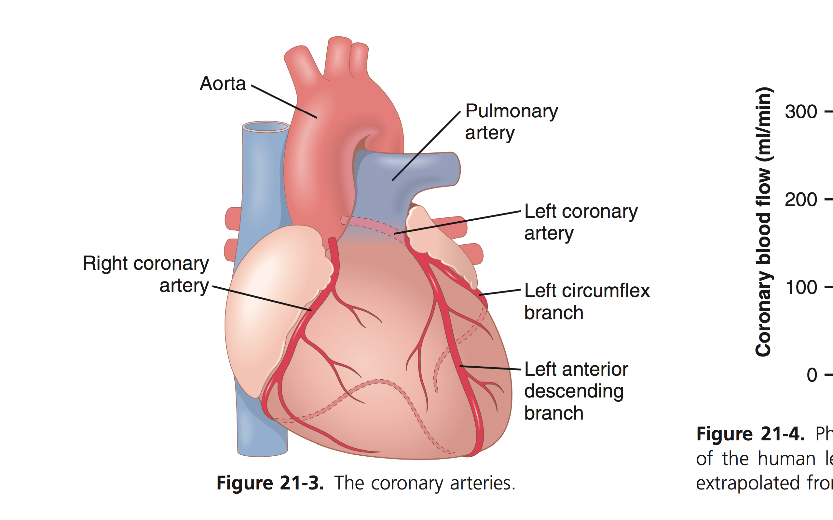
Arterial Supply - Extra Explanation
Figure 21-3 shows the heart and its coronary blood supply. Note that the main coronary arteries lie on the surface of the heart and smaller arteries then penetrate from the surface into the cardiac muscle mass. It is almost entirely through these arteries that the heart receives its nutritive blood supply. Only the inner 1/10 millimeter of the endocardial surface can obtain significant nutrition directly from the blood inside the cardiac chambers, so this source of muscle nutrition is minuscule.
The left coronary artery supplies mainly the anterior and left lateral portions of the left ventricle, whereas the right coronary artery supplies most of the right ventricle, as well as the posterior part of the left ventricle in 80 to 90 percent of people.
Most of the coronary venous blood flow from the left ventricular muscle returns to the right atrium of the heart by way of the coronary sinus, which is about 75% of the total coronary blood flow. On the other hand, most of the coronary venous blood from the right ventricular muscle returns through small anterior cardiac veins that flow directly into the right atrium, not by way of the coronary sinus. A very small amount of coronary venous blood also flows back into the heart through very minute the besian veins, which empty directly into all chambers of the heart.

Slide 18
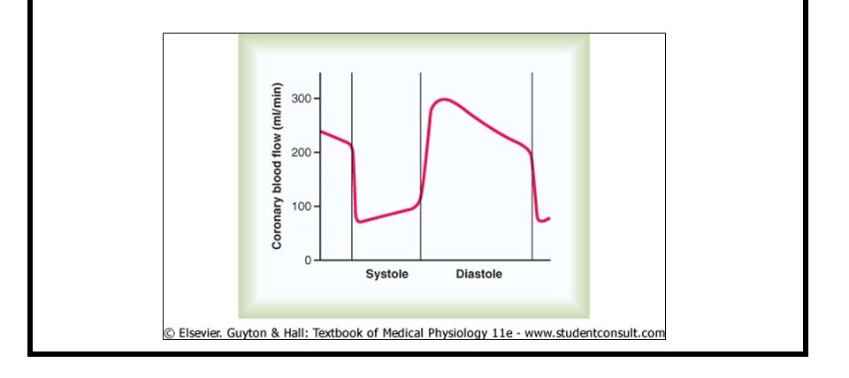
Coronary Arteries
The coronary arteries supply blood flow to the heart, and when functioning normally, they ensure adequate oxygenation of the myocardium at all levels of cardiac activity.
  Left main coronary artery divides into left anterior descending artery (anterior interventricular) and circumflex artery.
  Right coronary artery divides into smaller branches, including the right posterior descending artery (posterior interventricular) and the acute marginal artery.
  Both coronaries arise from the coronary sinuses just superior to the aortic valve cusps at the aortic root.
  coronary Ostia (origins of the coronary arteries) may vary in shape & location, most of which are of no clinical significance. *
  * عادة Right Coronary artery يطلع من Right coronary cusp و Left Coronary artery يطلع من left coronary cusp بس يختلفون من أي جهة من coronary cusp طالعين، والاختلاف هذا ما يؤدي إلى أي مرض
Phasic Changes in Coronary Blood Flow During Systole & Diastole
The openings for the coronary arteries are on the aortic side of the aortic valve.
Aortic valve has three cusps: left, right, and posterior non-coronary cusps (NC)
The openings for the right and left coronary arteries are in different parts of the aortic valve.
Blood flow through the coronary arteries is greatest during diastole, due to recoil of the aorta which pushes blood back against the aortic valve, and hence pushing blood into the coronary arteries.
Blood flow to the subendocardial portion of Lt ventricle occurs during diastole only, and is not there during systole thus the subendocardial region of Lt ventricle is prone to ischemic damage and is the most common site of (MI)
In systole, blood is moving forward too rapidly to provide greatest flow. However, the turbulent flow in the ascending aorta pushes some blood back toward valve and into the coronary arteries.
.
In systole aortic valve is open limits space and blood is rushing forward -In diastole Aortic valve is closed so there is space + aortic recoil will cause blood to pour through coronary arteries.

Slide 19

Coronary Arteries
Coronary arteries
right
Right marginal artery (RMA)
Posterior descending branch
left
left anterior descending (LAD)
SA nodal artery
AV nodal artery
circumflex artery (CX)
left marginal artery (LMA)
SA node artery
Right vs. left: Branches:
right
smaller
arise from right coronary sinus
left
larger
arise from left coronary sinus
terminates by anastomosing with left coronary artery
terminates by anastomosing with right coronary artery

Slide 20
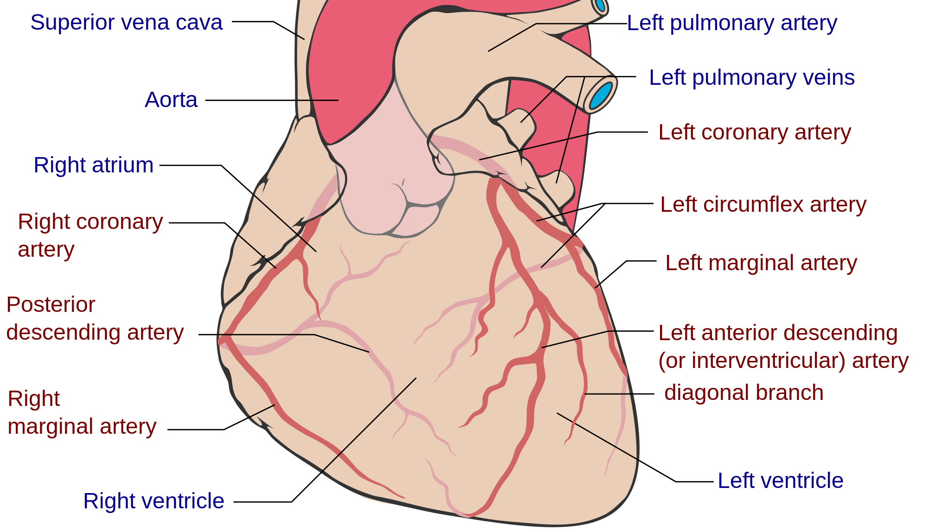
Cont.

Slide 21
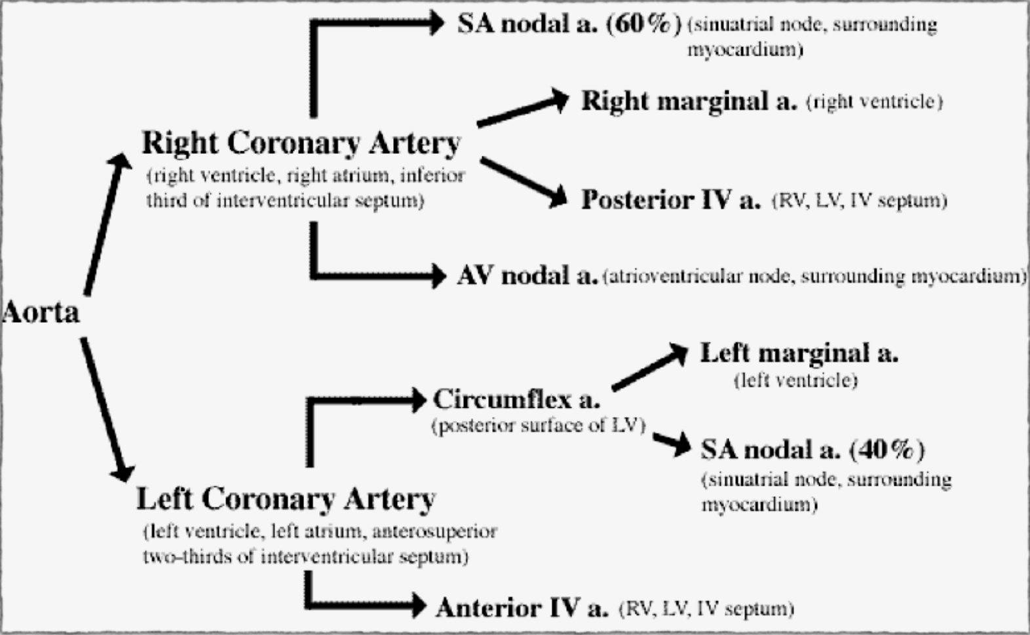
Coronary Arteries
We should know which branch supplies which area.
So knowing the branch affected when ischemia happens in each area of the heart.
They might ask…
* If someone is having ischemia in the anterior surface of the left ventricle, which branch is affected?
Anterior descending branch of the left coronary artery
* If the ischemia happened in the anterior 2/3 of the IV septum, which branch is affected?
Anterior descending artery of the left coronary.
* If the posterior left ventricle is affected, circumflex of the left coronary is affected.
* If the lateral surface of the left ventricle is affected, the left marginal of the left coronary.
* If SA node is affected, then both the right and the left coronary are affected.
lateral surface
RV: the margin near to IV septum
LV: anterior surface
IV septum: anterior 2/3

Slide 22
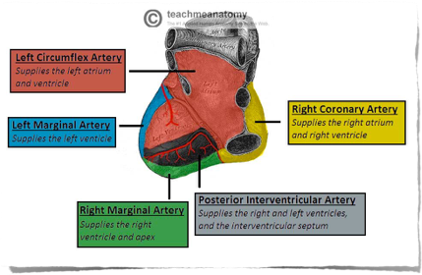
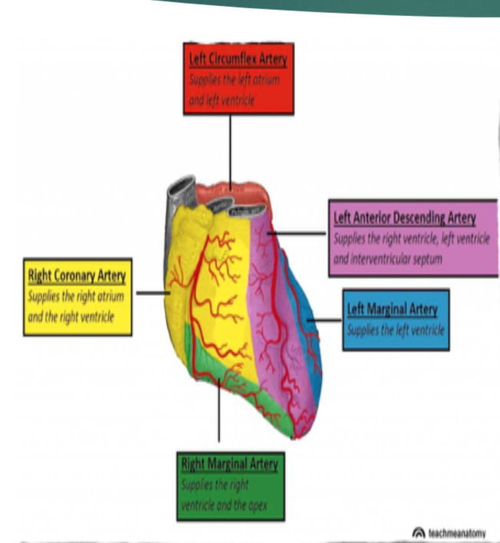
Areas of Distribution
Right Coronary Artery:
RMA:
RV, except the area adjoining the anterior inter ventricular (IV) groove.
PDA supplies:
- Posterior 1/3rd of the inter ventricular (IV) septum.
- Inferior part of Left ventricle adjoining the posterior inter ventricular groove.
SA nodal Artery supplies:
- The SA- node in 40% of cases, it is supplied by LCA
- Surrounding Right atrium.
AV nodal Artery supplies:
The AV- node a part of the left branch of AV bundle
Surrounding right atrium
Left Coronary Artery:
LAD:
Anterior & apical parts of the heart: LV & the TV area adjoining the anterior inter ventricular groove.
Anterior 2/3rds of the inter ventricular septum.
CX & LMA:
- Lateral & posterior surfaces of the heart: LV & SA-node.

Slide 23

Collateral Circulation Transmural Arteries
Cardiac anastomosis:
The two coronary arteries anastomose in
the myocardium.
Extra cardiac anastomosis:
-The two coronary arteries anastomose with:
Vasa vasorum of the aorta.
Vasa vasorum of pulmonary arteries.
Internal thoracic arteries.
The bronchial arteries.
Phrenic arteries.
Extra cardiac channels open up in case of emergencies, when the coronary arteries are blocked.
The main coronary arteries feed transmural arteries.
Transmural arteries plunge into the muscle of the ventricles.
Transmural arteries supply arterioles, which control flow to capillaries:
There are ~4000 capillaries/cm2 of myocardium. Adequate blood supply is important. Inadequate blood supply results in ischemia and myocardial infarction (MI).

Slide 24
Venous and Lymphatic Drainage
Venous Drainage:
Venous drainage brings deoxygenated blood back to the heart.
Cardiac venous drainage occur through:
Coronary sinus, which lies in the posterior part of the atrioventricular groove & is a continuation of the great cardiac vein. (Most of the venous drainage of the heart returns through the coronary sinus and anterior cardiac veins).
- Anterior, middle & small cardiac veins.
- Venae Cordis Minimae (smallest cardiac veins).
Most of the venous blood return to the heart into the Right atrium through the coronary sinus via the cardiac veins.
5- 10% drains directly into heart chambers, Right atrium & Right ventricle: by the anterior cardiac vein & the small veins that open directly into the heart chambers.
Lymphatic Drainage:
Lymphatics of the heart accompany the two coronary arteries.
Lymphatics of the heart form two trunks:
- The right trunk: ends in the brachiocephalic node.
- The left trunk: ends into the tracheo-bronchial lymph nodes, at the bifurcation of the trachea.

Slide 25
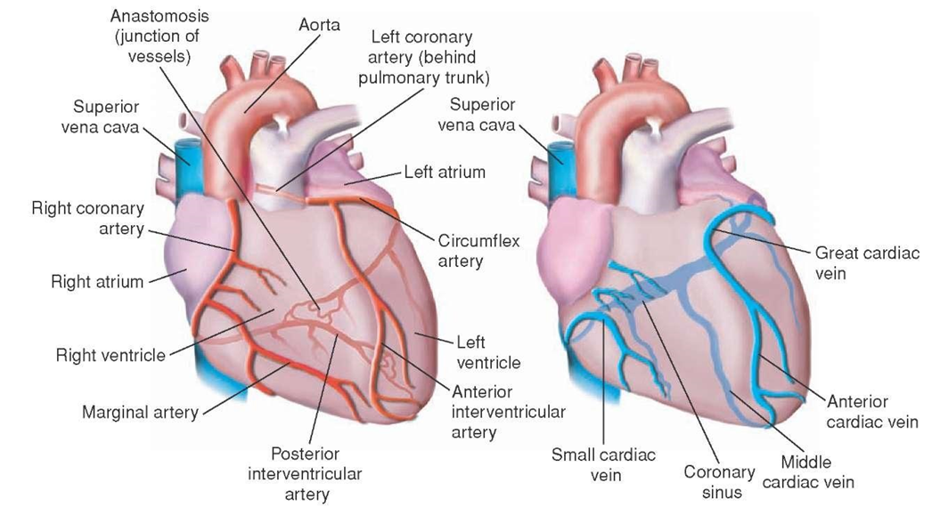
Coronary Dominance
Coronary dominance depends on which artery (or arteries) gives rise to the posterior descending artery (PDA), that runs along the posterior side of the heart & supplies the AV- node.
A person can be:
Right dominant - Left dominant - Co-dominant.
Coronary dominance is recognized by the presence of septal perforating branches.
The right coronary artery is dominant in 80–85% cases.
The circumflex branch of the left coronary artery is dominant in 8-10% cases
لمن نقول إن الشريان التاجي dominantمعناته يغذي SA and AV nodes، عامةً right CA هو dominant لكن في هذي الحالة صار circumflex لأنه طلع branch for AV node
Balanced or co-dominance is found in 7-10% of population where the posterior inter ventricular artery is formed by both Right coronary & LCX arteries.
Clinical importance:
- In left dominance, a block in LCA affect the entire left ventricle & IV septum.
- In right or balanced dominance, a block in RCA at least spares 2/3 of the septum and left ventricle
The left coronary artery supplies mainly the anterior and left lateral portions of the left ventricle, whereas the right coronary artery supplies most of the right ventricle, as well as the posterior part of the left ventricle in 80 to 90 percent of people. (from 435’s team).

Slide 26
Coronary Blood Flow
Consists of: arterial supply, venous drainage, lymphatic drainage
Coronary blood flow at rest in humans = 250 ml/min (5% of cardiac output).
The right coronary artery has a greater flow in 50% of population.
The left has a greater flow in 20%.
Flow is equal in 30%.
Increases in proportion to exercise or work output
Venous blood:
At rest the heart extracts 60-70% of oxygen from the blood delivered to the heart.
Why?
Because, the heart muscle has more mitochondria (40% the cell volume) that generate energy for cardiac contraction by aerobic metabolism (other tissues extract only 25% of O2).
When more O2 is needed as during exercise, coronary blood flow increases.
During strenuous exercise, the heart in the young adult increases its cardiac output 4-7 folds, and it pumps this blood against a higher than normal arterial pressure. Consequently, the work output of the heart under severe conditions may increase 6 to 9 folds. At the same time, the coronary blood flow increases 3-4 folds to supply the extra nutrients needed by the heart. This increase is not as much as the increase in workload, which means that the ratio of energy expenditure by the heart to coronary blood flow increases. Thus, the “efficiency” of cardiac utilization of energy increases to make up for the relative deficiency of coronary blood supply.

Slide 27
Control of Coronary Blood Flow
ONLY IN MALES’ SLIDES
Autoregulation
Physical factors
Myogenic mechanisms
Nervous control
Control of coronary blood flow
Metabolic control
NB: Constriction and dilation of the coronary arteries is governed primarily by local regulatory mechanisms. This regulates the amount of blood flow to the myocardium in a manner that matches the amount of oxygen delivered to the myocardium with the myocardial oxygen demand.

Slide 28
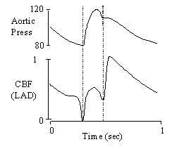
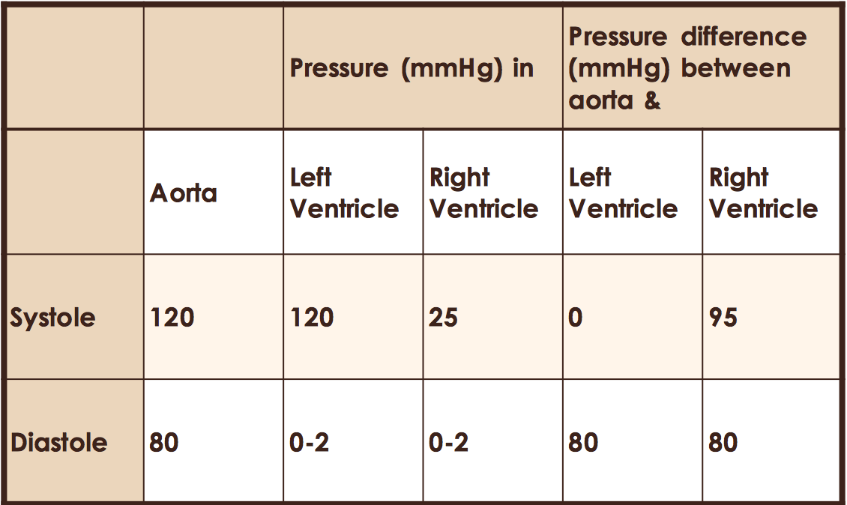
Control of Coronary Blood Flow: 1- Physical Factors
Coronary Perfusion Pressure: the pressure that pushes the blood into coronaries.
Aortic pressure and direction of blood flow influence the perfusion pressure feeding the coronary arteries.
Flow is minimum at isovolumetric contraction why??
myocardial arterioles are squeezed
Flow is highest at dicrotic wave ( due to aortic recoil )
أحنا نقارن بين الضغط بالأورطا والبطين سواء الأيمن أو الأيسر ليه؟ عشان الشرايين التاجية بتطلع من عند الأورطا بالتالي ضغطها بيكون نفس ضغط الأورطا
In systole | In diastole
The aortic pressure is highest but the direction and velocity of blood flow limit the coronary perfusion pressure. Additionally, the turbulent blood flow in the ascending aorta limits the coronary perfusion pressure. Pressure difference between the aorta & Right ventricle is greater therefore more blood flow to Right ventricle occurs. Coronary arteries are compressed. Therefore, blood flow to the LV is reduced. | The aortic pressure is lower than in systole. However, the perfusion pressure is greatest due to recoil of blood back against aortic valves (origin of coronary arteries).
عشان يكون عندي flow لازم يصير فيه فرق بالضغط، كون البطين الأيسر مافيه فرق بالضغط في فترة الانقباض معناته مافيه flow بالتالي مافيه دم يوصل
2-13
Because the pressure difference is greater, the right ventricle gets blood and nutrients better the the left ventricle

Slide 29
Cont.
ONLY IN MALES’ SLIDES
Phasic pattern of coronary flow; Systolic Crunch (squeeze)
Most coronary blood flow (about 70%) occurs during diastole. Flow is driven by the aortic blood pressure, with the flow declining as the aortic pressure drops.
Only about 30% of coronary blood flow occurs during systole.
Blood supply to the myocardium is substantially reduced during systole (systolic crunch).

Slide 30
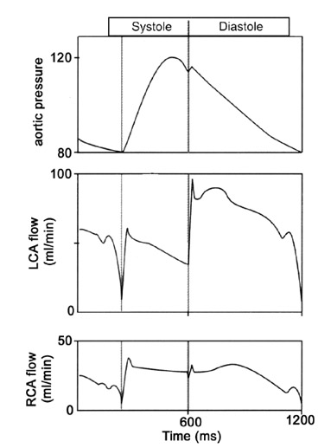
Cont.
ONLY IN MALES’ SLIDES
Systolic crunch:
Systolic crunch results is coronary extravascular resistance.
Contraction of the ventricular muscle during systole squeeze the arteries in the muscle, and hence increasing the resistance to flow.
The contraction is greatest near the endocardial surface. Thus, this region has the greatest “systolic crunch”.
The greatest resistance to flow is also found in the endocardial region of the heart.
Thus, the majority of myocardial infarctions begin at the endocardial region of the heart.

Slide 31
Cont.
ONLY IN MALES’ SLIDES
Systolic Crunch:
Systolic crunch has the biggest effect on the left ventricle, which has more muscle and generates more pressure.
Flow through the left coronary artery is reduced during systole, whereas there is little noticeable effect on flow in the right coronary artery.
During diastole, the ventricular muscle relaxes:
The heart normally spends 2/3 time of the cardiac cycle in diastole, so it is able to supply muscle with sufficient blood.
At greater heart rate, diastole is shortened. At greatest heart rate, there is also increased oxygen demand of the heart. This is coupled with the greater extravascular resistance to blood flow.
Metabolic regulation acts to compensate to increase blood flow in response to increased oxygen demand.

Slide 32
Cont.
ONLY IN MALES’ SLIDES
Reactive hyperemia: Occlusion of flow during systolic “crunch” would produce metabolic wastes, which act to dilate blood vessels and increase blood flow.
Consequently, coronary vessels (arteries) are severely compressed during systole.
Thus, these patients are more prone to develop myocardial ischemia.
Blood flow to the left ventricle is decreased in patients with aortic stenosis.
This is because in aortic stenosis, the left ventricle must generate much higher pressure to overcome the resistance of the stenotic aortic valve, in order to eject blood.
Reactive hyperemia is another manifestation of the local “metabolic” blood flow regulation mechanism; that is, lack of flow sets into motion all of the factors that cause vasodilation. After short periods of vascular occlusion, the extra blood flow during the reactive hyperemia phase lasts long enough to repay almost exactly the tissue oxygen deficit that has accrued during the period of occlusion. This mechanism emphasizes the close connection between local blood flow regulation and delivery of oxygen and other nutrients to the tissues.

Slide 33
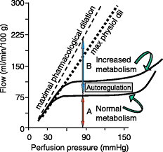
2- Myogenic Coronary Autoregulation
ONLY IN MALES’ SLIDES
Coronary blood flow is maintained nearly constant over a range of mean MAP, usually 60 to 140 mm Hg.
Above or below these limits autoregulation fails and coronary blood flow increases or decreases in a linear fashion with corresponding increases or decreases in aortic pressure.

Slide 34
3- Metabolic/Chemical Factors Control
Constriction and dilation of the coronary arteries is governed primarily by local regulatory mechanisms. This regulates the amount of blood flow to the myocardium in a manner that matches the amount of oxygen delivered to the myocardium with the myocardial oxygen demand.
When cardiac work increases, the coronary blood flow is increased and vice versa.
Myocardial oxygen requirement is the single most important factor in determining coronary blood flow.
Coronary vasodilators during increased activity are:
Increased H⁺
Adenosine
NO
Increased PCO₂
Increased K⁺
Prostaglandins
Local hypoxia
Histamine
Lactate
Adenine
Nucleotides
The metabolic theory can be understood easily by applying the basic principles of local blood flow regulation discussed in previous sections. Thus, when the arterial pressure becomes too great, the excess flow provides
The metabolic theory can be understood easily by applying the basic principles of local blood flow regulation discussed in previous sections. Thus, when the arterial pressure becomes too great, the excess flow provides too much oxygen and too many other nutrients to the tissues and “washes out” the vasodilators released by the tissues. These nutrients (especially oxygen) and decreased tissue levels of vasodilators then cause the blood vessels to constrict and return flow to nearly normal despite the increased pressure.

Slide 35
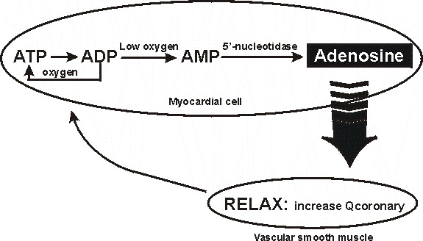
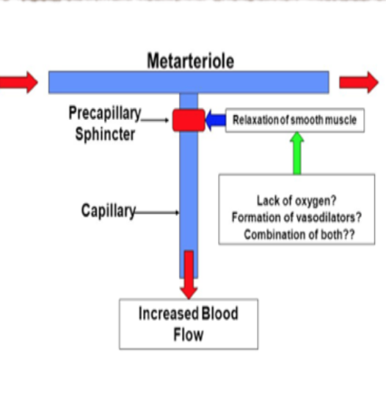
3- Metabolic Control Adenosine Hypothesis
ONLY IN MALES’ SLIDES
Myocardial cells need oxygen to convert ADP to ATP.
If oxygen is low, ADP is converted to AMP, which is broken down to Adenosine, which is lipid permeable.
Adenosine acts on receptor in smooth muscle in arteries and arterioles resulting in vasodilatation and increased coronary flow.

Slide 36
IV – Nervous Control
Coronary arteries have both α1- and β2-adrenergic receptors.
Stimulation of α1-receptors cause vasoconstriction, while β2-receptor activation causes vasodilatation.
Experimental direct stimulation of the cardiac sympathetic fibers causes coronary vasoconstriction, due to the presence of more α- than β- adrenergic receptors in the coronaries.
However, during physiologic conditions of enhanced sympathetic activity, the heart rate and contractility are both activated by sympathetic nerve fibers and blood catecholamines on myocardial β1-adrenergic receptors. The resulting increase in cardiac metabolites induces vasodilatation that overrides the direct constrictor effect of sympathetic fibers to the vascular wall with a net increased Coronary blood flow.
Thus, it is evident that such extrinsic control can be overridden by the local cardiac metabolic state.
In cardiac and skeletal muscle: # β-receptors > # α-receptors
→ Adrenaline promotes vasodilation
In most other tissues: # α-receptors > # β -receptors
→ Adrenaline promotes vasoconstriction
α: vasoconstriction (more epicardial), β: vasodilation (more in intramuscular arteries)

Slide 37
IV – Nervous Control
Parasympathetic (Vagal) stimulation of the heart causes modest coronary vasodilation (due to the direct effects of released acetylcholine on the coronaries).
However, if parasympathetic activation of the heart results in a significant decrease in myocardial oxygen demand due to a reduction in heart rate, then intrinsic metabolic mechanisms will increase coronary vascular resistance by constricting the vessels.
  In summary, sympathetic activation to the heart results in coronary vasodilation and increased coronary flow due to increased metabolic activity (increased heart rate, contractility).
  Parasympathetic activation of the heart results in a significant decrease in myocardial oxygen demand due to a reduction in heart rate, and so decreases coronary blood flow.
CBF reduced with tachycardia, as the diastolic period will be shortened.

Slide 38
IV – Nervous Control
Sympathetic Stimulation causes vasodilation directly and indirectly
-Indirect: Sympathetic stimulation will lead to release of adrenaline & noradrenaline, ^ HR & force of contraction. Vasodilator metabolites will be increased leading to coronary vasodilatation.
-Direct effect of sympathetic stimulation:
Experimentally, injection of noradrenalin after blocking of the beta adrenergic receptors in un-anesthetized animals elicits coronary vasoconstriction.
One view: In myocardium b2 receptors are higher in number so sympathetic stimulation directly causes vasodilation
Another view: alpha 1 is higher sympathetic stimulation will cause vasoconstriction + increase HR and contractility → more metabolic products → dilation of arterioles So sympathetic stimulation indirectly causes vasodilation
Parasympathetic stimulation causes vasoconstriction indirectly:
Some physiologists believe that parasympathetic goes to coronary arterioles and release ach and causes vasodilation of arterioles; however, HR decreases → less O2 requirement (less O2 demand) → vasoconstriction

Slide 39
ONLY IN MALES’ SLIDES
Risk Factors for Coronary Artery Disease (CAD)
Conventional risk factors:
Older age: Over age 45 years in men and over age 55 years in women
Family history of early heart disease.
Race: Among persons with CAD, the cardiovascular death rate for African Americans is reported to be particularly high.
Modifiable risk factors:
High blood cholesterol levels (specifically, low-density lipoprotein cholesterol [LDL-C])
High blood pressure
Cigarette smoking: Cessation of cigarette smoking constitutes the single most important preventive measure for CAD
Diabetes mellitus
Obesity
Lack of physical activity
Metabolic syndrome
Mental stress and depression

Slide 40
IV – Nervous control
Benefits of indirect effect of nor-adrenergic discharge:
When systemic blood pressure decreases very low.
Reflex increase of nor adrenergic discharge.
Increase CBF secondary to metabolic changes in the myocardium.
In this way, circulation of the heart is preserved while the flow to other organs compromised.
Control of Coronary Blood Flow (CBF):
1. Pressure gradient across the aorta. 2. Chemical factors. 3. Neural factors.
CBF shows considerable autoregulation.
Local muscle metabolism is the primary controller:
- Oxygen demand is a major factor in local coronary blood flow regulation.
Nervous control of CBF:
- Direct effects of nervous stimuli on the coronary vasculature.
- Sympathetic greater effect than parasympathetic.

Slide 41
Extra Explanation From Guyton (We Recommend Reading this!)
Nervous Control of Coronary Blood Flow
Stimulation of the autonomic nerves to the heart can affect coronary blood flow both directly and indirectly. The direct effects result from action of the nervous transmitter substances acetylcholine from the vagus nerves and norepinephrine from the sympathetic nerves on the coronary vessels. The indirect effects result from secondary changes in coronary blood flow caused by increased or decreased activity of the heart.
The indirect effects, which are mostly opposite to the direct effects, play a far more important role in normal control of coronary blood flow. Thus, sympathetic stimulation, which releases norepinephrine from the sympathetic nerves and epinephrine as well as norepinephrine from the adrenal medullae, increases both heart rate and heart contractility and increases the rate of metabolism of the heart. In turn, the increased metabolism of the heart sets off local blood flow regulatory mechanisms for dilating the coronary vessels, and the blood flow increases approximately in proportion to the metabolic needs of the heart muscle. In contrast, vagal stimulation, with its release of acetylcholine, slows the heart and has a slight depressive effect on heart contractility. These effects decrease cardiac oxygen consumption and, there- fore, indirectly constrict the coronary arteries.
Direct Effects of Nervous Stimuli on the Coronary Vasculature.
The distribution of parasympathetic (vagal) nerve fibers to the ventricular coronary system is not very great. However, the acetylcholine released by parasympathetic stimulation has a direct effect to dilate the coronary arteries.
Much more extensive sympathetic innervation of the coronary vessels occurs. In Chapter 61, we see that the sympathetic transmitter substances norepinephrine and epinephrine can have either vascular constrictor or vascular dilator effects, depending on the presence or absence of constrictor or dilator receptors in the blood vessel walls. The constrictor receptors are called alpha receptors and the dilator receptors are called beta receptors. Both alpha and beta receptors exist in the coronary vessels. In general, the epicardial coronary vessels have a preponderance of alpha receptors, whereas the intramuscular arteries may have a preponderance of beta receptors. Therefore, sympathetic stimulation can, at least theoretically, cause slight overall coronary constriction or dilation, but usually constriction. In some people, the alpha vasoconstrictor effects seem to be disproportionately severe, and these people can have vasospastic myocardial ischemia during periods of excess sympathetic drive, often with resultant anginal pain.
Metabolic factors, especially myocardial oxygen consumption, are the major controllers of myocardial blood flow. Whenever the direct effects of nervous stimulation reduce coronary blood flow, the metabolic control of coronary flow usually overrides the direct coronary nervous effects within seconds.

Slide 42
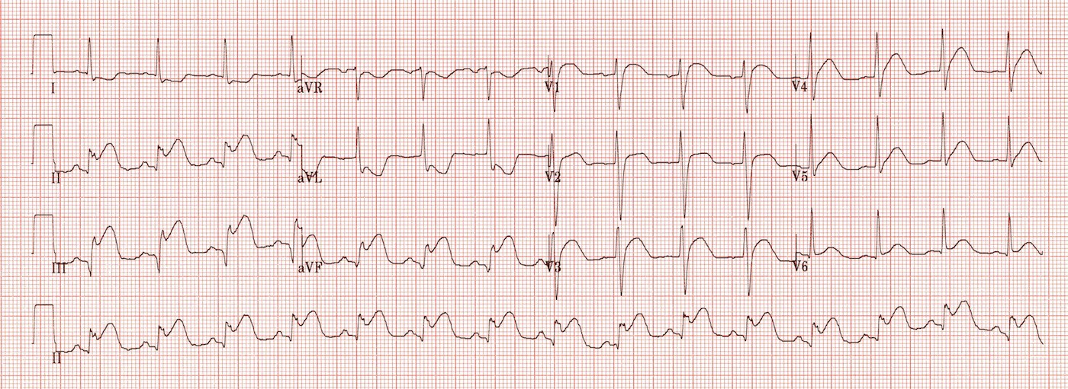
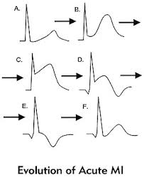
ONLY IN MALES’ SLIDES
ECG Changes (Not Important)
Patient says he has substernal chest pain that radiates to left shoulder; myocardial ischemia is clinically manifested as angina.
If ischemia is severe it manifests as MI.
In myocardial ischemia, exercise ECG must be done (if ECG is taken at rest it will appear normal)
Electrocardiographic changes during exercise test.
Upper trace – significant horizontal ST segment depression during exercise.
Myocardial ischemia → depression of S-T segment
MI → elevation of S-T segment
Electrocardiographic changes in inferior MI

Slide 43
Link to Editing File
(Please be sure to check this file frequently for any edits or updates on all of our lectures.)
Quiz
https://www.onlineexambuilder.com/coronary-circulation/exam-142433
References:
Girls’ and boys’ slides.
Guyton and Hall Textbook of Medical Physiology (Thirteenth Edition.)

Slide 44
Thank you!
اعمل لترسم بسمة، اعمل لتمسح دمعة، اعمل و أنت تعلم أن الله لا يضيع أجر من أحسن عملا.
The Physiology 436 Team:
Female Members:
Najd AlTheeb
Amal AlShaibi
Allulu Alsulayhem
Ghada Alhadlaq
Heba Alnasser
Male Members:
Fahad AlFayez
Mohammed Nasr
Faisal Alfawaz
Abdulllatif Alabdullatif
Abdullah Bassam
Nasser Abu-dujain
Mohammed Almutlaq
Team Leaders:
Qaiss Almuhaideb
Lulwah Alshiha
Contact us:
Physiology436@gmail.com
@Physiology436

