Slide 1
The Electrocardiogram (ECG)
Red: very important.
Green: Doctor’s notes.
Pink: formulas.
Yellow: numbers.
Gray: notes and explanation.
Physiology Team 436 – Cardiovascular Block Lecture 5
Lecture: If work is intended for initial studying.
Review: If work is intended for revision.

Slide 2
Objectives
Study Smart: focus on mutual topics.
From the students’ guide:
Identify waves of ECG and the physiological cause of each.
Define the normal intervals and segments.
Discuss the bipolar and unipolar leads and their locations.
Discuss the bipolar limb lead and the cardiac axis (Quick method).

Slide 3
ONLY IN MALES’ SLIDES
The Electrocardiogram (ECG/EKG)
If a recording electrode is applied on any point on the surface of the trunk, it will detect electrical waves reflecting the electrical activity in the heart. These electrical waves may be as small as 1 mv and are amplified, recorded on ECG paper / monitor / computer and stored.
When there are no propagating potentials, no waves are recorded and the recording needle will be on the line of zero potential, which is called the isoelectric line.
For recording an ECG, two electrodes are required.
the active electrode (also called searching electrode or exploring electrode) | reference electrode
applied to a recoding point on the surface of the body. | serves a reference to the active electrode.
Heart rate
Normal intervals
Rhythm
Regular
Single p-wave precedes every QRS complex
P-R interval is constant and within normal range
Cardiac axis
ONLY IN FEMALES’ SLIDES
Practical use of the ECG

Slide 4
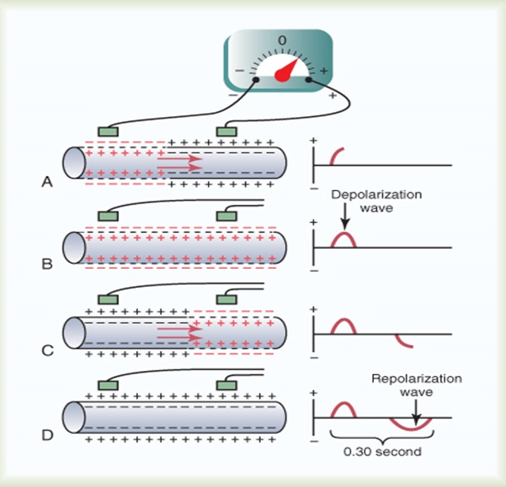
ONLY IN MALES’ SLIDES
The Active and Reference Electrodes
A positive wave is recorded when depolarization is propagating towards the electrode or when repolarization is propagating away from the electrode.
A negative wave is recorded when depolarization is propagating away from the electrode or when repolarization is propagating towards the electrode.
شرح الرسمة:
Active electrode is attached to positive end of galvanometer. Reference electrode attached to negative end of galvanometer
(A/B) Depolarization ( intracellular +) is propagating towards Active Electrode → positive wave ( above isoelectric line )
C/D Repolarization ( intracellular - ) propagating towards active electrode → negative wave

Slide 5
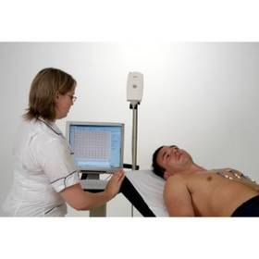
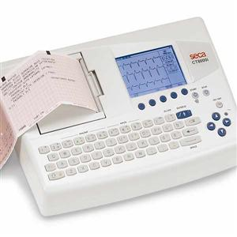
The Normal Electrocardiogram (ECG)
The Electrocardiogram (ECG) is a recording of the electrical activity of the heart
Methods for Recording Electrocardiograms
The depolarization wave spreads through the heart
electrical currents pass (from bass to apex) into the surrounding tissue
part of the current reaches the surface of the body
Computer-based and electronic display
Pen recorder and a moving sheet
The electrical potentials generated by these currents can be recorded from electrodes placed on the skin opposite the heart
This is possible as the body tissues function as electrical conductors because they contain electrolytes.
The electrical waves start from the base of the heart (SA node) then move to AV node and spread to the apex.

Slide 6
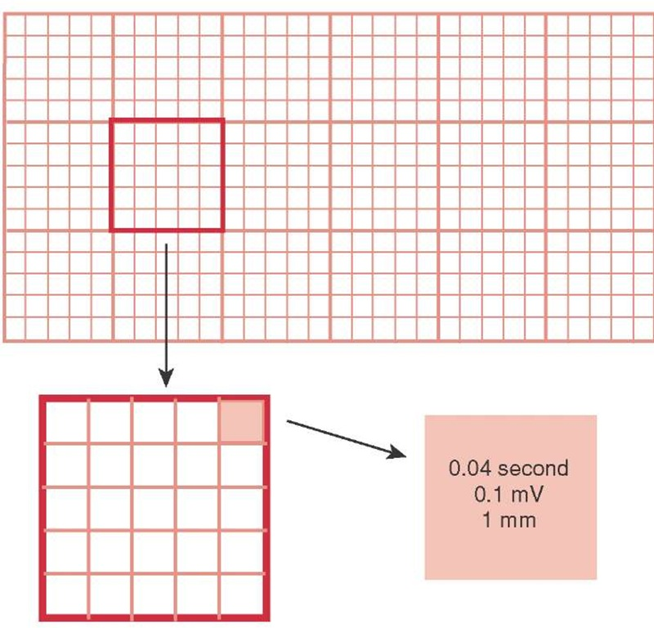
The Normal Electrocardiogram (ECG)
The vertical calibration lines: Voltage(millivolt)
1 small square in the vertical calibration = 1 mm = 0.1 mv.
5 small lines (large square) = 0.5 mV (IN MALES’ SLIDES ) 1mV (IN FEMALES’ SLIDES )
The horizontal calibration lines: Time (seconds)
1 inch(25 small lines) = 1 second
Each inch is divided by 5 dark vertical lines
The interval between the dark lines (large squares 5mm)= 0.2 second
thin line (small squares 1mm)= 0.04 second
Because 1 / 25 = 0.04
5 small lines (squares) = 1 large square

Slide 7
The Normal Electrocardiogram(ECG)
Video of (Understanding ECG) Duration: (4)mins
1-Wave | Caused by (represents) | How To Know it’s Normal | Notes
P wave | atrial depolarization It is a small positive deflection caused by systoli or contraction of atria. | Amplitude < 2.5 mm Duration < 0.12 sec | . Why is it small? Because the atria's walls is thinner and its contraction is weaker than the ventricles
QRS complex | depolarization of the ventricles |  | (ventricular contraction/systole Where’s the atrial repolarization? It’s hidden and masked by the QRS complex.
T wave | repolarization of the ventricles | Polarity of P wave = polarity of T wave
1- Waves (voltage + time)
2- Intervals (time only)
3- Segments (part of an interval)
In ventricles:
First part that gets depolarized is septum ( by left bundle branch)
Then Depolarization of LV & RV
Last part of ventricles to depolarize is pulmonary conus
Q wave is due to depolarization of septum by left bundle branch
S wave is due to depolarization of pulmonary conus
( depolarization is from epicardium to pericardium while repolarization is from pericardium to epicardium)

Slide 8
The Normal Electrocardiogram (ECG)
2- Interval | Represents | How to Know it’s Normal | Notes
P-R interval | It is the time between the beginning of the P wave and the beginning of the QRS complex interval between the beginning of electrical excitation of the atria and the beginning of excitation of the ventricles. | The P-R interval is about 0.16 second | (from SA node to ventricle) between the beginning of the atrial contraction and the ventricular contraction) # of small lines multiplied by 0.04
Q-T interval (Ventricular changes only) | is the time from the beginning of the Q wave to the end of the T wave The QT interval represents electrical depolarization and repolarization of the ventricles (contraction of the ventricles) | Q-T interval is about 0.35 second | Contraction of the ventricles last from the beginning of the Q wave to the end of the T wave. QT interval roughly approximates the period of ventricular systole. Relaxation hasn’t begun but repolarization has # of small lines multiplied by 0.04

Slide 9
The Normal Electrocardiogram (ECG)
3- Segment | Represents | Notes
S-T segment | No electrical potentials are measured on the body surface; ventricular muscle cells are in the plateau phase of their action potentials | T wave represents ventricular repolarization (phase 3) , ST segment is before T wave → so it happens in phase 2 ( plateau
ONLY IN FEMALES’ SLIDES
heart rate:
The heart rate is the repetition of the time interval between two successive heartbeats
If the interval between 2 beats is 1 second , the heart rate is 60 beats per minute.
It is the RR interval = 0.8 seconds
0.8 / 60 = BPM

Slide 10
ECG Waves
ONLY IN MALES’ SLIDES
Video of (ECG Interpretation - Cardiac Electrical Activity) Duration (7min)
The impulse originates at the SA node and spreads to the atria.
Atrial depolarisation generates a ‘P wave’ on the ECG.
The impulse is delayed at the
AV node.
Question :
Why atrial repolarization does
not appear in ECG?
Because atrial repolarization happens at the same time of ventricle depolarization,and ventricle depolarization is stronger so it will appear instead of atrial repolarization in the ECG.
The impulse then spreads to ventricles generating a QRS complex.
Ventricles repolarize forming a T wave.
Ventricles uniformly depolarised - ST segment

Slide 11
Normal Rate and Rhythm; Sinus Rhythm
ONLY IN MALES’ SLIDES
Impulses originate in the SA node regularly at a rate of 60-100 beats per minute in adults.
P waves upright, uniform in size and contour from beat to beat.
Each P is followed by a QRS complex with a resulting P:QRS ratio 1:1.
All complexes are evenly spaced.
PR interval is constant and within normal range.

Slide 12
Abnormalities in ECG
ONLY IN MALES’ SLIDES
What defines a normal QRS complex?
Duration: 0.08 – 0.10 sec
Increased width of the complex is characteristic of defects in the branch bundles or Purkinje fibres, i.e., bundle branch block.
What defines a normal PR interval?
0.12 – 0.21 sec
What is defined by an increased PR interval? →Primary AV block
What is the significance of decreased PR interval?
→Accessory pathway (impulse passes from atria to ventricles without passing into AV node)

Slide 13
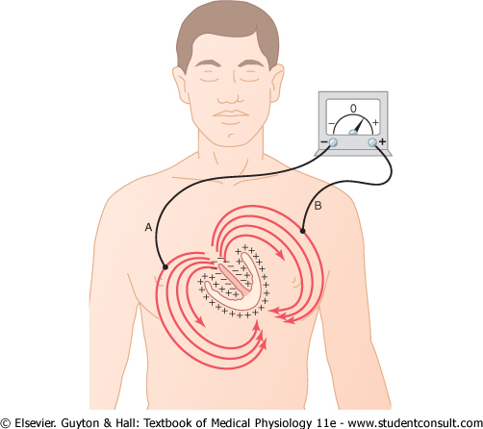
Flow of Electrical Current in the Heart
ONLY IN FEMALES’ SLIDES
In normal ventricles , current flows:
From negative→ positive
From the base toward → the apex
From electronegative inner surface → electropositive outer surface
An electrode placed near the base of the heart is electronegative, and near the apex is electropositive
The first area that depolarizes is the ventricular septum

Slide 14
The ECG Leads
Video of (ECG leads) Duration: (3)mins
Lead: two wires and their electrodes (one positive one negative) to make a complete circuit
Unipolar Leads
Chest Leads
Augmented Limb Leads
Bipolar Leads
Bipolar Limb Leads
3 categories will give us 12 lines.
(Lead I, Lead II, Lead III)
(V1, V2, V3, V4, V5, V6)
(aVR, aVL, aVF)
An ECG lead is the ECG record obtained when the recording electrodes are placed at specific points on the body.

Slide 15
ONLY IN MALES’ SLIDES
Unipolar and Bipolar leads
Unipolar ECG leads
Bipolar ECG leads
means that the ECG is recorded from two electrodes
These are the ECG records obtained when the active electrode is applied to a recording point and the reference electrode is applied to another recording point.
The ECG will be a record of the changes in electrical potential at the active electrode relative to the reference electrode.
There are 3 bipolar leads: Lead I, Lead II and Lead III
These are the ECG records obtained when the reference electrode is at zero potential. The active electrode is applied to the recording points on the body surface.
There are six standard unipolar chest leads recorded from the six standard chest points and designated as V1, V2, V3, V4, V5 and V6.
There are other three standard unipolar limb leads recorded from the standard limb points and designated as aVL, aVR, aVF.

Slide 16
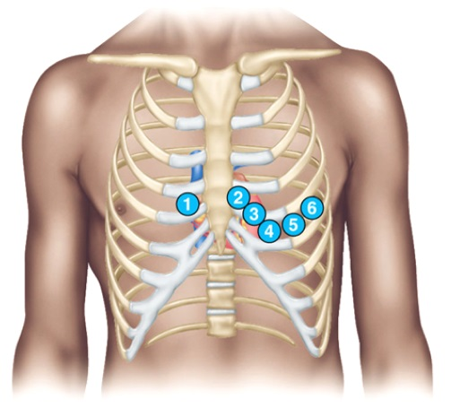
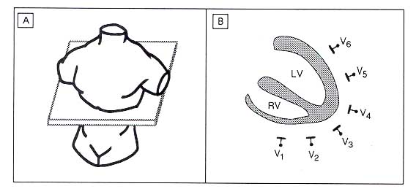
Unipolar Chest Points
ONLY IN MALES’ SLIDES
ONLY IN FEMALES’ SLIDES
V₁: at the right fourth
intercostals space near the sternum.
V₂: at the left fourth intercostals space near the sternum.
V₃: midway between V₂ and V₄.
V₄: at the left fifth intercostals space at the midcalvicular line.
V₅: at the left fifth intercostals space at the anterior axillary line.
V₆: at the left fifth intercostals space at the midaxillary line.
Recorded from the
anterior surface of the chest (V1, V2, V3, V4, V5, V6)
Positive electrode on the chest
The indifferent electrode is the negative electrode connected to the right arm, left arm, and left leg
V1 and V2: QRS are mainly negative because the chest leads are nearer to the base of the heart
V3,V4 and V6 are mainly positive because the chest electrode are nearer to the apex
V4 at apex of heart

Slide 17
Unipolar Augmented Limb Leads
ONLY IN MALES’ SLIDES
ONLY IN FEMALES’ SLIDES
The two limbs are connected to the negative terminal of the ECG, but only one is recording. and the third limb is connected to the positive
When the positive terminal is on:
The right arm (aVR): inverted
The left arm (aVL)
The left leg (aVF)
All are similar to the standard limb leads
aVL: at the junction of the left arm with the trunk. Any point on the left upper limb has the same potential.
aVR: at the junction of the right arm with the trunk. Any point on the right upper limb has the same potential.
aVF: at the junction of the left lower limb with the trunk. Any point on the left or right lower limbs has the same potential.
VL faces anterolateral surface, VR faces anterior surface, VF faces inferior surface.

Slide 18
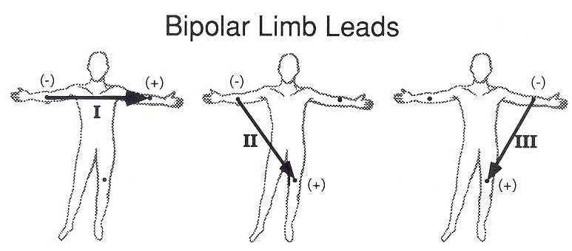
Bipolar ECG Leads
ONLY IN MALES’ SLIDES
Lead I:
The right arm : –ve
The left arm: +ve
Lead I: records the potential between left arm and right arm. The active electrode is at VL and the reference electrode is at VR.
Lead II: records the potential between left leg and right arm. The active electrode is at VF and the reference electrode is at VR.
Lead III: records the potential between left leg and left arm. The active electrode is at VF and the reference electrode is at VL.
ONLY IN FEMALES’ SLIDES
Lead II:
The right arm: -ve
The left leg: +ve
Lead III:
The left arm: -ve
The left leg: +ve
Positive is the active electrode.
Negative is the reference electrode.

Slide 19
Doctor’s Notes
ONLY IN MALES’ SLIDES
Anterior surface of heart → RV
Anterolateral surface → LV
Inferior (diaphragmatic) surface → RV & LV
Surface of the heart | Leads
Anterior surface | V1, V2, aVR
Anteroseptal surface | V3,V4
Anterolateral surface | V5,V6, aVL, Lead I
Inferior Surface | aVF, Lead II, Lead III
If a person has an inferior wall myocardial infarction, ECG changes will be in AVF lead 2 and lead 3

Slide 20
Einthoven's Triangle & law
Einthoven's Triangle:
is drawn around the area of the heart
The two apices at the upper part of the triangle represent the points at which the two arms connect electrically
The lower apex is the point at which the left leg connects
Einthoven’s Law:
if the electrical potential of any two of the three bipolar limb leads are known, the third one can be determined mathematically by summing the first two (note the +ve and -ve signs)
The sum of the voltage in Lead I + Lead III= Lead
Einthoven’s law: E_{I} + E_{III} = E_{II}
ONLY IN MALES’ SLIDES
Lead I = E_{LA}- E_{RA}
Lead II = E_{LL}- E_{RA}
Lead III = E_{LL}- E_{LA}
In the ECG, at any given instant, the potential of any wave in lead II is equal to the sum of the potentials in lead I and III.
LA= Left Arm. RA= Right Arm. LL= Left Leg. E= Electrical potential

Slide 21
Link to Editing File (Please be sure to check this file frequently for any edits or updates on all of our lectures.)
Quiz
https://www.onlineexambuilder.com/ecg/exam-137070
References:
Girls’ and boys’ slides.
Guyton and Hall Textbook of Medical Physiology (Thirteenth Edition.)

Slide 22
Thank you!
اعمل لترسم بسمة، اعمل لتمسح دمعة، اعمل و أنت تعلم أن الله لا يضيع أجر من أحسن عملا.
The Physiology 436 Team:
Female Members:
Ghadah Almazrou
Sumaya AlGhamdi
Nouf Aloqaili
Lama Alfawzan
Munirah Aldofyan
Male Members:
Faisal Alfawaz
Mohammed Almutllaq
Team Leaders:
Qaiss Almuhaideb
Lulwah Alshiha
Contact us:
Physiology436@gmail.com
@Physiology436

