Slide 1
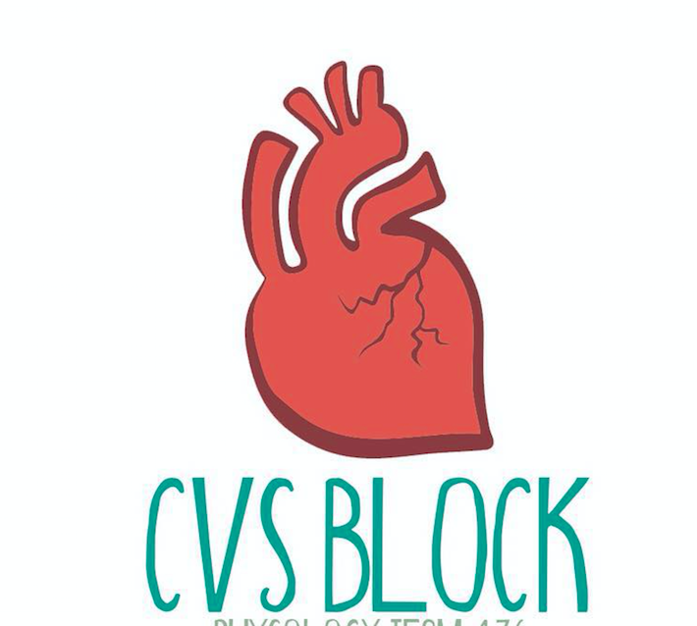
Cardiac Science: Cardiac Arrhythmias
Red: very important.
Green: Doctor’s notes.
Pink: formulas.
Yellow: numbers.
Gray: notes and explanation.
Physiology Team 436 – Cardiovascular Block Lecture 6
Lecture: If work is intended for initial studying.
Review: If work is intended for revision.

Slide 2
Objectives
Study Smart: focus on mutual topics.
From the students’ guide:
Identify normal rhythm
Identify the main pathophysiological causes of cardiac arrhythmias (Arrhythmogenesis) } Identify sinus arrhythmias
Define different ectopic foci of excitation and the mechanism of re-entry phenomena } Identify conduction block.
Identify electrolyte abnormalities (K+, Ca++)
Enumerate the common arrhythmias and describe the basic ECG changes

Slide 3
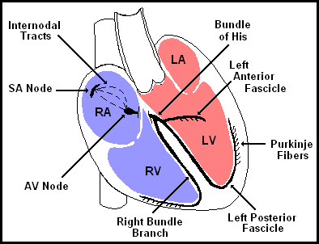
The Normal Conduction System
ONLY IN FEMALES’ SLIDES
Interpretation
Develop a systematic approach to reading EKGs and use it every time.
The system we will practice is:
Heart Rate
Rhythm
(including intervals and blocks)
Axis
Hypertrophy
Ischemia
ONLY IN MALES’ SLIDES
SA node:
cardiac pacemaker
Paces at rate of 60-100 bpm (average of 70 bpm)
AV node: 45-60 bpm
Purkinje: 15-45 bpm

Slide 4
Interpretation: Heart Rate
ONLY IN FEMALES’ SLIDES
Rule of 300: Divide 300 by the number of boxes between each QRS = rate
Number of big boxes | Rate
1 | 300
2 | 150
3 | 100
4 | 75
5 | 60
6 | 50
HR of 60-100 per minute is normal
HR > 100 = tachycardia
HR < 60 = bradycardia
BOTH MALES’ & FEMALES’ SLIDES
Heart rate in picture below:(300 / 6) = 50 bpm
Heart rate may vary depending on:
Age
Activity
Time of day

Slide 6
Normal Sinus Rhythm; NSR
Regular
Each P followed by QRS with resulting
PR interval is constant and within normal range
PP interval is constant.
ONLY IN FEMALES’ SLIDES
Doctor said we don’t need to memorize all of this.

Slide 7
Classification of Cardiac Arrhythmias
Cardiac Arrhythmias
(According to Heart Rate)
2) Tachyarrhythmias
1) Bradyarrhythmias
ONLY IN FEMALES’ SLIDES
Cardiac Arrhythmias
(According to Mechanism of Arrhythmia)
2) Arrhythmias due to alterations or disturbances of impulse formation
1) Arrhythmias due to disturbances of impulse conduction
Blocks at different points in the spread of impulse through the heart
ONLY IN MALES’ SLIDES
Classifications of Cardiac Arrhythmias:
Rate above or below normal (tachy vs. bradycardia)
Regular or irregular rhythm
Narrow or broad QRS complex
Relation to P wave
Supraventricular Vs. ventricular

Slide 8
Anatomical Classification of Cardiac Arrhythmias (origin of the arrhythmia)
ONLY IN FEMALES’ SLIDES
Cardiac Arrhythmias
Ventricular arrhythmias
(Wide QRS)
Supraventricular arrhythmias
Atrioventricular (AV) junctional arrhythmias
Atrial Arrhythmias
(Narrow QRS)
1-Ventricualr extrasystole
2-Ventricular Tachycardia
3-Ventricular Fibrillation
1-Atrial extrasystoles (APC)
2-Atrial Tachycardia
3-Atrial Flutter
4-Atrial Fibrillation
*
*
Extrasystole = premature beats= premature complexes= premature contractions
* Also considered as Arrhythmia due to triggered activity and reentry.

Slide 9
Arrhythmias Due to Alterations or Disturbances of Impulse Formation
Mechanisms:
Enhanced automaticity.
Triggered activity.
Reentrant circuits (circus movement).
ONLY IN FEMALES’ SLIDES
Arrhythmias due to alterations or disturbances of impulse formation
Arrhythmias due to alterations in SA node pacemaker activity
Arrhythmias due to enhanced automaticity of the AV junction
Arrhythmias due to triggered activity and reentry
Other mechanism
Abnormal rhythmicity of the pacemaker
Blocks at different points in the spread of impulse through the heart

Slide 10
Mechanisms of Arrhythmias Due to Alterations or Disturbances of Impulse Formation EXTRA
1. Enhanced automaticity | 2. Triggered activity | 3. Re-entry (Lewis circus movement)
Enhanced automaticity is defined as an inappropriate increase in the rate of discharge of a tissue having physiological pacemaker properties (i.e., sinus node, atrioventricular node or Purkinje fibers). | The term triggered activity is used to define the appearance of automaticity as a result of external stimulation, and may arise in tissues that do not demonstrate physiological automaticity. | Re-entry (reentry): occurs when a cardiac impulse re-excites some region of the heart through which the impulse has already passed in that heart beat. Unidirectional or partial conduction block is required to initiate re-entry.

Slide 11
Causes of Cardiac Arrhythmias
ONLY IN FEMALES’ SLIDES
Abnormal rhythmicity of the pacemaker
Shift of the pacemaker from the sinus node to another place in the heart
Blocks at different points during the spread of the impulse through the heart
Abnormal pathways of impulse transmission through the heart
Spontaneous generation of spurious impulses in almost any part of the heart
Rate above or below normal
Regular or irregular rhythm
Narrow or broad QRS complex
Relation to P waves

Slide 12
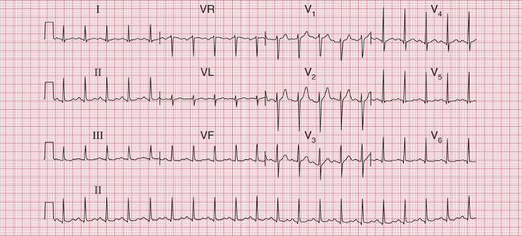
Arrhythmias Due to Alterations in SA Node Pacemaker Activity
1) Sinus Bradycardia
Heart rate slower than 60 per minute
2) Sinus Tachycardia
Heart rate faster than 100 per minute
1- Physiological Causes:
--Expiration.
2- Pharmacological and pathological Causes:
- Parasympathetic stimulation
Causes:
1- Physiological:
-During exercise, sympathetic stimulation, increased body temperature
-Inspiration
2- Pharmacological and pathological:
-Sympathetic stimulation
- Digoxin drug.

Slide 13
Differential Diagnosis of Tachycardia
ONLY IN FEMALES’ SLIDES
Tachycardia | Narrow Complex | Wide Complex
Regular | Sinus Tachy SVT Atrial flutter | ST w/ aberrancy SVT w/ aberrancy VT
Irregular | A-fib A-flutter w/ variable conduction MAT | A-fib w/ aberrancy A-fib w/ WPW VT

Slide 14
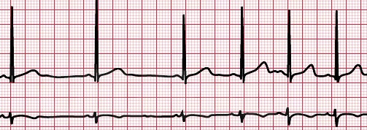
Arrhythmias Due to Alterations in SA Node Pacemaker Activity
3) Respiratory sinus arrhythmia
Sinus arrhythmia is an increase in heart rate during inspiration and a decrease during expiration
It is a normal finding in children and young adults and tends to diminish or disappear with age.
Causes:
1- Sinus arrhythmia is due to variations in the vagal tone that affects the SA node.
ONLY IN MALES’ SLIDES
Sinus Arrhythmia: Result from spillover of signals from the medullary respiratory center into the adjacent vasomotor center during inspiration and expiratory cycles of respiration. The spillover signals cause alternate increase and decrease in the number of impulses transmitted through the sympathetic and vagus nerves to the heart

Slide 15
Atrial and Ventricular Extrasystoles
Abnormal Cardiac Rhythms that Result from Impulse Conduction Block
ONLY IN FEMALES’ SLIDES
Extrasystoles = premature beats = premature contractions = premature complexes
If the focus is in the ventricles, the premature beat is called ventricular premature beat.
If the focus is in the atrial wall, the premature beat is called atrial premature beat.
Ectopic foci can also cause a premature beat in AV junction.
Causes:
Ischemia
Irritation of cardiac muscle by calcified foci
Caffeine
Sinoatrial Block
The impulse from the S-A node is blocked before it
enters the atrial muscle → Cessation (no) of P waves
A-V Block
When impulse from the S-A node is blocked
Causes:
Ischemia of the A-V node
Compression of the A-V node by scar formation Inflammation of the A-V node
Strong vagal stimulation

Slide 16
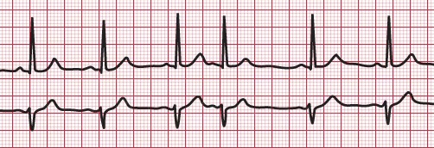
Atrial Extrasystoles
Short P-R interval depending on how far the ectopic foci from the AV node.
Pulse deficit if there is no time for the ventricles to fill with blood.
The time between the premature contraction and the succeeding beat is increased (Compensatory pause).

Slide 17
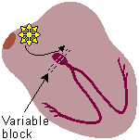
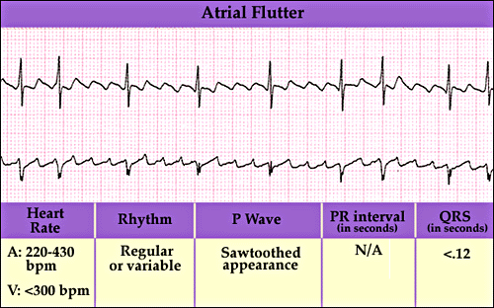
Atrial Flutter
Atrial flutter occurs when the atria are stimulated to beat at a rate 250 beats per minute.
Atrial flutter results in poor atrial pumping since some parts of the atria are relaxing while other parts are contracting.
A single large wave travels around and around in the atria
The refractory period of the AV node causes 2-3 beats of atria for one single ventricular beat 2:1 or 2:3 rhythm.
ONLY IN MALES’ SLIDES

Slide 18
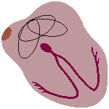
Atrial Fibrillation (AF)
Same mechanism as ventricular fibrillation.
It can occur only in atria without affecting the ventricles.
It occurs more frequently in patients with enlarged heart.
The atria do not pump if they are fibrillating.
The efficiency of ventricular filling is decreased 20 to 30%
No P wave, or high frequency of low voltage P wave
A person can live for years with atrial fibrillation
Treatment: DC shock

Slide 19
Ventricular extrasystoles
Prolong QRS complex because the impulses are carried out with myocardial fibers with slower conduction rate than Purkinje fibers
Increase QRS complexes voltage because QRS wave from one ventricle can not neutralize the one from the other ventricle
After PVCs, the T wave has an electrical potential of opposite polarity of that of the QRS because of the slow conduction in the myocardial fibers, the fibers that depolarizes first will repolarize first
Causes: drugs, caffeine, smoking, lack of sleep, emotional irritations

Slide 20
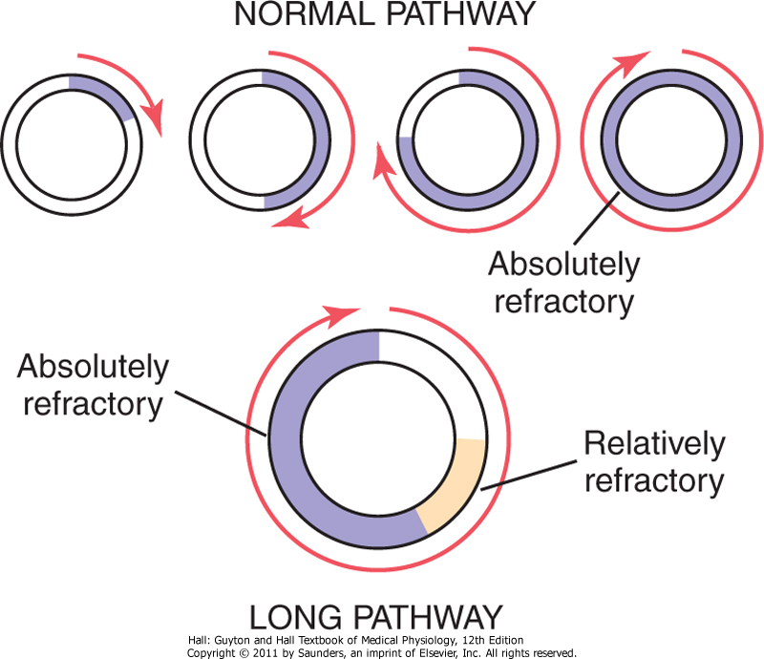
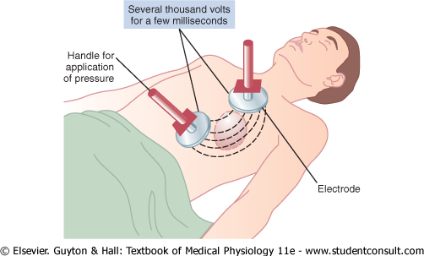
Ventricular Fibrillation
The most serious of all arrhythmias
Cause: impulses stimulate one part of the ventricles, then another, then itself.
Many part contracts at the same time while other parts relax. (Circus movement)
Causes: sudden electrical shock, ischemia
Tachycardia
Irregular rhythm
Broad QRS complex
No P wave
Treatment : DC shock

Slide 21
Abnormal Cardiac Rhythms that Result from Impulse Conduction Block
ONLY IN FEMALES’ SLIDES
Sinoatrial Block
Blockade of the S-A node impulse before entering atrial muscle.
Cessation of P wave (difficulty of seeing p wave)
A-V Block
When impulse from the S-A node is blocked
First degree block
Second degree block
Third degree block
Causes of SA and AV Block:
Ischemia of the A-V node
Compression of the A-V node by scar formation
Inflammation of the A-V node
Strong vagal stimulation

Slide 22
Other Arrhythmias Due to Disturbances of Impulse Conduction (impulse conduction block)
Arrhythmias due to Alterations in impulse conduction
Heart block
= Atrioventricular (AV) block
Bundle branch block
1st degree block (partial block): all impulses pass through the AV node but with greater than normal delay.
2nd degree block: some, but not all impulses pass through the AV node.
3rd degree block (complete block): no impulses pass through AV node → atria and ventricles beat independently.

Slide 23
Heart Block

Slide 24
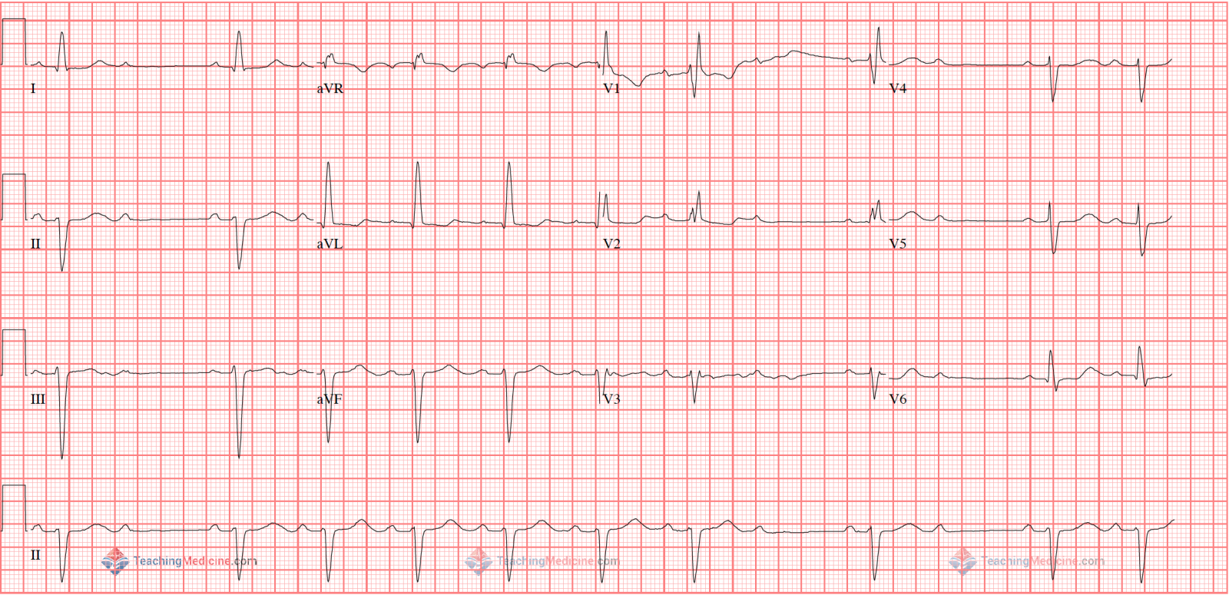
Heart Block = Atrioventricular (AV) Block
1st degree block: all impulses pass through the AV node but with greater than normal delay. Every P wave is followed by R wave.
P-R interval is prolonged = 0.2 second
2nd degree AV block:
P-R interval > 0.25 second
Only few impulses pass to the ventricles
→ atria beat faster than ventricles
→“dropped beat” of the ventricles
Mobitz I: Progressive increase in P-R interval until one QRS is dropped.
Mobitz II: Constant PR prolongation + dropped beat
3rd degree AV block: (complete heart block).
Complete dissociation of P wave and QRS waves
Ventricle escape from the influence of S-A node
Atrial rate is 100 beats/min
Ventricular rate is 57 beats/min. (40 in females)
Stroke-Adams Syndrome:: AV block comes and goes
Mobitz I:
Mobitz II

Slide 25
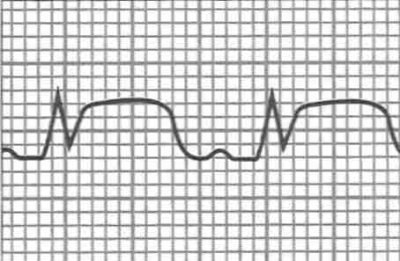
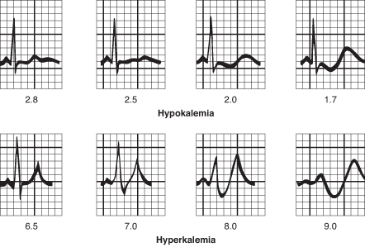
Diseases in ECG:
ONLY IN FEMALES’ SLIDES
1. Ischemia: common use of ECG is acute chest pain.
Cause: restriction of blood flow to the myocardium due to
reversible: angina pectoris
Irreversible: myocardial infarction.
Ischemia → injury → infarction
2. Reversible Ischemia: Inverted T wave - ST segment depression.
3. Myocardial infarction: ST segment elevation – Deep Q wave. Complete loss of blood supply to the myocardium resulting in necrosis or death of tissue.
4. Hypokalemia: Flat T wave
5. Hyperkalemia: Tall peak T wave.

Slide 26
Link to Editing File (Please be sure to check this file frequently for any edits or updates on all of our lectures.)
Quiz
https://www.onlineexambuilder.com/arrhythmias/exam-139189
References:
Girls’ and boys’ slides.
Guyton and Hall Textbook of Medical Physiology (Thirteenth Edition.)

Slide 27
Thank you!
اعمل لترسم بسمة، اعمل لتمسح دمعة، اعمل و أنت تعلم أن الله لا يضيع أجر من أحسن عملا.
The Physiology 436 Team:
Female Members:
Amal AlShaibi
Rana Barasain
Male Members:
Mohammed Almutllaq
Team Leaders:
Qaiss Almuhaideb
Lulwah Alshiha
Contact us:
Physiology436@gmail.com
@Physiology436

